Slide 1


Training to become loving fathers…
like God

Slide 2

1 John 3:1-3
God’s Love allowed us to be His Sons
1 Behold what manner of love the Father has bestowed on us, that we should be called children of God! Therefore the world does not know us, because it did not know Him. 2 Beloved, now we are children of God; and it has not yet been revealed what we shall be, but we know that when He is revealed, we shall be like Him, for we shall see Him as He is. 3 And everyone who has this hope in Him purifies himself, just as He is pure.
Our Goal is to be like Him

Slide 3

God’s love for us is the motive force that drives us to love our kids
God loved us when we didn’t deserve it
God reconciled us when we were enemies
God sacrificed His son when we were sinners
Our children are no worse than we are. God uses our children to help us understand what He goes through to save us.
If God so loved us, we ought to love our children. (see 1Jn 4:10)

Slide 4
Psalm 103:11-14
God shows us mercy & pities us
11 For as the heavens are high above the earth, so great is His mercy toward those who fear Him; 12 As far as the east is from the west, so far has He removed our transgressions from us.
13 As a father pities his children, so the Lord pities those who fear Him. 14 For He knows our frame; He remembers that we are dust.
This is our model for parenting our children

Slide 5
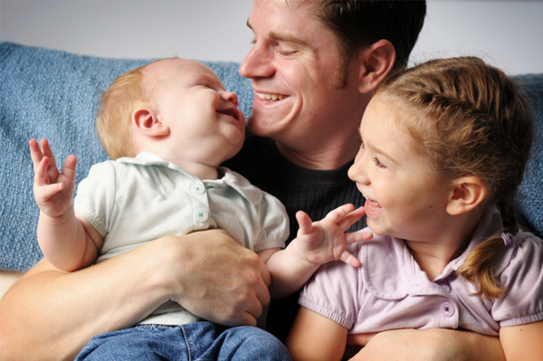
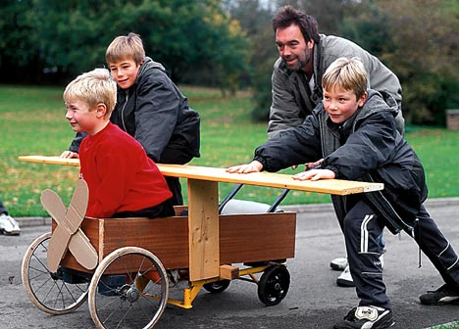
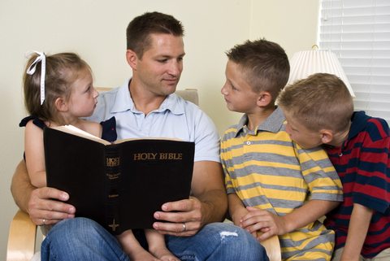
Ways to Love your Kids
Realize that kids can be annoying
Entertain your kids, don’t just manage
Help them with their jobs & responsibilities
Be happy & try to like what they like
Discipline your kids
Coach your kids in a sport or hobby they enjoy
Give your kids space
Do Bible readings with them!

Slide 6
Ephesians 6:4
Be careful not to provoke your kids
4 And you, fathers, do not provoke your children to wrath, but bring them up in the training and admonition of the Lord.
Colossians 3:21
21 Fathers, do not provoke your children, lest they become discouraged.
Remember, God is the model
He is patient, kind, & merciful

Slide 7
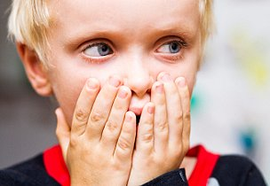
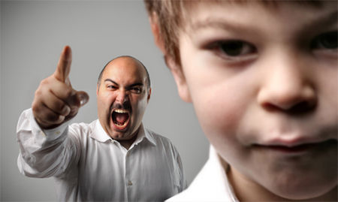
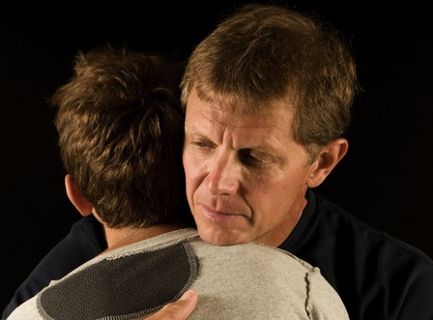
Learn to forgive mistakes
Be realistic: assume from the start they will make many mistakes – like us!
Don’t get angry: use mistakes as a learning experience like God does with us
Practice forgiveness: God knows we need the practice so he gives us spouses, children and ecclesias!
Mistakes are an opportunity to grow

Slide 8
Hebrews 12:7-11
God doesn’t punish us, he chastens us
7 If you endure chastening, God deals with you as with sons; for what son is there whom a father does not chasten? 8 But if you are without chastening, of which all have become partakers, then you are illegitimate and not sons. 9 Furthermore, we have had human fathers who corrected us, and we paid them respect. Shall we not much more readily be in subjection to the Father of spirits and live? 10 For they indeed for a few days chastened us as seemed best to them, but He for our profit, that we may be partakers of His holiness. 11 Now no chastening seems to be joyful for the present, but painful; nevertheless, afterward it yields the peaceable fruit of righteousness to those who have been trained by it.
This is the model for us dealing with our kids
Chasten your kids for their profit to train them

Slide 9
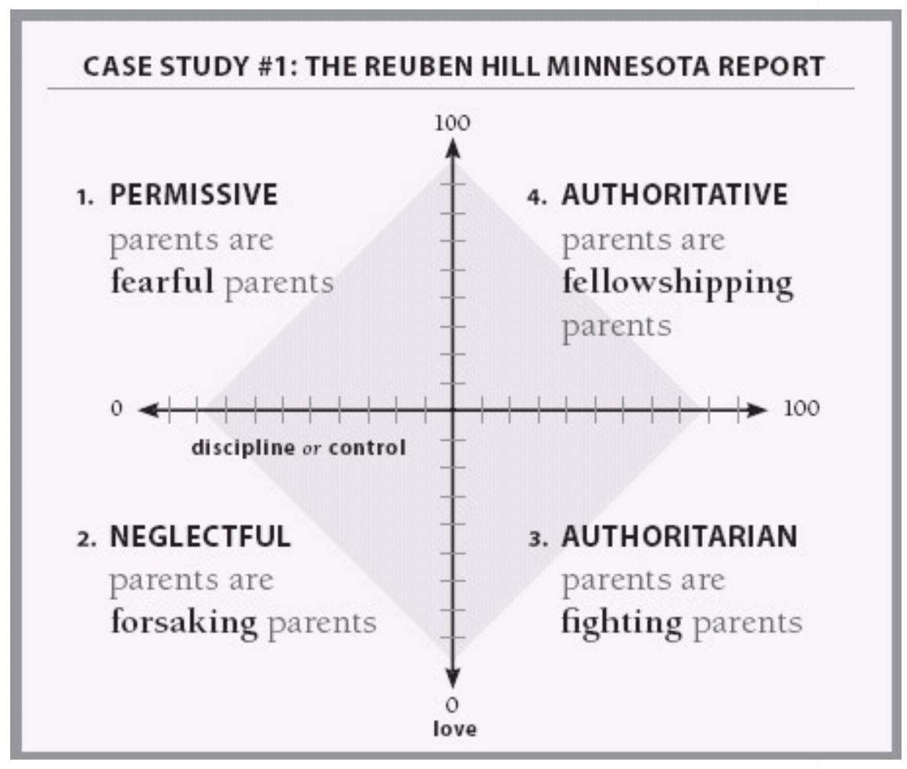
God is our model!
G

Slide 10
Exodus 34:6-7
Learning to balance justice & mercy
"The Lord, the Lord God, merciful and gracious, longsuffering, and abounding in goodness and truth, 7 keeping mercy for thousands, forgiving iniquity and transgression and sin, by no means clearing the guilty, visiting the iniquity of the fathers upon the children and the children's children to the third and the fourth generation."
Parenting children helps us understand how to reflect God’s character

Slide 11
