Slide 1
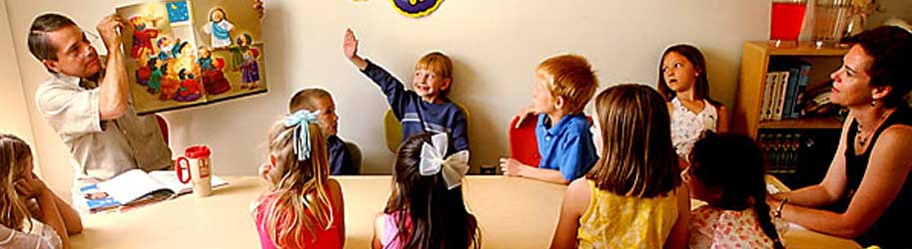
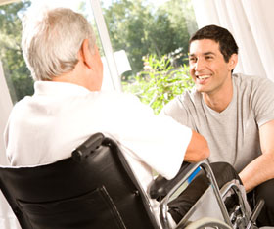
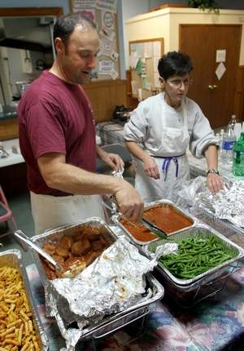
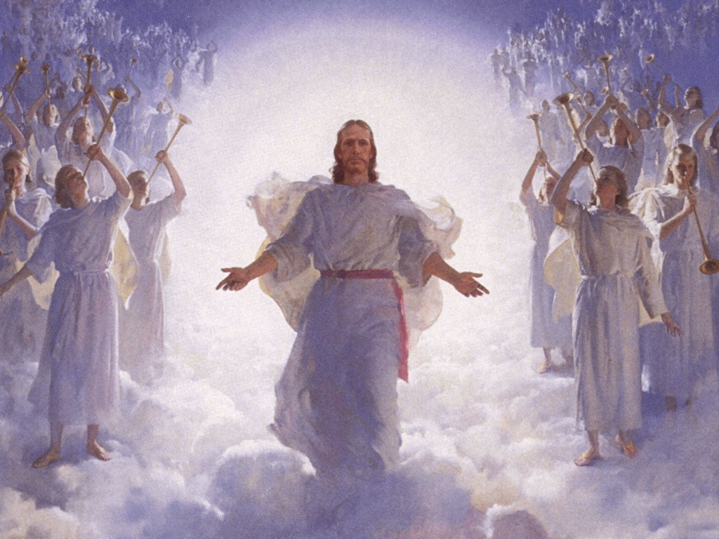
Becoming Servants in God’s Family…
like Angels

Slide 2

Luke 20:34-37
We are training now to join the angels
34 Jesus answered and said to them, "The sons of this age marry and are given in marriage. 35 But those who are counted worthy to attain that age, and the resurrection from the dead, neither marry nor are given in marriage; 36 nor can they die anymore, for they are equal to the angels and are sons of God, being sons of the resurrection.
God has invited us to join His family

Slide 3
Ephesians 2:14-15
God is developing a Family
14 For this reason (“that the Gentiles should be fellow heirs” v.6) I bow my knees to the Father of our Lord Jesus Christ,
15 from whom the whole family in heaven and earth is named,
The Angels are already part of God’s family
We have been invited to join, by adoption
Now is the time to practice living in God’s family

Slide 4
John 13:12-17 (NIV)
God’s children serve one another
12 When he had finished washing their feet, he put on his clothes and returned to his place. "Do you understand what I have done for you?" he asked them. 13 "You call me 'Teacher' and 'Lord,' and rightly so, for that is what I am. 14 Now that I, your Lord and Teacher, have washed your feet, you also should wash one another's feet. 15 I have set you an example that you should do as I have done for you. 16 I tell you the truth, no servant is greater than his master, nor is a messenger greater than the one who sent him. 17 Now that you know these things, you will be blessed if you do them.
Our Families & Ecclesias provide us an opportunity to serve one another in Love (Gal 5:13)

Slide 5
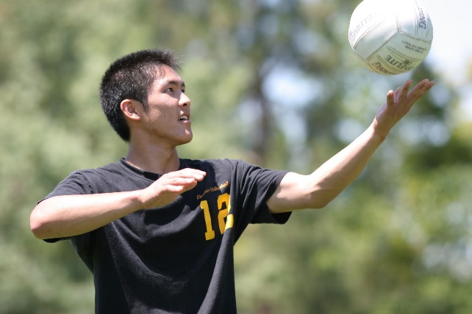
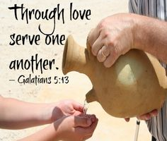
Now is our time to practice serving!
Our families & ecclesias are the training ground
God controls who is in our families & ecclesias
  It’s not “my family” or “my ecclesia” – it’s God’s!
He provides the right members we need to develop our characters to be like His
He’s waiting to see if we can grow to “serve one another in love”
God is training us to join His family forever
Our coach won’t except excuses for not trying

Slide 6
Genesis 19:15-16
God’s family members live like Him
15 When the morning dawned, the angels urged Lot to hurry, saying, "Arise, take your wife and your two daughters who are here, lest you be consumed in the punishment of the city."
16 And while he lingered, the men took hold of his hand, his wife's hand, and the hands of his two daughters, the LORD being merciful to him, and they brought him out and set him outside the city.
17 So it came to pass, when they had brought them outside, that he said, "Escape for your life! Do not look behind you nor stay anywhere in the plain. Escape to the mountains, lest you be destroyed.”
Note the patience, kindness, compassion & mercy of angels!
They learned how to do it & so can we!

Slide 7
Philippians 2:1-5 (NIV)
Have the attitude of Jesus Christ
1 If you have any encouragement from being united with Christ, if any comfort from his love, if any fellowship with the Spirit, if any tenderness and compassion, 2 then make my joy complete by being like-minded, having the same love, being one in spirit and purpose. 3 Do nothing out of selfish ambition or vain conceit, but in humility consider others better than yourselves. 4 Each of you should look not only to your own interests, but also to the interests of others.
5 Your attitude should be the same as that of Christ Jesus:
We learn to serve others when we consider them more important than ourselves!

Slide 8
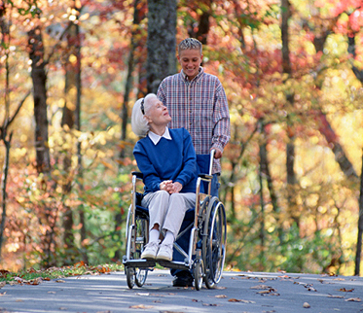
Service means putting others first!
Need to consider it’s God’s family
He has asked us to serve His whole in love
True service is providing them with what they need, not what we want to provide
We learn to put God’s will before our own
It will involve sacrifice of self
Keep the goal in focus: we aim to join angels
When we lose ourselves in serving God’s family, we become united with Him

Slide 9
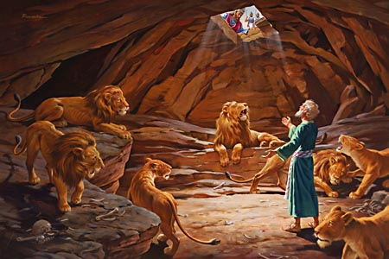
Angels do God’s will…not their own
God sent His angels and shut the lions’ mouths
We need to learn to live like angels now!

Slide 10
Angels compassionately help us!
Matthew 26:42-43
42 Again, a second time, He went away and prayed, saying, "O My Father, if this cup cannot pass away from Me unless I drink it, Your will be done."
43 Then an angel appeared to Him from heaven, strengthening Him.
Luke 22:43-44
44 And being in agony, He prayed more earnestly. Then His sweat became like great drops of blood falling
Matthew 26:43
43 And He came and found them asleep again, for their eyes were heavy.
Let’s go home committed to serve one another in love!

Slide 11


