Slide 1
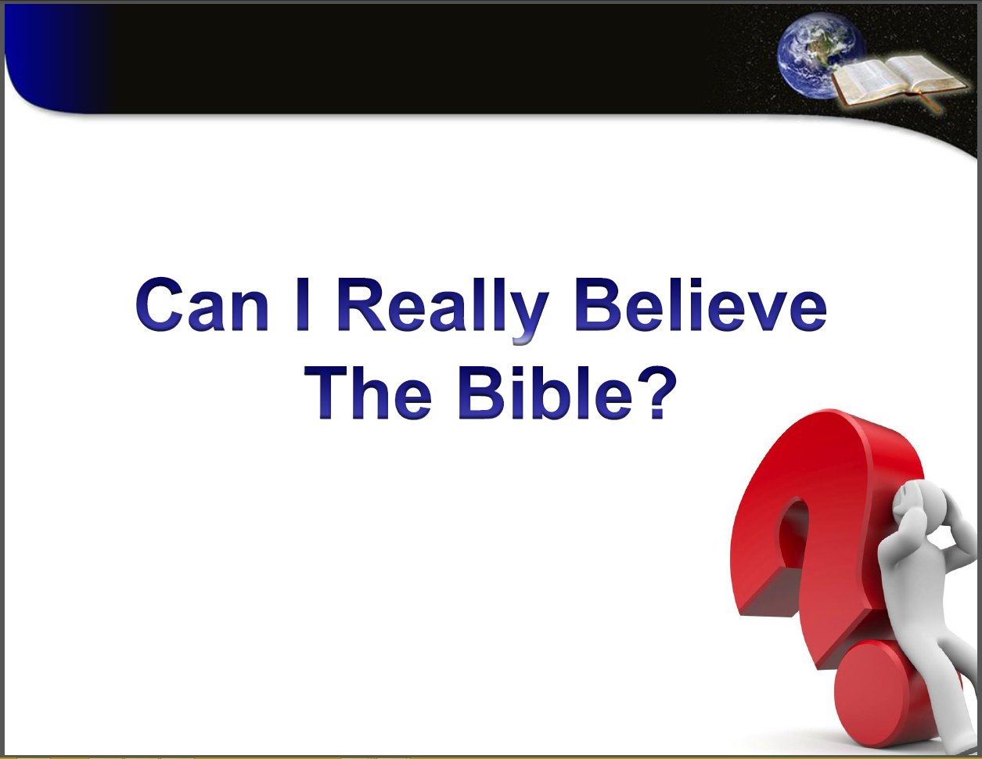

Notes:
Asked yourself
Most God fearing people confronted
If going to contemplate life change
Q needs to be asked and answered
I not answer for you. Ind choice
I just present with some with some thoughts to help u make decision.
Things may not considered before.

Slide 2
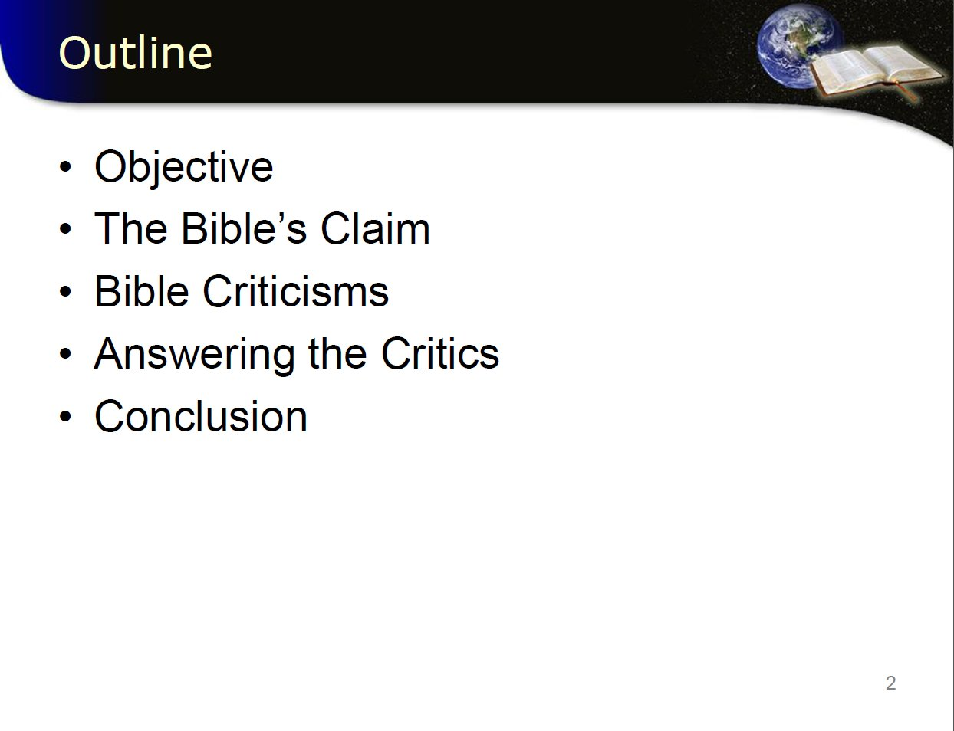
Notes:
Because of implications – people cast doubt on Bible
To try and discredit.
On its legitimacy of
1:Historical accuracy
2:The Miracles
3:Authorship
4: Prophecies
And more
So our outline is ….Read slide

Slide 3
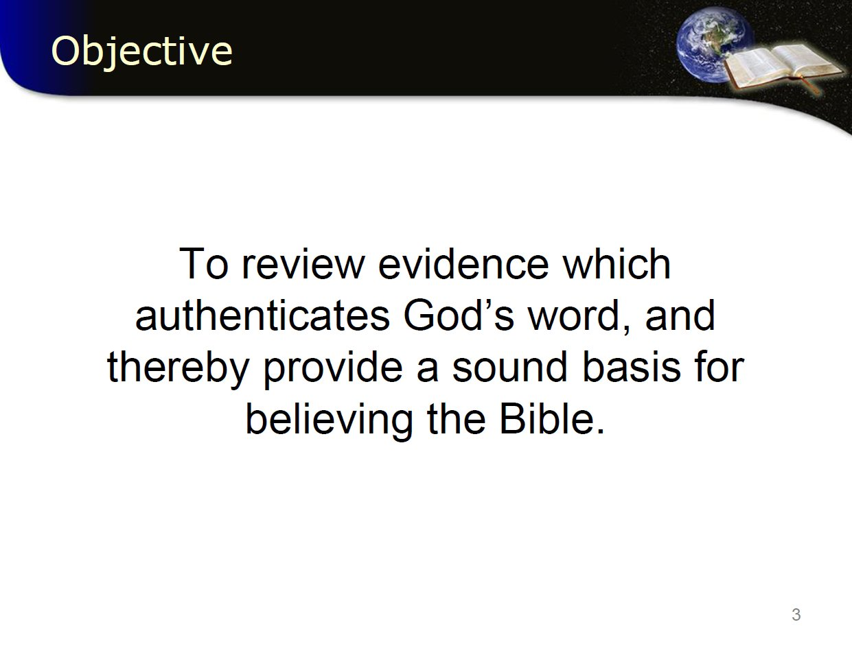
Notes:
Objective
I am a Christadelphian, I believe message from God (Text)
I chose to accept message and consequences
Not unbiased approach. No apology for that –

Slide 4
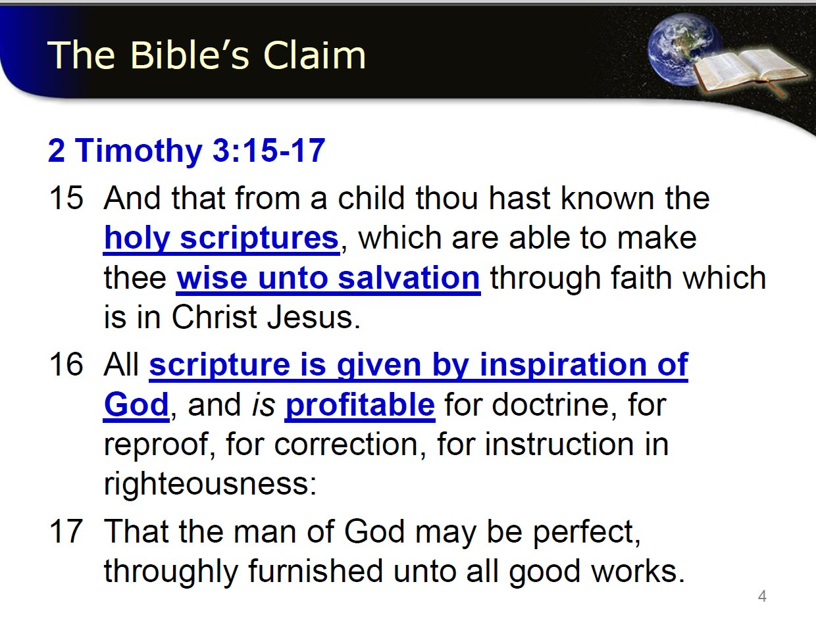
Notes:
Bible claim about itself?.......Read
Separate scriptures!

Slide 5
Salvation (Latin salvatio; Greek sōtēria; Hebrew yeshu'ah) is being saved or protected from harm^{[1]} or being saved or delivered from some dire situation.^{[2]} In religion, salvation is stated as the saving of the soul from sin and its consequences.^{[3]}
Notes:
Wise……salvation.. being saved or delivered from some dire situation.
Bold claim - How much literature can you say that about?
@

Slide 6
Notes:
Read Vs:16
Message is worth something –Profitable
Claims from God –All powerfull…
Stands upto testing
Instructs how to be righteous…. integrity, equity, justice, straightness, innocent, true, sincere
How much literature can makes that claim?
If you choose accept to follow God the Words will change lives..
very challenging to an individual.
Life choice will have to be made
most don’t like being told how to live –
result try discredit it

Slide 7
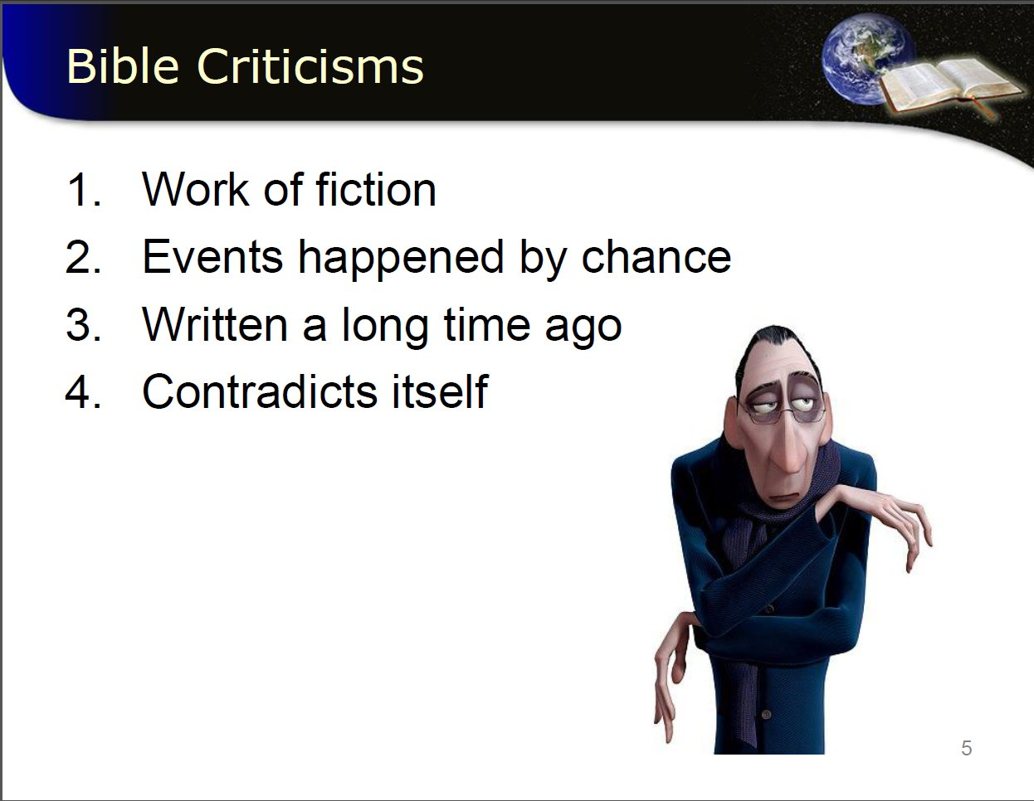
Notes:
What are the criticisms?
4 main….
1: interesting story book with moral connotations, Fiction, Made up.
2: prophecy accurate by chance- if you make loads of predictions some inevitably come true - Flawed argument
3: So old…. Need Go forward with modern advances not backwards, outdated, not relevent.
4: says do no harm to no man yet told to destroy enemies.

Slide 8
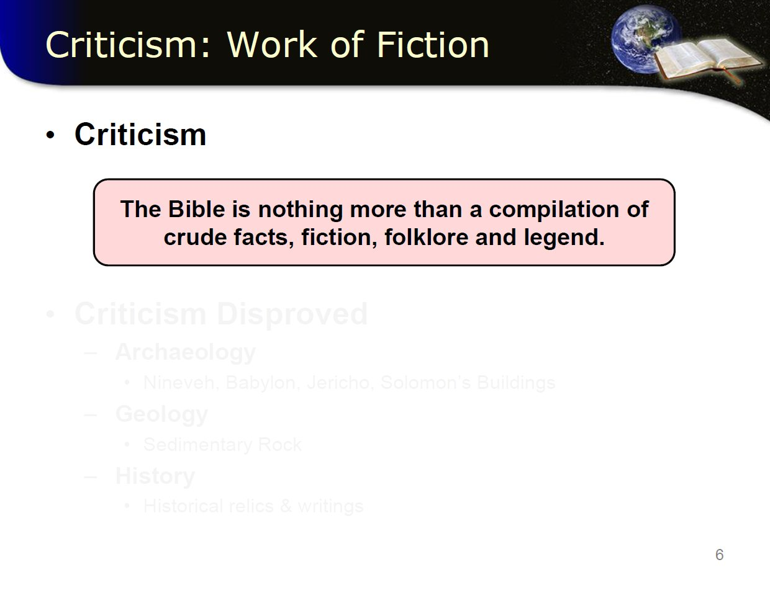

Slide 9
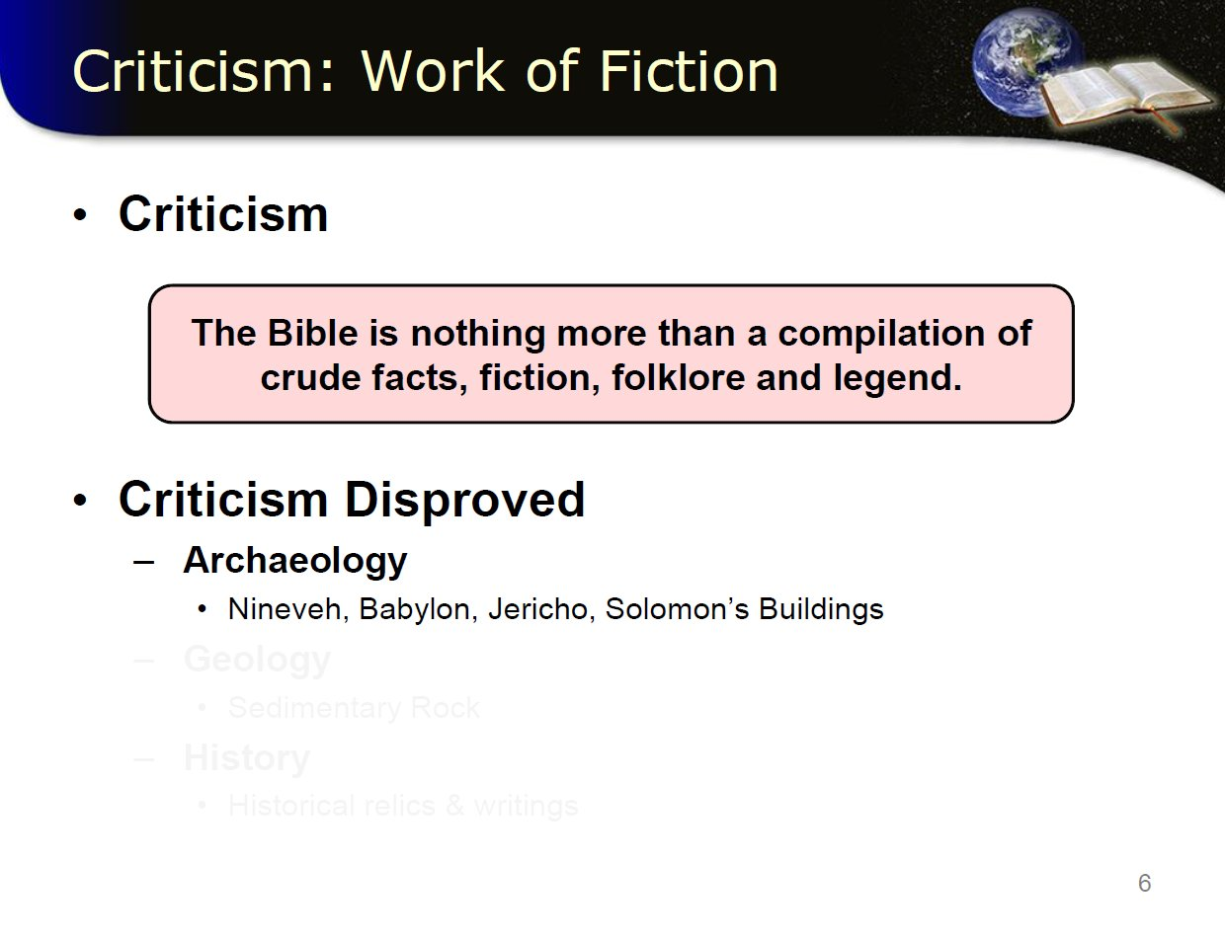
Notes:
Detailed descriptions found in bible could not be verified, too specific in detail to be true – Simply made up
Yet last few decades archaeology has revealed just how accurate the bible has been.
Look at some e.g. in mo…..that help prove people, places & events

Slide 10
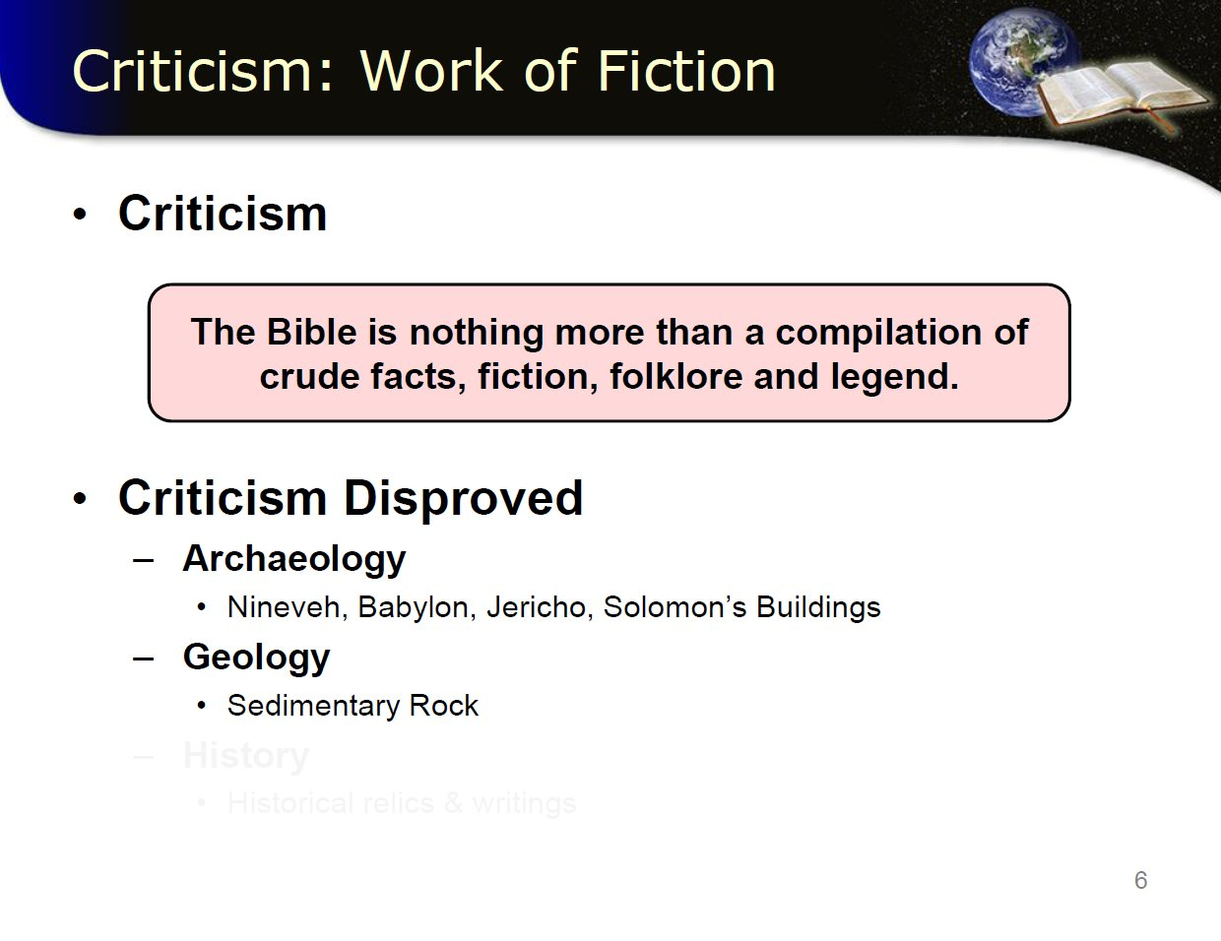
Notes:
Geology proves rather than disproves.
eg Noah sedimentary rock is found in mountains – formed by water
not spend time on this as it’s a whole subject in self and have other talks on our channel that deal with this in gr8 detail.

Slide 11
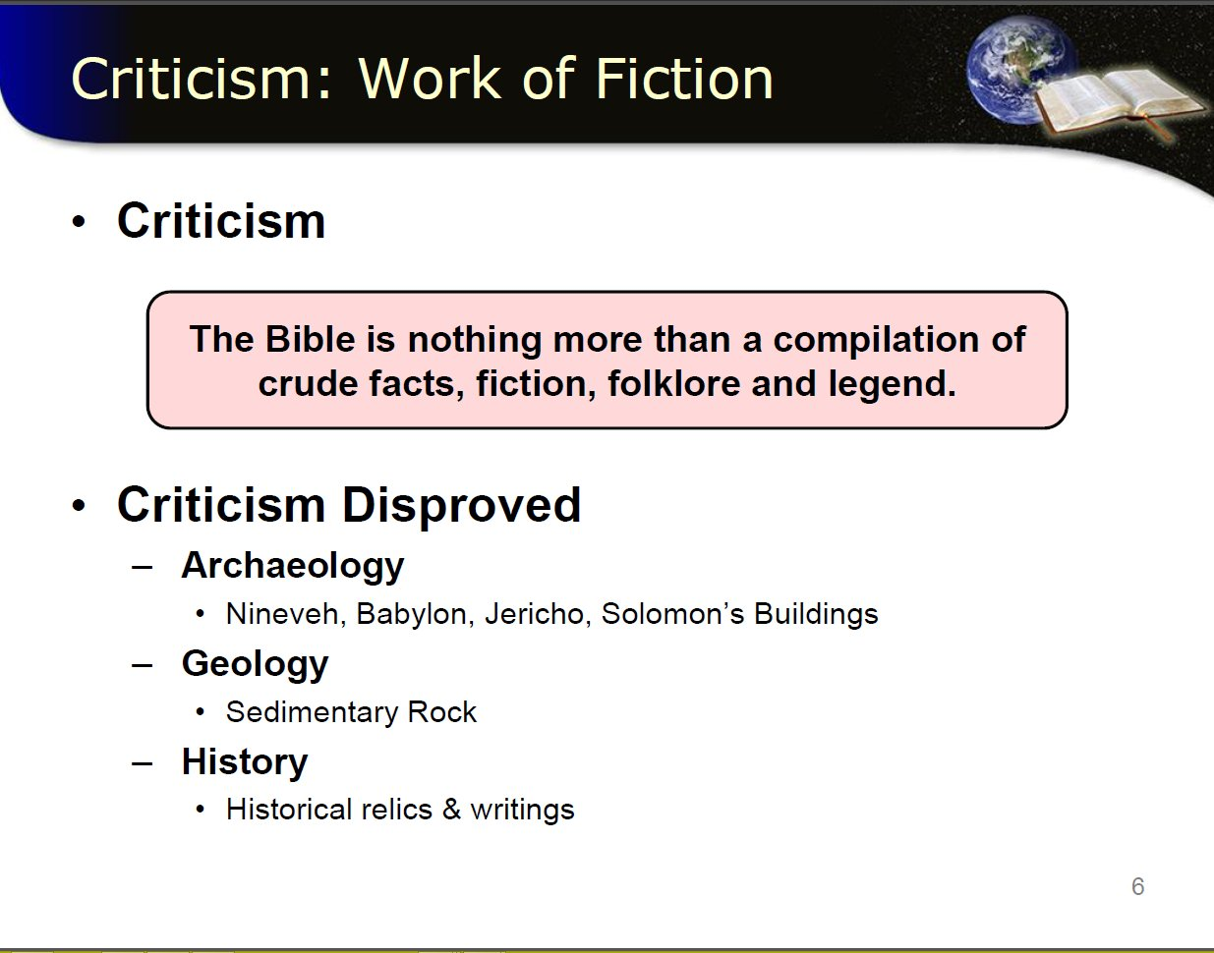
Notes:
The Bible not only history available to us – many nations mentioned in bible have left records of dealings with God and his chosen people the Jews.
other contemporary historians left detailed accounts, artefacts, inscriptions
Corroborate, harmonise or support bible record.
Lets look at some archaeological evidence that has been discovered, in terms of human history, only recently.
there are a few
@

Slide 12
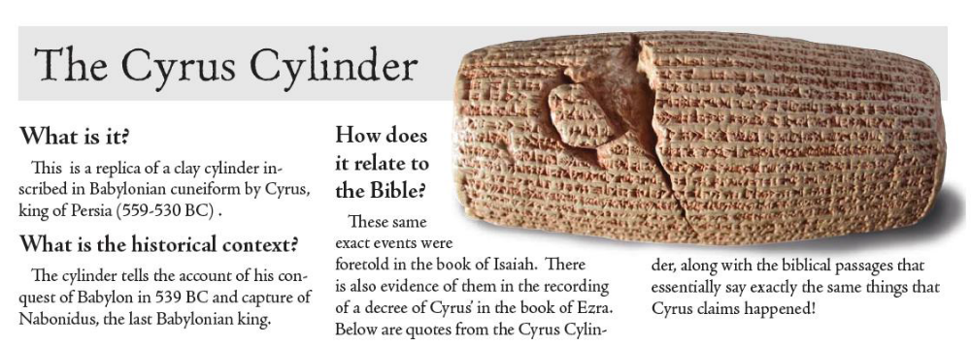
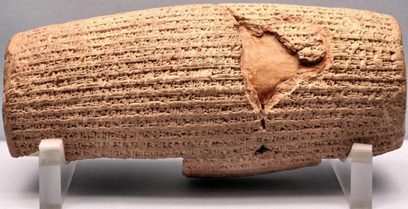
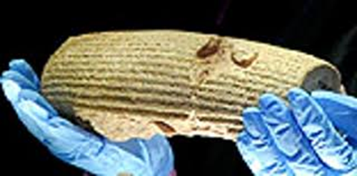
Notes:
Replica
Inscribed curiform
Discovered in March 1879 in temple ruins of Babylon (now Iraq) by Hormuzd Rassam – an archaeologist
Details when Cyrus incorporated Babylon into the Persian Empire
how relate to bible?
@

Slide 13
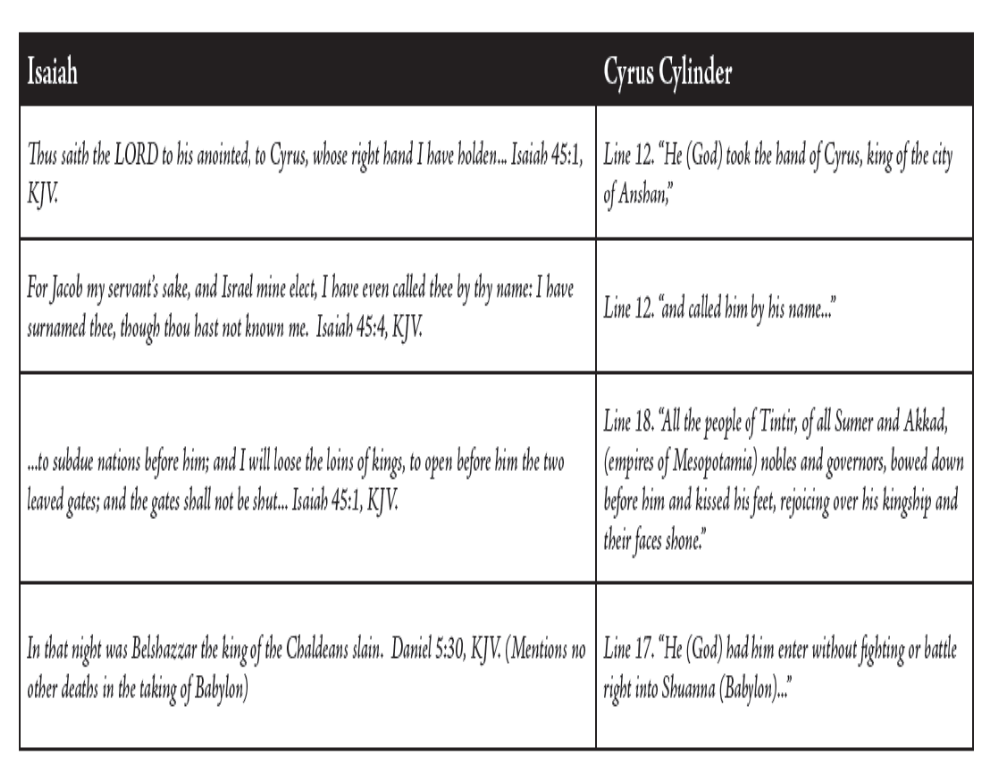
Notes:
Read
‘how does it relate to the Bible’ text.
Praises Cyrus, establishes his genealogy and presents him as a king in the line of kings
Nabonidus, the Babylonian king Cyrus conquered, is denounced as an impious oppressor of the Babylonian people.
The cylinder presents Cyrus as the new ruler that the Babylonian god, Marduk chose to restore peace and order to Babylon.
It says that the Babylonian people welcomed Cyrus as the new ruler of Babylon and that he entered the city in peace.
Cyrus is praised for improving the lives of the Babylonian people, allowing displaced peoples to return to their lands, and for restoring temples in the empire
So lets highlight the passage we see there…. @

Slide 14
Thus saith the Lord to his anointed,
to Cyrus, whose right hand I have holden,…
For Jacob my servant’s sake, and Israel mine elect,
I have even called thee by thy name: I have surnamed thee, though thou hast not known me.
to subdue nations before him;
and I will loose the loins of kings,
to open before him the two leaved gates; and the gates shall not be shut;
In that night was Belshazzar the king of the Chaldeans slain.
Notes:
Read 1st line
Coincidence or collaboration or documented fact.
Read 2nd line
external piece of evidence that confirms the Biblical account.
serious implications!
Ask your self What does this mean to you as individual?
for long time claimed Babylon not existed this cylinder pops up - not only confirms existed , confirms Bible account!
Significance of the find? @

Slide 15
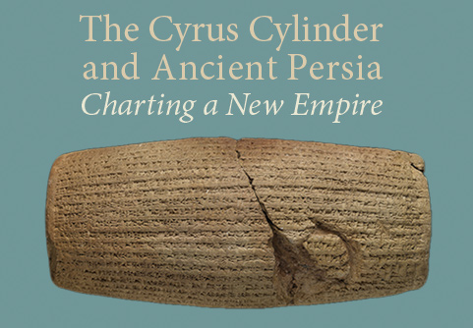
Significance of the Cyrus Cylinder
Iran uses it to demonstrate the time when the Persians ruled the world
Many politicians use it today as the oldest declaration of “human rights” because Cyrus let many captive peoples return to their native lands
Supports the authority of the Bible, because the Bible predicted that Cyrus would overthrow Babylon and set the Jews free
  The prophet Isaiah named Cyrus by name about 150 years before Cyrus was born!
  Isaiah prophesied around 730BC and Cyrus was born about 580BC
It is evidence of the reliability of the Bible!
Notes:
Read
@

Slide 16
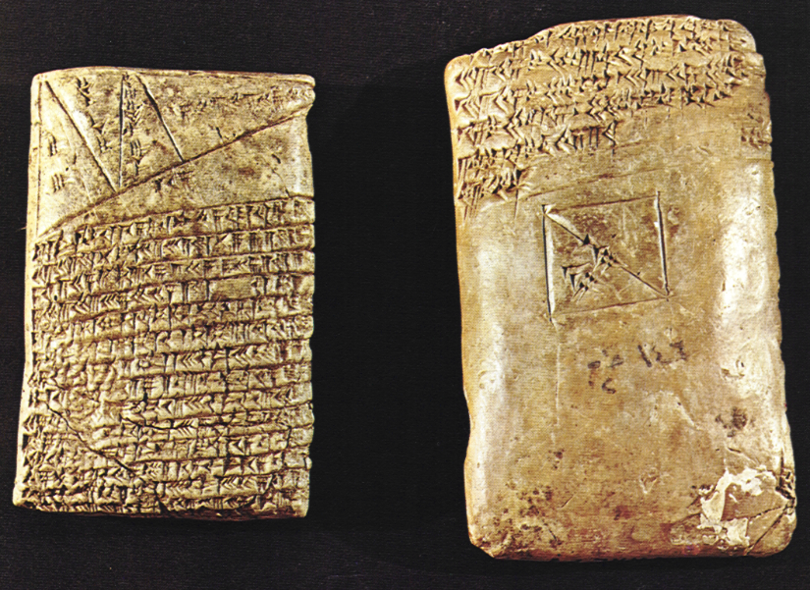
British Museum has two other tablets with the same information
In January 2010,
the British Museum announced that two cuneiform tablets in its collection had been found to be inscribed with the same text as that on the Cyrus Cylinder, which, according to the Museum, "show that the text of the Cylinder was probably a proclamation that was widely distributed across the Persian Empire."
Further support on the reliability of the Bible

Slide 17
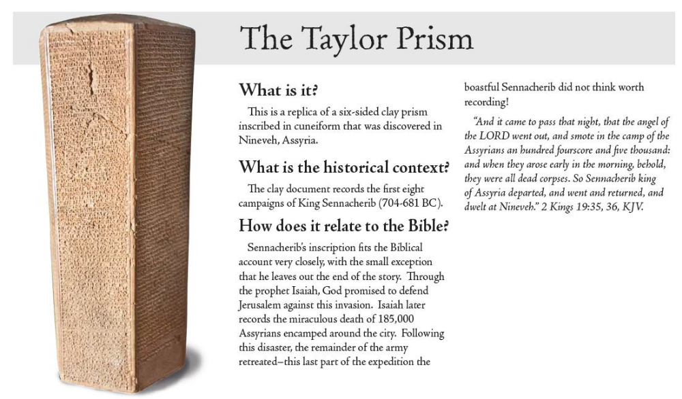
Notes:
Read – ‘what is it’
again, Claimed by critics Nineveh never existed so discounted story of Jonah
Read upto quote – then next page…….@

Slide 18
And it came to pass that night, that the angel of the Lord went out, and smote in the camp of the Assyrians an hundred fourscore and five thousand: and when they arose early in the morning, behold, they were all dead corpses.
36 So Sennacherib king of Assyria departed, and went and returned, and dwelt at Nineveh.
Notes:
Let look at another piece of archaeology evidence…..

Slide 19
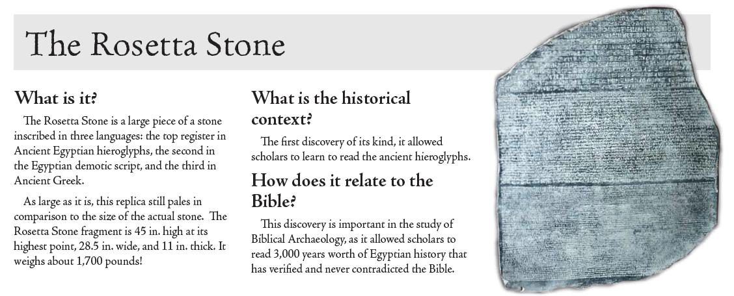
Notes:
Read
‘ what is it’

Slide 20
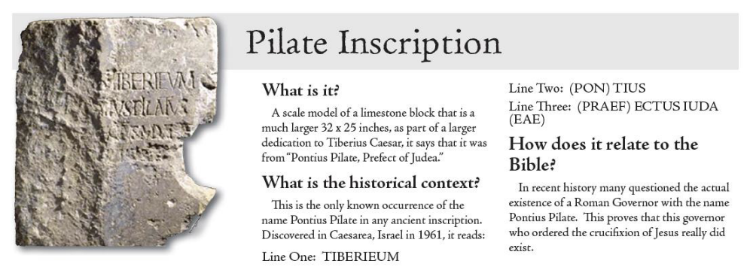

Slide 21
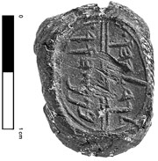
2008
Archaeologists unearth
proof of plot
to kill Prophet
Jeremiah
Notes:
Israeli archaeologists have unearthed a seal impression belonging to a minister of the biblical King Zedekiah, which dates back 2,600 years, during an archaeological dig in Jerusalem's ancient City of David. The finding helps corroborate the story pertaining to the biblical minister's demand to have the prophet Jeremiah killed.
The seal impression, or bulla, with the name Ged-alya-hu ben Pashur, who served as minister to King Zedekiah (597-586 BCE) according to the Book of Jeremiah, was found completely intact just meters away from a separate seal impression of another of Zedekia's ministers, Yehu-kual ben Shel-emy-ahu, which was unearthed three years ago.
Both ministers are mentioned in the Book of Jeremiah (Jeremiah 38 1-4) along with two other ministers when they came to King Zedekiah demanding the death of the prophet Jeremiah for preaching to the besieged city to surrender. Advertisement
The impressions, measuring 1 cm in diameter each, were found among the debris of the destruction of the First Temple period, by an excavation team led by Prof. Eilat Mazar of the Hebrew University of Jerusalem.
The excavation at the history-rich City of David, which is located just outside the walls of the Old City near Dung Gate, has proven, in recent years, to be a treasure trove for archaeologists.
"Only rarely do archaeologists come across findings of significant figures in history, which help lift the dust of history and bring the biblical story to life in such a tangible way," Mazar said.
The letters are in ancient Hebrew and are very clearly preserved, Mazar added.

Slide 22
2008
Archaeologists unearth
proof of plot
to kill Prophet
Jeremiah
Notes:
The impressions, measuring 1 cm in diameter each, were found among the debris of the destruction of the First Temple period, by an excavation team led by Prof. Eilat Mazar of the Hebrew University of Jerusalem.
The excavation at the history-rich City of David, which is located just outside the walls of the Old City near Dung Gate, has proven, in recent years, to be a treasure trove for archaeologists.
"Only rarely do archaeologists come across findings of significant figures in history, which help lift the dust of history and bring the biblical story to life in such a tangible way," Mazar said.
The letters are in ancient Hebrew and are very clearly preserved, Mazar added.

Slide 23
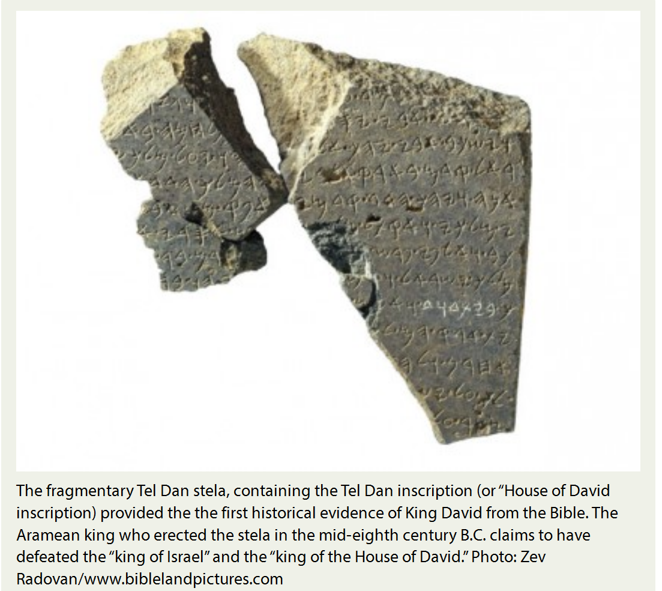
Unearthed in 1993
Tel Dan in
Northern Israel
Notes:
The Tel Dan Stele is a broken stele (inscribed stone) discovered in 1993-94 during excavations at Tel Dan in northern Israel.
It consists of several fragments making up part of a triumphal inscription inAramaic, left most probably by Hazael of Aram-Damascus, an important regional figure in the late 9th-century BCE.
Hazael (or more accurately, the unnamed king) boasts of his victories over the king of Israel and his ally the king of the "House of David" (bytdwd), the first time the name David had been found outside of the Bible.^{[1]}

Slide 24
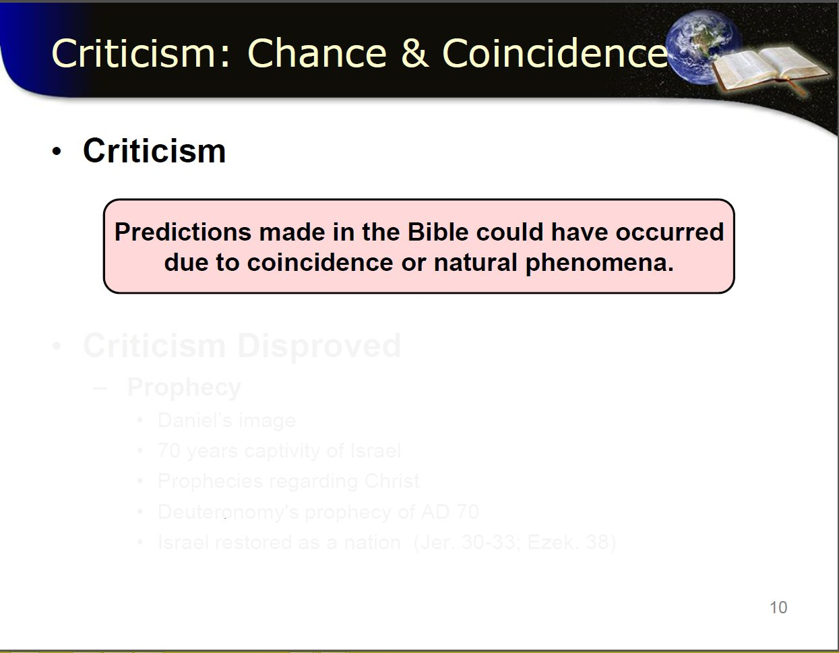

Slide 25
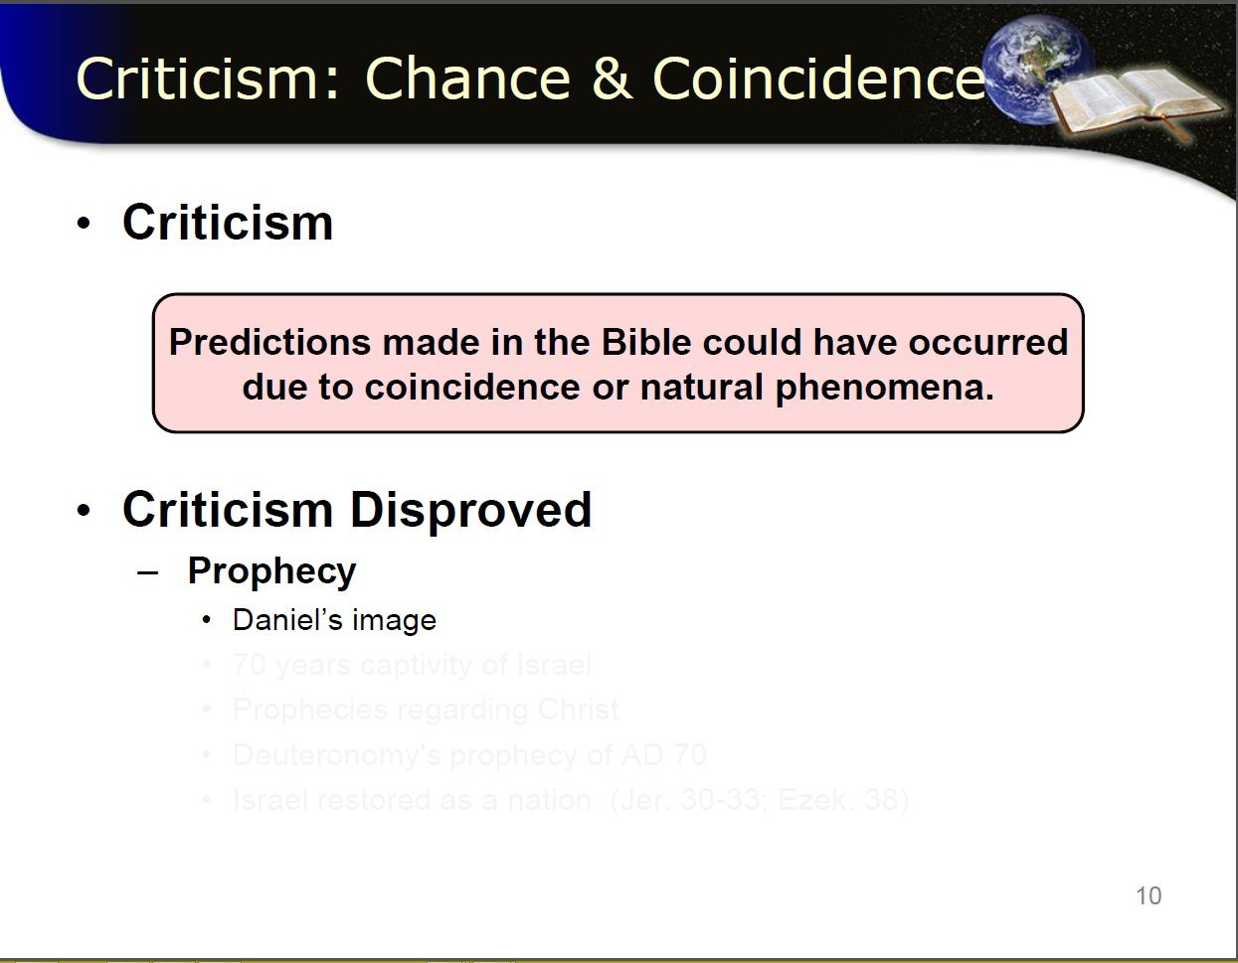

Slide 26
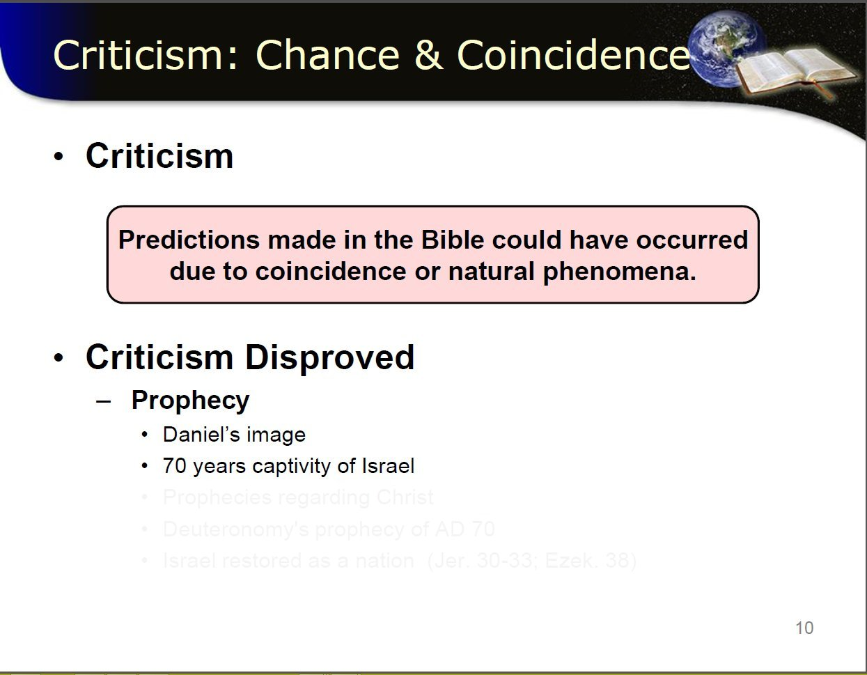

Slide 27
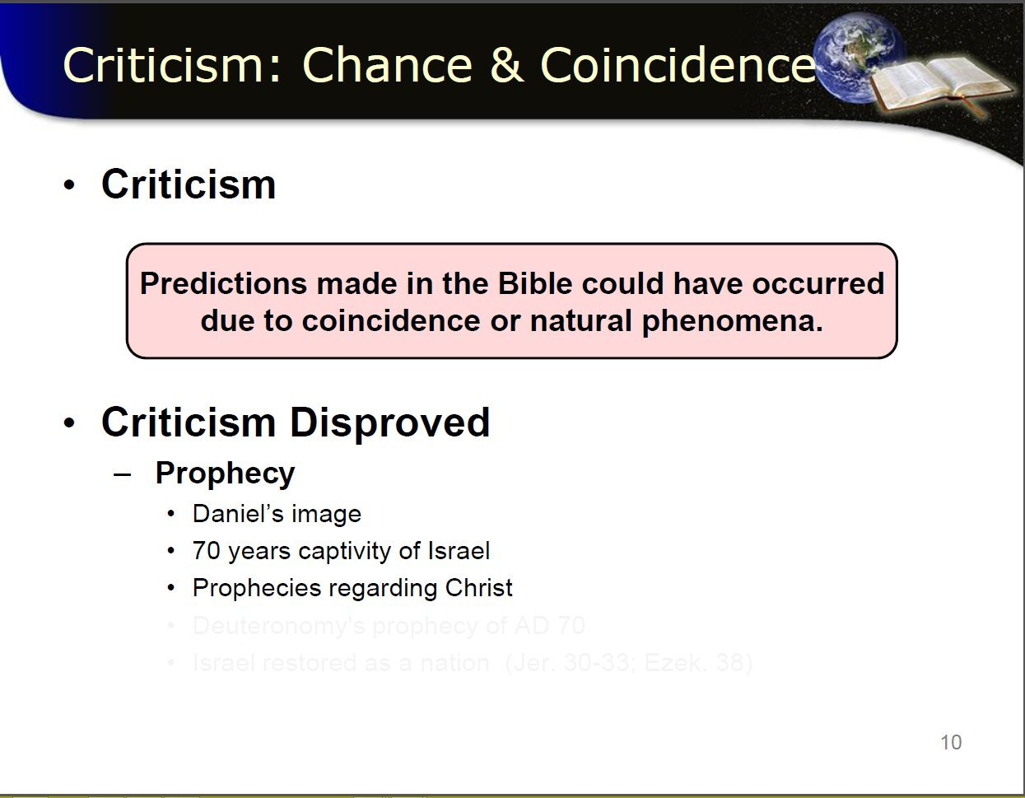

Slide 28
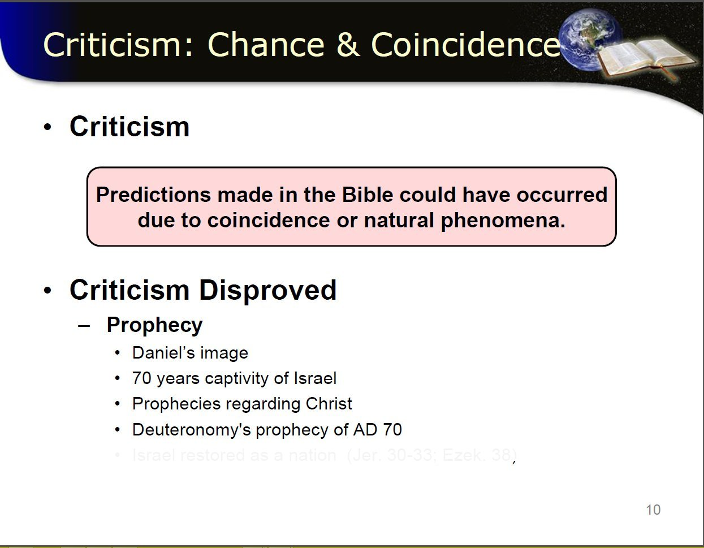
Notes:
Deuteronomy 28:49
"The Lord shall bring a nation against thee from far, from the end of the earth, as swift as the eagle flieth; a nation whose tongue thou shalt not understand;"

Slide 29
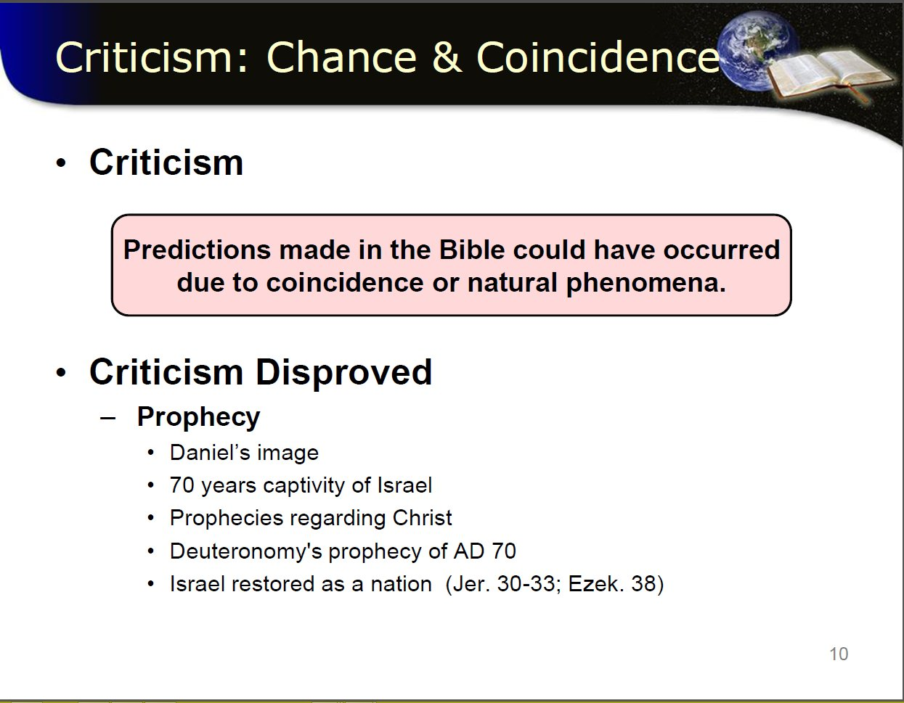
Notes:
Read:
Lets look at the 1st of those
Daniel image….
@

Slide 30
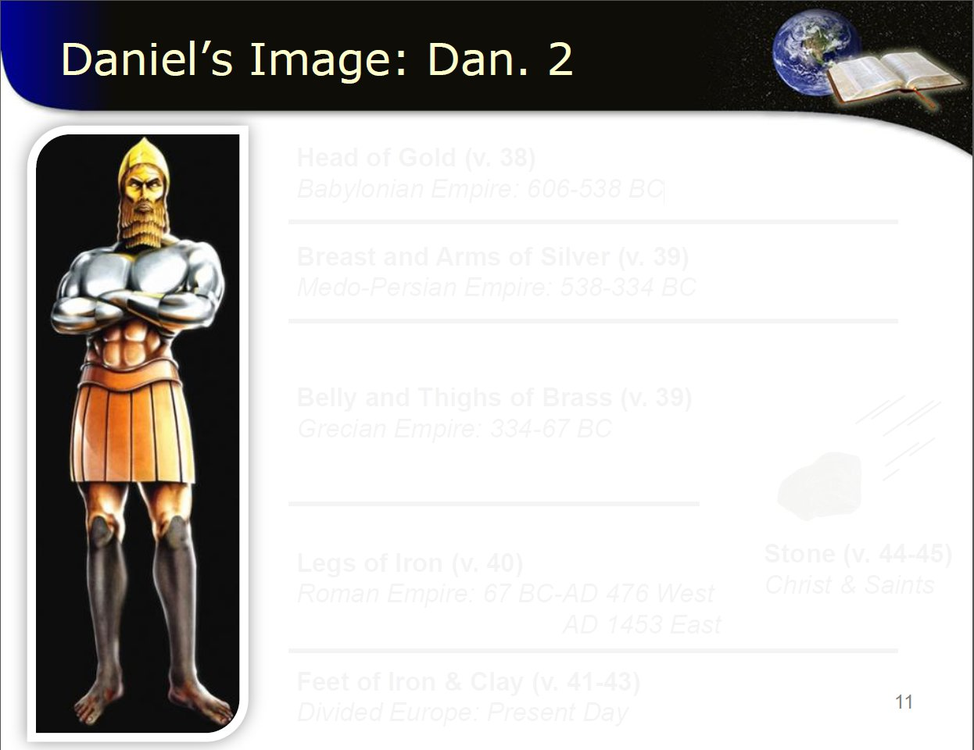

Slide 31
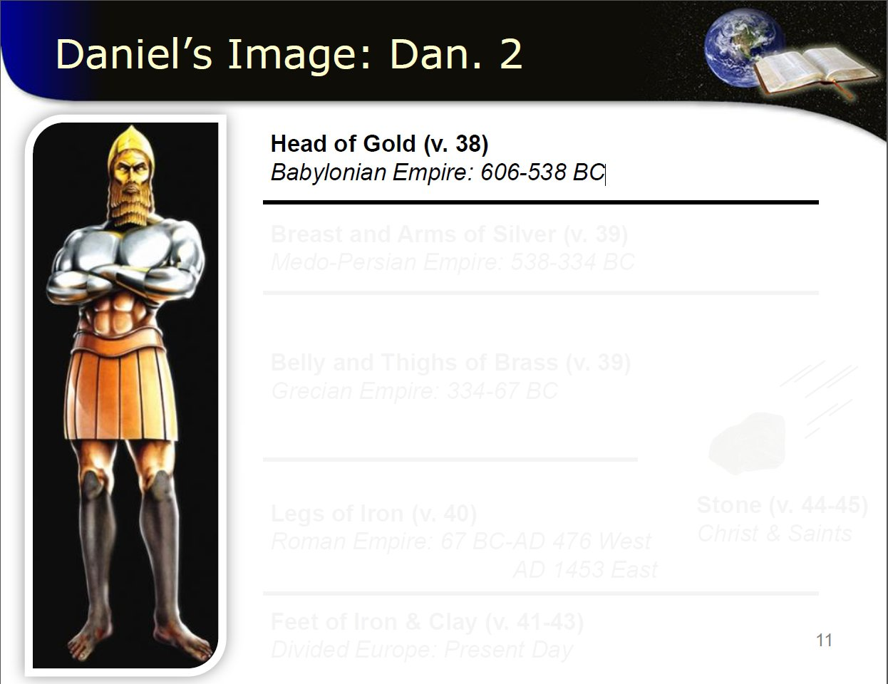

Slide 32
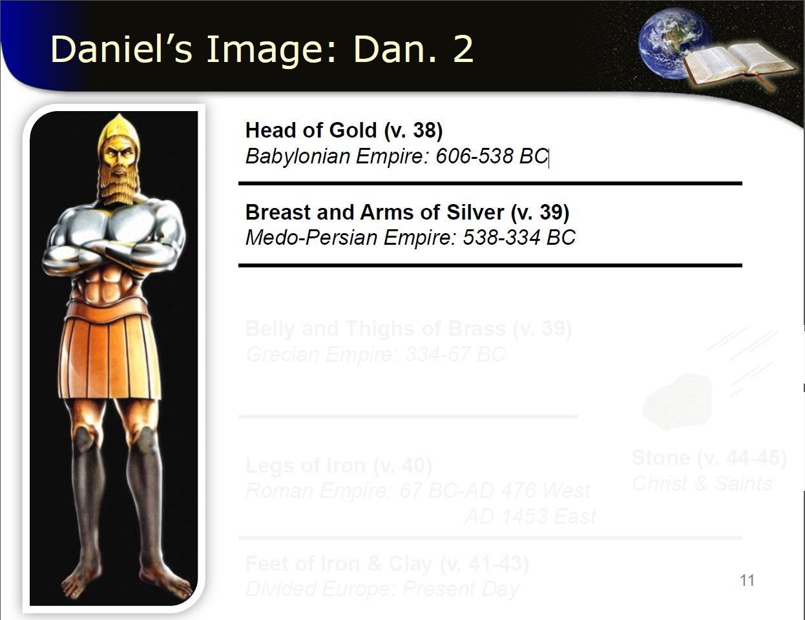

Slide 33
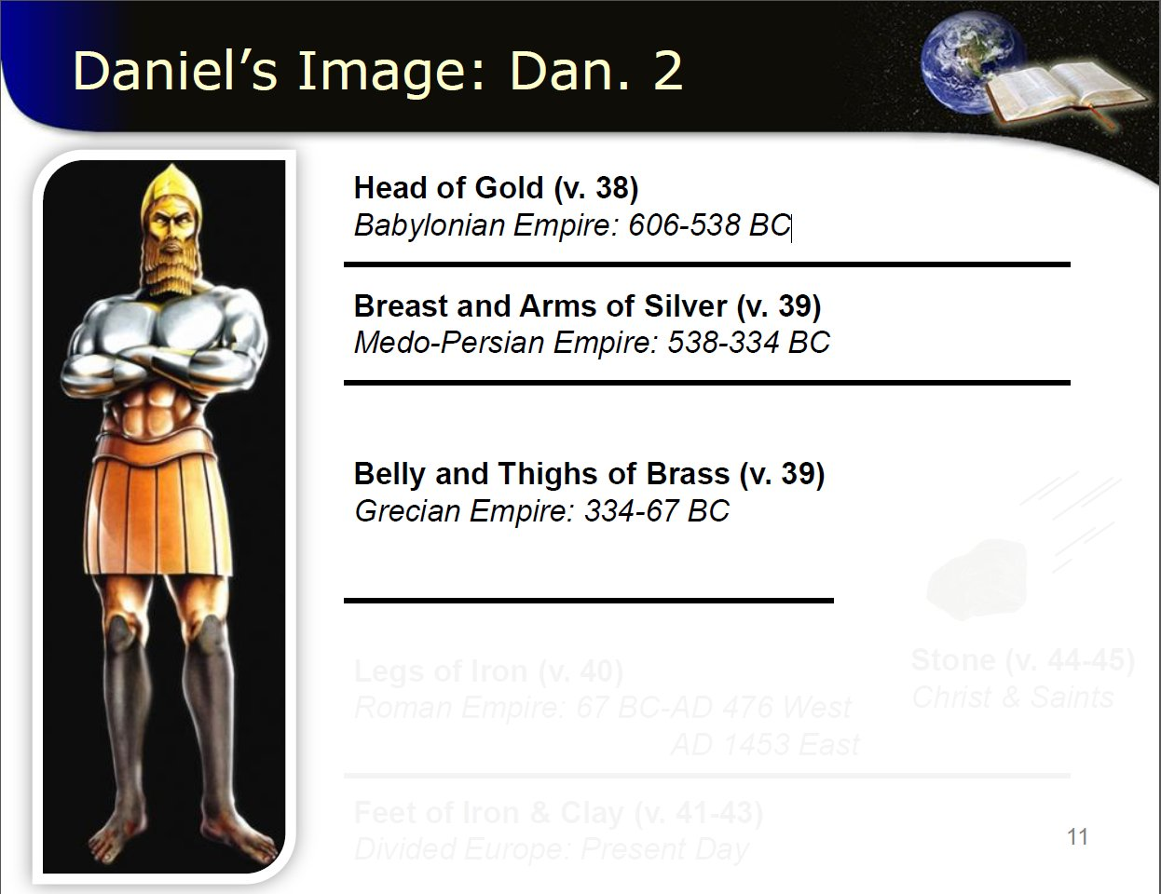

Slide 34
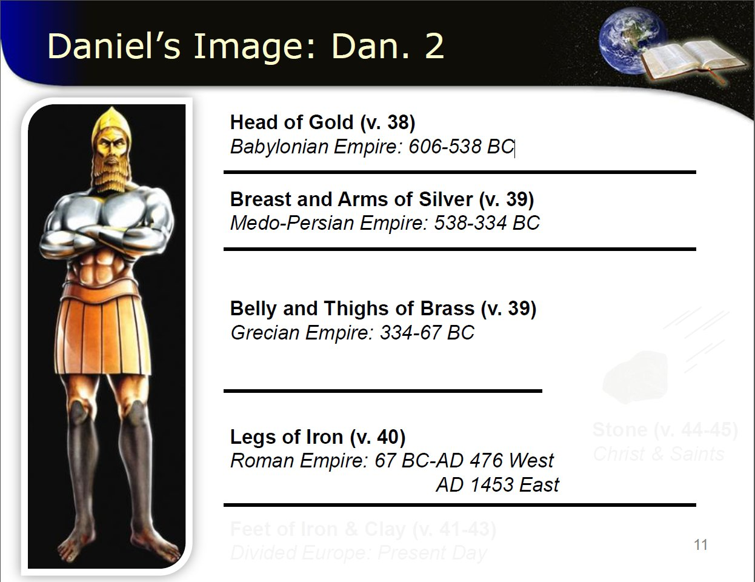

Slide 35


Slide 36
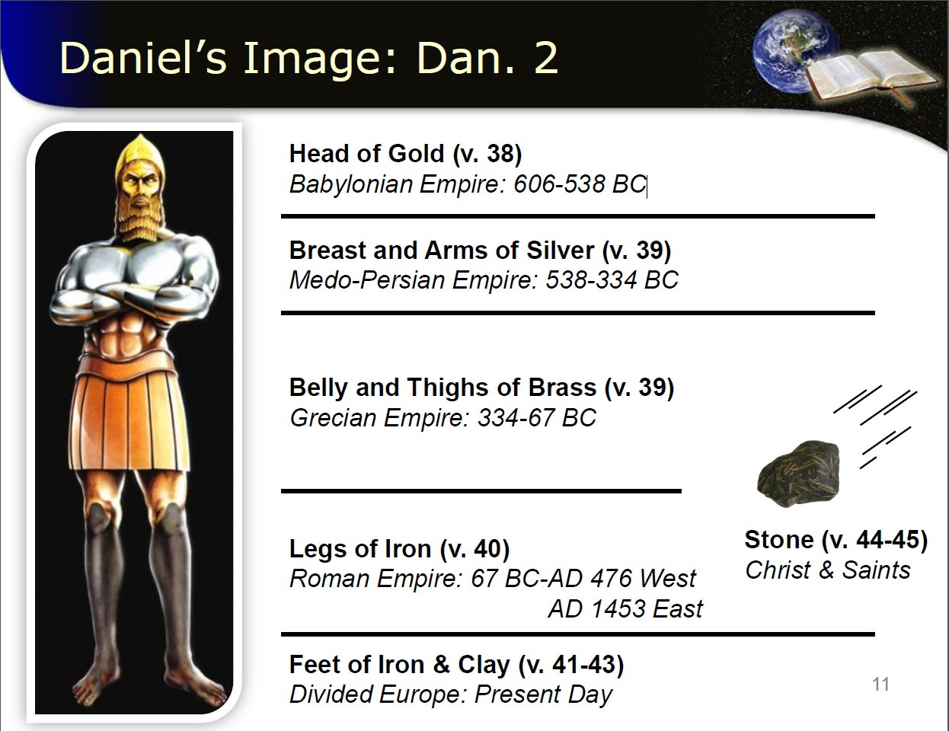
Notes:
SO WE HAVE RELIABLE PROFETIC MESSAGE!

Slide 37
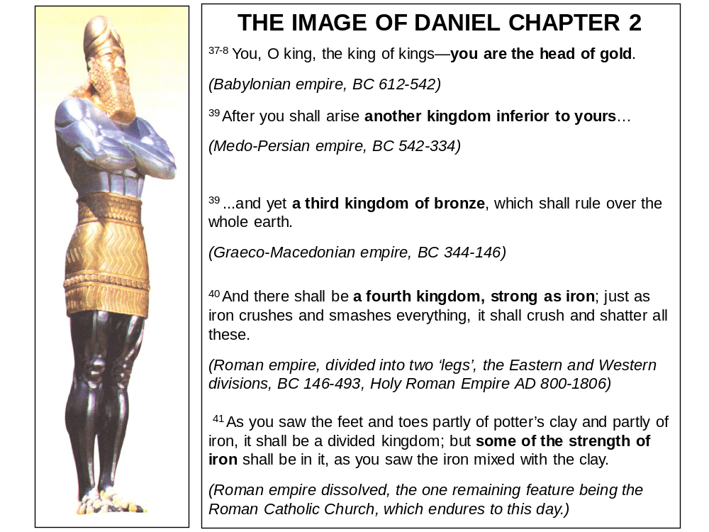

Slide 38
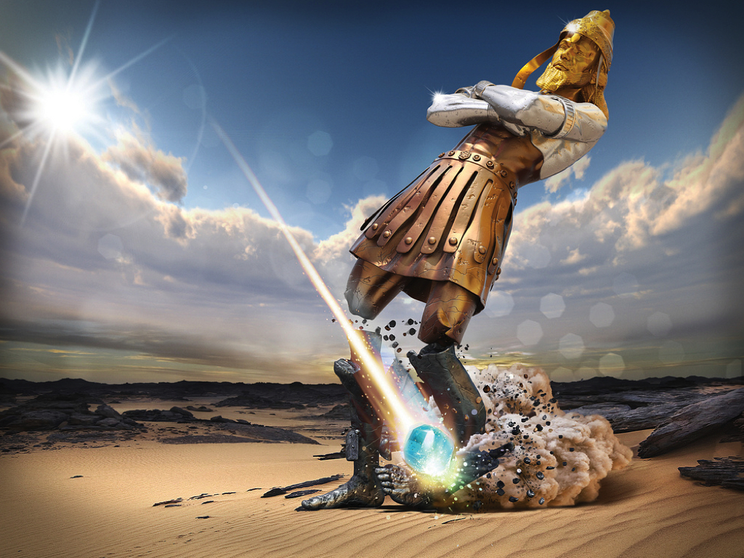

Slide 39
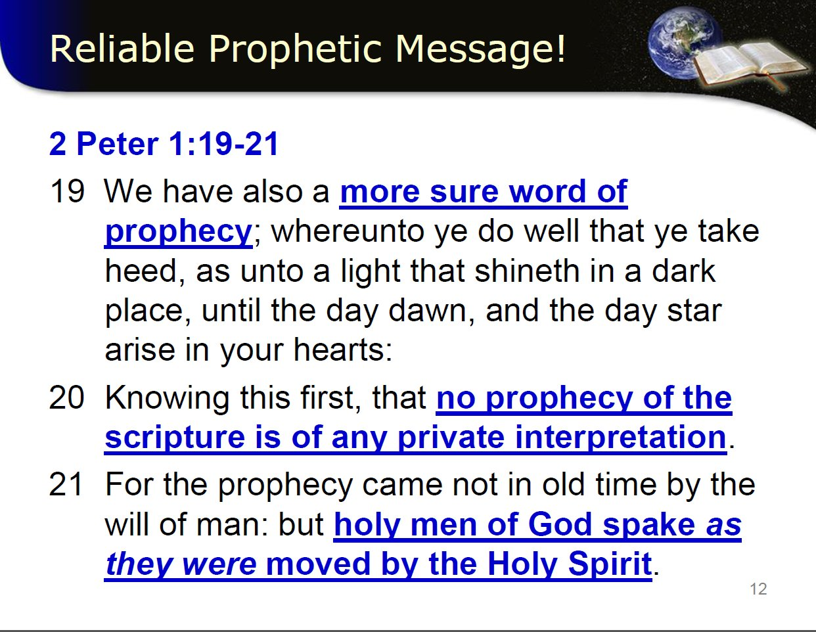

Slide 40
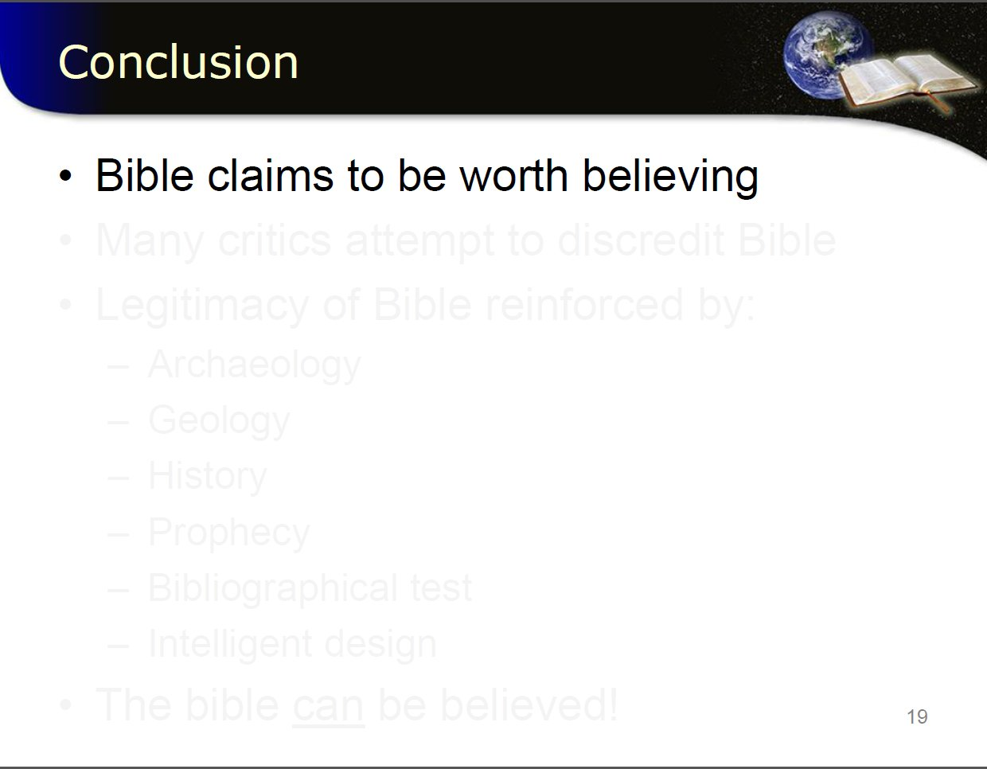
Notes:
Seen this to be true from arch and historic view point

Slide 41
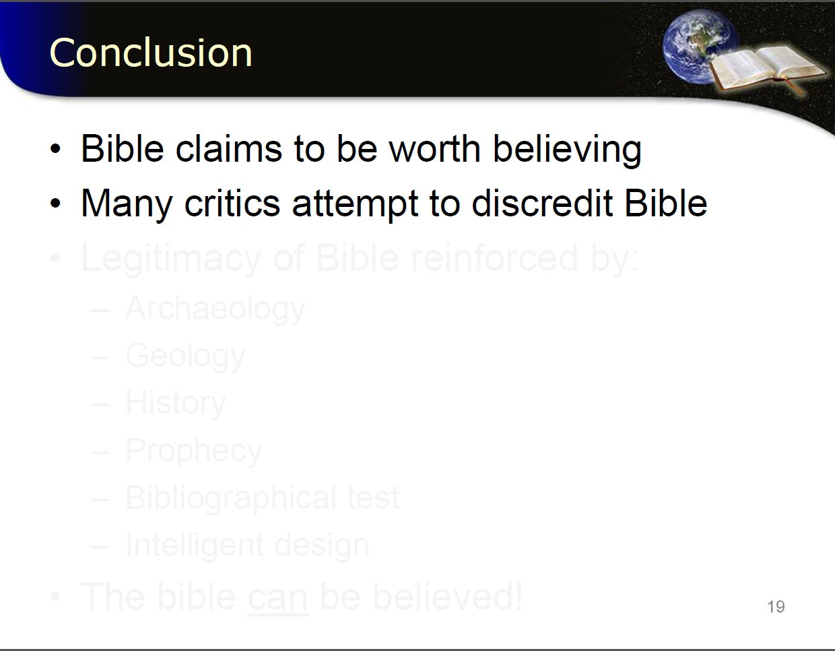
Notes:
Shown how arch proves not disproves bible credibility

Slide 42
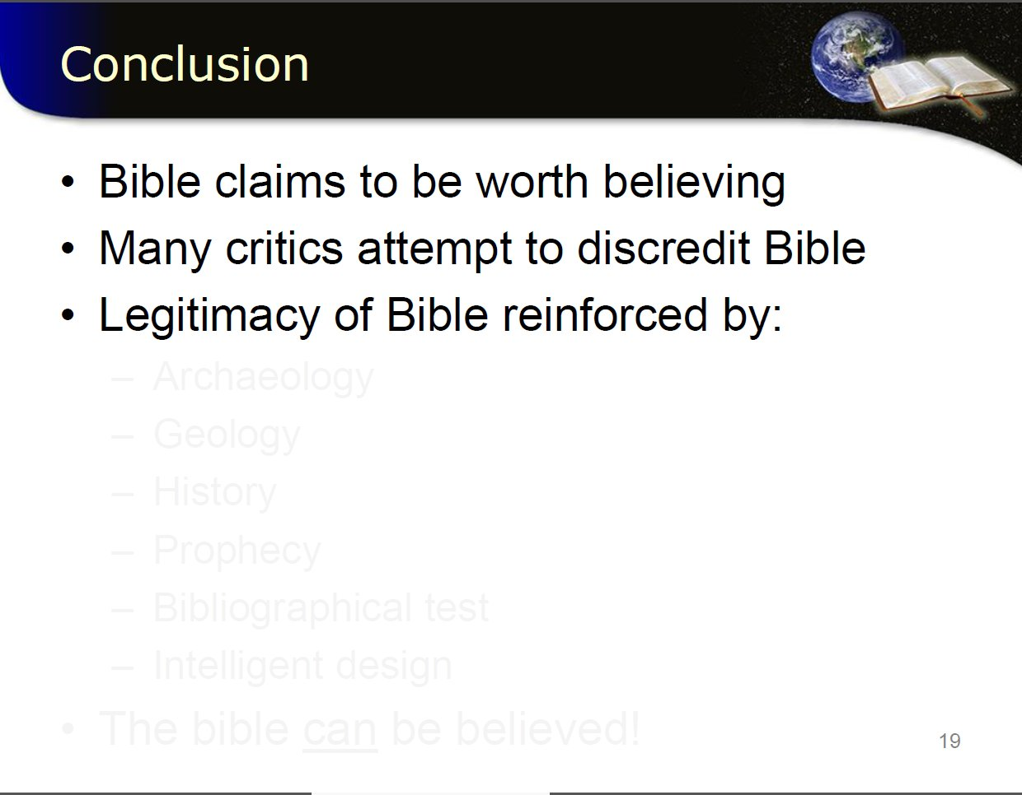

Slide 43
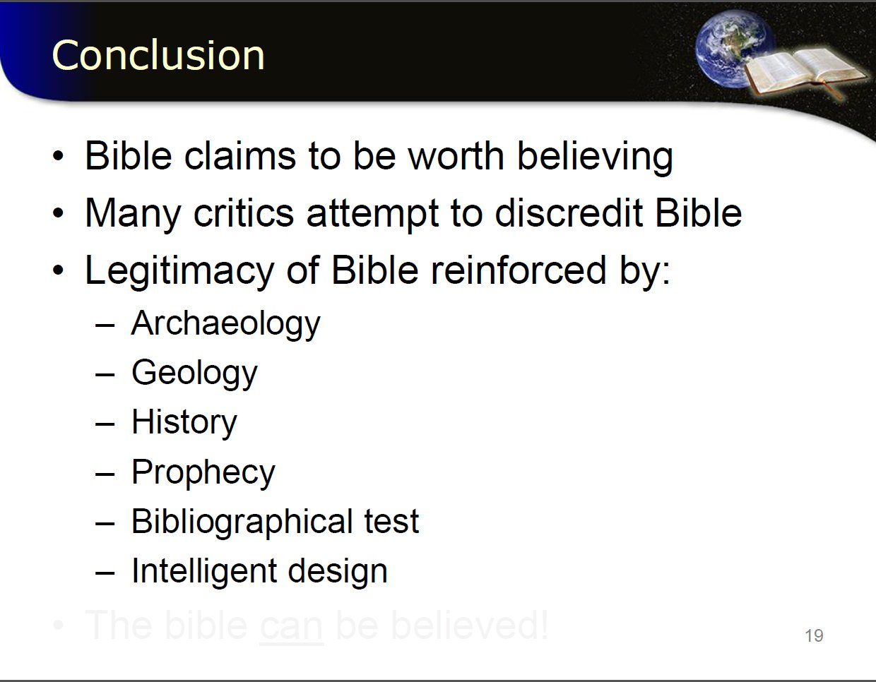

Slide 44
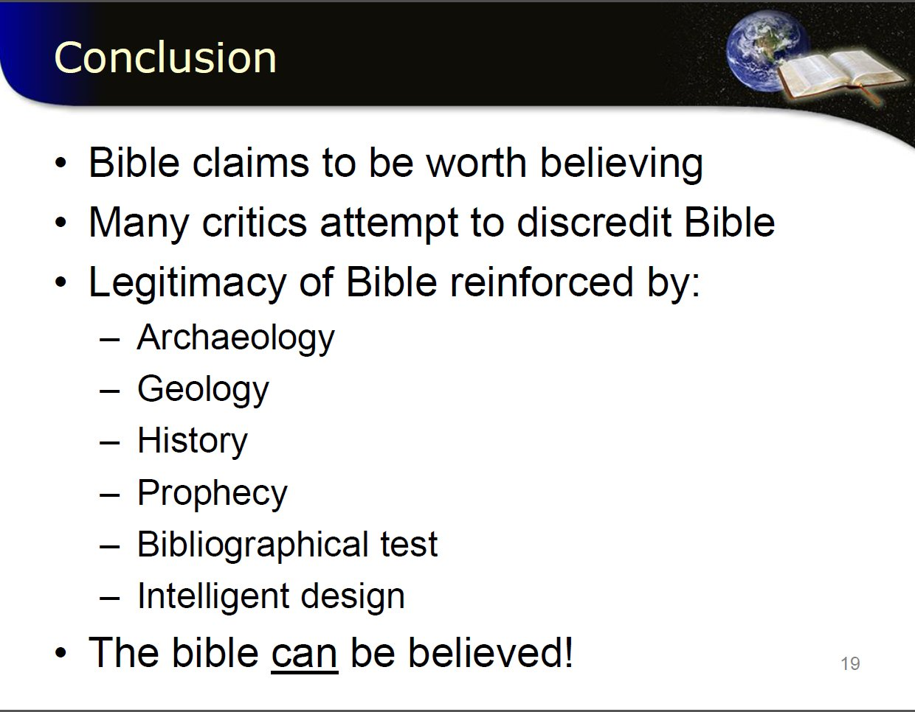
The Bible Can Be Believed

Slide 45
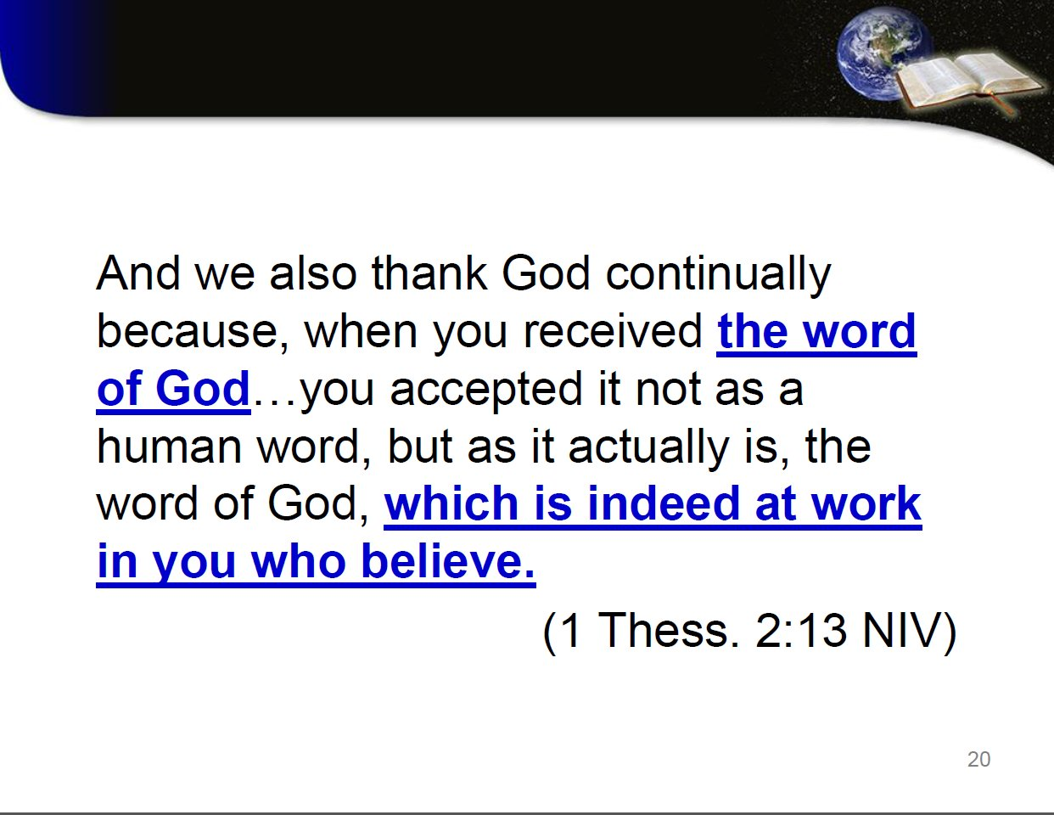
The Bible Can Be Belived

Slide 47
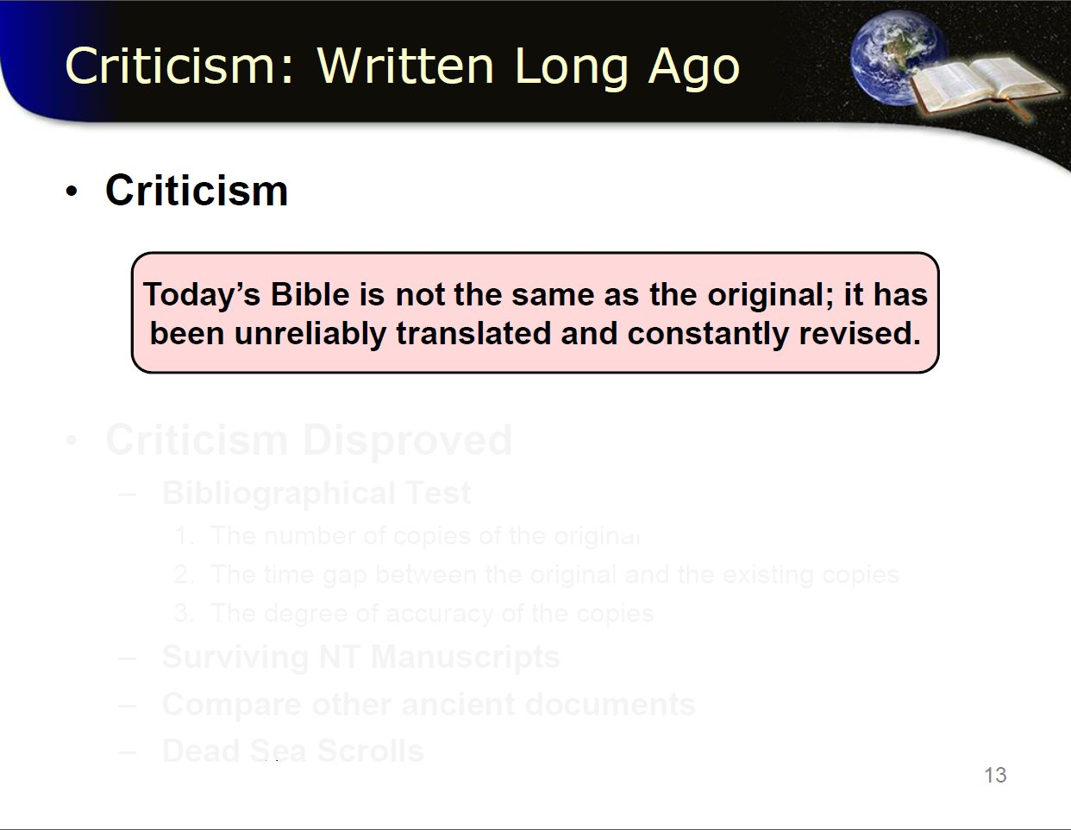
Notes:
another

Slide 48
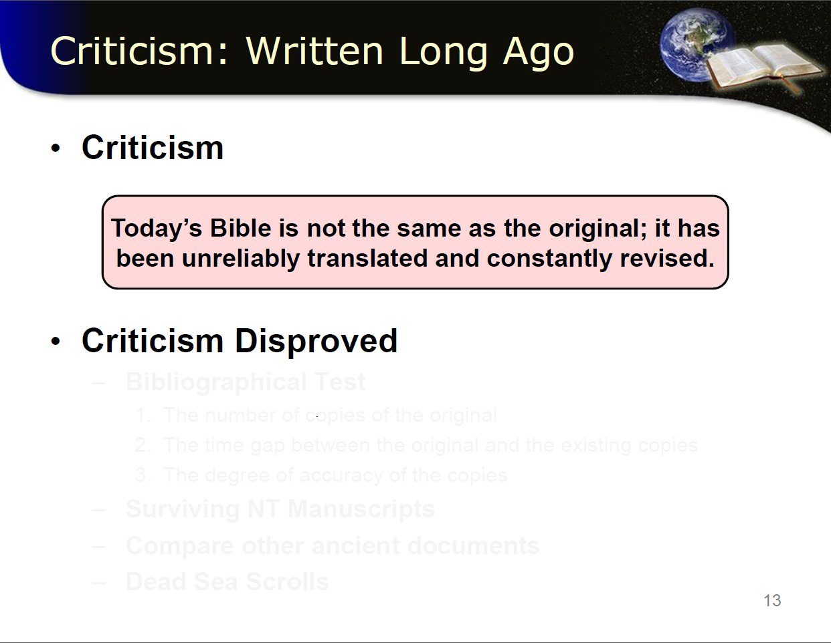

Slide 49
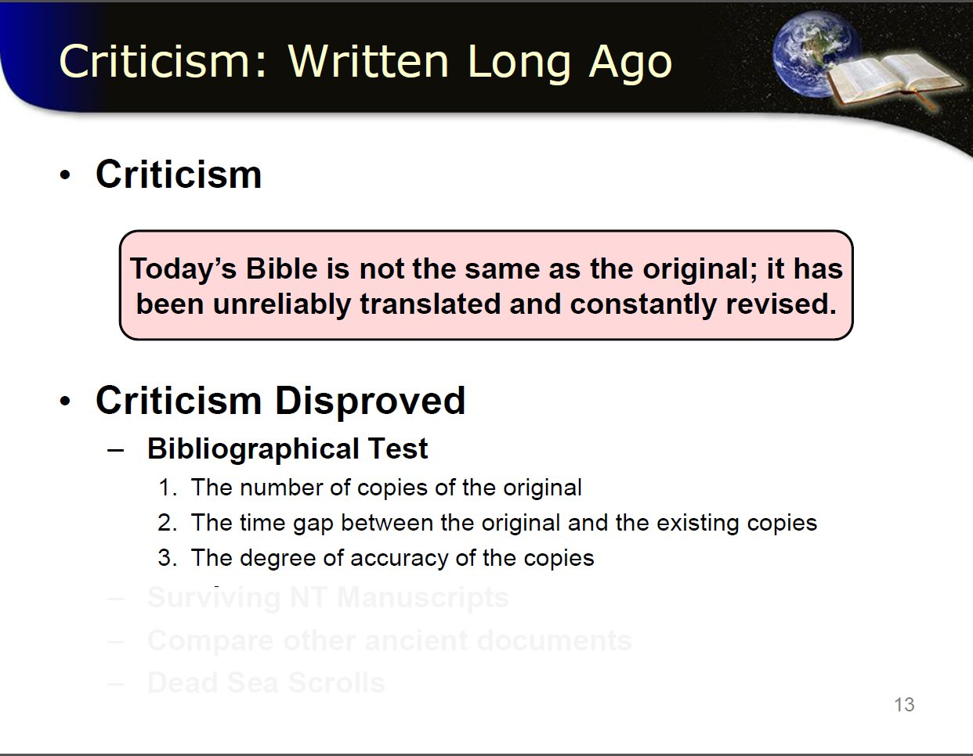

Slide 50
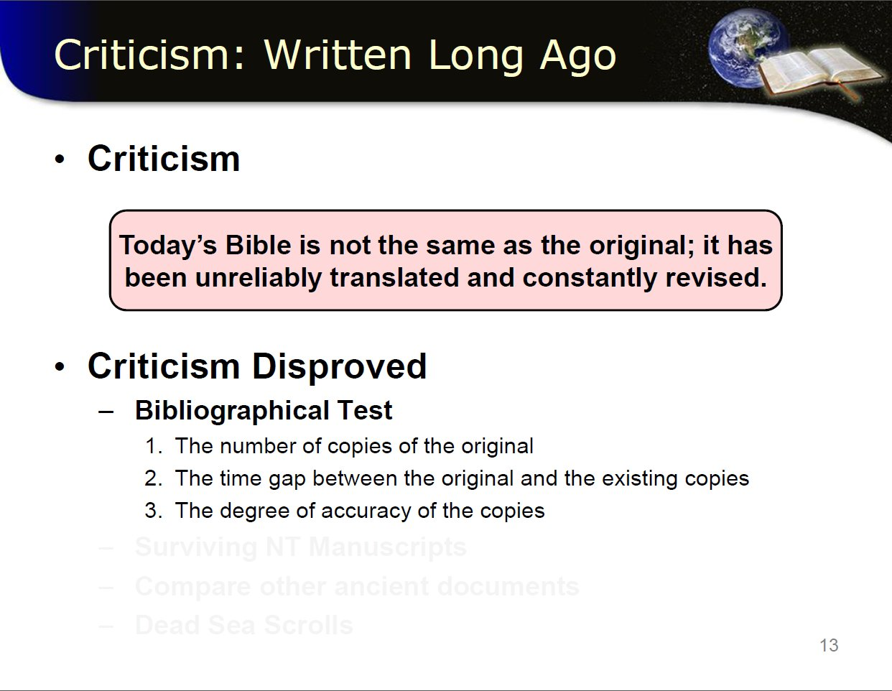
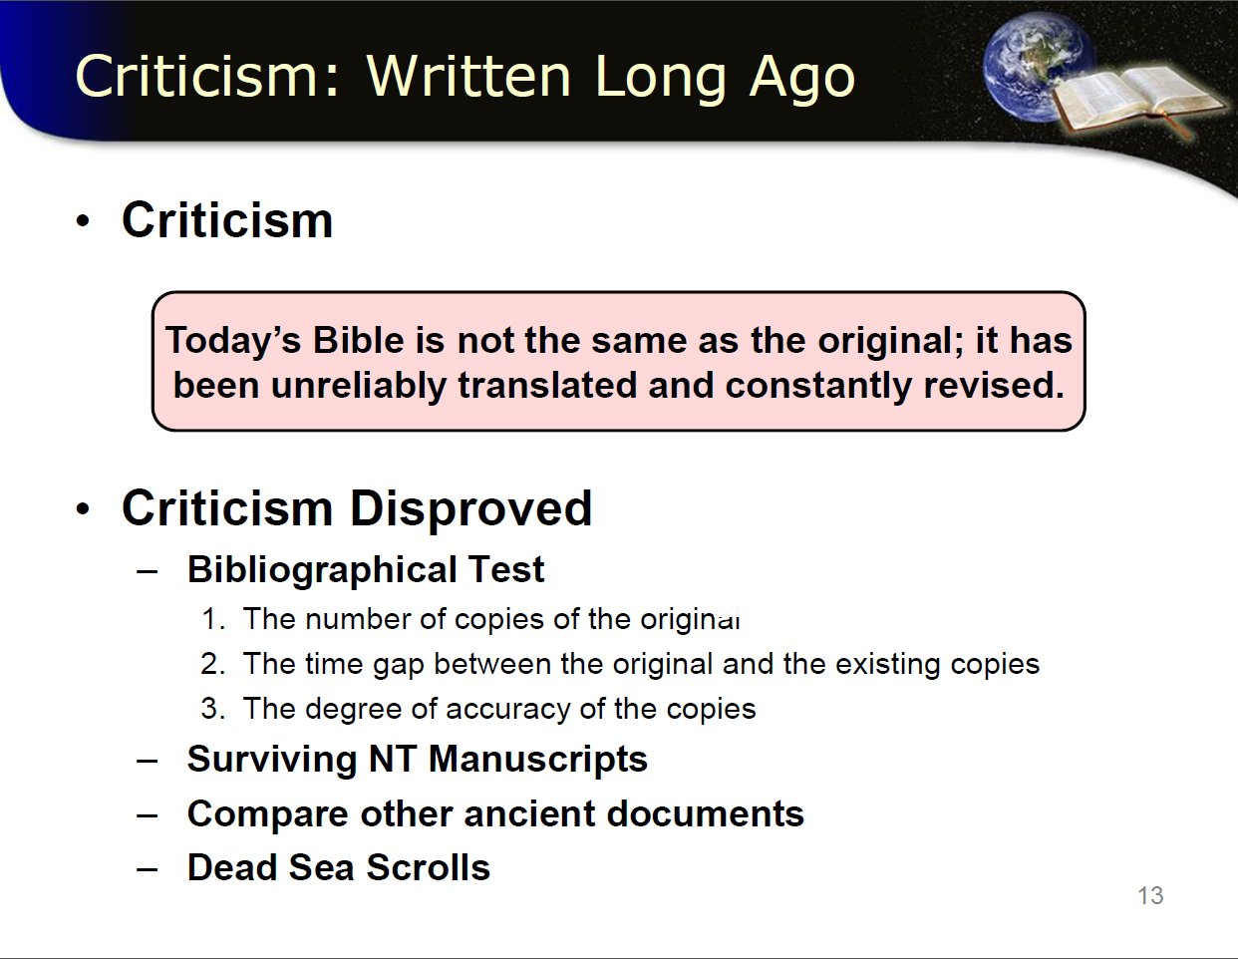

Slide 51
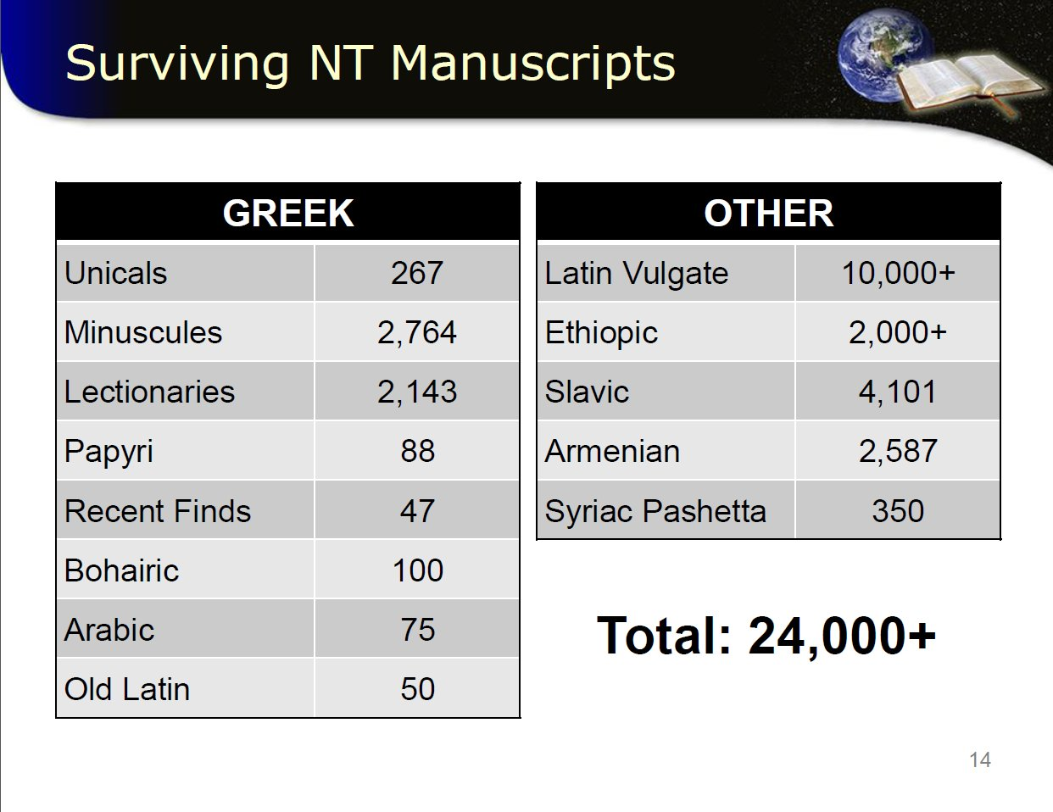

Slide 52
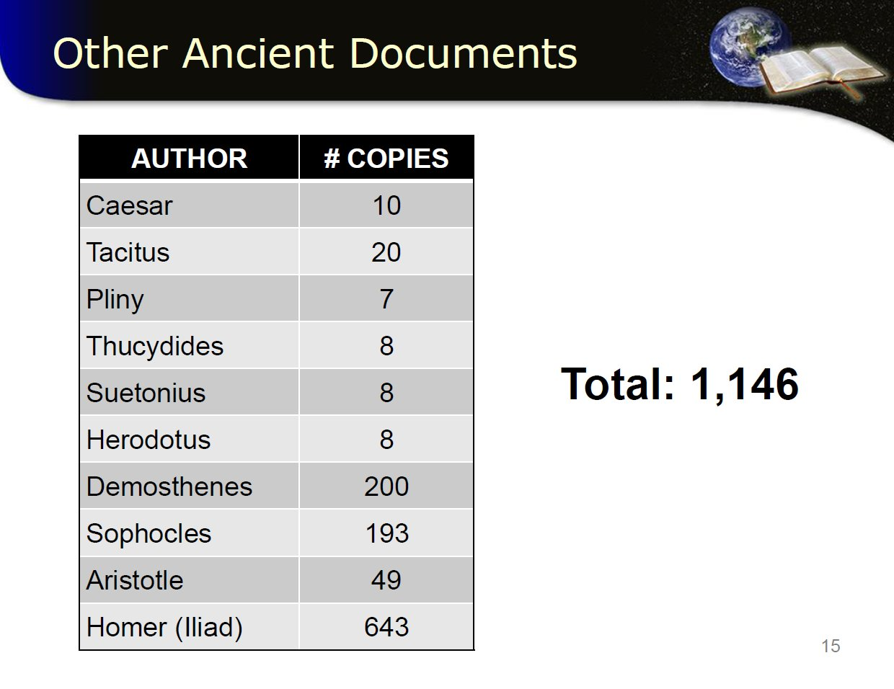

Slide 53
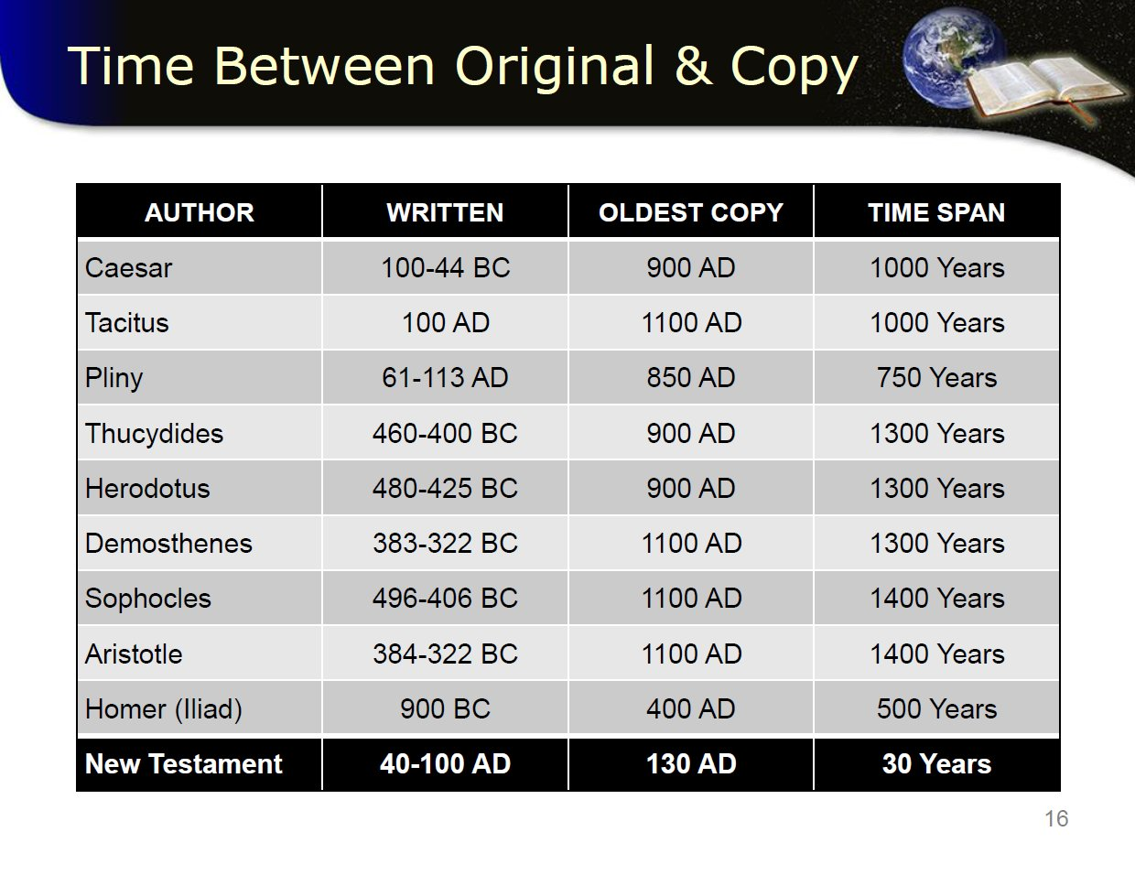

Slide 54
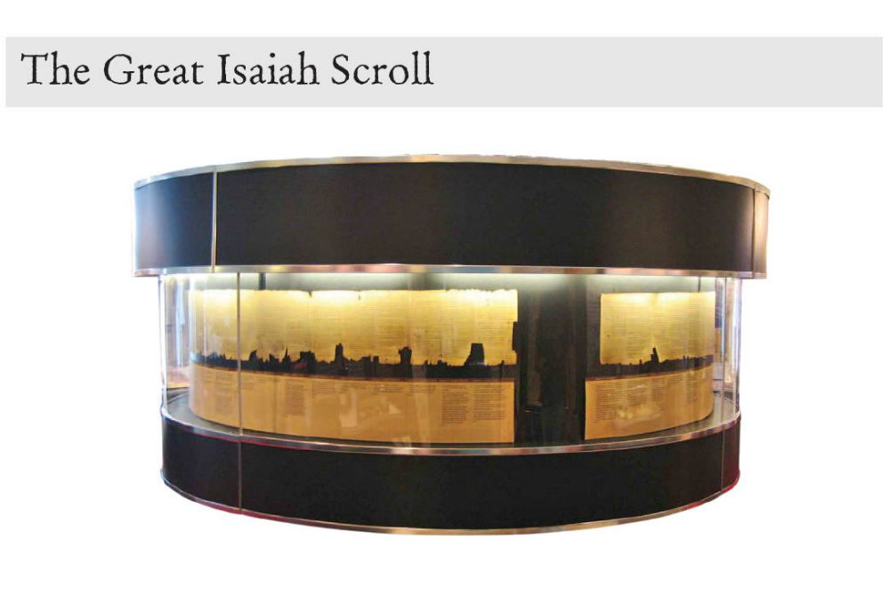

THE DEAD SEA SCROLLS

Slide 55


Slide 56


Slide 57


Slide 58


