Slide 1
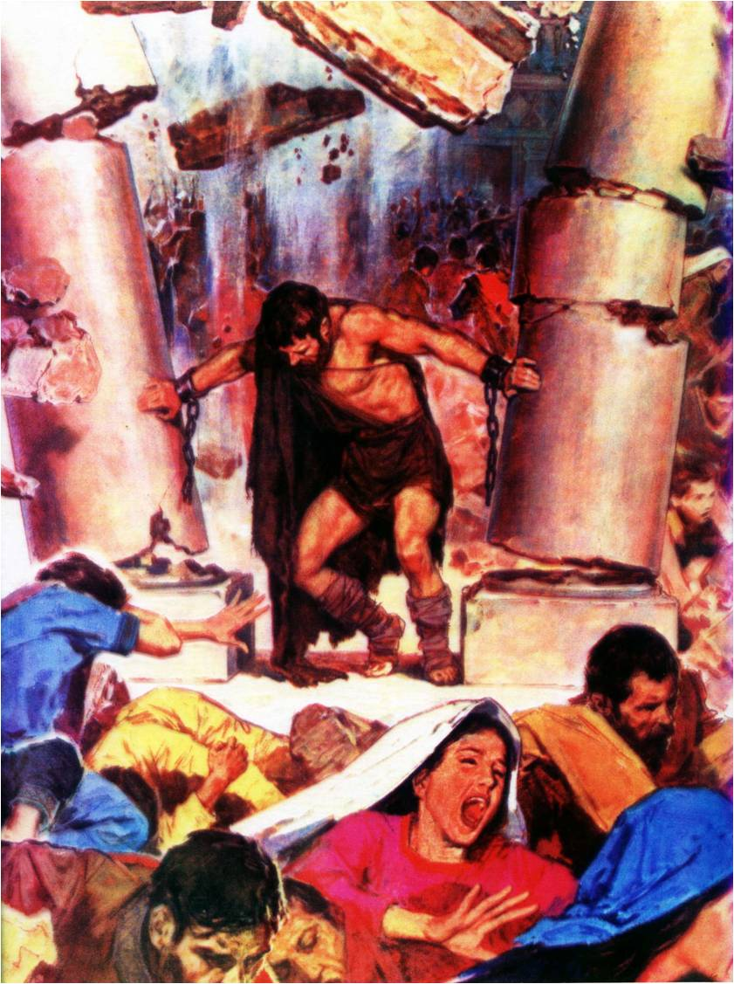
Samson –
God’s strength made perfect in weakness
Study 1
“Every man did right in his own eyes”

Slide 2
Structure of the Book of Judges
Chap. 1:1-3:6 The failure of Israel to consolidate their inheritance
Chap. 3:7-16:31 The history of Israel under the Judges
Chap. 17:1-21:25 - Two appendices to the book
Appendix 1
Chap. 17-18 Corruption of Doctrine
Appendix 2
Chap. 19-21 Corruption of Practice
Between 2:9 & 10

Slide 3
The challenge of generational change
The angel at Bochim
Joshua (110)
Elders
“all that generation”
Idolatry
Generation that knew not Yahweh
Miracles
Era of the two appendices – Judges 17 to 21
The Wilderness generation
Samson – God’s strength made perfect in weakness

Slide 4
Proof of the timing of the Appendices
Appendix 1
Judges 18:30 – “Jonathan, the son of Gershom, the son of Manasseh” is the grandson of Moses – Ex. 2:22; 18:3. Manasseh means “causing to forget” (this is a significant choice by the Sopherim as a substitute for Moses).
Appendix 2
Judges 20:28 – Phinehas the son of Eleazar and grandson of Aaron was high priest of Israel at this crisis. He distinguished himself in the crisis involving the women of Moab – Num. 25:7-8.
Samson – God’s strength made perfect in weakness

Slide 5
Content of the Appendices
Judges 17 – The house of Micah manufactures an idol and creates a false priesthood
Judges 18 – Displaced Danites seek a place to dwell in the far north of the land and carry away Micah’s idol and priest to establish an apostasy
Judges 19 – A Levite retrieves his wayward concubine only to lose her to a band of brutal sodomites in Gibeah of Benjamin
Judges 20 – Indignant but hypocritical Israel gather to cleanse Benjamin but suffer terribly
Judges 21 – Israel in a quandary try dubious methods to find wives for Benjamin’s survivors
Samson – God’s strength made perfect in weakness

Slide 6
There was no king in Israel
This statement occurs 4 times – Judges 17:6; 18:1; 19:1; 21:25.
In the first and last occurrences the statement “every man did that which was right in his own eyes” is added. Omit italicised words and read literally: “every man did right in his own eyes”.
This was a time of rationalisation and self-justification. Men found a way to justify almost any kind of behaviour and to dress it up in the garb of respectability.
When men set their own standards, invariably God is left out, though His name may be used.
Samson – God’s strength made perfect in weakness

Slide 7
A brother’s lament in 2011
We are currently in the Golden Age of Sin. Right is wrong and wrong is right. The only real sin today is talking about sin. We have the perfect storm of humanism, evolution and moral relativity in society around us. This has eroded our standards and brought about a moral and doctrinal laxity in our ecclesias. In an honest effort to become more loving and kind, we are now threatened by a dynamic of extreme tolerance. In that climate, the tolerant stand idle as people simply do as they please, but swiftly condemn anyone who judges doctrine and behaviour according to Biblical standards.
Samson – God’s strength made perfect in weakness

Slide 8
The pattern of decline
Strength
Decline is usually more like this with incremental changes eroding strength over decades.
Decline in a large community rarely happens like this
Apostasy
Years
10 20 30 40 50 60 70 80
Samson – God’s strength made perfect in weakness

Slide 9
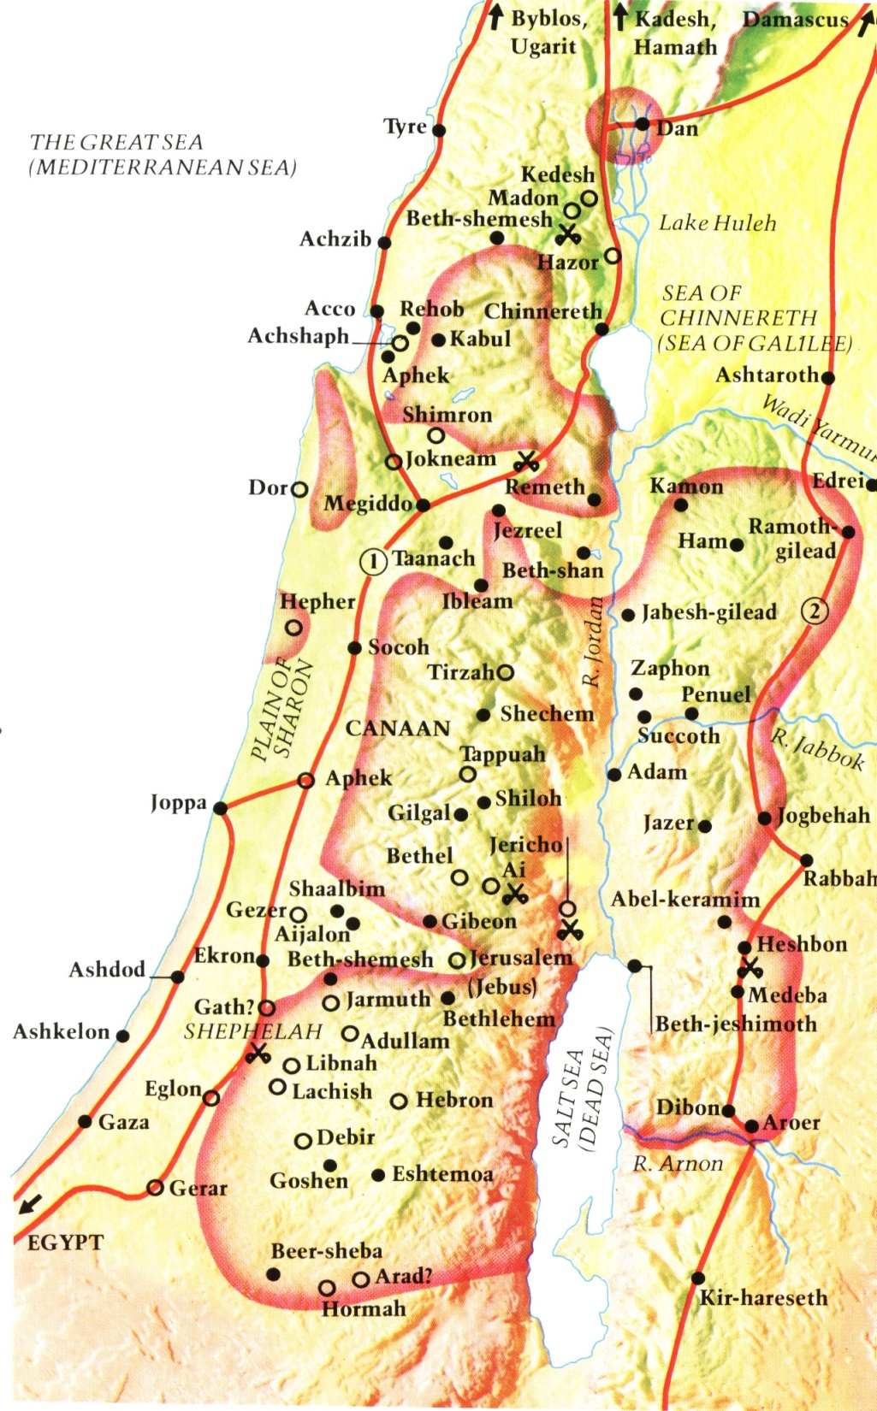
Israel’s settlement of the Land in the time of the Judges
This map shows the possible shape of Israel’s settlement in the land at the time of Judges 2

Slide 10
The compromise of convenience Judges 1:22-26
The inflexible rule was to destroy every Canaanite – Deut. 20:16-17.
God had forewarned that Israel would need to be patient and persistent to overthrow some cities – Deut. 20:19-20.
The house of Joseph traded the Divine imperative for the path of convenience.
The “House of God” is not established by compromise – see 1 Kings 12:29.
Canaanites prospered to the future detriment of Israel – Judges 2:3.

Slide 11
Remaining inhabitants a snare Judges 2:3
And ye shall make no league with the inhabitants of this land; ye shall throw down their altars: but ye have not obeyed my voice: why have ye done this?
Wherefore I also said, I will not drive them out from before you; but they shall be as thorns in your sides, and their gods shall be a snare unto you.

Slide 12
Danger of the old inhabitants Num. 33:51
Speak unto the children of Israel, and say unto them, When ye are passed over Jordan into the land of Canaan;
Then ye shall drive out all the inhabitants of the land from before you, and destroy all their pictures, and destroy all their molten images and quite pluck down all their high places:

Slide 13
Canaanites = Thorns Num.33:55
But if ye will not drive out the inhabitants of the land from before you; then it shall come to pass, that those which ye let remain of them shall be pricks in your eyes, and thorns in your sides, and shall vex you in the land wherein ye dwell.

Slide 14
Canaanites = Thorns Joshua 23:13
Know for a certainty that the LORD your God will no more drive out any of these nations from before you; but they shall be snares and traps unto you, and scourges in your sides, and thorns in your eyes, until ye perish from off this good land which the LORD your God hath given you.

Slide 15
The challenge of association
In His anger Yahweh decreed He would not drive out the Canaanites, but leave them to prove Israel.
This was important for those who had not experienced warfare in taking their inheritance.
This is our position – every individual must be tested in the warfare of faith.
The test comes from being associated by necessity and circumstances with different types of people – neighbours, work colleagues, unbelieving relatives, acquaintances, etc.
A minority may be hostile, but the vast majority will be desirous of peace and friendship.
Samson – God’s strength made perfect in weakness

Slide 16
The anatomy of ecclesial decline
When resolve is weakened, unwise and ill-conceived decisions change the direction of the community
Strength
Minor changes eventually lead to a major change of direction. Change then occurs more easily and decline is more rapid.
Apostasy
Years
10 20 30 40 50 60 70 80
Samson – God’s strength made perfect in weakness

Slide 17
The nations who proved Israel
Philistines – “to roll in the dust” – the only warlike nation of four. Ready to fight to protect their interests and deliver retribution.
Canaanites – “to bend the knee; humiliate”. Merchants whose policy was always peace through compromise and accommodation.
Sidonians – “to lie in wait to hunt”. The permissive, free society. Lured the unwary through immorality and base behaviour.
Hivites – “a villager”. Promoted prosperity and peace through inter-marriage, trade and compromise. The corrupt materialistic society.
Samson – God’s strength made perfect in weakness

Slide 18
Six cycles of failure and redemption
Sin brings suffering, and seeking God brings salvation
 | SIN | SUFFERING | SUPPLICATION | DELIVERANCE
1 | Served Baalim Judges 3:7 | Cushan-rishathaim | Judges 3:9 | Othniel
2 | Did evil – 3:12 | Eglon | Jud. 3:15 | Ehud
3 | Did evil – 4:1 | Jabin and Sisera | Jud. 4:3 | Deborah, Barak, Jael
4 | Did evil – 6:1 | Midian | Jud. 6:6 | Gideon
5 | Did evil – 10:6 | Ammonites | Jud. 10:10 | Jephthah
6 | Did evil – 13:1 | Philistines | Jud. 10:15 (?) | Samson
Samson – God’s strength made perfect in weakness

Slide 19
The Judges of Israel
“judges” – Heb. shophetim – rulers; from verb: to put right and then rule.
There were 13 judges – 12 called by God and one impostor (Abimelech).
Foreshadowed 12 faithful apostles and one impostor – Judas.
More importantly foreshadowed the rise of the Papacy – Abimelech was the 6th judge (self appointed) – 6 is the number of man – the number of the Man of Sin is 666 – Rev. 13:18.
Samson – God’s strength made perfect in weakness

Slide 20
“Yahweh raised them up judges”
JUDGE | YEARS | JUDGES | ADVERSARY
Othniel | 40 | 3:8-11 | Cushan-rishathaim
Ehud | 80 | 3:12-30 | Eglon
Shamgar |  | 3:31 | Philistines
Deborah | 40 | Chps. 4 & 5 | Jabin
Gideon | 40 | Chps. 6-8 | Midian
Tola | 23 | 10:1-2
Jair | 22 | 10:3-5
Jephthah | 6 | 11:1-12:7 | Ammon
Ibzan | 7 | 12:8-10
Elon | 10 | 12:11-12
Abdon | 8 | 12:13-15
Samson | 20 | Chps. 13-16 | Philistines
Samson – God’s strength made perfect in weakness

Slide 21
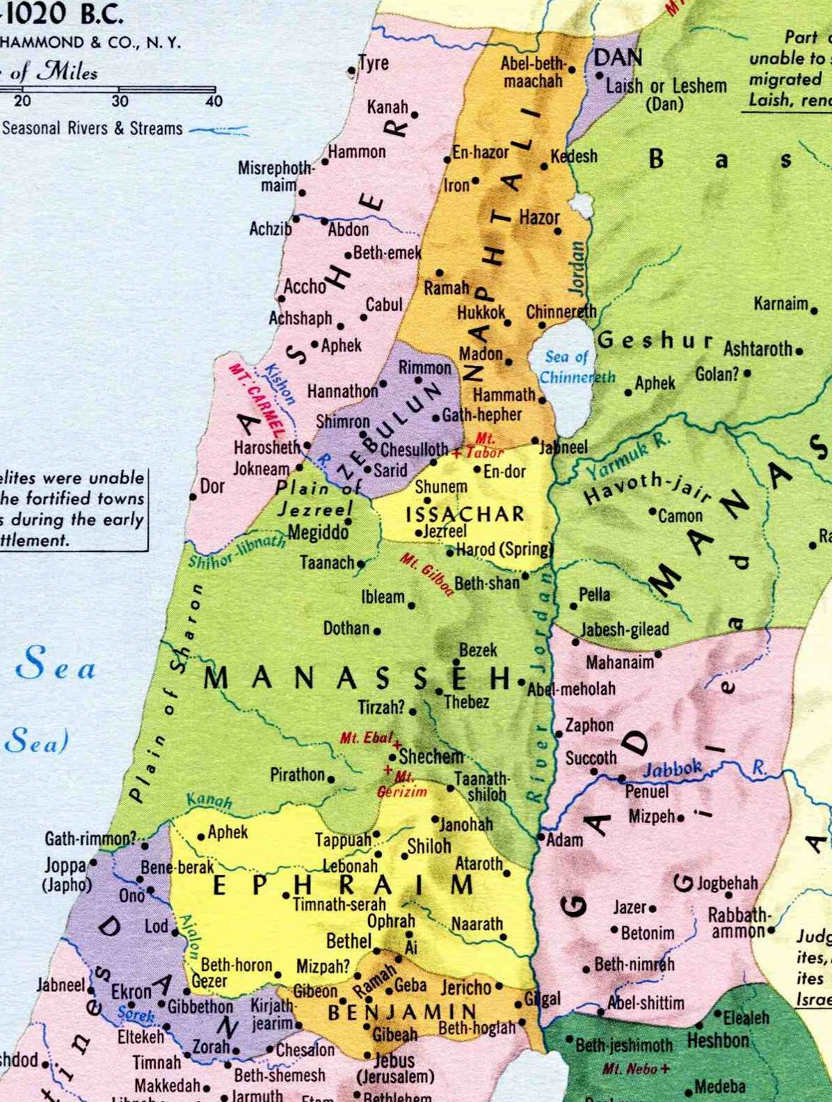
Inheritance of Dan
Another inheritance and religion
for the tribe of Dan
Dan the largest tribe, unable to secure inheritance.
600 migrate north and capture Laish – Jud. 18:11,27-28.
Remainder of Dan forced on to heights between Zorah and Eshtaol – Jud. 1:34; 18:2.
Samson

Slide 22
The camp of Dan
The Amorites and Philistines pushed the Danites to the heights of Zorah and Eshtaol.
The family of Samson resided in the camp of Dan between Zorah and Eshtaol.
Amorites
Eshtaol
Philistines

Slide 23
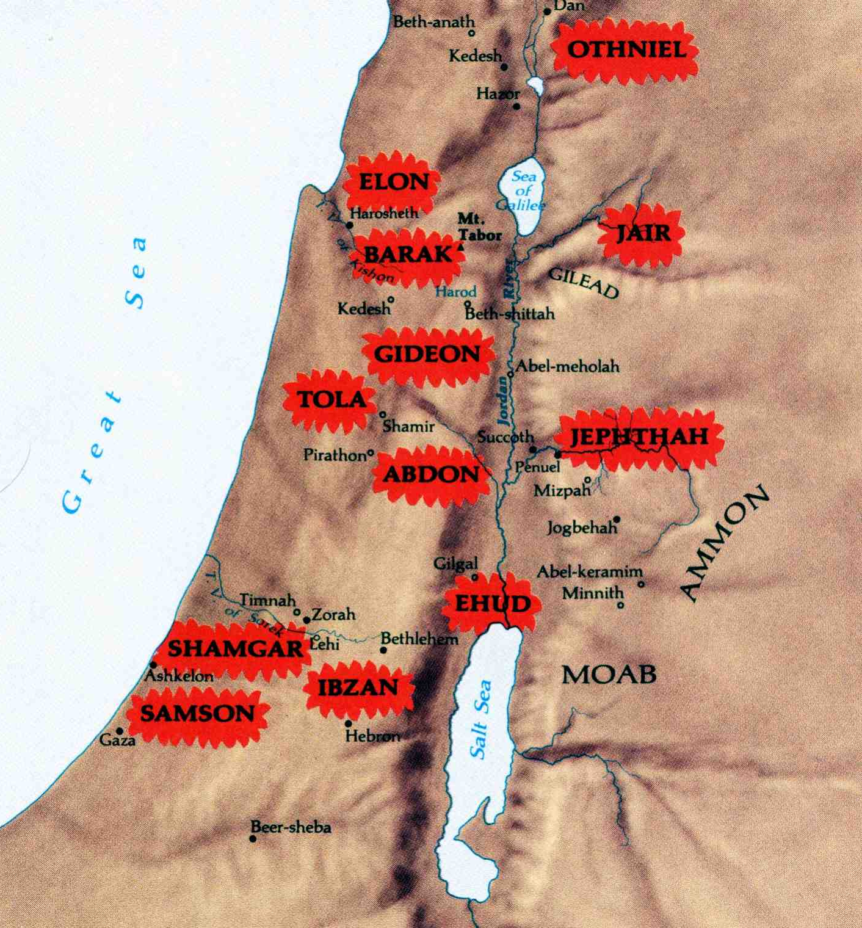
Where the Judges ruled in Israel
The twelfth judge of Israel was confined in a narrow strip of highland between Zorah and Eshtaol amidst a brow-beaten and dispirited people

Slide 24
Next Study (God willing)
Study 2
“A Nazarite unto God from the womb”

Slide 25
… ….
...

