Slide 1
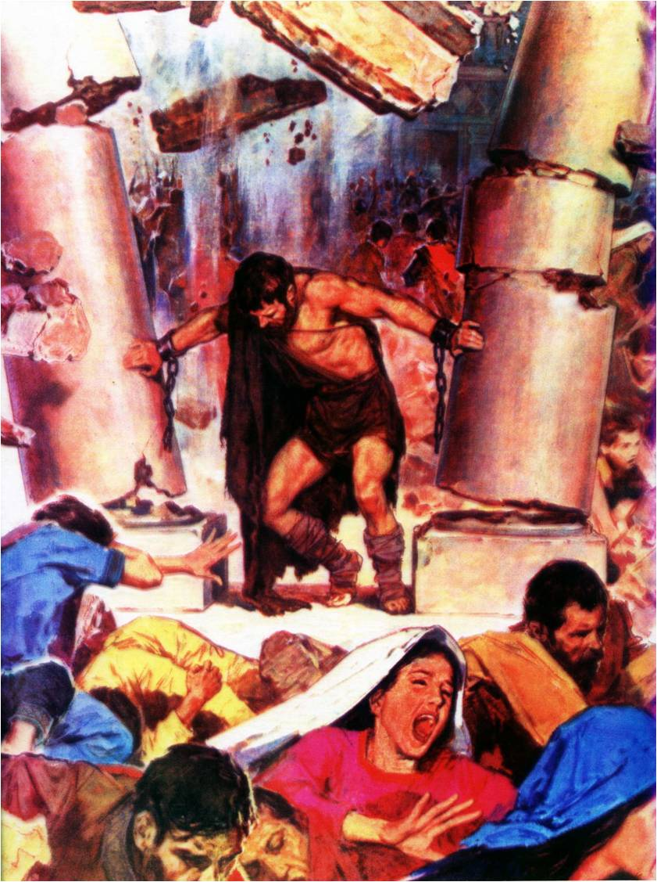
Samson –
God’s strength made perfect in weakness
Study 2
“A Nazarite unto God from the womb”

Slide 2
The Camp of Dan
The Amorites and Philistines pushed the Danites to the heights of Zorah and Eshtaol.
The family of Samson resided in the camp of Dan between Zorah and Eshtaol.
Amorites
Eshtaol
Philistines

Slide 3
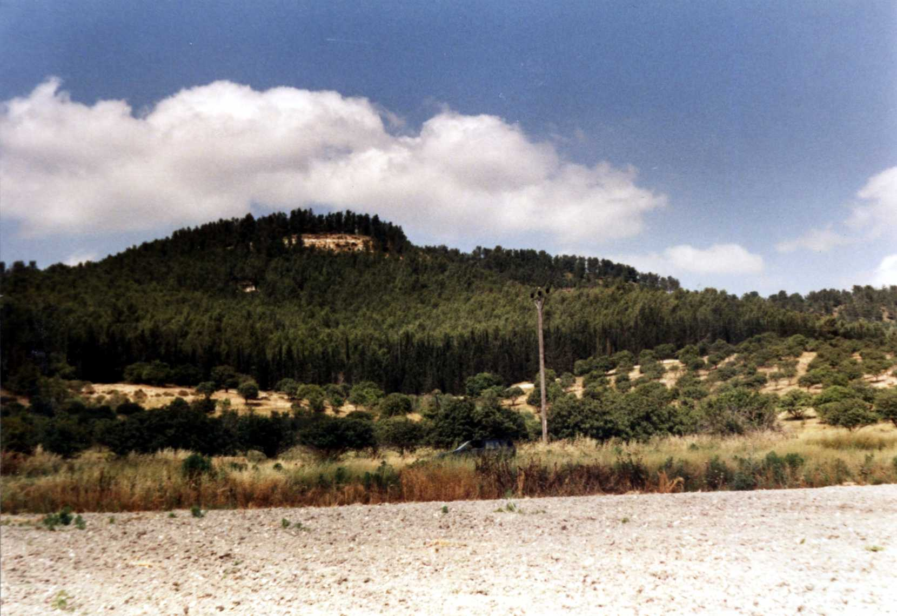
The Hill of Zorah
Looking north from the Valley of Sorek

Slide 4
Samson – Type of Israel
Nazarite from birth, separated to Divine service - Lev.20:24 (badal – divide, separate).
God the source of his amazing strength -Exodus 15:13.
His strength inexplicable to his enemies -Micah 7:16.
Invincible whilst faithful to his vow - Deut. 28:7.
He was constantly going astray - Judges 2:17-18.

Slide 5
Samson – Type of Israel
God forsook him when he broke his vow - Lev. 26:15-20.
Sin leads to blindness and chains – 2 Kings 25:7.
Captive slave in prison house - 2 Chron. 36:25-26.
Despite his failings he has a glorious future - Rom. 11:25-26.

Slide 6
Six cycles of failure and redemption
Sin brings suffering, and seeking God brings salvation
 | SIN | SUFFERING | SUPPLICATION | DELIVERANCE
1 | Served Baalim Judges 3:7 | Cushan-rishathaim | Judges 3:9 | Othniel
2 | Did evil – 3:12 | Eglon | Jud. 3:15 | Ehud
3 | Did evil – 4:1 | Jabin and Sisera | Jud. 4:3 | Deborah, Barak, Jael
4 | Did evil – 6:1 | Midian | Jud. 6:6 | Gideon
5 | Did evil – 10:6 | Ammonites | Jud. 10:10 | Jephthah
6 | Did evil – 13:1 | Philistines | Jud. 10:15 (?) | Samson

Slide 7
An Angel visits Manoah’s wife
Judges 13:2-5
V.2 – “Manoah” – “rest”.
“wife” – isha – woman, wife.
“barren, and bore not” – Emphasis on the impotence of man.
V.4 – “drink not wine or strong drink” – The woman was to be the true Nazarite.
V.5 – “Nazarite” – separate; consecrated.
“unto God from the womb” – Samson’s mother extrapolated this – V.7.

Slide 8
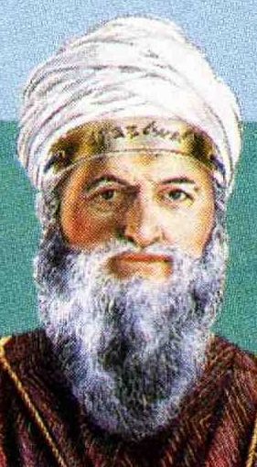
Nazariteship - Separation of the head from the body
Common denominator for all 3 Nazarite stipulations
Strong drink – works through the body to affect the brain.
Undressed hair – mimicked the high priest’s turban = separation of head.
Avoid death – repudiate natural feelings after Aaron’s example (Lev. 10:6-7) by lifting the mind above body.
Principle – Col. 3:1-5

Slide 9
Separating the head
Wine – symbol of intoxicating influences which dull the mind and confuse the senses – Prov. 23:20-21,29-34.
Head – 8 occs. (“hair” only 2 occs. V.5,18) – note use of nezer (“crown”) – Ex. 29:6; 39:30; Lev. 8:9; 21:12 – “Holiness to Yahweh” in the mind.
Death – Basis Lev. 10:6-7; 21:10-12 – Both High Priest and Nazarite had to rise above natural feelings towards one’s own ‘flesh’.

Slide 10
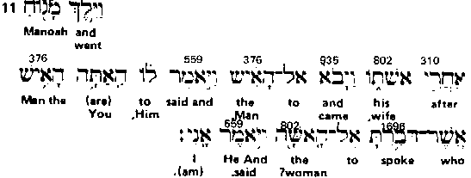
The Woman – The true Nazarite
Interlinear text for Judges 13:11
Isha (no article) occurs 7 times in chapter always translated “wife”.
Isha (with definite article) – occurs 7 times in chapter always translated “the woman”.

Slide 11
Isha in Judges 13
Isha without the article occurs 7 times always translated “wife” – Vv. 2, 11, 19, 20, 21, 22, 23.
Isha with the article occurs 7 times always translated “the woman” – Vv. 3, 6, 9, 10, 11, 13, 24. 14 = certainty of covenant.
7 is the covenant number and the subject “the woman” points to Gen. 3:15.
Samson’s mother goes nameless in Scripture because she represents the Divine mind here.
Hence, she is the true Nazarite in the story!

Slide 12
Isha in Judges 14 & 15
Isha occurs 13 times in Judges 14 & 15 always in reference to the Philistine girl Samson married.
13 is the scriptural number for rebellion (Gen. 14:4).
Hence, the Spirit memorialises Samson’s rebellion.

Slide 13
The woman = Divine thinking
Gen. 3:1-2;15 – Initially upheld God’s law, and even extrapolated it.
In time, Eve was utterly deceived (ekapatao – to deceive wholly; delude thoroughly) - 1 Tim. 2:12-14; 2 Cor. 11:3 (“beguiled”).
Adam was not deceived by the serpent’s reasoning – 1 Tim. 2:14.
Consequently, Adam is held responsible for the introduction of sin and death into the world – Rom. 5:12.
Gen. 3:15 – God excludes man from the means of redemption – John 1:13.

Slide 14
The three conflicts of Gen. 3:15
Serpent versus the Woman = hostility between carnal thinking and divine thinking – Rom. 8:5-7.
Serpent’s seed versus Woman’s seed = A “generation of vipers” in conflict with Christ – Matt. 23:33; John 8:39-44.
Woman’s seed versus the Serpent = Christ to conquer sin in the body of his flesh by death and resurrection – Col. 2:15.

Slide 15
Col. 2:15
"Having spoiled" – apekduomai (singular, masculine, middle voice) - to divest wholly one's self; wholly to strip off for one's self. Lit. - "having stripped". (Cp. "spoil" v.8 sulagogeo - to lead away as booty).
"principalities and powers" – arche = chief (akin to arkon), and exousia = authorities. Both these words are preceded by the definite article.
"made a shew" - diegmatizo - to exhibit.
"openly" – en parrhesia - Lit. "in public". Denotes the deportment by which one becomes conspicuous or secures publicity.

Slide 16
Col. 2:15 (2)
"triumphing over" - thriambeuo (singular, masculine) - to make an acclamatory procession; i.e. to conquer. Lit. "leading in triumph".
"them" - autous (plural, masculine) - Lit. "themselves".
"in it" – en auto (singular, masculine, dative case - the case of personal interest). Lit. "within himself".
Christ's triumph over the serpent in himself was complete on the tree - thus he triumphed over the power that motivated Jewish and Roman principalities to crucify him.
How many perceived who was the true victor on that day?

Slide 17
The critical role of the woman in the birth of Samson
V.9 – “God hearkened to the voice of Manoah” – Manoah makes the request but the angel visits “the woman” – V.10.
V.11 – “the man” – ish – great man.
V.13 – “Of all that I said unto the woman let her beware” – “The woman” was the key factor to Nazariteship.
V.15 – “let us detain thee” – First hint of deficiency in Manoah’s understanding. He seeks to worship “the man”.

Slide 18
Samson’s weakness revealed in his father’s actions
V.16 – “thou must offer it unto Yahweh” – Manoah intended an offering to a man.
“Manoah knew not that he was an angel” – Proof. Acknowledging one he perceived to be a man is prescient of Samson’s future problem – giving the countenance of men too much regard.
“What is thy name” – Manoah thought he was asking a human being!
“do thee honour” – Manoah still blind.

Slide 19
Comprehending the incomprehensible
V.18 – “Why askest thou thus after my name, seeing it is secret?” – paliy - wonderful, incomprehensible, extra-ordinary. 2 occs. O.T. – Ps. 139:6.
V.19 – “offered it upon a rock unto Yahweh” – Manoah finally understands.
“wonderously” – pala - to be marvellous, be wonderful, be surpassing, be extraordinary, separate by distinguishing action. God revealed to man!

Slide 20
Contrast Manoah and his wife Judges 13:22-23
Manoah’s wife shows her perception – 3 reasons why they would not die.
Their offering accepted – “If it pleased Yahweh to kill us he would not have received a burnt offering at our hands.”
The angel ascended as their mediator – “neither would he have shewed us all these things.”
A son was to be born to them – “nor would he have told such things as these.”

Slide 21
Samson’s mother - Representative of the Divine mind gives three reasons we do not ‘die’ eternally
Taken in reverse order:
A Son was born to God by “the woman”;
God was revealed to man thereby;
A great sacrifice was made.
Isa. 9:6 – “For unto us a child is born, unto us a son is given.”

Slide 22
The seed of the woman
Luke 2:7 – “And she brought forth her firstborn son.”
V.24 – “And the woman bore a son” – 7th occurrence of “the woman” in chapter. 7 = covenant. Type of the birth of Christ.
“son” – ben – a son as family builder.
“Samson” – “like the sun”; “brilliant sunlight”. Named after the face of the angel – V.19-20.
“and the child grew and Yahweh blessed him” – Cp. Luke 2:40.
And the child grew, and waxed strong in spirit, filled with wisdom: and the grace of God was upon him.

Slide 23
Next Study (God willing)
Study 3 – “Moved at times between Zorah and Eshtaol ”

Slide 24
… ….
...

