Slide 1
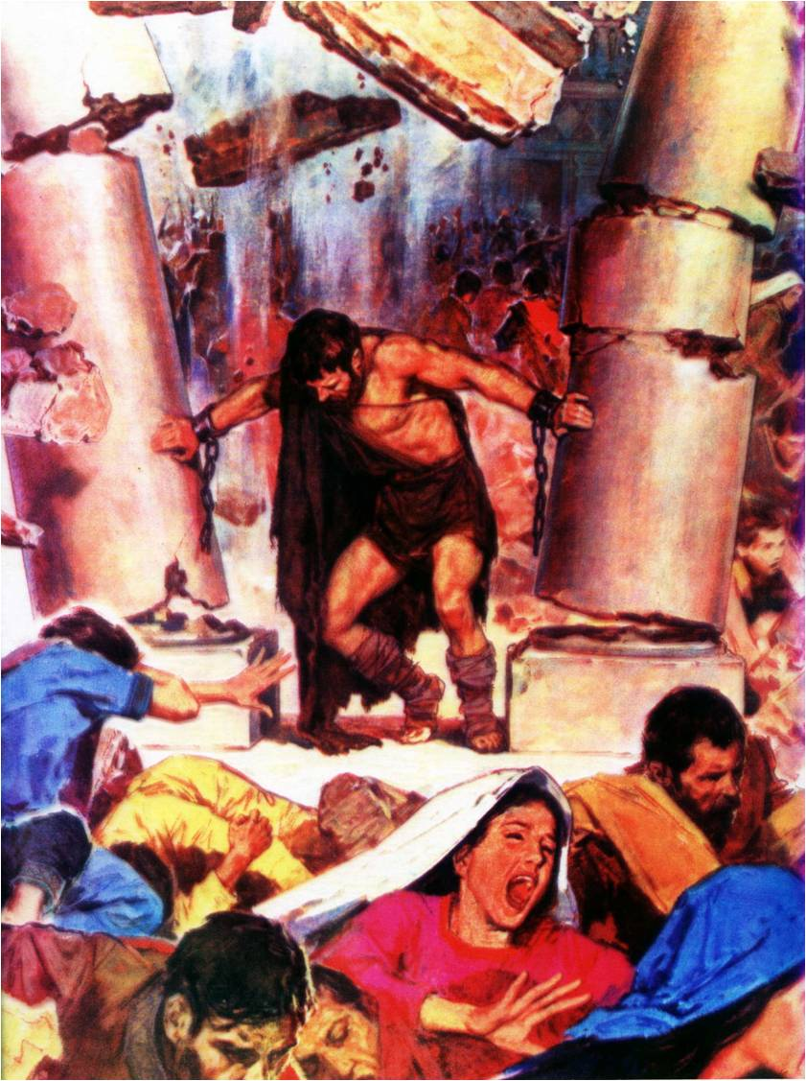
Samson –
God’s strength made perfect in weakness
Study 3
“Moved at times between Zorah and Eshtaol ”

Slide 2
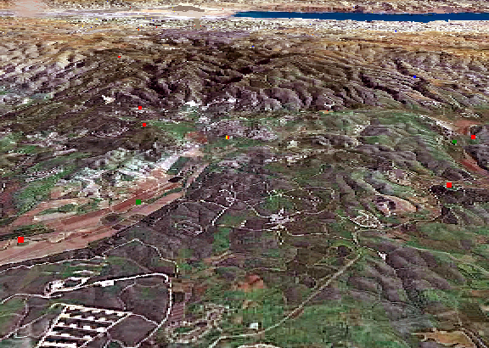
What should have been Samson’s battleground became his playground!
Eshtahol
Beth-Shemesh
Shochoh
Zorah
“Valley of Sorek”
Azekah
Timnath
“And the Spirit of Yahweh began to move him at times in the camp of Dan between Zorah and Eshtaol” - Judges 13:25.

Slide 3
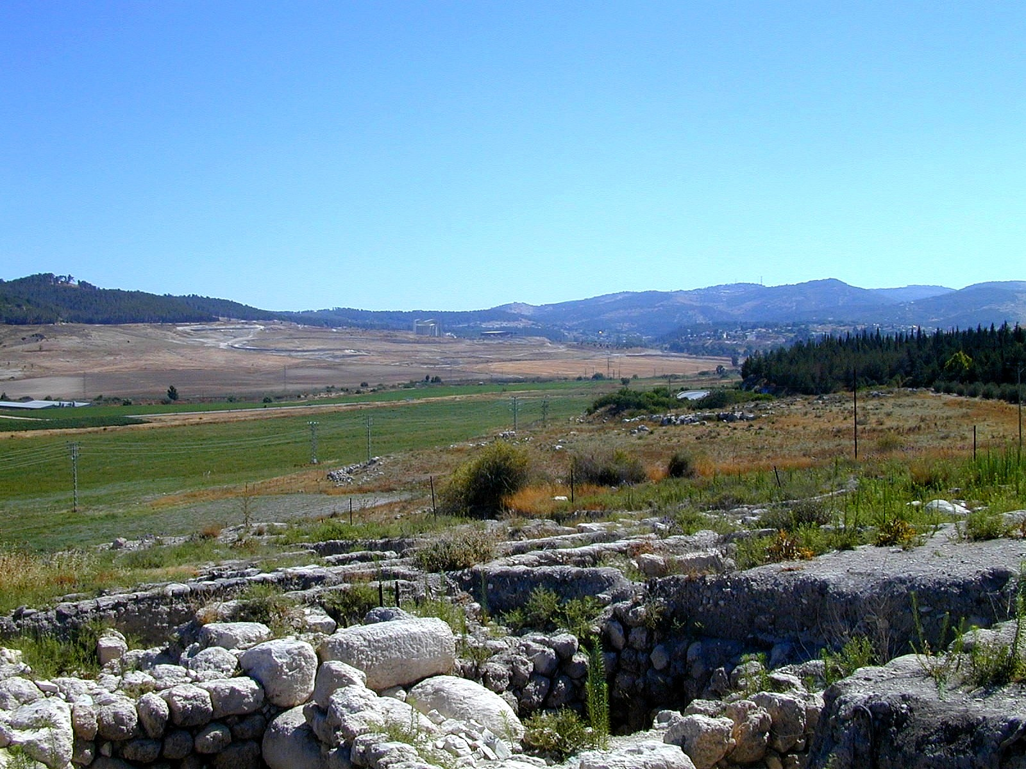
Zorah and Eshtaol

Slide 4
The Spirit moved Samson
Judges 13:25
There is no equivalent in the Hebrew for the phrase “at times”.
“to move him at times” – pa’am – to tap, beat persistently; hence thrust, impel, agitate. Roth. – “to urge him to and fro”.
pa’am occurs 5 times in O.T. – In Gen. 41:8, Dan. 2:1,3 it refers to kings troubled by divinely bestowed dreams; in Ps. 77:4 Asaph is sorely troubled by the activity of God in his life.

Slide 5
In the Camp of Dan – Judges 13:25
“in the camp of Dan” – i.e. a temporary abode (for probation). Roth. (mgn.), R.V. and R.S.V. all translate it as “Mahaneh-dan” (A.V. mgn.).
Dan signifies to make a choice – see its origin Gen. 30:6.
“between” – lit. in Hebrew “between Zorah and between Eshtaol” – other occs. are found Gen. 1:4; Lev. 27:12.
Hence, Samson was compelled by the activity of God in his life to make choices between flesh and spirit.

Slide 6
Between Zorah and Eshtaol
Zorah
“A wasp” (as stinging). Translated “hornet” Ex. 23:28; Deut. 7:20; Josh. 24:12.
Root – tsara – to scourge; Gesenius – to strike down.
Represents the activity of the Spirit
Eshtaol
“Intreaty”; “petition, request” (Gesenius).
Root – sha’el – to inquire; request, to demand.
Represents the range of voices of intreaty working in Samson’s life

Slide 9
Paul’s struggle - Rom. 7:17-20
¹⁷ Now then it is no more I that do it, but sin that dwelleth in me.
¹⁸ For I know that in me (that is, in my flesh,) dwelleth no good thing: for to will is present with me; but how to perform that which is good I find not.
¹⁹ For the good that I would I do not: but the evil which I would not, that I do.
²⁰ Now if I do that I would not, it is no more I that do it, but sin that dwelleth in me.
Metonym for the cause of sin = a bias towards sin

Slide 10
Paul’s struggle - Rom. 7:21-24
²¹ I find then a law, that, when I would do good, evil is present with me.
²² For I delight in the law of God after the inward man:
²³ But I see another law in my members, warring against the law of my mind, and bringing me into captivity to the law of sin which is in my members.
²⁴ O wretched man that I am! who shall deliver me from the body of this death?
RSV - “this body of death.”
Roman practice to bind a corpse to living prisoner

Slide 11
The oscillation of Samson’s life
Eshtaol | Zorah
Judges 14:2-3 14:15-17 15:1-2 15:11-13 16:1 16:6-17 16:26-28 | Judges 14:5-6 14:19 15:3-5 15:14-15 16:3 16:19-21 16:29-30

Slide 12
Marriage with the alien fatal
Judges 14:1 – “went down” – yarad – to descend, decline, march down, sink down.
“Timnath” – “the assigned portion”. Assigned to Dan – Josh. 19:43 (“Thimnathah”).
“saw” – ra’ah – to see. Samson’s great problem was his eyes.
“Philistines” – “Immigrants”; root – palash – to roll in dust.
V.2 – “came up” – alah – to ascend. He had opportunity to reconsider his choice.

Slide 13
Parental guidance ignored
Judges 14:2 – “told his father and his mother” – Wise move! Parental guidance in the face of crucial decisions is very important.
V.3 – “among the daughters of thy brethren” – “Only in the Lord” is the Divine rule for marriage – 1 Cor. 7:39.
“she pleaseth me well” – yashar ayin – Lit. “right in my eyes”. Root of the word “right” – Judges 21:25.

Slide 14
Occasion against the Philistines
V.4 - “it was of Yahweh” – Some think this means that the principle of separation from the world is laid aside.
“he sought an occasion” – ta’anah – an opportunity; time of heat or estrous, sexual drive (of animal). Only 2 occs. O.T. – Jer. 2:24. God uses the mistakes of men to further His purpose – Cp. Gen. 16. He does not change His principles.
V.5 – “and his father and mother” – His mother only went once. She did not attend the wedding – V.10.

Slide 15
Vineyard – Symbol of inheritance
Judges 14:5 – “came to the vineyards of Timnath” – The vineyard is a symbol for inheritance in the Land – Ps. 80:8-9.
Thou hast brought a vine out of Egypt: thou hast cast out the heathen, and planted it.
Thou preparedst room before it, and didst cause it to take deep root, and it filled the land. – Ps. 80:8-9.

Slide 16
Vineyard – Symbol of inheritance
Isaiah 5:1-2
Now will I sing to my well-beloved a song of my beloved touching his vineyard. My well-beloved hath a vineyard in a very fruitful hill:
And he fenced it, and gathered out the stones thereof, and planted it with the choicest vine, and built a tower in the midst of it, and also made a winepress therein: and he looked that it should bring forth grapes, and it brought forth wild grapes.

Slide 17
Isaiah 5:3-4
And now, O inhabitants of Jerusalem, and men of Judah, judge, I pray you, between me and my vineyard.
What could have been done more to my vineyard, that I have not done in it? wherefore, when I looked that it should bring forth grapes, brought it forth wild grapes?
Samson was in a place that represented Israel’s inheritance, assigned to Dan, but inhabited by Philistines who needed to be removed by Divine power.

Slide 18
The Philistine lion – Judges 14:5
“a young lion roared against him” – The young lion represents the Philistines, Israel’s enemies (and in particular Samson’s fiancé) as it does in Isa. 5.
Isa. 5:25 – “Therefore is the anger of Yahweh kindled against his people, and he hath stretched forth his hand against them, and hath smitten them…
Isa. 5:29 - Their roaring shall be like a lion, they shall roar like young lions.

Slide 19
The Spirit and the lion – Judges 14:5
“roared against him” – sha’ag – to rumble, moan. Preparatory to attack.
“mightily” – tsaleach – to rush.
“rent” – shasa – tear, split, cleave.
“nothing in his hand” – Emphasizes the power of the spirit. Not human power.
“told not his father or his mother” – A terrible mistake. He needed their advice to correctly interpret this incident.
“he went down and talked with the woman” – Parents excluded. The flesh won!

Slide 20
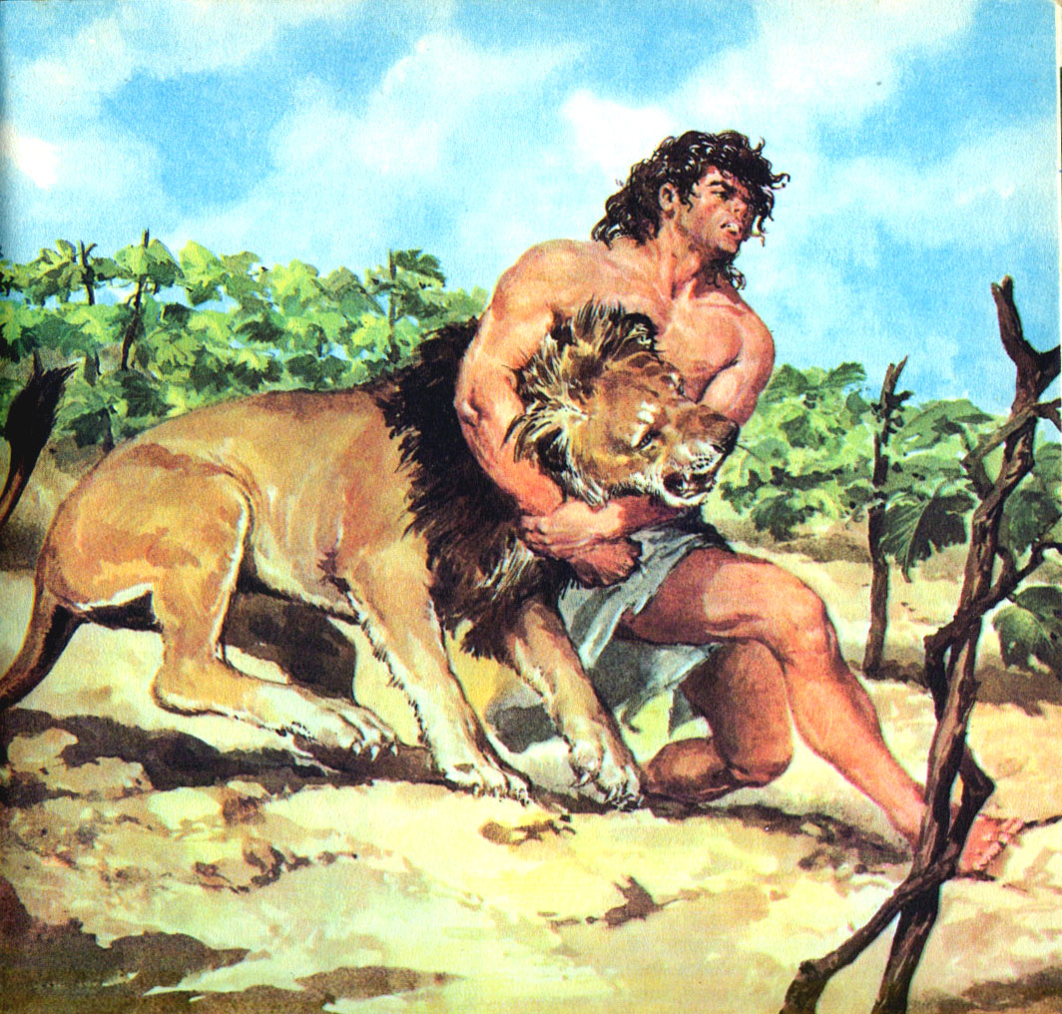
“He turned aside to see the ruin of the lion” Judges 14:8
“And he said unto them, Out of the eater came forth meat, and out of the strong came forth sweetness” - Judges 14:14

Slide 21
The ruin of the lion – Judges 14:8
“he returned to take her” – Samson’s flesh is in control. Eshtaol ascendant.
“he turned aside” – Zorah intervenes.
“carcase” – mappeleth - carcass, ruin, overthrow.
“a swarm of bees” – deborah – (in the sense of orderly motion); bees. (Zorah)
“honey” – See Prov. 24:13.
“carcase” - geviyâh - a corpse, carcass, dead body.

Slide 22
Divided families - Judges 14
V.9 – “but he told them not” – Samson knew his parents would interpret the vineyard experience as God’s intervention in his life to turn him around.
V.10 – “So his father went down” – But not his mother, revealing her attitude.
V.11 – “when they saw him” – Suspicious Philistines appoint 30 ‘watch dogs’.
V.12-18 – “riddle” - chîydâh - a puzzle; hence a trick, conundrum. Aggravating riddle ensures a week of turbulence.

Slide 23
Elpis Israel pg. 68
All the posterity of Adam, when they attain the age of puberty, and their eyes are in the opening crisis, begin to eat of the Tree of the Knowledge of good and evil. Previous to that natural change, they are in their innocency. But, thenceforth, the world, as a serpent-entwined fruit tree, stands before the mind, enticing it to take and eat, and enjoy the good things it affords. To speculate upon the lawfulness of compliance is partly to give consent.

Slide 24
Elpis Israel pg. 68
There must be no reasoning upon the harmlessness of conforming to the world. Its enticements without, and the sympathizing instincts of the flesh within, must be instantly suppressed; for, to hold a parley with its lusts, is dangerous. When one is seduced by the deceitfulness of sin, “he is drawn away of his own lusts, and enticed. Then when lust hath conceived, it bringeth forth sin ; and sin when it is finished, bringeth forth death,” in other words, he plucks the forbidden fruit, and dies, if not forgiven.

Slide 25
Plowing with the heifer
V.18 – “If ye had not plowed with my heifer” – A wife should be subordinate and loyal to her husband as Israel was called upon to be to Yahweh.
“heifer” – eglah – female calf. 14 occs. O.T. – 1st Gen. 15:9.
“Ephraim was a trained heifer, that loveth to tread out the corn, and I spared her fair neck, but I will put Ephraim to the yoke” - Hosea 10:11 (RSV)

Slide 26
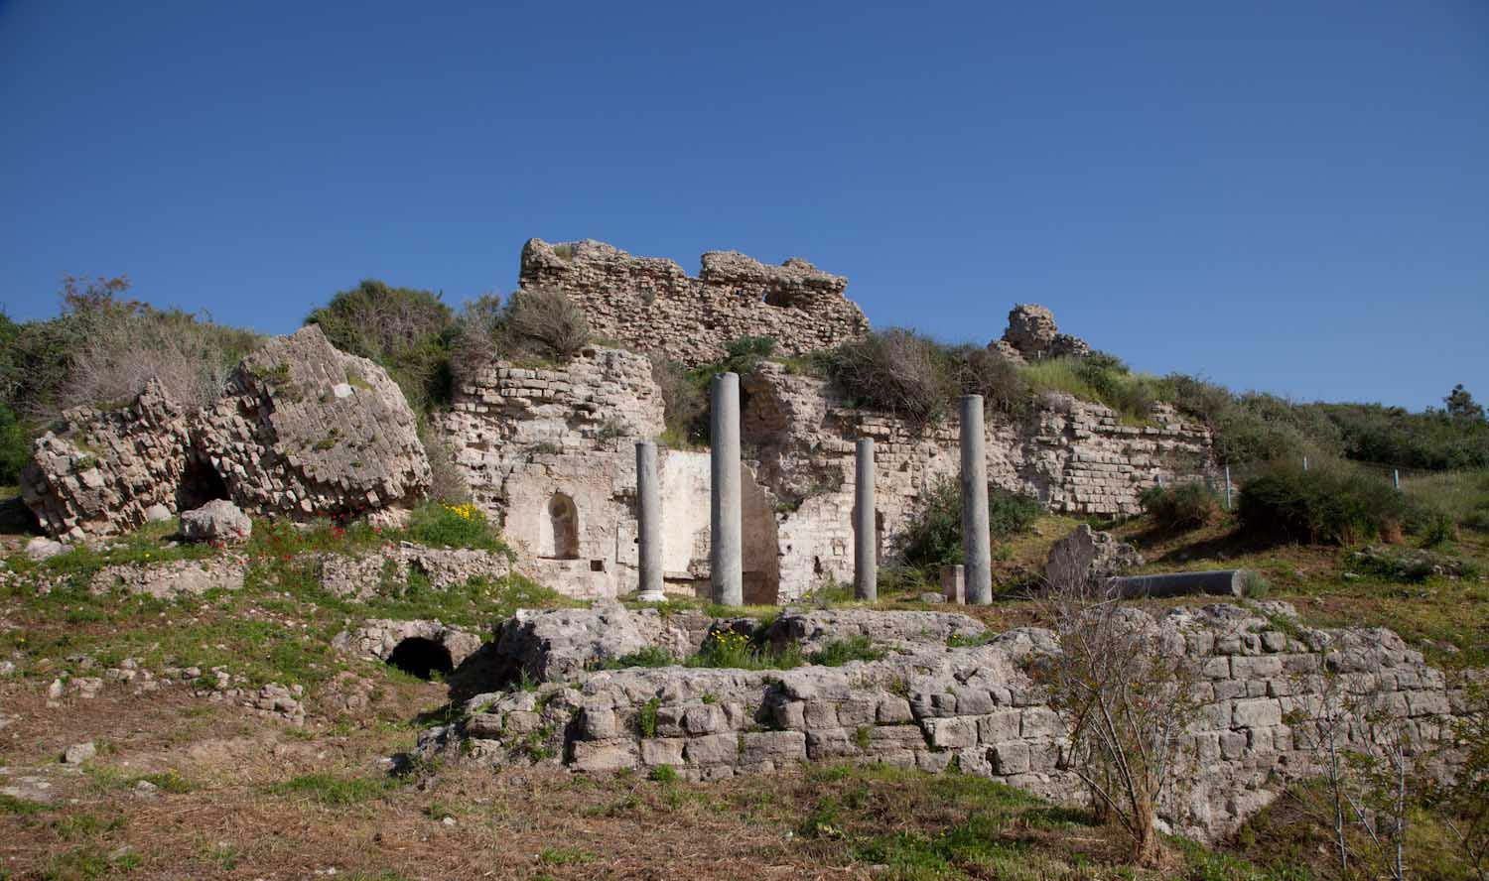
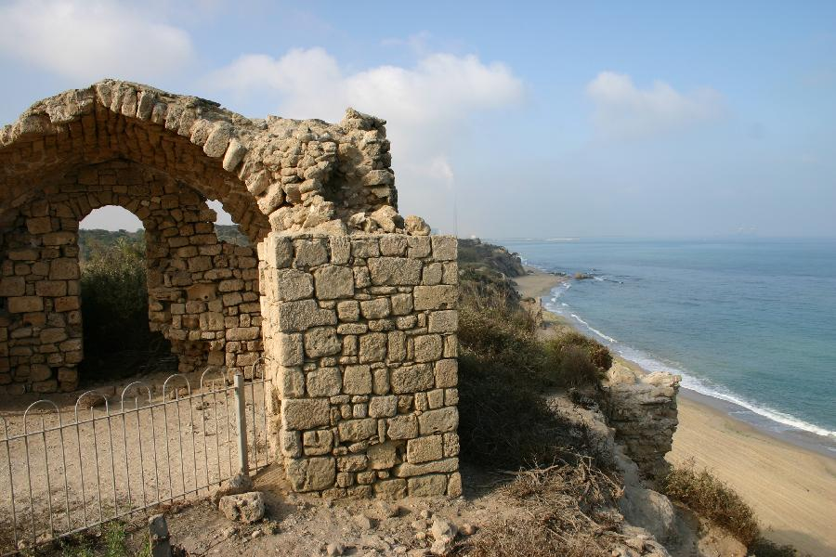
Samson’s loss – Spirit’s gain
Judges 14:19 – “the Spirit of Yahweh came upon him” – Repeat of V.6. Zorah triumphs briefly to rescue Samson.
“Ashkelon” - “the fire of infamy: I shall be weighed” (BDB). An important place for Philistines.

Slide 27
Ashkelon – An important centre
“Tell it not in Gath, publish it not in the streets (Heb. markets) of Askelon; lest the daughters of the Philistines rejoice, lest the daughters of the uncircumcised triumph.” – 2 Samuel 1:20.
“And the coast shall be for the remnant of the house of Judah; they shall feed thereupon: in the houses of Ashkelon shall they lie down in the evening” - Zeph. 2:7.

Slide 28
Samson’s loss – Spirit’s gain
Judges 14:19 – “his anger was kindled” – Samson’s anger not assuaged by release of debt. But he did ascend to his home!
V.20 – “companion” – merea – a confidential friend. His ‘best man’.
“friend” – ra’ah – to tend a flock (as a ‘best man’ should).
Eshtaol | Zorah
Judges 14:2-3 14:15-17 | Judges 14:5-6 14:19

Slide 29
Next Study (God willing)
Study 4 –
“The spirit of Yahweh came mightily upon him ”

Slide 30
… ….
...

