Slide 1
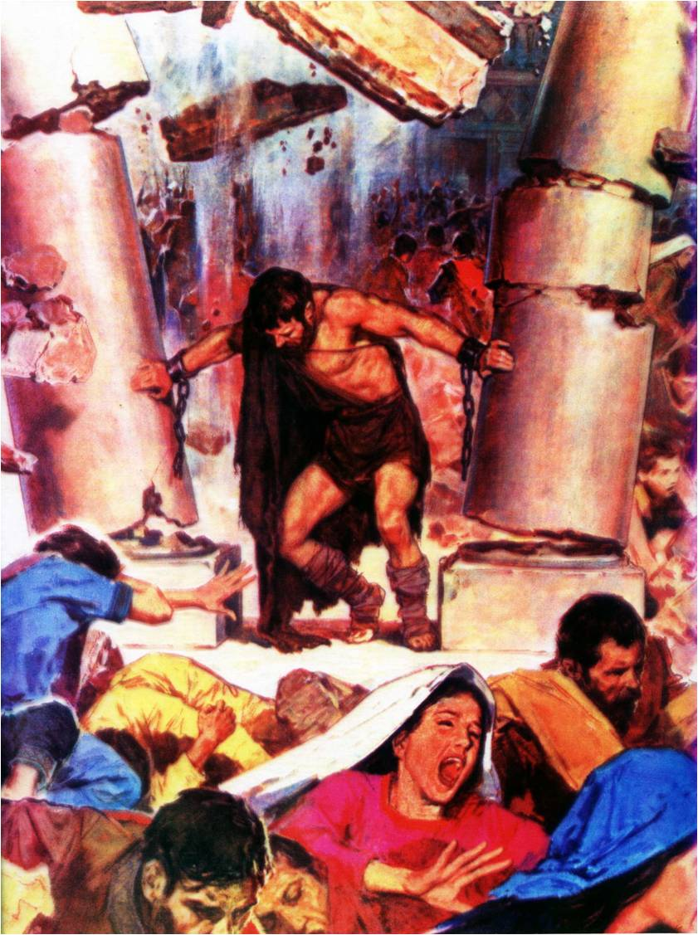
Samson –
God’s strength made perfect in weakness
Study 4
“The spirit of Yahweh came mightily upon him ”

Slide 2
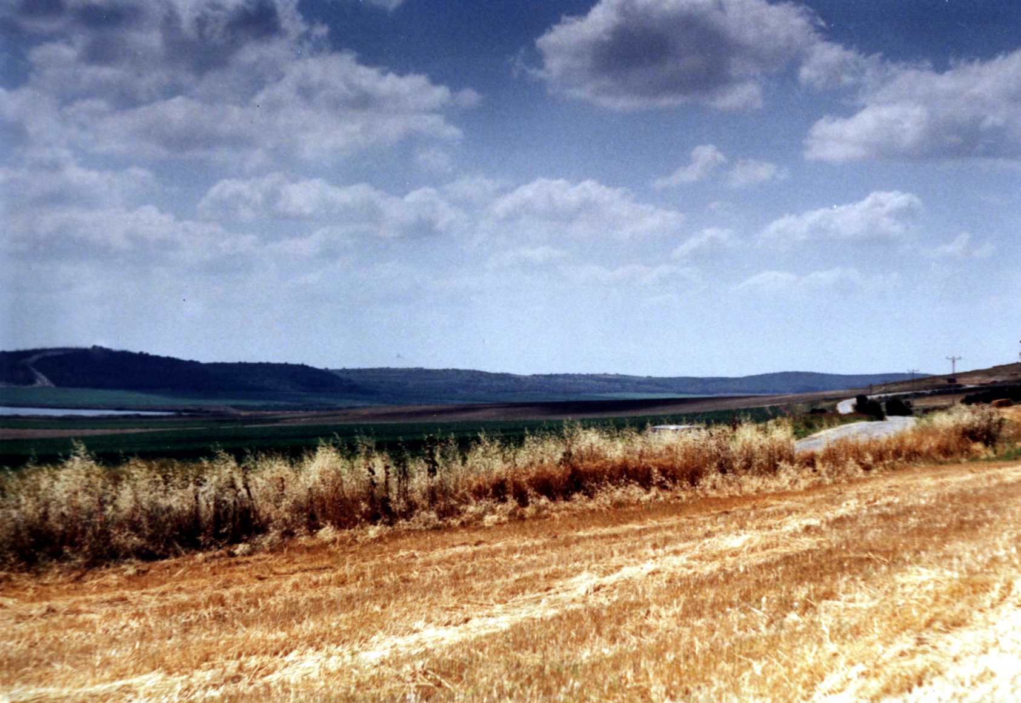
The Valley of Sorek
Timnath
Looking west towards the land of the Philistines

Slide 3
The Oscillation of Samson’s Life
Eshtaol | Zorah
Judges 14:2-3 14:15-17 15:1-2 15:11-13 16:1 16:6-17 16:26-28 | Judges 14:5-6 14:19 15:3-5 15:14-15 16:3 16:19-21 16:29-30

Slide 4
Betrayed by ‘friends’
Judges 15:1 – “within a while” – Physical urges soon swamp spiritual anger.
“a kid” – Conciliatory gift as an apology for his anger.
“the chamber” – Inner room = bedroom. His intentions clear.
V.2 – “hadst utterly hated her” – Not an unreasonable conclusion.
“take her” – Offers a substitute based on what he thought motivated Samson.

Slide 5
Philistine bread basket decimated
Judges 15:3 – RSV – “This time I shall be blameless in regard to the Philistines, when I do them mischief.”
“three hundred” – Cp. Judges 7:8 = a full complement. Cp. 30 Jud. 14:11; 3,000 V11.
“foxes” – shu’al - a jackal (as a burrower). Foxes are solitary; jackals gregarious and cowardly and carrion eaters.
“firebrands” – lappid – to shine; a lamp or flame. See use Jud. 7:16; Ezek. 1:13; Dan. 10:6. 14 occs. O.T.

Slide 6
Firebrands - Lappid
The lamps of Gideon - Judg. 7:16
Abraham’s burning lamp - Gen.15:17
Lamp of salvation - Isa. 62:1
Appearance of lamps - Ezek. 1:13
Eyes as lamps of fire - Dan.10:16

Slide 7
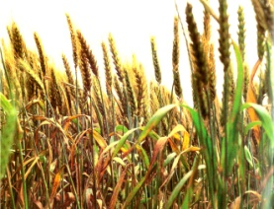
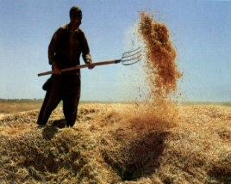
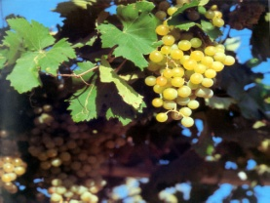
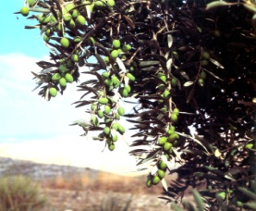
Economic ruin of the Philistines!
“And when he had set the brands on fire, he let them go into the standing corn of the Philistines, and burnt up both the shocks, and also the standing corn, with the vineyards and olives” - Judges 15:5.
“standing corn”
“shocks” Heb. “heap up”
“vineyards”
“Olives”

Slide 8
Savage revenge – Judges 15:6-8
V.6 – “Who hath done this?” – Like men the Philistines intend to exact revenge.
“burnt her and her father with fire” - Poetic justice received – see Judges 14:15.
V.7 – “yet will I be avenged of you” – RSV – “If this is what you do, I swear I will be avenged upon you, and after that I will quit.”
“cease” – We can never quit in this war.
V.8 – “hip and thigh” – Roth. – “leg on thigh”; i.e. piled them up like Gen. 32:11.

Slide 9
Betrayal of Judah
V.8 – “went down” – While the Philistines “went up” V.9.
“top” - sai’yph - a fissure (of rocks).
“rock” – selah – lofty craggy rock.
“Etam” – “hawk ground”. “Lair of wild beasts” (BDB).
V.9 – “Lehi” – “jaw”. Root – jaw bone.
V.10 – “the men of Judah said” – Peace at any price policy is dangerous. They should have supported Samson.

Slide 10
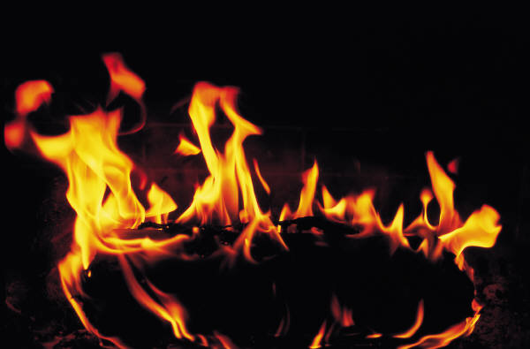
The true role of Judah’s leaders
In that day will I make the governors of Judah like a hearth of fire among the wood, and like a torch of fire in a sheaf; and they shall devour all the people round about, on the right hand and on the left: and Jerusalem shall be inhabited again in her own place, even in Jerusalem. - Zechariah 12:6

Slide 11
Compromise of Judah
Judges 15:11 – “three thousand men of Judah” – More than enough with Samson and God’s help to overthrow Philistine oppression.
“the Philistines are rulers over us” – Yahweh should have ruled over them!
“done unto us” – Self-interest rules. Fence sitting is dangerous. No doubt about their responsibility – Josh. 23:6-13.
V.12 – “to bind thee” – Philistine’s work – V.10.

Slide 12
Responsibility to others
Bro. Roberts commentary on Luke 17:1-2
“It is manifest that by the law of Christ we are under an obligation to consider the bearing of our actions upon others. If we are indifferent on this head we may find ourselves unexpectedly confronted with unknown responsibilities in the day of account.”
Nazareth Revisited page 406

Slide 13
From Etam to Lehi bound
V.12 – “Swear unto me” – For their protection, for he would protect himself.
V.13 – “two new cords” – Ygs. Lit. – “two thick bands”.
V.14 – “shouted” – rua – to split the ears with sound; a war cry.
“the Spirit of Yahweh came mightily upon him” – 7 times the Spirit came upon him. 7 is the Spirit number.
“loosed” – masas – liquefy, dissolve, melt. Roth. – “his bonds melted from off his hands.”

Slide 14
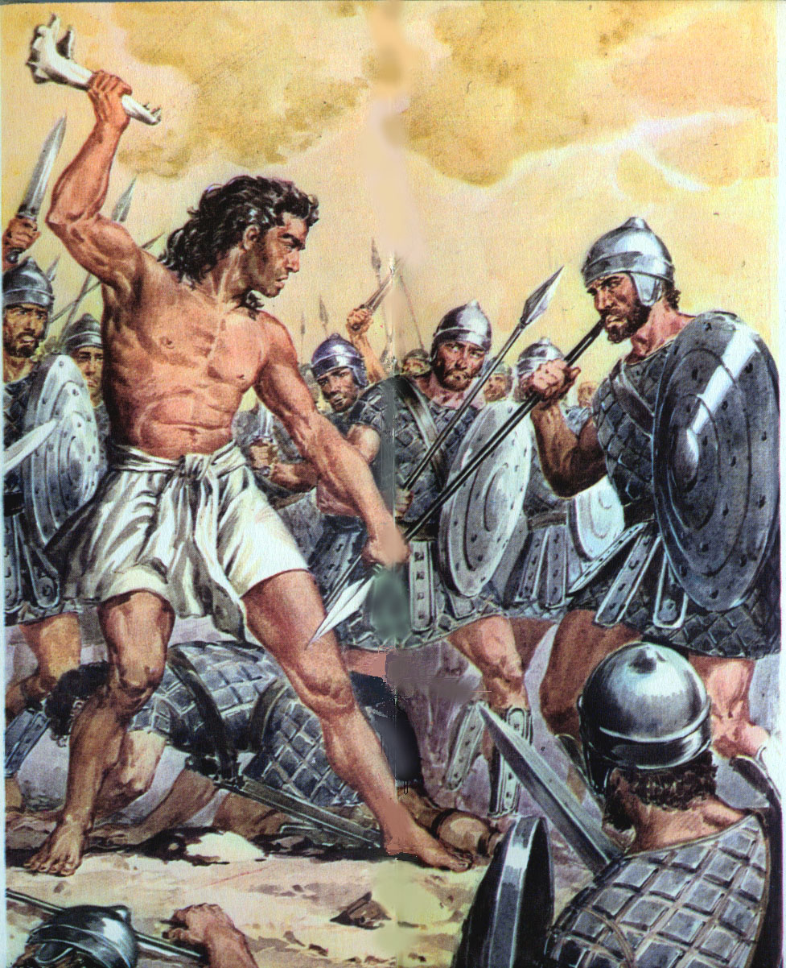
… ….
Victory with the jawbone of an ass
Judges 15:14-17
Samson

Slide 15
Israel defenceless except for Yahweh working through faithful men and women
“Now there was no blacksmith found throughout all the land of Israel: for the Philistines said, Lest the Hebrews make them swords or spears:
But all the Israelites went down to the Philistines, to sharpen every man his share, and his colter, and his axe, and his mattock” – 1 Samuel 13:19-20.

Slide 16
God’s strength made perfect in weakness
A left handed man – Judges 3:15-16.
Three hundred men with lamps - 7:6,16.
An ox goad - 3:31.
A woman and a millstone – 9:53.
A woman and a tent peg – 4:21-22.
A social outcast - 11:2-3.
A woman – a mother in Israel – 5:7.
The jawbone of an ass – 15:16.

Slide 17
Lessons in Lehi – Judges 15
V.15 – “he found” – In Lehi – a narrow fissure leading to Etam.
“a new jaw-bone” – tariy – moist; dripping. Roth. – “the jawbone of an ass newly-slain.”
“ass” – chamor – male ass – symbol of Israel. A sign to both Samson and Israel.
“put forth his hand” – Samson should have grasped corrupt and unredeemed Israel and wielded them with God’s power as an effective weapon against Philistines.

Slide 18
One should chase a thousand!
“O that they were wise, that they understood this, that they would consider their latter end! How should one chase a thousand, and two put ten thousand to flight, except their Rock had sold them, and the LORD had shut them up?” - Deut. 32:29-30.
“And the Philistines were afraid, for they said, God is come into the camp. And they said, Woe unto us! for there hath not been such a thing heretofore. Woe unto us! who shall deliver us out of the hand of these mighty Gods? these are the Gods that smote the Egyptians with all the plagues in the wilderness” - 1 Samuel 4:8.

Slide 19
More lessons in Lehi
V.16 – “heaps upon heaps” – Roth. – “And Samson said, With the jawbone of an ass,—have I piled them up in heaps! With the jawbone of an ass, have I smitten a thousand men!”
“I” – Strength attributed to self. Samson had to learn an important lesson.
V.17 – “he cast away the jaw-bone” – He should have rallied Israel to finally crush the Philistines.
“Ramath-lehi” – “Height of a jaw-bone”.

Slide 20
God quenches Samson’s thirst
Judges 15:18 – “sore athirst” – The Spirit is gone! Now left a weak mortal man.
“Thou hast given” – Corrects his mistake.
“great deliverance” – Roth. – “this great salvation.”
“the uncircumcised” – Term of derision. Cp. 14:3 – parental influence kicks in.
V.19 – “an hollow place” – maktesh – a mortar. Roth. – “God clave open the hollow that is in Lehi.”
“in the jaw” – Should be ‘Lehi’.

Slide 21
The Spirit returns to the humble
V.19 – “there came water thereout” – Water symbol of the Spirit (John 7:38-39).
“his spirit came again” – Roth. – “and his spirit came back.” The Spirit is the only real instrument of spiritual revival.
“En-hakkore” – “Fountain of one calling”; “Fountain of the crier.” He had learnt his lesson – for the time being.
“he judged Israel...twenty years” – Reads like an epitaph. Would have been best if it had been the end of the story.

Slide 22
Next Study (God willing)
Study 5 –
“Samson’s fatal brinkmanship”

Slide 23
… ….
...

