Slide 1
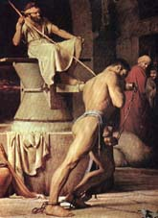
Samson –
God’s strength made perfect in weakness
Study 5
“Samson’s fatal brinkmanship”

Slide 2
The oscillation of Samson’s life
Eshtaol | Zorah
Judges 14:2-3 14:15-17 15:1-2 15:11-13 16:1 16:6-17 16:26-28 | Judges 14:5-6 14:19 15:3-5 15:14-15 16:3 16:19-21 16:29-30

Slide 3
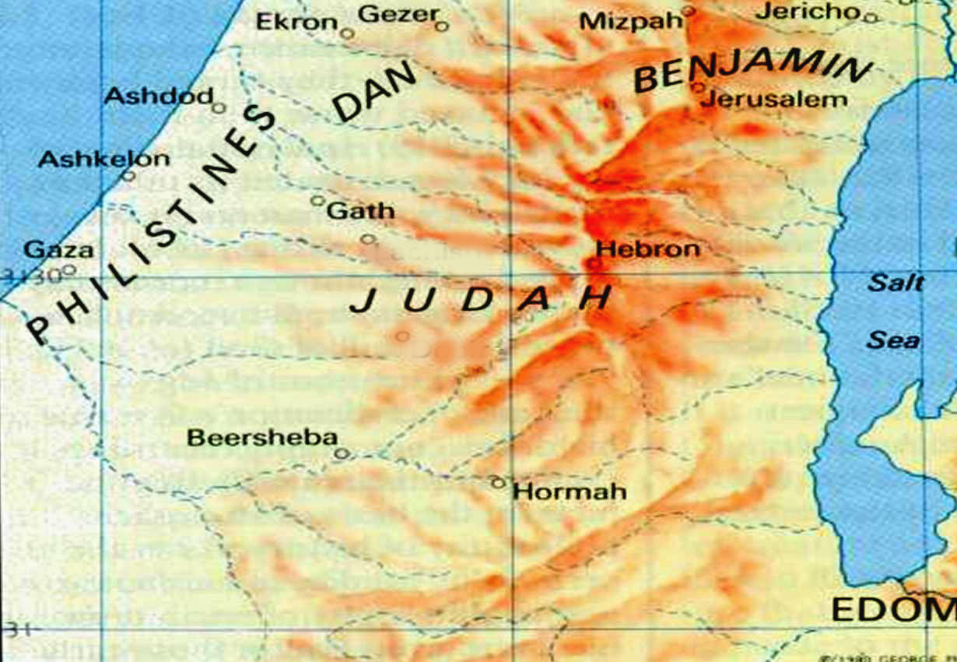
Gaza
“Then went Samson to Gaza”

Slide 4
The harlot of Gaza – Judges 16:1-3
V.1 – “Gaza” – “the strong”. The strong-hold and monument of Philistine power becomes place to display his weakness.
“saw there an harlot” – ishah zanah – Lit. a woman, a harlot. Samson’s eyes and desires again overcome him.
“went in unto her” – Declension from 14:1. God is offended by sin but is ready to help those who abandon it.
V.2 – “quiet all night” – Roth. – “but kept themselves quiet all night”. Cp. John 3:19.

Slide 5
The gates of Gaza
V.2 – “In the morning” – Roth. – “until the light of the morning”. Basically the meaning of his name.
V.3 – “midnight” – chetsiy layil – Lit. “middle of the twist away from light”. This had been Samson’s darkest hour to now.
“the gate of the city” – Most important place in the city – Gen. 22:17; 23:10,18; 24:60; Deut. 22:15,24; 2 Sam. 19:8. Place of judging, ownership and control.
“two posts” – See Deut. 6:9; Prov. 8:32-36.

Slide 6
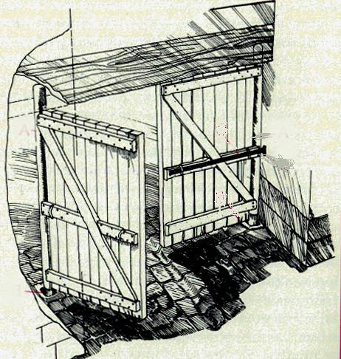
“The gate of his enemies” Genesis 22:17
Represents the whole city - Deut. 12:12.
Public resort to hear news - Neh. 8:1,3.
Centre of administration of justice - Josh. 20:4.
Audience with ambassadors - 2 Sam. 19:8.
Public market place - 2 Kings 7:1.

Slide 7
Gates carried to Hebron
V.3 – “went away with them” – Roth. – “and tare them away.”
“bar and all” – Typical of Christ – Mic. 2:12-13.
“shoulder” – Symbol for rulership and government – Isa. 9:6.
“before Hebron” – Roth. – “that faceth Hebron.” Hebron = fellowship. Patriarchs (3 faithful married couples!) buried here waiting for Christ to fulfil Gen. 22:17. Distance of about 65 kms (40 miles).

Slide 8
Zorah
Gaza
Hebron
And Samson lay till midnight, and arose at midnight, and took the doors of the gate of the city, and the two posts, and went away with them, bar and all, and put them upon his shoulders, and carried them up to the top of a hill that is before Hebron. Judges 16:3

Slide 9
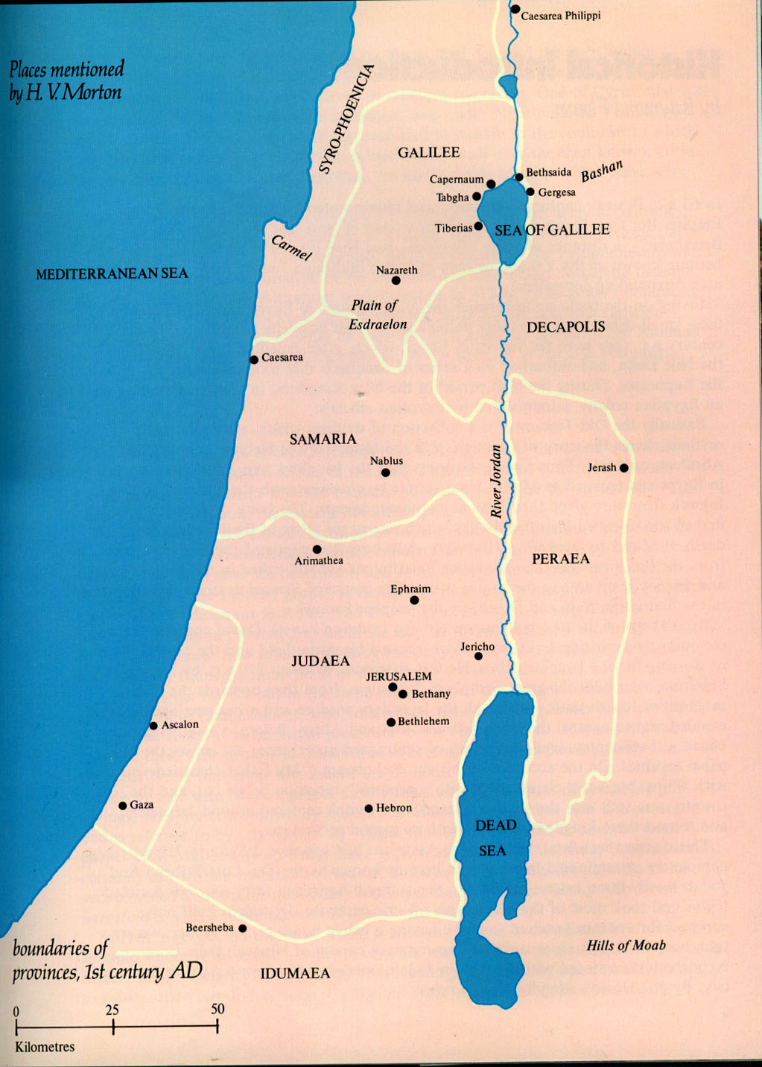
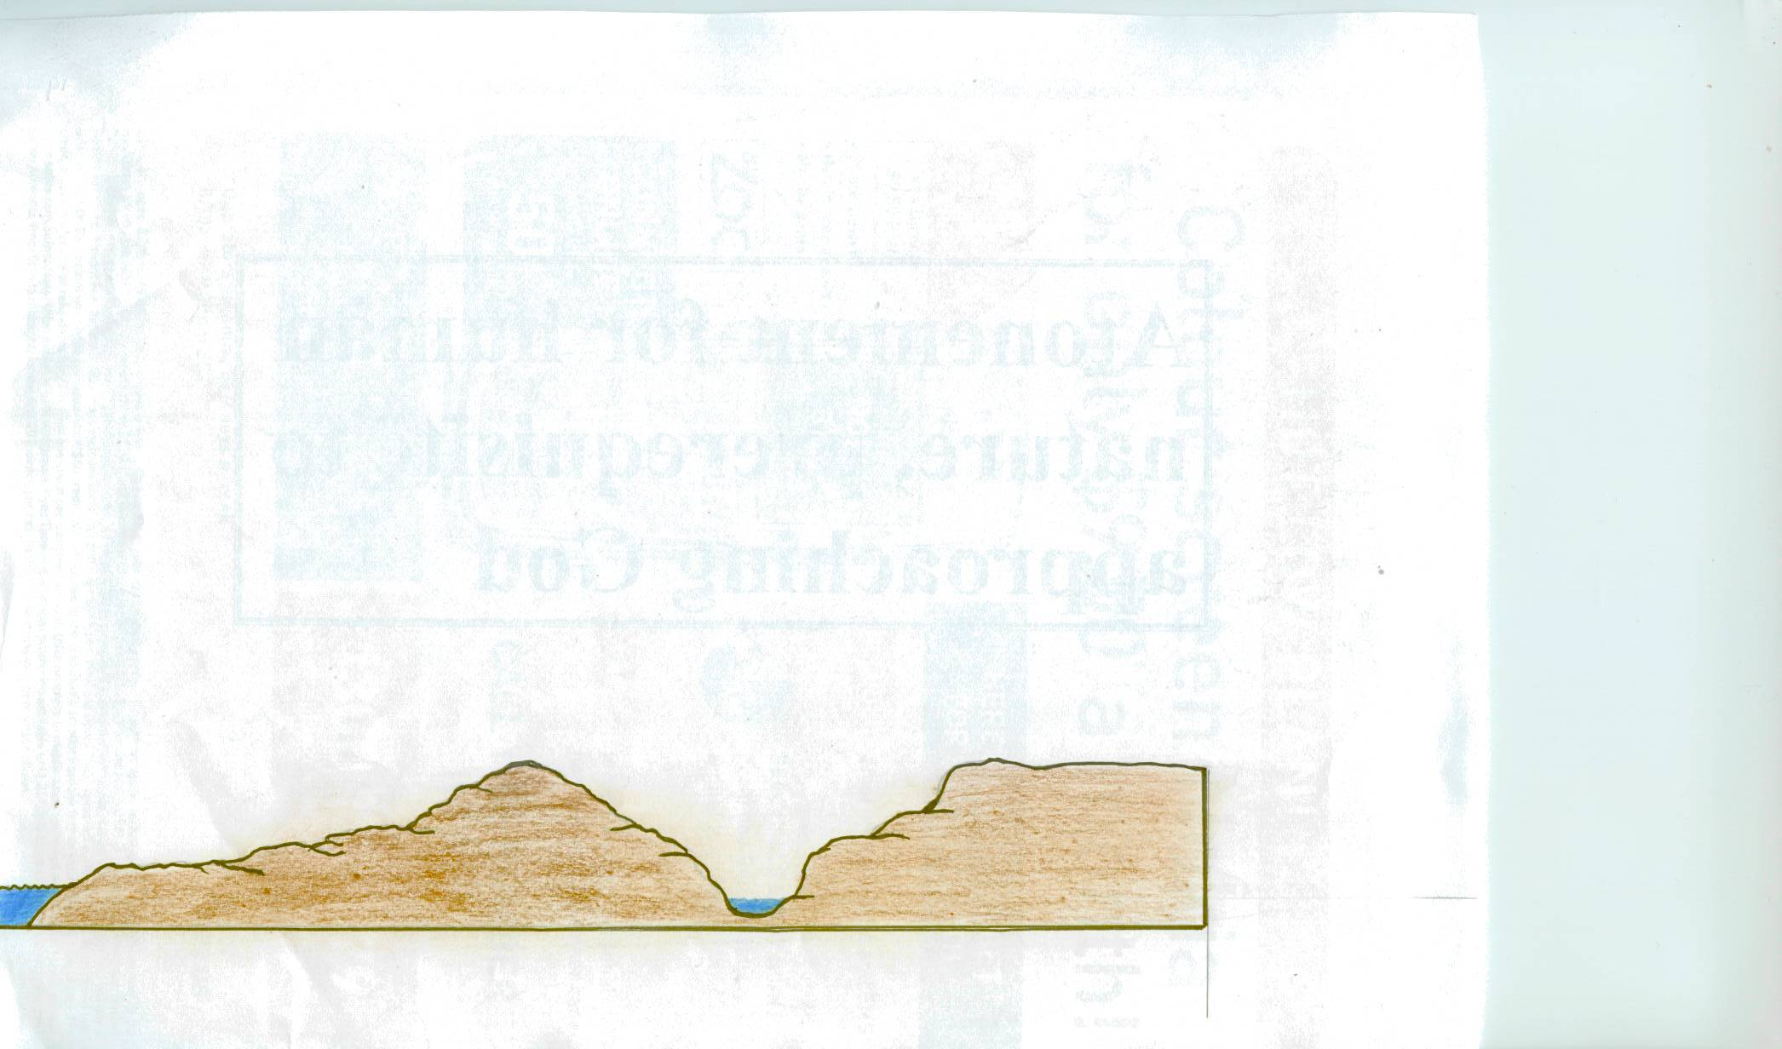
Gaza
Hebron
70 kms or 40 miles
From here one can see clearly the issues facing us in the world
Hebron
Gaza

Slide 10
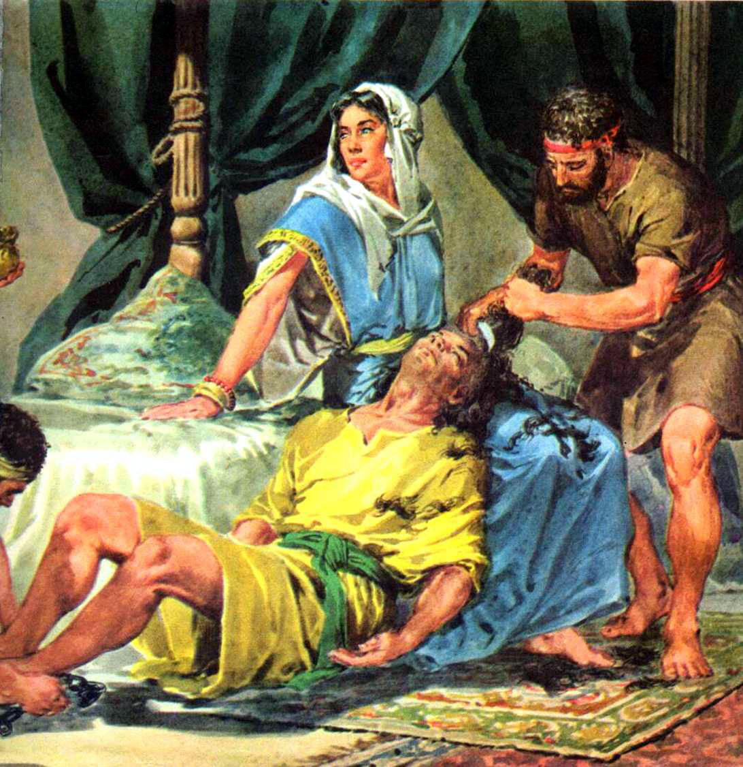
… ….
Samson and Delilah
Judges 16:4-20

Slide 11
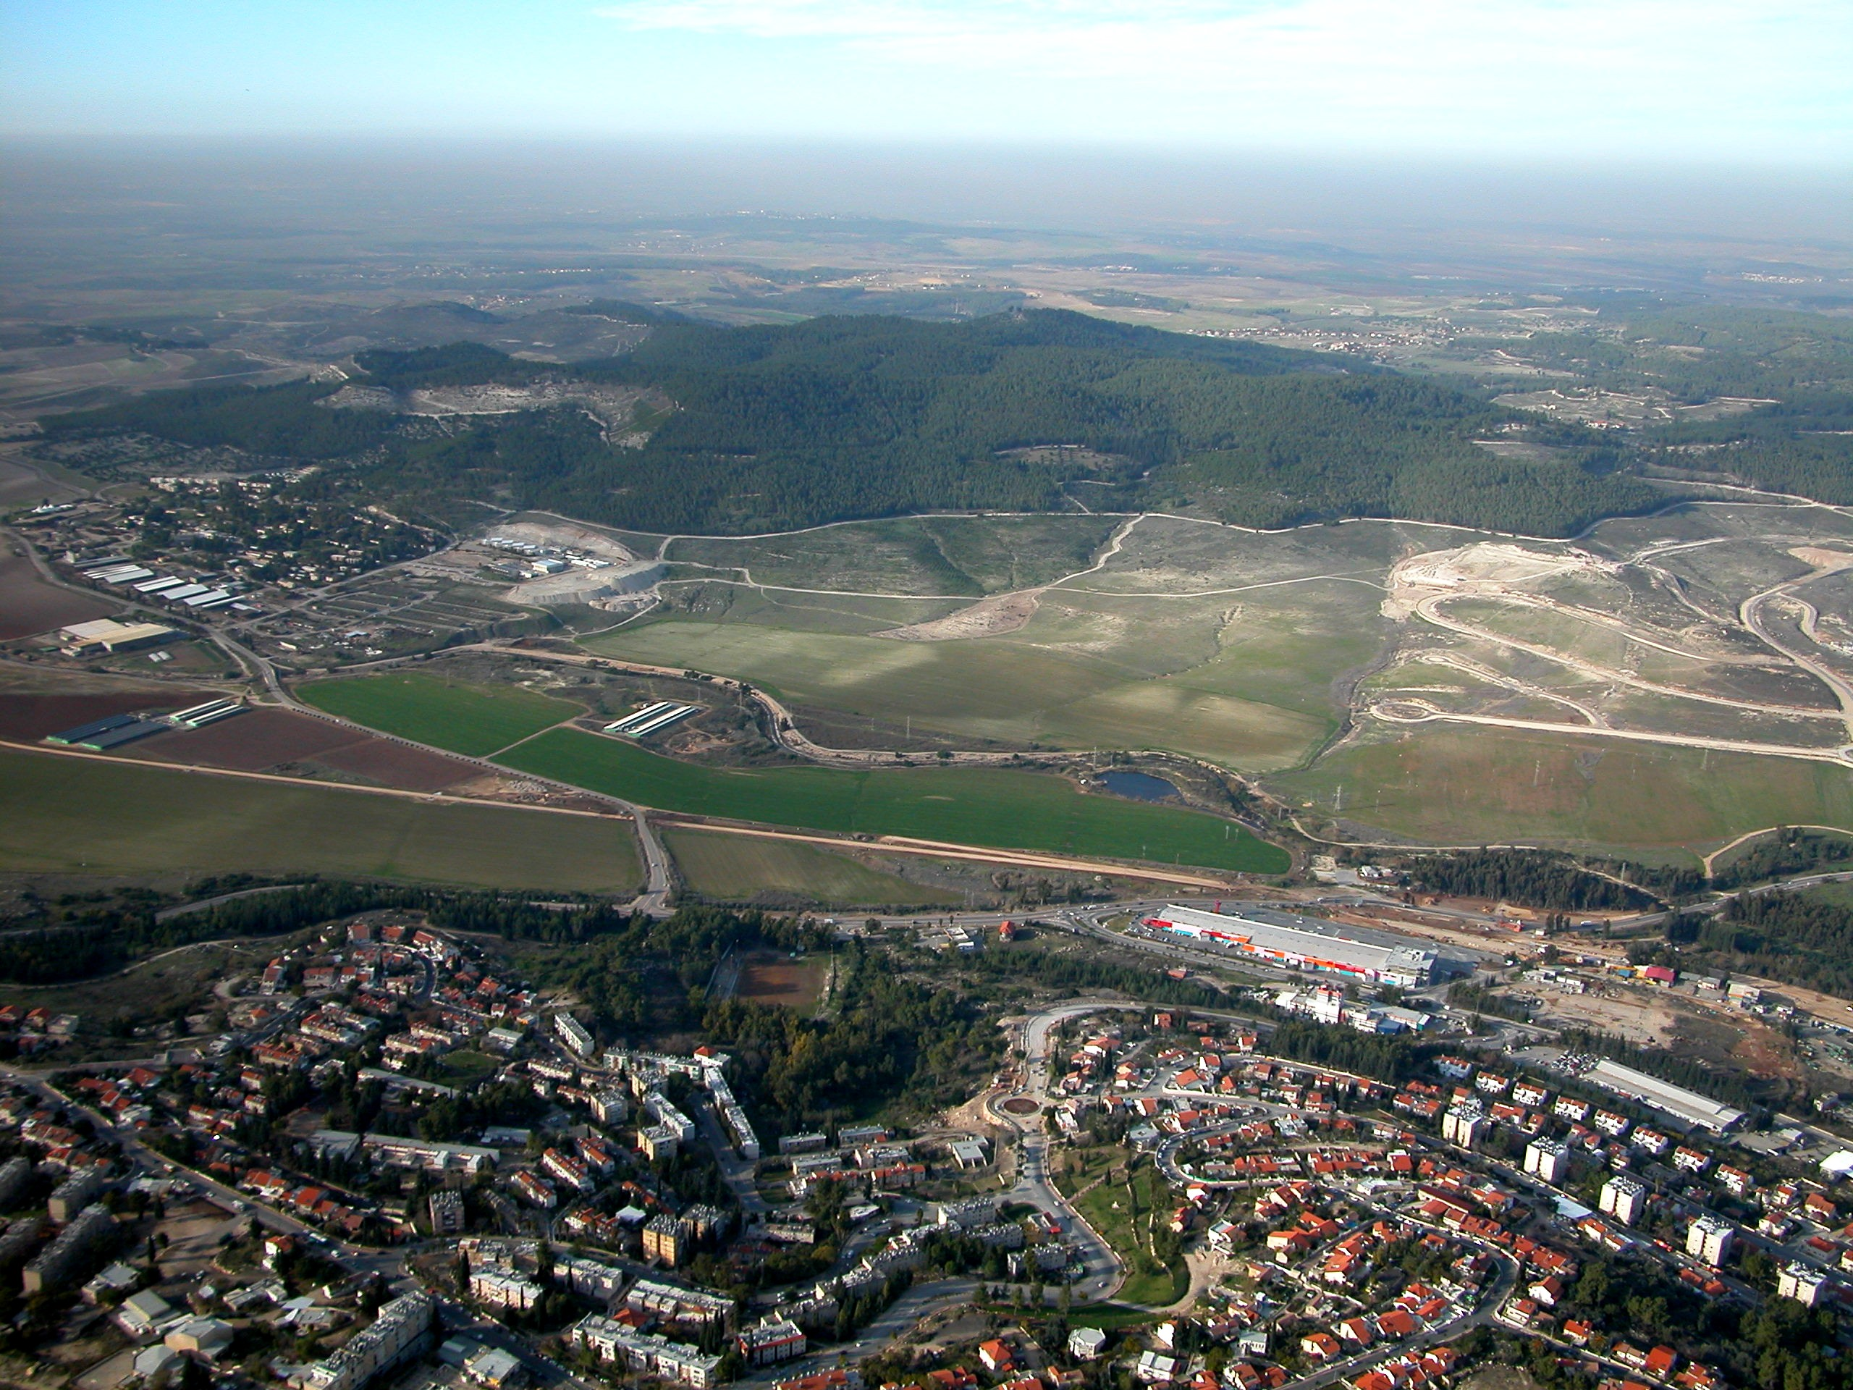
The valley of Sorek
The home of the choicest intoxicants the world can offer
“And it came to pass afterward, that he loved a woman in the valley of Sorek, whose name was Delilah” - Judges 16:4

Slide 12
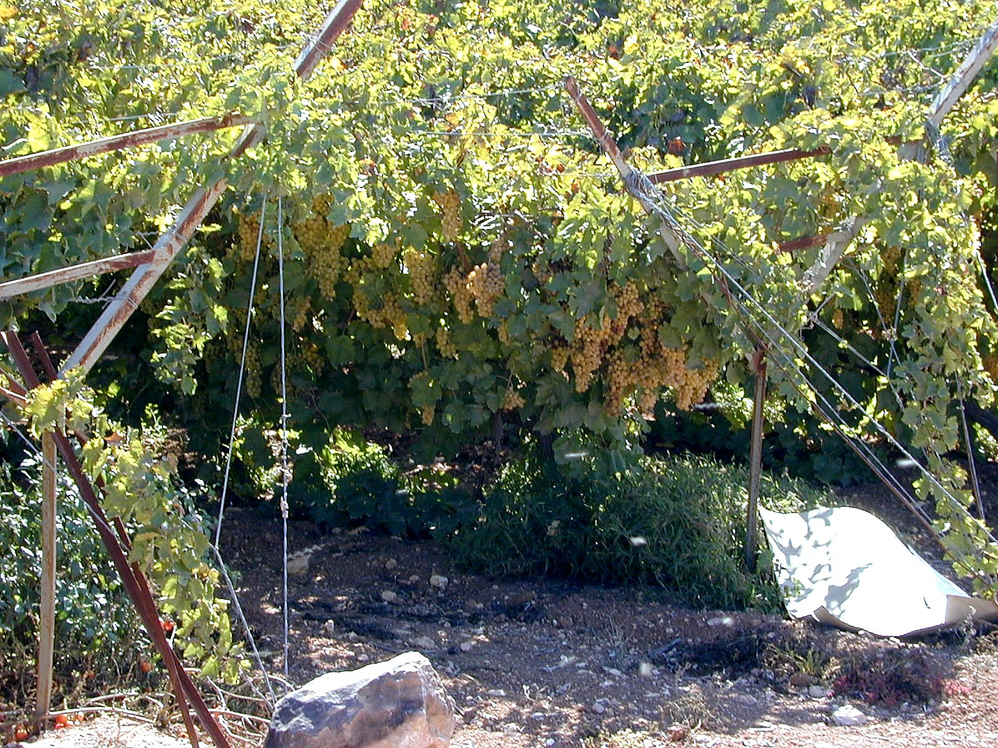
Grapes growing in the valley of Sorek
“Yet I had planted thee a noble vine, wholly a right seed: how then art thou turned into the degenerate plant of a strange vine unto me?” - Jeremiah 2:21

Slide 13
Samson blinded by Delilah – Judges 16
V.4 – “loved” – ahab - to have affection for (sexually or otherwise).
“Sorek” – A vine; root redness; a vine stock producing purple grapes for the best wine.
“Delilah” – Languishing; to slacken; be feeble.
V.5 – “came up unto her” – Reveals her status and power.

Slide 14

Delilah
Heb. “weak”, “feeble”, but a woman of strong influence.
Could be an Israelite - Judges 16:9.
Rates a visit from the 5 lords of the Philistines - v.5.
Receives 5 x 1,000 pieces of silver (approx. $60,000) - v.5.
Lived in her own home (without husband) in the best of the land – v.4.

Slide 15
Delilah
Her home big enough to hide a company of men – v.9.
She is discerning and mercenary – v.18.
Incredibly cold and merciless – v.19.
Prov. 6:26
For by means of a whorish woman a man is brought to a piece of bread: and the adulteress will hunt for the precious life.

Slide 16
The secret of Samson’s strength
V.5 – “see wherein his great strength lieth” – Not in physique or stature. The world does not understand spiritual strength. It is from God.
“bind” – asar – to yoke or hitch.
“afflict” – anah – browbeating. Roth. – “humble”.
“eleven hundred pieces of silver” – In Judges 17:2 represents the life savings of a well-to-do family. 5,500 pieces is a considerable sum of money.

Slide 17
Samson’s fatal brinkmanship
V.6 – “Tell me” – First clear warning of the danger of parleying with the serpent.
V.7 – “seven” – Covenant number – V.13.
“green withs” – lach yether – fresh cords. RSV – “fresh bowstrings”.
“never dried” – i.e. by never being cut off the vine.
“then shall I be weak” – He was already showing his human weakness.
“another man” – echad adam – one (i.e. united) with earthy man.

Slide 18
Cat and mouse folly repeated
V.9 – “abiding with her in the chamber” – LITV – “sitting for her in an inner room.”
“tow” – ne’oreth – a strand of flax.
“when it toucheth the fire” – Roth. – “when fire bloweth thereon.”
V.10 – “thou hast mocked me” – Roth. – “Lo! thou hast been laughing at me.” There is no fury like that of a woman scorned.
“told me lies” – Roth. – “falsehoods.” Pernicious hypocrisy.
V.11 – “new ropes” – Cp. Judah Jud.15:13.

Slide 19
The point of no return
V.11 – “never were occupied” – Roth. – “wherewith work was never done.”
V.12 – “Delilah therefore took” – In v.8 it was the lords who supplied the cord. Now a scorned woman seeks revenge.
V.13 – “weavest” – She wove iniquity – Isa. 59:2-6.
“seven locks” – Hair of his Nazarite covenant – Num. 6:18.
“web” – masseketh - spreading out; that is, the warp in a loom.

Slide 20
Woven in a web of deceit
V.14 – “fastened” – taqa - to clatter, that is, slap (the hands together), clang. Roth. – “So she beat them up with the pin.”
“went away” – Cp. V.3 – Lesson not learnt.
“pin of the beam” – Roth. – “and pulled out the pin of the loom, and the warp.”
V.15 – “How canst thou say, I love thee” – This scorned woman uses the lowest form of hypocrisy to complete her plot on a duped lover.

Slide 21
“She caused him to yield”
Compare Proverbs 7:21
Judges 16:15-16 - And she said unto him, How canst thou say, I love thee, when thine heart is not with me? thou hast mocked me these three times, and hast not told me wherein thy great strength lieth.
And it came to pass, when she pressed him daily with her words, and urged him, so that his soul was vexed unto death.
Mentally – “with her words”.
Emotionally – “How canst thou say, I love you”.
Physically – “urged him” (Heb. “to press upon”).

Slide 22
Daily torture ends in death
V.16 – “pressed” – tsuwq – to compress; i.e. oppress, distress. Roth. – “she urged him with her words continually”.
“urged” – alats – to press. Roth. – “pressed”.
“vexed” – qatsar – to dock off; curtail. Roth. – “became impatient”. Int. Bible – “grieved”.
“unto death” – muth - to die, kill, have one executed. He no longer cared!
Eshtaol prevails!

Slide 23
Warning - Proverbs 7:21-27
With her much fair speech she caused him to yield, with the flattering of her lips she forced him.
He goeth after her straightway, as an ox goeth to the slaughter, or as a fool to the correction of the stocks;
Till a dart strike through his liver; as a bird hasteth to the snare, and knoweth not that it is for his life.
Hearken unto me now therefore, O ye children, and attend to the words of my mouth.
Let not thine heart decline to her ways, go not astray in her paths.
For she hath cast down many wounded: yea, many strong men have been slain by her.
Her house is the way to hell, going down to the chambers of death.

Slide 24
Capitulation – Covenant forsaken
V.17 – “all his heart” – Foolish - Prov. 12:23; 29:11; Mic. 7:5. His love for Nazariteship abandoned.
“a Nazarite unto God” – The secret revealed – the commitment abandoned.
“mother’s womb” – Type for all born into Christadelphian families.
“shaven” – Performed either for failure or fulfilment – Num. 6:9,18.
“my strength will go from me” – It was God’s strength that would leave him – v.20.

Slide 25
Yahweh departs from Samson
V.18 – “money in their hand” – Roth. – “brought up the silver in their hand.” They knew their woman had won.
V.19 – “sleep upon her knees” – She wanted to feel his weakness.
“she began to afflict him” – Roth. – “she began to humble him.”
V.20 – “as at other times” – Roth. – “as time after time.”
“shake myself” – na’ar - rustling of mane, (accompanies the lion’s roar); to tumble about.

Slide 26
Gaza revisited tragically
V.20 – “Yahweh was departed from him” – The principle – James 4:8; Ecc. 7:26.
V.21 – “put out” – naqar - to bore, pick, dig, pick out.
“eyes” – Symbol of spiritual intelligence, but Samson’s greatest enemy. Now blind he could ‘see’.
“fetters of brass” – Ygs. Lit. – “two brazen fetters.” Symbol of flesh.
“grind” – The work of women (Job 31:10) or animals. It is all very poetic.

Slide 27
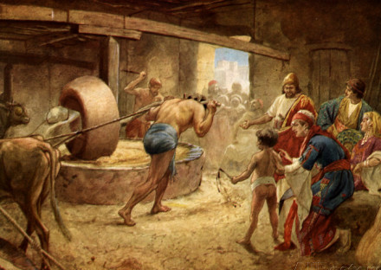
Tragic ironies – Judges 15 & 16
Destroyed Philistine crops – Now ends up grinding their grain.
Slew 1,000 with the jawbone of an ass – Now doing the work of an ass as a beast of burden.
Could not leave Philistine women alone – Now performs women’s work.
Poetic outcomes are designed to turn men from folly, not just bring justice!

Slide 28
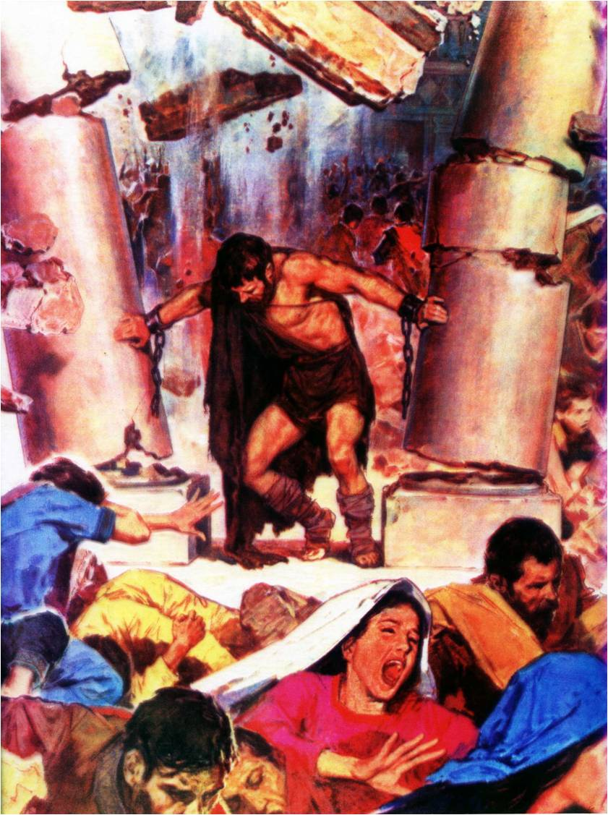
Next Study (God willing)
Study 6 –
“God's strength made perfect in weakness ”

Slide 29
… ….
...

Slide 30

 


