Slide 1
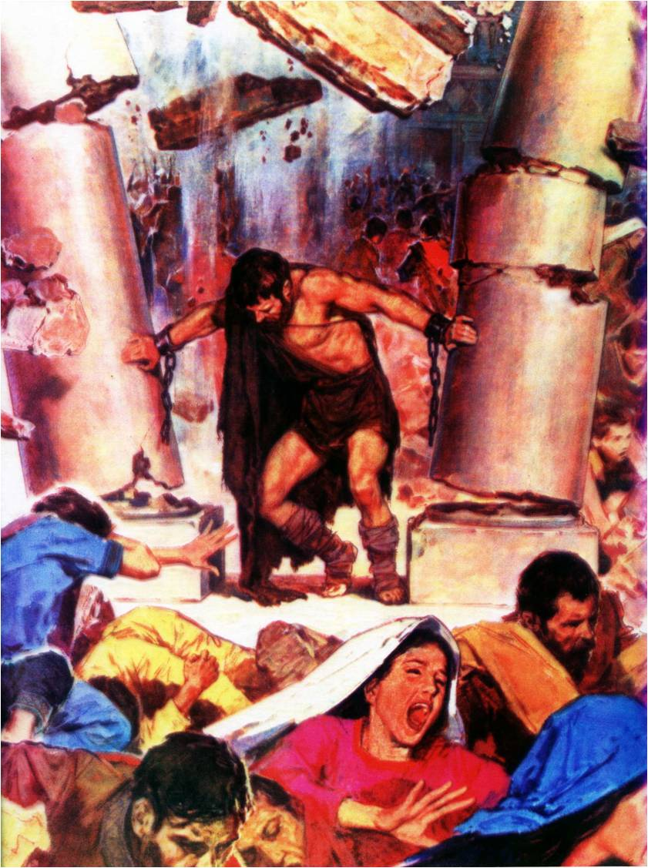
Samson –
God’s strength made perfect in weakness
Study 6
“God’s strength made perfect in weakness”

Slide 2

The death of Samson
Judges 16:22 – The mark of his Nazarite-ship grows again.
Acknowledged he deserved to die.
Sought vengeance for only one eye.
Slew more Philistines in his death than in life.

Slide 3
“The eyes of the blind shall see out of obscurity” (Isaiah 29:18)
V.21 - “put out his eyes” - These were his problem – Jud. 14:1,3,7.
“to Gaza” - Scene of the harlot’s embrace, and one of his great triumphs - Jud. 16:1-4.
“fetters of brass” - Double brass, slave to sin’s flesh.
“grind in the prison” - He burnt their grain, he now helps to feed them – Jud. 15:5.

Slide 4
New start for failed Nazarite
Judges 16:22 – “hair of his head began to grow again” – Symbol of his Nazariteship resumed. The failed vow is restarted now with clear spiritual vision – Num. 6:12.
V.23 – “Dagon” – “Fish-god”. Human face, hands and feet on trunk like a fish – 1 Sam. 5:4.
“Our god hath delivered Samson” – A fatal mistake by the Philistines. Now an unequal contest between dieties.

Slide 5
Philistines make sport
V.24 – “destroyer” – chareb – to parch; i.e. desolate, destroy. RSV – “ravager.” LITV – “the devastator.”
“which slew many of us” – Roth. – “who multiplied our slain.”
V.25 – “merry” – towb – good. LITV – “when their heart felt good.”
“make us sport” – sachaq – to laugh (in pleasure or detraction). LITV – “he shall entertain us.” Josephus – “insult him over our wine” (Cp. 14:12).

Slide 6
Complete humiliation
V.25 – “he made them sport” - As he had made sport of them – Jud. 14:12. Now totally humiliated – Isa. 50:5-6.
When we are nothing we understand God, and He can be everything to us. Samson now knows what it means to be a true Nazarite.
V.26 – “unto the lad that held him by the hand” – LITV – “to the young man grasping his hand.” This young man was orchestrating the mirth.

Slide 7
Leaning on the pillars
V.26 – “Suffer me” – nuach – to rest. LITV – “Let me alone.”
“feel” – mush – to touch.
“lean” – sha’an – to support oneself. Harassed and exhausted Samson seeks to rest, but has a plan in mind.
V.27 – “men and women” – enoshim and noshim – Lit. Weak mortal men and women – refers to the common folk.
V.27 – “on the roof three thousand” – Cp. 3,000 in Israel – Jud. 15:11.

Slide 8
The final appeal
V.27 – “men and women” – ish and ishah – great men and great women. Refers to the aristocracy in the upper stalls.
“beheld while Samson made sport” – LITV – “watching Samson entertaining.”
V.28 – “called unto Yahweh” – Cp. V.20. Recognition that God had left him. Did not presume on God’s power any more.
“O Lord GOD” – “He who will be rulers”.
“remember me” – For one last act to vindicate Yahweh’s name.

Slide 9
One eye avenged
V.28 – “only this once” – Call to be helped just one final time and forgotten.
“O God” – elohim – mighty ones.
“at once avenged” – Roth. – “with one avenging.”
“for my two eyes” – RSV – “for one of my two eyes.” (Roth. Mgn.) Asked to be left with infirmity – 2 Cor. 12:7-9.
Paraphrase - “O Lord Yahweh remember me, and strengthen me, I pray thee, only this once, that I may have one more avenging, for one of my eyes.”

Slide 10
The pillars of the house
V.29 – “took hold” – laphath – to bend, grasp with a twisting motion.
“two middle pillars” – These have been discovered in the ruins of ancient Philistine temples.
“on which it was borne up” – Roth. – “and whereon it was upheld, and he braced himself against them.”
V.30 – “Let me die” – nephesh – soul. Request to die forever – admission that he was a Philistine – Ezek. 28:10; 31:18: 32:19.

Slide 11
Samson’s final act of faith
V.30 – “bowed” – natah – to stretch or spread out; by imp. to bend away.
“all his might” – Roth. – “bowed mightily”, i.e. with God’s strength.
“at his death” – Because finally slew his greatest enemy – himself.
V.31 – “house of his father” – Perhaps his parents dead – should have stayed with them.
“took him and brought him up” – Roth. – “and lifted him, and carried him up.” At last Samson goes up – Jud. 14:1.

Slide 12
Samson at rest – Judges 16:31
Buried between Zorah and Eshtaol.
In the burial place of Manoah his father.
Manoah means “rest”. The root signifies “resting place, state or condition of rest”.
Judges 13:2 records that Manoah was “a man of Zorah”.
Samson was laid to rest close to Zorah – the Spirit was finally victorious in his life.
Zorah finally prevails!

Slide 13
“So the dead which he slew at his death were more than they which he slew in his life.”

Slide 14
… ….
...

