Slide 1
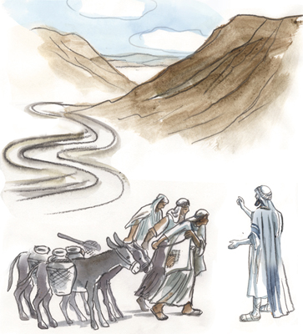
THE
NETHINIM

Slide 2
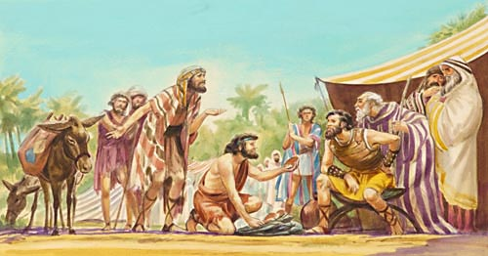
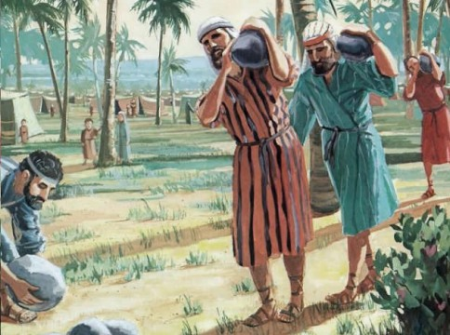
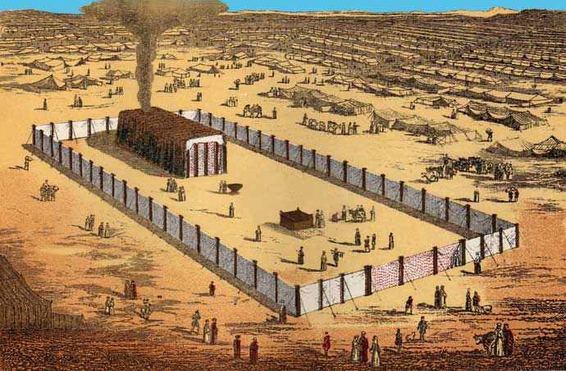
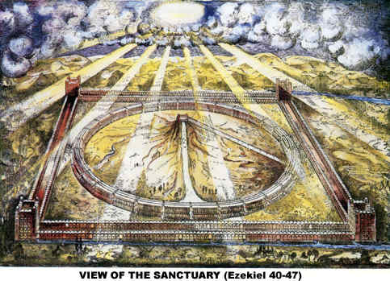
THE AGENDA
WHO WERE THEY?
WHAT DID THEY DO?
WHERE DID THEY LIVE?
EXHORTATIONS

Slide 3
NETHINIM
NATHIYN (naw-theen) = One given
NATHAN = To give
● Approximately 18 Occurrences:
1 Chronicles, Ezra, Nehemiah
Now the first inhabitants that dwelt in their possessions in their cities were, the Israelites, the priests, Levites, and the Nethinims.
1 Chronicles 9:2
But the Nethinims dwelt in Ophel: and Ziha and Gispa were over the Nethinims.
Nehemiah 11:21

Slide 4
HEBREW ‘IM’
Words with the suffix ‘im’ that are plural
lohemi = Elohim
hcrebmiu = Cherubim
mistith = Shittim
arhpmise = Seraphim
aphmitre = Teraphim
irmu = Urim
htmimum = Thummim

Slide 5
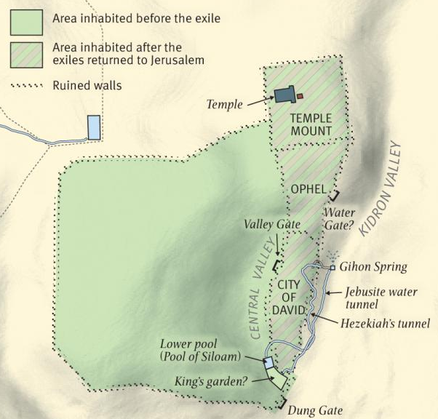
OPHEL
OPHEL = The high place, ascend
● Southeast side of the Temple Mt.

Slide 6
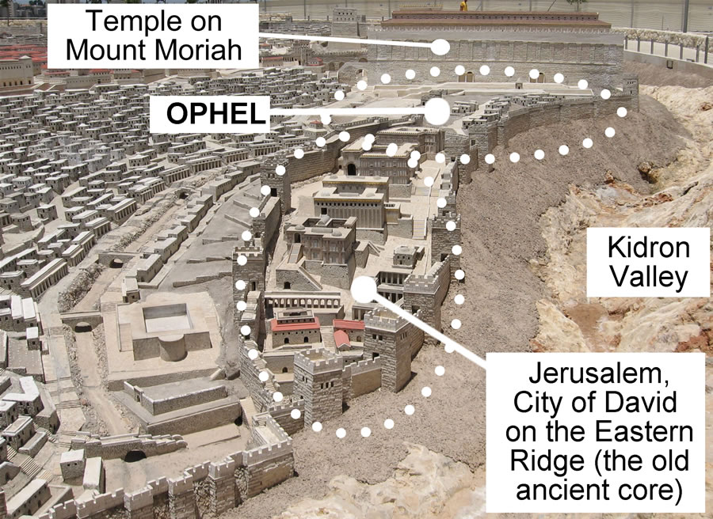

Slide 7
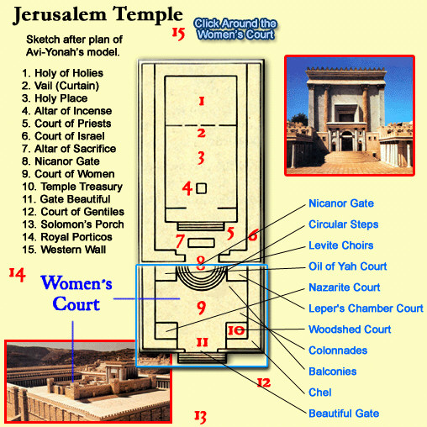

Slide 8
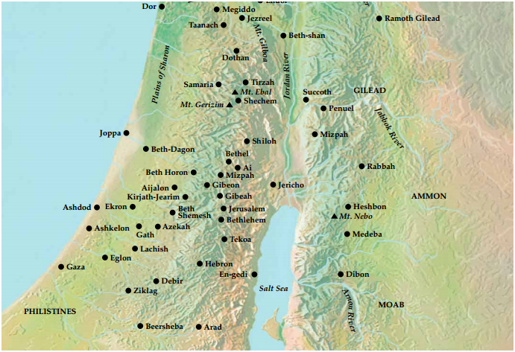

Slide 9

CONQUERED
● The Mehunim
● 2 Chronicles 26:3, 7
● The Nephusim
● 1 Chronicles 5:18 – 19
● The Midianites
● Numbers 31:1 – 2, 47

Slide 10
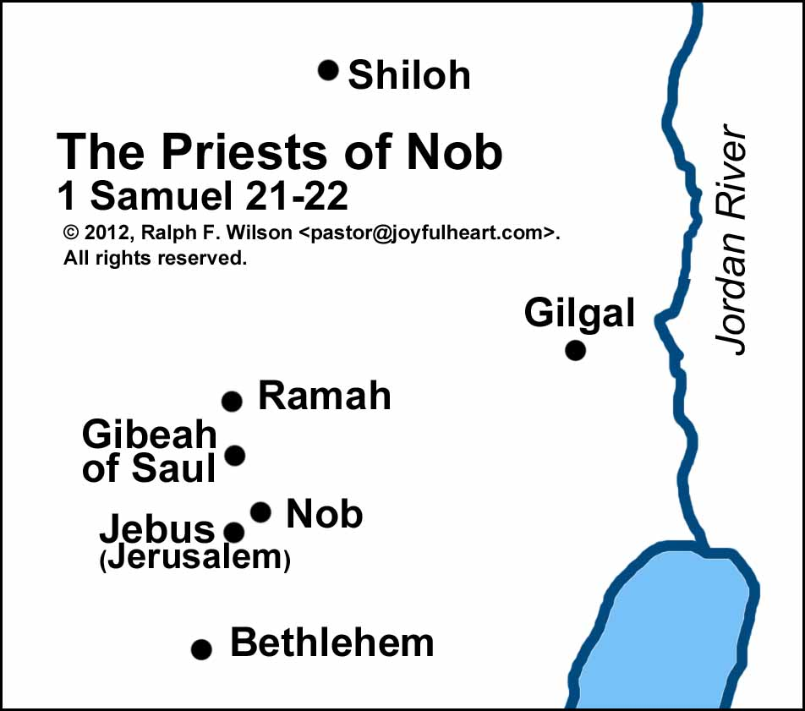

Slide 11
HIERARCHY
Sons of Aaron
“And thou shalt give the Levites unto Aaron and to his sons...”
Numbers 3:9
The Levites
“...the Levites shall be mine...”
Numbers 3:12
The Nethinim
“Also of the Nethinims, whom David and the princes had appointed for the service of the Levites...”
Ezra 8:20

