Slide 1
Christ in the Judges
Study 1 – “Who shall go up for us first - Caleb, Othniel and Achsah”

Slide 2
Structure of the Book of Judges
Chap. 1:1-3:6 The failure of Israel to consolidate their inheritance
Chap. 3:7-16:31 The history of Israel under the Judges
Chap. 17:1-21:25 Two appendices to the book
Appendix 1
Chap. 17-18 Corruption of Doctrine
Appendix 2
Chap. 19-21 Corruption of Practice
Fit between Judges 2:9-10

Slide 3
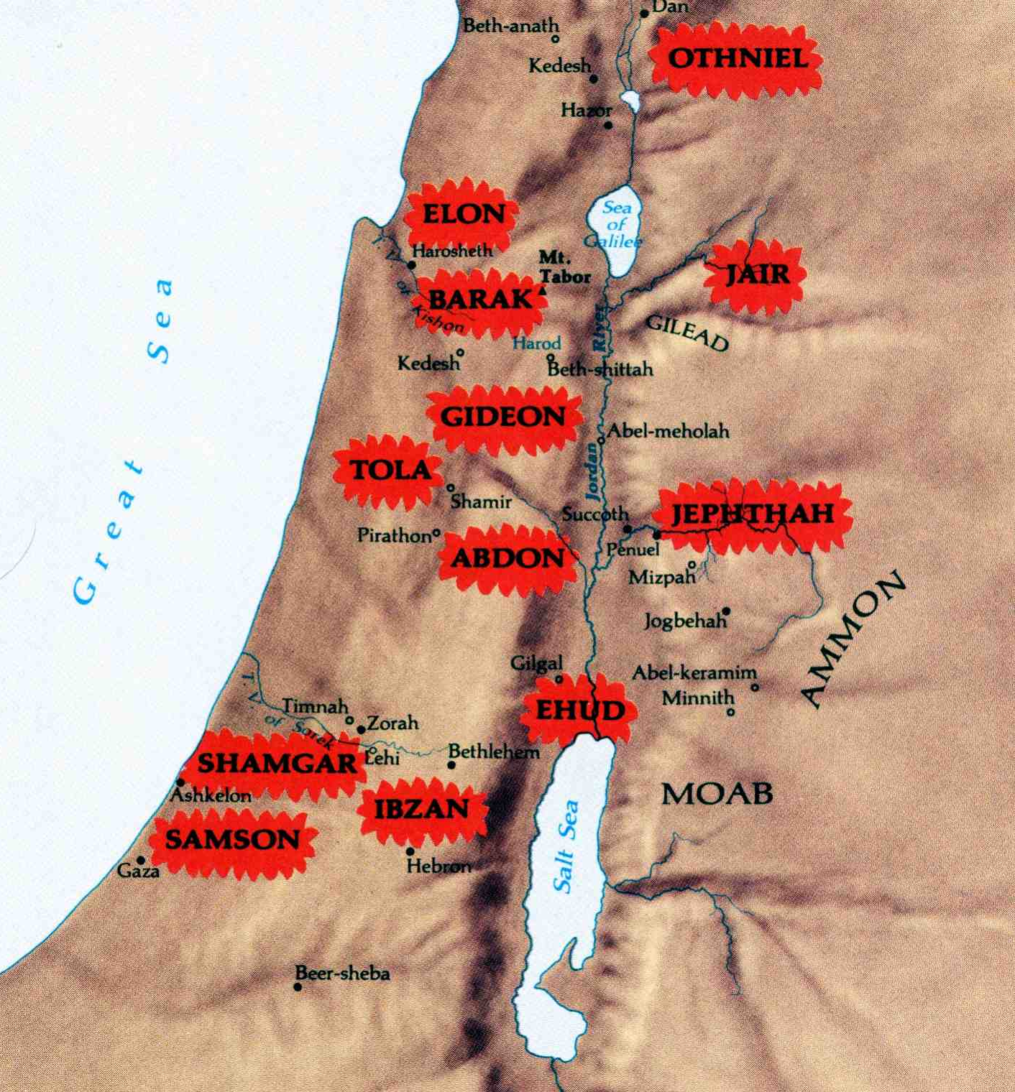


Where the Judges ruled in Israel
The period of the Kings was about to commence when all the tribes would gain a cohesiveness under a central administration which had not existed during the whole period of the Judges.
Raised up in local areas where problems existed, the Judges did not always influence the whole nation

Slide 4
Christ in the Judges
The periods covered by the types in the book
Death of Christ
Dark ages
Armageddon
Millennium
Othniel
Ehud
Deborah & Barak
Gideon
Abimelech
Jephthah
The End

Slide 5
The case of Shamgar
Judges 3:31 – Shamgar performed ‘Samson-like’ feats – Why is there only one verse to recount his story?
The answer is simple!
Judges is not history. It is prophecy!
Shamgar was not a type of Christ like some others who followed him.
Rule of thumb – Where there is a substantial record of a judge they are a type of Christ.

Slide 6
Two basic misconceptions – Jud. 1:1
Consider the chronological order of Judges 1 – hence the position of Judges 1:1.
“Who shall go up for us against the Canaanites…”
“…first, to fight against them?”
Israel incorrect on two counts:
Responsibility of “every man” to go up and seize his inheritance – Josh. 24:28; Judges 2:6.
Yahweh had already gone up “first” to destroy organised resistance – Josh. 21:43-45.

Slide 7
Canaanites
Hebrew – from the root kana – to bend the knee; hence to humiliate, vanquish; hence to be humble, be humbled, be subdued, be brought down, be low, be under, be brought into subjection.
Phil. 3:21 - “who shall transform the body of our humiliation to its becoming conformed to the body of his glory” (Young’s Literal).

Slide 8
“Judah shall go up”
Yahweh saw faith and leadership in Judah – in the family of Caleb!
But Judah as a tribe failed with Adoni-bezek resulting in the first case of……
National Judaism!

Slide 9
Adoni-bezek
His name signifies “Lord (master) of lightning”.
King of Canaanites = King Sin (humiliation).
Humiliated captives by amputation.
Judah cut off his thumbs and big toes.
Adoni-bezek thought this was God’s revenge.
But Yahweh’s law was clear – extermination Deut. 20:15-16.
His mind was left to contrive and scheme until Jerusalem was finally lost – v.7, 21.
Judaism restricts works (thumbs) and walk (toes), but leaves the carnal mind untouched.

Slide 10
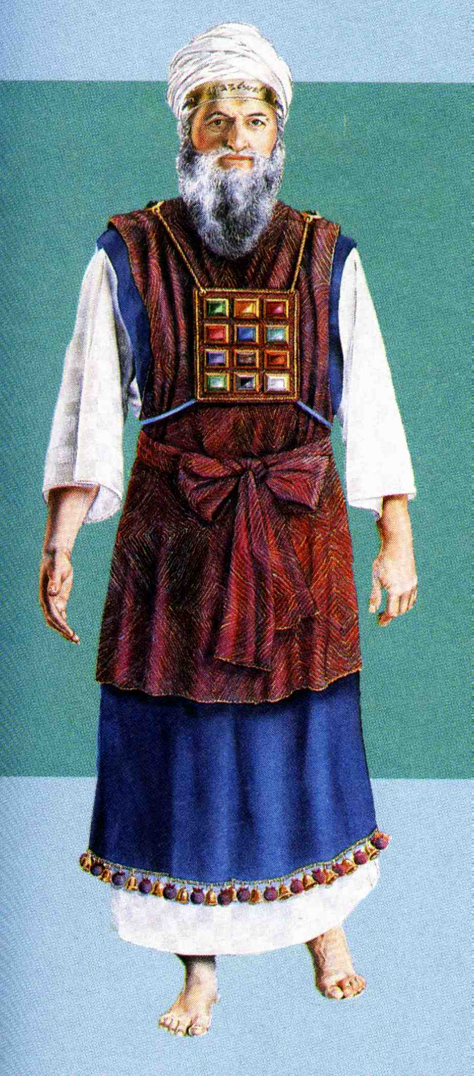
The Adoni-Bezek principle
Aaron and his sons were anointed with blood on the right ear, thumb and great toe. This spoke of hearing, working and walking in the way – Lev. 8:23.
Ear = mind (thoughts)
Thumb = works (activity)
Great toe = walk (ways)
Adoni-Bezek was forced to submit by hand and foot, but nothing was done about his thinking!

Slide 11
Caleb the son of Jephunneh
Caleb means “a dog”, from a root “to yelp, or to attack”. The dog was a Jewish symbol for the Gentiles.
Jephunneh - “he will be prepared” (Strong), or “he will be facing” (BDB).
Kenezite - “a descendent of Kenaz”. Kenaz signifies “hunter”.
Caleb’s prominent position in Judah (Num. 13:6) probably indicates his ancestors had joined the Patriarchs in the Land.

Slide 12
Promise at Hebron – Gen. 15
Hebrew – from the root cheber - association, company, band, shared, association, society; hence association; fellowship.
This was the city which became a stumbling-block to the 10 spies – Num. 13:22, 28.
Here the patriarchs and their wives were buried in the cave of Machpelah (“folded together”) - Gen. 23:19; 50:13.
This was the only place Caleb wanted as his inheritance – Josh. 14:6-15.

Slide 13
Caleb the Kenezite
Num. 32:6-12 – Not overwhelmed by the giants of Hebron – Num. 13:6,22-30; 14:6-10,24,30.
Josh. 14:6-15 – The focus on Hebron because of two families of ‘giants’. Twice called a “Kenezite” – v.6,14.
Josh. 21:9-12 – Caleb happy to give the city of Hebron to the Levites, so long as he could retain the fields.

Slide 14
The paradox of the Kenites and Kenezites – Gen. 15:19
The first two tribes listed of 10 to be removed from the land so that Christ could inherit it.
Some Kenites (the Rechabites) will have a permanent inheritance in the Land (Jer. 35:18-19) while many Jews will not!
The most prominent Kenezite in history will have a place beside Abraham, Isaac and Jacob in the Land of Promise.

Slide 15
The three giants – Judges 1:10
Hebron – association; fellowship.
Kirjath-arba - city of the four (giants).
Sheshai – whitish (like leprosy); six (Hitchcock) = Lust of the flesh.
Ahiman - “my brother is a gift” = Lust of the eyes.
Talmai – ridged; root meaning to accumulate; a bank or terrace = Pride of life.
1 John 2:16 - “For all that is in the world, the lust of the flesh, and the lust of the eyes, and the pride of life…”

Slide 16
The capture of Debir
First called Kirjath-Sepher = “City of a book”; “Booktown”
Renamed Debir = “The shrine” (innermost part of the sanctuary)
Type of Jerusalem in two eras of time
Hebron
Debir

Slide 17
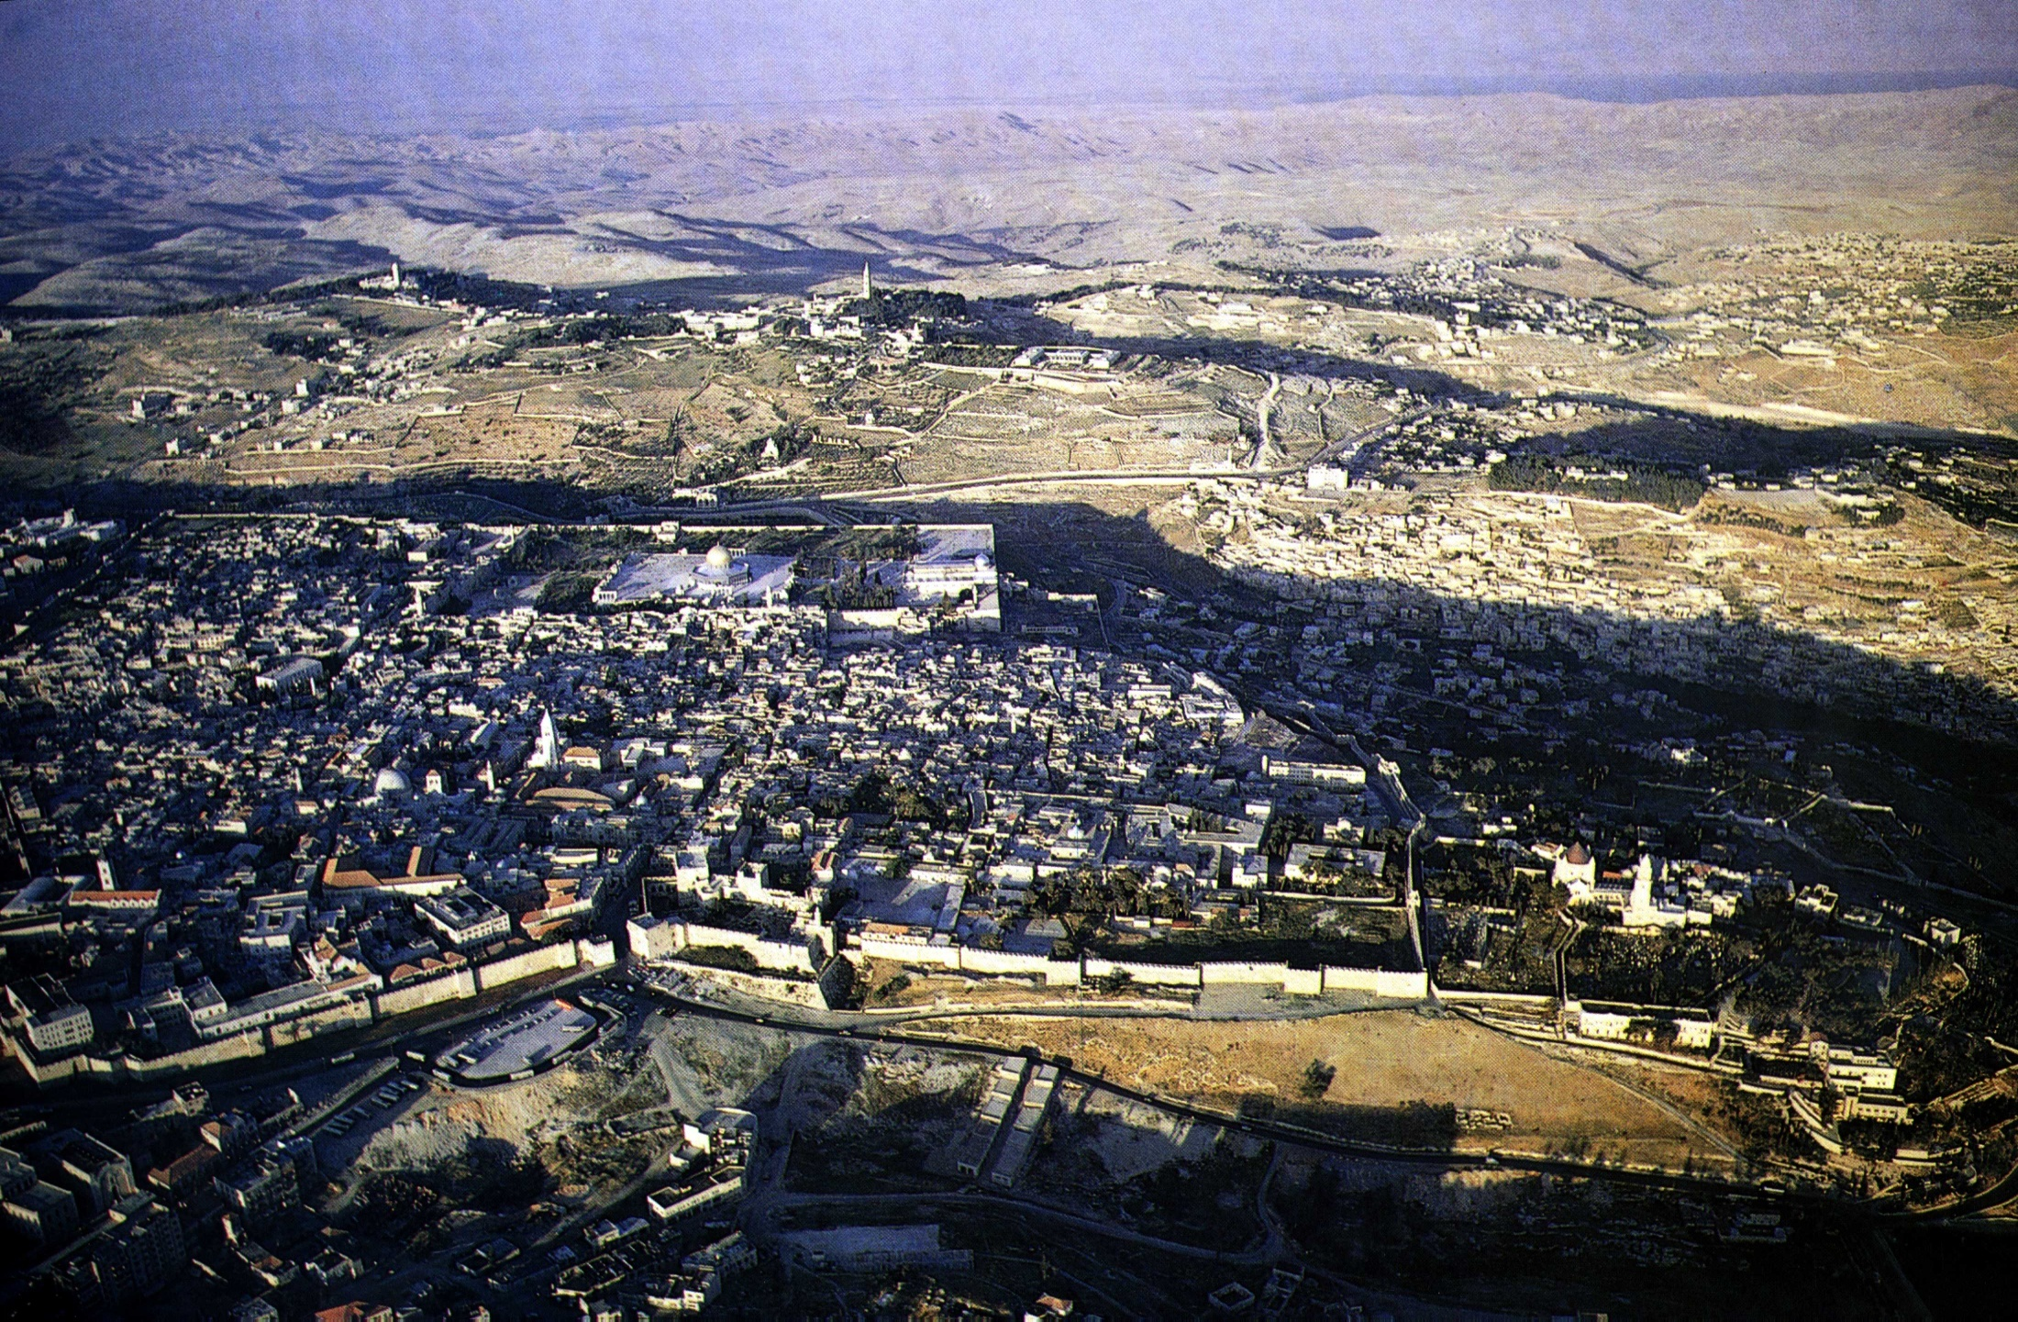
The City of the Book today
Jerusalem from the west

Slide 18
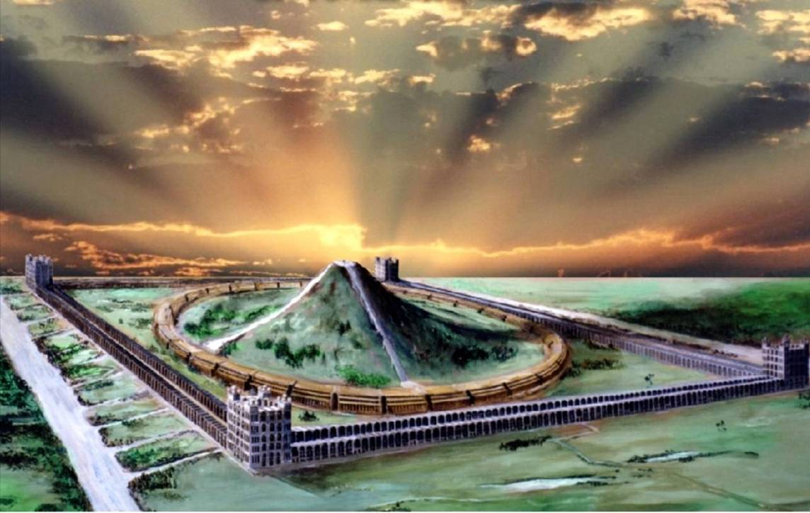
The Sanctuary
“The shrine” (innermost part of the sanctuary)
The Most Holy
Cameos of the Kingdom

Slide 19
Othniel – Type of Christ
Othniel – “Lion of God” (Gesenius).
Of the tribe of Judah – Rev. 5:1-6.
Son of Kenaz = “to hunt, hunter”.
Called “Caleb’s younger brother” actually nephew – 1 Chron. 4:13-15.
Israel’s first judge – Judges 3:9-10.
Judged Israel for 40 years – Judges 3:11.

Slide 20
Achsah – Type of the Bride of Christ
Achsah – “anklet”; root a fetter; hence an anklet. She was a willing “bondslave” to her lord – Rom. 6:16; 1 Cor. 7:22-23.
Daughter of Caleb – “a dog”. The Jewish symbol of the Gentiles.
Caleb was a Kenezite - Josh. 14:6, 14; Gen. 15:19.
Kenezites were an original Canaanitish tribe
Caleb’s family must have attached themselves to Israel in the days of the Patriarchs and intermarried – Caleb was a ruler of Judah.
Therefore Achsah was of both Jewish and Gentile origin – like the Bride of Christ.

Slide 21
The importance of Water
Achsah “moved” (cuwth – to prick; stimulate) Othniel to ask Caleb for “the field” where she knew there were perennial springs.
She took the initiative to request from her father “the field” near Debir (“the shrine”) – had already spied out the land.
She equated “a blessing” with the supply of water in a dry land – the word “south” is negeb – to be parched.
Given the upper and lower springs –fulness of blessings of the word of God – Eph. 5:26.

Slide 22
Mesopotamia = Babylon
Cushan-risha-thaim
Mesopotamia means “the highland between the two rivers”

Slide 23
Othniel’s victory over Babylon
Cushan-risha-thaim = “Cush of double wickedness” – Judges 3:8,10.
King of Mesopotamia = “highland of the two rivers”; i.e. the area of ancient Babylon – the original Cush – Gen. 2:13; 10:10. This is where the kingdom of men was first established. Its founder was Nimrod, son of Cush – Gen. 10:8.
Cushan-risha-thaim is a type of “Babylon the great” in its final manifestation in opposition to the rule of Christ – Rev. 17:3-5; 12-14.
Othniel’s triumph and 40 years rest types Christ’s victory and the Millennial ‘rest’.

Slide 24
Next study… God willing
“Ehud and the atoning work of Christ”

Slide 25
...

