Slide 1
Christ in the Judges
Study 2 – “Ehud and the atoning work of Christ”

Slide 2
Christ in the Judges
The periods covered by the types in the book
Death of Christ
Dark ages
Armageddon
Millennium
Othniel
Ehud
Deborah & Barak
Gideon
Abimelech
Jephthah
The End

Slide 3
The case of Shamgar
Judges 3:31 – Shamgar performed ‘Samson-like’ feats – Why is there only one verse to recount his story?
The answer is simple!
Judges is not history. It is prophecy!
Shamgar was not a type of Christ like some others who followed him.
Rule of thumb – Where there is a substantial record of a judge they are a type of Christ.

Slide 4
Othniel – Type of Christ
Othniel – “Lion of God” (Gesenius).
Of the tribe of Judah – Rev. 5:1-6.
Captured Kirjath-Sepher (“city of a book”) and made it “holy” (Debir).
Took as his prize – Achsah = type of the bride of Christ – Rev. 14:1.
Israel’s first judge – Judges 3:9-10.
Judged Israel for 40 years – Judges 3:11 = the Millennium.

Slide 5
Achsah – Type of the Bride of Christ
Achsah – “anklet”; root a fetter; hence an anklet. She was a willing “bondslave” to her lord – Rom. 6:16; 1 Cor. 7:22-23.
Daughter of Caleb – “a dog”. The Jewish symbol of the Gentiles.
Caleb was a Kenezite (Canaanitish tribe), but was prominent in Judah - Josh. 14:6, 14; Gen. 15:19.
Therefore Achsah was of both Jewish and Gentile origin – like the Bride of Christ.

Slide 6
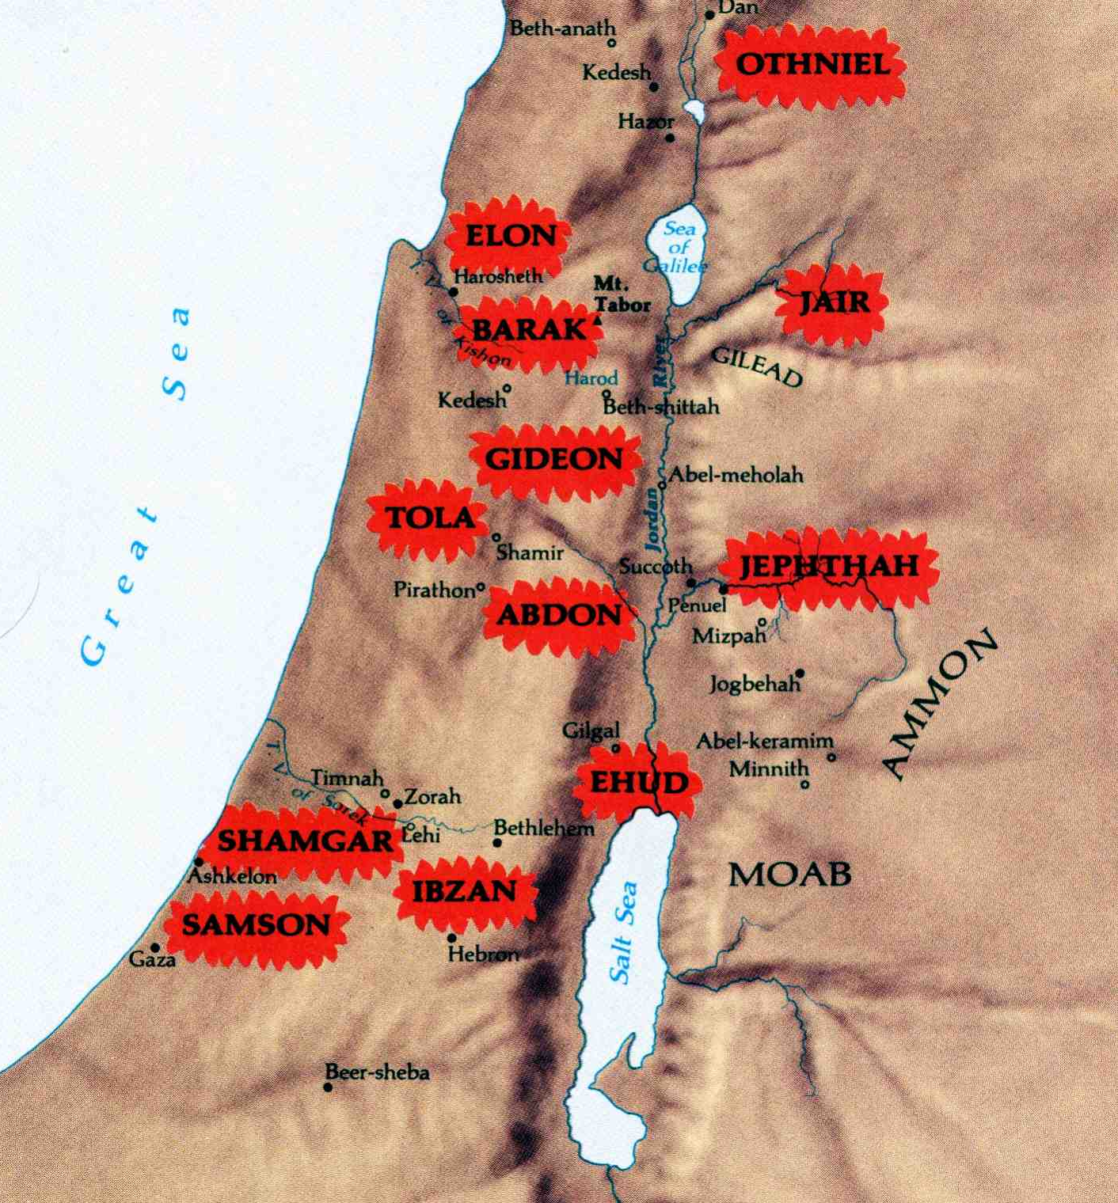


Where the Judges ruled in Israel
The area of Israel’s inheritance impacted by 18 years of oppression by Eglon the fat man of Moab.
The work of Ehud performed here

Slide 7
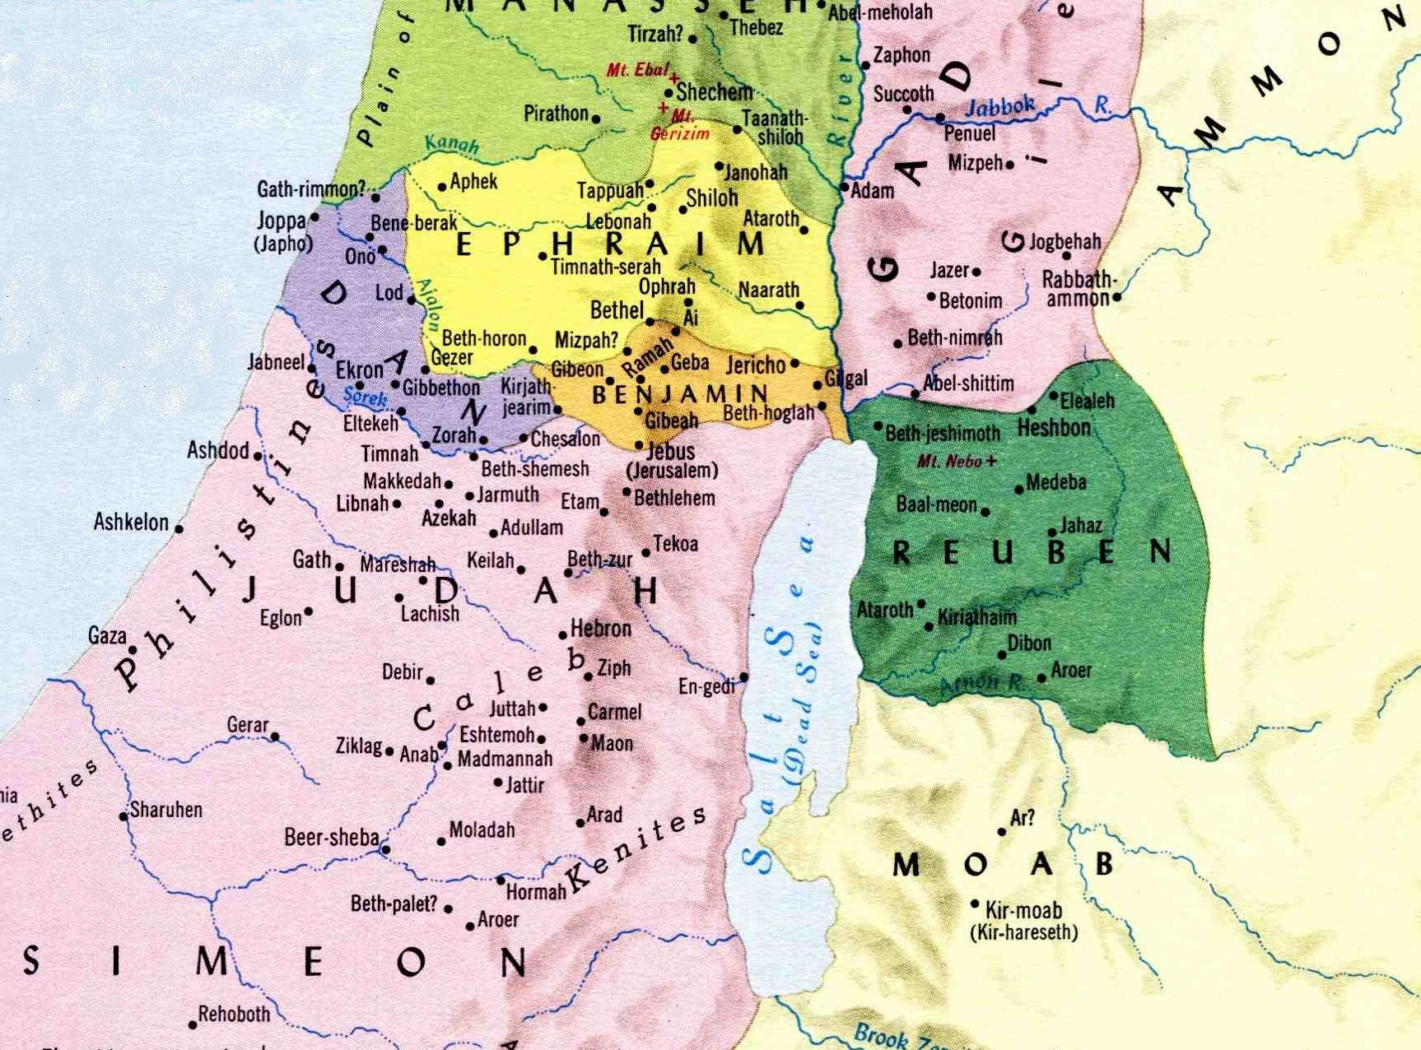
Eglon of Moab gathers his confederates
Ehud – Saviour of Israel
Jericho represented Israel’s capture of the land and victory over all their enemies – see Josh. 24:11
Ammon
Ehud of Benjamin
Amalekites

Slide 8
Eglon the king of Moab
His name means “like a calf”; from a root meaning to be round or circular. Cp. Lev. 16:11 – the bullock was the sin offering the high priest made for himself on the Day of Atonement.
Judges 3:17 – Emphasises Eglon was an “exceedingly fat man” (Roth.). Ample symbol for indulgent flesh with an insatiable appetite – unable to be appeased.
Ammon and Amalek were among Israel’s first and most implacable enemies – Deut. 25:17-18.

Slide 9
Ehud – Yahweh’s Saviour Judges 3:15
“deliverer” is yasha – to be open, wide or free; hence a deliverer or saviour (see mgn. v.9). The word is used 21 times in Judges.
Ehud means “united” from root “to unify”.
Son (ben – family builder) of Gera – “a grain” hence a seed (singular) – Gal. 3:16.

Slide 10
Ehud – Yahweh’s Saviour Judges 3:15
A Benjamite – “son of the right hand” (Ps. 80:17).
“a man (ish – mighty man) left-handed”; i.e. shut up or impeded in the right hand (symbol of power). Hence, not reliant on human strength.
“by him”; i.e. he was Israel’s chosen representative.
“present” – minchah – gift, present; i.e. an acknowledgement offering.

Slide 11
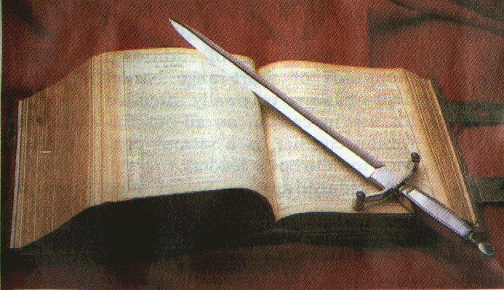
Ehud’s dagger
Home made – the struggle with the flesh is an individual matter.
chereb – a knife or a sword. First occ. Gen. 3:24 – “a flaming sword”.
“two edges” – Symbol for the Word of God – Heb. 4:12 – “sharper than any two-edged sword”.
“cubit length” – about 18” or 45 cm. About the same length as the Roman machaira – Eph. 6:17.
Girded on right thigh (strongest and best part of body – Lev. 7:32-34); i.e. the word was in his mind – 1 Pet. 1:13.

Slide 12
A secret errand to King Sin
V.19 - “errand” is the word dabar – word. Roth. - “a secret word”. The secret word he had was the two edged sword girded on his thigh.
V.20 – “message” is also dabar – word; i.e. the word of God.
Ehud and Eglon alone behind locked doors. Typical of the putting to death of King Sin by the power of the word of God girded in the ‘mind’ of the unifier of Israel - the son of the right hand who put no trust in the arm of flesh.
Ehud set forth the work of Yahweh’s saviour.

Slide 13
Victorious over the tomb
The locked parlour (v.23) represents the tomb of Christ (Matt. 27:66) where “the body of sin” (Rom. 6:6) lay “dead on the earth” (v.25).
Ehud ‘escaped’ alive beyond “the quarries” (peciyl – idols) of carnality to Seirath – she goat or kid (used Lev. 4:28; 5:6); i.e. the place where the ‘sin offering’ was memorialised.
Blew a trumpet (resurrection) in Mt. Ephraim (“double fruit” – Jew and Gentile) and went “before” his people to battle with the call, “Follow after me” (Matt. 19:21; John 21:19,22).
Eliminated all carnal flesh at the waters of baptism (Matt. 3:5-6).

Slide 14
The End - 1 Cor. 15:24-28
Then cometh the end, when he shall have delivered up the kingdom to God, even the Father; when he shall have put down all rule and all authority and power.
For he must reign, till he hath put all enemies under his feet.
The last enemy that shall be destroyed is death.
For he hath put all things under his feet. But when he saith all things are put under him, it is manifest that he is excepted, which did put all things under him.
And when all things shall be subdued unto him, then shall the Son also himself be subject unto him that put all things under him, that God may be all in all.
The Greek word pas occurs 10 times in this bracket of verses.

Slide 15
Rest fourscore years
The Greek word pas (all) is used 10 times in 1 Cor. 15:24-28 (a context of its own).
The Greek word hupo (“under”) occurs 8 times in the passage – twice by itself and 6 times as part of the word hupotasso.
8 is the number of a new beginning and immortality.
10 is the number for all.
Hence, 80 years (8 x 10) represents the period beyond the Millennium when God is all in all.

Slide 16
Next study… God willing
“Deborah and Barak -Gen. 3:15 in an enacted parable”

