Slide 1
Christ in the Judges
Study 3 – “Deborah and Barak - Gen. 3:15 in an enacted parable”

Slide 2
Where the participants in the drama of Judges 4 lived
The serpent and “the woman” in the Atonement
Home of Barak
Tent of Jael
Home of Jabin
Mt Tabor
Home of Sisera
Home of Deborah

Slide 3
Jabin king of Canaan
His name means “intelligent” or “wise” – the characteristic of the serpent – Gen. 3:1.
Jabin is a dynastic name – there were two who ruled from Hazor (“village”) – Cp. Josh. 11:1.
In both contexts – Josh. 11 and Jud. 4 Jabin is a type of the serpent in political manifestation (cp. Rev. 20).
“Canaan” = “humiliated”. Monarch of humiliation – Phil. 3:21.
Judges 4 is an enacted parable of the overthrow of the serpent power by Christ.

Slide 4
Sisera – “Seed of the Serpent”
Name means “warlike array” or “a field of battle”.
Harosheth signifies “Mechanical work”.
As Jabin’s captain he represents the seed of the serpent in violent political manifestation.
Chariots of iron point in type to Rome.
Sisera’s plundering made Israel’s life unbearable – Jud. 4:3; 5:30

Slide 5
Cameo of Gen. 3:15
Jabin – Type of the serpent (carnal mind).
Sisera – Type of the seed of the serpent.
Deborah – Representative of the Divine mind – “the woman”.
Barak – Type of Christ – seed of the woman.
10,000 men – Type of Christ’s disciples.
Heber – Type of Judas Iscariot the betrayer.
Jael – Representative of the Divine mind in Christ – the Divine element in the Atonement.

Slide 6
Deborah – “The Woman”
Name signifies “a bee” from root “orderly motion” (a noun of unity) = symbol for Divine wisdom in action (the mind of God).
Lapidoth – “to shine as lightning”. A divine light (truth) – shines for all to see – Luke 17:24.
Palm – tamar – to be erect or upright – see Ps.92:12; Jer. 10:5; S.S. 7:7. Evergreen – noted for striking beauty and uprightness. Fruit in head. Determined growth towards light.
Ramah – “a height” (i.e. heavenly places).
Bethel – “House of God” (the Ecclesia).

Slide 7
Barak – Type of Christ
His name signifies “glittering” or “a flashing sword” (from the sun shining on a moving blade) – symbol of the word of God in action – Heb. 4:12. Christ was the word made flesh – John 1:14.
Son of Abinoam – “Father of graciousness”
Revealed as type of Christ – Jud. 5:12 is quoted in Ps. 68:18 – cited Eph. 4:8.
Kedesh-Naphtali – “The sanctuary of my wrestling”. City of refuge (Josh. 20:7), 20 miles (32 kms) from Nazareth (Christ in preparation for mission).

Slide 8
Zebulun and Naphtali respond
Sisera marshals his forces at Kishon
A violent storm sweeps across Jezreel
The Canaanites are all destroyed
Sisera alone escapes on foot to Jael’s tent
Deborah sends for Barak
Barak leads them to Mt. Tabor
Judges 5:4 – Massive rainfall
Judges 5:20-21 - Kishon floods
Battle of Kishon

Slide 9
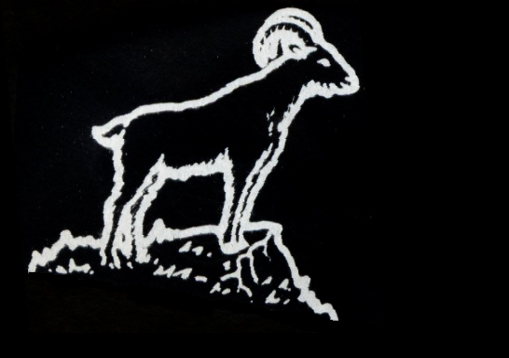
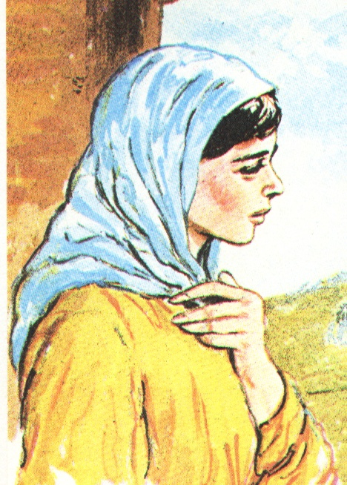
Jael – The wife of Heber
Her name signifies “a wild goat”; the sense of the root is climbing or ascending. Jael was surefooted in a difficult and harsh environment.
Her husband Heber was a traitor to the Truth and in league with Jabin. She was isolated from family and ecclesia, yet faithful and determined.
For her deeds she was “blessed above women” – Jud. 5:24 (4:9).

Slide 10
Why two women?
Deborah represents the “woman” of Gen. 3:15 – the thinking of God which is at enmity with serpent thinking.
Jael represents the Divine way of thinking in action against ‘the serpent’ within her tent.
Jael’s deliberate identification with Sisera (short of being defiled by him) represents Christ’s identification with human nature.
The struggle in the tent is a cameo of Christ’s internal struggle against the serpent within.
Hence, ‘woman’ = the Divine element in the Atonement – God’s victory over flesh!

Slide 11
The three conflicts of Gen. 3:15
Serpent versus the Woman = hostility between carnal thinking and divine thinking – Rom. 8:5-7.
Serpent’s seed versus Woman’s seed = A “generation of vipers” in conflict with Christ – Matt. 23:33; John 8:39-44.
Woman’s seed versus the Serpent = Christ to conquer sin in the body of his flesh by death and resurrection – Col. 2:15.

Slide 12
In the tent of Jael – Judges 5:26-27
26 Her hand, to the tent-pin, put she forth, and, her right hand, to the toilers’ mallet,—Then smote she Sisera, She shattered his head, Yea she split open and pierced through his temples:
27 Between her feet, he bowed—he fell, he lay,—Between her feet, he bowed—he fell, Where he bowed, There, he fell—destroyed!
The first task was to break the skull – this would render him unconscious.
Then the tent peg could be driven home.
1
Summary – and first strike
2
3

Slide 13
The struggle in Jael’s tent
First strike – designed to break Sisera’s skull – did not succeed
Second battering – suppression of mortal enemy – not entirely successful
Third battering – final suppression and calm resolution
“Is not my word ...like a hammer that breaketh the rock in pieces?” – Jer. 23:29

Slide 14
Jael and Gethsemane
The name signifies – “an oil press”. Cp. Luke 22:44 – “...great drops of blood”.
Matt. 26:36-46 – The Lord makes three forays into the depths of the garden which match the events in Jael’s tent.
Significantly, the Lord takes with him three of his closest disciples.
Struggle 1 – A violent internal struggle. His Father’s will given priority – V.39.
Struggle 2 – Growing resignation – Father’s will must be done – V.42.
Struggle 3 – Final triumph – calm resolve.

Slide 15
God subdued Jabin the king of Canaan
“subdued” – kana – to bend the knee; hence to humiliate, vanquish. Root of Canaan.
Repetition of “Jabin the king of Canaan”. prefigures the three stages of Christ’s work.
V.23 – the first stage of God’s work in Christ – subduing the serpent in the flesh of one man.
V.24 – the second stage at the return of Christ – the “children of Israel” prevail over serpent – Saints redeemed from serpent.
V.24 – the third and final stage at end of Millennium when serpent power is “destroyed”.

Slide 16
“He has done it” – Ps. 22:31
There are several stages leading to the final declaration “It is done”:
John 19:30 – “It is finished” – The personal triumph of Christ guaranteed the ultimate fulfilment of God’s purpose.
Rev. 16:17 – Equates to Ezek. 39:8 = Saints triumph. Armageddon is the beginning of the “day of Yahweh” to subdue the nations.
Rev. 21:6 – Declaration that God’s purpose is complete. All nations now incorporated into one nation – Israel. Sin and death abolished.

Slide 17
Next study……..God willing
“Gideon – Confirming the covenant made unto the fathers”

