Slide 1
Christ in the Judges
Study 4 – “Gideon – Confirming the covenant made unto the fathers”
Christ in the Judges

Slide 2
Gideon as a type of Christ
Gideon’s triumph over Midian is used as a type of Armageddon – Ps. 83:9,11; Isa. 9:4; 10:26.
The work of Gideon can be divided into 3 stages, answering to the work of Christ –
The first advent – sacrifice and confirm-ing the covenant made unto the fathers.
Second advent – resurrection and judgement of the household.
Armageddon - subjugation of the nations and the redemption of Israel.
Christ in the Judges

Slide 3
The pattern of types – Judges 6
Israel forsake Yahweh’s covenant – V.1
Israel impoverished by invaders – Vv.2-6
A mighty prophet raised up as a forerunner to Gideon – Vv.8-10
A covenant deliverer sent – Vv.11-16
Abrahamic covenant confirmed by sacrifice – Vv.19-27
Christ in the Judges

Slide 4
The quarrel of Yahweh’s Covenant
“Midian” = quarrel. See Lev. 26:25.
Son of Abraham by Keturah (Gen. 25:2).
7 years affliction – cp. “seven times” – Lev. 26:18,21,24,28.
Enemies “without number” – Abrahamic covenant language – Lev. 26:42-45.
Gideon is a type of Christ in relation
to the Abrahamic Covenant
Christ in the Judges

Slide 5
The gods of Canaan
Baal – lord, master, owner, possessor. Baal is lord of all that is worldly, fleshly, sensual and devilish.
Baal-berith – Lord of the covenant
Baal-gad – Lord of good-fortune
Baal-hamon – Lord of wealth
Baal-hazor – Lord of the village
Baal-meon – Lord of the dwelling
Baal-peor – Lord of the opening
Baal-tamar – Lord of the palm tree
Baal-zebub – Lord of the flies (dung heap)
Obligations
Gambling/Luck
Money/Income
Family/Community
House/Goods
Sexual freedom
Environment
Health
Judges 8:33 - And it cometh to pass, when Gideon is dead, that the sons of Israel turn back and go a-whoring after the Baalim, and set over them Baal-Berith for a god. (Ygs Lit.)
“turned again” – shub - to return, turn back
Christ in the Judges

Slide 6
The invasion of the Midianites, Amalekites and children of the east for 7 years
Home of Gideon
Christ in the Judges

Slide 7
The nameless prophet – A voice
V. 8 – Lit. “Yahweh sent a man (ish – great man), a prophet”.
Nameless – he was a divine “voice” – like John the Baptist – John 1:23.
Lists 7 things that Yahweh did for Israel – covenant faithfulness.
The message is based on Gen. 15:13-16,18-21 – the Abrahamic covenant.
Cp. the work of John Baptist – Luke 1:68-74.
V.10 – “….ye have not obeyed my voice”.
Christ in the Judges

Slide 8
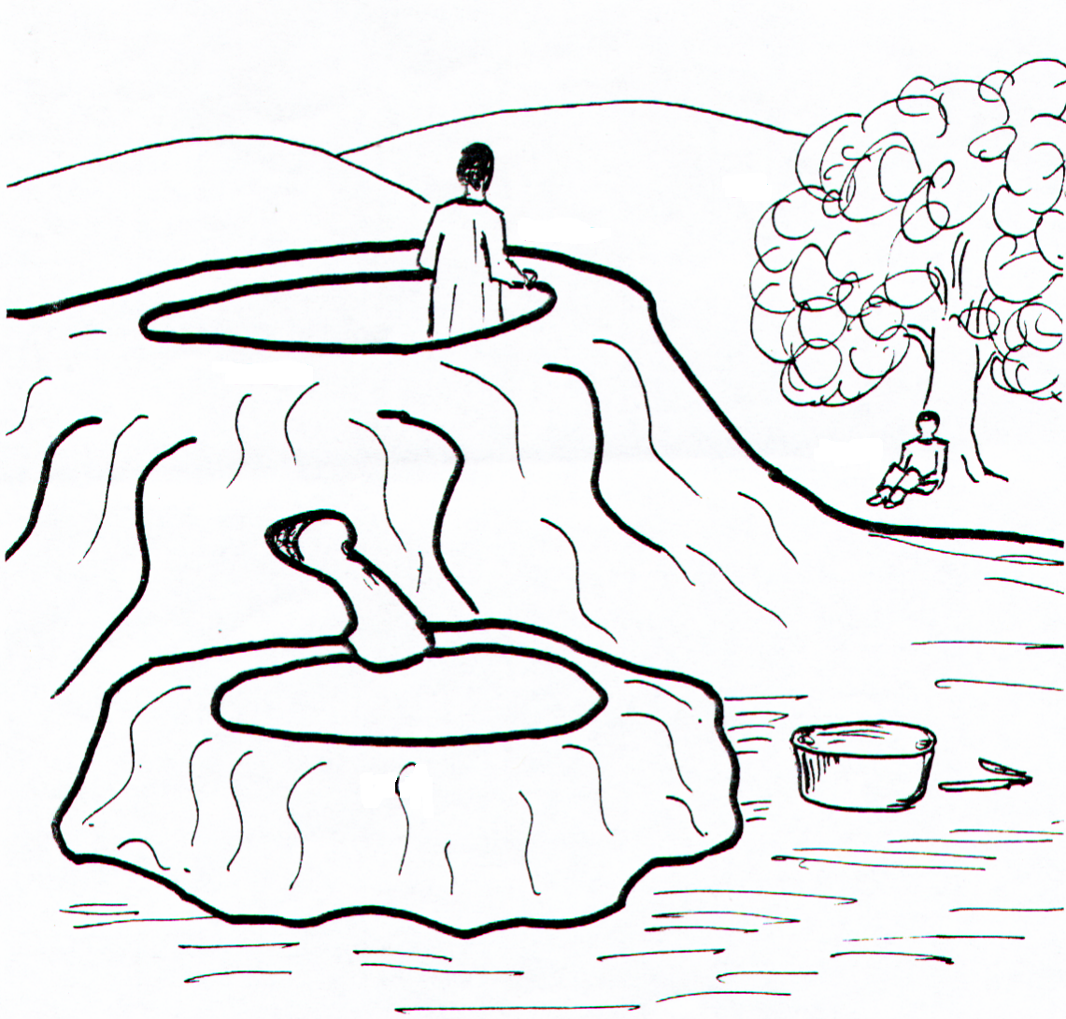
Judges 6:11
Gideon hides from the Midianites
“And there came an angel of Yahweh, and sat under an oak which was in Ophrah…. and his son Gideon threshed wheat in the winepress, to hide from the Midianites.”
Oak
Selah
The Angel
Tzur

Slide 9
Gideon – Type of Christ
Raised up in the poorest circumstances – V.15.
From Manasseh = Natural Israel; but Ophrah is in Ephraim = Abrahamic Ecclesia - Gen. 48:19.
At one morally with Yahweh – V.12,16.
Acknowledged that all flesh is grass – V.22.
Sought deliverance from death – V.22.
Saved out of death – V.23.
The key issue of the Angel’s message is that Gideon would deliver Israel “as one man” - A type of the work of the Son of God.
Christ in the Judges

Slide 10
That Rock was Christ 1 Cor. 10:4
Ex. 17:6 – “Behold, I will stand before thee there upon the rock in Horeb; and thou shalt smite the rock”.
The Hebrew word “rock” is tzur – a large rock or boulder.
Moses struck this rock with the serpent rod portraying the crucifixion of Christ.
Thus, tzur relates here to the mortality of Christ.
Christ in the Judges

Slide 11
The Rock “followed them”
Selah at Kadesh-Barnea
Moses struck the Tzur at Rephidim
He was to speak to the Selah at Kadesh-Barnea
40 years later
Tzur at Rephidim
Christ in the Judges

Slide 12
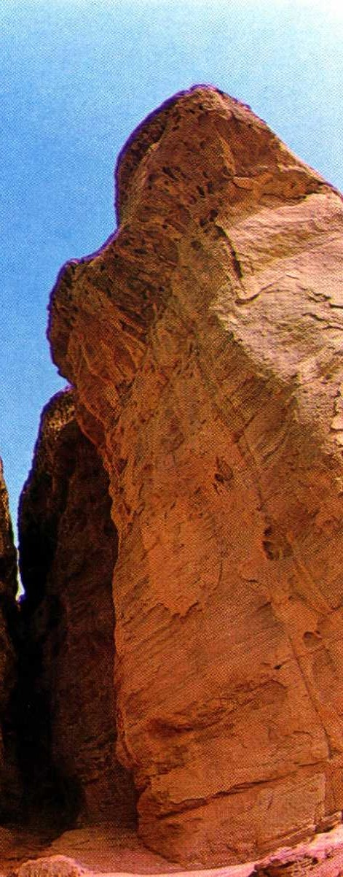
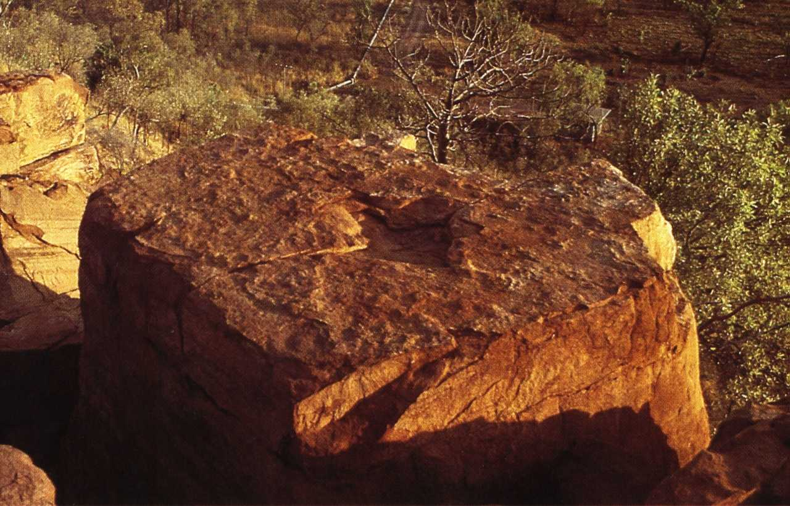
Tzur and Selah
Tzur refers to a huge boulder.
Selah refers to a lofty, craggy rock or cliff.
Selah
Christ in the Judges

Slide 13
The Rock that followed them
Num 20:8 – “Take the rod, and gather thou the assembly together, thou, and Aaron thy brother, and speak ye unto the rock before their eyes”.
The Hebrew word “rock” is selah – a lofty, craggy rock; i.e. Inaccessible (5 occs.)
Moses was to speak to this rock, but struck it twice thus destroying the type.
Hence, selah represented Christ in his immortality as mediator between God and man = access to Divine grace.
Christ in the Judges

Slide 14
The use of tzur and selah in the O.T.
First occurrence of tzur is in Ex. 17:6 (twice).
Num. 20:8 is also the first occurrence of selah.
Paul unites these two passages in 1 Cor. 10:4.
Both tzur and selah are used to represent Yahweh, particularly in the Psalms.
The context and scriptural commentary determine the way to interpret these words.
Christ in the Judges

Slide 15
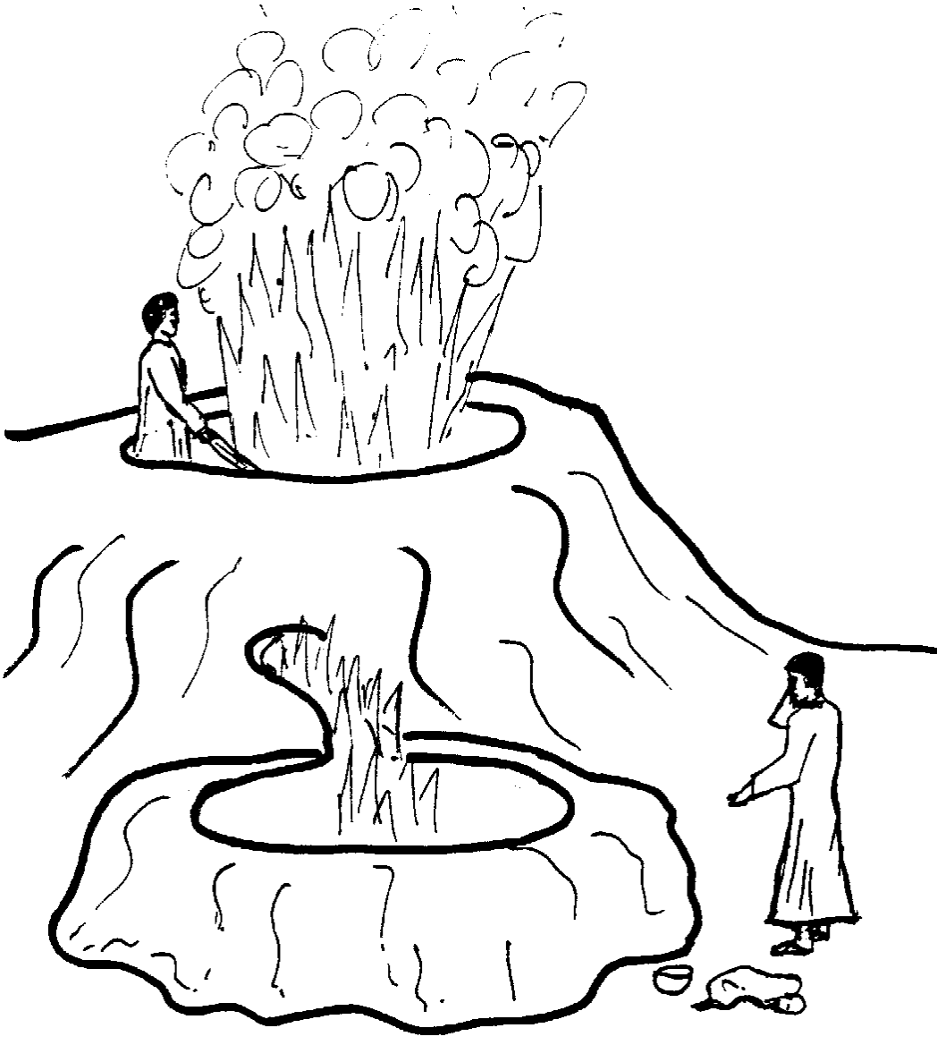
Judges 6:21
“Then the angel of Yahweh put forth the end of the staff that was in his hand, and touched the flesh and the unleavened cakes; and there rose up fire out of the tzur, and consumed the flesh and the unleavened cakes”
The Angel
Immortality
Selah
Gideon
Mortality
Tzur

Slide 16
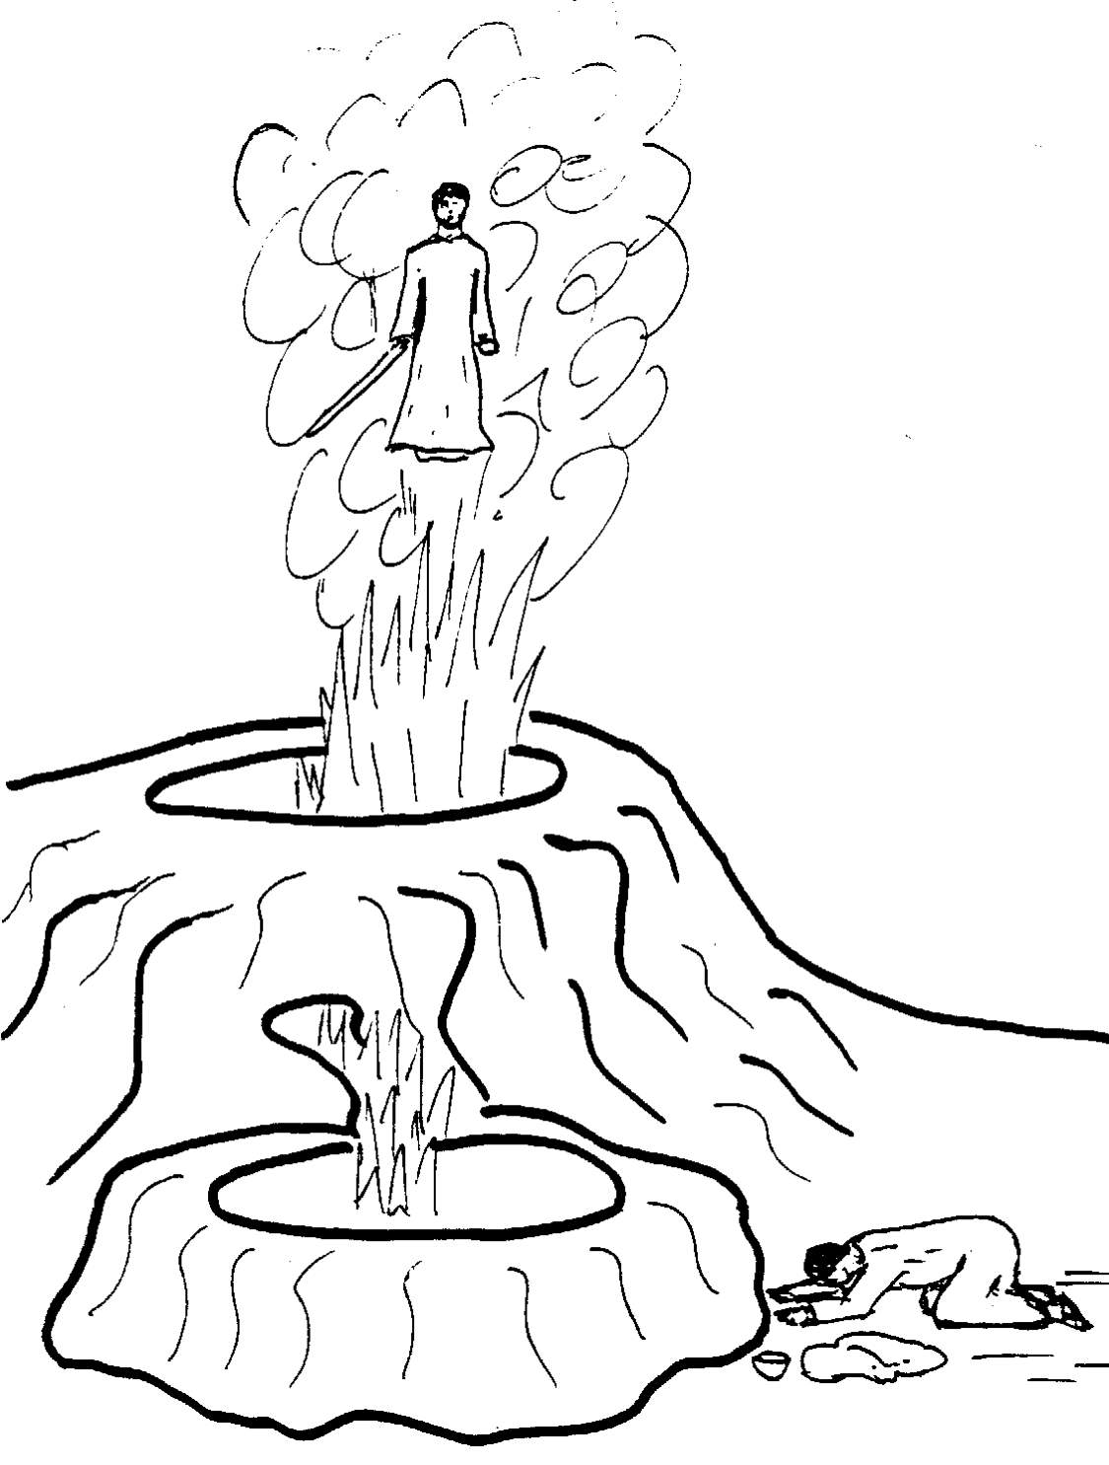
Judges 6:21
The Angel
“Then the angel of Yahweh departed out of his sight.”
Gideon builds the Yahweh-Shalom altar on the winepress
Selah
Tzur

Slide 17
The sacrificial work of Christ foreshadowed
The 3 stages of Gideon’s work represented by 3 altars all built the same day.
The Selah/Tzur Altar – Christ’s redemption, glorification and ascension.
Yahweh Shalom Altar (on winepress, but without sacrifice) – Christ our altar – fellowship through him for others.
Altar in father’s house – Abrahamic covenant confirmed by sacrifice.
Christ in the Judges

Slide 18
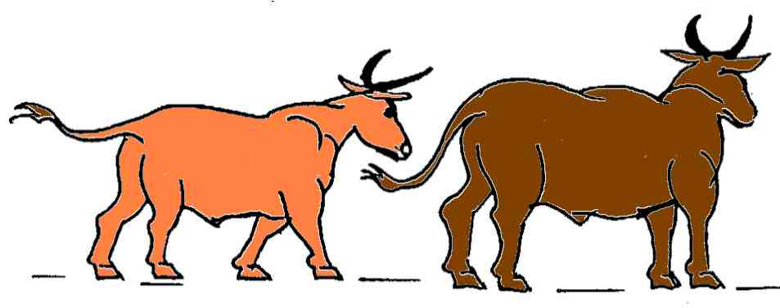
The two bullocks
Judges 6:25 – “Take the young ox which is to thy father, and the second bullock of seven years”. (Ygs.)
Young bullock
Second bullock
– 7 years
So, how would you number them?
X 2nd
1
2

Slide 19
Two bullocks – Two covenants
The young bullock would have been 2 to 3 years old – yet is mentioned first.
The 7 year old bullock is much older but is called the “second”. This unusual feature points to a remarkable type.
Mosaic Covenant – the ‘youngest’ (given 430 years after the Abrahamic) but is called the “first” in Heb. 8:7; 10:9.
Abrahamic Covenant – the oldest (by 430 years) but is called the “second” because ratified by the sacrifice of Christ - Rom. 15:8.
Christ in the Judges

Slide 20
Two Covenants
Though given first, the Abrahamic Covenant is called the second (and the “new”) because it was ratified by the sacrifice of Christ centuries after the Mosaic was ratified by animal sacrifices.
Sacrifice of Christ
Abrahamic
Mosaic
430 yrs
Ratified by blood of animals – Ex. 24
Ratified by the sacrifice of Christ
Christ in the Judges

Slide 21
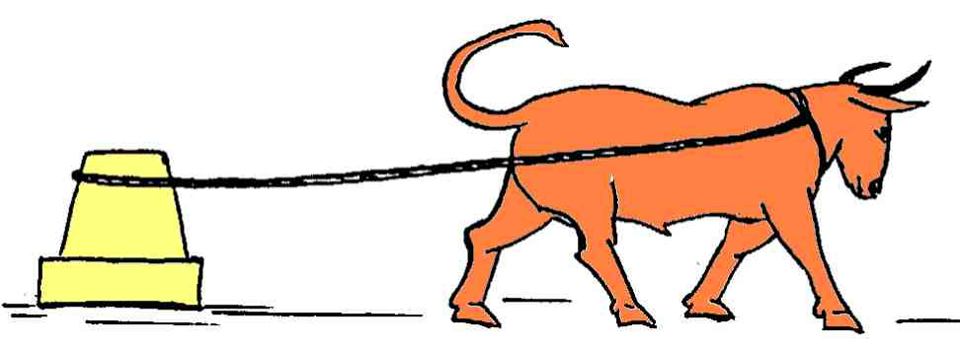
The young bullock
Probably employed to throw down the altar of Baal-berith in Gideon’s father’s house.
Represents the Mosaic Covenant – the Law of Moses was given to overthrow idolatry in Israel. First 2 commandments illustrate this.

Slide 22
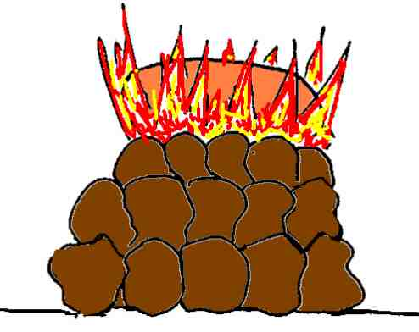
The second bullock sacrificed
Judges 6:26 - The word “rock” is ma’uz – a fortified place. Translated “fortress” in Jer. 16:19. This was a stronghold of fleshly worship now to be overthrown.
RSV – “with stones laid in due order” – Ex. 20:25.
The second bullock representing the Abrahamic Covenant is offered on a Divine altar and accepted.
Christ in the Judges

Slide 23
Compare the sacrifice of Christ
Gideon worked at night (v.27) – Darkness descended 3 hours before Christ died.
Gideon’s sacrifice of the bullock was outside of the Law – Christ was crucified “outside the camp”.
There was no priest present at Gideon’s sacrifice – No priest officiated at Christ’s sacrifice.
“The wood of the grove” was cursed (v.26) – The cross brought a curse on Christ.
Christ in the Judges

Slide 24
The several names of Gideon
Gideon – “Hewer down”
Jerubbaal – “Contender with Baal” (v.32)
Jerubbesheth – “He shall contend against confusion and shame” – 2 Sam. 11:21
Gideon’s work was typical of the work of Christ
Christ in the Judges

Slide 25
Christ in the Judges
Next Study – God willing
Study 5 – “Gideon and the work of Christ’s Second Advent”
Christ in the Judges

