Slide 1
Christ in the Judges
Study 5 – “Gideon and the work of Christ’s Second Advent”
Christ in the Judges

Slide 2
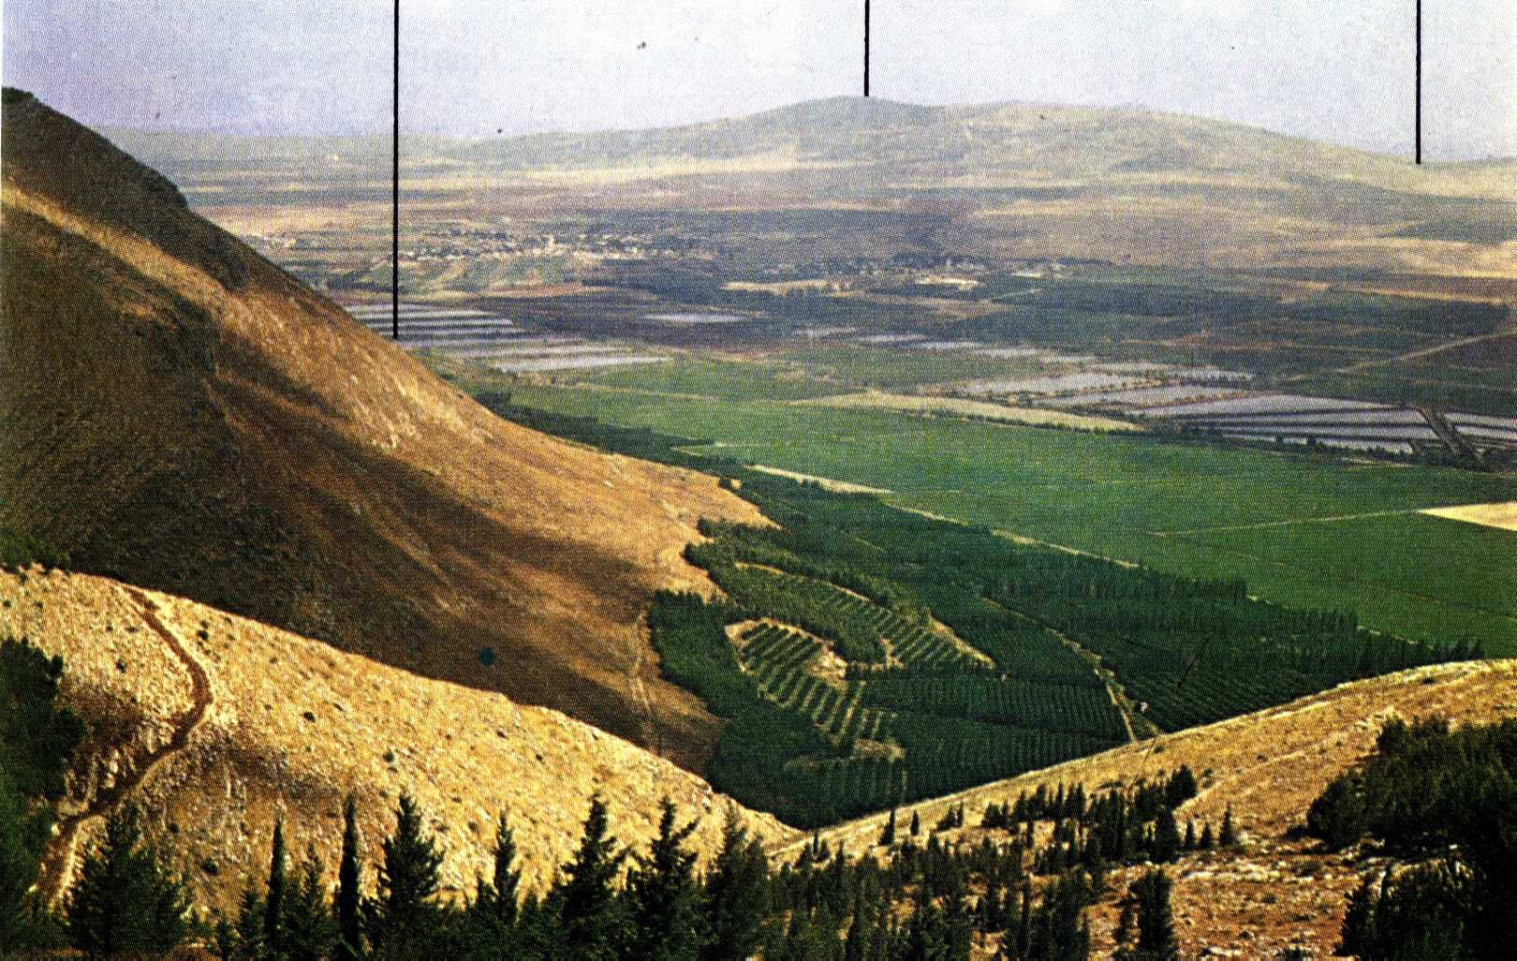
The hill of Moreh from Mt. Gilboa
The Spring of Harod
Hill of Moreh
Camp of Midianites

Slide 3
Dew as a symbol
A blessing from heaven – Gen. 27:28; Deut. 33:13; Zech. 8:12; Ps. 133:3; Prov. 19:12; Hos. 14:5; Mic. 5:7.
Represents God’s word – Deut. 32:2.
Symbol of the resurrection of the dead – Ps. 110:3; Isa. 26:19.
Isa. 26:19 - “Thy dead, shall come to life again, My dead body, they shall arise,—Awake and shout for joy, ye that dwell in the dust For, a dew of light, is thy dew.” (Rotherham)
Christ in the Judges

Slide 4
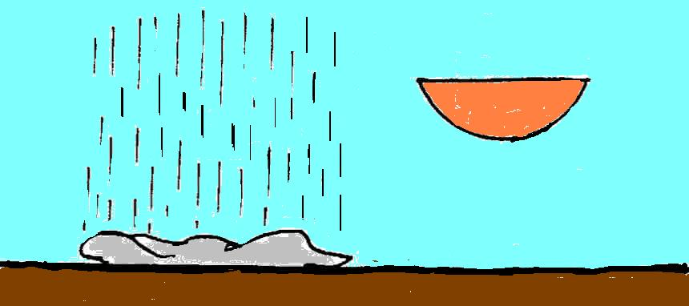
Sign of the fleece – 1st night
During the first night of Gentile darkness – AD 30 – Christ was raised from the dead and granted eternal life.
Dew
Full of water
sephel
Earthen vessel
From sacrificial death to a change of nature
Threshing floor
Christ’s afflicted brethren
Christ in the Judges

Slide 5
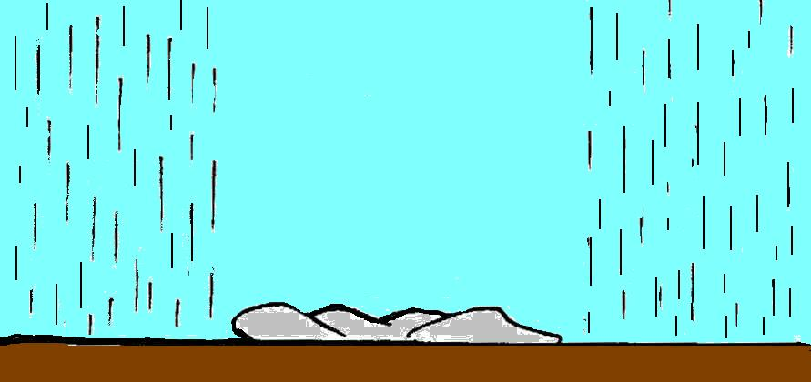
Sign of the fleece – 2nd night
During the second night of Gentile darkness – Prefigures the resurrection of the dead.
The dry fleece represents Christ as immortal mediator who will come to raise his brethren
Dew
Dew
Fleece dry
Christ’s brethren raised
Ps.110:3; Isa. 26:19
Christ in the Judges

Slide 6
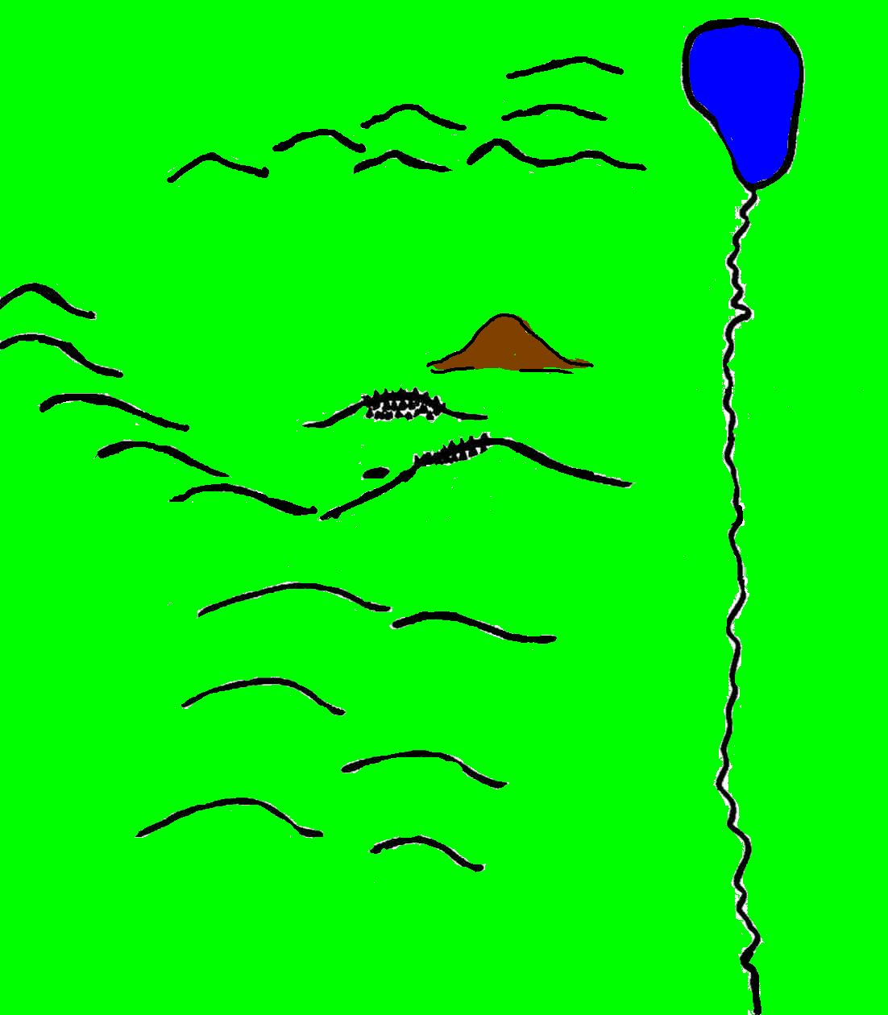
The judgement of the household
As the Midianites (Gogian confederacy – Ps. 83:9-11; Isa. 9:4 & 10:26) gather to the north, Gideon prepares his army.
Midianites

Slide 7
Three classes at the Judgement Seat
The fearful and afraid – Faithless
The careless and insensitive to danger – Self-confident
The vigilant and sensitive to danger – Faithful
22,000
9,700
300 (less than 1% of total)
Rev. 21:8 - But the fearful, and unbelieving ..shall have their part in the lake which burneth with fire and brimstone: which is the second death.
Christ in the Judges

Slide 8
The judgement of the household
135,000 Midianites
The fearful and faithless depart via Mt. Gilead!
Now only 10,000 remain – still “too many”!
22,000
Gilead
22,000 judged themselves unworthy!
The rejected do not go home! Their lot is to wander in “outer darkness” or Europe.
Christ in the Judges

Slide 9
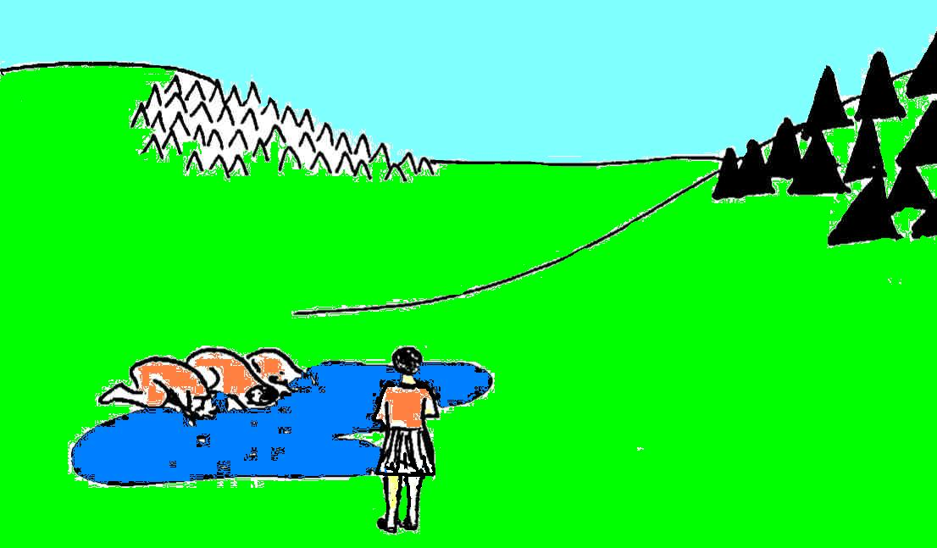
The selection of Gideon’s army
Camp of Israel
Hill of Moreh
Camp of the Midianites
Mt. Gilboa
A test instituted by God!
Gideon (the judge)
Well of Harod (trembling)
Christ in the Judges

Slide 10
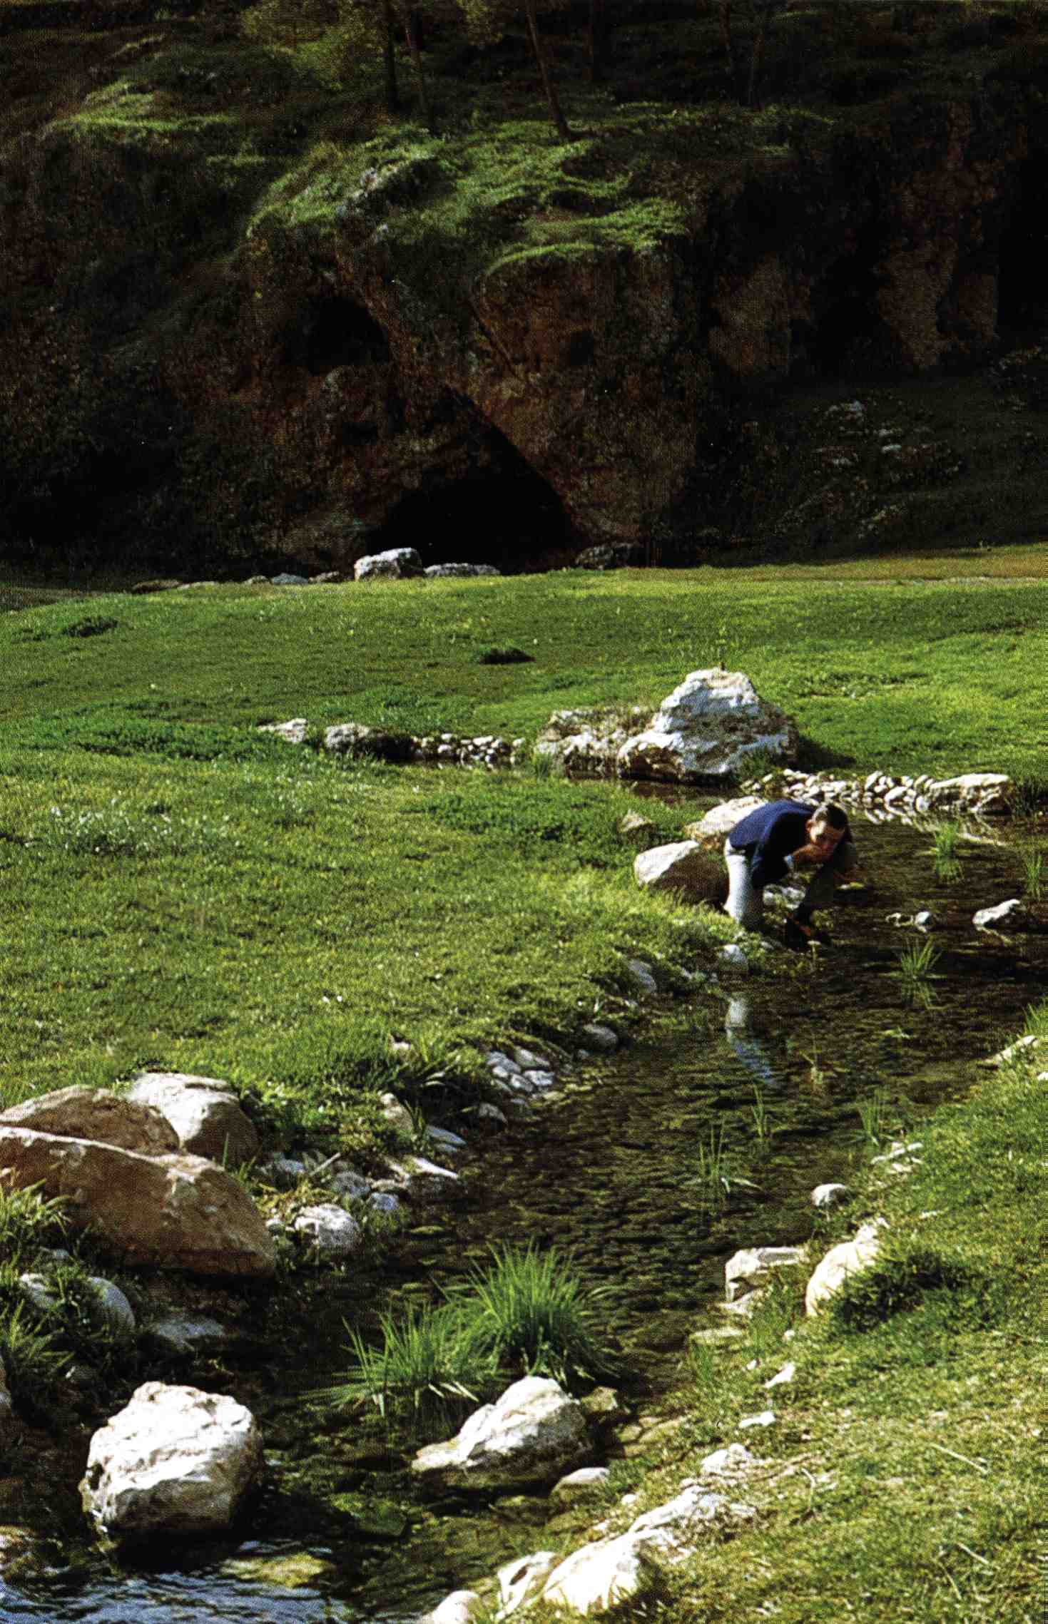
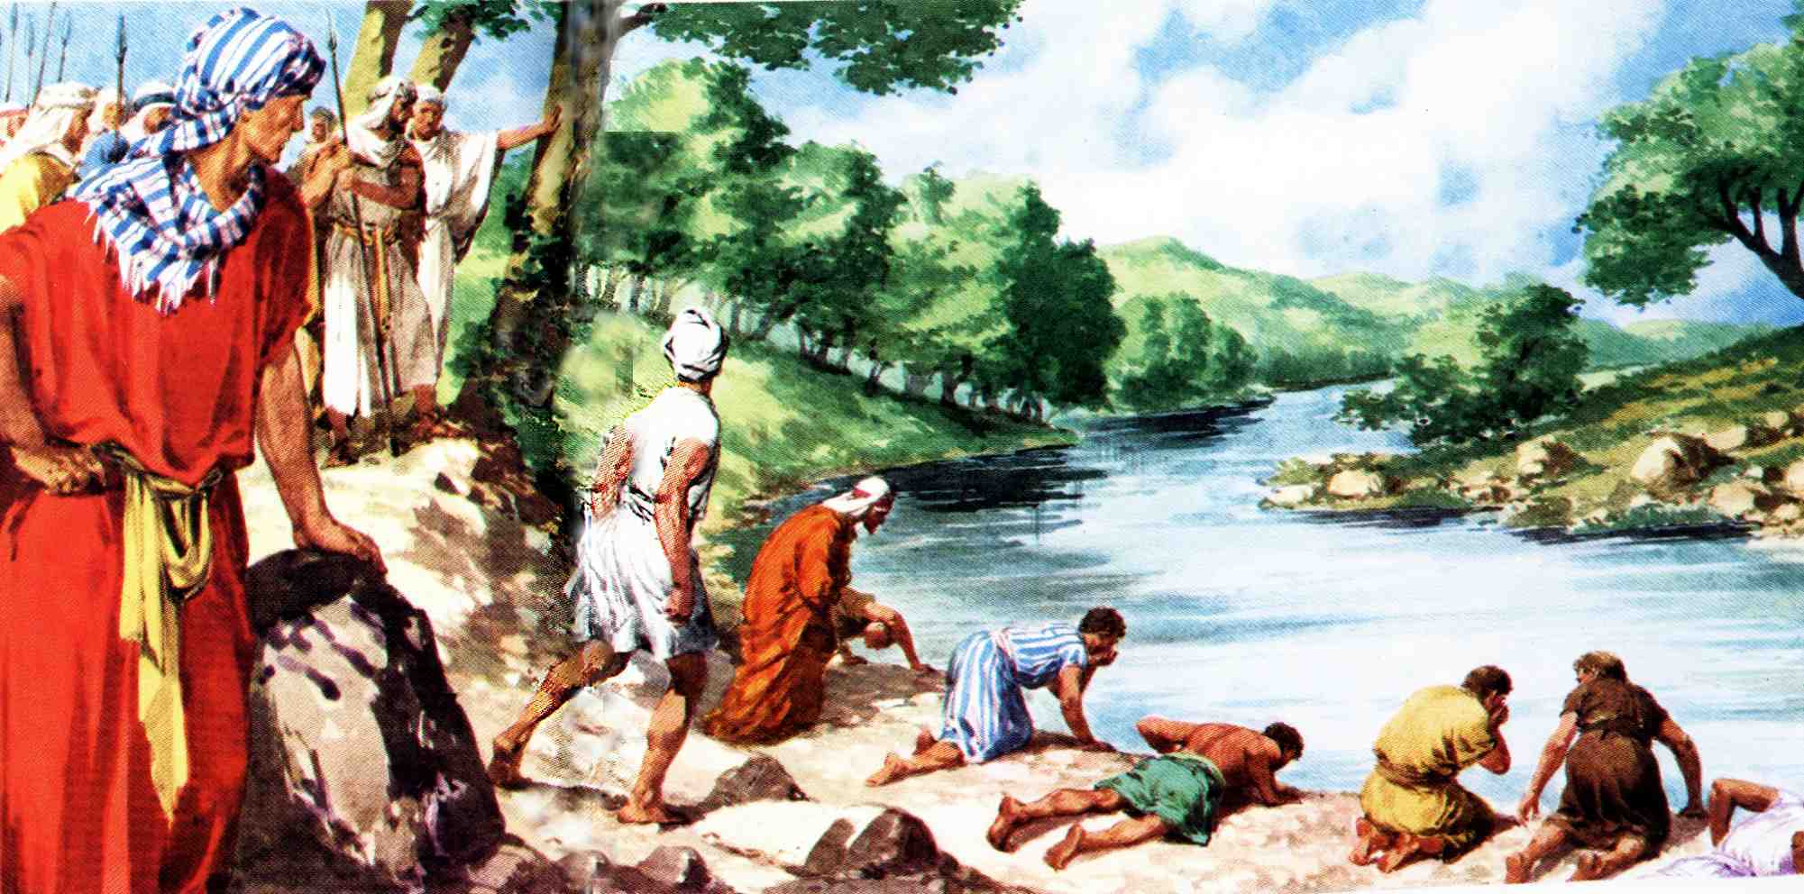
The Spring of Harod
Today!
Gideon selects his men on the basis of God’s prescription
Christ in the Judges

Slide 11
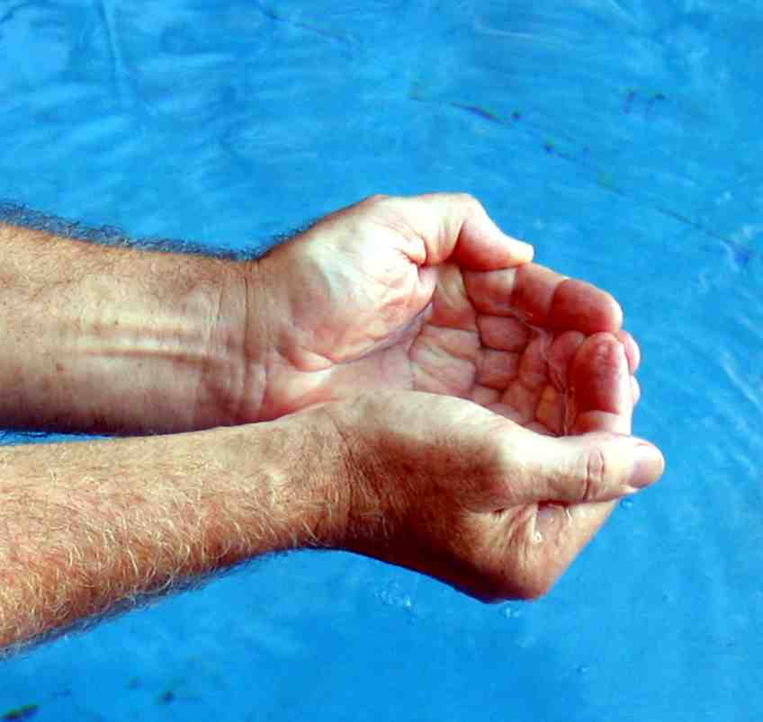
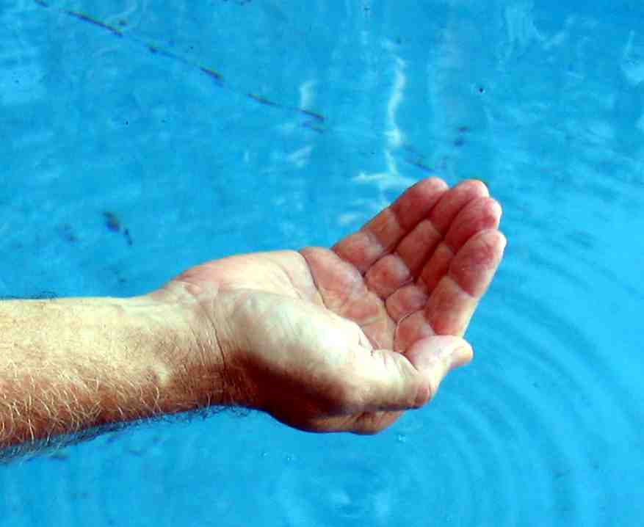
A handful of water
Judges 7:6 – Roth. – “lapped with their hand to their mouth”.
They did not use two hands – only one!
The difference in volume of water of two cupped hands compared to one hand is………..
2 hands
1 hand
Christ in the Judges

Slide 12
Lapping water with tongue
Dew and water are both symbols for the word of God – Deut. 32:2; Eph. 5:26.
Lapping is an action of the tongue to ingest water - an action not unlike talking.
Meditation is like talking to oneself.
Ps. 119:97-98 – “meditation” – siyach -reflection, contemplation; to ponder, i.e. to talk, converse with oneself.
Meditation on the Word is the key to life.
Christ in the Judges

Slide 13
The principles of judgement
Lappeth as a dog – with his tongue
1. Slow but steady intake.
2. Demands persistence and consistent application.
Hand to their mouth
1. Single hand – small reservoir. Requires continual dipping into source of water.
2. Hand (works) and mouth (profession of the heart) inseparably linked – way of life thus springs from intake of the word.
Christ in the Judges

Slide 14
The principles of judgement
Upright stance – No bending knees
1. Probably necessitates wading into the source of water.
2. Permits ease of movement at onset of danger.
3. Bespeaks alertness and sensitivity to presence of the enemy.
Eyes watchful
1. Eyes never cast earthwards.
2. Attentive and alert while lapping (like a dog).
3. Never took eyes off the enemy.
Christ in the Judges

Slide 15
The basis of rejection
Boweth down upon knees to drink
1. A Canaanite posture – Submission to body of humiliation even while drinking water of word.
2. Reckless and careless in the face of danger – Insensitive to the presence of the enemy.
3. Betrayed self-confidence and pre- occupation with self.
Christ in the Judges

Slide 16
The basis of rejection
Rapid and deep drinking
1. Acknowledged need of the word, but spasmodic and erratic intake.
2. Saw drinking water as an end in itself – it did not produce sensitivity to enemy.
Bro. Thomas – Elpis Israel page 76 – “This sinful nature we inherit. It is our misfortune not our crime that we possess it. We are only blameworthy when, being supplied with the power of subduing it, we permit it to reign over us.”
Christ in the Judges

Slide 17
We can all read and think!
Daily meditation on the scriptures requires only organisation of our time and our mind, and the inclination to do so.
The word is the source of motivation to apply divine principles in daily life – thought is the basis of action.
“For it is God which worketh in you both to will and to do of his good pleasure.” – Phil. 2:13
Christ in the Judges

Slide 18
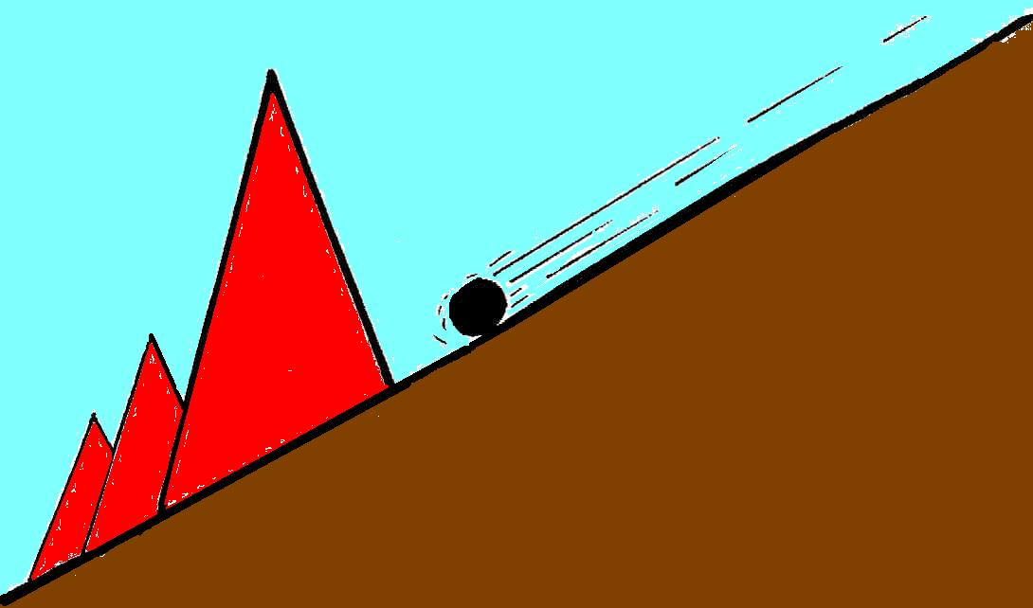
The dream of the barley cake
Midianites - The Gogian host Isa.9:4; 10:24-26
Gideon (Christ) “a round cake of barley bread”
“The Tent” Dan. 11:45
A parable of the overthrow of the Gogian host by Christ.
The sword of Yahweh and of Gideon

Slide 19
The cake of barley bread – Type of Christ
Barley ripened before wheat – Ex. 9:31.
Thus was used in the wave loaf at Passover – Lev. 23:10-12 (1 Cor. 5:7).
Barley half the value of wheat – 2 Kings 7:1; Horses food – 1 Kings 4:28.
Lowest form of human consumption – Ezek. 4:12.
Similarly Christ was despised and rejected of men – Isa. 53:3; though he was the bread God sent from heaven – John 6:56.
Christ in the Judges

Slide 20
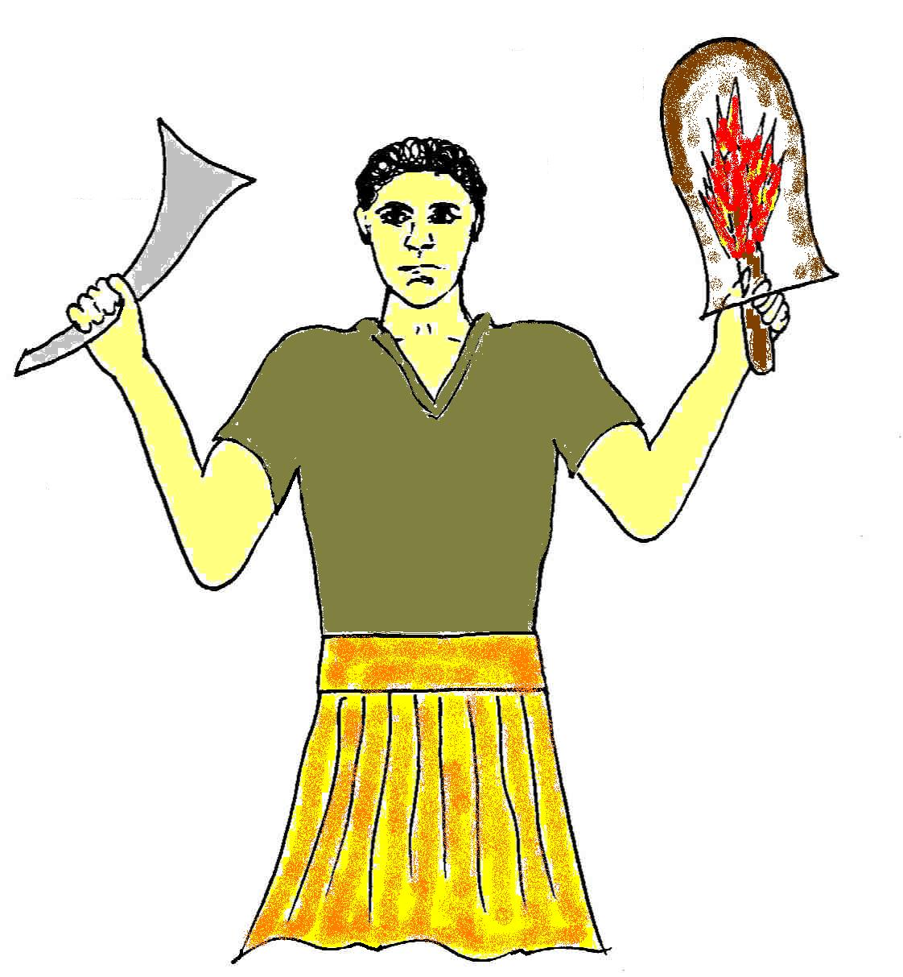
“Thou shalt smite the Midianites as one man.”
Occurs 8 times = immortality
Man of the One
Shophar trumpet
“As I do, so shall ye do”
Right hand (Divine power)
Judges 6:16
Christ in the Judges

Slide 21
Shophar
Horn, ram’s horn.
Significantly, first 3 occs. in Ex. 19 & 20, next in Lev. 25:9 (twice), then 14 times in Josh. 6.
Note the events –
1. Ex. 19 & 20 - Sinai (judgement seat);
2. Lev. 25:9 - Jubilee (every man returns to his family and inheritance);
3. Josh. 6 - Armageddon!
This is the exact order of events in Jud. 7.
Christ in the Judges

Slide 22
“Thou shalt smite the Midianites as one man.”
Occurs 8 times = immortality
Man of the One
Shekinah glory (Divine light)
Shophar trumpet
“As I do, so shall ye do”
Right hand (Divine power)
Left hand (mortal weakness).
Earthernware vessel (mortal body)
Judges 6:16
“pitcher” occurs 4 times = righteousness
Christ in the Judges

Slide 23
Gideon’s triumph - Type of Christ
A sudden and unexpected attack – cp. Christ’s sudden appearance at Armageddon – Zech. 14:3.
Mutual slaughter destroys enemy – Ezek. 38:21.
Victory by divine power – Human prowess denied – cp. Zech. 4:6.
Became judge over Israel by victory – Acts 17:31.
Faithful 300 participated in victory – The brethren of Christ share his triumph – Ps. 149:4-9; Rev. 2:26.
Christ in the Judges

Slide 24
Armageddon and beyond
Midianites = Gogian confederacy – Isa. 9:4-5; 10:24-26; Ps. 83:9-11.
Note only Oreb is mentioned in Isa. 10:26 – Why?
Oreb – The raven (Prov. 30:17) = Russia
Zeeb – The wolf (Luke 10:3) = Papacy
The 2 phases of Divine judgement
“Harvest” (Jud. 7:24) Rev. 14:14-16 Rev. 16:16 | “Vintage” (7:25; 8:2) Rev. 14:17-20 Isa. 63:1-3
Christ in the Judges

Slide 25
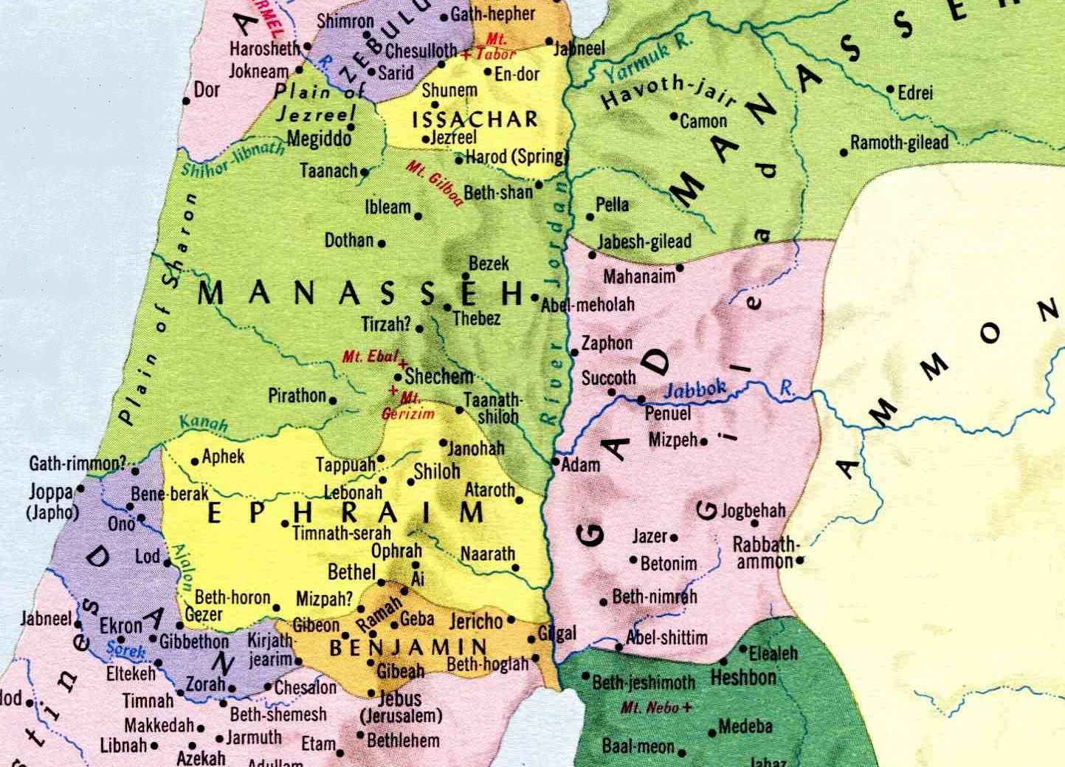
Gideon pursues the Midianites
The tribe of Ephraim defeat Oreb and Zeeb at the fords of Jordan
Rout in Jezreel
Gideon and his men faint seek help from Succoth and Penuel
Gideon returns after triumph to punish and purge the men of Succoth and Penuel
Zebah and Zalmunna escape across Jordan
Zebah and Zalmunna defeated at Nobah and Jogbehah

Slide 26
The pursuit of Zebah and Zalmunna
Zebah – “to slaughter a sacrifice”.
Zalmunna – “shade has been denied”.
Long pursuit associated with the purging and judgement of Jews living east of Jordan (outside of the Land).
Zebah and Zalmunna represent Catholic rebellion to the rule of Christ over a period of 40 years – Ps. 2; 83.
Christ in the Judges

Slide 28
Succoth and Penuel
Both places named by Jacob returning from exile outside the Promised Land – Gen. 32:30; 33:17.
Penuel memorialised Jacob’s wrestling with the angel and became the basis of prophecies of the return of Israel – Mic. 4:6-7; Zeph. 3:19.
Succoth was named because Jacob erected booths for his family – a flimsy, temporary structure, a booth spoke of reliance on God – Ps. 27:5; 31:20; and redemption - Lev. 23:42-43.
Christ in the Judges

Slide 29
The Second Exodus of Israel
Ephraim’s gleanings in war – Vv.1-3 (Zech. 9).
Gideon seeks cooperation of Jews outside the Land – Vv.4-5 (Isa. 11:11-12).
Rebels purged in the wilderness – Vv.6-7; 13-16 (Ezek. 20:33-38).
Jewish confidence in power and wealth broken – Vv.8-9,17 (Hos. 2:14-19).
Israel acknowledge a king – V.22 (Ezek. 37:22-24).
Christ in the Judges

Slide 30
The Second Exodus of Israel
40 years under Elijah’s leadership
“the land of the north” (Jer. 3:18)
Elijah’s mission
30 years conflict
Wilderness of the Peoples
(Rev. 17:3)
Baptism
(Isa.
11:11-16)
Rebels purged out
Bonds of the Covenant
Roth. – “and will contend (shaphat – to judge) with you there face to face” – Ezek. 20:35

Slide 31
One King over them all Judges 8:22
In the wake of Gideon’s victory and the purging of Succoth and Penuel, Israel chose Gideon to rule over them - So Israel will acknowledge one king when divine judgements are complete – Ezek. 37:22.
Israel sought to establish a perpetual dynasty – So Christ’s rule will last a thousand years – Rev. 20:4,6.
Gideon declined and declared Yahweh to be Israel’s king – So Christ will give the kingdom back to God – 1 Cor. 15:24.
Christ in the Judges

Slide 32
Messiah in the Judges
The periods covered by the types in the book
Death of Christ
Dark ages
Armageddon
Millennium
Othniel
Ehud
Deborah & Barak
Gideon
Abimelech
Jephthah
The End
Christ in the Judges

Slide 33
Abimelech the imposter
There were 12 divinely appointed judges.
Abimelech was self-appointed (making a total of 13 = rebellion – Gen. 14:4).
Abimelech is the 6th judge in chronological order – 6 is the number of man – Rev. 13:18.
Rev. 13:18 - Here is wisdom. Let him that hath understanding count the number of the beast: for it is the number of a man; and his number is Six hundred threescore and six.
Christ in the Judges

Slide 34
Abimelech the son of Gideon as a type of the rise, history and destruction of the Papacy
Judges 8:27-9:21 – The rise of the Papacy
Judges 9:22-49 – The history of Papal ascendancy
Judges 9:50-57 – The destruction of the Papacy
Christ in the Judges

Slide 35
Abimelech and the rise of the Papacy
Gideon’s house ensnared by an external form of worship – The Roman Church grew out of a judaistic apostasy in Christ’s house.
Abimelech was born out of wedlock to a woman estranged from Gideon’s house – The ‘man of sin’ was born out of fornication by the apostate ecclesia (2 Thess. 2:3-4).
Abimelech means “Father-king” – The title “Papacy” signifies Papal government. Papa or Pope means “father”. The Pope is a “ruling father” in the view of unenlightened men.
Christ in the Judges

Slide 36
Persecution of the Ecclesia
9:2-3 – Abimelech’s house made an alliance with the “men of Shechem (i.e. government – 1 Kings 12:1; Isa. 9:4,6) to overthrow Gideon’s house – The apostate church made an alliance with the State to assume control of the religious world and destroy the true ecclesia.
9:5 – Abimelech slew his brethren – The apostate church persecuted to the death the true ecclesia.
9:5,21 – Jotham escaped and fled to Beer (“a pit”) – The remnant of the true ecclesia found refuge in “the wilderness” (Rev. 12:6).
Christ in the Judges

Slide 37
Two witnesses
Shechem = government (political witness).
Gaal (“loathing”; rt. to detest) son of Ebed (“a servant”, or as some have it, Eber – “to cross over”; i.e. into opposition) forged a loose alliance with the men of Shechem against Abimelech – Religious witness (God’s “servant” – Rev. 11:3) who loathed Rome’s dogmas and rule crossed over and joined with political witness to fight against Papal dominion.
Christ in the Judges

Slide 38
The death of the Witnesses
Strife between the men of Shechem and Abimelech began 3 years after he established his political power.
3 years (in Jewish terms) is 3 x 360 days = 1080 days (or years on a day for a year principle).
Between the decree of Phocas proclaiming the Pope’s political authority and the Revocation of the Edit of Nantes was 1077 years (608-1685).
After a violent struggle Abimelech finally slew all the men of Shechem – So in 1685 the witnesses were slain.
Christ in the Judges

Slide 39
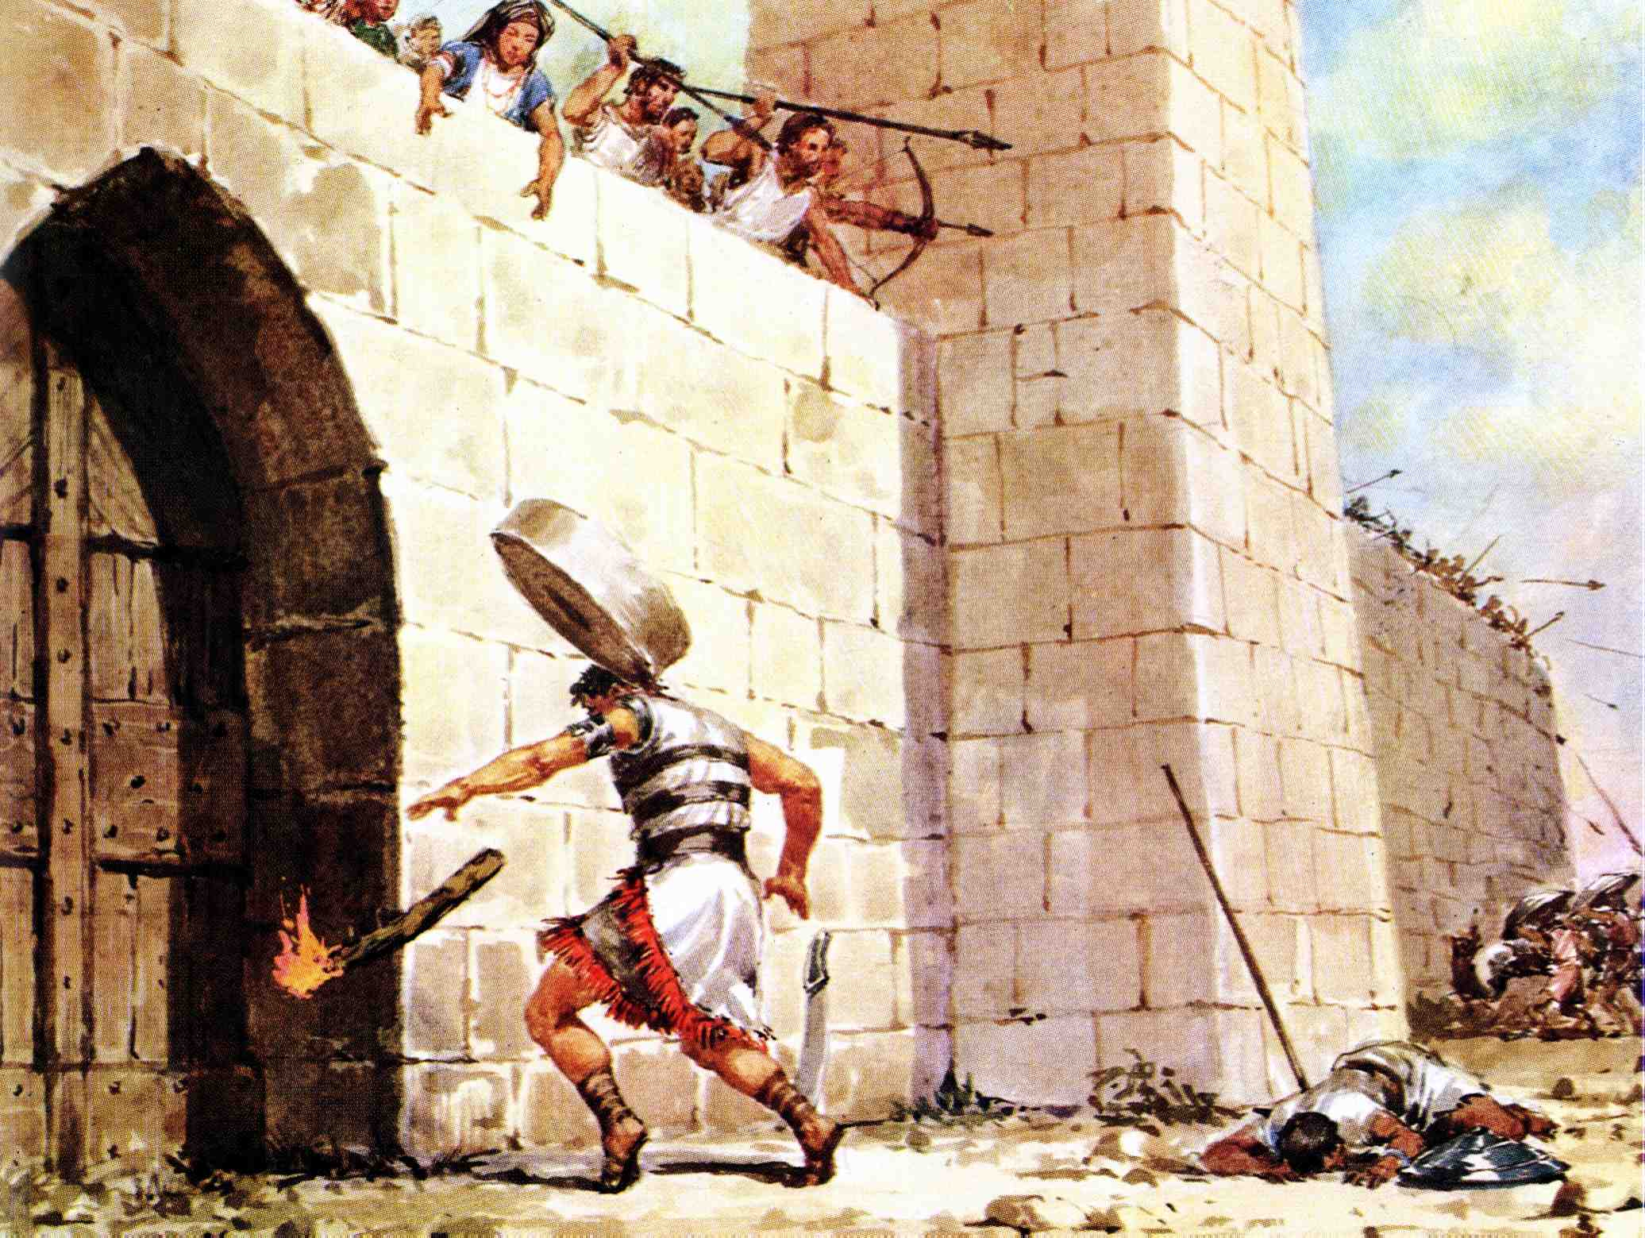
The death of Abimelech

Slide 40
The end of the Papacy
Rev 18:21
And a mighty angel took up a stone like a great millstone, and cast it into the sea, saying, Thus with violence shall that great city Babylon be thrown down, and shall be found no more at all.
The Papal system is to be destroyed by Christ and his bride – the true ecclesia.

Slide 41
Christ in the Judges
Next Study – God willing
Study 6 – “Jephthah – The return of Israel’s rejected deliverer”
Christ in the Judges

