Slide 1
Christ in the Judges
Study 6 – “Jephthah - The return of Israel’s rejected Deliverer”
Christ in the Judges

Slide 2
5th major apostasy of Israel
Judges 10:6-9
5 is number of grace – Not evident here.
Roth. - “and served the Baals and the Ashtoreths” – male and female deities.
Borrowed gods of surrounding nations.
Typical of Jews from AD 70 onwards.
Problems from Philistines and Ammon – cp. Palestinians and Russian Gog.
Ammon – “tribal” (a people as a congregated unit).
18 years = 2 x 9 – double judgement – Isa. 40:2.
Christ in the Judges

Slide 3
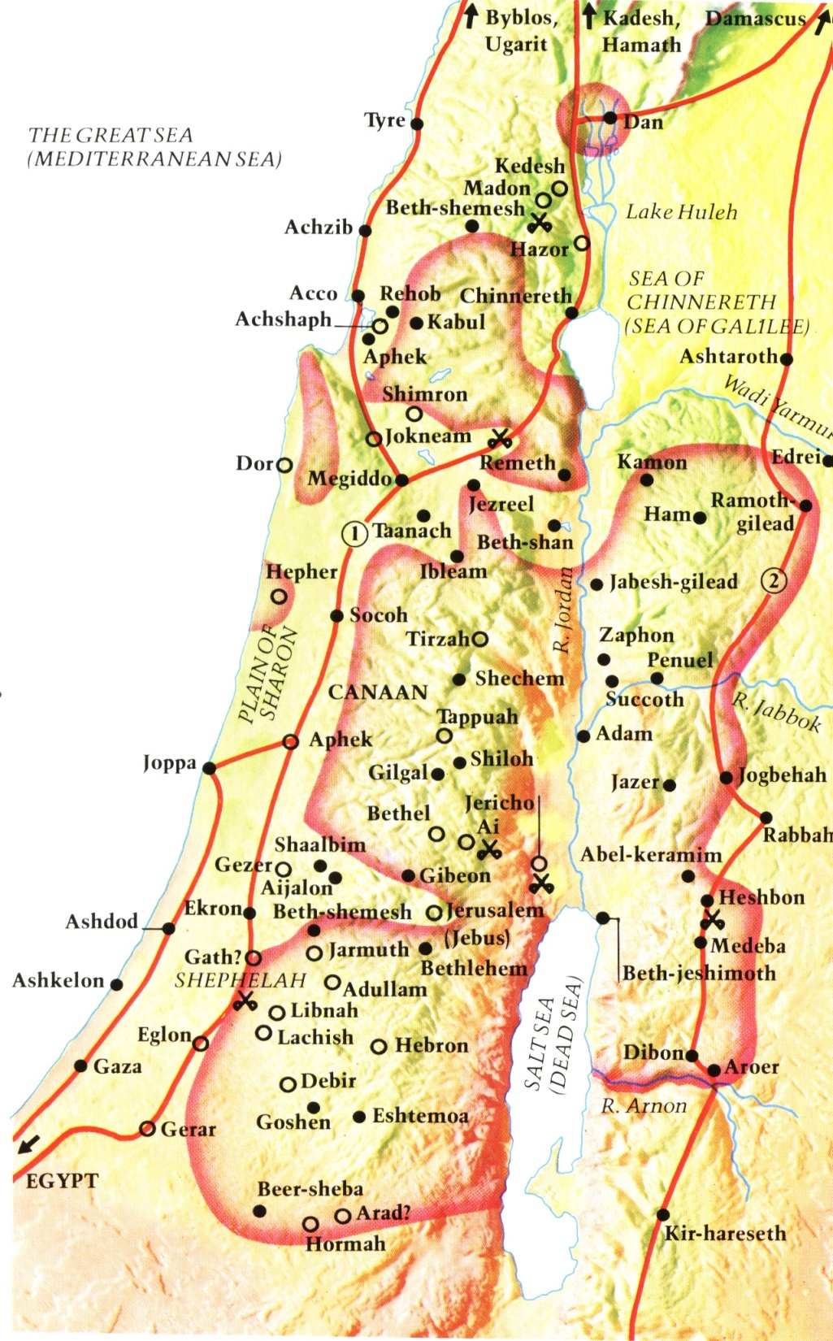
Israel chooses gods from surrounding nations
Syria
Zidon
Moab
Ammon
Philistines
Jewish settlement in time of the Judges
Christ in the Judges

Slide 4
Yahweh hides His face from Israel - Judges 10:10-14
Confession and plea for help repudiated.
Unusual!
Principle – Isa. 59:1-2.
Type – Isa. 59:16-20.
Warning – 2 Pet. 2:20-22.
Christ in the Judges

Slide 5
Indirect response to genuine repentance - Judges 10:15-18
Genuine repentance not easy – rarely universal.
Yahweh always responds to it!
Silence! – Israel turns to human redeemer.
Yahweh had prepared just the man (ish).
Jephthah a type of Christ as redeemer of latter day Israel.
Christ in the Judges

Slide 6
Jephthah the Gileadite
His name means “He will open”. Ges. - “Whom, or what God sets free” – Epitomises his work as Israel’s deliverer and as a type of Christ.
“mighty man of valour” – gibbor chayil – powerful warrior of strength. Cp. Isa. 9:6.
Right of firstborn rejected – Deut. 21:15-17; 23:2.
Fled to land of Tob - “good”.
“vain” – req – empty. Not necessarily evil.
Christ in the Judges

Slide 7
The standing of Jephthah
Many opinions – some negative.
Accused of ambition, rashness, worldliness (e.g. offering human sacrifice).
Yahweh sent him – 1 Sam. 12:10-11.
Man of faith – Heb. 11:32.
Scripture silent about failings.
Christ in the Judges

Slide 8
Christ in the Judges
The periods covered by the types in the book
Death of Christ
Dark ages
Armageddon
Millennium
Othniel
Ehud
Deborah & Barak
Gideon
Abimelech
Jephthah
The End
Christ in the Judges

Slide 9
Jephthah – Type of Christ
A type of Christ’s first advent and his rejection by Israel
Conceived out of marriage – 11:1.
Gilead’s wife bare him sons – 11:2.
Christ born of a virgin – Matt. 1:18-23.
Yahweh’s wife, Israel (Jer. 3:14,20), bare Him sons, namely the priests, scribes, Pharisees and the Jews.
Christ in the Judges

Slide 10
Jephthah – Type of Christ
Through envy and jealousy Jephthah’s brethren cast him out – 11:2.
Jephthah fled to Tob (“goodness and fruitfulness”) and gathered to himself the despised of this world – 11:3.
For envy Christ’s ‘brethren’ rejected and crucified him – Mk. 15:10.
Christ ascended to heaven and the ‘foolish’, ‘weak’ and ‘despised’ of the world gathered unto him – 1 Cor.1:26-29.
Christ in the Judges

Slide 11
Jephthah – Type of Christ
A type of Christ’s acceptance by Israel at his second advent
In distress from un-provoked invasion by Ammon (“tribal”, i.e. a people as a congregated unit), Israel call upon Jephthah to deliver them – 11:4.
Israel under attack by Gogian host will cry to Yahweh for help – Hos. 5:15.
Christ in the Judges

Slide 12
Jephthah – Type of Christ
Jephthah agrees to be Israel’s head and captain only if Yahweh gives him victory over Ammon – 11:5-11.
Jephthah defeats Ammon after fruitless negotiations – 11:12-33.
Christ will claim the throne of David and rulership over the world by divine authority and power – Ps.2:6-9.
Christ will defeat Gog and all nations who refuse to submit to his ultimatum – Ps. 2:10-12; Rev.14:6-7; 11:15.
Christ in the Judges

Slide 13
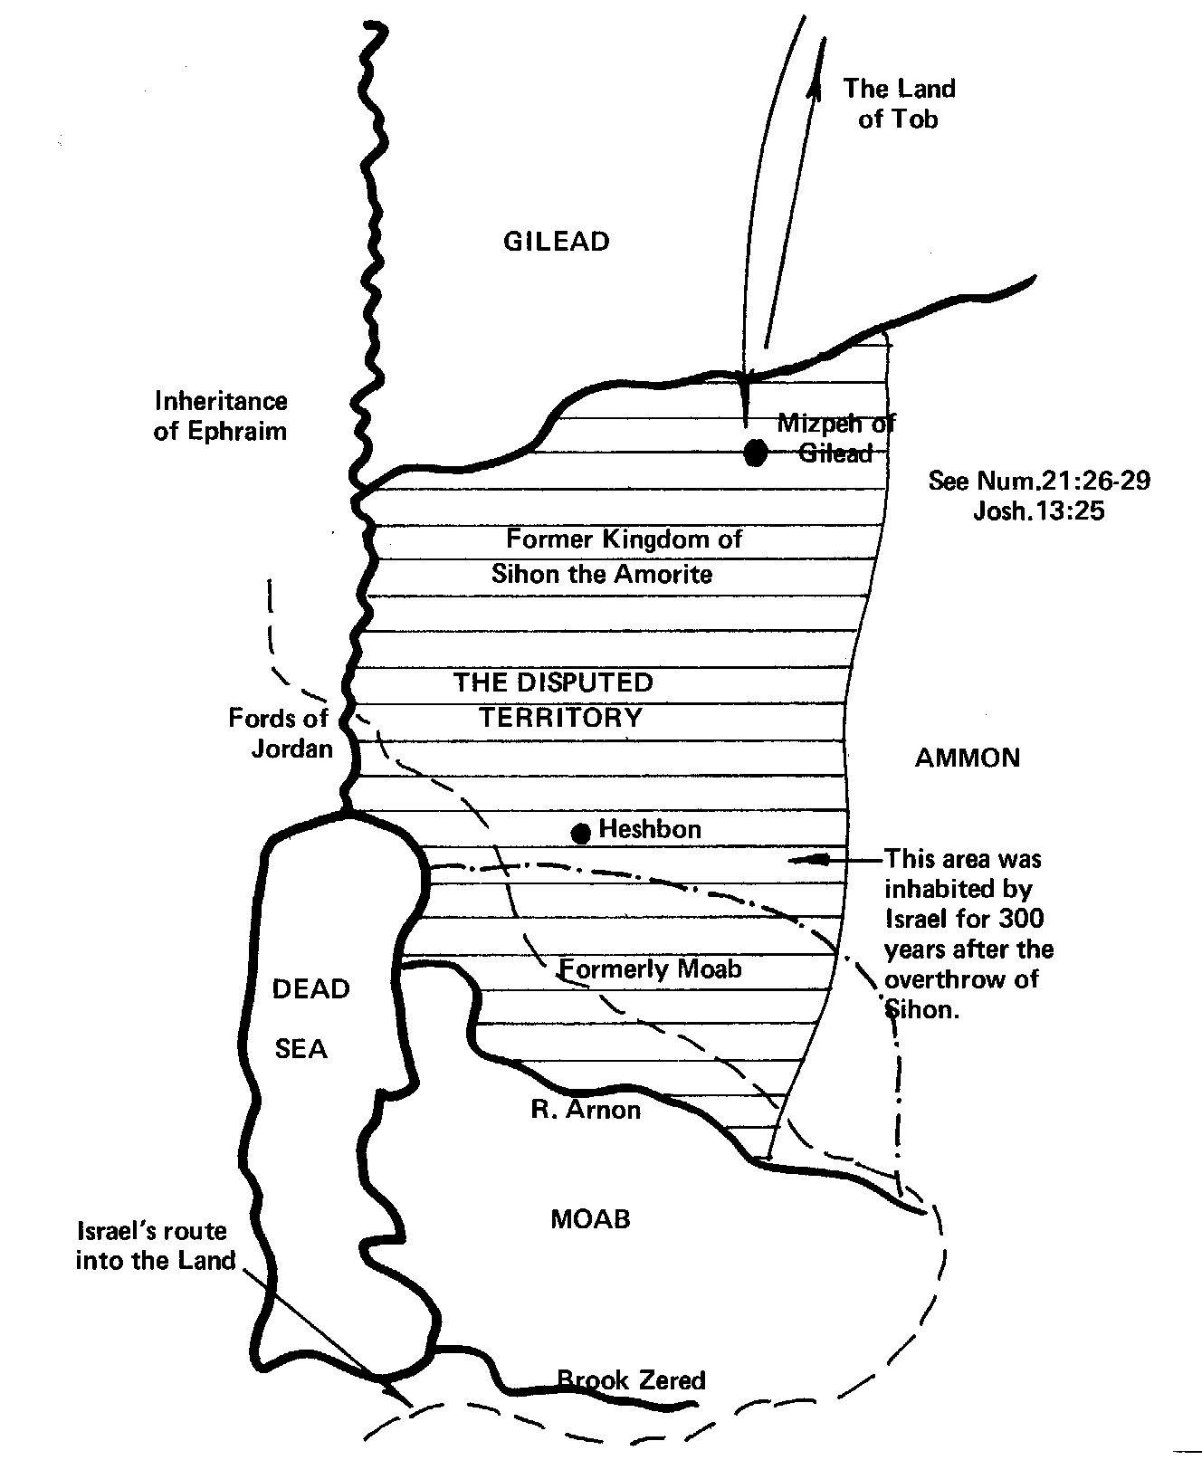
The disputed territory
V.13 – King of Ammon claims land from Arnon to Jabbok after 300 years.
V.15-27 – Jephthah recounts the historical facts and gives four unanswerable reasons.
Christ in the Judges

Slide 14
Jephthah’s incontrovertible case
Judges 11:12-28
V.17 – Quoted from Num. 20:1.
V.19-22 – almost verbatim from Num. 21:21-25.
The four reasons advanced by Jephthah:
Possession – the rights of conquest
Power – the strength of national deities
Acquiescence – by better placed claimants
Time – the lapse of all claims
Christ in the Judges

Slide 15
The facts about Jephthah’s vow
Jephthah intended a human sacrifice but left the choice to God.
His vow fell under the law of devoted things.
Until 12th Century AD there was no debate about the fate of Jephthah’s daughter.
Josephus records that Jephthah sacrificed his daughter.
Rabbi Kimchi invented the theory that she was dedicated to the Tabernacle service.
The A.V. margin for V.40 is incorrect.
Christ in the Judges

Slide 16
Jephthah’s Vow
V.29 – “came” – hayah – to exist, become.
“passed over” – Movement of the Spirit.
Knew the irreversible law of vows – Num. 30.
“without fail” – Crucial basis of vow.
“whosoever” – Human but not specified.
The choice left to God – many options!
“shall surely be Yahweh’s” – Invokes the law of devoted things – Lev. 27:28-29.
Roth. – “and I will offer him up as an ascending sacrifice”.
Like Abraham!
Christ in the Judges
Notes:
braham

Slide 17
The law of devoted things
Lev. 27:28-29
Answer to the ‘problem’ of ‘human sacrifice’.
Jephthah’s vow fell under its provisions.
Only applied to “all that belongeth to him”.
“devoted” is cherem – something cut off, or separated – i.e. given to Yahweh with no right of redemption.
V.29 - Roth. – “As touching any one devoted who may be devoted from among men he shall not be ransomed - he must be surely put to death.”
Christ in the Judges

Slide 18
Jephthah’s Daughter
V.34 – “only child” – yachiyd – only one, solitary. Occs. 12 times O.T. – first 3 occs. Gen. 22:2,12,16. Next here. See Ps. 22:20; Zech. 12:10 (final).
Promises to Abraham made unconditional in Gen. 22 – Yahweh will fulfill them “without fail” and Abraham’s seed will “possess the gate of his enemies” – Gen. 22:17; cp. Heb. 6:13-18.
To accomplish this Yahweh had to provide His only begotten Son – the ultimate sacrifice.
This is the principle invoked by Jephthah in his vow.
Christ in the Judges

Slide 19
Type of Christ
Abraham and Isaac are mirrored by Jephthah and his daughter – Both point to Yahweh and His son.
These “only ones” cooperated fully with their father in a work of redemption “without fail”.
They died to fulfill the will of their father, but were not personally worthy of the kind of death they suffered.
Like Christ, Jephthah’s daughter was totally submissive to her father’s will because Israel’s redemption depended on it.
Christ in the Judges

Slide 20
Jephthah – Type of Christ
After defeating the invading forces Jephthah returns home and fulfills his vow by offering up his only child, a virgin daughter – 11:34-39.
After the defeat of Gog, Christ will dedicate the refined third of Judah (the virgin daughter of Zion – Lam.2:13) to Yahweh as a “whole burnt offering” – Zech.13:9; Mal.3:2-4; cp. Isa.66:20.
Christ in the Judges

Slide 21
Jephthah – Type of Christ
Jephthah’s daughter spent two months in mourning before being offered – 11:37-39.
The refined third of Judah will mourn bitterly in “houses apart” before their final acceptance by Yahweh – Zech. 12:10-14.
Christ in the Judges

Slide 22
Christ in the Judges
Next Study – God willing
Study 7 – “Jephthah purges the proud tribe of Ephraim”
Christ in the Judges

