Slide 1
Christ in the Judges
Study 7 – “Jephthah purges the proud tribe of Ephraim”
Christ in the Judges

Slide 2
The deliverance of Jacob
There are two stages to the deliverance of Jacob:
Christ will “save the tents of Judah” first immediately after Armageddon – Zech. 12:7.
Elijah will lead the Second Exodus for 40 years to recover all Jews outside the Land – Ezek. 20.
Stage 1
Judah saved
Armageddon
Stage 2
The Second Exodus of Israel
40 years
Christ in the Judges

Slide 3
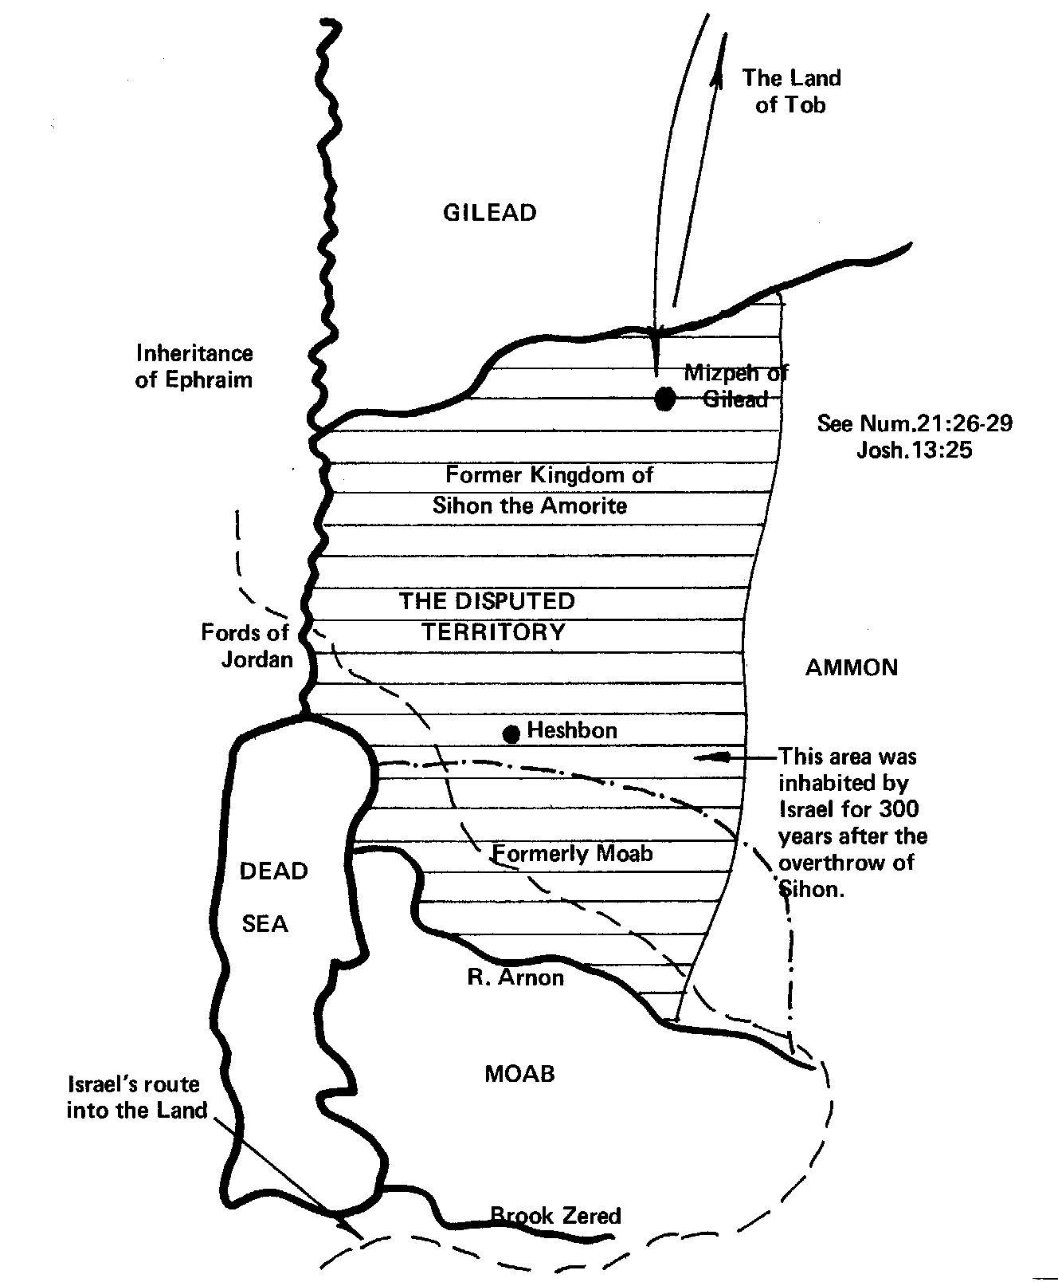
Victory over the Ammonites
V.29 – Jephthah advances against Ammon (Gog).
V.32-33 – The Ammonites defeated (Ezek. 38:18-23).
V.34 – 12:6 – Jephthah purges two ‘houses’.
Christ in the Judges

Slide 4
Israel and Judah in the Prophetic Scriptures
‘Israel’, ‘Ephraim’ and ‘the remnant of Jacob’ – Refers to scattered Jewry worldwide – Zech. 9:13; Ezek. 20:27, 30, 39; Mic. 5:7-8.
‘Judah’ – Refers to the Jews in the Land at Christ’s return – Zech. 12:7.
Where the people in the Land are the subject, not the land itself
Christ in the Judges

Slide 5
The fords of Jordan
Where Israel crossed into the Land – Josh. 3:14-17.
In the vicinity where John the Baptist baptised – John 1:28.
Represents Baptism
Christ in the Judges

Slide 6
Jephthah – Type of Christ
Jephthah killed all Ephraimites who were influenced by the ways of the Canaanites (42,000 - 6 x 7 = the end of flesh) – 12:6.
Christ will not permit the Canaanite or those influenced by them into the House of Yahweh – Zech. 14:21.
Christ in the Judges

Slide 7
“Say now Shibboleth”
Shibboleth = “a stream or flood”.
Sibboleth = “an ear of grain”.
Principle – John 12:24 – “Except a corn of wheat fall into the ground and die, it abideth alone: but if it die, it bringeth forth much fruit.”
An adopted speech pattern, not a speech impediment – Roth. “and he could not take heed to speak in that manner”. Ygs. Lit. – “and is not prepared to speak right”. Keil & Delitzsch – “not taking care to pronounce it correctly”.
“…for of the abundance of the heart his mouth speaketh” – Luke 6:45.
Christ in the Judges

Slide 8
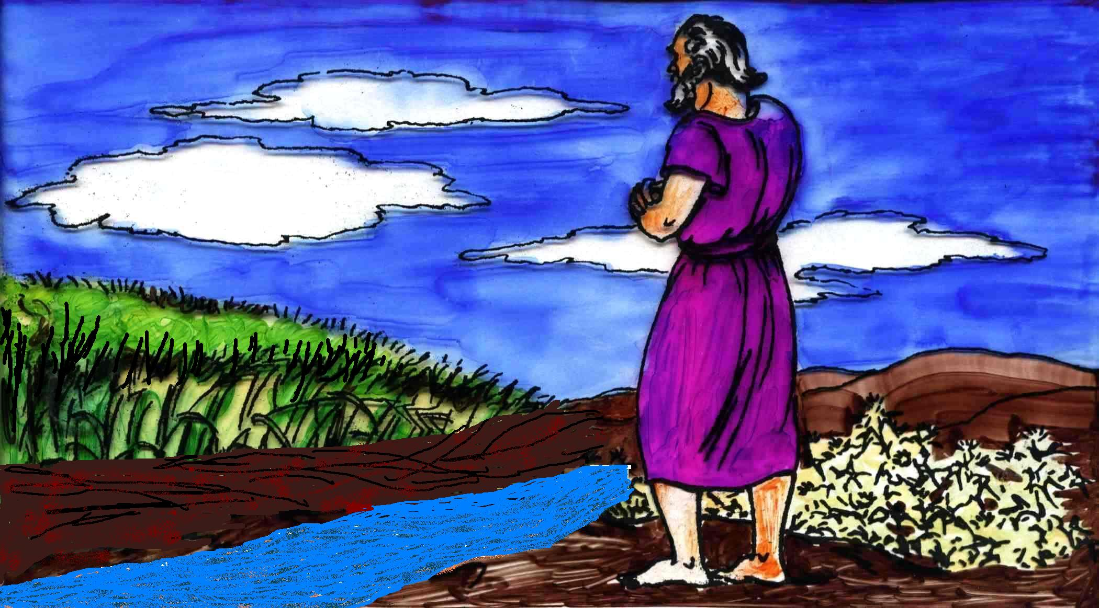
Shibboleth or Sibboleth?
Sibboleth – An ear of grain
Between probation and inheritance is the principle of baptism.
Shibboleth – A stream or flood
Christ in the Judges

Slide 9
The Tell-el-amarna Letters
“Amenhotep IV (Akhnaton), who was Pharaoh from 1387 to 1366 B.C., built a new capital, which he named Akhetaton. It was situated on the east bank of the Nile River, about 160 miles above the Delta and nearly 300 below Thebes; the modern name is Tell el-Amarna. Here were found in the year 1887 more than 350 clay tablets. They were written in Akkadian, the international language of the 15th and 14th centuries B.C., and proved to be the correspondence of the vassal princes and governors in Syria and Palestine with their overlords, Amenhotep III and IV. Nearly all of them were written in Syria and Palestine, and accordingly they are of first-hand value for the light they shed on conditions in Palestine of that period.”
Westminster Dictionary of the Bible
Christ in the Judges

Slide 10
Amoritish speech
The substitution of the "S" for the "Sh" sound of Hebrew was an Amorite peculiarity.
Shiloh - locals pronounce it Seilun.
The Tell-el-amarna Letters show that this was a characteristic of the Amorite tongue. Shiloh appears in the 'Letters' as Zilu.
Condor says – “This has always presented the difficulty that the "S" is not the proper representative of the Hebrew Shi.”
The majority of Ephraimites had adopted the speech (and ways) of the Amorites.
Christ in the Judges

Slide 11
Jephthah – Type of Christ
Jephthah relinquished his judgeship in his seventh year and Ibzan (“splendid”) succeeded him – 12:7-8.
Christ will “deliver up the kingdom to God” (the Splendid One) at the end of the seventh millennium – 1 Cor.15:24.
Christ in the Judges

Slide 12
Jephthah’s destiny
Mortal Heritage
Born in dubious circumstances.
Disinherited by own family and friends.
Banished and hated.
Paid the ultimate sacrifice.
No earthly inheritance.
Died – family line extinct.
Spiritual Heritage
Awaits resurrection – ‘Born’ incorruptible.
Will inherit life eternal.
Glory and honour.
Will reap the fruit of sacrifice.
Eternal inheritance in Kingdom.
Forever with his daughter and ‘family’.
Christ in the Judges

Slide 13
The true Messiah now appears,
The types are all withdrawn;
So fly the shadows and the stars
Before the rising dawn.
Christ in the Judges

Slide 14
Christ in the Judges

