Slide 1
The Marriage Supper of the Lamb
May Family Gathering – Okanagan West
2014

Slide 2
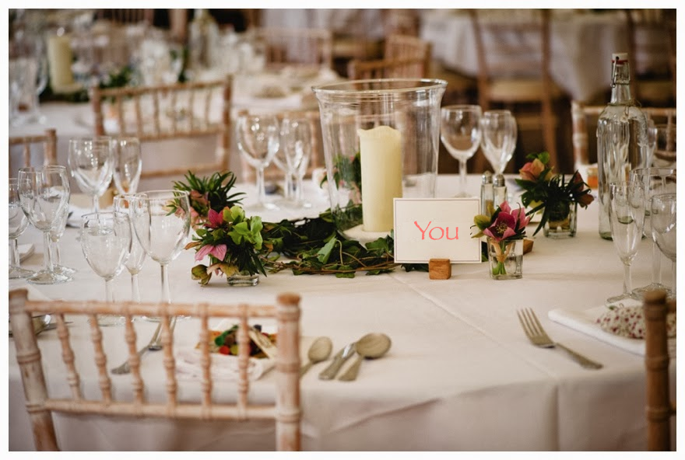

Slide 3
Breakdown of Classes
Saturday
  Class 1 – Preparation of the Bride
  Class 2 – The Wedding
Sunday
  Class 3 – Exposing the False Bride
  Exhortation – Thou Art Worthy
Monday
  Class 4 – One Nation Under Christ
  Class 5 – The Presentation of the Lamb’s Wife

Slide 4
Preparation of the Bride
Class 1

Slide 5
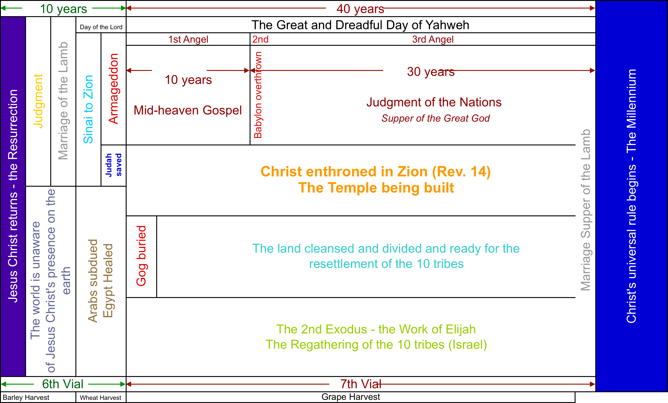
Context

Slide 6
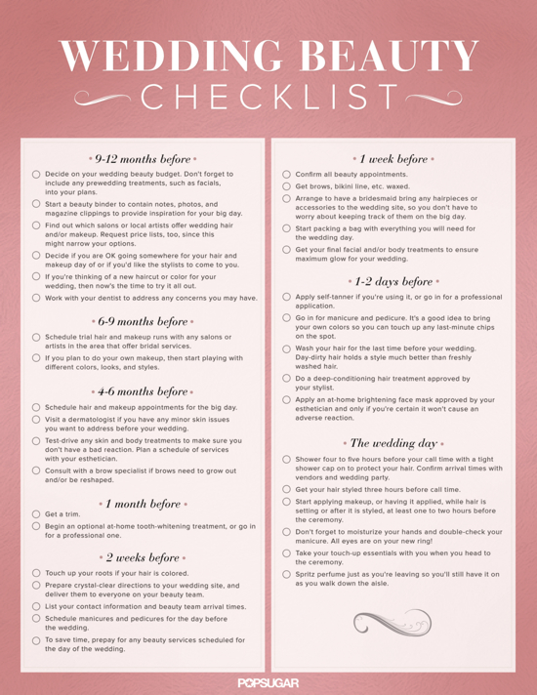
The Preparation of the Bride
Notes:
Preparation of the Bride – If only it were so easy!

Slide 7
Qualities of the Bride of Christ
Revelation
  Came out of great tribulation – 7:14
  Washed their robes and made them white in the blood of the lamb – 7:14
  Not adulterers, but virgins – 14:4
  Without guile and faultless – 14:5
Galatians
  Their fruit is love, joy, peace, longsuffering, gentleness, goodness, faith, meekness, temperance – 5:22-23
  Crucified the flesh with the affections and lusts – 5:24
Notes:
Great tribulation – our persecution is the ease and immorality of this world
Washed – 1v5 – washed us from our sins in his blood – when? When we associate ourselves with that blood at our baptism. Matt. 26v28 “my blood of the new testament, which is shed for many for the remission of sins.” Eph. 1v7 “We have redemption through his blood, the forgiveness of sins, according to the riches of his grace” I John 1v3-7 – when we share the apostle’s doctrine and walk in that light then “we have fellowship one with another, and the blood of Jesus Christ his Son, cleanseth us from all sin.”
Not adulterous – the adultery of Revelation is the intermingling of doctrine. Confirmed in II Cor. 11:2-4
Without guile (deceit) – a quality of Christ in I Pet. 2:22 and should be a quality of ours in I Pet. 3:10 “For he that will love life, and see good days, let him refrain his tongue from evil, and his lips that they speak no guile:”
Faultless? How are we presented faultless?
Eph. 1v4 – “he hath chosen us in him before the foundation of the world, that we should be holy and without blame before him in love:”
Eph. 5v27 – will come to shortly – present to himself holy and without blemish
Col. 1v22 – look up – in some areas of our community we are losing sight of the importance of doctrine in our relationship with Christ
Jude 24-25 – “Now unto him that is able to keep you from falling, and to present you faultless before the presence of his glory with exceeding joy, 25 to the only wise God our Saviour, be glory and majesty, dominion and power, both now and ever. Amen.”
John speaks of us being sinless in his epistles – so complete is the atoning work of our Lord that we can be presented without fault at the appearing of our Lord Jesus Christ.
Galatians – they that are Christ’s

Slide 8
Cameo in Ruth
Ruth 2:10-13
The Account | The Type
Fell on her face and bowed herself to the ground | Before Christ
It hath been fully shewed me Done to your mother-in-law Left Moab Joined Israel
Judgment
Practiced true religion!
James 1:27

Slide 9
Cameo of Esther
Esther 2:8-18
Given things for purification
  From a word meaning to scrape or clean
  Same Hebrew word used in Pro. 20:30 (cleanseth)
  6 months of oil of myrrh, 6 months of sweet odours, and “other things” for purifying
Chose no adornment other than what was appointed
In her choosing, she was shown grace and mercy
Notes:
Purification – v12
Myrrh – Exo. 30:23 – used in the holy anointing oil.

Slide 10
Cameo in Daniel
Daniel 10:8-12
The Account | The Type
In a deep sleep face down on the ground | Death
Hand touched him and set him on his knees “Stand upright” | Resurrection
A man greatly beloved Set thine heart to understand Chasten thyself before thy God Thy words were heard | Judgment A man of study Walked in the light A man of prayer

Slide 11
Developing Those Qualities
We don’t have to do it alone!
  Ephesians 5:25-27
  Matthew 11:28-30
Not a new concept
  Exodus 23:20-33 – the first exodus
  Hosea 2 – the second exodus
Whatsoever things are…
Notes:
Finally brethren whatsoever things are true, honest, just, pure, lovely, good report; if there be any virtue, and if there be any praise, think on these things.
Come together weekly to encourage each other in this development.

