Slide 1
The Marriage Supper of the Lamb
May Family Gathering – Okanagan West
2014

Slide 2
Breakdown of Classes
Saturday
  Class 1 – Preparation of the Bride
  Class 2 – The Wedding!
Sunday
  Class 3 – Exposing the False Bride
  Exhortation – Thou art worthy
Monday
  Class 4 – One Nation Under Christ
  Class 5 – The Presentation of the Lamb’s Wife

Slide 3
The Wedding!
Class 2

Slide 4
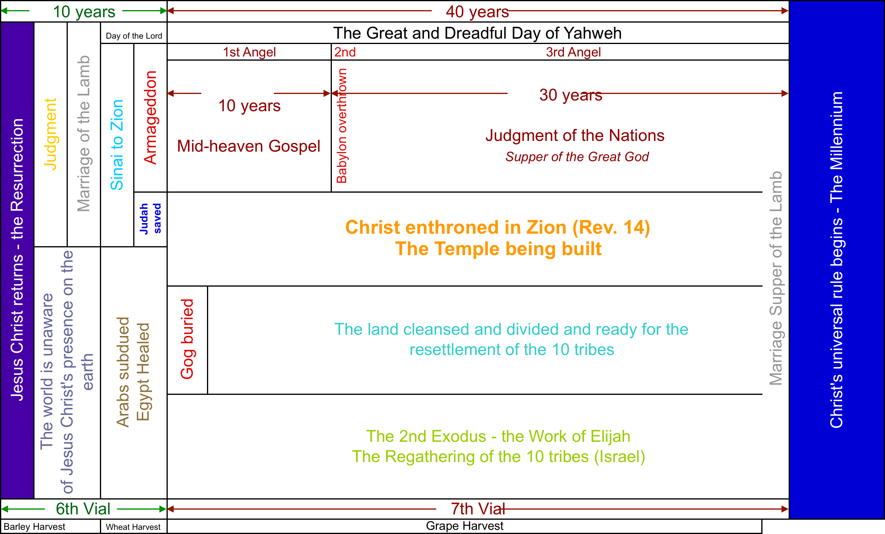
Context
Notes:
Revelation 19:7-8 – the marriage of the Lamb to his Bride – clothing with immortality – although the marriage supper of the lamb is in the next verse and the harlot has been destroyed in the previous chapter we know that the marriage must take place where we have it on this slide!

Slide 5
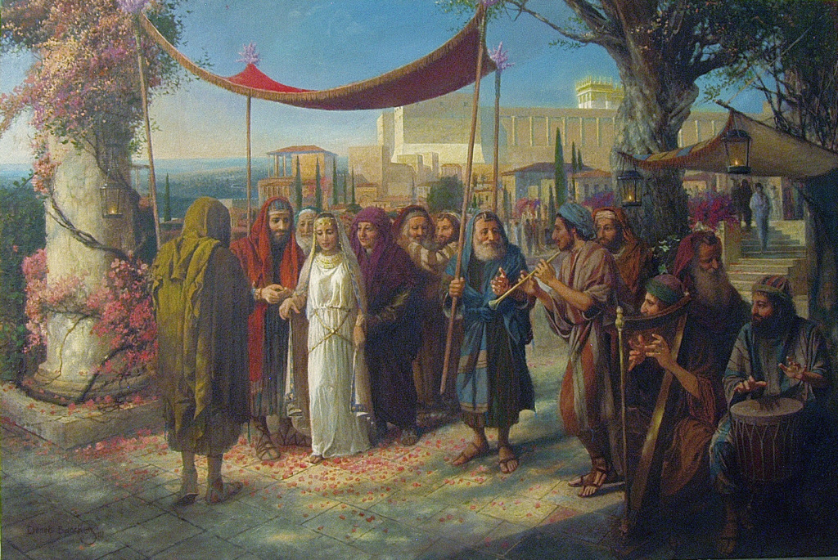
Parables of a Wedding
Matthew 22:1-14
  2 invitations
  A guest improperly dressed
    Revelation 16:15
  Rejection = destruction
Sitting down at a Wedding
  “I will come in to sup with him and he with me”
  Luke 12:37
Move these verses to later in the presentation – with the sitting down with Abraham … after Ruth
Notes:
1st invitation rejected – judged themselves unworthy – Acts 13:44-46 – Paul and Barnabas turn to the Gentiles
2nd invitation accepted – but a man enters without a wedding garment. Come from the highways and the biways – but customary to offer a garment to those who had travelled – Gen. 45:22 – look up Revelation 16:15
This parable puts the wedding of Christ and his bride in close proximity to the judgment seat (which we will review on the next slide)
Matthew 25:1-13 – v10 – the wise went in with him to the marriage – what had the wise done (to audience)?
Rev. 3:20 As many as I love I rebuke and chasten – “Behold, I stand at the door, and knock: if any man hear my voice, and open the door, I will come in to him, and will sup with him, and he with me.”
Luke 12:37 “Blessed are those servants, whom the lord when he cometh shall find watching: verily I say unto you, that he shall gird himself, and make them to sit down to meat, and will come forth and serve them.”

Slide 6
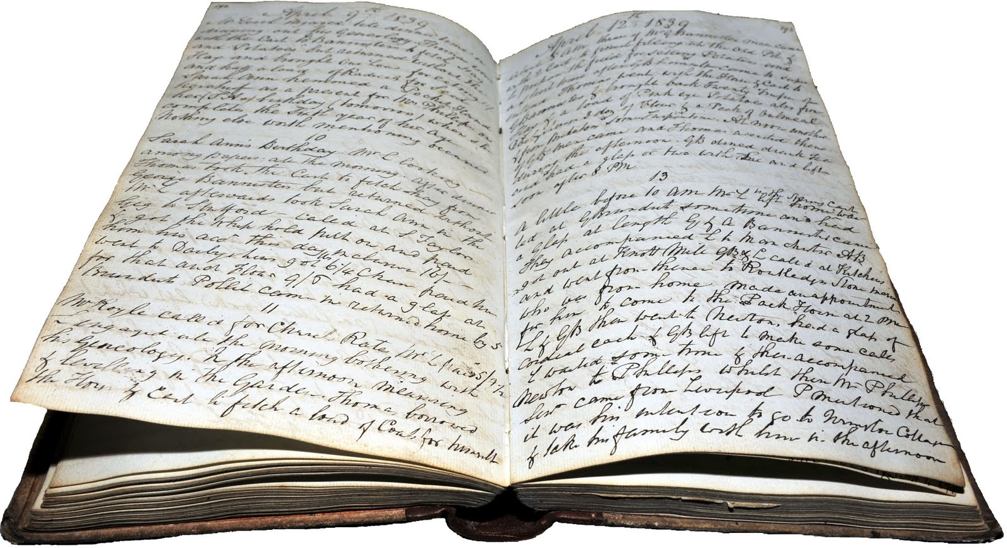
God’s Books
A book of life (of those who accepted the invitation)
  Exodus 32:33 – our sins can have us removed
  Psalm 69:28 – let them be blotted out
  Daniel 12:1 – deliverance for those recorded in the book
  Philippians 4:3 – Paul’s fellowlabourers in the book of life
  Revelation 3:5, 13:8; 17:8; 20:15; 21:27; 22:19
A book of records
  Esther 6:1 – Mordecai’s good deed
  Psalm 56:8 – Psalmist’s tears
  Matthew 12:35-37 – Every careless or indifferent word
  Revelation 20:12 – according to their works
Notes:
Daniel 7:9-10 – Judgment with books open (before progressing)
Open Bibles to Exodus 32:32-33 – center margin references – key reference passage
Psalm 69 – Messianic – v21 “in my thirst they gave me vinegar to drink”. Those that judged Christ unworthy of life were blotted out.
When is our name written in the book? When we accept the invitation – that is when we are baptized. Look up Rev. 3:5

Slide 7
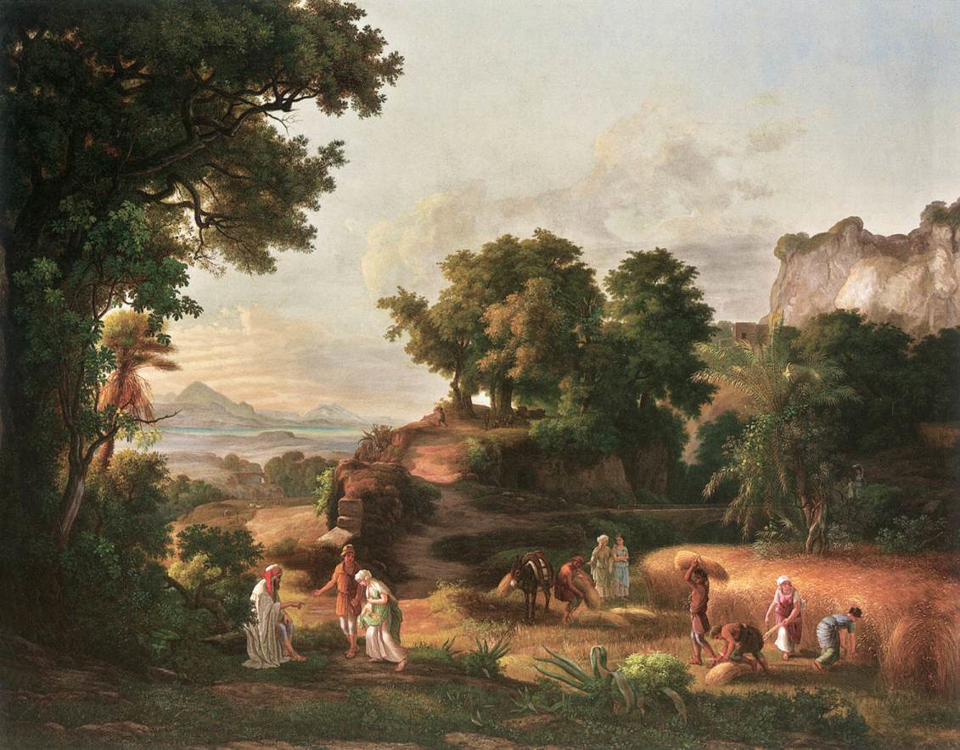
Cameo in Ruth
Ruth 2:14
  Come sit at my table
  Sat beside the reapers
  Reached her parched corn
  Dip morsel in the vinegar
Notes:
Barley – the lowest form of grain – used for animal feed (slide)
the beginning of the barley harvest was celebrated first with the Passover and then the feast of unleavened bread
Harvest is a reaping and an ingathering – this is the ingathering of the lowly – the foolish things of this world with which God will confound the wise. (I Cor 1:27)
Passover – redemption of the firstborns of Israel
Swept all the leaven out of their house – What does leaven represent? according to I Cor. 5:8 it represents malice and wickedness
What then does unleavened represent? Sincerity and truth according to the same passage – in the context of the Passover lamb – he who was without blemish!
Does not the barley harvest then stand for the judgment of the saints (slide)
V14 – come sit at my table – eat bread – dip morsel in the vinegar – In Numbers 6 “vinegar of wine”. Invitation to fellowship at a memorial table
“she sat beside the reapers” – different roles in the ecclesia – reapers – angels (Matt. 24:31)
“parched corn” – Lev. 23:10-14 – were not to eat of it until they had offered a sheaf or an omer of the first fruits unto the priest – with an he-lamb without blemish and a meal offering and a drink offering. The fruits of our labours
And left – had leftovers – which she brought to Naomi – “even the dogs eat the crumbs which fall from the Master’s table”
Matt. 15:21-28 – now the Jew eats the crumbs that have fallen from the Master’s table whereunto a Gentile sat and partook of the meal!

Slide 8
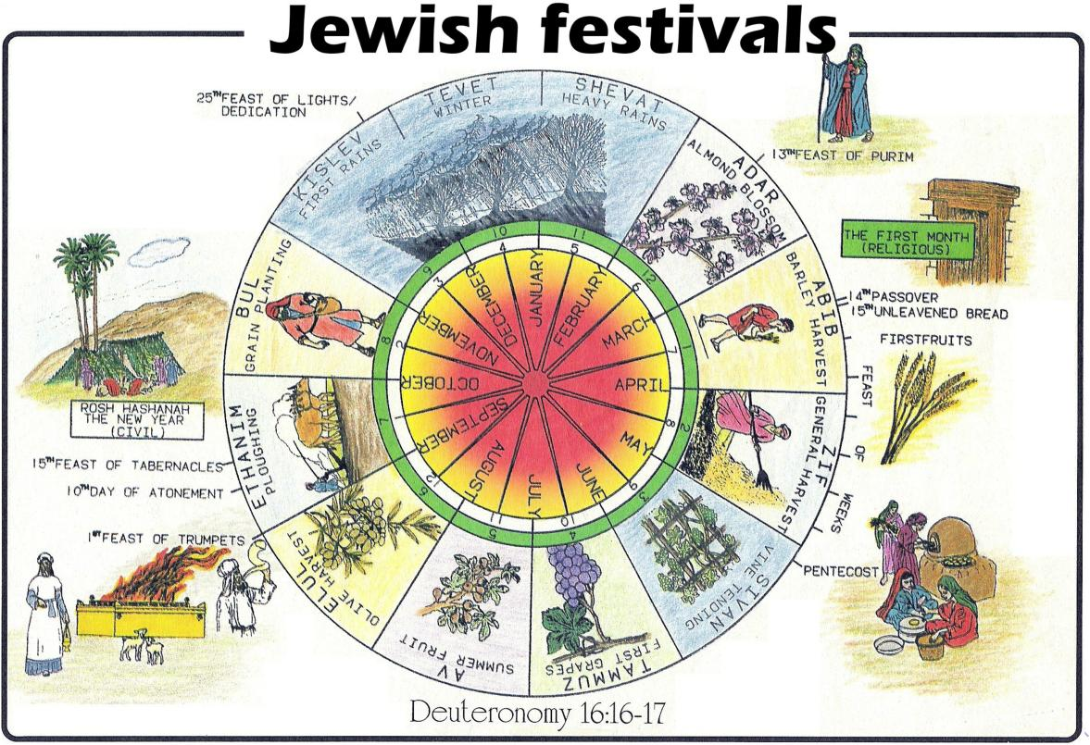

Slide 9
Location of the Wedding
Mt. Sinai?
  Deuteronomy 33:2
  “The LORD came from Sinai, and dawned from Seir upon us; he shone forth from Mount Paran, he came from the ten thousands of holy ones, with flaming fire at his right hand.” RSV
  Habakkuk 3:3-8
Notes:
Flaming fire – notice echo to II The. 1:7-8

Slide 10
Other Details – Unknown
Length of celebration
  ?
  Until that day I drink it new with you – Matthew 26:29
  Sitting down with the patriarchs – Matthew 8:11-12
Giving of instruction
  ?
  The Pattern in Israel – I Chronicles 23-29
  Conference of Angels – I Kings 22:19-23
  Parable of the pounds – Luke 19:12-26
  The Acts of the Apostles
Notes:
Read I Chronicles 23:1-3
Acts 1:8

Slide 11
Assignments!

Slide 12
Kingdom Jobs in Jerusalem
Carpenters/Project Managers/Foremen
  Eze. 40:6-9…; Exo. 36:1-4, 8, 37:1; Eze. 47:22-23
Day Care Attendant
  Zech. 8:5; Deu. 6:6-7; Eze. 47:22-23
Finance Officer
  Proverbs 13:22; I Chr. 26:20-27; Josh. 6:19, 24

Slide 13
Kingdom Jobs
Gardener/Landscaper
  Gen. 2:8-9, 15; Rev. 22:1-2 w Eze. 47:12; Mic. 4:4
Musicians
  I Chr. 25:1-7; II Chr. 20:14-19,22; Luke 2:11-14
Teachers/Priests
  Mal. 2:6-7; Psa. 122:5; Eze. 43:18-19; 44:15-17; 48:11

Slide 14
Kingdom Jobs
Governers
  I Chr. 27:16-22; Luk. 19:12-27
Captains of thousands and hundred
  Psa. 149; I Chr. 26:29-32 (Secret Service); I Chr. 27:1-15

Slide 15
