Slide 1
The Marriage Supper of the Lamb
Exposing the False Bride
May Family Gathering – Okanagan West
2014

Slide 2
Breakdown of Classes
Saturday
  Class 1 – Preparation of the Bride
  Class 2 – The Wedding!
Sunday
  Class 3 – Revealing the False Bride
  Exhortation – Thou art worthy
Monday
  Class 4 – One Nation Under Christ
  Class 5 – The Presentation of the Lamb’s Wife

Slide 3
A Harlot in Revelation
– Revelation 2:20-23
Introduction to the Harlot
Characteristics of Jezebel
  Chaste?
  Princess of Zidon
  Zidonians worshipped Ashtoreth (I Kings 11:5)
  and Baal (I Kings 16:31)
  Killed the prophets of the Lord (I Kings 18:4) that had been situated throughout the land from the days of Samuel
Roots in Genesis
Notes:
Might have thought we were going to Revelation 12 where one who was supposed to be a chaste virgin is pregnant with child. The letter to the ecclesia at Thyatira.
Jezebel’s introduction – I Kings 16:31-33
Genesis 10 & 11

Slide 4
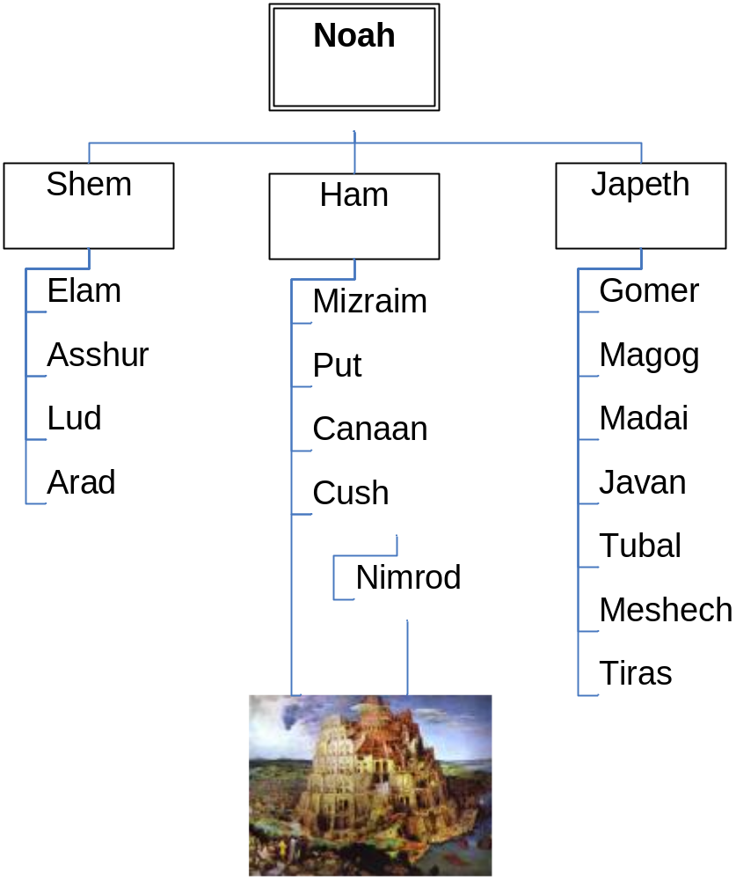
Babylon’s Origin
Notes:
Gen. 10:8-10
Family tree…

Slide 5
About Nimrod
Nimrod = rebellion – to revolt
“And Cush begat Nimrod: he began to be a mighty one in the earth. He was a mighty hunter before the LORD: wherefore it is said, Even as Nimrod the mighty hunter before the LORD.”
  Gen. 6 – “mighty men of renown (a name), men of old (everlasting).”
  Before the Lord – in the face of – an affront to Yahweh
Notes:
Nimrod = rebellion or valiant – Gesenius’ – rebel
Mic. 5:5 “the land of Nimrod” = Babylon
V8 Might one = gibbor
V9 mighty hunter = gibbor tsayid
V9 mighty hunter = gibbor tsayid
What are we being told?
Well – what is a gibbor?
Gen. 6:4 – might men of old (everlasting), men of renown (made a name for themselves)
Nimrod was one of these – born of a daughter of men by one who was once a son of God but had become a giant in his own eyes.
One whose wickedness was great in the earth, whose thoughts of his heart were only evil continually.
Why the connection with Gen. 6 – pre-deluvian? To connect the allegorical lineages. The daughters of men? Gen. 4:19 Adah “ornament” – “to adorn oneself” & Zillah “to grow dark or cast shadows”
Those of the seed of Cain in the way of Cain – one who let sin rule in his heart; who slew Abel because his own works were wicked; who would kill out of greed and envy
The seed of the serpent – at war with the seed of the woman
In Gen. 6 the seed of the serpent was winning the war against the seed of the woman and would have wiped her out if not for God’s intervention.

Slide 6
About Nimrod
“And the beginning of his kingdom was Babel, and Erech, and Accad, and Calneh, in the land of Shinar. Out of that land he went forth into Assyria, and builded Nineveh, and Rehoboth-ir, and Calah, and Resen between Nineveh and Calah (the same is the great city).” Gen. 10:10-12 ASV

Slide 7
The Tower of Babel
“one language and one speech” = one ideology
“and they said” = “and a man said to his neighbour”
“let us make us a name”
Josephus records – “God will never be able to flood us out again”
Notes:
Read v1-10 (Gen. 11)
Now man starts to accumulate into cities once again. Seek to build a name for themselves – in the face of God.
V3 “they said one to another” – mgn. “a man said to his neighbour” – one man – 10:10 – the beginning of his kingdom was Babel or Babylon – from whence came Asshur and built Nineveh (Assyria)
The man? Nimrod – build the tower of Babel
Began to be a mighty one – profaned – Gesenius states – to loose or set free
Gen. 11:9 – God scatters them and that is the last we hear of Nimrod in the word of God – but far from the last we hear of Babylon and Nineveh.

Slide 8
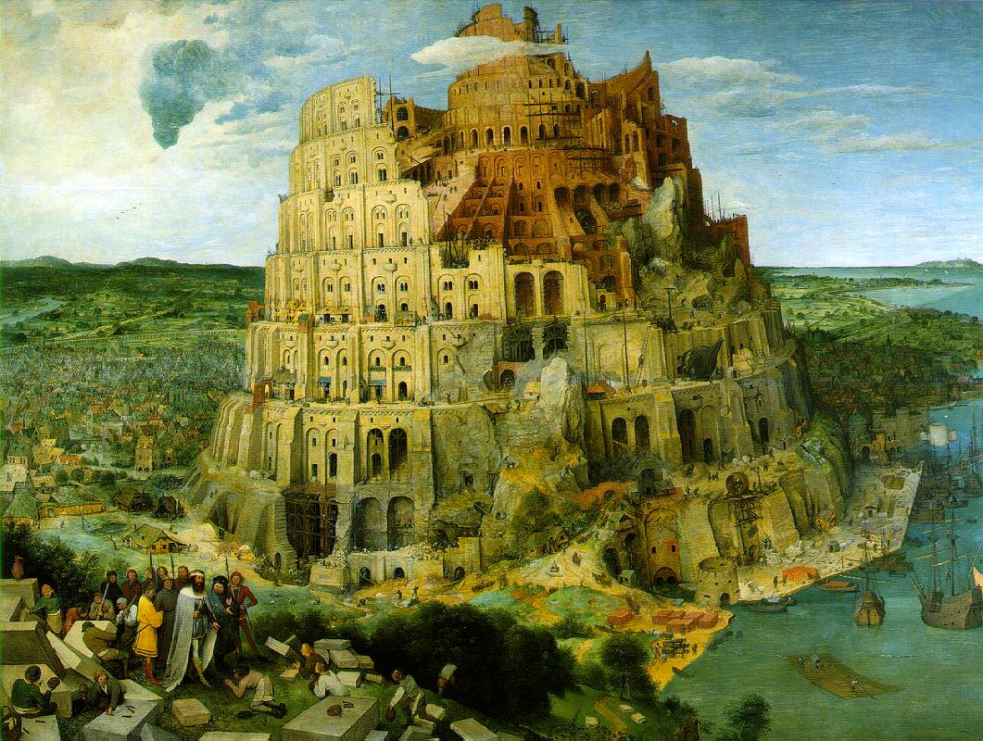

Slide 9
Babylon
History records that Cush – also called Kish and Bel -settled in Babylon first
Bel =“the confounder” … of languages of religion
Bel – later called Baal and Jannus
Cush began the form of false religion that spread throughout Canaan
Notes:
Where the biblical record volumes of history around the world pick up the story – and they all tell the same story.
Recall (Gen. 11:1) that the whole earth was of one language and of one speech. One language – one speech – set of words – ideology (the content of thinking characteristic of an individual, group, or culture) – the ideology revealed in their collective speech.
When separated they carried with them the ideology – concepts from the kingdom of Babylon.
If it was a kingdom – who was its king?
Nimrod – so Nimrod was the first king of Babylon…

Slide 10
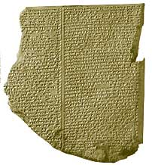
Nimrod in History
Gilgamesh Epic
Babylonian story of early history
Gilgamesh = Nimrod
Enuma Elish
Ancient Egyptian Records
Notes:
All around the world there are stories of a flood – Native Americans – Incas – Egypt – Babylon – China – did humanity restart in all those countries? No – they carried the stories with them in their new languages after the smiting of Gen. 11. Likewise they carried with them the system of worship that had been established in Babylon.
We could go to records of any number of nations to discover the system of worship established by the king of Babylon and his mother.
We will go to the Gilgamesh Epic – Babylonian writing

Slide 11
Untimely Death
Nimrod died young – judicially executed
The Two Babylons by Alexander Hislop
“…the Egyptian account of the death of Osiris. The Egyptians say, that the grand enemy {Sem} of their God {Nimrod} overcame him, not by open violence, but that, having entered into a conspiracy with seventy-two of the leading men of Egypt, he got him into his power, put him to death, and then cut his dead body into pieces, and sent the different parts to so many different cities throughout the country.”
Nimrod – king priest of Babylon slain by Shem – king priest of Salem
Notes:
(if Bro. Thomas is correct in identifying Shem with Melchizedek)

Slide 12
Semiramis’ Tale
Semiramis, the mother of Nimrod ruled with him. At Nimrod’s death her power would be removed – unless …
Gen. 3:15
“the ancient world in general, were perfectly aware of the primeval promise in Eden, and they knew right well that the bruising of the heel of the promised seed implied his death, and that the curse would only be removed from the world by the death of the Grand Deliverer.” The Two Babylons
Nimrod was the promised seed – continued to live as diety
Semiramis was now the mother of diety – who would remove her from the throne?
Notes:
Some debate over whether Semeramis is Nimrod’s wife or mother – either way – when Nimrod was slain before his years she concocts a legend to keep her own position of authority.
All familiar with Gen. 3 – bruise the heel of the he who would end the curse (bruise the head of the serpent)

Slide 13
Semiramis, the mother of God
Ishtar
Ashtoreth (I Kng. 11)
Queen of Heaven (Jer. 44)
Diana (Act. 19)
Isis (Egypt)
Mary, the mother of God

Slide 14
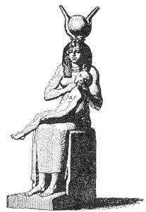
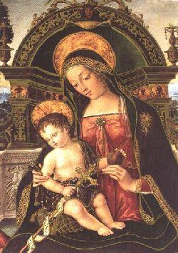
Virgin Mother of God

Slide 15
Nimrod by other names
Ninus
  (Niniveh = inhabitant of Ninus)
Nabu
Molech (Ammonites)
Gilgamesh (Babylon)
Achilles (Greek)
Thor (Scandanavian)
Vishnu (Indian)
Theolt (Mexican)
Tammuz (Zidon)
Osiris (Horus)
Notes:
How does mythology stack up?
(Greece) Achilles heel? – he was struck in the only place he was vulnerable
(India) Vishnu – slays a serpent Calyia
(Scandanavia) Thor – crushes the head of the great serpent with a mace.
(Mexico) Teotl – crushes a serpent

Slide 16
Babylon Dispersed
“from thence did the LORD scatter them abroad upon the face of all the earth.”Genesis 11:9
Took the religion of Babylon and the fable of Semiramis with them into all nations.
“Babylon hath been a golden cup in the LORD’S hand, that made all the earth drunken: the nations have drunken of her wine; therefore the nations are mad.” Jeremiah 51v7
Notes:
This is the story of two seeds – at enmity with each other! From the days of the flood. The posterity and philosophy of Nimrod and the posterity and religion of Shem (second half of Genesis 11).

Slide 17
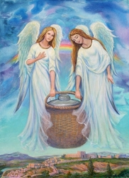
Ahola & Aholiba
Ahab & Jezebel’s legacy!
God’s care for them and yet they committed adultery
  Ezekiel 16
  Ezekiel 23
Judaism mixed with paganism
  Zechariah 5:5-11
Notes:
16V15, 21-22
V26 – harlot with Egyptians
V28 – whore with the Assyrians
V29 – fornication with the Chaldeans
V35-40 – destruction of her
Ahola – her tent (calf worship of Israel)
Aholiba – my tent is in her (temple in Jerusalem)
Eze. 23:1-4 – crime
45-47 – judgment of adultery

Slide 18


The Claim of the Harlot
“I sit a queen, and am no widow, and shall see no sorrow”
  by Jezebel
  by Semiramis
  by the Roman Catholic Church
FOUR MARKS OF THE TRUE CHURCH
  If we wish to locate the Church founded by Jesus, we need to locate the one that has the four chief marks or qualities of his Church. The Church we seek must be one, holy, catholic, and apostolic.
Notes:
Rev. 18:7

Slide 19
The Church Is One
(Rom. 12:5, 1 Cor. 10:17, 12:13, CCC 813–822)
Jesus established only one Church, not a collection of differing churches (Lutheran, Baptist, Anglican, and so on). The Bible says the Church is the bride of Christ (Eph. 5:23–32). Jesus can have but one spouse, and his spouse is the Catholic Church.

Slide 20
The Church Is Holy
(Eph. 5:25–27, Rev. 19:7–8, CCC 823–829)
By his grace Jesus makes the Church holy, just as he is holy. This doesn’t mean that each member is always holy. Jesus said there would be both good and bad members in the Church (John 6:70), and not all the members would go to heaven (Matt. 7:21–23).
But the Church itself is holy because it is the source of holiness and is the guardian of the special means of grace Jesus established, the sacraments (cf. Eph. 5:26).

Slide 21
The Church Is Catholic
(Matt. 28:19–20, Rev. 5:9–10, CCC 830–856)
Jesus’ Church is called catholic ("universal" in Greek) because it is his gift to all people. He told his apostles to go throughout the world and make disciples of "all nations" (Matt. 28:19–20).
For 2,000 years the Catholic Church has carried out this mission, preaching the good news that Christ died for all men and that he wants all of us to be members of his universal family (Gal. 3:28).

Slide 22
The Church Is Apostolic
(Eph. 2:19–20, CCC 857–865)
The Church Jesus founded is apostolic because he appointed the apostles to be the first leaders of the Church, and their successors were to be its future leaders. The apostles were the first bishops, and, since the first century, there has been an unbroken line of Catholic bishops faithfully handing on what the apostles taught the first Christians in Scripture and oral Tradition (2 Tim. 2:2).
These beliefs include the bodily Resurrection of Jesus, the Real Presence of Jesus in the Eucharist, the sacrificial nature of the Mass, the forgiveness of sins through a priest, baptismal regeneration, the existence of purgatory, Mary’s special role, and much more —even the doctrine of apostolic succession itself.

Slide 23
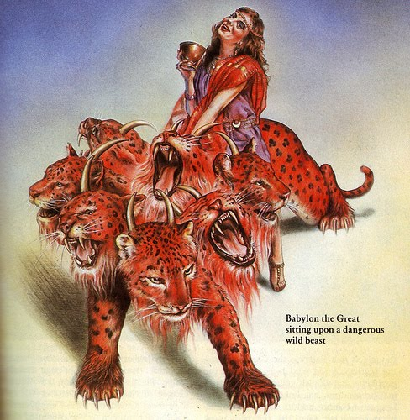
Drunk with Her Wine
“Babylon hath been a golden cup in the LORD’s hand, that made all the earth drunken: the nations have drunken of her wine; therefore the nations are mad.” Jeremiah 51:7
Revelation 17:1-3
  A great whore
  Kings of the earth fornicated with her
  Inhabitants of the earth made drunk
  Mystery Babylon the great
  Sitting on many waters, a scarlet beast in the wilderness

Slide 24
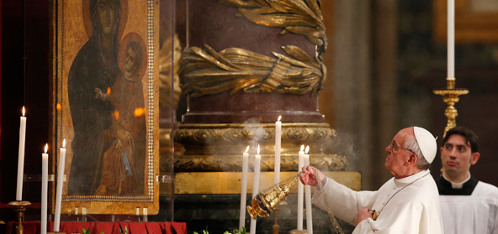
“She shall be utterly burned”
Notes:
Revelation 18:1-3, 20-24 – destruction of the harlot
Revelation 19:1-2 – in the context of the marriage supper of the lamb

