Slide 1
The Marriage Supper of the Lamb
One Nation Under Christ
May Family Gathering – Okanagan
2014

Slide 2
Breakdown of Classes
Saturday
  Class 1 – Preparation of the Bride
  Class 2 – The Wedding of the Lamb and his Bride
  Evening Program – The Bridegroom Cometh!
Sunday
  Class 3 – Revealing the False Bride
  Exhortation – Thou art worthy
Monday
  Class 4 – One Nation Under Christ
  Class 5 – The Presentation of the Lamb’s Wife

Slide 3
Promise of Restoration
Restoration of the whole house of Israel
  Jeremiah 30 – Yet will I not make a full end of thee
  Isaiah 11:10-16 – The Lord will set his hand again the second time to recover the remnant of his people
  Jeremiah 33:7-18 – I will perform that good thing
  Ezekiel 37:15-28 – I will make them one nation in the land
Notes:
Ezekiel 16:60-62;
Look up Jer. 33:14-15 house of Israel and the house of Judah
Ezekiel 37:22-24 “And I will make them one nation in the land upon the mountains of Israel; and one king shall be king to them all: and they shall be no more two nations, neither shall they be divided into two kingdoms any more at all: neither shall they defile themselves any more with their idols, nor with their detestable things, nor with any of their transgressions: but I will save them out of all their dwelling places, wherein they have sinned, and will cleanse them: so shall they be my people, and I will be their God. And David my servant shall be king over them; and they all shall have one shepherd:”
They are the first dominion of the kingdom – Micah 4:8 – reason for restoring before the presentation of the bride.

Slide 4
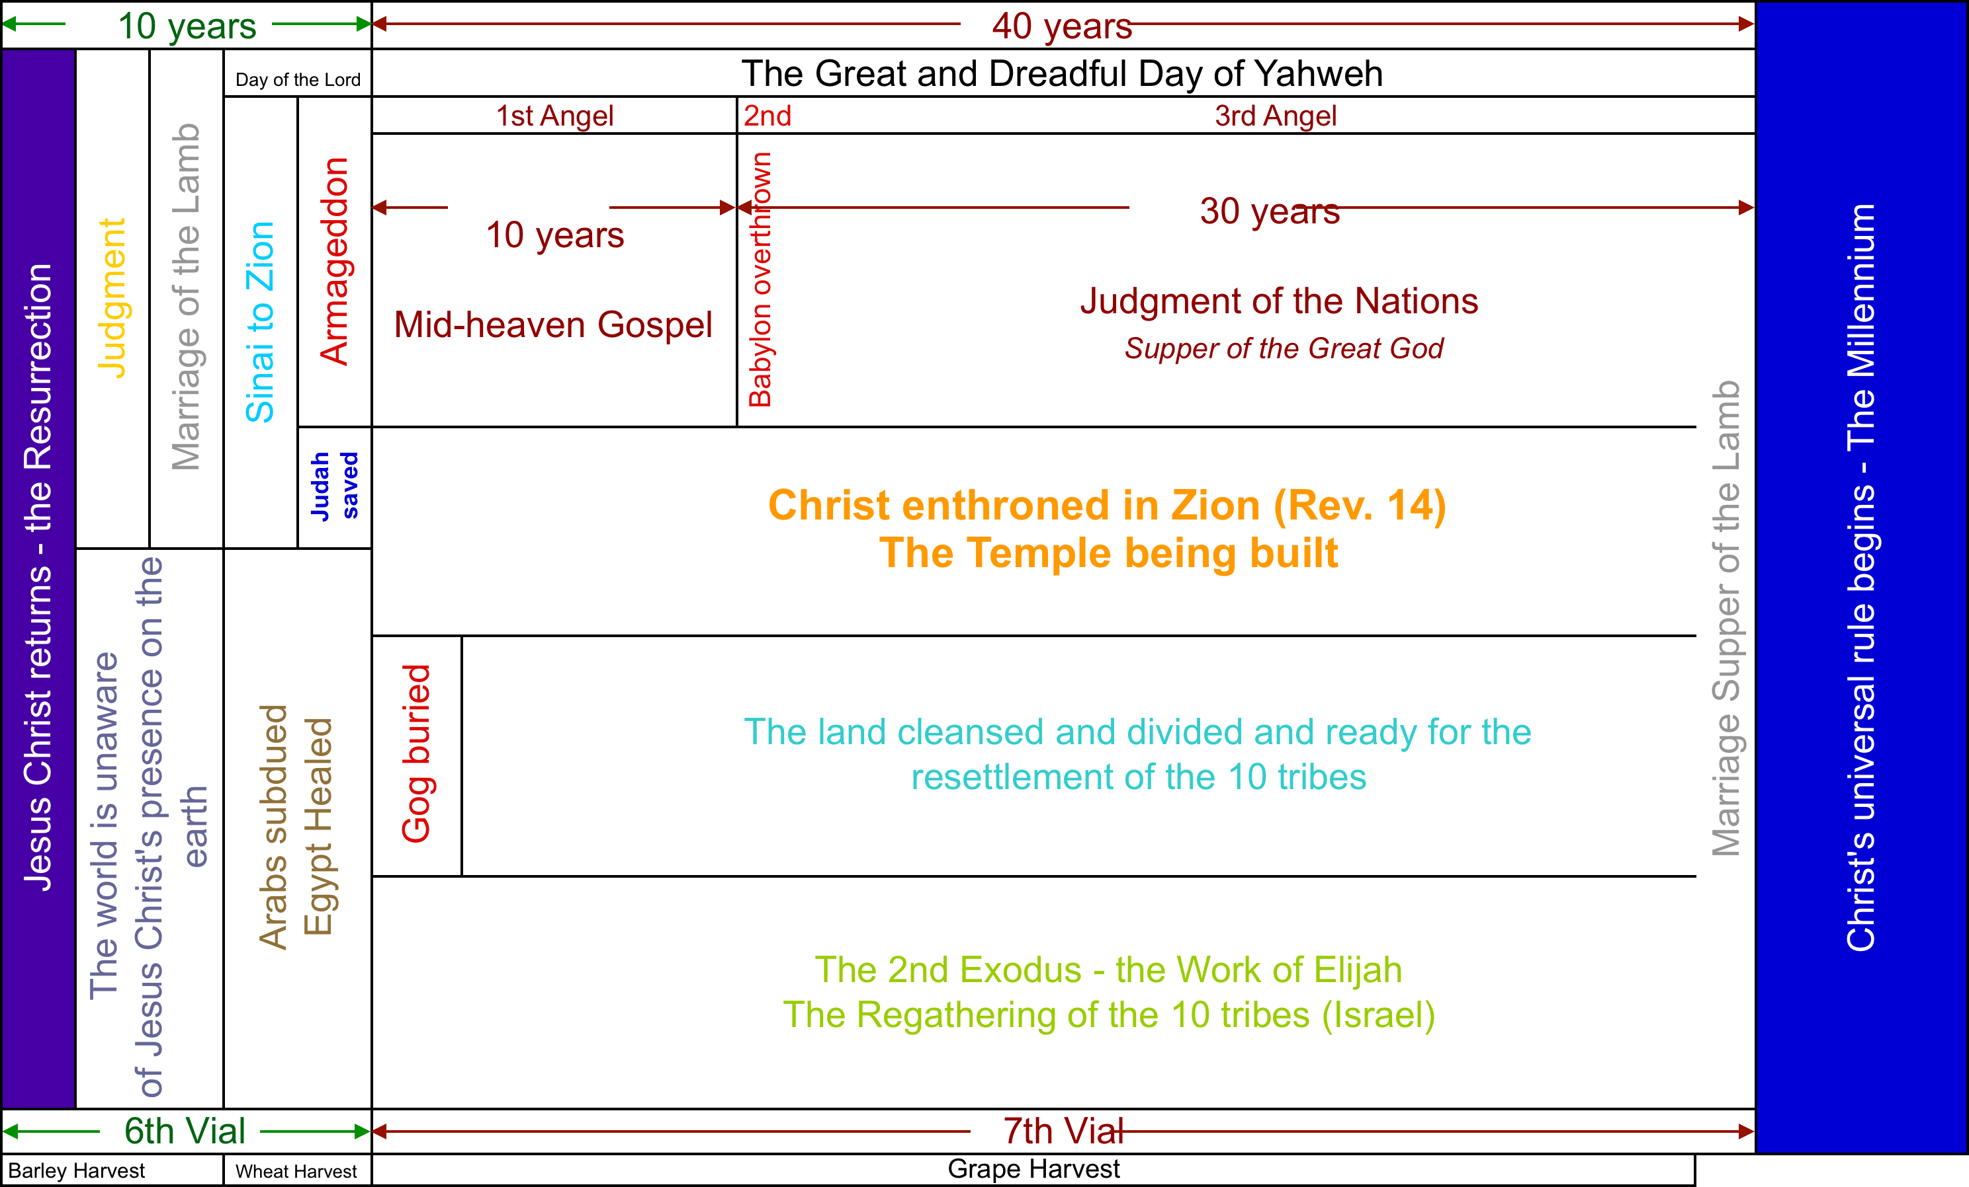
Context

Slide 5
Restoration Timeline
1948 – Return of Jews from all nations – “Judah” exists!
Judah saved and converted
Call to Israel to return home – Elijah Mission
Brought out of all nations to Europe
A remnant saved
Judah brings them home
One nation under their prince – Jesus Christ

Slide 6
Judah First
But not at the same time
  Jeremiah 23:1-9 – Judah, then Israel
    Judah – Jews in the land
    Israel – Jews scattered – the diaspora
Pattern in the settling of the Promised Land
  Judges 1:1-2 – Who shall go up first? Judah
Notes:
Context of Jeremiah 23 – 22:24-25, 30 Judah without a king to sit on David’s throne
Don’t talk about the shepherds yet – we will in 3 slides

Slide 7
Judah & Israel Defined
Prophets after Israel’s removal from the land:
  Jeremiah; Ezekiel; Daniel; Joel; Obadiah; Nahum; Habakkuk; Zephaniah; Haggai; Zechariah; Malachi
When these prophets write about “Israel” they were referring to the Jews that had been displaced by the Assyrians.
When they write about “Judah” they were referring to Jews in the land.

Slide 8
Judah = Jews in the Land
Judah = Judah and Benjamin (I Kings 12:21)
+ the Levites (II Chronicles 11:13-14)
+ the faithful (II Chronicles 11:16)
+ the remnant (II Chronicles 30:11-12)
Notes:
II Chr. 11 – after Jeroboam made priests of the lowest in the land – left for Judah
II Chr. 30 – Hezekiah’s letters

Slide 9
Judah First
Joel 3:1 – bring again the captivity of Judah & Jerusalem
Zechariah 12:7 – save the tents of Judah first
“I will setup shepherds over them, which shall feed them” – Jeremiah 23:3
When?
Micah 5:5 – when the Assyrian shall come into our land
  After the battle of Armageddon
Notes:
Look up Micah 5:5

Slide 10
Then Israel – 2nd Exodus
Israel (Jews in dispersion) is 16 million in population and is largely in unbelief. From Amos we discover they will be indistinguishable from the Gentiles in the last days.
They will live in nations both friendly and hostile to the Jews
  Micah 5:7-9
Commanded to return
  Jer. 3:12-16 – Return thou backsliding Israel
  Isa. 43:5-6 – I will say to the North, Give up!
  Zech. 2:6 – Come from the North
  Rev. 18:4 – Come out of Babylon
Notes:
Look up Mic. 5:7-9
Look up Jer. 3.12-16

Slide 11
Then Israel – 2nd Exodus
Israel’s response – Eze. 20:31-43
  As the families of the countries
  With fury poured out
  Wilderness of the people
    Rev. 17:3
  I will plead with thee
  I will cause you to pass under the rod
    Lev. 27:32 with Amos 5:3 – 90% are rebels
  All the house of Israel will serve me
  Ye shall loathe yourselves
Notes:
Eze. 20:31-32
36-38
Tithe – 1/10th
- Lev. 27:32 “And concerning the tithe of the herd, or of the flock, even of whatsoever passeth under the rod, the tenth shall be holy unto the LORD.”
Amos 5:3 “For thus saith the Lord GOD; the city that went out by a thousand shall leave an hundred, and that which went forth by an hundred shall leave ten, to the house of Israel.”
v43

Slide 12
Then Israel – 2nd Exodus
Purge out the rebels
  Hos. 2:14 – I will allure her into the wilderness
  Isa. 63:10-14
  Amos 9:9-10
    “For, lo, I will command, and I will sift the house of Israel among all nations, like as corn is sifted in a sieve, yet shall not the least grain fall upon the earth. All the sinners of my people shall die by the sword, which say, The evil shall not overtake nor prevent us.”
  Zech. 10:3-10 – Judah & Israel used in the battles
  Isa. 34
Notes:
Isa. 34 – parallel to Rev. 14:6-7 – mid-heaven gospel
Isa. 63 – next slide

Slide 13
Then Israel – 2nd Exodus
A highway in the wilderness
  Isa. 11:16
    “there shall be an highway for the remnant of his people”
  Hos. 6:1-2
    “Come, and let us return unto the LORD: For he hath torn, and he will heal us; He hath smitten, and he will bind us up”
  Isa. 35:8-10 – a way in the wilderness
  Jer. 3:18 – Judah helps bring Israel home
Prepared for the Land
  Hos. 2 – speak to thy heart
  Isa. 63:1-6 – Who is this that cometh from Edom?
Notes:
Look up Hosea 2 – remember the “I will”s

Slide 14
Then Israel – 2nd Exodus
Hearts turned – the whole house of Israel united
  Eze. 36:21-29 – I will give you an heart of flesh
  Micah 7:14-20 – cast their sins into the sea
  Eze. 37:20-28 – David my servant shall be king over them
  Genesis 45:1-15 – Joseph with his brethren
  Jer. 23:7-8 – God known to Israel as a restorer from all lands
  Jer. 33
Notes:
Micah 7:14-20 – sins cast into the sea (Jer. 50:20)
see Mark 11:20-23 – have faith in God – mountain cast into the sea – context 20 – the dried up fig tree
What mountain? V12-14 – Bethany – which is located where? On the Mt. of Olives
II Kngs 23:13 with I Kngs 11:7 – for this reason called the Mount of Offence
Do we correctly understand? Mark 11:24-26

Slide 15
The Work of Elijah
“Hear me, O LORD, hear me, that this people may know that thou art the LORD God, and that thou hast turned their heart back again.” I Kings 18:37
“Elias was a man subject to like passions as we are, and he prayed earnestly that it might not rain: and it rained not on the earth by the space of three years and six months. And he prayed again, and the heaven gave rain, and the earth brought forth her fruit.” James 5:17-18
Notes:
Why would Elijah pray for no rain? Leviticus 26:18-23
Elijah’s mission? Malachi 4:5-6

Slide 16
Malachi 4
¹ For, behold, the day cometh, that shall burn as an oven; and all the proud, yea, and all that do wickedly, shall be stubble: and the day that cometh shall burn them up, saith the LORD of hosts, that it shall leave them neither root nor branch. ² But unto you that fear my name shall the Sun of righteousness arise with healing in his wings; and ye shall go forth, and grow up as calves of the stall. ³ And ye shall tread down the wicked; for they shall be ashes under the soles of your feet in the day that I shall do this, saith the LORD of hosts. ⁴ Remember ye the law of Moses my servant, which I commanded unto him in Horeb for all Israel, with the statutes and judgments. ⁵ Behold, I will send you Elijah the prophet before the coming of the great and dreadful day of the LORD: ⁶ And he shall turn the heart of the fathers to the children, and the heart of the children to their fathers, lest I come and smite the earth with a curse.
Day that shall burn = Armageddon
Psa. 83:13 – destruction of Gog
Sun of Righteousness = Christ
Calves of the stall = saints
Deu. 4:10-40
Great and dreadful day of the LORD
Joel 2:31
“Day” of judgment of the nations
Notes:
Contrast Joel 2:31 with Joel 2:1-10
How will the heart be turned?
Mal. 3:1-3 – Refiner’s fire (Isa. 1:21-31); Fuller’s soap (Jer. 2:22)
Process to last 40 years - Micah 7:15
Look up Deu. 4:10

Slide 17
The Spirit of Elijah
Fire from heaven to destroy?
  Luke 9:54-56 – No – to save
Turn the hearts – Luke 1:16-17
A voice! – Matthew 3:3-4; John 1:21
Hear him! – Matthew 11:14-15

Slide 18
