Slide 1
The Marriage Supper of the Lamb
The Presentation of the Lamb’s Wife
May Family Gathering – Okanagan
2014

Slide 2
Breakdown of Classes
Saturday
  Class 1 – Preparation of the Bride
  Class 2 – The Wedding of the Lamb and his Bride
  Evening Program – The Bridegroom Cometh!
Sunday
  Class 3 – Revealing the False Bride
  Exhortation – Thou art worthy
Monday
  Class 4 – One Nation Under Christ
  Class 5 – The Presentation of the Lamb’s Wife

Slide 3
Where we’ve come from
Preparation of the Bride
Judgment Seat of Christ
Wedding Ceremony & Tasks
Armageddon – Judah Saved
2nd Exodus – Judah & Israel United
Exposing the False Bride
Great Supper of God Almighty
Marriage Supper of the Lamb

Slide 4
Great Supper of God
  Invitation to dine – Ezekiel 39:17-24
    Sacrifice = Gog destroyed
    Partake = participation & acknowledgment
  Only accepted by some – Revelation 19:11-21
    Beast = nations who reject call to submit
      Where whore sits – Rev. 17:7
    Birds = accept in the invitation to submit
    White horse = Israel
      Isa. 63:13

Slide 5
Great Supper of God
Plight of the birds
  The mustard seed – Matthew 13:31-32
  Inhabit the emptied wilderness – Isaiah 34:11-15
Parallel symbols – Matthew 13:24-30
  Beasts = Tares
  Birds = Wheat
  The field is the world
  “Wilt thou then that we go and gather them up? Nay”
    I Corinthians 5:13 “them that are without God judgeth.”

Slide 6
New Jerusalem
“I will shew thee the bride, the Lamb’s wife.”
That great city – contrast Revelation 17:18
The Holy Jerusalem – contrast Revelation 11:8
Descending out of heaven from God – John 3:3, 13, 31
Having the glory of God – John 1:14
Notes:
That great city v10 (Rev. 21:1-3) – first occurrence in the Bible – Gen. 10:12, read 8-12;
Resen – to bridle (Psalm 32:9 “Be ye not as the horse, Or as the mule, which have no understanding: Whose mouth must be held in with bit and bridle,”) – also means to push off a bridle
The Holy Jerusalem which was turned into Sodom and Egypt by Ahab and Jezebel is now converted to Zion – the city of the beloved! While Jerusalem was being taken apart stone by stone, God was working a new work – still the building up of Zion. Isa. 28:16 – “Behold, I lay in Zion for a foundation a stone, a tried stone, a precious corner stone, a sure foundation:”
Having the glory of God – as Ruth reflected the characteristics of Boaz so those constituting this city, the bride of Christ are those who reflect the characteristics of our Lord

Slide 7
Building of New Jerusalem
I Peter 2:5-8 – lively stones
Malachi 3:16-18 – jewels
  From the breastplate (Exodus 28:15-21)
Hebrews 12:18-24 – the city of the living God
The city which Abraham looked unto – Hebrews 11:10
  Architect and Builder is God
  V16 – prepared for them a city
Notes:
12 gates with the names of the twelve tribes of Israel
12 angels at the gates
12 foundations with the names of the twelve apostles
12 pearls at 12 gates

Slide 8
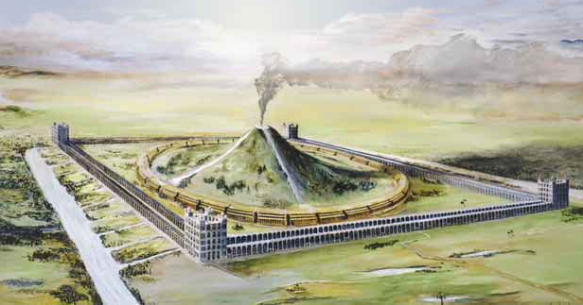
New Order
I create a new heavens and a new earth
  Isaiah 65:17-25
Let us go up to the mountain of the LORD
  Isaiah 2:2-4
“The kingdoms of this world are become the kingdoms of our Lord, and of his Christ; and he shall reign for ever and ever.” – Revelation 11:15
Notes:
(If time read Psalm 149)
Read Isa. 65:17-25
Isaiah 2:2-4 “And it shall come to pass in the last days,
That the mountain of the LORD’s house shall be established in the top of the mountains,
And shall be exalted above the hills;
And all nations shall flow unto it.
3 And many people shall go and say,
Come ye, and let us go up to the mountain of the LORD,
To the house of the God of Jacob;
And he will teach us of his ways,
And we will walk in his paths:
For out of Zion shall go forth the law,
And the word of the LORD from Jerusalem.
4 And he shall judge among the nations,
And shall rebuke many people:
And they shall beat their swords into plowshares,
And their spears into pruninghooks:
Nation shall not lift up sword against nation,
Neither shall they learn war any more.”
Read Rev. 11:15

Slide 9
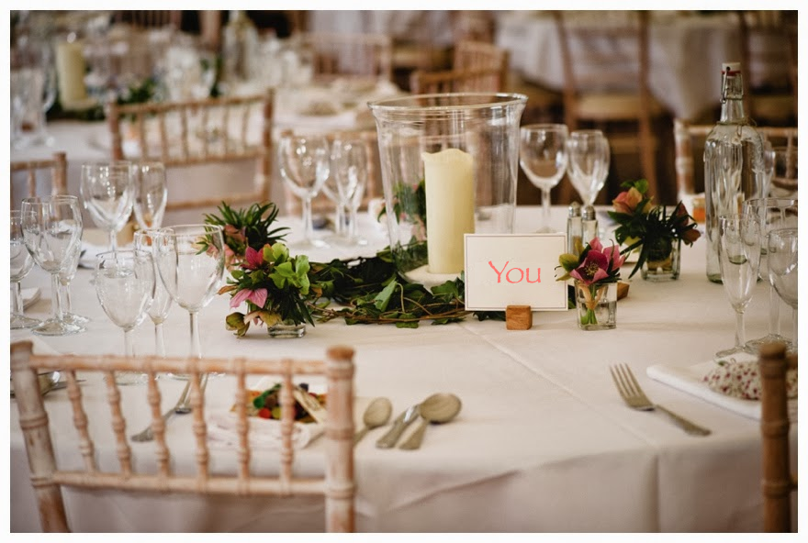
Notes:
A pleasure to enjoy fellowship with you this weekend. We wish you God’s blessing as you raise your families, and build up your ecclesia.

