Slide 1










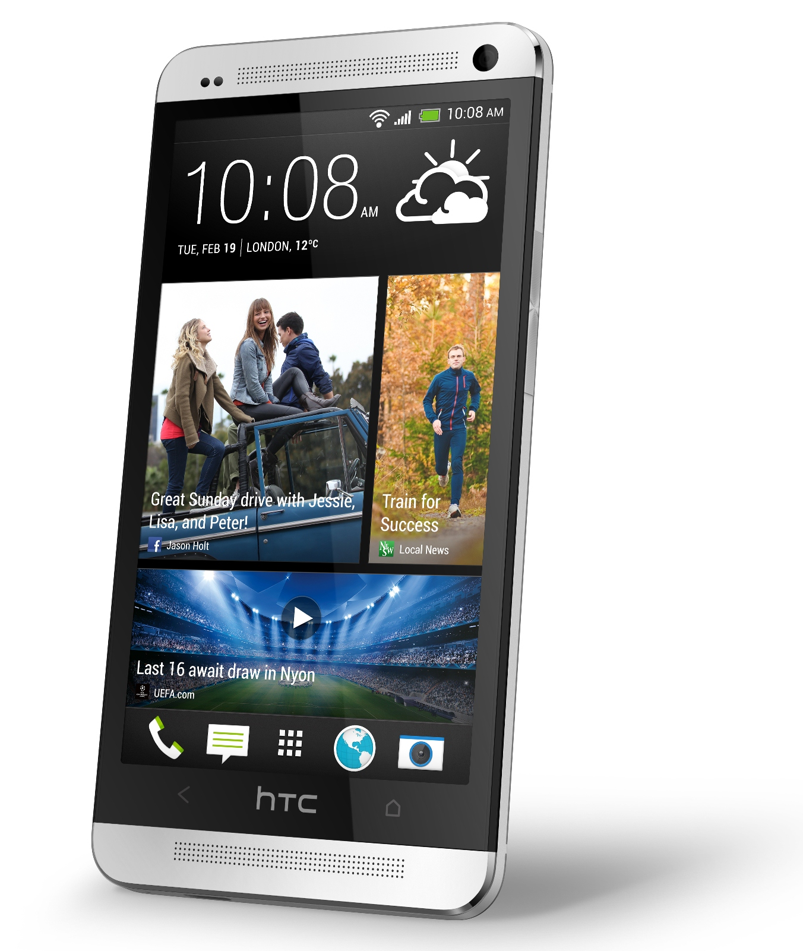
Does the Bible provide instruction for communication in the 21st century?
Notes:
Principles to be discussed this evening are timeless. They apply to old fashioned communication, and to 21st century. New mediums don’t change the principles. I am not opposed to new forms of communication, Facebook
Skype
Twitter
Google buzz
Instagram
Whatsap
Linked in
Yahoo
Youtube

Slide 2
Speak often one to another
Speaking often to each other can help us get into the Kingdom
  Malachi 3:16-18
Exhort one another daily while it is called today
  Hebrews 3:13
Technology has enabled us to accomplish this like never before.
Notes:
Look up Mal. 3:16-18
Heb. 3:12-14 “exhort one another daily, while it is called To day; lest any of you be hardened through the deceitfulness of sin.”

Slide 3
Face to Face
Some things are not meant to be communicated through a pen, or keyboard, or keypad
Exodus 33:11 – the LORD spoke to Moses face to face
III John 13-14 – there were things John would not write but needed to communicate them face to face
Notes:
Moses face to face – read in our readings last night (Deu. 34:10)
Don’t forget the value of face to face conversation – 7% words; 38% tone; 55% expression & body language
What things should NOT be communicated electronically?

Slide 4
Face to Face
“Argue your case with your neighbor himself, and do not reveal another’s secret, lest he who hears you bring shame upon you, and your ill repute have no end.” – Proverbs 25:9-10 (ESV)
Matthew 18:15 – between you and them alone
Notes:
Always assume that what you write will be distributed to everyone
Contrast posting on Facebook – or tweeting
Arranging brethren – don’t discuss sensitive matters over email! Make a phone call or better yet – face to face. Brant County’s AB email policy.
Matthew 18 – Christ provides instruction about restoring brethren – between you and them alone!

Slide 5
Principles to guide communication
Do all to the glory of God
  It’s not all about you
Seasoned with salt
  No corrupt communication
Time to …
In a multitude of words there is no lack of sin
“Friends”, Followers, Circles
Good listening
Social etiquette
Notes:
We’ve introduced the potential benefits of this technology and the concept that we should use discretion regarding it’s use. Let’s look now at principles guiding our use of these technologies to communicate – and all communication.
All to the glory of God - Umbrella principle – in conflict with the worlds standards
Seasoned with Salt – content of our communication
Time to… - there is a time for different things but must watch time that is pilfered away
Multitude – use discretion in our speech – think before we communicate
Friends – promoting pride
Good listening – take time to communicate
Social – common sense principles

Slide 6
It’s ALL about ME
Narcissism: Extreme selfishness, with a grandiose view of one's own talents and a craving for admiration.
I am so important that I will grace you with information about my personal life such as when I am brushing my teeth, or where I ate lunch, or what music I am listening to, or …
“The fool does not desire understanding, but only to air his thoughts.” Proverbs 18:2 (Tanakh)
Notes:
Do all to the glory of God – I Cor 10:31
“Fools care nothing for thoughtful discourse; all they do is run off at the mouth.” – The Message

Slide 7
Do ALL to the glory of God
Includes all communication
  Talking
  Emailing
  Writing letters
  Texting
  Instagramming
  Tweeting
  Messaging
  BBMing
  Skyping
Self examination
  Does our post, our profile, our public exposure of the use of our time, our text, our video, our picture demonstrate that we are ambassadors for Christ, that we are doing all to the glory of God?
Notes:
II Cor. 5:17-21 – Ambassadors for Christ!

Slide 8
Seasoned with Salt
Colossians 4:6 – seasoned with salt
Our communication should not include these
  “But among you there must not be even a hint of sexual immorality, or of any kind of impurity, or of greed, because these are improper for God’s holy people. Nor should there be obscenity, foolish talk or coarse joking, which are out of place, but rather thanksgiving. For of this you can be sure: No immoral, impure or greedy person—such a man is an idolater—has any inheritance in the kingdom of Christ and of God.” Ephesians 5:3-5
Notes:
“Let your speech be alway with grace, seasoned with salt, that ye may know how ye ought to answer every man.”
What does seasoned with salt conjure up in your mind?
Eph. 5:3-5 from NIV

Slide 9
Seasoned with Salt
Kind and helpful communication
  Christ was given “the tongue of the learned, that he should know how to speak a word in season to him that is weary.” – Isa. 50:4
  “Heaviness in the heart of man maketh it stoop: but a good word maketh it glad.” – Proverbs 12:25
  “A man hath joy by the answer of his mouth: and a word spoken in due season, how good is it!” – Proverbs 15:23
Notes:
What does this take? The thought process required?
What about being “real”? Is this a facade? Shouldn’t we keep it real? Raw.

Slide 10
Time to …
“Time is at once the most valuable and the most perishable of all our possessions.”
Ephesians 5:15-21 – redeeming the time
“In all toil there is profit, but mere talk tends only to poverty.” Proverbs 14:23 (ESV)
Time of our probation is running out!
  Romans 13:11-12; I Corinthians 7:29-31; Hebrews 10:25; I Peter 4:7
  “So teach us to number our days, that we may apply our hearts unto wisdom.”
Notes:
John Randolph (Virginia Senator – late 1700s)
Ephesians 5 – circumspectly = consider all circumstances and possible consequences
Last quote – Psalm 90:12

Slide 11
Multitude of Words
Words of the wise for the wise
Proverbs 10:19-21 – multitude of words = more opportunity to sin
“Whoever guards his mouth preserves his life; he who opens wide his lips comes to ruin.” – Proverbs 13:3 (ESV)
“Even a fool who keeps silent is considered wise; when he closes his lips, he is deemed intelligent.” Proverbs 17:28 (ESV)
“Seest thou a man that is hasty in his words? there is more hope of a fool than of him.” Proverbs 29:20
James 3:1-12
Notes:
Every idle word – Matt. 12:36
Lookup James if time – else summarize

Slide 12
Multitude of Words
“Besides that, they learn to waste their time, going from house to house. And they not only waste their time but also begin to gossip and busy themselves with other people’s lives, saying things they should not say.” I Tim. 5:13 (NCV)
“A troublemaker plants seeds of strife; gossip separates the best of friends.” Pro. 16:28
Notes:
What are you talking about? Other people?! Seriously??

Slide 13
‘Friends’, Followers, Circles
Matthew 23:5-12 – condemnation for pomp
Social media, as with all forms of communication, can be used as a weapon!
Social bullying has even resulted in suicides
Notes:
Concepts and the news prompt a feeling of elevated self importance
Defriend you – delete you from my circle

Slide 14
Good listening
“Wherefore, my beloved brethren, let every man be swift to hear, slow to speak,”
  James 1:19
“He that answereth a matter before he heareth it, it is folly and shame unto him.”
  Proverbs 18:13
“Seek first to understand, then to be understood.”
Notes:
Similar to the multitude of words quote.
Common theme – take time – you don’t need to answer it right now – put the phone down!

Slide 15
Rules of Social Etiquette
Keep a distance from others while talking on the phone.
Don't use your phone (texting or talking) when having a meal with someone or when in conversation.
Face to face test!
Notes:
Glenn is going to call! Discussion with Richard about game night.
Should be common sense – if someone was talking to you, you wouldn’t turn away and start talking to someone else!
Would I say it face to face?

Slide 16
Social Impact

Slide 17
Principles to guide communication
Do all to the glory of God
  It’s not all about you
Seasoned with salt
  No corrupt communication
Time to …
In a multitude of words there is no lack of sin
“Friends”, Followers, Circles
Good listening
Social etiquette
Notes:
All to the glory of God - Umbrella principle – in conflict with the worlds standards
Seasoned with Salt – content of our communication
Time to… - there is a time for different things but must watch time that is pilfered away
Multitude – use discretion in our speech – think before we communicate
Friends – promoting pride
Good listening – take time to communicate
Social – common sense principles

