Slide 1
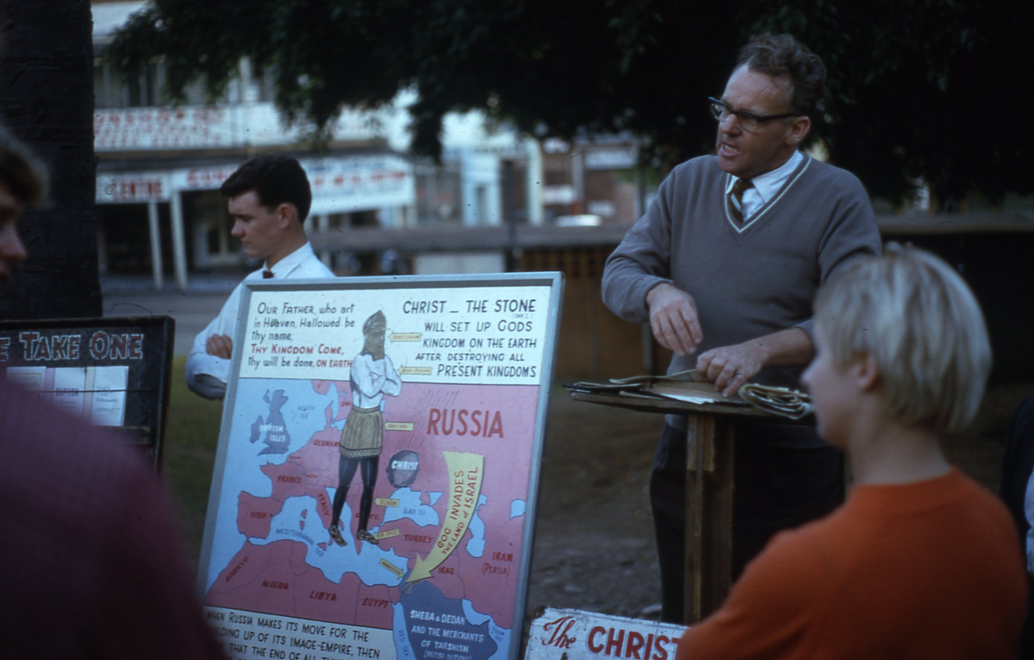
“That I May Speak Boldly As I Ought to Speak” Eph 6:20
North Battleford
Ecclesia Study Weekend
The Time to SPEAK!

Slide 2
Our Tongues get us into Big Trouble
James 3:5-8
5 Even so the tongue is a little member, and boasteth great things. Behold, how great a matter a little fire kindleth!
6 And the tongue is a fire, a world of iniquity: so is the tongue among our members, that it defileth the whole body, and setteth on fire the course of nature; and it is set on fire of hell.
7 For every kind of beasts, and of birds, and of serpents, and of things in the sea, is tamed, and hath been tamed of mankind:
8 But the tongue can no man tame; it is an unruly evil, full of deadly poison.
The Time to Speak!

Slide 3
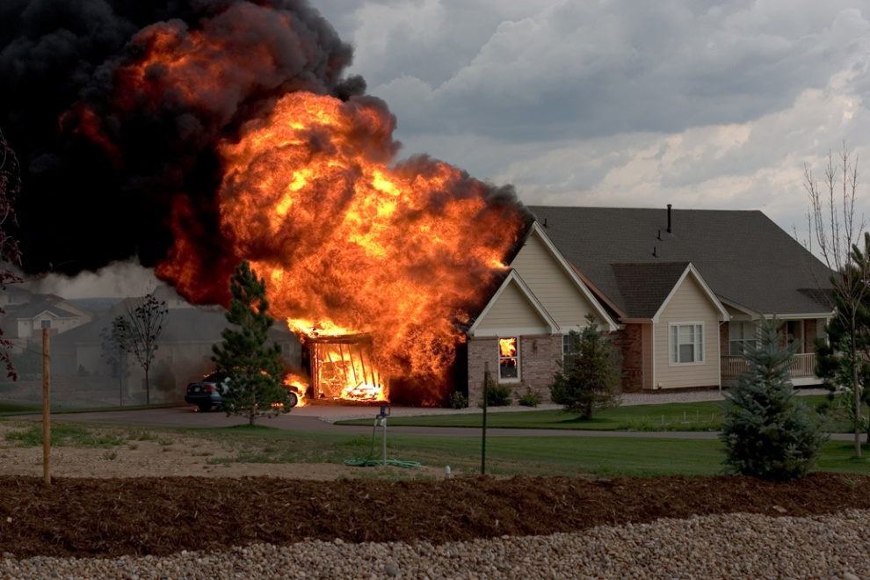
A Time to Shout!
This is a time to speak out!
It is a time to be bigoted about what is true!
Even if someone inside is not aware of the fact.
Even if someone else does like to be awakened out of sleep!
The Time to Speak!

Slide 4
A Time to Speak: Even a Bigot!
Acts 4:11-12
11 This is the stone which was set at nought of you builders, which is become the head of the corner.
12 Neither is there salvation in any other: for there is none other name under heaven given among men, whereby we must be saved.
People are lost by worshipping other gods.
Jesus Christ is the only way to eternal life.
The Time to Speak!

Slide 5
A time to SPEAK!
Ecclesiastes 3:7-8
7 A time to rend, and a time to sew; a time to keep silence, and a time to speak;
8 A time to love, and a time to hate; a time of war, and a time of peace.
The time to speak comes and goes, when it is gone, it is too late to speak!
There is also a time to keep silence and wisdom is bound up in knowing when and abiding by it.
The Time to Speak!

Slide 6
The Witness: A time to Speak!
Leviticus 5:1
1 And if a soul sin, and hear the voice of swearing, and is a witness, whether he hath seen or known of it; if he do not utter it, then he shall bear his iniquity.
A witness must speak up!
Whether it is welcome or unwelcome!
The Time to Speak!

Slide 7
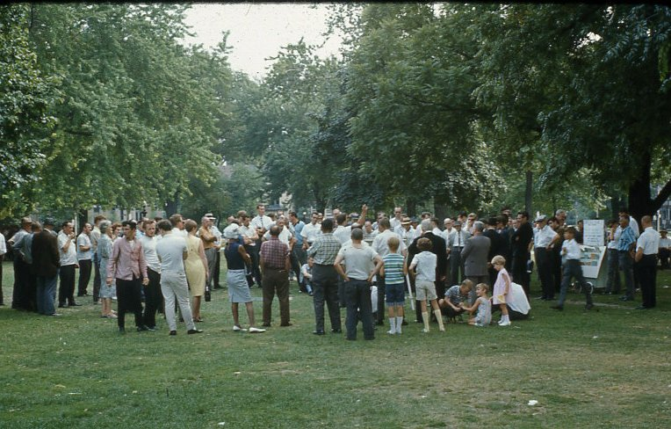
Open-air Preaching
The Time to Speak!

Slide 8
A vow: A time to Speak!
Numbers 30:4
4 And her father hear her vow, and her bond wherewith she hath bound her soul, and her father shall hold his peace at her: then all her vows shall stand, and every bond wherewith she hath bound her soul shall stand.
The Father had a window of opportunity to speak up!
If he did not speak up at the right time, it was too late to do so later.
The Time to Speak!

Slide 9
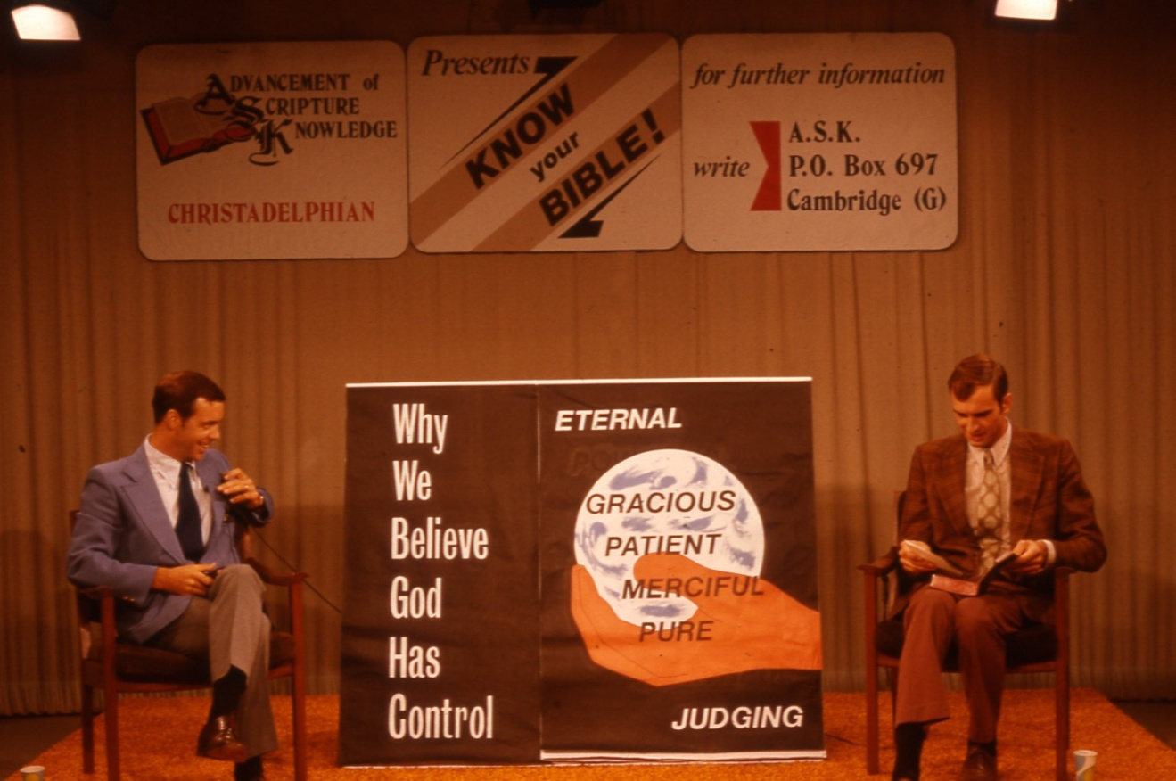
Little-time TV
The Time to Speak!

Slide 10
Watchmen: a time to Speak!
Ezekiel 33:7-8
7 So thou, O son of man, I have set thee a watchman unto the house of Israel; therefore thou shalt hear the word at my mouth, and warn them from me.
8 When I say unto the wicked, O wicked man, thou shalt surely die; if thou dost not speak to warn the wicked from his way, that wicked man shall die in his iniquity; but his blood will I require at thine hand.
The watchman of the Lord had an obligation to warn the people.
If he didn’t, then their blood would be required of him.
The Time to Speak!

Slide 11
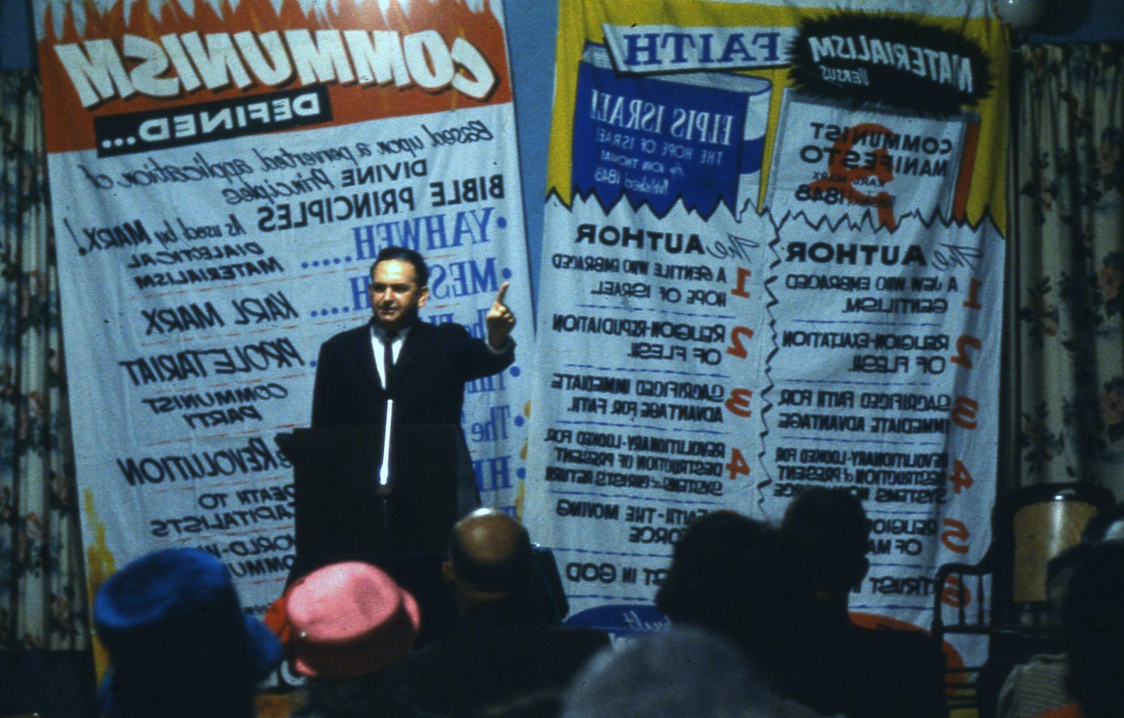
Have Something to Say!
The Time to Speak!

Slide 12
Our Hope: Speak Up!
1 Peter 3:15
15 But sanctify the Lord God in your hearts: and be ready always to give an answer to every man that asketh you a reason of the hope that is in you with meekness and fear:
Have an answer thought out and ready for the opportunity when it comes.
The Time to Speak!

Slide 13
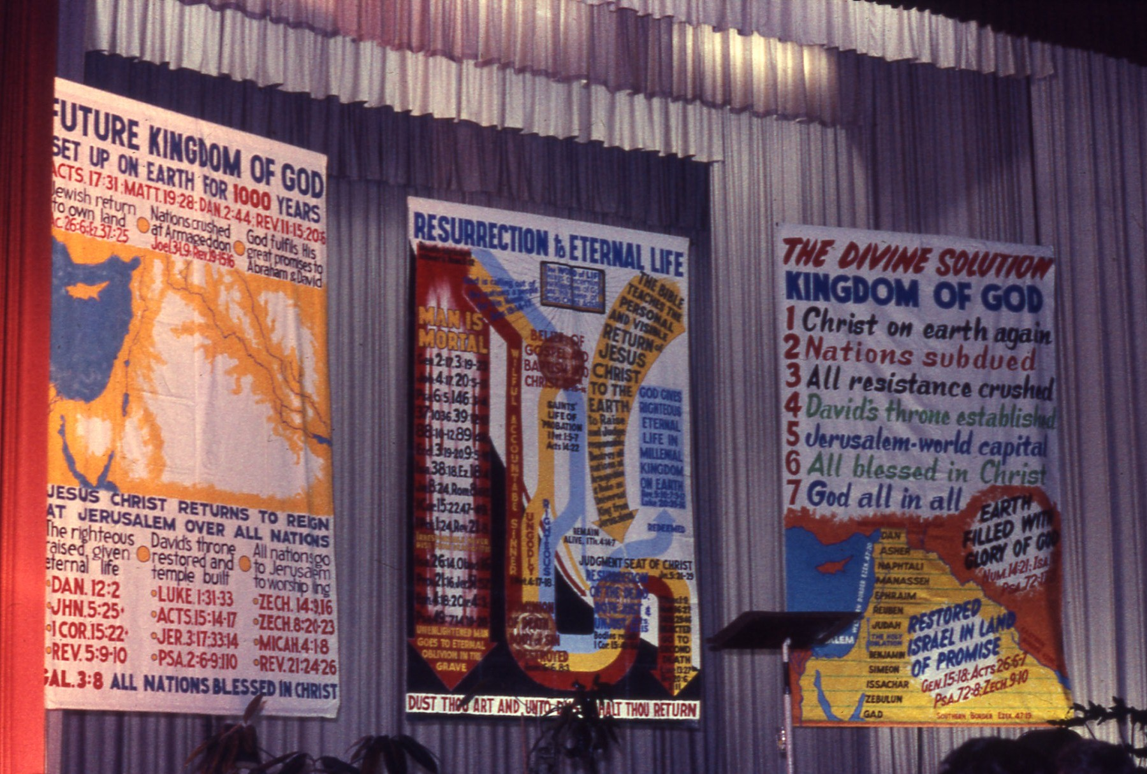
Bring Them in by the 1000s
The Time to Speak!

Slide 14
The Command to Preach
2 Timothy 4:2-4 KJV
2 Preach the word; be instant in season, out of season; reprove, rebuke, exhort with all longsuffering and doctrine.
3 For the time will come when they will not endure sound doctrine; but after their own lusts shall they heap to themselves teachers, having itching ears;
4 And they shall turn away their ears from the truth, and shall be turned unto fables.
This is a command of God for all believers.
The importance of doing this is heightened by the time when they will not endure sound teaching.
The Time to Speak!

Slide 15
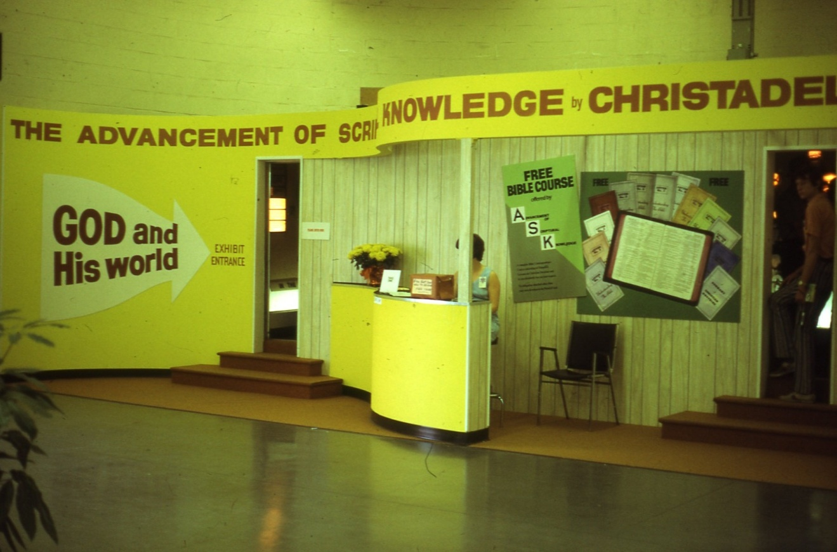
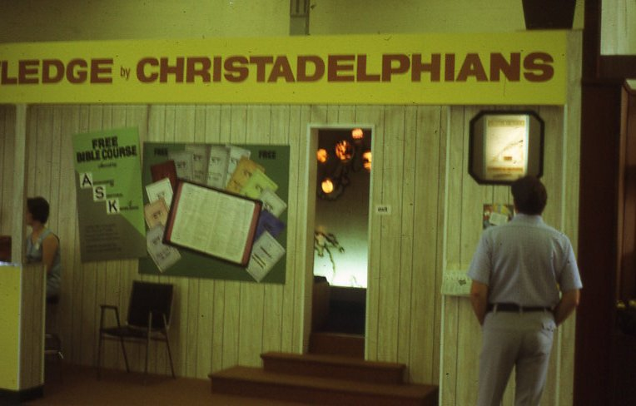
Special Exhibition at the CNE
The Time to Speak!

Slide 16
Preach the Word!
2 Timothy 4:2 AMP
2 Herald and preach the word! Keep your sense of urgency (stand by, be at hand and ready whether the opportunity seems to be favourable or unfavourable, whether it is convenient or inconvenient, whether it be welcome or unwelcome), you as preacher of the Word are to show people in what way their lives are wrong and convince them, rebuking and correcting, warning and urging and encouraging them being unflagging and inexhaustible in patience and teaching.
The Time to Speak!

Slide 17
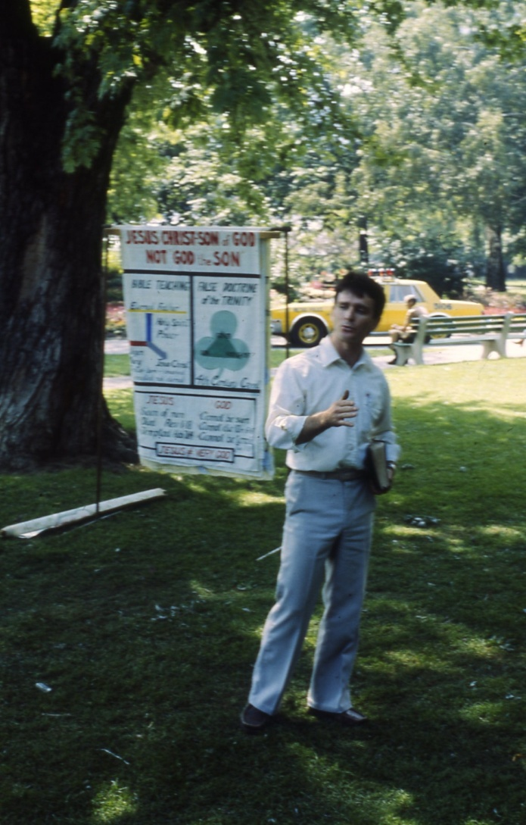
Tell the World – Anywhere!
The Time to Speak!

Slide 18
Are we driven by fear or ‘power’?
2 Timothy 1:7
7 For God hath not given us the spirit of fear; but of power, and of love, and of a sound mind.
Fear NT:1167 deilia (di-lee'-ah); from NT:1169; timidity:
KJV – fear
Power NT:1411 dunamis (doo'-nam-is); from NT:1410; force (literally or figuratively); specially, miraculous power (usually by implication, a miracle itself):
The Time to Speak!

Slide 19
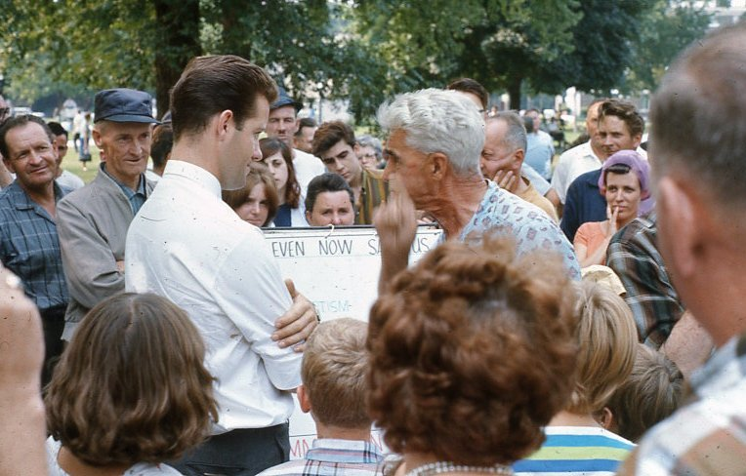
Answer Their Questions!
The Time to Speak!

Slide 20
Are we involved or ashamed?
Ashamed NT:1870 epaischunomai (ep-ahee-skhoo'-nom-ahee); from NT:1909 and NT:153; to feel shame for something:
KJV - be ashamed.
Partaker NT:4777 kakopatheo (soong-kak-op-ath-eh'-o); from NT:4862 and NT:2553; to suffer hardship in company with:
KJV - be partaker of afflictions.
2 Timothy 1:8
18 Be not thou therefore ashamed of the testimony of our Lord, nor of me his prisoner: but be thou partaker of the afflictions of the gospel according to the power of God;
The Time to Speak!

Slide 21
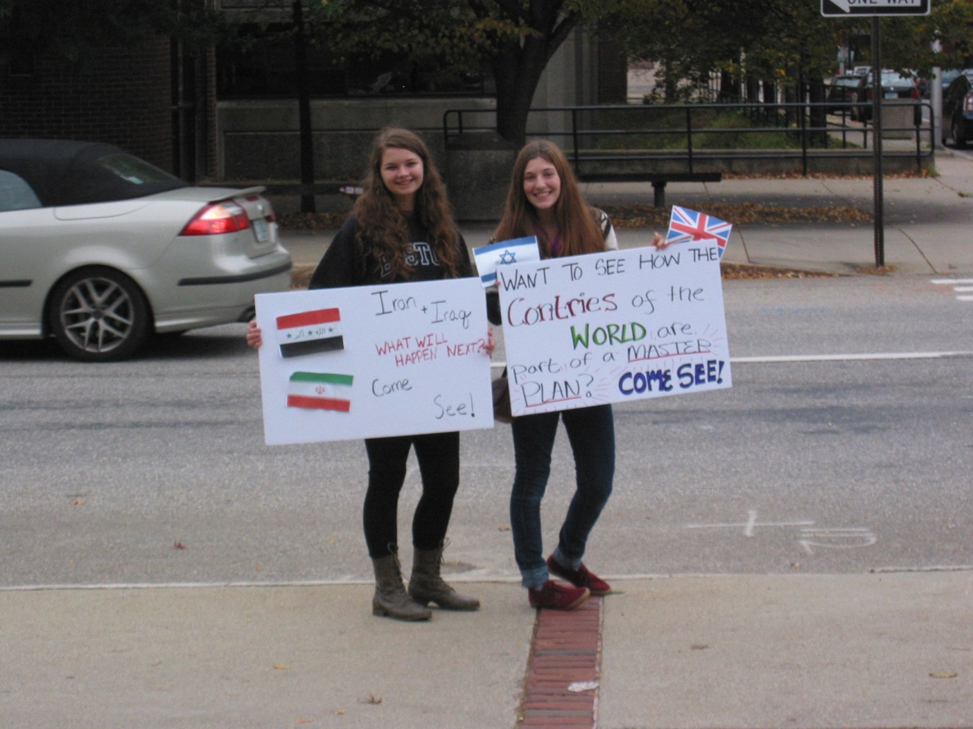
Main Street Advertisement
The Time to Speak!

Slide 22
A Time to Speak: Bible Prophecy!
Joel 3:1-2
1 For, behold, in those days, and in that time, when I shall bring again the captivity of Judah and Jerusalem,
2 I will also gather all nations, and will bring them down into the valley of Jehoshaphat, and will plead with them there for my people and for my heritage Israel, whom they have scattered among the nations, and parted my land.
The situation in Syria, Egypt, Israel, Russia, the EU, etc. is so very similar to what our Bible tells us to watch for at the time of the end.
The Time to Speak!

Slide 23
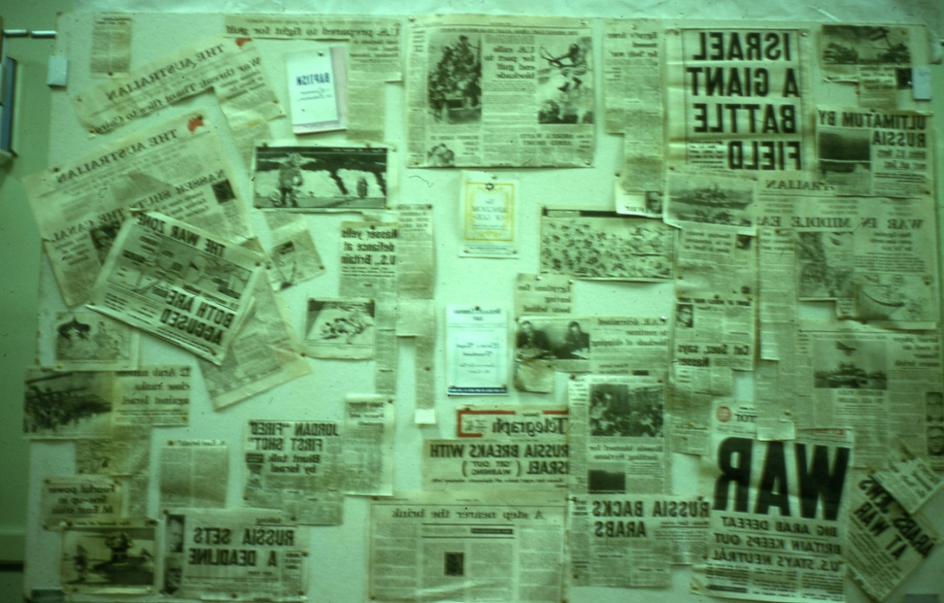
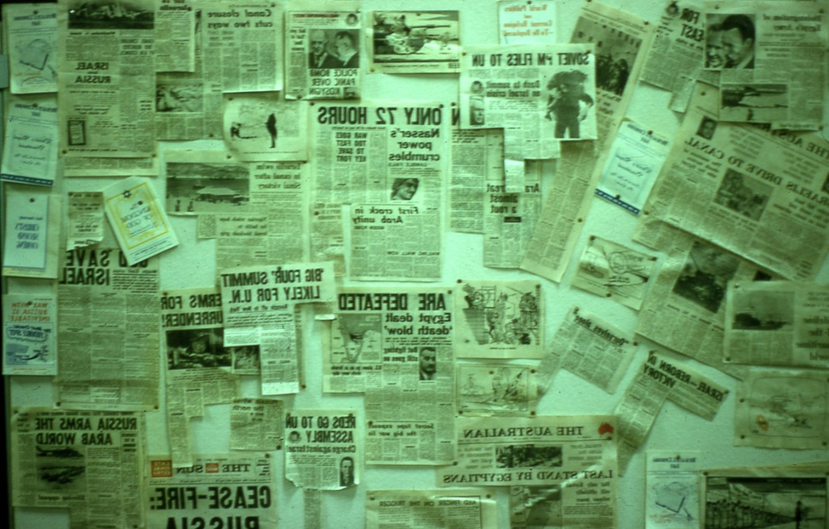
Take Advantage of the Times!
Early June, 1967
The Time to Speak!

Slide 24
Like Onesiphorus!
2 Timothy 1:16-17
16 The Lord give mercy unto the house of Onesiphorus; for he oft refreshed me, and was not ashamed of my chain:
17 But, when he was in Rome, he sought me out very diligently, and found me.
He may not have spoken many words but by his deeds he identified with the Apostle and likely lost his life doing so.
The Time to Speak!

Slide 25
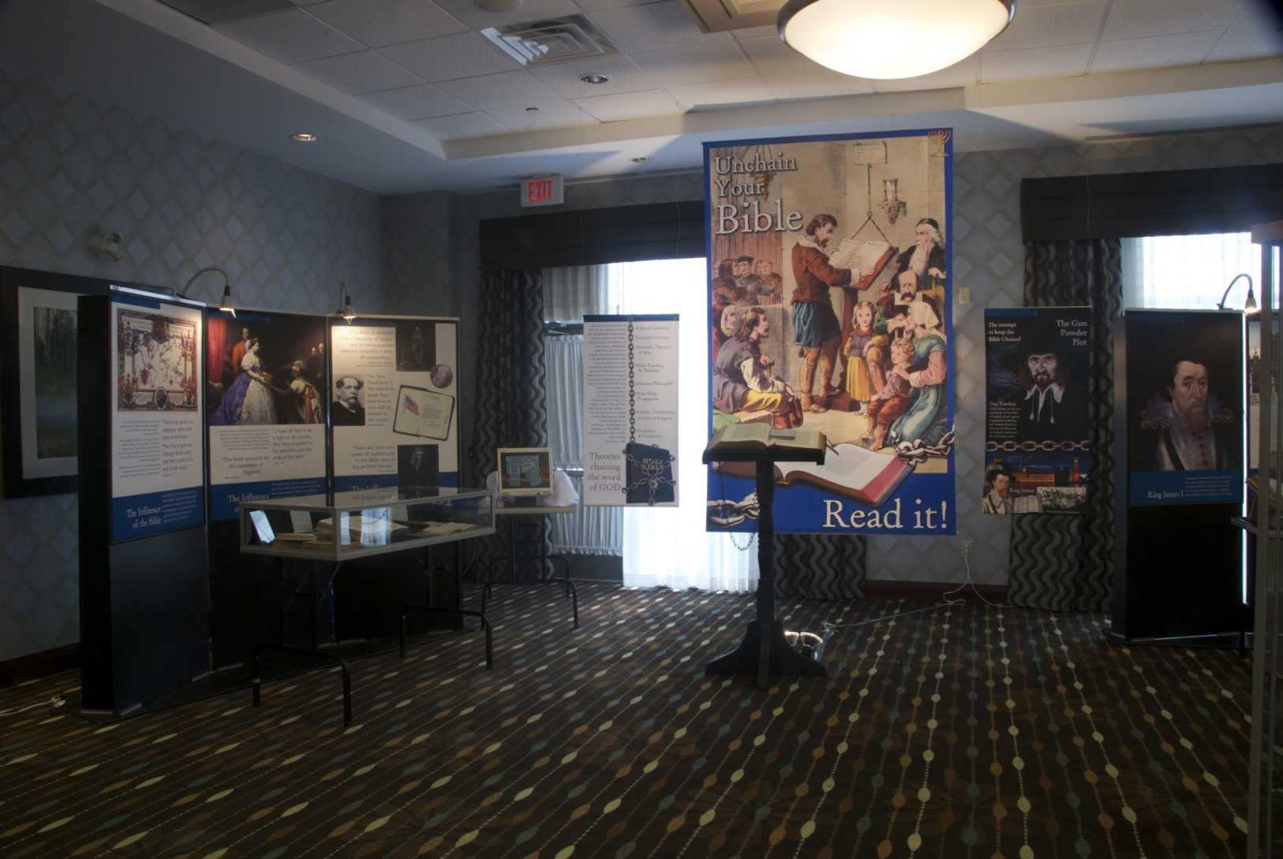
Bible Exhibitions
The Time to Speak!

Slide 26
A Time to Speak: Confession!
Joshua 7:19-20
19 And Joshua said unto Achan, My son, give, I pray thee, glory to the Lord God of Israel, and make confession unto him; and tell me now what thou hast done; hide it not from me.
20 And Achan answered Joshua, and said, Indeed I have sinned against the Lord God of Israel, and thus and thus have I done:
This is likely a typical scene at the Judgment Seat of Christ for those who never confessed before.
The Time to Speak!

Slide 27
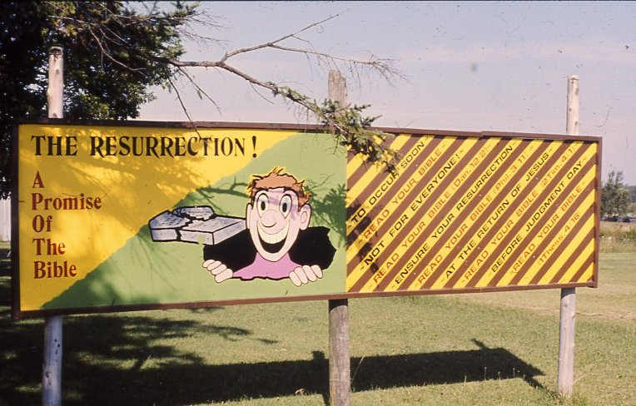
Signs for your front lawn!
The Time to Speak!

Slide 28
Given to us for safe keeping!
Committed NT:3866 paratheke (par-ath-ay'-kay); from NT:3908; a deposit, i.e. (figuratively) trust:
KJV - committed unto.
Keep NT:5442 phulasso (foo-las'-so); probably from NT:5443 through the idea of isolation; to watch, i.e. be on guard (literally of figuratively); by implication, to preserve, obey, avoid:
KJV - beward, keep (self), observe, save. Compare NT:5083.
2 Timothy 1:14
14 That good thing which was committed unto thee keep by the Holy Ghost which dwelleth in us.
The Time to Speak!

Slide 29
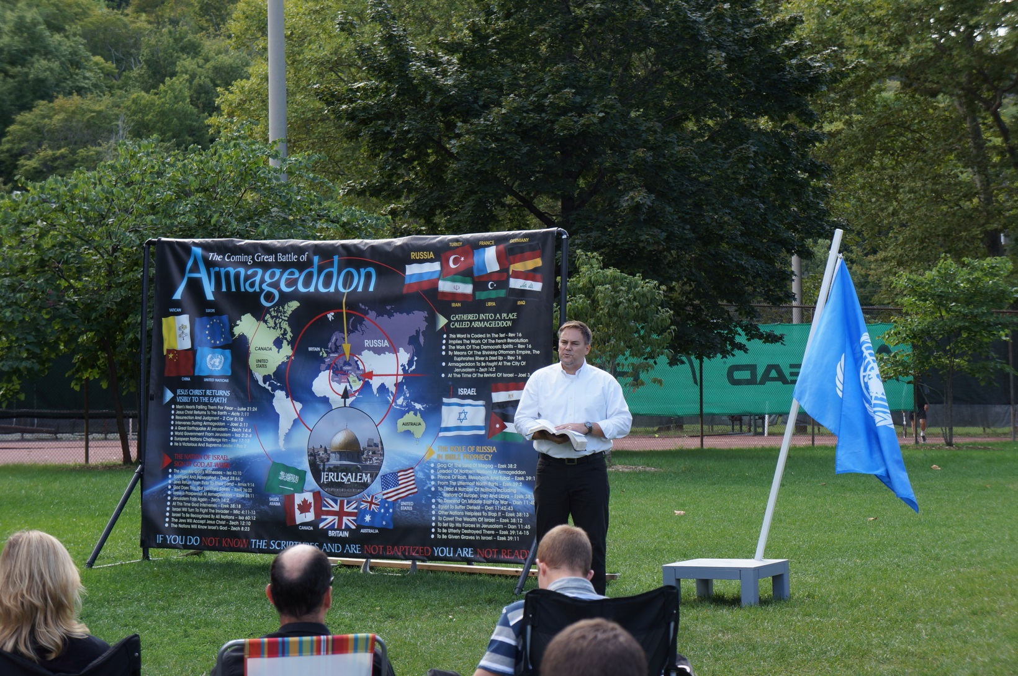
Armageddon is Coming!
The Time to Speak!

Slide 30
Arguing from Silence
It is highly revealing that in all the descriptions of hell in the Bible, we never read of infants or little children there. Nor do we read of infants and little children standing at the Great White Throne of judgment, which is the judgment of the wicked dead and the precursor to the lake of fire (Revelation 20:11-15). The complete silence of Scripture regarding the presence of infants in eternal torment militates against their being there. And since purgatory and limbo are unbiblical doctrines, (see chapter 13), the only conclusion we can draw is that infants and young children go straight to heaven at the moment of death.
Reasoning from the Scriptures with Catholics; Ron Rhodes; 2000
The Time to Speak!

Slide 31
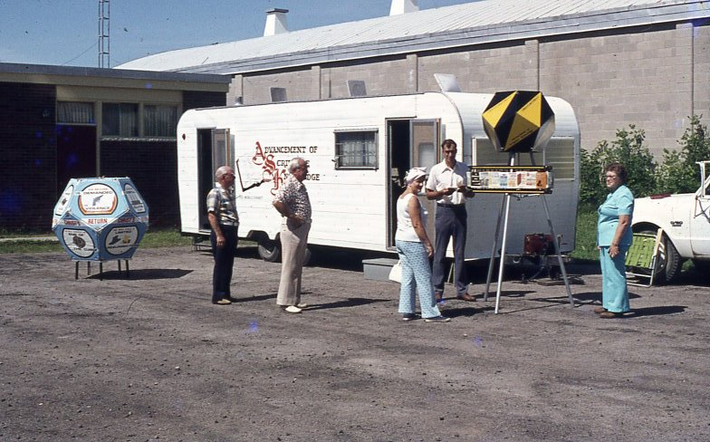
All Topics!
The Time to Speak!

Slide 32
Issues of the Day
Spirit NT:4151 pneuma (pnyoo'-mah); from NT:4154; a current of air, i.e. breath (blast) or a breeze; by analogy or figuratively, a spirit, i.e. (human) the rational soul, (by implication) vital principle, mental disposition, etc., or (superhuman) an angel, demon, or (divine) God, Christ's spirit, the Holy Spirit:
1 John 4:1 KJV
4 Beloved, believe not every spirit, but try the spirits whether they are of God: because many false prophets are gone out into the world.
The Time to Speak!

Slide 33
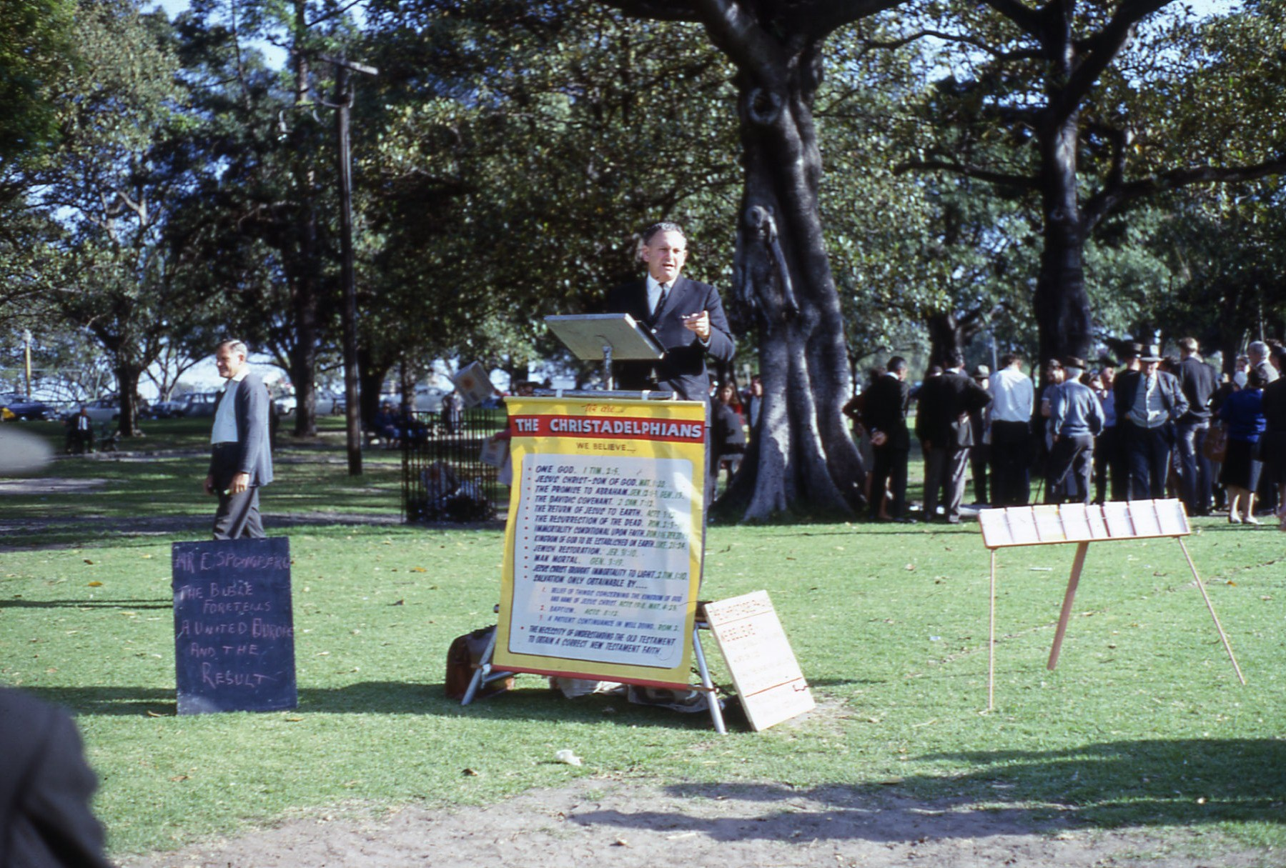
Who are the Christadelphians?
The Time to Speak!

Slide 34
Issues of the Day
Wind NT:417 anemos (an'-em-os); from the base of NT:109; wind; (plural) by implication (the four) quarters (of the earth):
KJV - wind.
Sleight G2940 kubeia
koo-bi'-ah
From κύβος kubos (a “cube”, that is, die for playing); gambling, that is, (figuratively) artifice or fraud: - sleight.
Ephesians 4:12 KJV
14 That we henceforth be no more children, tossed to and fro, and carried about with every wind of doctrine, by the sleight of men, and cunning craftiness, whereby they lie in wait to deceive;
The Time to Speak!

Slide 35
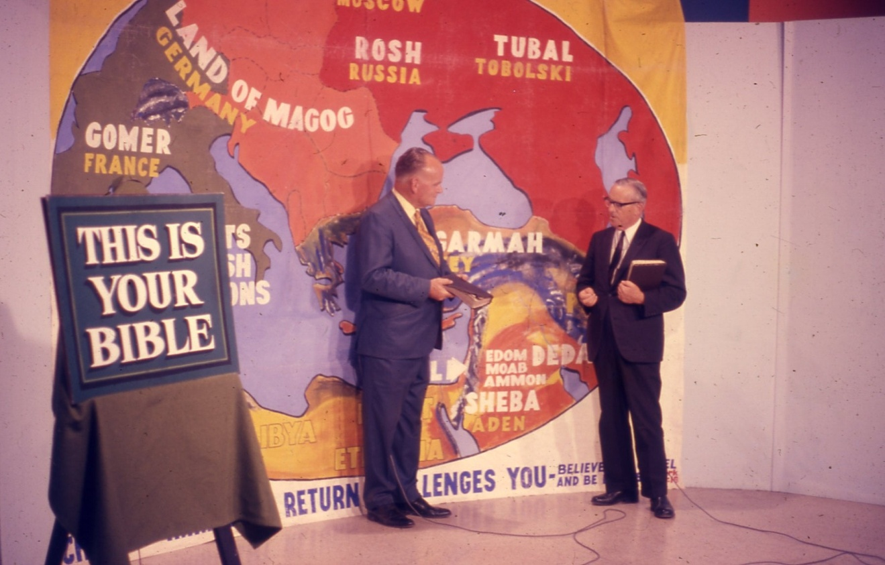
Big-time TV!
The Time to Speak!

Slide 36
Pray to speak boldly...
Ephesians 6:18-20
18 Praying always with all prayer and supplication in the Spirit, and watching thereunto with all perseverance and supplication for all saints;
19 And for me, that utterance may be given unto me, that I may open my mouth boldly, to make known the mystery of the gospel,
20 For which I am an ambassador in bonds: that therein I may speak boldly, as I ought to speak.
The Time to Speak!

