Slide 1
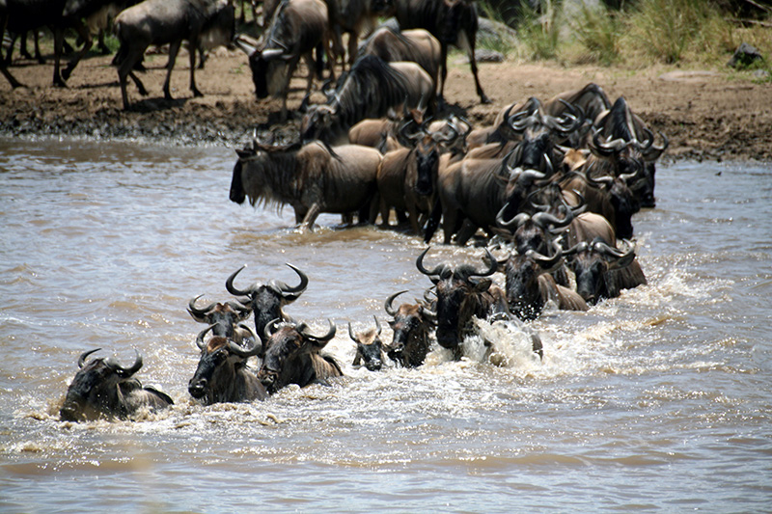
“Follow Me”
Class 1
“ensamples to the flock” 1Peter 5:3

Slide 2
Outline of Classes
Class 1:
“ensamples to the flock” 1Peter 5:3
Class 2:
“except the Father which hath sent me draw him” John 6:44
Class 3:
“I come to do thy will, O God” Hebrews 10:9
Class 4:
“take up his cross daily, and follow me” Luke 9:23
Exhort:
“more blessed to give than to receive” Acts 20:35
Class 5:
“when thou art converted …” Luke 22:32
Class 6:
“be ye followers of me …” 1Cor 11:1
Class 7:
“I will make you fishers of men” Matthew 4:19

Slide 3
English Meanings of “Follow”
To go or come after; move behind in the same direction: Drive ahead and I’ll follow you.
To accept as a guide or leader; accept the authority of.
To conform to, comply with, or act in accordance with; obey: to follow orders; to follow advice.
To imitate or copy: to follow the latest fads.
To come after as a result or consequence; result from: Higher prices usually follow wage increases.
To go after or along with (a person) as companion.
To go in pursuit of: to follow an enemy.
To try to attain to: to follow an ideal.

Slide 4
“Ensamples to the flock”
1 Peter 5:1-3
1 The elders which are among you I exhort, who am also an elder, and a witness of the sufferings of Christ, and also a partaker of the glory that shall be revealed:
2 Feed the flock of God which is among you, taking the oversight thereof, not by constraint, but willingly; not for filthy lucre, but of a ready mind;
3 Neither as being lords over God's heritage, but being ensamples to the flock.
Ensamples G5179 tupos
too'-pos
From G5180; a die (as struck), that is, (by implication) a stamp or scar; by analogy a shape, that is, a statue, (figuratively) style or resemblance; specifically a sampler (“type”), that is, a model (for imitation) or instance (for warning): - en- (ex-) ample, fashion, figure, form, manner, pattern, print.

Slide 5
Abraham
Romans 4:19-22
19 And being not weak in faith, he considered not his own body now dead, when he was about an hundred years old, neither yet the deadness of Sara's womb:
20 He staggered not at the promise of God through unbelief; but was strong in faith, giving glory to God;
21 And being fully persuaded that, what he had promised, he was able also to perform.
22 And therefore it was imputed to him for righteousness.
Acted out his conviction!
Fully persuaded G4135
play-rof-or-eh'-o
From G4134 and G5409; to carry out fully (in evidence), that is, completely assure (or convince), entirely accomplish: - most surely believe, fully know (persuade), make full proof of.

Slide 6
Phinehas
Numbers 25:11-13
11 Phinehas, the son of Eleazar, the son of Aaron the priest, hath turned my wrath away from the children of Israel, while he was zealous for my sake among them, that I consumed not the children of Israel in my jealousy.
12 Wherefore say, Behold, I give unto him my covenant of peace:
13 And he shall have it, and his seed after him, even the covenant of an everlasting priesthood; because he was zealous for his God, and made an atonement for the children of Israel.
Phinehas acted out of his zeal for his God.
Zealous H7065 kaw-naw'
A primitive root; to be (causatively make) zealous, that is, (in a bad sense) jealous or envious: - (be) envy (-ious), be (move to, provoke to) jealous (-y), X very, (be) zeal (-ous).
Atonement: H3722 kaw-far'
A primitive root; to cover (specifically with bitumen); figuratively to expiate or condone, to placate or cancel:

Slide 7
Ehud said – “follow after me”
Judges 3:27-28
27 And it came to pass, when he was come, that he blew a trumpet in the mountain of Ephraim, and the children of Israel went down with him from the mount, and he before them.
28 And he said unto them, Follow after me: for the LORD hath delivered your enemies the Moabites into your hand. And they went down after him, and took the fords of Jordan toward Moab, and suffered not a man to pass over.
Follow H7291 raw-daf'
A primitive root; to run after (usually with hostile intent; figuratively (of time) gone by): - chase, put to flight, follow (after, on), hunt, (be under) persecute (-ion, -or), pursue (-r).
This kind of ‘following’ does not imply any spiritual relationship.

Slide 8
Qualities worth following
Deuteronomy 16:19-20
19 Thou shalt not wrest judgment; thou shalt not respect persons, neither take a gift: for a gift doth blind the eyes of the wise, and pervert the words of the righteous.
20 That which is altogether just shalt thou follow, that thou mayest live, and inherit the land which the LORD thy God giveth thee.
Follow – H7291
This is the same word, but it would require a very different course of action to achieve it.

Slide 9
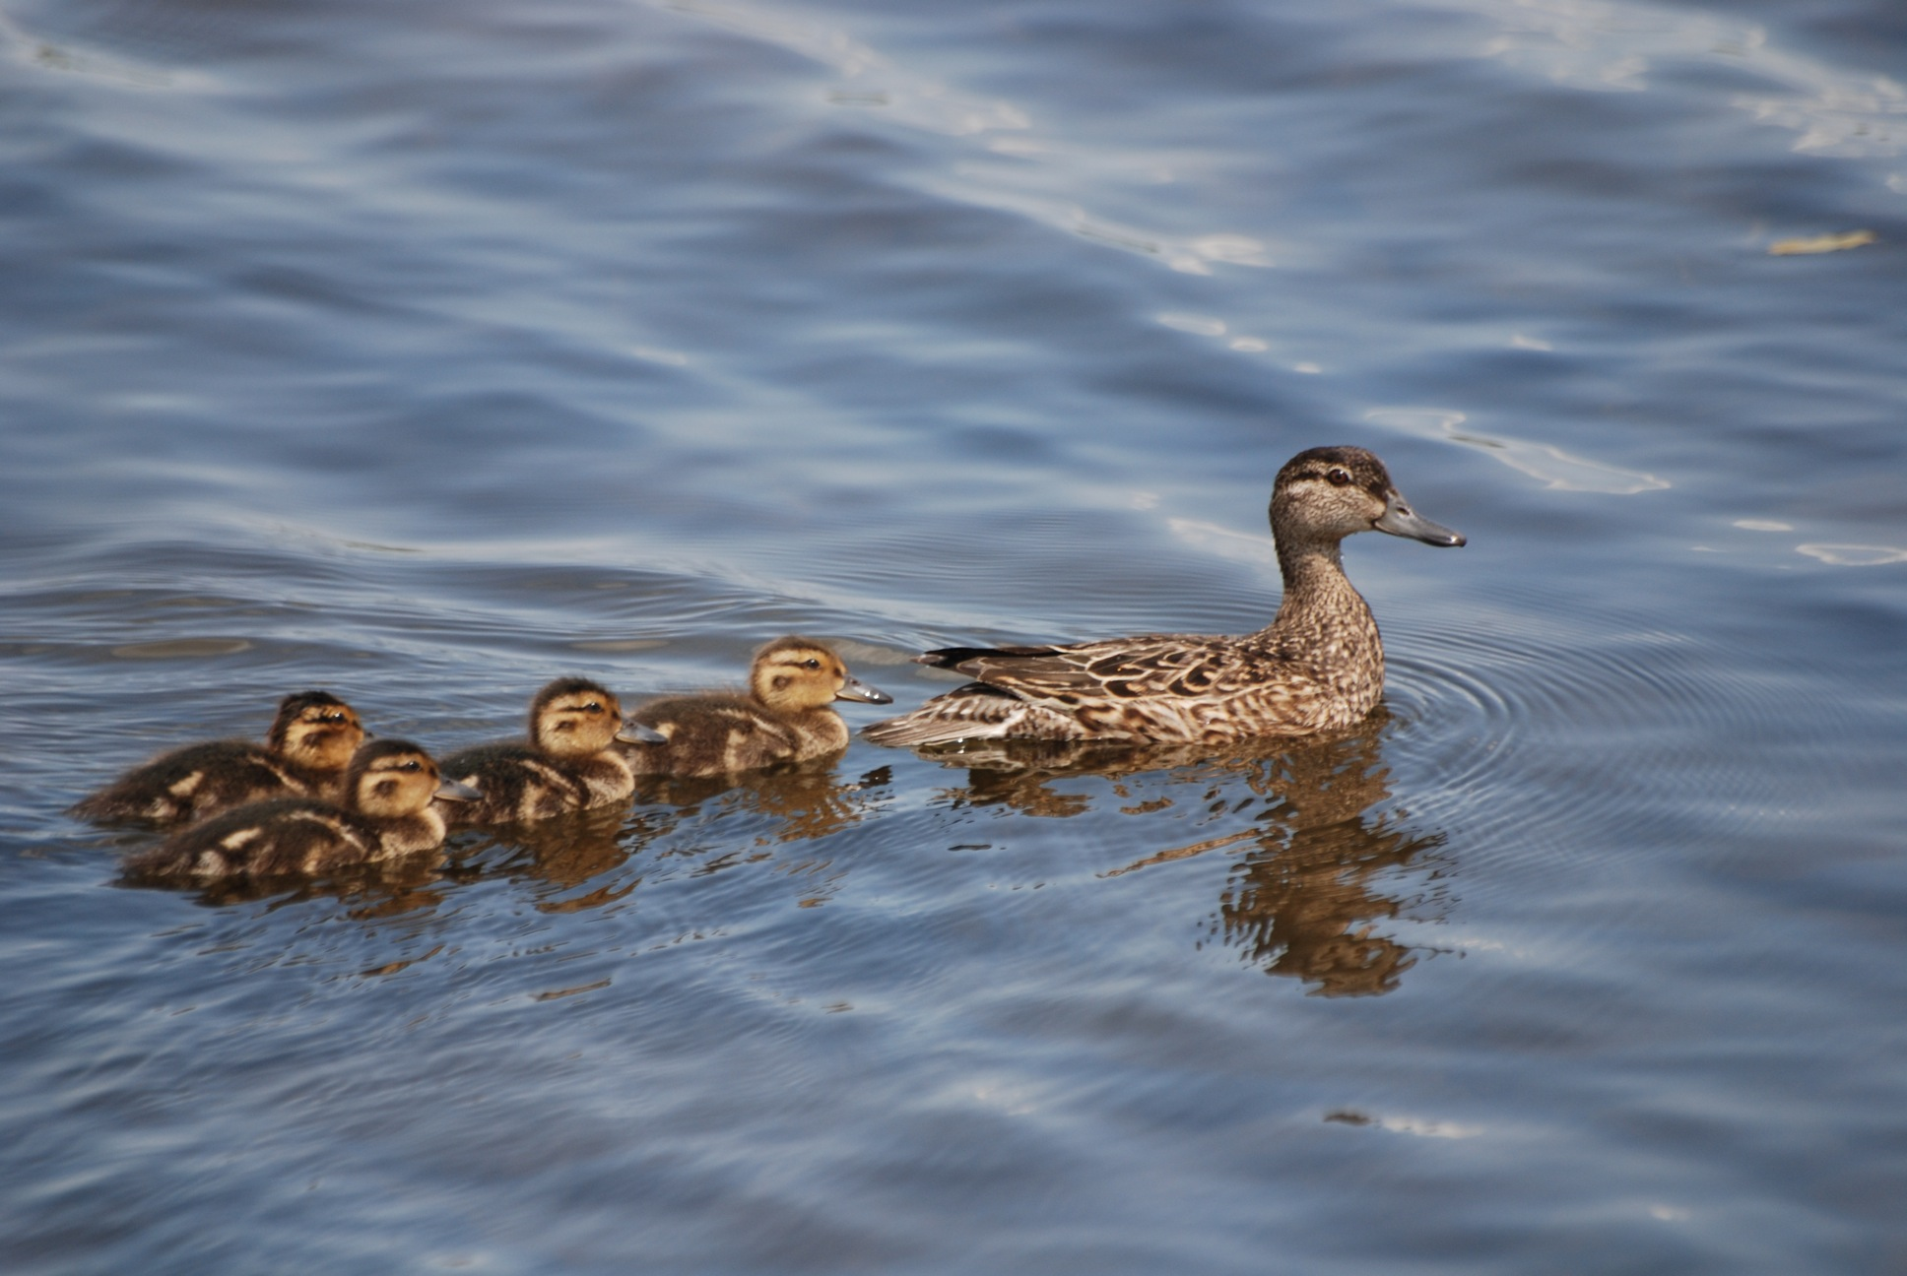
“Follow Me”

Slide 10
Caleb – followed fully
Numbers 14:24
24 But my servant Caleb, because he had another spirit with him, and hath followed me fully, him will I bring into the land whereinto he went; and his seed shall possess it.
Followed H4390
maw-lay', maw-law'
A primitive root, to fill or (intransitively) be full of, in a wide application (literally and figuratively):
H310 akh-ar'
From H309; properly the hind part; generally used as an adverb or conjugation, after (in various senses):

Slide 11
God expected Belief
Numbers 32:11-12
11 Surely none of the men that came up out of Egypt, from twenty years old and upward, shall see the land which I sware unto Abraham, unto Isaac, and unto Jacob; because they have not wholly followed me:
12 Save Caleb the son of Jephunneh the Kenezite, and Joshua the son of Nun: for they have wholly followed the LORD.
Following implied filling oneself with trust in the Word of Yahweh.
Those who were scared by the appearance of big men and giant walls were not “full of” Yahweh.

Slide 12
Jeroboam the son of Nebat
1 Kings 11:38
38 And it shall be, if thou wilt hearken unto all that I command thee, and wilt walk in my ways, and do that is right in my sight, to keep my statutes and my commandments, as David my servant did; that I will be with thee, and build thee a sure house, as I built for David, and will give Israel unto thee.
1 Kings 12:26-27
26 And Jeroboam said in his heart, Now shall the kingdom return to the house of David:
27 If this people go up to do sacrifice in the house of the LORD at Jerusalem, then shall the heart of this people turn again unto their lord, even unto Rehoboam king of Judah, and they shall kill me, and go again to Rehoboam king of Judah.
This faithlessness was at the root of what Jeroboam decided to do.

Slide 13
David was the Standard to Follow
1 Kings 14:8-9
8 And rent the kingdom away from the house of David, and gave it thee: and yet thou hast not been as my servant David, who kept my commandments, and who followed me with all his heart, to do that only which was right in mine eyes;
9 But hast done evil above all that were before thee: for thou hast gone and made thee other gods, and molten images, to provoke me to anger, and hast cast me behind thy back:
Jeroboam cast YHWH behind his back – obviously not prepared to follow.
When he received the ten tribes from YHWH he was expected to maintain the way of David the King.
He had received the tokens of a true prophecy. He was told this would happen 1Ki 11:31. This was the token of a true prophet. Deut 18:21-22

Slide 14
Ahab followed Baalim
1 Kings 18:17-18
17 And it came to pass, when Ahab saw Elijah, that Ahab said unto him, Art thou he that troubleth Israel?
18 And he answered, I have not troubled Israel; but thou, and thy father's house, in that ye have forsaken the commandments of the LORD, and thou hast followed Baalim.
Ahab measured Elijah by his God.
Elijah measured Ahab by his God.
We are to be measured by the God we follow.

Slide 15
Following Yahweh or Vanity?
2 Kings 17:14-15
14 Notwithstanding they would not hear, but hardened their necks, like to the neck of their fathers, that did not believe in the LORD their God.
15 And they rejected his statutes, and his covenant that he made with their fathers, and his testimonies which he testified against them; and they followed vanity, and became vain, and went after the heathen that were round about them, concerning whom the LORD had charged them, that they should not do like them.
Worship directed to the idols of the nations was an exercise of vanity.
Hence, they became ‘empty headed’ just like their idols.

Slide 16
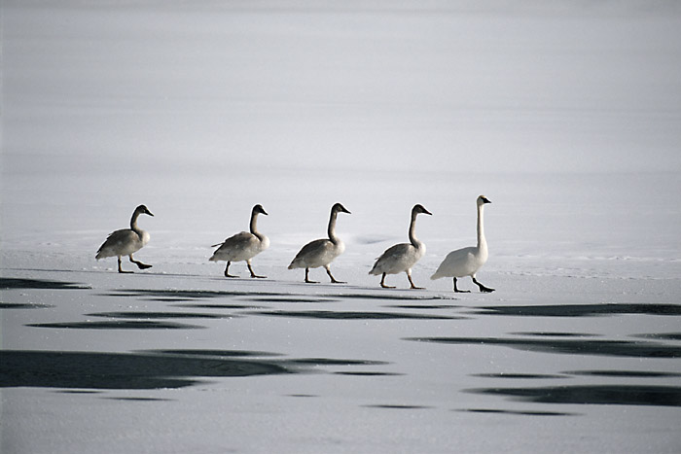
“Follow Me”

Slide 17
Worship Him in Spirit
John 4:23-24
23 But the hour cometh, and now is, when the true worshippers shall worship the Father in spirit and in truth: for the Father seeketh such to worship him.
24 God is a Spirit: and they that worship him must worship him in spirit and in truth.
Not all connections made in the theme of “following” can be made by finding a link to that word.
Connections made by ‘spirit’ take us much further.

Slide 18
Gehazi pursued Naaman
2Kings 5:20-21
20 But Gehazi, the servant of Elisha the man of God, said, Behold, my master hath spared Naaman this Syrian, in not receiving at his hands that which he brought: but, as the LORD liveth, I will run after him, and take somewhat of him.
21 So Gehazi followed after Naaman. And when Naaman saw him running after him, he lighted down from the chariot to meet him, and said, Is all well?
“as YHWH liveth” why would he profane this phrase?
2Ki 4:30 And the mother of the child said, As the LORD liveth, and as thy soul liveth, I will not leave thee. And he arose, and followed her.
2Ki 5:16 But he said, As the LORD liveth, before whom I stand, I will receive none. And he urged him to take it; but he refused.

Slide 19
Gehazi pursued Naaman
2Kings 5:20-21
20 But Gehazi, the servant of Elisha the man of God, said, Behold, my master hath spared Naaman this Syrian, in not receiving at his hands that which he brought: but, as the LORD liveth, I will run after him, and take somewhat of him.
21 So Gehazi followed after Naaman. And when Naaman saw him running after him, he lighted down from the chariot to meet him, and said, Is all well?
Followed H7291 râdaph
BDB Definition:
1) to be behind, follow after, pursue, persecute, run after
1a) (Qal)
  1a1) to pursue, put to flight, chase, dog, attend closely upon
  1a2) to persecute, harass (figuratively)
  1a3) to follow after, aim to secure (figuratively)
  1a4) to run after (a bribe) (figuratively)
1b) (Niphal)
  1b1) to be pursued
  1b2) one pursued (participle)
1c) (Piel) to pursue ardently, aim eagerly to secure, pursue
1d) (Pual) to be pursued, be chased away
1e) (Hiphil) to pursue, chase
Part of Speech: verb

Slide 20
Ebedmelech the Ethiopian
Jeremiah 38:6-7
6 Then took they Jeremiah, and cast him into the dungeon of Malchiah the son of Hammelech, that was in the court of the prison: and they let down Jeremiah with cords. And in the dungeon there was no water, but mire: so Jeremiah sunk in the mire.
7 Now when Ebedmelech the Ethiopian, one of the eunuchs which was in the king's house, heard that they had put Jeremiah in the dungeon; the king then sitting in the gate of Benjamin;
God would save Jeremiah but who could he use under these circumstances.
The king had just given the princes his authority to act against Jeremiah.
Jeremiah was sinking in the mire, time was of essence.

Slide 21
Ebedmelech the Ethiopian
Jeremiah 38:8-9
8 Ebedmelech went forth out of the king's house, and spake to the king, saying,
9 My lord the king, these men have done evil in all that they have done to Jeremiah the prophet, whom they have cast into the dungeon; and he is like to die for hunger in the place where he is: for there is no more bread in the city.
Who was brave enough to go to the King for help after these events?
Ebedmelech, a eunuch from the King’s house.

Slide 22
Ebedmelech the Ethiopian
Jeremiah 38:10-11
10 Then the king commanded Ebedmelech the Ethiopian, saying, Take from hence thirty men with thee, and take up Jeremiah the prophet out of the dungeon, before he die.
11 So Ebedmelech took the men with him, and went into the house of the king under the treasury, and took thence old cast clouts and old rotten rags, and let them down by cords into the dungeon to Jeremiah.
Cast clouts H5499
eh-khaw-baw'
From H5498; a rag: - cast clout.
Rotten rags H4418
maw-lawkh'
From H4414 in its original sense; a rag or old garment: - rotten rag.

Slide 23
Ebedmelech the Ethiopian
Jeremiah 38:12-13
12 And Ebedmelech the Ethiopian said unto Jeremiah, Put now these old cast clouts and rotten rags under thine armholes under the cords. And Jeremiah did so.
13 So they drew up Jeremiah with cords, and took him up out of the dungeon: and Jeremiah remained in the court of the prison.
Faithful Ebedmelech was in command.
Jeremiah was saved from a cruel death.

Slide 24
Ebedmelech the Ethiopian
Jeremiah 39:15-18
15 Now the word of the LORD came unto Jeremiah, while he was shut up in the court of the prison, saying,
16 Go and speak to Ebedmelech the Ethiopian, saying, Thus saith the LORD of hosts, the God of Israel; Behold, I will bring my words upon this city for evil, and not for good; and they shall be accomplished in that day before thee.
17 But I will deliver thee in that day, saith the LORD: and thou shalt not be given into the hand of the men of whom thou art afraid.
18 For I will surely deliver thee, and thou shalt not fall by the sword, but thy life shall be for a prey unto thee: because thou hast put thy trust in me, saith the LORD.
Ebedmelech would be saved because of his regard for God and his servant Jeremiah.
The ‘spirit’ of Ebedmelech was in concert with his God.
This occurred even though the King he was serving was faithless.
God notices those who follow Him in spirit and works with them.

Slide 25
The Example of our Lord Jesus
John 14:8-10
8 Philip saith unto him, Lord, shew us the Father, and it sufficeth us.
9 Jesus saith unto him, Have I been so long time with you, and yet hast thou not known me, Philip? he that hath seen me hath seen the Father; and how sayest thou then, Shew us the Father?
10 Believest thou not that I am in the Father, and the Father in me? the words that I speak unto you I speak not of myself: but the Father that dwelleth in me, he doeth the works.
Following at the highest level does not use simple terms like “follow,”
Rather, it uses metaphors like “dwelleth in me.”
This is the level of “following” that we shall aspire to understand this weekend.

