Slide 1
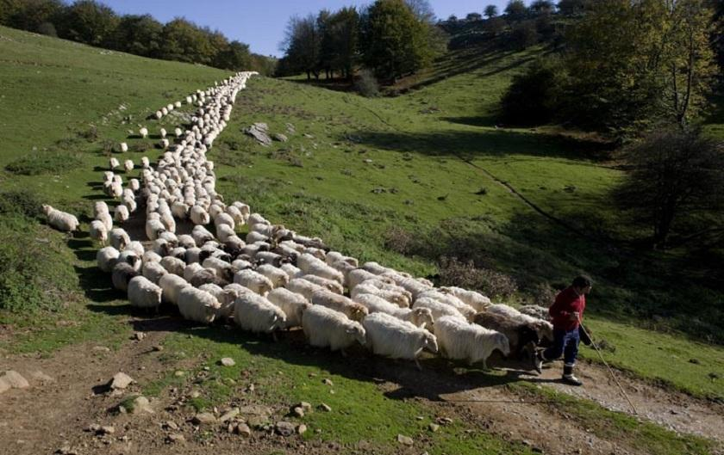
Follow Me
Class 2
“Except the Father which hath sent me draw him” John 6:44

Slide 2
Except the Father … draw him
John 6:43-45
43 Jesus therefore answered and said unto them, Murmur not among yourselves.
44 No man can come to me, except the Father which hath sent me draw him: and I will raise him up at the last day.
45 It is written in the prophets, And they shall be all taught of God. Every man therefore that hath heard, and hath learned of the Father, cometh unto me.
Draw G1670
helkuō / helkō
Thayer Definition:
1) to draw, drag off
2) metaphorically, to draw by inward power, lead, impel
Part of Speech: verb
But how does the Father draw us, to follow Him?

Slide 3
He that cometh to God …
Hebrews 11:6
6 But without faith it is impossible to please him: for he that cometh to God must believe that he is, and that he is a rewarder of them that diligently seek him.
We cannot begin to follow our God without these essential basic beliefs.

Slide 4
God: “All in All”
1 Corinthians 15:28
28 And when all things shall be subdued unto him, then shall the Son also himself be subject unto him that put all things under him, that God may be all in all.
This is the ultimate purpose of God for what He has created on the earth.
Knowing His purpose helps get our lives in line.

Slide 5
Make up your mind!
1 Kings 18:21
21 And Elijah came unto all the people, and said, How long halt ye between two opinions? if the LORD be God, follow him: but if Baal, then follow him. And the people answered him not a word.
Follow H1980 H310 haw-lak'
Akin to H3212; a primitive root; to walk (in a great variety of applications, literally and figuratively):
H310 akh-ar'
From H309; properly the hind part; generally used as an adverb or conjugation, after (in various senses):

Slide 6
The Still Small Voice!
1 Kings 19:11-12
11 And he said, Go forth, and stand upon the mount before the LORD. And, behold, the LORD passed by, and a great and strong wind rent the mountains, and brake in pieces the rocks before the LORD; but the LORD was not in the wind: and after the wind an earthquake; but the LORD was not in the earthquake:
12 And after the earthquake a fire; but the LORD was not in the fire: and after the fire a still small voice.
Still H1827 dem-aw-maw'
Feminine from H1826; quiet: - calm, silence, still.
Small H1851 dak
From H1854; crushed, that is, (by implication) small or thin: - dwarf, lean [-fleshed], very little thing, small, thin.
Voice H6963 kole, kole
From an unused root meaning to call aloud; a voice or sound:

Slide 7
This voice energized Gideon!
Judges 7:14-15
14 And his fellow answered and said, This is nothing else save the sword of Gideon the son of Joash, a man of Israel: for into his hand hath God delivered Midian, and all the host.
15 And it was so, when Gideon heard the telling of the dream, and the interpretation thereof, that he worshipped, and returned into the host of Israel, and said, Arise; for the LORD hath delivered into your hand the host of Midian.
He was invited by God to gain further strength that his army of 300 men could rout one that had over 100,000.
He heard a still small voice, but the circumstances amplified it into conviction.
He immediately worshipped his God for this gracious act of giving him courage.

Slide 8
Diligently Listen
Diligently hearken H8085 2x
shaw-mah'
A primitive root; to hear intelligently (often with implication of attention, obedience, etc.; causatively to tell, etc.):
Give ear H238 aw-zan'
A primitive root; probably to expand; but used only as a denominative from H241; to broaden out the ear (with the hand), that is, (by implication) to listen: - give (perceive by the) ear, hear (-ken). See H239.
Exodus 15:26
26 And said, If thou wilt diligently hearken to the voice of the LORD thy God, and wilt do that which is right in his sight, and wilt give ear to his commandments, and keep all his statutes, I will put none of these diseases upon thee, which I have brought upon the Egyptians: for I am the LORD that healeth thee.

Slide 9
Not many mighty … are called
1 Corinthians 1:26-29
26 For ye see your calling, brethren, how that not many wise men after the flesh, not many mighty, not many noble, are called:
27 But God hath chosen the foolish things of the world to confound the wise; and God hath chosen the weak things of the world to confound the things which are mighty;
28 And base things of the world, and things which are despised, hath God chosen, yea, and things which are not, to bring to nought things that are:
29 That no flesh should glory in his presence.
The circumstances surrounding the lives of mighty and famous people makes conviction of unpopular religious ideas difficult to accept.
Sir Isaac Newton by being famous and influential was somewhat muted about his religious convictions.

Slide 10
Everlasting burnings
Isaiah 33:14-16
14 The sinners in Zion are afraid; fearfulness hath surprised the hypocrites. Who among us shall dwell with the devouring fire? who among us shall dwell with everlasting burnings?
15 He that walketh righteously, and speaketh uprightly; he that despiseth the gain of oppressions, that shaketh his hands from holding of bribes, that stoppeth his ears from hearing of blood, and shutteth his eyes from seeing evil;
16 He shall dwell on high: his place of defence shall be the munitions of rocks: bread shall be given him; his waters shall be sure.
Dwelling with, or following God requires more than just intellectual assent.
These verses show that lifestyle is a better indicator of belief than just a statement of conviction.

Slide 11
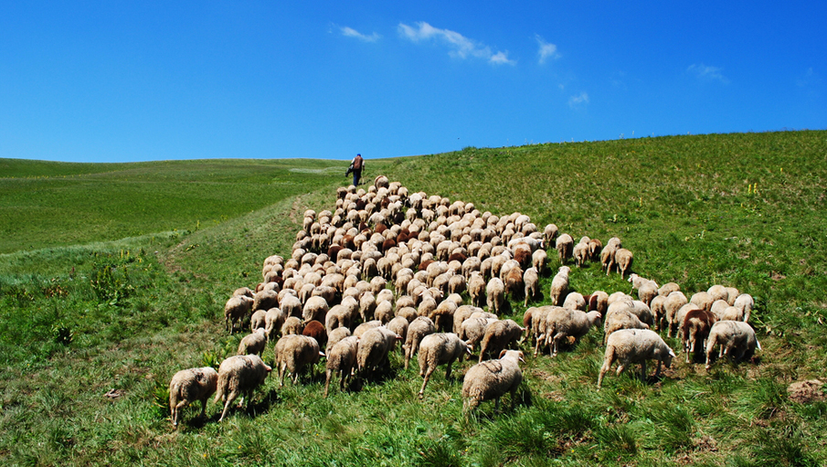
“Follow Me”

Slide 12
Have everlasting life
John 3:16-17
16 For God so loved the world, that he gave his only begotten Son, that whosoever believeth in him should not perish, but have everlasting life.
17 For God sent not his Son into the world to condemn the world; but that the world through him might be saved.
We are far more likely to appreciate the promises of the Scriptures when we get to know what perishing really means.
The One who has created us has shown His love in the very desirable way He tries to save us.
The attractiveness of His method of salvation “draws us.”

Slide 13
Drawn with bands of love
Hosea 11:3-4
3 I taught Ephraim also to go, taking them by their arms; but they knew not that I healed them.
4 I drew them with cords of a man, with bands of love: and I was to them as they that take off the yoke on their jaws, and I laid meat unto them.
Drew H4900 mâshak
maw-shak'
A primitive root; to draw, used in a great variety of applications (including to sow, to sound, to prolong, to develop, to march, to remove, to delay, to be tall, etc.):
The feelings associated with being healed through the power of answered prayer, “draw us” closer to God.

Slide 14
For He is Kind
Luke 6:35-36
35 But love ye your enemies, and do good, and lend, hoping for nothing again; and your reward shall be great, and ye shall be the children of the Highest: for he is kind unto the unthankful and to the evil.
36 Be ye therefore merciful, as your Father also is merciful.
We are His children when by seeing His example of benevolence we are ‘drawn’ closer to Him and try to emulate His example.

Slide 15
His love commends itself
Commendeth G4921
sunistaō sunistanō sunistēmi
soon-is-tah'-o, soon-is-tah'-an'-o, soon-is-tah'-ay-mee
From G4862 and G2476 (including its collateral forms); to set together, that is, (by implication) to introduce (favorably), or (figuratively) to exhibit; intransitively to stand near, or (figuratively) to constitute:
God stands by His example, so to speak, to commend it to us in order that we might be ‘drawn’ to His side.
Romans 5:7-8
7 For scarcely for a righteous man will one die: yet peradventure for a good man some would even dare to die.
8 But God commendeth his love toward us, in that, while we were yet sinners, Christ died for us.

Slide 16
If God so loved us
1 John 4:9-11
9 In this was manifested the love of God toward us, because that God sent his only begotten Son into the world, that we might live through him.
10 Herein is love, not that we loved God, but that he loved us, and sent his Son to be the propitiation for our sins.
11 Beloved, if God so loved us, we ought also to love one another.
We must first appreciate the fact that God has shown his love toward us.
Out of gratitude we should love one another.

Slide 17
Following God’s Example
Matthew 5:44-45
44 But I say unto you, Love your enemies, bless them that curse you, do good to them that hate you, and pray for them which despitefully use you, and persecute you;
45 That ye may be the children of your Father which is in heaven: for he maketh his sun to rise on the evil and on the good, and sendeth rain on the just and on the unjust.
To be generous towards all and give according to how God gives.
This is what being children means – having the character of your parents.

Slide 18
Great and precious promises
2 Peter 1:3-4
3 According as his divine power hath given unto us all things that pertain unto life and godliness, through the knowledge of him that hath called us to glory and virtue:
4 Whereby are given unto us exceeding great and precious promises: that by these ye might be partakers of the divine nature, having escaped the corruption that is in the world through lust.
These promises of God are very motivational.
We need to be constantly reminded of them and to firmly embrace them.
By them we escape from the enticements of the world.

Slide 19
Whatsoever we ask
1 John 3:21-22
21 Beloved, if our heart condemn us not, then have we confidence toward God.
22 And whatsoever we ask, we receive of him, because we keep his commandments, and do those things that are pleasing in his sight.
This is a way of life for those who mature in it.
It is difficult to shift a person off this lifestyle.

Slide 20
Followers of God
Ephesians 5:1-2
1 Be ye therefore followers of God, as dear children;
2 And walk in love, as Christ also hath loved us, and hath given himself for us an offering and a sacrifice to God for a sweetsmelling savour.
Followers G3402
mimētēs
mim-ay-tace'
From G3401; an imitator: - follower.
God is the example of a loving parent and who has thereby endeared himself to them.

Slide 21
Followers of God - Forgiveness
Matthew 6:14-15
14 For if ye forgive men their trespasses, your heavenly Father will also forgive you:
15 But if ye forgive not men their trespasses, neither will your Father forgive your trespasses.
Our forgiveness is conditional.
Our personal forgiveness is based on our willingness to forgive others.
God works with guilt to draw us into forgiveness.

Slide 22
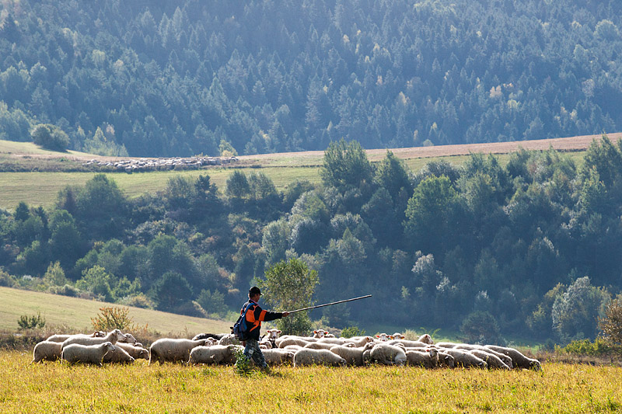
“Follow Me”

Slide 23
I will raise them up a prophet
Deuteronomy 18:17-19
17 And the LORD said unto me, They have well spoken that which they have spoken.
18 I will raise them up a Prophet from among their brethren, like unto thee, and will put my words in his mouth; and he shall speak unto them all that I shall command him.
19 And it shall come to pass, that whosoever will not hearken unto my words which he shall speak in my name, I will require it of him.
Jesus was that prophet that Moses had been told about some 1500 years before.
Jesus was His obedience son who told those to whom he was sent that he was not speaking of himself, but by commandment.

Slide 24
God was in Christ
2 Corinthians 5:17-19
17 Therefore if any man be in Christ, he is a new creature: old things are passed away; behold, all things are become new.
18 And all things are of God, who hath reconciled us to himself by Jesus Christ, and hath given to us the ministry of reconciliation;
19 To wit, that God was in Christ, reconciling the world unto himself, not imputing their trespasses unto them; and hath committed unto us the word of reconciliation.
God would not be willing to be manifested in a person who was less willing to do His will.
Jesus left an example for us and footsteps to follow by first of all, following God himself.

