Slide 1
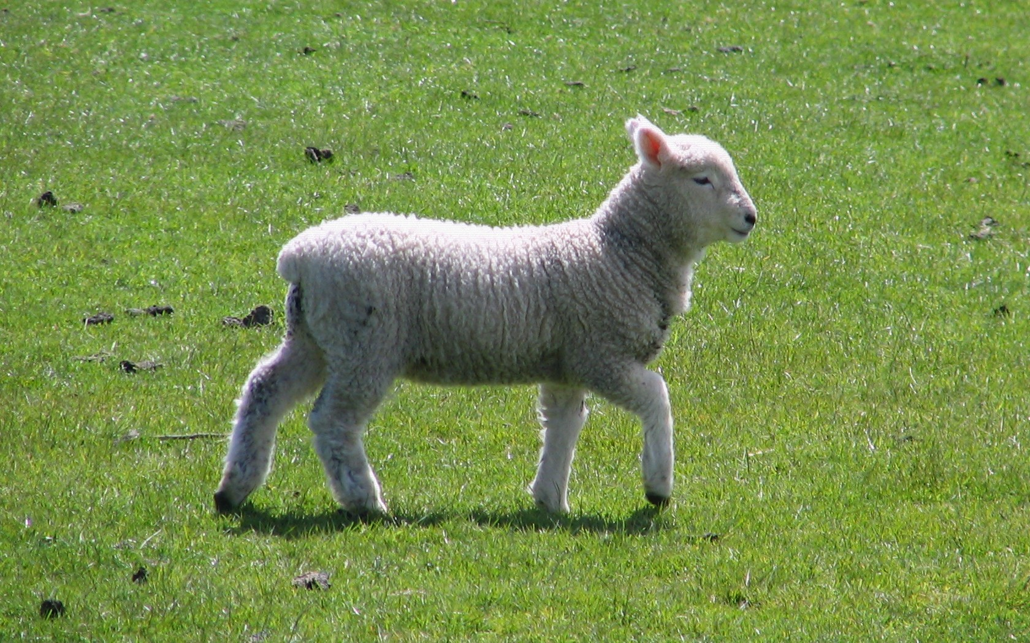
“Follow Me”
Class 3
“I come to do thy will, O God” Hebrews 10:9

Slide 2
Behold the Lamb of God
John 1:34-37
34 And I saw, and bare record that this is the Son of God.
35 Again the next day after John stood, and two of his disciples;
36 And looking upon Jesus as he walked, he saith, Behold the Lamb of God!
37 And the two disciples heard him speak, and they followed Jesus.
This was the way in which every valley was to be exalted, every mountain and hill made low, etc.

Slide 3
Him that sent me
John 12:44-47
44 Jesus cried and said, He that believeth on me, believeth not on me, but on him that sent me.
45 And he that seeth me seeth him that sent me.
46 I am come a light into the world, that whosoever believeth on me should not abide in darkness.
47 And if any man hear my words, and believe not, I judge him not: for I came not to judge the world, but to save the world.
Jesus publicly acknowledges that he is following the One that sent him.
Jesus’ purpose during this part of his work was to save the world.
His words did not mean that people wouldn’t be judged.

Slide 4
He gave me a commandment
John 12:48-50
48 He that rejecteth me, and receiveth not my words, hath one that judgeth him: the word that I have spoken, the same shall judge him in the last day.
49 For I have not spoken of myself; but the Father which sent me, he gave me a commandment, what I should say, and what I should speak.
50 And I know that his commandment is life everlasting: whatsoever I speak therefore, even as the Father said unto me, so I speak.
Again Jesus tries to illustrate that he was following orders from his Father who sent him.
He was however, not ducking responsibility for what he said, but defending the honour of his Father and the truth of his message.

Slide 5
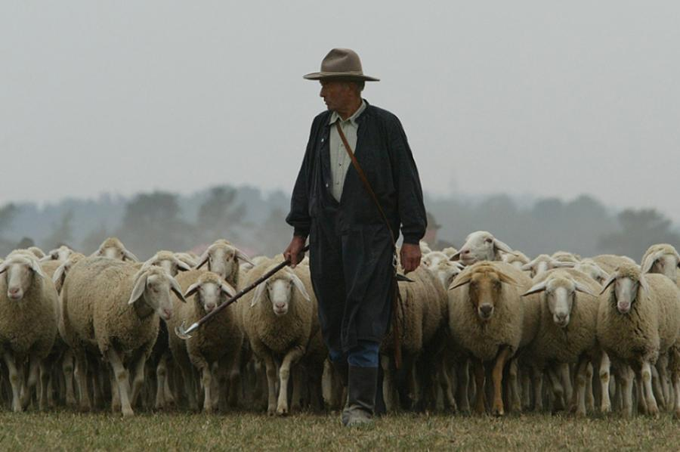
“Follow me”

Slide 6
I am the good shepherd
John 10:11-12
11 I am the good shepherd: the good shepherd giveth his life for the sheep.
12 But he that is an hireling, and not the shepherd, whose own the sheep are not, seeth the wolf coming, and leaveth the sheep, and fleeth: and the wolf catcheth them, and scattereth the sheep.
This is a strong analogy in the Scriptures.
The Lord laid his life down for the sake of his sheep.

Slide 7
Hast thou not known me?
John 14:8-11
8 Philip saith unto him, Lord, shew us the Father, and it sufficeth us.
9 Jesus saith unto him, Have I been so long time with you, and yet hast thou not known me, Philip? he that hath seen me hath seen the Father; and how sayest thou then, Shew us the Father?
10 Believest thou not that I am in the Father, and the Father in me? the words that I speak unto you I speak not of myself: but the Father that dwelleth in me, he doeth the works.
11 Believe me that I am in the Father, and the Father in me: or else believe me for the very works' sake.
Jesus did not mean that to see Jesus was to see the Father literally.
No one can see the Father and live. 1Ti 6:15-16
Jesus showed the character of his Father.
In that sense, he was “in his Father” and the Father was “in him.”
That is the object of “following.”

Slide 8
“That they may be one”
John 17:9-11
9 I pray for them: I pray not for the world, but for them which thou hast given me; for they are thine.
10 And all mine are thine, and thine are mine; and I am glorified in them.
11 And now I am no more in the world, but these are in the world, and I come to thee. Holy Father, keep through thine own name those whom thou hast given me, that they may be one, as we are.
The oneness shared between the Father and Jesus related to purpose and accomplishment.
He intended that the oneness should involve many others.
That is what “spiritual following” implies.

Slide 9
“I delight to do thy will”
Psalms 40:6-8
6 Sacrifice and offering thou didst not desire; mine ears hast thou opened: burnt offering and sin offering hast thou not required.
7 Then said I, Lo, I come: in the volume of the book it is written of me,
8 I delight to do thy will, O my God: yea, thy law is within my heart.
Sacrifice and offering had become the object of worship instead of a means to the object.
Jesus showed the weightier part involving everyday character.
Do we delight in doing God’s will?

Slide 10
“I have not hid thy righteousness”
Psalms 40:9-10
9 I have preached righteousness in the great congregation: lo, I have not refrained my lips, O LORD, thou knowest.
10 I have not hid thy righteousness within my heart; I have declared thy faithfulness and thy salvation: I have not concealed thy lovingkindness and thy truth from the great congregation.
Jesus’ lips spoke when it was time to speak.
He did not hesitate to speak words of encouragement or rebuke.

Slide 11
“Thy will be done”
Matthew 6:8-10
8 Be not ye therefore like unto them: for your Father knoweth what things ye have need of, before ye ask him.
9 After this manner therefore pray ye: Our Father which art in heaven, Hallowed be thy name.
10 Thy kingdom come. Thy will be done in earth, as it is in heaven.
There are consequences associated with desiring God’s will to be done in earth as it is in heaven.
When we pray, it is important to think it through.
Following Yahweh means to be “in Him.”

Slide 12
“Not as I will”
Matthew 26:39-42
39 And he went a little further, and fell on his face, and prayed, saying, O my Father, if it be possible, let this cup pass from me: nevertheless not as I will, but as thou wilt.
40 And he cometh unto the disciples, and findeth them asleep, and saith unto Peter, What, could ye not watch with me one hour?
41 Watch and pray, that ye enter not into temptation: the spirit indeed is willing, but the flesh is weak.
42 He went away again the second time, and prayed, saying, O my Father, if this cup may not pass away from me, except I drink it, thy will be done.
A resignation to the will of His Father was a key characteristic of our Lord.
This is an important acknowledgement for the Lord to make.
His will, like our will, was a reflection of his whole being and in particular a reflection of the anticipation of his flesh.

Slide 13
“I come to do thy will”
Hebrews 10:5-7
5 Wherefore when he cometh into the world, he saith, Sacrifice and offering thou wouldest not, but a body hast thou prepared me:
6 In burnt offerings and sacrifices for sin thou hast had no pleasure.
7 Then said I, Lo, I come (in the volume of the book it is written of me,) to do thy will, O God.
It was imperative that Jesus came “in the flesh.”
This is where the victory needed to be won.
Yet for Jesus’ to win in sin’s arena he needed to have an overwhelming desire to do God’s will.

Slide 14
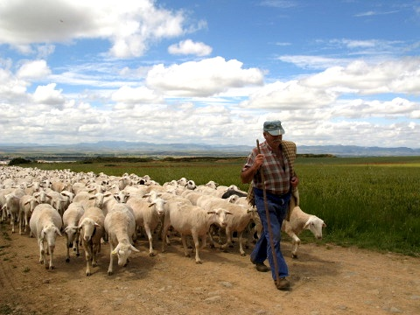
“Follow Me”

Slide 15
“of quick understanding”
Isaiah 11:1-3
1 And there shall come forth a rod out of the stem of Jesse, and a Branch shall grow out of his roots:
2 And the spirit of the LORD shall rest upon him, the spirit of wisdom and understanding, the spirit of counsel and might, the spirit of knowledge and of the fear of the LORD;
3 And shall make him of quick understanding in the fear of the LORD: and he shall not judge after the sight of his eyes, neither reprove after the hearing of his ears:
Quick understanding H7306 roo'-akh
A primitive root; properly to blow, that is, breathe; only (literally) to smell or (by implication perceive (figuratively to anticipate, enjoy): - accept, smell, X touch, make of quick understanding.
The Gospel Records often allude to this ability of Jesus’ to respond spiritually and quickly to a challenging situation.

Slide 16
“He wakeneth my ear”
Isaiah 50:4-7
4 The Lord GOD hath given me the tongue of the learned, that I should know how to speak a word in season to him that is weary: he wakeneth morning by morning, he wakeneth mine ear to hear as the learned.
5 The Lord GOD hath opened mine ear, and I was not rebellious, neither turned away back.
6 I gave my back to the smiters, and my cheeks to them that plucked off the hair: I hid not my face from shame and spitting.
7 For the Lord GOD will help me; therefore shall I not be confounded: therefore have I set my face like a flint, and I know that I shall not be ashamed.
Wakeneth H5782 oor
A primitive root (rather identical with H5783 through the idea of opening the eyes); to wake (literally or figuratively): - (a-) wake (-n, up), lift up (self), X master, raise (up), stir up (self).
Opened H6605 paw-thakh'
A primitive root; to open wide (literally or figuratively); specifically to loosen, begin, plough, carve: - appear, break forth, draw (out), let go free, (en-) grave (-n), loose (self), (be, beset) open (-ing), put off, ungird, unstop, have vent.

Slide 17
“By his knowledge”
Isaiah 53:9-11
9 And he made his grave with the wicked, and with the rich in his death; because he had done no violence, neither was any deceit in his mouth.
10 Yet it pleased the LORD to bruise him; he hath put him to grief: when thou shalt make his soul an offering for sin, he shall see his seed, he shall prolong his days, and the pleasure of the LORD shall prosper in his hand.
11 He shall see of the travail of his soul, and shall be satisfied: by his knowledge shall my righteous servant justify many; for he shall bear their iniquities.
Knowledge is a first line of defense, as such one must first of all know what is happening.
Jesus could perceive what people were thinking.
He knew how God viewed the matter.
He recognized his role in “saving life.”

Slide 18
“He learned obedience”
Hebrews 5:7-9
7 Who in the days of his flesh, when he had offered up prayers and supplications with strong crying and tears unto him that was able to save him from death, and was heard in that he feared;
8 Though he were a Son, yet learned he obedience by the things which he suffered;
9 And being made perfect, he became the author of eternal salvation unto all them that obey him;
But not by the method of “trial and error.”
He learned the price of obedience through what he suffered.
He didn’t ask for 12 legions of angels to deliver him.
He committed himself to his Father’s protection.

Slide 19
“Tempted like as we are”
Hebrews 4:15-16
15 For we have not an high priest which cannot be touched with the feeling of our infirmities; but was in all points tempted like as we are, yet without sin.
16 Let us therefore come boldly unto the throne of grace, that we may obtain mercy, and find grace to help in time of need.
This was essential to remain “at one” with the Father.
It was necessary in order to condemn sin, “in the flesh.”
It was crucial for him to experience this in order to be the great High Priest and Mediator.

Slide 20
“That they may be one”
John 17:21-23
21 That they all may be one; as thou, Father, art in me, and I in thee, that they also may be one in us: that the world may believe that thou hast sent me.
22 And the glory which thou gavest me I have given them; that they may be one, even as we are one:
23 I in them, and thou in me, that they may be made perfect in one; and that the world may know that thou hast sent me, and hast loved them, as thou hast loved me.
God’s plan in putting the concept of “following” in place was to produce a “oneness” of spirit in all so inclined to follow.
That “oneness” requires us to be of the same mind as the Father and the Son.

Slide 21
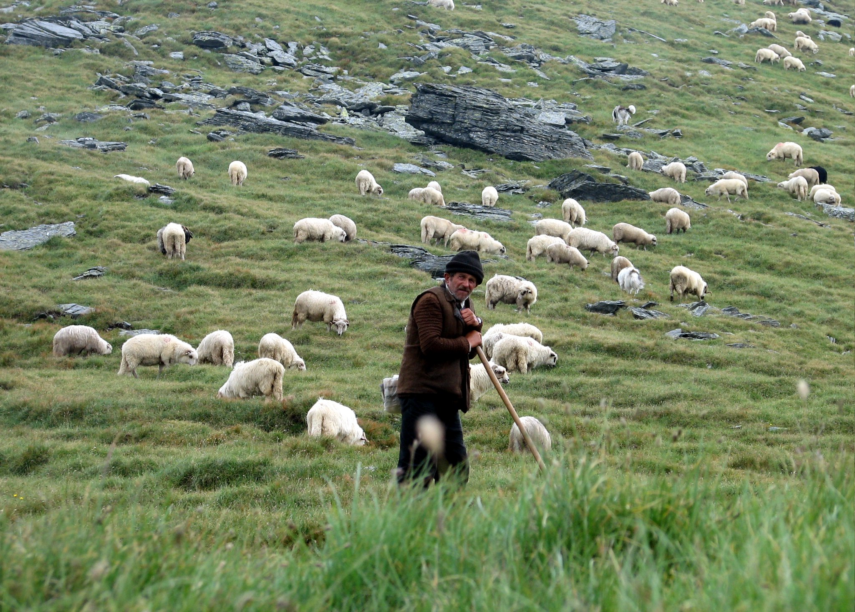
“Follow Me”

Slide 22
“Cometh unto me”
John 6:44-45
44 No man can come to me, except the Father which hath sent me draw him: and I will raise him up at the last day.
45 It is written in the prophets, And they shall be all taught of God. Every man therefore that hath heard, and hath learned of the Father, cometh unto me.
Coming to Jesus without first having “learned of the Father” will be fruitless.

Slide 23
“With the same mind”
1 Peter 4:1-2
1 Forasmuch then as Christ hath suffered for us in the flesh, arm yourselves likewise with the same mind: for he that hath suffered in the flesh hath ceased from sin;
2 That he no longer should live the rest of his time in the flesh to the lusts of men, but to the will of God.
Arm G3695 hop-lid'-zo
From G3696; to equip (with weapons [middle voice and figuratively]): - arm self.
This is an important part of following the Lord: we need to desire to have the same attitude and mind set towards our mission in life.
It is no wonder that He said we must “eat his flesh” and “drink his blood”.

Slide 24
“Let this mind be in you”
Philippians 2:5-8
5 Let this mind be in you, which was also in Christ Jesus:
6 Who, being in the form of God, thought it not robbery to be equal with God:
7 But made himself of no reputation, and took upon him the form of a servant, and was made in the likeness of men:
8 And being found in fashion as a man, he humbled himself, and became obedient unto death, even the death of the cross.
Know why this passage is included in “Wrested Scriptures.”
Philippians 2:6 ESV
6 who, though he was in the form of God, did not count equality with God a thing to be grasped,
He was obedient to the point of giving up his life.
This is the price associated with following him.

Slide 25
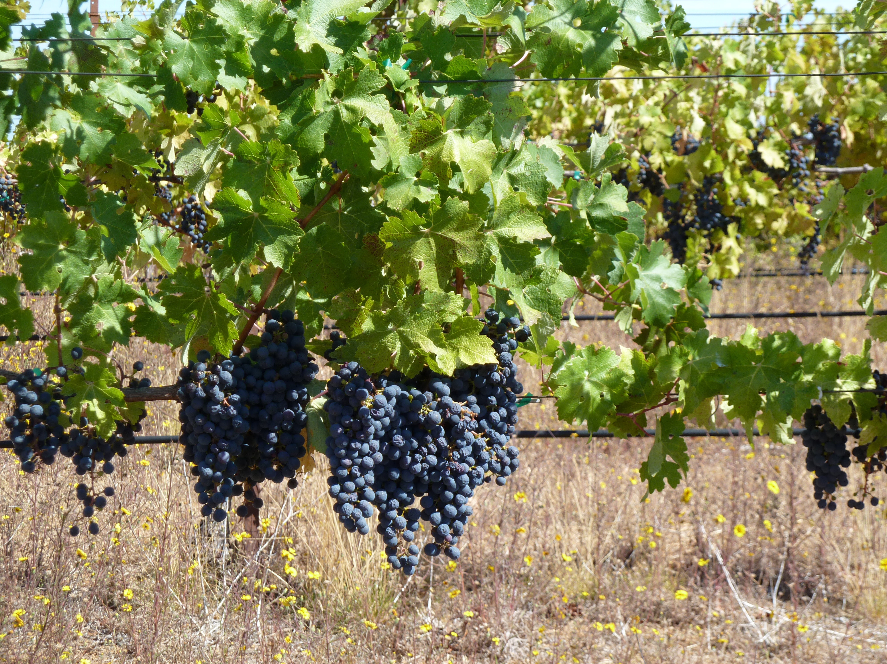
“I am the Vine”

Slide 26
Jesus is the Vine
John 15:1-2
1 I am the true vine, and my Father is the husbandman.
2 Every branch in me that beareth not fruit he taketh away: and every branch that beareth fruit, he purgeth it, that it may bring forth more fruit.
This analogy is helpful in the sense of “following.”
We could never duplicate the life of Jesus.
We must be dedicated to the task of producing fruit for the “Husbandman.”

Slide 27
Jesus is the Word made Flesh
Not “incarnation” as Christendom sees it.
Incarnation: The doctrine that the second person of the trinity assumed human form in the person of Jesus Christ.
“The Incarnation is therefore the mystery of the wonderful union of the divine and human natures in the one person of the Word.” CC483
But living by the standard of the Word of God
John 1:14
14 And the Word was made flesh, and dwelt among us, (and we beheld his glory, the glory as of the only begotten of the Father,) full of grace and truth.

Slide 28
Jesus is the Light of the World
John 8:12
12 Then spake Jesus again unto them, saying, I am the light of the world: he that followeth me shall not walk in darkness, but shall have the light of life.
Jesus is unique in this.
Not Mohammed.
Not Joseph Smith.
Not Darwin.
Not Einstein.
Not everyone.
In this we must take the role of a bigot – there is only ONE “light of the world.”

