Slide 1
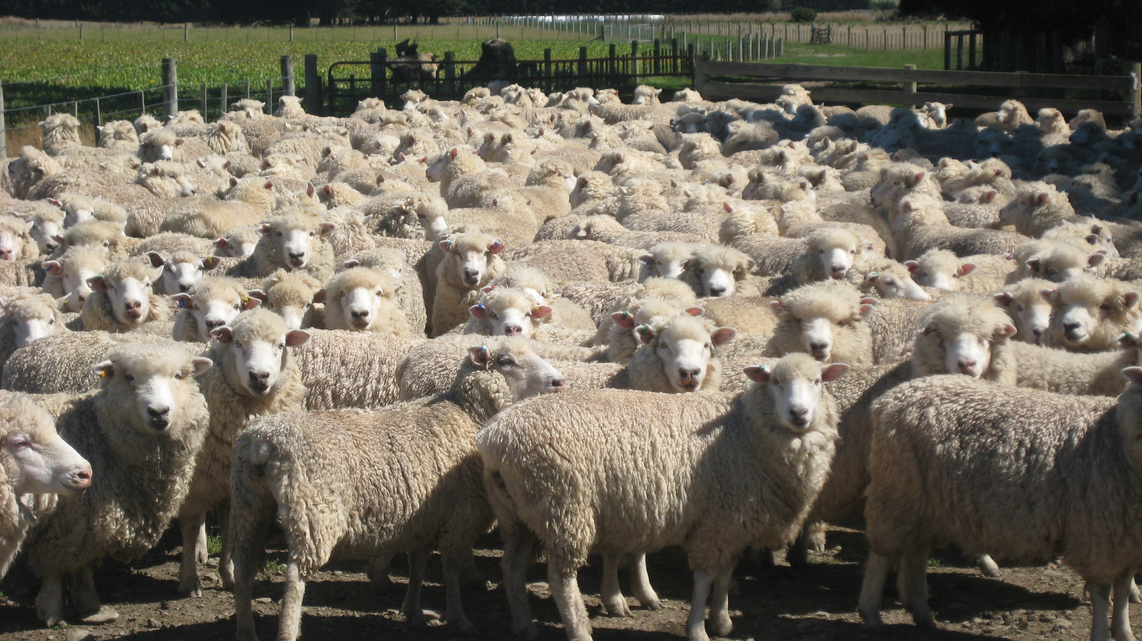
“Follow Me”
Class 4
“Take up his cross daily, and follow me” Luke 9:23

Slide 2
Training of the Disciples
Luke 9:55-56
55 But he turned, and rebuked them, and said, Ye know not what manner of spirit ye are of.
56 For the Son of man is not come to destroy men's lives, but to save them. And they went to another village.
Jesus had to continually work on his disciples to establish the right attitude for the work of fishing for men.

Slide 3
The cost of Following
Luke 9:57-58
57 And it came to pass, that, as they went in the way, a certain man said unto him, Lord, I will follow thee whithersoever thou goest.
58 And Jesus said unto him, Foxes have holes, and birds of the air have nests; but the Son of man hath not where to lay his head.
The life of a disciple is very different than that of a citizen of the world.
This person was an enthusiastic would-be follower of the Lord, but likely did not fully appreciate what was required.
We need to count the cost before the event – not after.

Slide 4
Suffer me first
Luke 9:59-60
59 And he said unto another, Follow me. But he said, Lord, suffer me first to go and bury my father.
60 Jesus said unto him, Let the dead bury their dead: but go thou and preach the kingdom of God.
It is unlikely that the father in question had already died and just needed to be buried.
“Bury my father” is more likely an idiom meaning to stay with one’s parents until they are dead.
Preaching the Kingdom of God is the greater task.

Slide 5
Who are the “dead”?
Ephesians 2:1-2
1 And you hath he quickened, who were dead in trespasses and sins;
2 Wherein in time past ye walked according to the course of this world, according to the prince of the power of the air, the spirit that now worketh in the children of disobedience:
People who are literally dead obviously cannot bury anyone.
But unconverted people, have different priorites.

Slide 6
Dealing with Family
Matthew 10:36-37
36 And a man's foes shall be they of his own household.
37 He that loveth father or mother more than me is not worthy of me: and he that loveth son or daughter more than me is not worthy of me.
In some cases whole families are converted.
In many other cases, the Gospel divides families.
We all need to decide to what family we belong.

Slide 7
Bid them farewell
Luke 9:61-62
61 And another also said, Lord, I will follow thee; but let me first go bid them farewell, which are at home at my house.
62 And Jesus said unto him, No man, having put his hand to the plough, and looking back, is fit for the kingdom of God.
A mere saying goodbye is quite different from “looking back” as they did in the wilderness.
Did this person really know of Elisha and was he requiting the Lord for his former response?
If this is the case, Jesus’ answer is remarkable.
Elisha was plowing.

Slide 8
Elisha burnt the bridge back
1 Kings 19:20-21
20 And he left the oxen, and ran after Elijah, and said, Let me, I pray thee, kiss my father and my mother, and then I will follow thee. And he said unto him, Go back again: for what have I done to thee?
21 And he returned back from him, and took a yoke of oxen, and slew them, and boiled their flesh with the instruments of the oxen, and gave unto the people, and they did eat. Then he arose, and went after Elijah, and ministered unto him.
The matter was settled in favour of the work of Yahweh.
His future was filled with a very different life style.
What is different from this and let me first bury my father?

Slide 9
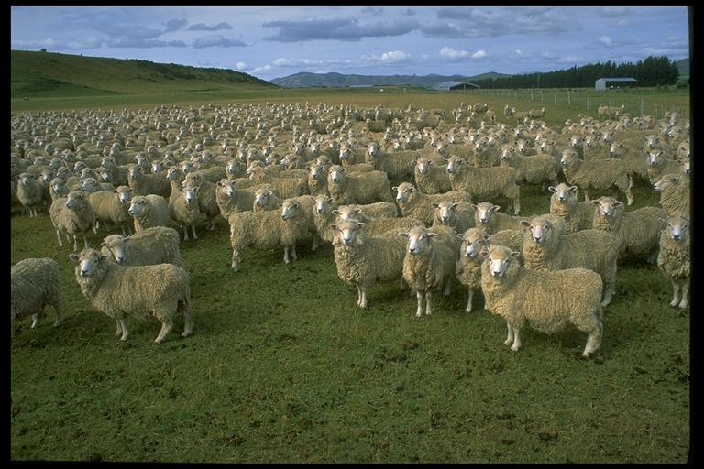
“Follow Me”

Slide 10
The Lord: His Command
Matthew 16:24-25
24 Then said Jesus unto his disciples, If any man will come after me, let him deny himself, and take up his cross, and follow me.
25 For whosoever will save his life shall lose it: and whosoever will lose his life for my sake shall find it.
There is no freedom for a person “taking up his cross.”
Who would take up following the Lord with this reward?
In losing one’s life for the sake of discipleship of the Lord, was to find it.
This requires genuine belief.

Slide 11
The Lord and His sheep
John 10:26-28
26 But ye believe not, because ye are not of my sheep, as I said unto you.
27 My sheep hear my voice, and I know them, and they follow me:
28 And I give unto them eternal life; and they shall never perish, neither shall any man pluck them out of my hand.
Sheep are unique in their flocking and following.
They can be led, but not driven.
This ordinary, but remarkable scene was to underscore discipleship.
It implied a simple faith in the leader, a desire to follow and a resistance to be distracted.

Slide 12
Multitudes followed him
Matthew 4:25
25 And there followed him great multitudes of people from Galilee, and from Decapolis, and from Jerusalem, and from Judaea, and from beyond Jordan.
These people came to hear him, see him and to be healed.
But how many came to be his disciples?

Slide 13
The women that followed
Luke 8:1-3
1 And it came to pass afterward, that he went throughout every city and village, preaching and shewing the glad tidings of the kingdom of God: and the twelve were with him,
2 And certain women, which had been healed of evil spirits and infirmities, Mary called Magdalene, out of whom went seven devils,
3 And Joanna the wife of Chuza Herod's steward, and Susanna, and many others, which ministered unto him of their substance.
If this scene occurred very often it implies the dedication of these women.
Jesus schedule was not published ahead of time, hence meal times and “breaks” would have been hard to manage.

Slide 14
Ye which have followed me
Mark 10:28-30
28 Then Peter began to say unto him, Lo, we have left all, and have followed thee.
29 And Jesus answered and said, Verily I say unto you, There is no man that hath left house, or brethren, or sisters, or father, or mother, or wife, or children, or lands, for my sake, and the gospel's,
30 But he shall receive an hundredfold now in this time, houses, and brethren, and sisters, and mothers, and children, and lands, with persecutions; and in the world to come eternal life.
This question was bound to arise, but we are indebted to Peter to formally ask it in order to get the Lord’s answer.
One must believe that God is a rewarder of those that diligently seek him.
Our God is well aware of the cost of following.

Slide 15
Serve me: Follow me
John 12:25-26
25 He that loveth his life shall lose it; and he that hateth his life in this world shall keep it unto life eternal.
26 If any man serve me, let him follow me; and where I am, there shall also my servant be: if any man serve me, him will my Father honour.
We need to think this through and identify ways in which by loving our life, we can lose it.
Serve G1247
dee-ak-on-eh'-o
From G1249; to be an attendant, that is, wait upon (menially or as a host, friend or [figuratively] teacher); technically to act as a Christian deacon: - (ad-) minister (unto), serve, use the office of a deacon.

Slide 16
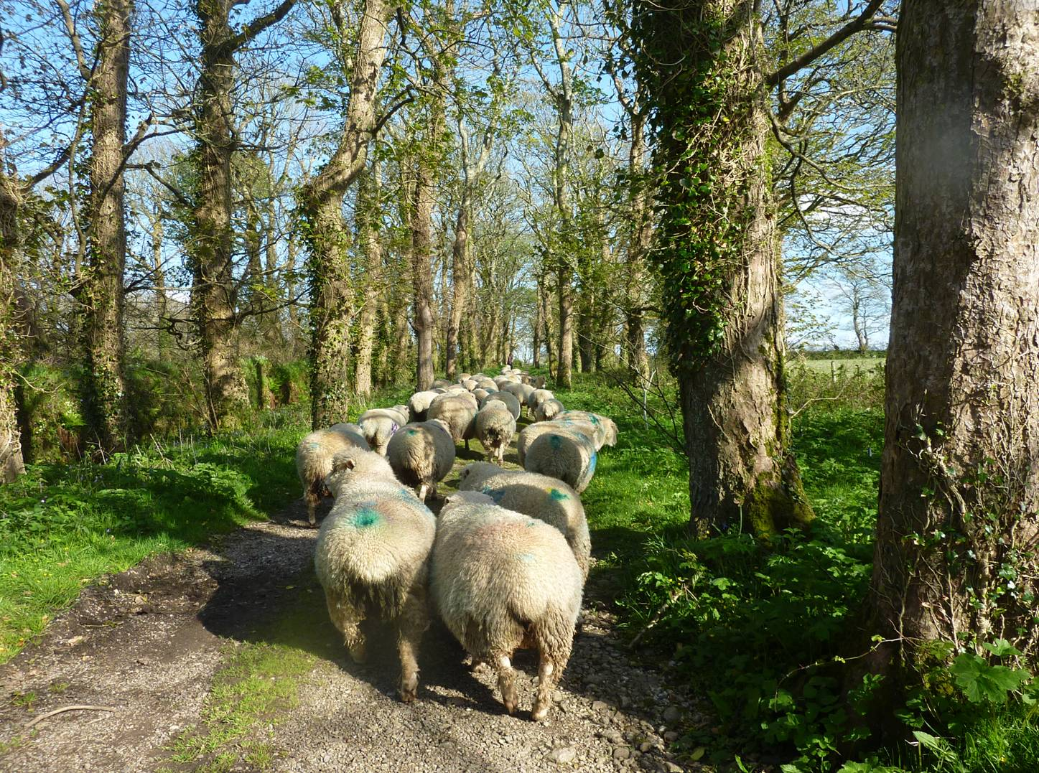
The Price of Turning Back

Slide 17
Looking Back ?
Genesis 19:25-26
25 And he overthrew those cities, and all the plain, and all the inhabitants of the cities, and that which grew upon the ground.
26 But his wife looked back from behind him, and she became a pillar of salt.
Why did she look back?
Did she not share the abhorrence of the lifestyle of the Sodomites?
Did she rank ‘family’ above her God?
Did she forget – not to look back?

Slide 18
Remember Lot’s wife
Luke 17:30-33
30 Even thus shall it be in the day when the Son of man is revealed.
31 In that day, he which shall be upon the housetop, and his stuff in the house, let him not come down to take it away: and he that is in the field, let him likewise not return back.
32 Remember Lot's wife.
33 Whosoever shall seek to save his life shall lose it; and whosoever shall lose his life shall preserve it.
This problem will be repeated because it is typical of human behaviour.
To preserve her life, she had to be prepared to give up everything she presently had.

Slide 19
Better not to have known
2 Peter 2:21-22
21 For it had been better for them not to have known the way of righteousness, than, after they have known it, to turn from the holy commandment delivered unto them.
22 But it is happened unto them according to the true proverb, The dog is turned to his own vomit again; and the sow that was washed to her wallowing in the mire.
Every disciple should sort this out as best they can, before they start.
It is disgusting and revolting to see animals perform this behaviour.

Slide 20
Except ye eat the flesh …
John 6:53-54
53 Then Jesus said unto them, Verily, verily, I say unto you, Except ye eat the flesh of the Son of man, and drink his blood, ye have no life in you.
54 Whoso eateth my flesh, and drinketh my blood, hath eternal life; and I will raise him up at the last day.
Jesus was speaking about “following” him, so closely that they had to have the same “mind.”
They couldn’t accept the idea and couldn’t fathom the analogy.

Slide 21
Many disciples went back …
John 6:66-69
66 From that time many of his disciples went back, and walked no more with him.
67 Then said Jesus unto the twelve, Will ye also go away?
68 Then Simon Peter answered him, Lord, to whom shall we go? thou hast the words of eternal life.
69 And we believe and are sure that thou art that Christ, the Son of the living God.
He did not mean that his disciples must literally eat his flesh and drink his blood.
Jesus told them:
John 6:63
63 It is the spirit that quickeneth; the flesh profiteth nothing: the words that I speak unto you, they are spirit, and they are life.
Despite this many left him at this time.
Do we understand this teaching of the Lord?

Slide 22
Double mindedness
James 1:6-8
6 But let him ask in faith, nothing wavering. For he that wavereth is like a wave of the sea driven with the wind and tossed.
7 For let not that man think that he shall receive any thing of the Lord.
8 A double minded man is unstable in all his ways.
Following the Lord is not for double minded people.
We either follow Him and can always be found in the crowd of disciples who are with Him, or we cannot be found there.
People who cannot make up their mind are counted with the disbelievers!

Slide 23
Memories of the Past
Numbers 11:4-6
4 And the mixt multitude that was among them fell a lusting: and the children of Israel also wept again, and said, Who shall give us flesh to eat?
5 We remember the fish, which we did eat in Egypt freely; the cucumbers, and the melons, and the leeks, and the onions, and the garlick:
6 But now our soul is dried away: there is nothing at all, beside this manna, before our eyes.
This is a real word of caution for would-be followers of the Lord who have come from a “checkered” past.
We must reject the impulse to be entertained by mentally dwelling in the past.

Slide 24
Letting the imagination wander
Hebrews 11:14-16
14 For they that say such things declare plainly that they seek a country.
15 And truly, if they had been mindful of that country from whence they came out, they might have had opportunity to have returned.
16 But now they desire a better country, that is, an heavenly: wherefore God is not ashamed to be called their God: for he hath prepared for them a city.
Again, this is a problem for those who have left behind a way of life as not worthy of discipleship.
To imagine how it may have turned out is to set a snare for yourself.
Never look back!!

