Slide 1
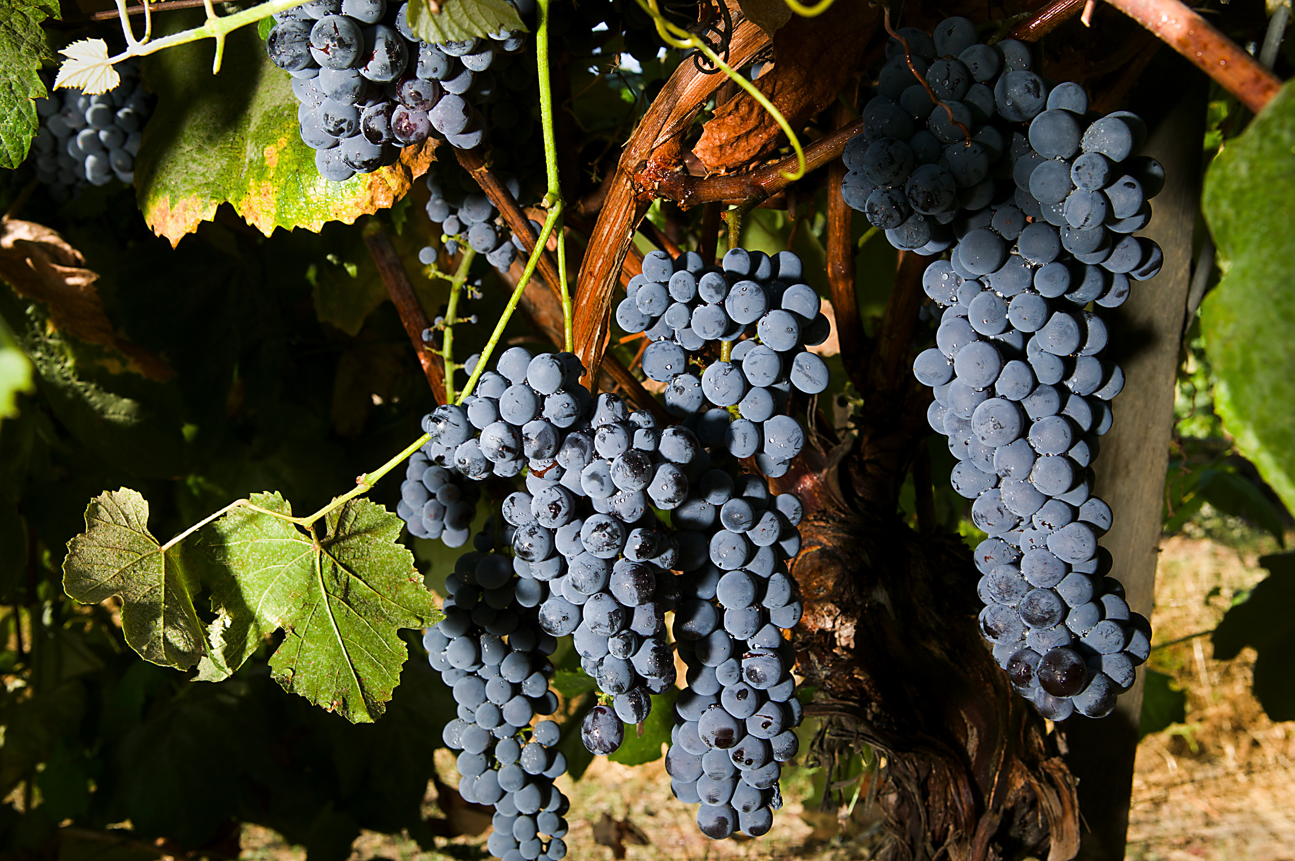
Follow Me
Exhortation
(More Blessed to Give than to Receive)

Slide 2
Grievous wolves
Acts 20:29-31
29 For I know this, that after my departing shall grievous wolves enter in among you, not sparing the flock.
30 Also of your own selves shall men arise, speaking perverse things, to draw away disciples after them.
31 Therefore watch, and remember, that by the space of three years I ceased not to warn every one night and day with tears.

Slide 3
So labouring … support the weak!
Acts 20:32-36
32 And now, brethren, I commend you to God, and to the word of his grace, which is able to build you up, and to give you an inheritance among all them which are sanctified.
33 I have coveted no man's silver, or gold, or apparel.
34 Yea, ye yourselves know, that these hands have ministered unto my necessities, and to them that were with me.
35 I have shewed you all things, how that so labouring ye ought to support the weak, and to remember the words of the Lord Jesus, how he said, It is more blessed to give than to receive.
36 And when he had thus spoken, he kneeled down, and prayed with them all.

Slide 4
More Blessed to Give
Acts 20:34-35
34 Yea, ye yourselves know, that these hands have ministered unto my necessities, and to them that were with me.
35 I have shewed you all things, how that so labouring ye ought to support the weak, and to remember the words of the Lord Jesus, how he said, It is more blessed to give than to receive.
Give G1325 didōmi Thayer Definition:
1) to give
2) to give something to someone
2a) of one’s own accord to give one something, to his advantage
  2a1) to bestow a gift
2b) to grant, give to one as king, let have
2c) to supply, furnish, necessary things

Slide 5
Than to Receive
Acts 20:34-35
34 Yea, ye yourselves know, that these hands have ministered unto my necessities, and to them that were with me.
35 I have shewed you all things, how that so labouring ye ought to support the weak, and to remember the words of the Lord Jesus, how he said, It is more blessed to give than to receive.
Receive G2983 lambanō Thayer Definition:
1) to take
1a) to take with the hand, lay hold of, any person or thing in order to use it
  1a1) to take up a thing to be carried
  1a2) to take upon one’s self
1b) to take in order to carry away
  1b1) without the notion of violence, i,e to remove, take away

Slide 6
“Freely ye have received, freely give”
Matthew 10:7-8
7 And as ye go, preach, saying, The kingdom of heaven is at hand.
8 Heal the sick, cleanse the lepers, raise the dead, cast out devils: freely ye have received, freely give.
Freely G1432 dōrean
Thayer Definition:
1) freely, undeservedly
This context tells us immediately why it is more blessed to give than to receive.
This is the way it spreads - leaven

Slide 7
Took the loaves / Gave to Others (5000)
John 6:5-9
5 When Jesus then lifted up his eyes, and saw a great company come unto him, he saith unto Philip, Whence shall we buy bread, that these may eat?
6 And this he said to prove him: for he himself knew what he would do.
7 Philip answered him, Two hundred pennyworth of bread is not sufficient for them, that every one of them may take a little.
8 One of his disciples, Andrew, Simon Peter's brother, saith unto him,
9 There is a lad here, which hath five barley loaves, and two small fishes: but what are they among so many?

Slide 8
Took the loaves / Gave to Others (5000)
Luke 9:13-17
13 But he said unto them, Give ye them to eat. And they said, We have no more but five loaves and two fishes; except we should go and buy meat for all this people.
14 For they were about five thousand men. And he said to his disciples, Make them sit down by fifties in a company.
15 And they did so, and made them all sit down.
16 Then he took the five loaves and the two fishes, and looking up to heaven, he blessed them, and brake, and gave to the disciples to set before the multitude.
17 And they did eat, and were all filled: and there was taken up of fragments that remained to them twelve baskets.

Slide 9
Took the loaves / Gave to Others (4000)
Matthew 15:35-38
35 And he commanded the multitude to sit down on the ground.
36 And he took the seven loaves and the fishes, and gave thanks, and brake them, and gave to his disciples, and the disciples to the multitude.
37 And they did all eat, and were filled: and they took up of the broken meat that was left seven baskets full.
38 And they that did eat were four thousand men, beside women and children.

Slide 10
Bread given to us … to give
Matthew 26:26-28
26 And as they were eating, Jesus took bread, and blessed it, and brake it, and gave it to the disciples, and said, Take, eat; this is my body.
27 And he took the cup, and gave thanks, and gave it to them, saying, Drink ye all of it;
28 For this is my blood of the new testament, which is shed for many for the remission of sins.

Slide 11
“taketh bread & giveth them”
John 21:13-14
13 Jesus then cometh, and taketh bread, and giveth them, and fish likewise.
14 This is now the third time that Jesus shewed himself to his disciples, after that he was risen from the dead.

Slide 12
“Feed my lambs”
John 21:14-15
14 This is now the third time that Jesus shewed himself to his disciples, after that he was risen from the dead.
15 So when they had dined, Jesus saith to Simon Peter, Simon, son of Jonas, lovest thou me more than these? He saith unto him, Yea, Lord; thou knowest that I love thee. He saith unto him, Feed my lambs.

Slide 13
Parable of the Vine
John 15:1-2
1 I am the true vine, and my Father is the husbandman.
2 Every branch in me that beareth not fruit he taketh away: and every branch that beareth fruit, he purgeth it, that it may bring forth more fruit.

Slide 14
Parable of the Talents
Matthew 25:14-18
14 For the kingdom of heaven is as a man travelling into a far country, who called his own servants, and delivered unto them his goods.
15 And unto one he gave five talents, to another two, and to another one; to every man according to his several ability; and straightway took his journey.
16 Then he that had received the five talents went and traded with the same, and made them other five talents.
17 And likewise he that had received two, he also gained other two.
18 But he that had received one went and digged in the earth, and hid his lord's money.

Slide 15
Take the Talent from Him
Matthew 25:27-28
27 Thou oughtest therefore to have put my money to the exchangers, and then at my coming I should have received mine own with usury.
28 Take therefore the talent from him, and give it unto him which hath ten talents.
The person who achieved nothing did nothing.
Should have given it to others who at least would have provided interest.
He lost his life.

Slide 16
Parable of the Talents - Words
Goods G5224 hoop-ar'-khon-tah
Neuter plural of present participle active of G5225 as noun; things extant or in hand, that is, property or possessions: - goods, that which one has, things which (one) possesseth, substance, that hast.
Gave G1325
Received G2893
Traded G2038 er-gad'-zom-ahee
Middle voice from G2041; to toil (as a task, occupation, etc.), (by implication) effect, be engaged in or with, etc.: - commit, do, labor for, minister about, trade (by), work.

Slide 17
Giving is Better
Children receive better than give.
Almost anyone can receive; but relatively few can give.
To give one must be industrious – but to give one can become dependent.
It is more noble to give than to receive.
Thou shalt lend but not borrow.

