Slide 1
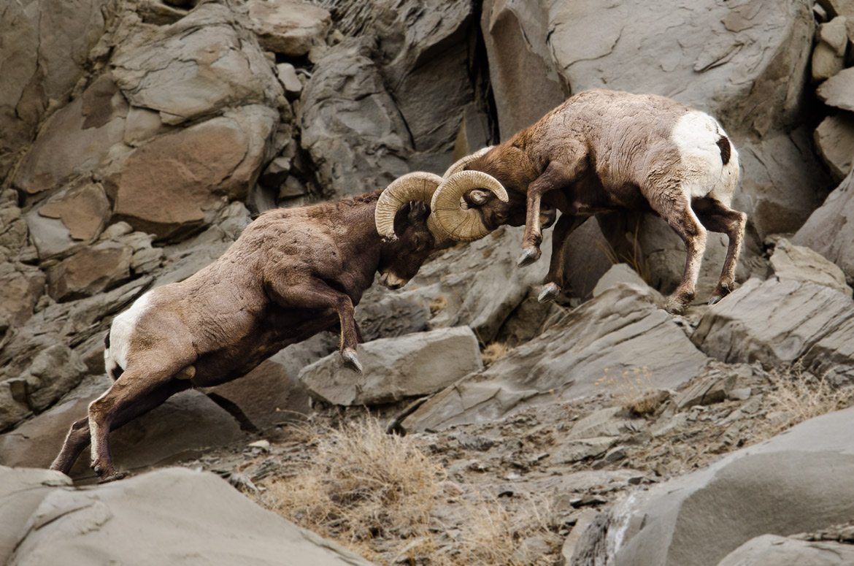
“Follow Me”
Class 5
“When thou art converted strengthen thy brethren” Luke 22:32

Slide 2
Preparation of the Soil
John 1:40-42
40 One of the two which heard John speak, and followed him, was Andrew, Simon Peter's brother.
41 He first findeth his own brother Simon, and saith unto him, We have found the Messias, which is, being interpreted, the Christ.
42 And he brought him to Jesus. And when Jesus beheld him, he said, Thou art Simon the son of Jona: thou shalt be called Cephas, which is by interpretation, A stone.
John the Baptist’s work involved preparing people for the ministry of the Jesus.
Thus his disciples were prepared to accept that they had “found” the Messiah.
Following him was another matter, as Peter was married and appears to have had a fishing business.

Slide 3
The Lord: His Command
Matthew 4:18-20
18 And Jesus, walking by the sea of Galilee, saw two brethren, Simon called Peter, and Andrew his brother, casting a net into the sea: for they were fishers.
19 And he saith unto them, Follow me, and I will make you fishers of men.
20 And they straightway left their nets, and followed him.
The words “follow me” may have sounded like an invitation.
More likely, they would have sounded like a command from a leader.

Slide 4
They followed him
Matthew 4:21-22
21 And going on from thence, he saw other two brethren, James the son of Zebedee, and John his brother, in a ship with Zebedee their father, mending their nets; and he called them.
22 And they immediately left the ship and their father, and followed him.
Jesus must have known who he was calling.
The fact of their immediate response of James and John to leave their profession and their father indicates their preparation to receive him as a leader.

Slide 5
What did “follow me” mean?
Luke 5:1-4
1 And it came to pass, that, as the people pressed upon him to hear the word of God, he stood by the lake of Gennesaret,
2 And saw two ships standing by the lake: but the fishermen were gone out of them, and were washing their nets.
3 And he entered into one of the ships, which was Simon's, and prayed him that he would thrust out a little from the land. And he sat down, and taught the people out of the ship.
4 Now when he had left speaking, he said unto Simon, Launch out into the deep, and let down your nets for a draught.
This appears to be a second incident where Jesus calls these disciples.
These fishermen would now learn that the Lord was a better fisherman than themselves.
He wanted them to be fishers of men.

Slide 6
The 2nd Calling to Follow
Luke 5:10-11
10 And so was also James, and John, the sons of Zebedee, which were partners with Simon. And Jesus said unto Simon, Fear not; from henceforth thou shalt catch men.
11 And when they had brought their ships to land, they forsook all, and followed him.
It is hard to imagine that they left the fish to rot because they had their father and hired men to help.
But they did need to forsake their profession in order to follow him.

Slide 7
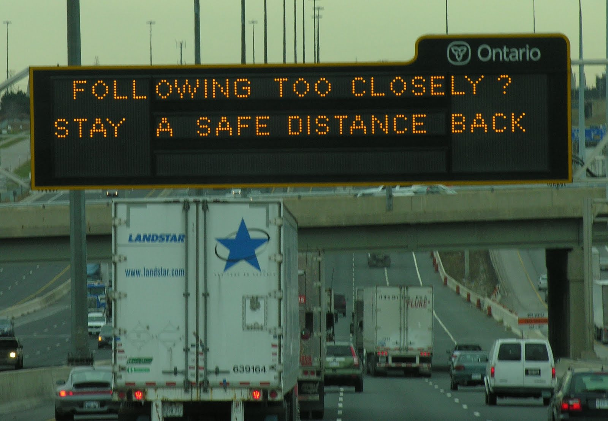
Learning to follow

Slide 8
Know who you are following
Mark 8:27-30
27 And Jesus went out, and his disciples, into the towns of Caesarea Philippi: and by the way he asked his disciples, saying unto them, Whom do men say that I am?
28 And they answered, John the Baptist: but some say, Elias; and others, One of the prophets.
29 And he saith unto them, But whom say ye that I am? And Peter answereth and saith unto him, Thou art the Christ.
30 And he charged them that they should tell no man of him.
Jesus put this question to them in an interesting way.
They needed to know for sure who Jesus was by way of His fulfillment of the Scriptures.
Peter knew – he was following because of his knowledge.

Slide 9
If ye believe not I am he
John 8:22-24
22 Then said the Jews, Will he kill himself? because he saith, Whither I go, ye cannot come.
23 And he said unto them, Ye are from beneath; I am from above: ye are of this world; I am not of this world.
24 I said therefore unto you, that ye shall die in your sins: for if ye believe not that I am he, ye shall die in your sins.
Jesus was the one the prophets had spoken about.
They foretold where he would be born, his ancestry, and his desire to serve God.
He was to be a prophet like Moses.
He was to be the King of Israel.
But many things associated with his sufferings they hadn’t yet understood.

Slide 10
Follow but not too close
Mark 8:31-33
31 And he began to teach them, that the Son of man must suffer many things, and be rejected of the elders, and of the chief priests, and scribes, and be killed, and after three days rise again.
32 And he spake that saying openly. And Peter took him, and began to rebuke him.
33 But when he had turned about and looked on his disciples, he rebuked Peter, saying, Get thee behind me, Satan: for thou savourest not the things that be of God, but the things that be of men.
Peter at this time was following too close and not prepared for the things that would happen to Jesus.
He was anticipating Jesus’ moves on a human scale.
Even his loyalty for Jesus was getting in the way of things Jesus knew had to happen.
Peter was distracted.
Jesus said the same words to the devil in Luke 4:8

Slide 11
Whither I go ye cannot come
John 13:33-35
33 Little children, yet a little while I am with you. Ye shall seek me: and as I said unto the Jews, Whither I go, ye cannot come; so now I say to you.
34 A new commandment I give unto you, That ye love one another; as I have loved you, that ye also love one another.
35 By this shall all men know that ye are my disciples, if ye have love one to another.
Jesus knew he would be departing from them, and he wanted them to have the same care for one another as he had shown for them.
He wanted it to be a mark of distinction.
They would learn later that this meant they would be called upon to lay down their lives for one another.

Slide 12
Ye cannot follow me now
John 13:36-38
36 Simon Peter said unto him, Lord, whither goest thou? Jesus answered him, Whither I go, thou canst not follow me now; but thou shalt follow me afterwards.
37 Peter said unto him, Lord, why cannot I follow thee now? I will lay down my life for thy sake.
38 Jesus answered him, Wilt thou lay down thy life for my sake? Verily, verily, I say unto thee, The cock shall not crow, till thou hast denied me thrice.
Rather than just being puzzled about where Jesus was going, Peter seems to question the reason why he could not follow.
Many of us would have said the same thing.
Jesus was speaking about dying by crucifixion, and he knew that Peter was not ready for that at that time.
Peter’s challenge of Jesus assessment however, led the Lord to have to prove the truth of his remarks.

Slide 13
When thou art converted
Luke 22:31-34
31 And the Lord said, Simon, Simon, behold, Satan hath desired to have you, that he may sift you as wheat:
32 But I have prayed for thee, that thy faith fail not: and when thou art converted, strengthen thy brethren.
33 And he said unto him, Lord, I am ready to go with thee, both into prison, and to death.
34 And he said, I tell thee, Peter, the cock shall not crow this day, before that thou shalt thrice deny that thou knowest me.
Peter misjudged his spiritual stature and thought he was in better condition.
Peter was likely in strife with the other disciples about who would be greatest in the Kingdom.
It is to be expected that this would have been very annoying to Jesus.
Verse 32 – what a challenging verse.
When are we converted?
Converted G1994 epistrephō
ep-ee-stref'-o
From G1909 and G4762; to revert (literally, figuratively or morally): - come (go) again, convert, (re-) turn (about, again).

Slide 14
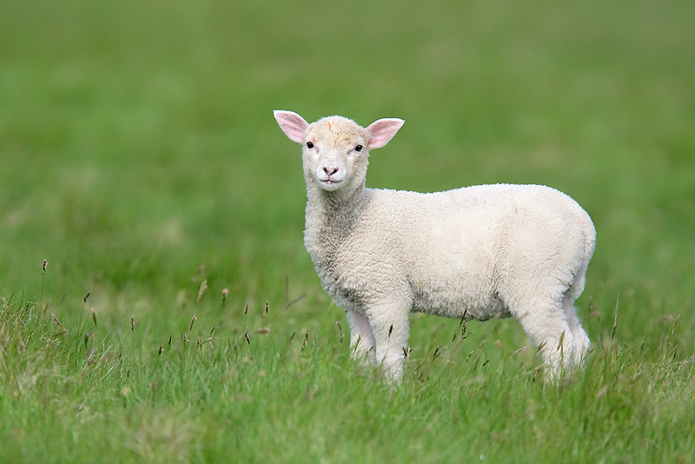
“Follow Me”

Slide 15
Here are two swords
Luke 22:36-38
36 Then said he unto them, But now, he that hath a purse, let him take it, and likewise his scrip: and he that hath no sword, let him sell his garment, and buy one.
37 For I say unto you, that this that is written must yet be accomplished in me, And he was reckoned among the transgressors: for the things concerning me have an end.
38 And they said, Lord, behold, here are two swords. And he said unto them, It is enough.
The ready availability of the swords implies they may have felt they would have to use them someday.
Why would just two swords be enough?

Slide 16
Put up thy sword
John 18:10-11
10 Then Simon Peter having a sword drew it, and smote the high priest's servant, and cut off his right ear. The servant's name was Malchus.
11 Then said Jesus unto Peter, Put up thy sword into the sheath: the cup which my Father hath given me, shall I not drink it?
Did Peter do this out of fear or loyalty?
Jesus asked them to bring a sword and Peter was ready to use it.
Now Jesus says that they are not to use the sword in their defence.

Slide 17
Shall perish with the sword
Matthew 26:51-54
51 And, behold, one of them which were with Jesus stretched out his hand, and drew his sword, and struck a servant of the high priest's, and smote off his ear.
52 Then said Jesus unto him, Put up again thy sword into his place: for all they that take the sword shall perish with the sword.
53 Thinkest thou that I cannot now pray to my Father, and he shall presently give me more than twelve legions of angels?
54 But how then shall the scriptures be fulfilled, that thus it must be?
If you take up the sword, be prepared to perish with the sword.
That is Jesus’ answer for settling disputes in this way, for now.
Peter probably didn’t think that Jesus could ask for 12,000 angels to defend him.
Did Peter know what Scriptures the Lord was referring to?

Slide 18
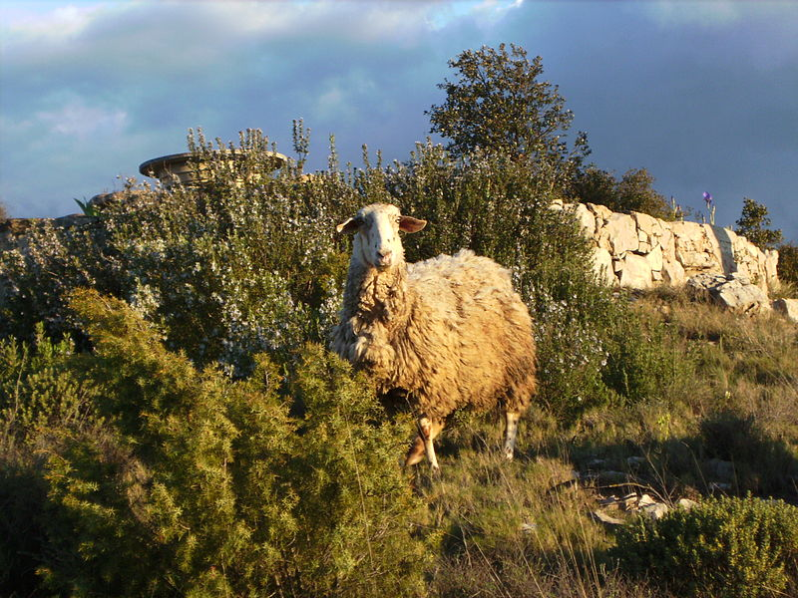
“Follow Me”

Slide 19
Peter followed afar off
Luke 22:54-55
54 Then took they him, and led him, and brought him into the high priest's house. And Peter followed afar off.
55 And when they had kindled a fire in the midst of the hall, and were set down together, Peter sat down among them.
Falling back led to Peter’s denials.
He wasn’t prepared to follow the Lord under these conditions.
He needed more preparation.
Is this where the expression “Petered Out” originated?
There are real dangers and evils for one who is following too far back.

Slide 20
Peter denied knowing Jesus
Luke 22:60-62
60 And Peter said, Man, I know not what thou sayest. And immediately, while he yet spake, the cock crew.
61 And the Lord turned, and looked upon Peter. And Peter remembered the word of the Lord, how he had said unto him, Before the cock crow, thou shalt deny me thrice.
62 And Peter went out, and wept bitterly.
How many disciples upon seeing how little faith they really had would go out and weep bitterly?
How many disciples learn from their mistakes?
Events like this in our life have a special importance in our learning how to follow.

Slide 21
The faint and weary
Deuteronomy 25:17-18
17 Remember what Amalek did unto thee by the way, when ye were come forth out of Egypt;
18 How he met thee by the way, and smote the hindmost of thee, even all that were feeble behind thee, when thou wast faint and weary; and he feared not God.
Falling behind leads a person into unique risks and special trials.

Slide 22
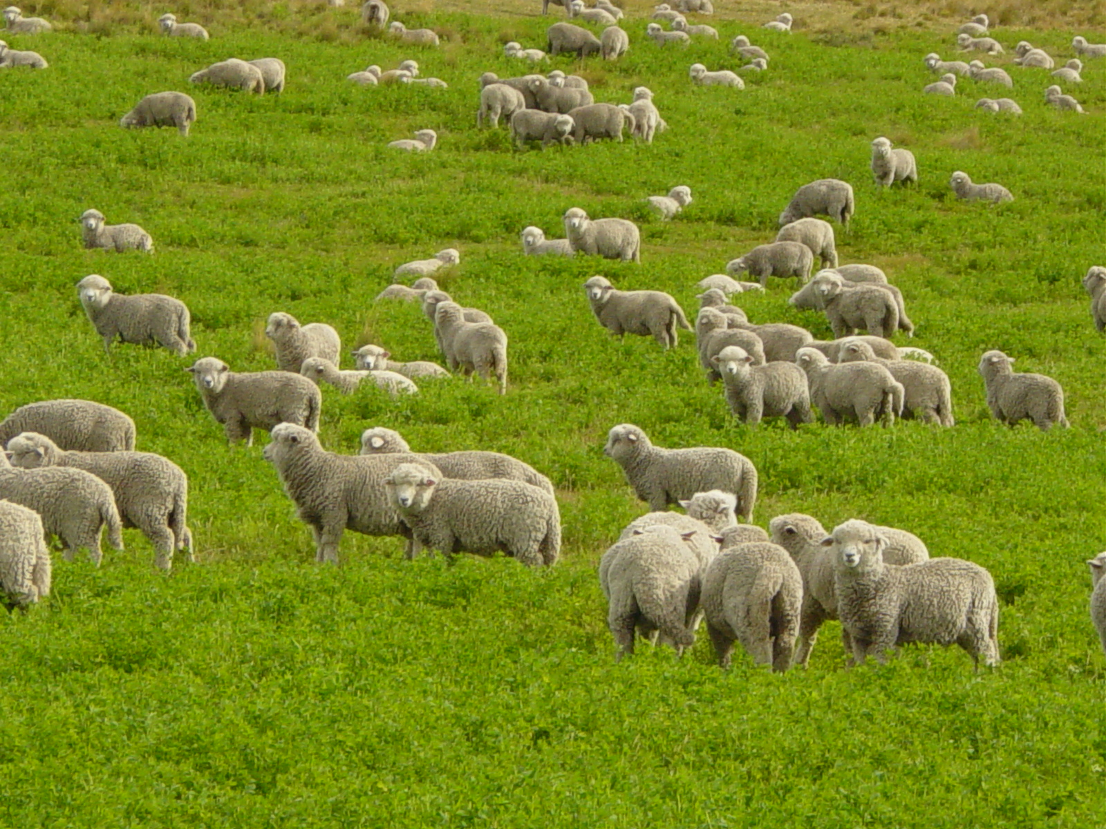
“Follow Me”

Slide 23
We ought to obey God
Acts 5:27-29
27 And when they had brought them, they set them before the council: and the high priest asked them,
28 Saying, Did not we straitly command you that ye should not teach in this name? and, behold, ye have filled Jerusalem with your doctrine, and intend to bring this man's blood upon us.
29 Then Peter and the other apostles answered and said, We ought to obey God rather than men.
Peter learned his lesson and we find him later following his Lord to the point of martyrdom.

Slide 24
Leaving us an example
1 Peter 2:21-23
21 For even hereunto were ye called: because Christ also suffered for us, leaving us an example, that ye should follow his steps:
22 Who did no sin, neither was guile found in his mouth:
23 Who, when he was reviled, reviled not again; when he suffered, he threatened not; but committed himself to him that judgeth righteously:
We have footsteps to follow and at times they are very valuable.
Under great pressure, Jesus never disobeyed his Father, did not use guile or stoop to using reviling language.
He did not threaten as a means to deter his persecutors.
He left the situation in the hands of his Father.
That’s the measure of trust we must have as well.

Slide 25
Feed the flock of God
1 Peter 5:1-3
1 The elders which are among you I exhort, who am also an elder, and a witness of the sufferings of Christ, and also a partaker of the glory that shall be revealed:
2 Feed the flock of God which is among you, taking the oversight thereof, not by constraint, but willingly; not for filthy lucre, but of a ready mind;
3 Neither as being lords over God's heritage, but being ensamples to the flock.
Peter’s use of these words for this exhortation indicates he was able to recall the lessons he learned in this regard.
We should not try to be a master over our fellow disciples but rise to the higher calling of being examples of behaviour that they can follow.

Slide 26
Always in Remembrance
2 Peter 1:12-13
12 Wherefore I will not be negligent to put you always in remembrance of these things, though ye know them, and be established in the present truth.
13 Yea, I think it meet, as long as I am in this tabernacle, to stir you up by putting you in remembrance;
This aspect of our discipleship can be too easily despised.
In many cases our problems are simply related to our lack of having a ‘presence of mind’ related to spiritual things.

Slide 27
After you have suffered awhile
1 Peter 5:10
10 But the God of all grace, who hath called us unto his eternal glory by Christ Jesus, after that ye have suffered a while, make you perfect, stablish, strengthen, settle you.
Suffering is but for a little while.
Perfect - complete.
Stablish - place in position.
Strengthen - by using props.
Settle - by firming up the ground around us.

Slide 28
Follow me
John 21:18-19
18 Verily, verily, I say unto thee, When thou wast young, thou girdedst thyself, and walkedst whither thou wouldest: but when thou shalt be old, thou shalt stretch forth thy hands, and another shall gird thee, and carry thee whither thou wouldest not.
19 This spake he, signifying by what death he should glorify God. And when he had spoken this, he saith unto him, Follow me.
These words would have had special significance to Peter.
He had heard them before and now knew much more about what they meant.
Are we prepared to “Follow Him”?

