Slide 1
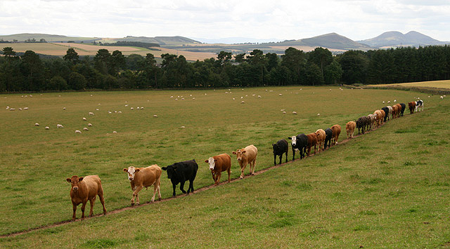
“Follow Me”
Class 6
“Be ye followers of me as I also am of Christ” 1Corinthians 11:1

Slide 2
The power of the Word of God
1 Thessalonians 2:13-14
13 For this cause also thank we God without ceasing, because, when ye received the word of God which ye heard of us, ye received it not as the word of men, but as it is in truth, the word of God, which effectually worketh also in you that believe.
14 For ye, brethren, became followers of the churches of God which in Judaea are in Christ Jesus: for ye also have suffered like things of your own countrymen, even as they have of the Jews:
Effectively worketh G1754
en-erg-eh'-o
From G1756; to be active, efficient: - do, (be) effectual (fervent), be mighty in, shew forth self, work (effectually in).
This is the understanding from which we anchor our life-style.

Slide 3
Even as I also am of Christ
1 Corinthians 11:1-2
1 Be ye followers of me, even as I also am of Christ.
2 Now I praise you, brethren, that ye remember me in all things, and keep the ordinances, as I delivered them to you.
Follower G3402
mim-ay-tace'
From G3401; an imitator: - follower.
We should pay careful attention to the difference between innovating and imitating.
We belong to a line of imitators.

Slide 4
Be ye followers of me
1 Corinthians 4:15-16
15 For though ye have ten thousand instructors in Christ, yet have ye not many fathers: for in Christ Jesus I have begotten you through the gospel.
16 Wherefore I beseech you, be ye followers of me.
Follower G3402
mim-ay-tace'
From G3401; an imitator: - follower.
Note the special emphasis on ‘fathers.’
The Apostle’s later life was a ‘role model’ for us all.

Slide 5
Follower – Of God / Of His Christ
Ephesians 5:1-2
1 Be ye therefore followers of God, as dear children;
2 And walk in love, as Christ also hath loved us, and hath given himself for us an offering and a sacrifice to God for a sweetsmelling savour.
Follower G3402
mim-ay-tace'
From G3401; an imitator: - follower.
The Apostle is careful to establish that the idea of ‘following’ starts with our God.

Slide 6
Role Models to Others
Ensamples G5179 too'-pos
From G5180; a die (as struck), that is, (by implication) a stamp or scar; by analogy a shape, that is, a statue, (figuratively) style or resemblance; specifically a sampler (“type”), that is, a model (for imitation) or instance (for warning):
In a sense we are all examples to someone else, but what are we examples of?
1 Thessalonians 1:6-7
6 And ye became followers of us, and of the Lord, having received the word in much affliction, with joy of the Holy Ghost:
7 So that ye were ensamples to all that believe in Macedonia and Achaia.

Slide 7
An important view of suffering
2 Corinthians 1:5-6
5 For as the sufferings of Christ abound in us, so our consolation also aboundeth by Christ.
6 And whether we be afflicted, it is for your consolation and salvation, which is effectual in the enduring of the same sufferings which we also suffer: or whether we be comforted, it is for your consolation and salvation.
Most of us suffer in pity of self.
The Apostle saw his sufferings as an extension of the sufferings of Christ.
He saw the need to establish a view of suffering that would be help others who were a novice to sin and its consequences.

Slide 8
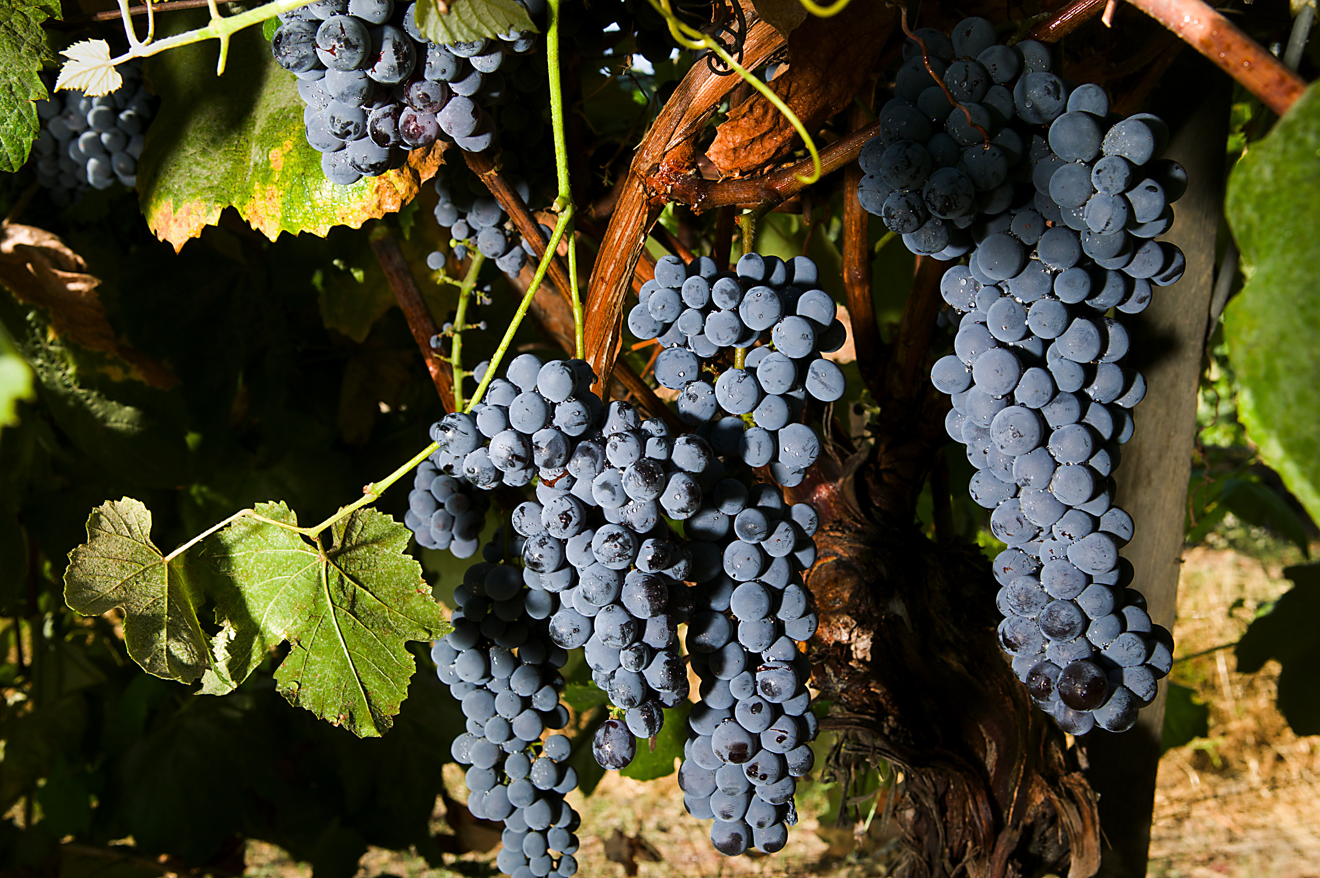
“By their fruits …
Matthew 7:16-20
16 Ye shall know them by their fruits. Do men gather grapes of thorns, or figs of thistles?
17 Even so every good tree bringeth forth good fruit; but a corrupt tree bringeth forth evil fruit.
18 A good tree cannot bring forth evil fruit, neither can a corrupt tree bring forth good fruit.
19 Every tree that bringeth not forth good fruit is hewn down, and cast into the fire.
20 Wherefore by their fruits ye shall know them.

Slide 9
Paul’s manner of life
1 Thessalonians 2:4-6
4 But as we were allowed of God to be put in trust with the gospel, even so we speak; not as pleasing men, but God, which trieth our hearts.
5 For neither at any time used we flattering words, as ye know, nor a cloke of covetousness; God is witness:
6 Nor of men sought we glory, neither of you, nor yet of others, when we might have been burdensome, as the apostles of Christ.
The example of Paul’s manner of life is exemplary.
His standard of leadership is rarely ever set, never mind actually met!

Slide 10
Follow – to imitate
2 Thessalonians 3:7-9
7 For yourselves know how ye ought to follow us: for we behaved not ourselves disorderly among you;
8 Neither did we eat any man's bread for nought; but wrought with labour and travail night and day, that we might not be chargeable to any of you:
9 Not because we have not power, but to make ourselves an ensample unto you to follow us.
These brethren understood that the Apostle was setting an example which needed to be followed.
By not following the Apostle’s pattern in these very matters, many people have made shipwreck of their faith.

Slide 11
The Apostle’s manner of life
Philippians 4:9-10
9 Those things, which ye have both learned, and received, and heard, and seen in me, do: and the God of peace shall be with you.
10 But I rejoiced in the Lord greatly, that now at the last your care of me hath flourished again; wherein ye were also careful, but ye lacked opportunity.
The Apostle Paul wanted us to follow this standard.
How mindful are we, to even try to set this standard for ourselves?
An exhortation by real-life experience is stronger than an exhortation of words alone.

Slide 12
“I had rather see a sermon” by Edgar A. Guest
I'd rather see a sermon
than hear one any day;
I'd rather one should walk with me than merely tell the way.
The eye's a better pupil
and more willing than the ear,
Fine counsel is confusing,
but example's always clear;
And the best of all preachers
are the men who live their creeds,
For to see good put in action
is what everybody needs.
I soon can learn to do it
if you'll let me see it done;
I can watch your hands in action,
but your tongue too fast may run.
And the lecture you deliver
may be very wise and true,
But I'd rather get my lessons
by observing what you do;
For I might misunderstand you
and the high advice you give,
But there's no misunderstanding
how you act and how you live.

Slide 13
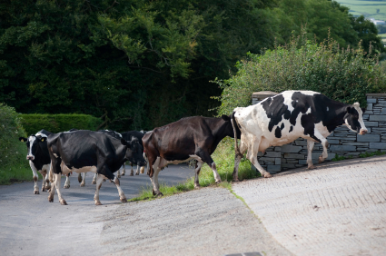
“Follow Me”

Slide 14
Role Models to Others
Hebrews 6:11-12
11 And we desire that every one of you do shew the same diligence to the full assurance of hope unto the end:
12 That ye be not slothful, but followers of them who through faith and patience inherit the promises.
Follower G3402
mim-ay-tace'
From G3401; an imitator: - follower.
Hence, to seek out others who are prepared to show you how to live.

Slide 15
Whose faith follow
Hebrews 13:6-7
6 So that we may boldly say, The Lord is my helper, and I will not fear what man shall do unto me.
7 Remember them which have the rule over you, who have spoken unto you the word of God: whose faith follow, considering the end of their conversation.
Follow G3401
mim-eh'-om-ahee
Middle voice from μῖμος mimos (a “mimic”); to imitate: - follow.
Those who have the rule over us today, are those who ‘lead’ us, or those we select to be our ecclesial servants.
We are directed to follow their faith.

Slide 16
As Ambassadors for Christ
2 Corinthians 5:18-20
18 And all things are of God, who hath reconciled us to himself by Jesus Christ, and hath given to us the ministry of reconciliation;
19 To wit, that God was in Christ, reconciling the world unto himself, not imputing their trespasses unto them; and hath committed unto us the word of reconciliation.
20 Now then we are ambassadors for Christ, as though God did beseech you by us: we pray you in Christ's stead, be ye reconciled to God.
Ambassadors G4243
pres-byoo'-o
From the base of G4245; to be a senior, that is, (by implication) act as a representative (figuratively preacher): - be an ambassador.
This is a reminder that the work of preaching is the Lord’s work – we are representatives and must ensure this.

Slide 17
For a Pattern
1 Timothy 1:15-16
15 This is a faithful saying, and worthy of all acceptation, that Christ Jesus came into the world to save sinners; of whom I am chief.
16 Howbeit for this cause I obtained mercy, that in me first Jesus Christ might shew forth all longsuffering, for a pattern to them which should hereafter believe on him to life everlasting.
Pattern G5296
υhoop-ot-oop'-o-sis
From a compound of G5259 and a derivative of G5179; typification under (after), that is, (concretely) a sketch (figuratively) for imitation: - form, pattern.
This pattern must be wonderful news to those who had formerly persecuted the ecclesia.

Slide 18
Thou forgavest the iniquity
Psalms 32:5-6
5 I acknowledged my sin unto thee, and mine iniquity have I not hid. I said, I will confess my transgressions unto the LORD; and thou forgavest the iniquity of my sin. Selah.
6 For this shall every one that is godly pray unto thee in a time when thou mayest be found: surely in the floods of great waters they shall not come nigh unto him.
This aspect of forgiveness is prominent in the word and must be one of the ways in which God ‘draws’ people.

Slide 19
Sinners shall be converted
Psalms 51:11-13
11 Cast me not away from thy presence; and take not thy holy spirit from me.
12 Restore unto me the joy of thy salvation; and uphold me with thy free spirit.
13 Then will I teach transgressors thy ways; and sinners shall be converted unto thee.
David brought shame upon the name of his God, but his sin also brought to light the relief of forgiveness for others who were tormented by similar misdeeds.

Slide 20
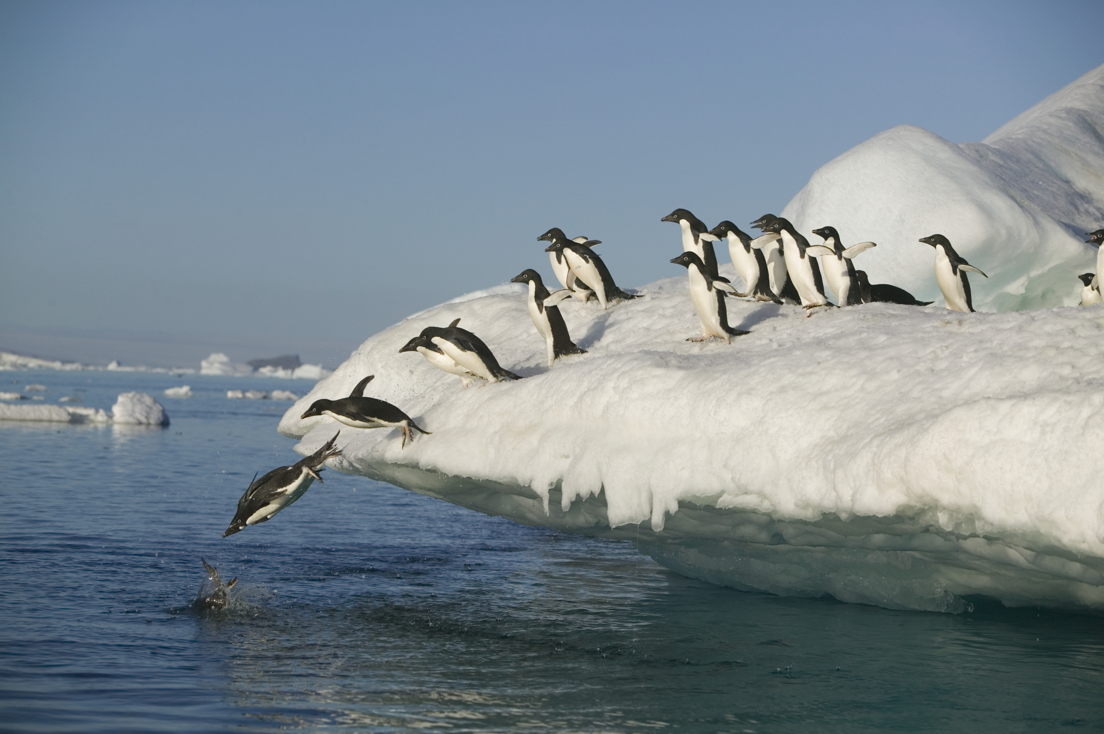
“Follow Me”

Slide 21
The Gospel is Passed on
2 Timothy 2:1-2
1 Thou therefore, my son, be strong in the grace that is in Christ Jesus.
2 And the things that thou hast heard of me among many witnesses, the same commit thou to faithful men, who shall be able to teach others also.
The concept of a relay race is a good way to see the operation of the growth of the ecclesia.
We train to ‘pass on’ the truth of God’s word to other ‘faithful’ individuals.

Slide 22
Keep it without spot
1 Timothy 6:13-14
13 I give thee charge in the sight of God, who quickeneth all things, and before Christ Jesus, who before Pontius Pilate witnessed a good confession;
14 That thou keep this commandment without spot, unrebukeable, until the appearing of our Lord Jesus Christ:
In order to pass on to others the Gospel that saves, we must be very careful not to allow any corruption into the process.

