Slide 1
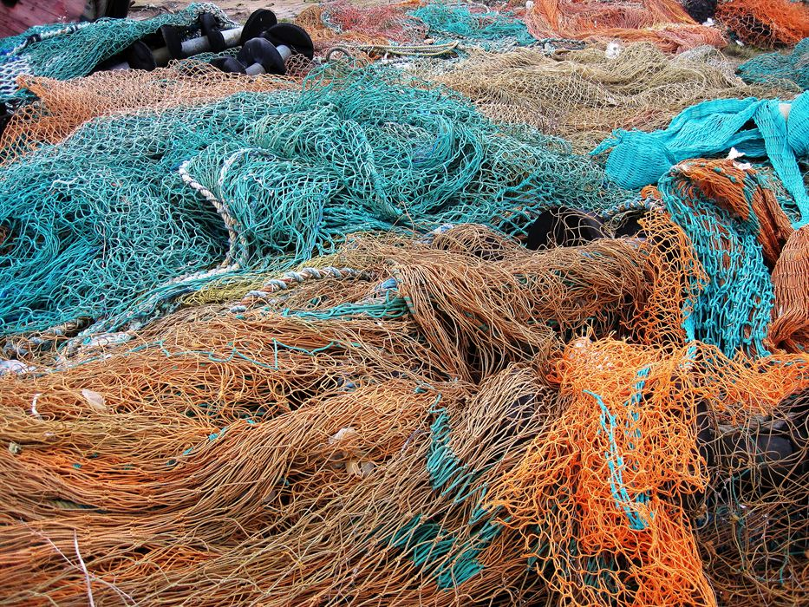
Follow Me
Class 7
“I will make you fishers of men” Matthew 4:19

Slide 2
Parable about fishing
Matthew 13:47-50
47 Again, the kingdom of heaven is like unto a net, that was cast into the sea, and gathered of every kind:
48 Which, when it was full, they drew to shore, and sat down, and gathered the good into vessels, but cast the bad away.
49 So shall it be at the end of the world: the angels shall come forth, and sever the wicked from among the just,
50 And shall cast them into the furnace of fire: there shall be wailing and gnashing of teeth.
The Kingdom of a heaven is like a net that was cast into the sea of mankind.
The gospel net draws in people of all kinds.
They will be sorted by the angels.

Slide 3
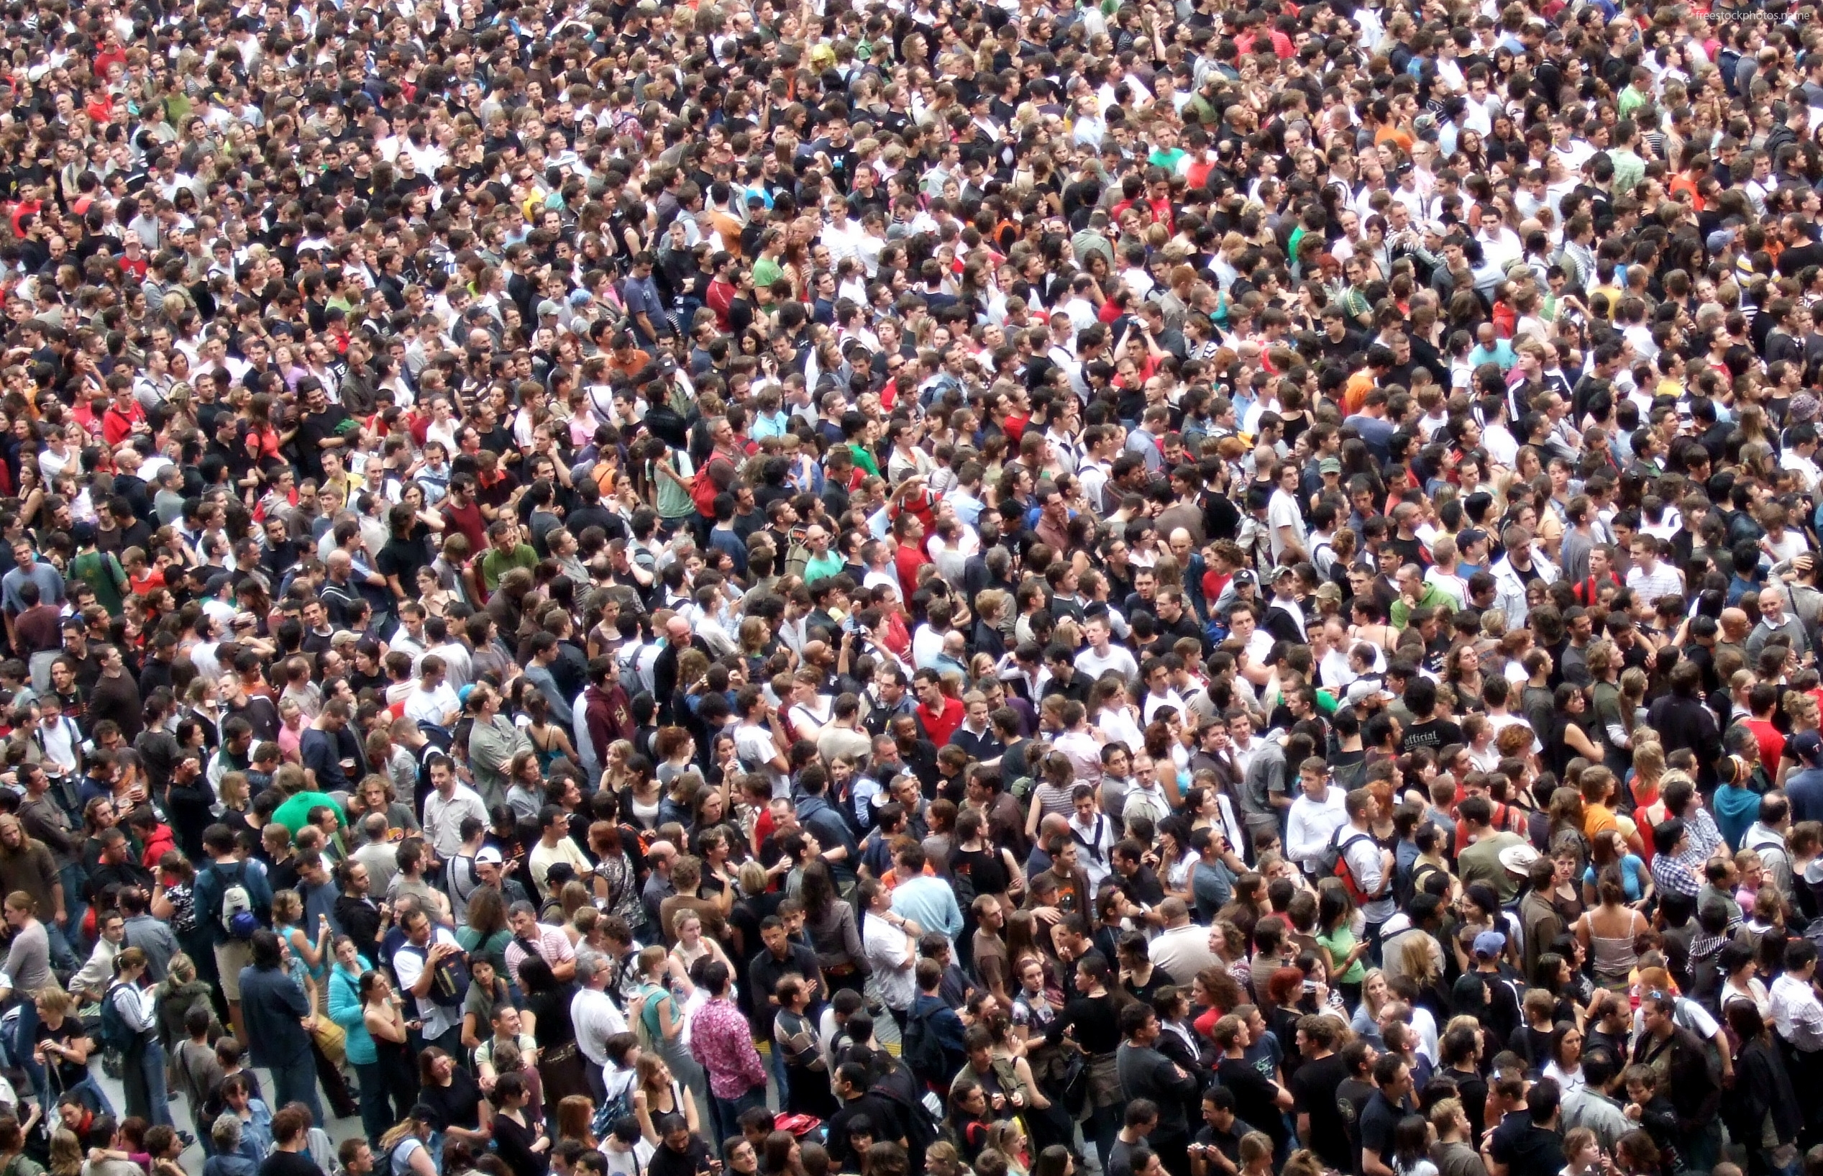
“I will make you Fishers of men”

Slide 4
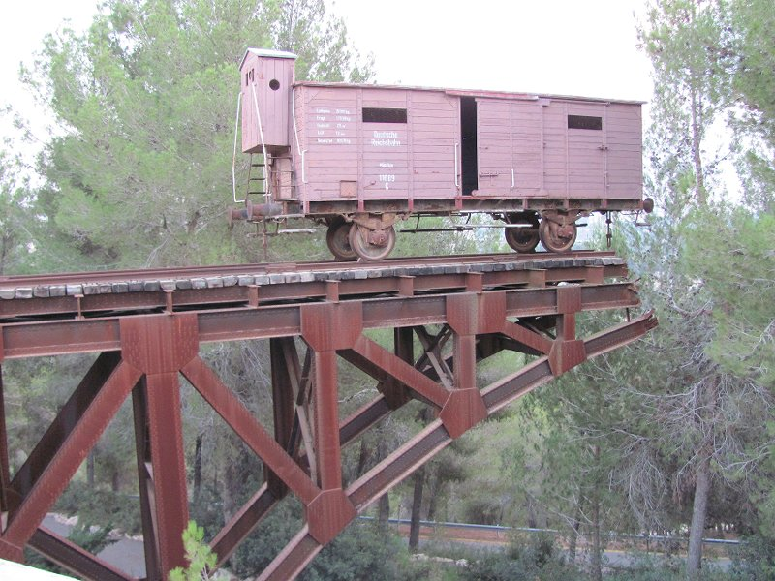
Fishing … only to kill
Jeremiah 16:16
16 Behold, I will send for many fishers saith the LORD, and they shall fish them; and afterward I will send for many hunters, and they shall hunt them from every mountain, and from every hill, and out of the holes of the rocks.

Slide 5
Peter’s 2nd calling
Luke 5:4-6
4 Now when he had left speaking, he said unto Simon, Launch out into the deep, and let down your nets for a draught.
5 And Simon answering said unto him, Master, we have toiled all the night, and have taken nothing: nevertheless at thy word I will let down the net.
6 And when they had this done, they inclosed a great multitude of fishes: and their net brake.
The command of the Lord was sufficient to make a difference.
The net broke – due to their unpreparedness for such a haul of fish.
How strong are our nets?

Slide 6
Both ships began to sink
Luke 5:7-9
7 And they beckoned unto their partners, which were in the other ship, that they should come and help them. And they came, and filled both the ships, so that they began to sink.
8 When Simon Peter saw it, he fell down at Jesus' knees, saying, Depart from me; for I am a sinful man, O Lord.
9 For he was astonished, and all that were with him, at the draught of the fishes which they had taken:
The fishermen were amazed by the great harvest.
The mark of distinction was the advice of the Lord to cast the net.

Slide 7
Thou shalt catch men
Luke 5:10-11
10 And so was also James, and John, the sons of Zebedee, which were partners with Simon. And Jesus said unto Simon, Fear not; from henceforth thou shalt catch men.
11 And when they had brought their ships to land, they forsook all, and followed him.
Catch G2221
dzogue-reh'-o
From the same as G2226 and G64; to take alive (make a prisoner of war), that is, (figuratively) to capture or ensnare: - take captive, catch.
Only other place this word is used is 2Ti 2:26

Slide 8
They were trying to catch him
Luke 11:53-54
53 And as he said these things unto them, the scribes and the Pharisees began to urge him vehemently, and to provoke him to speak of many things:
54 Laying wait for him, and seeking to catch something out of his mouth, that they might accuse him.
Catch G2340
thay-ryoo'-o
From G2339; to hunt (an animal), that is, (figuratively) to carp at: - catch.
This word is associated with evil intent.

Slide 9
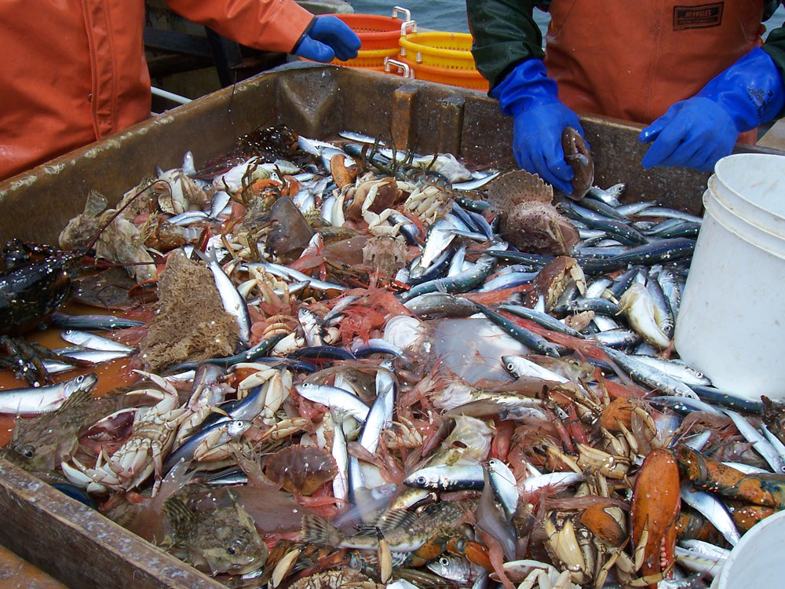
They were sorted

Slide 10
They caught nothing
John 21:3-4
3 Simon Peter saith unto them, I go a fishing. They say unto him, We also go with thee. They went forth, and entered into a ship immediately; and that night they caught nothing.
4 But when the morning was now come, Jesus stood on the shore: but the disciples knew not that it was Jesus.
This is “looking back” which puts even the best of us at risk of spiritual disaster.
Once again the fishermen were faced with catching nothing.

Slide 11
Cast the net on the right side
John 21:5-7
5 Then Jesus saith unto them, Children, have ye any meat? They answered him, No.
6 And he said unto them, Cast the net on the right side of the ship, and ye shall find. They cast therefore, and now they were not able to draw it for the multitude of fishes.
7 Therefore that disciple whom Jesus loved saith unto Peter, It is the Lord. Now when Simon Peter heard that it was the Lord, he girt his fisher's coat unto him, (for he was naked,) and did cast himself into the sea.
Surely the fish had not been there before the word of the Lord.
They may have concluded that without the Lord’s direction fishing was a waste of time.

Slide 12
Fish laid thereon, and bread
John 21:8-10
8 And the other disciples came in a little ship; (for they were not far from land, but as it were two hundred cubits,) dragging the net with fishes.
9 As soon then as they were come to land, they saw a fire of coals there, and fish laid thereon, and bread.
10 Jesus saith unto them, Bring of the fish which ye have now caught.
Jesus invited them to have a meal with food he was able to supply.
Why bring the fish they had caught?

Slide 13
The net was not broken
John 21:11-13
11 Simon Peter went up, and drew the net to land full of great fishes, an hundred and fifty and three: and for all there were so many, yet was not the net broken.
12 Jesus saith unto them, Come and dine. And none of the disciples durst ask him, Who art thou? knowing that it was the Lord.
13 Jesus then cometh, and taketh bread, and giveth them, and fish likewise.
It must have been remarkable that the net was not broken.
Peter again took the initiative and he was the focus of the lesson.

Slide 14
Lovest thou me more than these?
John 21:14-15
14 This is now the third time that Jesus shewed himself to his disciples, after that he was risen from the dead.
15 So when they had dined, Jesus saith to Simon Peter, Simon, son of Jonas, lovest thou me more than these? He saith unto him, Yea, Lord; thou knowest that I love thee. He saith unto him, Feed my lambs.
More G4119
pli'-own, pli'-on, pleh'-on
Comparative of G4183; more in quantity, number, or quality; also (in plural) the major portion:
The lesson seems to be related to the fish.
Would these men regress to fishing for fish, or advance to fishing for men?

Slide 15
Lovest thou me more than these?
John 21:16-17
16 He saith to him again the second time, Simon, son of Jonas, lovest thou me? He saith unto him, Yea, Lord; thou knowest that I love thee. He saith unto him, Feed my sheep.
17 He saith unto him the third time, Simon, son of Jonas, lovest thou me? Peter was grieved because he said unto him the third time, Lovest thou me? And he said unto him, Lord, thou knowest all things; thou knowest that I love thee. Jesus saith unto him, Feed my sheep.
Jesus had exhorted Peter to strengthen his brethren.
Now he was being asked whether he really “loved” the Lord.
To love the Lord is to accept the task of giving provender unto the sheep.
It is needless to say that sheep do not eat fish.

Slide 16
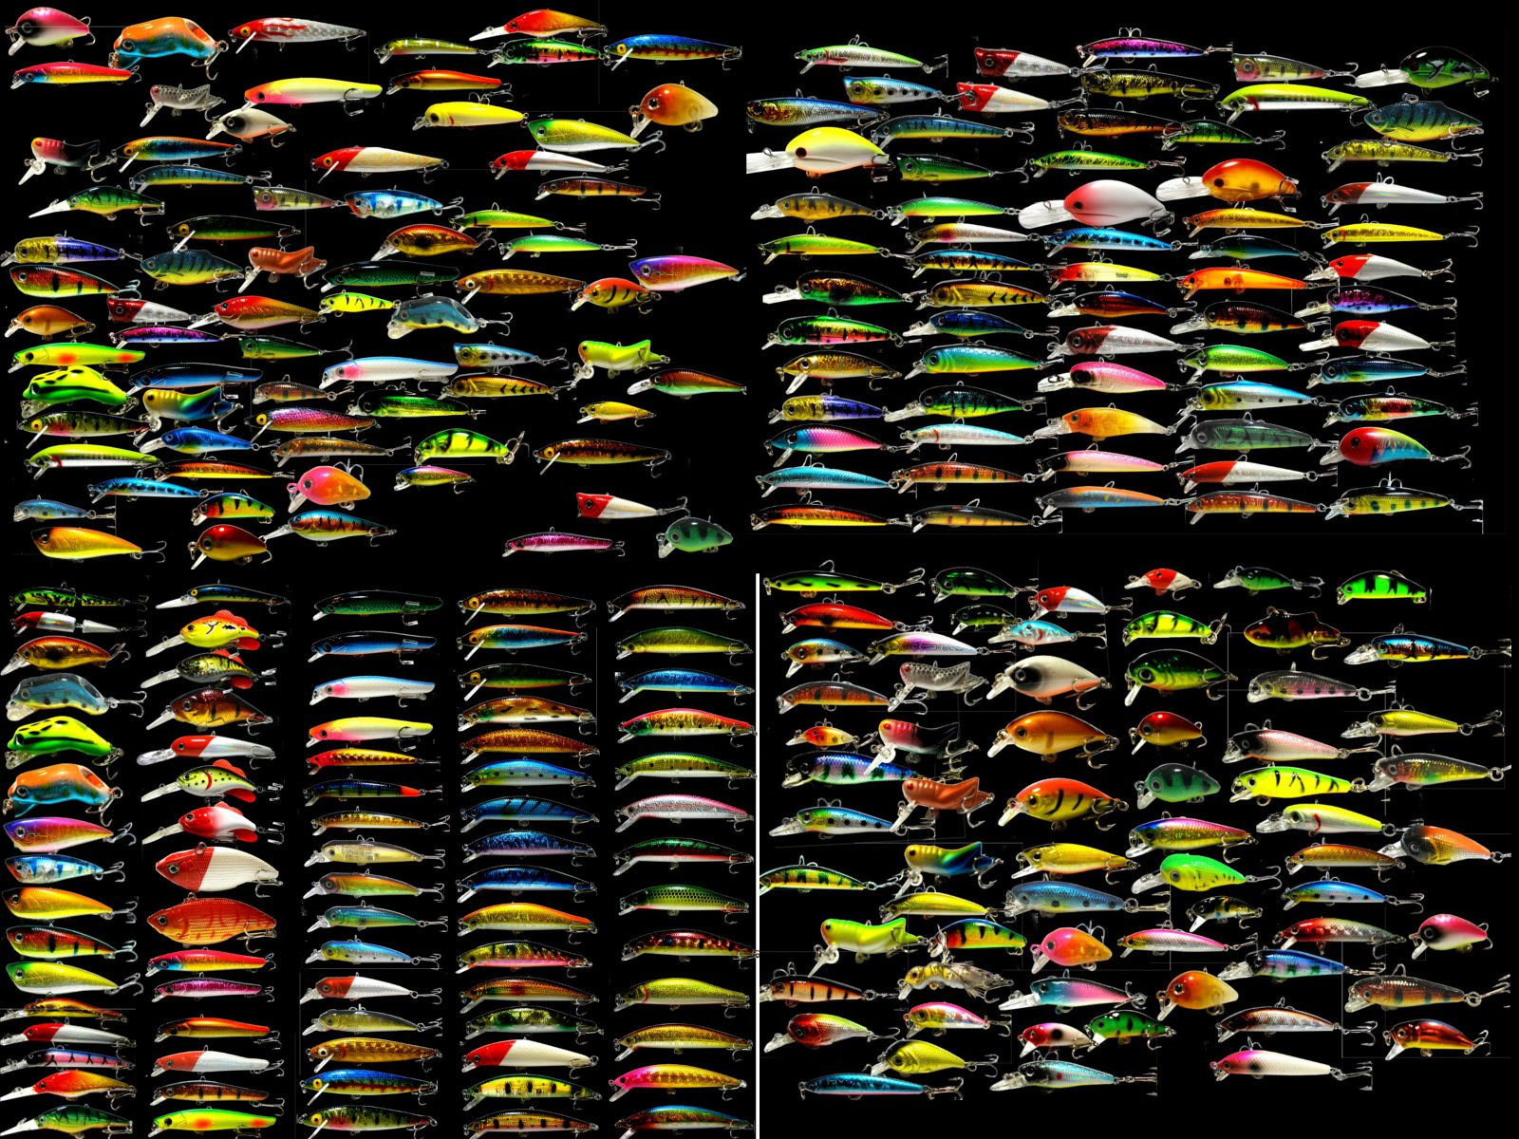
Fishers of men

Slide 17
To call out of them a people
Acts 15:14-17
14 Simeon hath declared how God at the first did visit the Gentiles, to take out of them a people for his name.
15 And to this agree the words of the prophets; as it is written,
16 After this I will return, and will build again the tabernacle of David, which is fallen down; and I will build again the ruins thereof, and I will set it up:
17 That the residue of men might seek after the Lord, and all the Gentiles, upon whom my name is called, saith the Lord, who doeth all these things.
This is the purpose of Deity with flesh – not primarily to save mankind, but to call out a people from the multitudes who will bear His name in the future age.
The Kingdom Age will not be a time for the ‘saints’ to put their feet up and relax.
The work of gathering in the great harvest provides a sense of ‘mission’ for a spiritual mind.

Slide 18
God draws them to him
John 6:44-45
44 No man can come to me, except the Father which hath sent me draw him: and I will raise him up at the last day.
45 It is written in the prophets, And they shall be all taught of God. Every man therefore that hath heard, and hath learned of the Father, cometh unto me.
The fundamental work of drawing out a people is the Father’s.
By his goodness; mercy; longsuffering; promises; unfailing help, etc.
It is wise therefore, for fishermen to keep these ideas in their tacklebox.

Slide 19
Prophetic vision
Proverbs 29:18 ESV
18 Where there is no prophetic vision the people cast off restraint, but blessed is he who keeps the law.
Some people are attracted by the vision of the future which God alone is able to give and guarantee.
God’s promises are treasured by those who admire their practical application to today’s world problems.

Slide 20
Jesus draws them to him
John 12:31-33
31 Now is the judgment of this world: now shall the prince of this world be cast out.
32 And I, if I be lifted up from the earth, will draw all men unto me.
33 This he said, signifying what death he should die.
Jesus, a man sent from God to supplement the task of selecting a multitude for the Name is also able to draw all men unto him.
Since we all disobey at times, we need the Lord and his role as Saviour and Mediator.

Slide 21
The firstfruits unto God
Revelation 14:4-5
4 These are they which were not defiled with women; for they are virgins. These are they which follow the Lamb whithersoever he goeth. These were redeemed from among men, being the firstfruits unto God and to the Lamb.
5 And in their mouth was found no guile: for they are without fault before the throne of God.
All those selected by God at the resurrection and judgment of mankind will constitute the firstfruits.
The greater work of the harvest will take place at the hands of the firstfruits.

Slide 22
Techniques – be ready always
1 Peter 3:15-16
15 But sanctify the Lord God in your hearts: and be ready always to give an answer to every man that asketh you a reason of the hope that is in you with meekness and fear:
16 Having a good conscience; that, whereas they speak evil of you, as of evildoers, they may be ashamed that falsely accuse your good conversation in Christ.
Peter always appeared ready to react to the Lord.
His testimony illustrated his loyalty, understanding and to some extent his weaknesses.

Slide 23
That I might gain the more
1 Corinthians 9:19-21
19 For though I be free from all men, yet have I made myself servant unto all, that I might gain the more.
20 And unto the Jews I became as a Jew, that I might gain the Jews; to them that are under the law, as under the law, that I might gain them that are under the law;
21 To them that are without law, as without law, (being not without law to God, but under the law to Christ,) that I might gain them that are without law.
The Apostle Paul was a follower of the Lord and an ambassador for the work of God.
He was willing to do whatever he had to do to accomplish this work.
Yet he never stepped over the line into disobedience of his God.

Slide 24
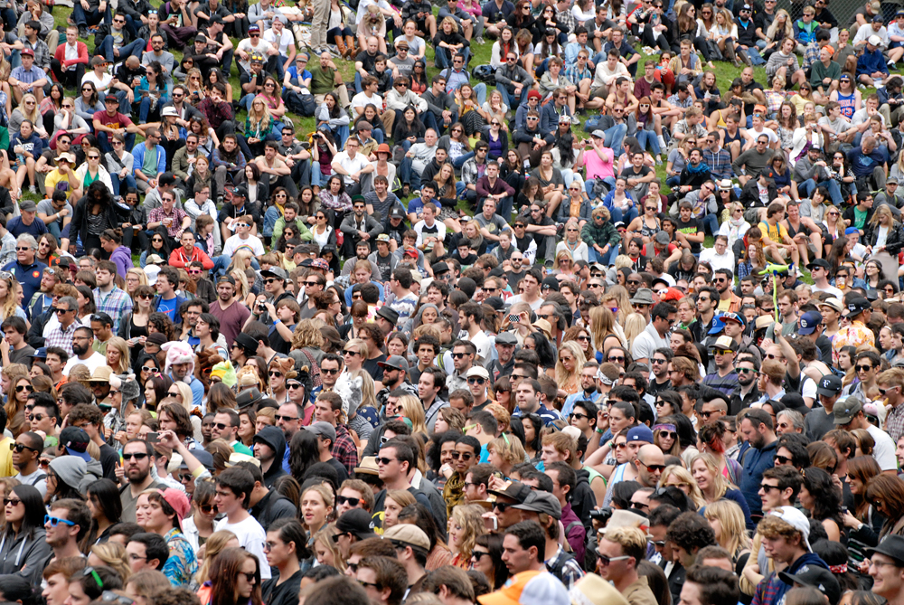
Fishing for men

Slide 25
Be gentle unto all men …
2 Timothy 2:24-26
24 And the servant of the Lord must not strive; but be gentle unto all men, apt to teach, patient,
25 In meekness instructing those that oppose themselves; if God peradventure will give them repentance to the acknowledging of the truth;
26 And that they may recover themselves out of the snare of the devil, who are taken captive by him at his will.
In teaching others it is important to remember that we are trying to save men and women, not to destroy them.
Being understanding of the great decisions that must be made we are likely to be more patient and apt to teach.

Slide 26
Be won by the behaviour
1 Peter 3:1-4
1 Likewise, ye wives, be in subjection to your own husbands; that, if any obey not the word, they also may without the word be won by the conversation of the wives;
2 While they behold your chaste conversation coupled with fear.
3 Whose adorning let it not be that outward adorning of plaiting the hair, and of wearing of gold, or of putting on of apparel;
4 But let it be the hidden man of the heart, in that which is not corruptible, even the ornament of a meek and quiet spirit, which is in the sight of God of great price.
Just witnessing the plain discipline to the Word of God in others is a powerful testimony.
It is required of all who follow the examples of the righteous.

Slide 27
Whether thou shalt save thy husband
1 Corinthians 7:13-16
13 And the woman which hath an husband that believeth not, and if he be pleased to dwell with her, let her not leave him.
14 For the unbelieving husband is sanctified by the wife, and the unbelieving wife is sanctified by the husband: else were your children unclean; but now are they holy.
15 But if the unbelieving depart, let him depart. A brother or a sister is not under bondage in such cases: but God hath called us to peace.
16 For what knowest thou, O wife, whether thou shalt save thy husband? or how knowest thou, O man, whether thou shalt save thy wife?
Perseverance and patience coupled with strong faith is a powerful agent in marriage and family settings.

Slide 28
Preach the Word
2 Timothy 4:1-2
1 I charge thee therefore before God, and the Lord Jesus Christ, who shall judge the quick and the dead at his appearing and his kingdom;
2 Preach the word; be instant in season, out of season; reprove, rebuke, exhort with all longsuffering and doctrine.
Preaching the Word to others with the urgency of this text must be done in word and deed.
To do so is to align our purpose for living with our God and to follow the examples of all those who accepted the high calling of the Lord to take up their cross and “Follow me.”

