Slide 1
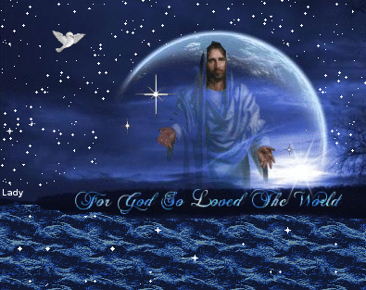
God’s Wonderful Plan of Redemption
Class 3:
God can and will Redeem us

Slide 2
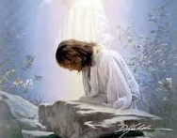
How did God save His Son?
Immersed him in the word
Isaiah 50:4-5
4 The Lord GOD has given Me the tongue of the learned, that I should know how to speak a word in season to him who is weary. He awakens Me morning by morning, he awakens My ear to hear as the learned.
5 The Lord GOD has opened My ear; and I was not rebellious, nor did I turn away.
Should be part of our daily food too!

Slide 3
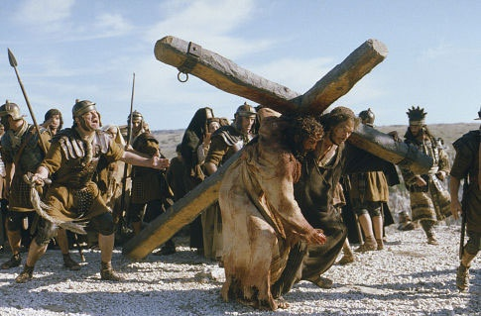
How did God save His Son?
Taught him obedience through suffering & trials
Hebrews 2:10, 16-18
10 For it was fitting for Him, for whom are all things and by whom are all things, in bringing many sons to glory, to make the captain of their salvation perfect through sufferings.
16 For indeed He does not give aid to angels, but He does give aid to the seed of Abraham.
17 Therefore, in all things He had to be made like His brethren, that He might be a merciful and faithful High Priest in things pertaining to God, to make propitiation for the sins of the people.
18 For in that He Himself has suffered, being tempted, He is able to aid those who are tempted.

Slide 4
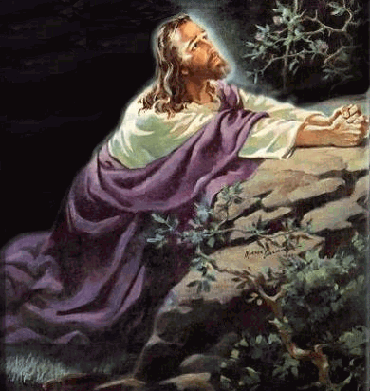
Hebrews 5:7-9
7 who, in the days of His flesh, when He had offered up prayers and supplications, with vehement cries and tears to Him who was able to save Him from death, and was heard because of His godly fear,
8 though He was a Son, yet He learned obedience by the things which He suffered.
9 And having been perfected, He became the author of eternal salvation to all who obey Him,
God still teaches us obedience through suffering

Slide 5
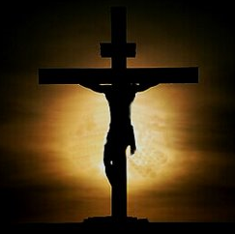
How did God save His Son?
Kept the Cross before him
Luke 9:20-23
20 He said to them, "But who do you say that I am?" Peter answered and said, "The Christ of God."
21 And He strictly warned and commanded them to tell this to no one,
22 saying, "The Son of Man must suffer many things, and be rejected by the elders and chief priests and scribes, and be killed, and be raised the third day."
23 Then He said to them all, "If anyone desires to come after Me, let him deny himself, and take up his cross daily, and follow Me.
Should be part of our daily focus too!

Slide 6

How did God save His Son?
Developed a trusting Faith in God
Hebrews 10:36-39
36 For you have need of endurance, so that after you have done the will of God, you may receive the promise:
37 "For yet a little while, and He who is coming will come and will not tarry.
38 Now the just shall live by faith; but if anyone draws back, my soul has no pleasure in him."
39 But we are not of those who draw back to perdition, but of those who believe to the saving of the soul.
Faith is what saves us too!

Slide 7

Hebrews 12:1-3
1 Therefore, since we have so great a cloud of witnesses surrounding us, let us also lay aside every encumbrance and the sin which so easily entangles us, and let us run with endurance the race that is set before us,
2 fixing our eyes on Jesus, the author and perfecter of faith [not “our faith”], who for the joy set before Him endured the cross, despising the shame, and has sat down at the right hand of the throne of God.
3 For consider Him who has endured such hostility by sinners against Himself, so that you will not grow weary and lose heart. (NASB)
Jesus developed the faith that saves. He completely trusted that God could do in him what was impossible for him to do himself.

Slide 8
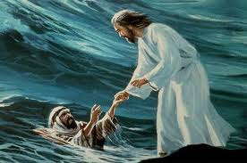
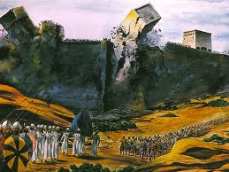
Romans 3:26 (KJV)
To declare, I say, at this time his righteousness: that he might be just, and the justifier of him which believeth in Jesus.
Romans 3:26 Barnes’ Notes
“Him which believeth in Jesus”
Greek, "Him who is of the faith of Jesus;"
Everyone is saved by faith

Slide 9
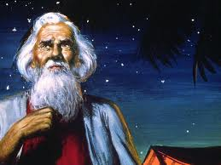
Romans 4:12, 16
12 and the father of circumcision to those who not only are of the circumcision, but who also walk in the steps of the faith which our father Abraham had while still uncircumcised.
16 Therefore it is of faith that it might be according to grace, so that the promise might be sure to all the seed, not only to those who are of the law, but also to those who are of the faith of Abraham, who is the father of us all. [same greek as “faith of Jesus” (3:26)
Abraham had the faith of Jesus

Slide 10
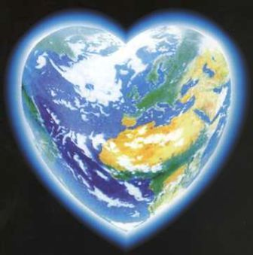
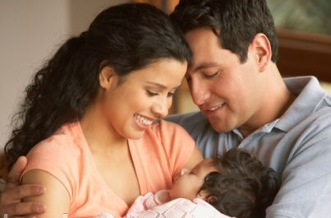
It’s all driven by God’s Love
John 3:16-18
16 "For God so loved the world that He gave His only begotten Son, that whoever believes in Him should not perish but have everlasting life.
17 "For God did not send His Son into the world to condemn the world, but that the world through Him might be saved.
18 "He who believes in Him is not condemned; but he who does not believe is condemned already, because he has not believed in the name of the only begotten Son of God.
God hopes that when we understand and appreciate His love, we will feel compelled to show His love to others

Slide 11

Philippians 2:11-14
God has provided the motive force to redeem us from Sin
11 and that every tongue should confess that Jesus Christ is Lord, to the glory of God the Father.
12 Therefore, my beloved, as you have always obeyed, not as in my presence only, but now much more in my absence, work out your own salvation with fear and trembling;
13 for it is God who works in you both to will and to do for His good pleasure.
14 Do all things without complaining and disputing,
It is God’s work in us, but we must show our agreement and participation by the choices we make!

Slide 12
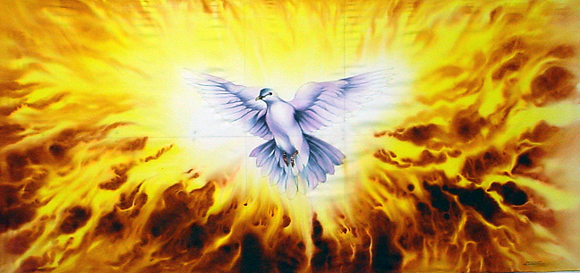
Ephesians 1:18-20
18 the eyes of your understanding being enlightened; that you may know what is the hope of His calling, what are the riches of the glory of His inheritance in the saints,
19 and what is the exceeding greatness of His power toward us who believe, according to the working of His mighty power
20 which He worked in Christ when He raised Him from the dead and seated Him at His right hand in the heavenly places,
That same power which brought Christ through life sinless and resurrected him, is available to us by faith

Slide 13
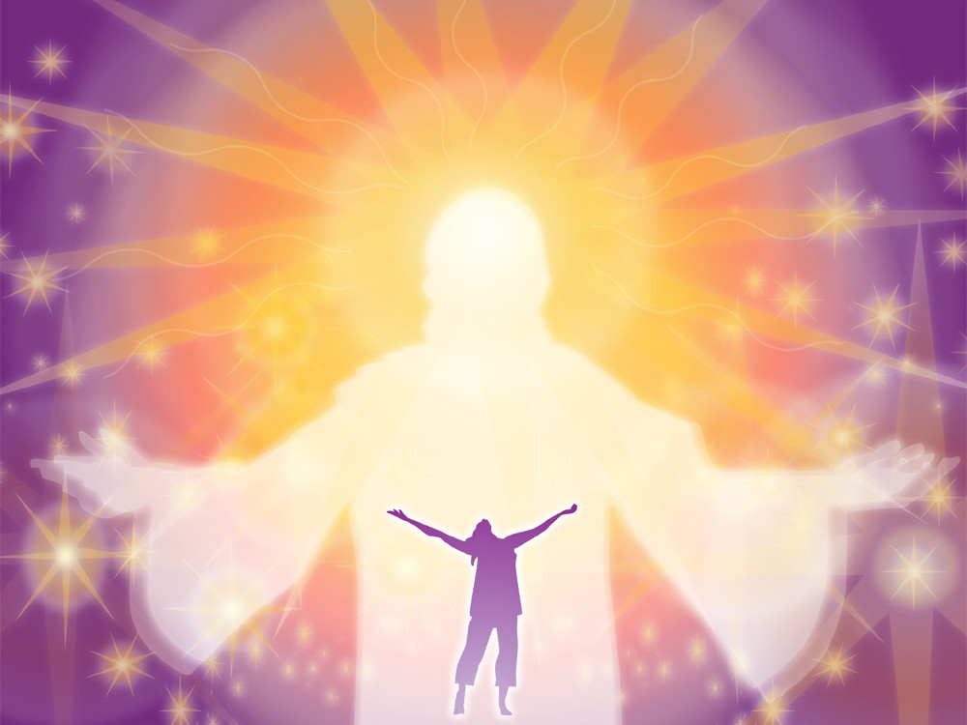
Ephesians 3:20-21
20 Now to Him who is able to do exceedingly abundantly above all that we ask or think, according to the power that works in us,
21 to Him be glory in the church by Christ Jesus to all generations, forever and ever. Amen.
God’s power can accomplish in us by faith, what is humanly impossible!

Slide 14

Romans 1:16-17
16 For I am not ashamed of the gospel of Christ, for it is the power of God to salvation for everyone who believes [has faith], for the Jew first and also for the Greek.
17 For in it the righteousness of God is revealed from faith to faith; as it is written, "The just shall live by faith."
The gospel of Christ is the power of God to save because it reveals the righteousness which is by faith

Slide 15
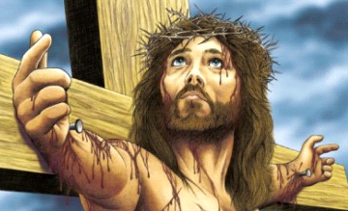
1 Corinthians 1:22-25
22 For Jews request a sign, and Greeks seek after wisdom;
23 but we preach Christ crucified, to the Jews a stumbling block and to the Greeks foolishness,
24 but to those who are called, both Jews and Greeks, Christ the power of God and the wisdom of God.
25 Because the foolishness of God is wiser than men, and the weakness of God is stronger than men.
Christ’s death on a cross becomes a moral power in our lives to empower us to continue the war against Sin

Slide 16
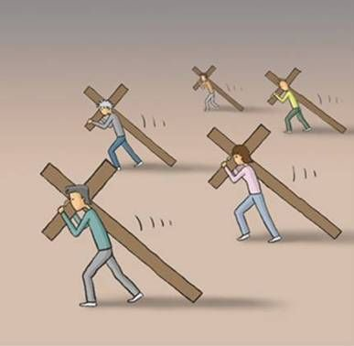
There’s only one Redemptive Plan
Luke 9:22-24
22 saying, "The Son of Man must suffer many things, and be rejected by the elders and chief priests and scribes, and be killed, and be raised the third day."
23 Then He said to them all, "If anyone desires to come after Me, let him deny himself [“not my will”], and take up his cross daily, and follow Me.
24 "For whoever desires to save his life will lose it, but whoever loses his life for My sake will save it.
We must join Christ daily in the battle with Sin

Slide 17

Romans 8:3-5
3 For what the law could not do in that it was weak through the flesh, God did by sending His own Son in the like- ness of sinful flesh, on account of sin: He condemned sin in the flesh,
4 that the righteous requirement of the law might be fulfilled in us who do not walk according to the flesh but according to the Spirit.
5 For those who live according to the flesh set their minds on the things of the flesh, but those who live according to the Spirit, the things of the Spirit.
We fulfill the righteous requirement of the law by walking according to the Spirit and putting to death the deeds of the body

Slide 18
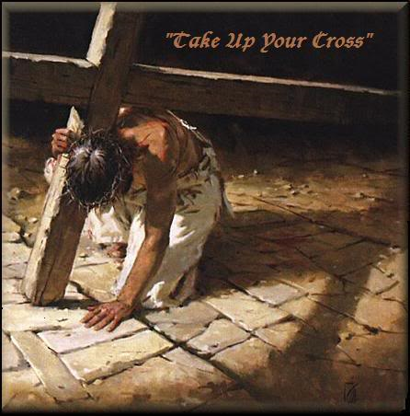
Colossians 3:5-10
5 Therefore put to death your members which are on the earth: fornication, unclean- ness, passion, evil desire, and covetous- ness, which is idolatry.
6 Because of these things the wrath of God is coming upon the sons of disobedience,
7 in which you yourselves once walked when you lived in them.
8 But now you yourselves are to put off all these: anger, wrath, malice, blasphemy, filthy language out of your mouth.
9 Do not lie to one another, since you have put off the old man with his deeds,
10 and have put on the new man who is renewed in knowledge according to the image of Him who created him,
This should change the way we live!

Slide 19
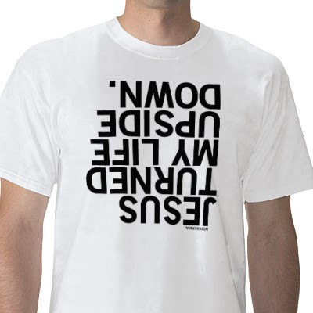
Titus 2:11-14
11 For the grace of God that brings salvation has appeared to all men,
12 teaching us that, denying ungod- liness and worldly lusts, we should live soberly, righteously, and godly in the present age,
13 looking for the blessed hope and glorious appearing of our great God and Savior Jesus Christ,
14 who gave Himself for us, that He might redeem us from every lawless deed and purify for Himself His own special people, zealous for good works.
God’s redemptive plan provides forgiveness of sins, and motivates us to live for God

Slide 20
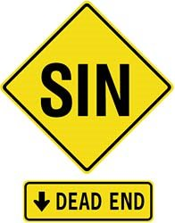
Acts 3:25-26
25 "You are sons of the prophets, and of the covenant which God made with our fathers, saying to Abraham, 'And in your seed all the families of the earth shall be blessed.'
26 "To you first, God, having raised up His Servant Jesus, sent Him to bless you, in turning away every one of you from your iniquities."
Part of the promise to Abraham was that God would convince his descendents to turn away from their iniquities – God would change their lives!

Slide 21
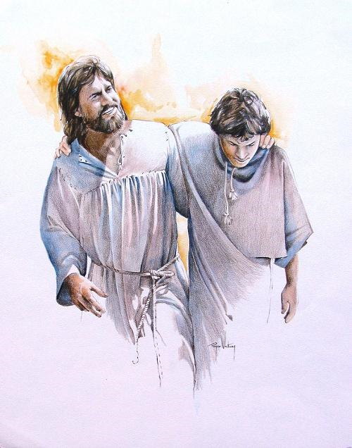
Galatians 5:13-16
13 For you, brethren, have been called to liberty; only do not use liberty as an opportunity for the flesh, but through love serve one another.
14 For all the law is fulfilled in one word, even in this: "You shall love your neighbor as yourself."
15 But if you bite and devour one another, beware lest you be consumed by one another!
16 I say then: Walk in the Spirit, and you shall not fulfill the lust of the flesh.
We have been freed from the restrictions of the Law so we can serve one another in love

Slide 22
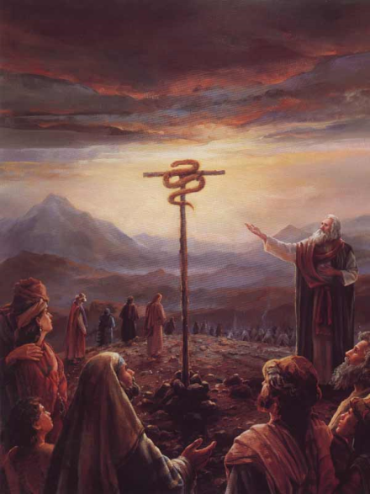
Galatians 5:22-26
22 But the fruit of the Spirit is love, joy, peace, longsuffering, kindness, goodness, faithfulness,
23 gentleness, self-control. Against such there is no law.
24 And those who are Christ's have crucified the flesh with its passions and desires.
25 If we live in the Spirit, let us also walk in the Spirit.
26 Let us not become conceited, provoking one another, envying one another.
When the mind of Christ grows in us every day, it produces the fruit of the Spirit that governs the way we treat each other

Slide 23
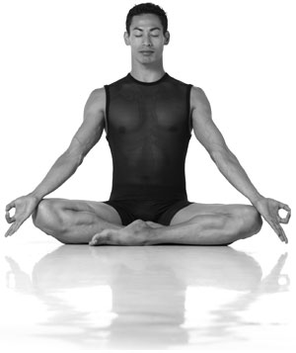
1 Corinthians 9:26-27
Paul’s Example
26 Therefore I run thus: not with uncertainty. Thus I fight: not as one who beats the air.
27 But I discipline my body and bring it into subjection, lest, when I have preached to others, I myself should become disqualified.
Paul joined Christ in his battle against Sin

Slide 24
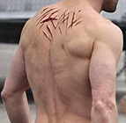

2 Corinthians 4:10
Paul’s Example
7 But we have this treasure in earthen vessels, that the excellence of the power may be of God and not of us.
8 We are hard pressed on every side, yet not crushed; we are perplexed, but not in despair;
9 persecuted, but not forsaken; struck down, but not destroyed--
10 always carrying about in the body the dying of the Lord Jesus, that the life of Jesus also may be manifested in our body.
11 For we who live are always delivered to death for Jesus' sake, that the life of Jesus also may be manifested in our mortal flesh.
12 So then death is working in us, but life in you.

Slide 25
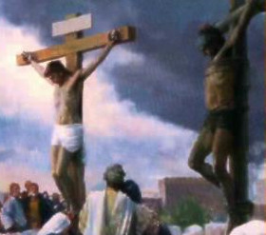
Galatians 2:18-21
Paul’s Example
18 "For if I build again those things which I destroyed, I make myself a transgressor.
19 "For I through the law died to the law that I might live to God.
20 "I have been crucified with Christ; it is no longer I who live, but Christ lives in me; and the life which I now live in the flesh I live by faith in the Son of God, who loved me and gave Himself for me.
21 "I do not set aside the grace of God; for if righteousness comes through the law, then Christ died in vain."
By God’s grace we can live like Christ in Faith!

Slide 26
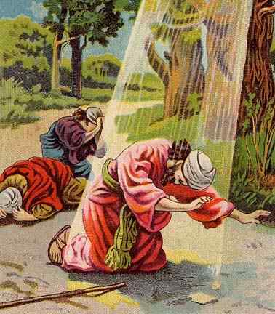

Galatians 6:13-16
Paul’s Example
13 For not even those who are circumcised keep the law, but they desire to have you circumcised that they may boast in your flesh.
14 But God forbid that I should boast except in the cross of our Lord Jesus Christ, by whom the world has been crucified to me, and I to the world.
15 For in Christ Jesus neither circumcision nor uncircumcision avails anything, but a new creation.
16 And as many as walk according to this rule, peace and mercy be upon them, and upon the Israel of God.
Paul is God’s proof that the victory can be won in others besides Jesus Christ

Slide 27
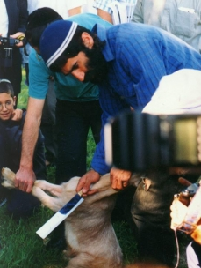
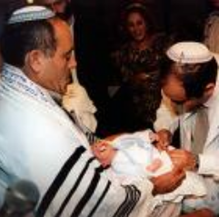
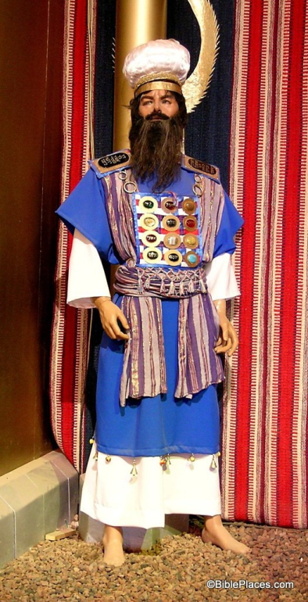
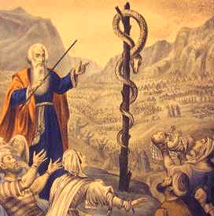
Tomorrow!
We will look at how God tried to explain His redemptive plan through rituals

