Slide 1

God’s wonderful Plan of Redemption
Class 6:
The Power of Faith working through Love (Gal. 5:6)

Slide 2
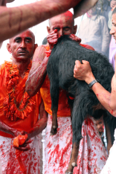
The Power of Faith in Jesus
Romans 3:19-28
19 Now we know that whatever the law says, it says to those who are under the law, that every mouth may be stopped, and all the world may become guilty before God.
20 Therefore by the deeds of the law no flesh will be justified in His sight, for by the law is the knowledge of sin.
21 But now the righteousness of God apart from the law is revealed, being witnessed by the Law and the Prophets,
22 even the righteousness of God, through faith in Jesus Christ, to all and on all who believe. For there is no difference;
23 for all have sinned and fall short of the glory of God,
Continued

Slide 3

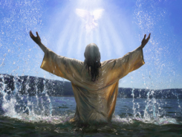
The Power of Faith in Jesus
Romans 3:19-28
24 being justified freely by His grace through the redemption that is in Christ Jesus,
25 whom God set forth as a propitiation [a gift that generates peace] by His blood, through faith, to demonstrate His righteousness, because in His forbearance God had passed over the sins that were previously committed,
26 to demonstrate at the present time His righteousness, that He might be just and the justifier of the one who has faith in Jesus. [the faith of Jesus]
27 Where is boasting then? It is excluded. By what law? Of works? No, but by the law of faith.
28 Therefore we conclude that a man is justified by faith apart from the deeds of the law.

Slide 4
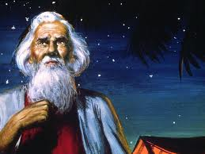
Abraham believed the Lord (Gen 15:6)
The Power of Faith
The one who will come from your own body will be your heir (15:4)
Count the stars… so will your descendants be (v.5)
Abraham believed the Lord & He counted it to him for righteousness (v.6)
“Against all hope, in hope Abraham believed” (Rom 4:18)

Slide 5
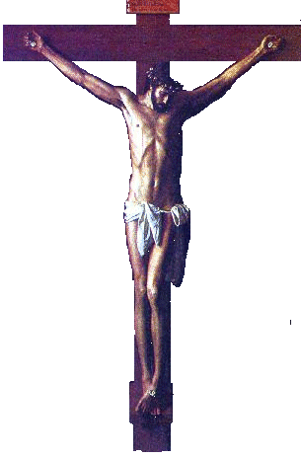
Different Viewpoints of the Cross
The People:
They judged Christ as a criminal who deserved to die a judicial, violent death. They punished Jesus with crucifixion and thought they were treating him as God would have punished a terrible sinner.
Christianity has built its substitution doctrine from this point of view, thinking God put Jesus through the punishment sinners deserve, so that sinners won’t have to be punished. The churches present Jesus as an innocent victim who died only for us in obedience to God.
God & Christ:
They look on the cross as the complete destruction of Sin. They finished the moral battle against Sin that Jesus was fighting everyday, by killing the cause of sin (the devil) in the body of Jesus. They judged the devil in human nature, condemned it to death, and then killed it. This was God’s declaration of righteousness – it showed us how to live!

Slide 6
Jesus is our Representative (“pioneer” RSV)
Substitution
1. Jesus died in my place as my substitute
2. Jesus took my place and suffered the punishment I deserve
3. Therefore, I can escape punishment since all my sins (past, present and future) have been borne away by Christ
Representation:
1. Jesus died to redeem himself first, as my representative (as one of us)
2. Jesus was not suffering anyone’s punishment. He willingly died to show me that Sin must be conquered and put to death
3. Therefore, I must follow Christ’s example, put to death my evil desires, and live for God. God will forgive my sins because I agree with Christ’s life and I will try to follow him.

Slide 7
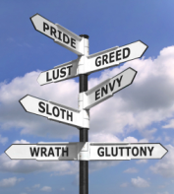
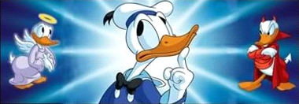
God’s Redemptive Plan deals with:
1) Our personal mistakes
God forgives our sins
2) Our sin-prone nature (evil desires)
God motivates us to fight it
This is the basis to forgive our sins

Slide 8
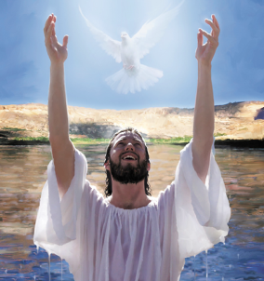
2 Corinthians 5:17-21
17 Therefore, if anyone is in Christ, he is a new creation; old things have passed away; behold, all things have become new.
18 Now all things are of God, who has reconciled us to Himself through Jesus Christ, and has given us the ministry of reconciliation,
19 that is, that God was in Christ reconciling the world to Himself, not imputing their trespasses to them, and has committed to us the word of reconciliation.
20 Now then, we are ambassadors for Christ, as though God were pleading through us: we implore you on Christ's behalf, be reconciled to God.
21 For He made Him who knew no sin to be sin for us, that we might become the righteousness of God in Him.

Slide 9
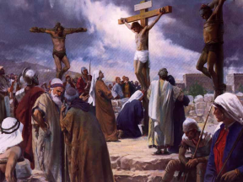
Isaiah 53:3-7
3 He is despised and rejected by men, a Man of sorrows and acquainted with grief. And we hid, as it were, our faces from Him; he was despised, and we did not esteem Him.
4 Surely He has borne our griefs and carried our sorrows; yet we esteemed Him stricken, smitten by God, and afflicted.
5 But He was wounded for our transgressions, he was bruised for our iniquities; the chastisement for our peace was upon Him, and by His stripes we are healed.
6 All we like sheep have gone astray; we have turned, every one, to his own way; and the LORD has laid on Him the iniquity of us all.
7 He was oppressed and He was afflicted, yet He opened not His mouth; he was led as a lamb to the slaughter, and as a sheep before its shearers is silent, so He opened not His mouth.

Slide 10
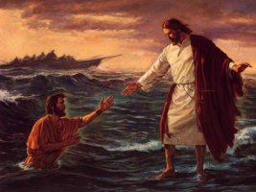
Hebrews 2:14-18 (RSV)
14 Since therefore the children share in flesh and blood, he himself likewise partook of the same nature, that through death he might destroy him who has the power of death, that is, the devil,
15 and deliver all those who through fear of death were subject to lifelong bondage.
16 For surely it is not with angels that he is concerned but with the descendants of Abraham.
17 Therefore he had to be made like his brethren in every respect, so that he might become a merciful and faithful high priest in the service of God, to make expiation for the sins of the people.
18 For because he himself has suffered and been tempted, he is able to help those who are tempted.

Slide 11
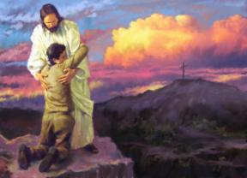
Hebrews 7:22-28
22 by so much more Jesus has become a surety of a better covenant.
23 Also there were many priests, because they were prevented by death from continuing.
24 But He, because He continues forever, has an unchangeable priesthood.
25 Therefore He is also able to save to the uttermost those who come to God through Him, since He always lives to make intercession for them.
26 For such a High Priest was fitting for us, who is holy, harmless, undefiled, separate from sinners, and has become higher than the heavens;
27 who does not need daily, as those high priests, to offer up sacrifices, first for His own sins and then for the people's, for this He did once for all when He offered up Himself.
28 For the law appoints as high priests men who have weakness, but the word of the oath, which came after the law, appoints the Son who has been perfected forever.

Slide 12
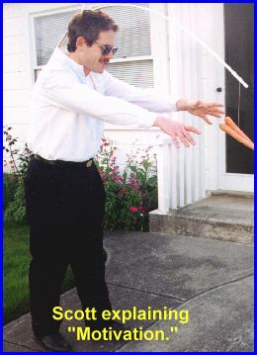
This world runs on “carrot & stick” motivation
Our educational and economic systems use this approach to motivate people. It is based on works and we are all very comfortable and familiar with it!

Slide 13
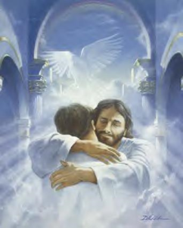
God uses a different strategy: He gives us grace as a gift and then asks us to respond to His kindness!
Ephesians 2:4-10
4 But God, who is rich in mercy, because of His great love with which He loved us,
5 even when we were dead in trespasses, made us alive together with Christ (by grace you have been saved),
6 and raised us up together, and made us sit together in the heavenly places in Christ Jesus,
7 that in the ages to come He might show the exceeding riches of His grace in His kindness toward us in Christ Jesus.

Slide 14

God gives us grace as a gift and then asks us to respond to His kindness!
Ephesians 2:4-10
8 For by grace you have been saved through faith, and that not of yourselves; it is the gift of God,
9 not of works, lest anyone should boast.
10 For we are His workmanship, created in Christ Jesus for good works, which God prepared beforehand that we should walk in them.

Slide 15
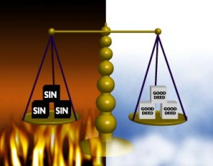
Don’t try to be justified by Law
Galatians 5:1-4
1 Stand fast therefore in the liberty by which Christ has made us free, and do not be entangled again with a yoke of bondage.
2 Indeed I, Paul, say to you that if you become circumcised, Christ will profit you nothing.
3 And I testify again to every man who becomes circumcised that he is a debtor to keep the whole law.
4 You have become estranged from Christ, you who attempt to be justified by law; you have fallen from grace.

Slide 16
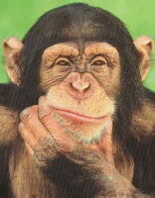
How do we know if we are living by law or by faith?
Do we depend on rituals to save us?
Do we serve one another through love?
Do we judge ourselves, or each other?
Do we stress a ritual more than the principles it is supposed to teach us?
Do we do our Bible readings to check them off, or so we can change our lives?
Do we go to meeting because “we have to” or because we want to?

Slide 17
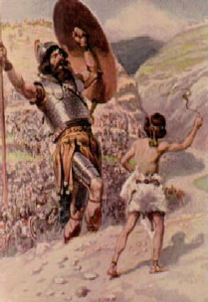
Faith has more power than Law
Hebrews 11:1-6
1 Now faith is the substance of things hoped for, the evidence of things not seen.
2 For by it the elders obtained a good testimony.
6 But without faith it is impossible to please Him, for he who comes to God must believe that He is, and that He is a rewarder of those who diligently seek Him.
Hebrews 11 is a testimony of what God did in people by faith, that works of law could never have accomplished!

Slide 18
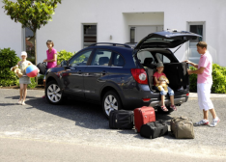
So, as we leave this camp….
Give thanks to God for his gift of kindness in redeeming us from Sin
Respond to God’s gift by walking with Him
Serve His family in love
Read our Bibles daily so we can join Christ in victory over sin
Attend meeting so we can help each other
Witness to our friends about God’s power to change our lives

Slide 19
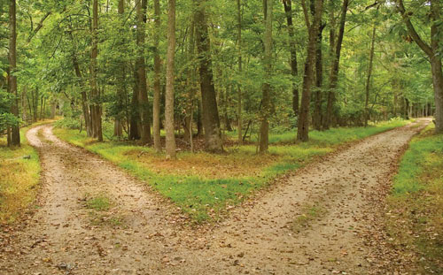
God wants us to make a choice
Satisfy our flesh
Eternal
life in God’s family
therefore choose life, that both you and your descendants may live (Deut 30:19)

Slide 20
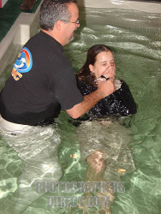
Titus 2:11-14
11 For the grace of God that brings salvation has appeared to all men,
12 teaching us that, denying ungodliness and worldly lusts, we should live soberly, righteously, and godly in the present age,
13 looking for the blessed hope and glorious appearing of our great God and Savior Jesus Christ,
14 who gave Himself for us, that He might redeem us from every lawless deed and purify for Himself His own special people, zealous for good works.

Slide 21
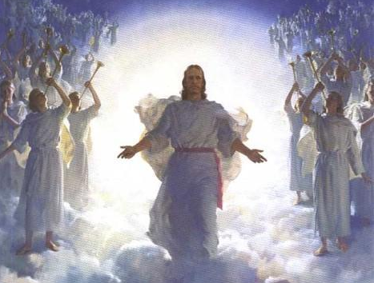
Christ has invited YOU to join God’s family forever...
don’t miss out!

Slide 22
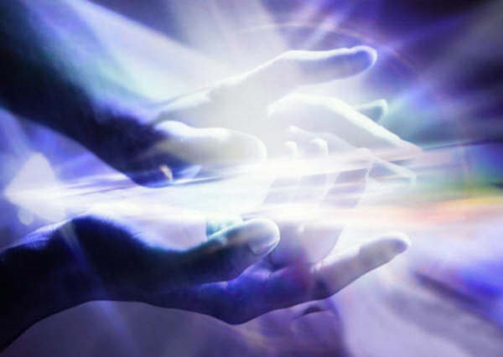
Thanks be to God for His indescribable gift!
(2 Corinthians 9:15)

