Slide 1
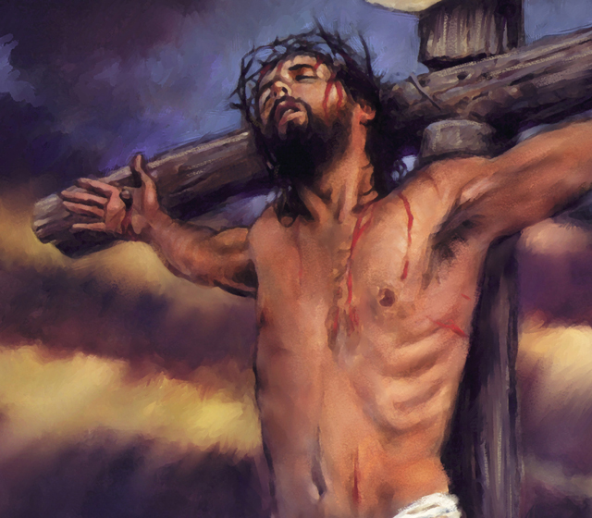
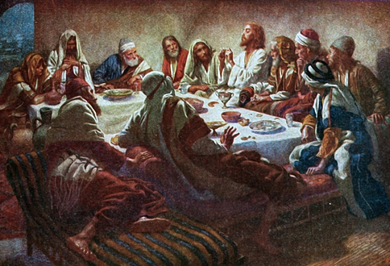
Christ’s Last Day
The Upper Room

Slide 2
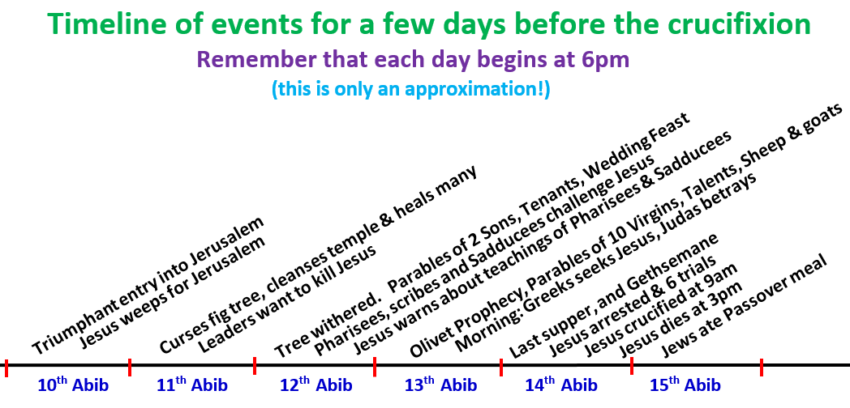
Where are we today?
Background & Upper Room

Slide 3
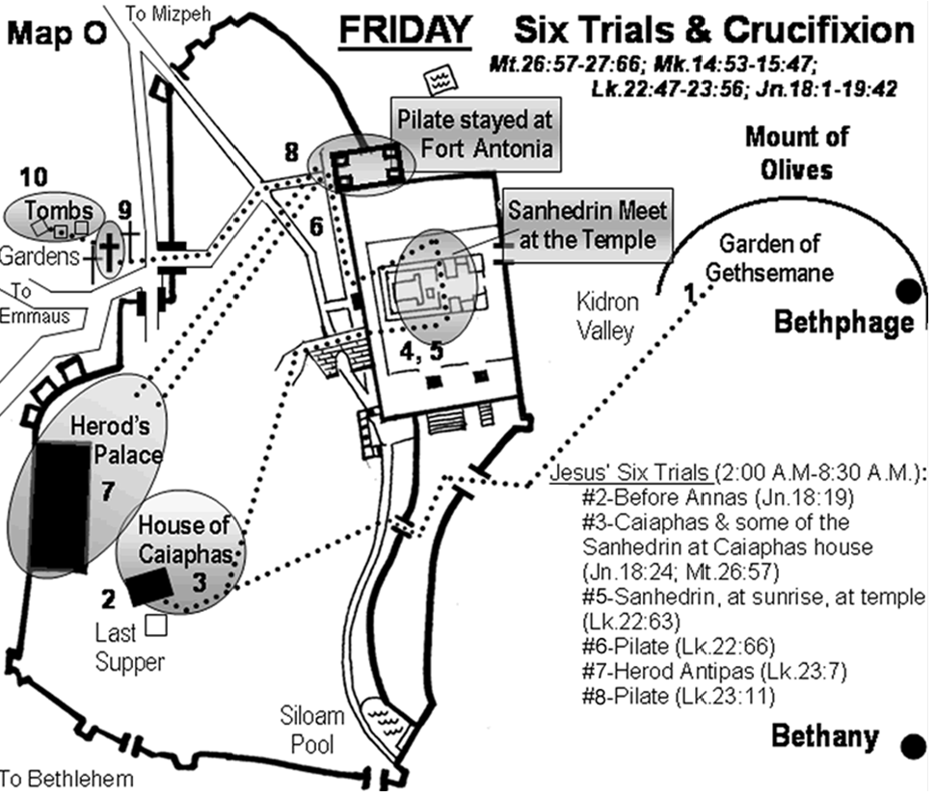

Slide 4
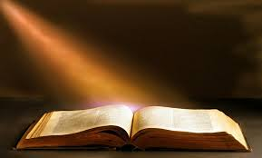
Look for the Lessons!
Daily Life Lessons
Don’t get hung up on sequence of events
  Must not be important or the gospels would present a consistent timeline
Don’t get side tracked on little details
  These can be interesting, but they don’t affect how we live our lives
Look for daily life lessons from these studies that you can take home and try to implement
These studies must change our lives!

Slide 5

Things to look for today
God was in control & Jesus knew it
  Faith in action: trusting what God knows is best
Note Jesus’ focus: he was committed to helping to save others
  Attempt to change Judas
  Effort to help Peter
  Help everyone survive events they did not understand
Timeline: try to figure out when the lamb was killed & when the Passover meal was eaten, & when the feast of unleavened bread took place
Let this mind be in you which was also in Christ Jesus

Slide 6
Things to look for today
Purpose of the Passover & Feast of Unleavened bread – what message did God intend believers to get from these events?
Why did Jesus wash their feet? What did he hope this would accomplish?
Predetermined vs freewill: how do these two items co-exist in God family?
Ways to get encouragement from reading the Bible: Like Jesus may have from reading the Psalms 111-118
Let this mind be in you which was also in Christ Jesus

Slide 7
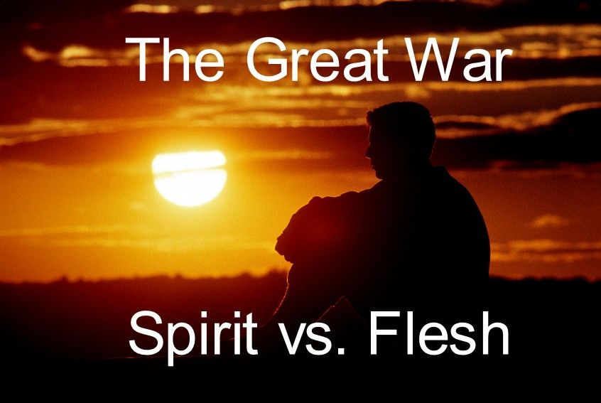
Watch the Battle! This study is about the greatest war ever fought
God set out to war against Sin & completely defeat it
Jesus fully cooperated and agreed with the war
Together, they conquered the greatest enemy of all and freed us from its power so we can live as children of God – no longer slaves to Sin
We have to join the war; God will strengthen us for the battle; Jesus will forgive us for the battles we lose
What are we waiting for? Join the Battle now!

Slide 8

Ephesians 6:14-18 (NIV)
Get prepared for the Battle!
14 Stand firm then, with the belt of truth buckled around your waist, with the breastplate of righteousness in place, 15 and with your feet fitted with the readiness that comes from the gospel of peace. 16 In addition to all this, take up the shield of faith, with which you can extinguish all the flaming arrows of the evil one. 17 Take the helmet of salvation and the sword of the Spirit, which is the word of God. 18 And pray in the Spirit on all occasions with all kinds of prayers and requests. With this in mind, be alert and always keep on praying for all the saints.
God will bless those who are prepared to join His fight with Sin

Slide 9
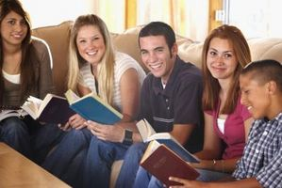
Discussion Time!

Slide 10

Lessons from Today to take home

Slide 11
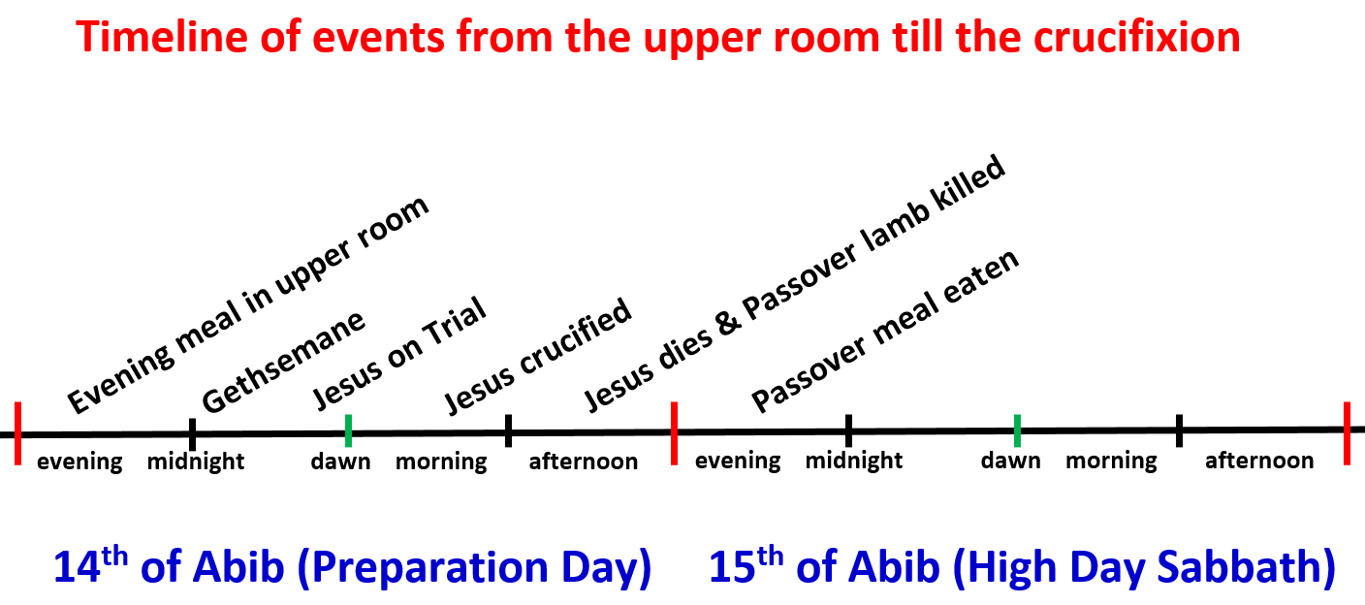
Jesus ate the last supper on the evening before the Passover meal

Slide 12
Luke 22:14-16
Christ’s Focus
14 When the hour had come, He sat down, and the twelve apostles with Him. 15 Then He said to them, "With fervent desire I have desired to eat this Passover with you before I suffer; 16 for I say to you, I will no longer eat of it until it is fulfilled in the kingdom of God."
Jesus wanted help & he wanted to help his disciples!

Slide 13
Exodus 12:15-20
Leaven (yeast)
15 Seven days you shall eat unleavened bread. On the first day you shall remove leaven from your houses. For whoever eats leavened bread from the first day until the seventh day, that person shall be cut off from Israel.
18 In the first month, on the fourteenth day of the month at evening, you shall eat unleavened bread, until the twenty-first day of the month at evening. 19 For seven days no leaven shall be found in your houses, since whoever eats what is leavened, that same person shall be cut off from the congregation of Israel, whether he is a stranger or a native of the land. 20 You shall eat nothing leavened; in all your dwellings you shall eat unleavened bread.'"
Therefore let us keep the feast, not with old leaven, nor with the leaven of malice and wickedness, but with the unleavened bread of sincerity and truth. (1Cor 5:8)

Slide 14
John 13:2-5
Christ’s Focus
2 And supper being ended, the devil having already put it into the heart of Judas Iscariot, Simon's son, to betray Him, 3 Jesus, knowing that the Father had given all things into His hands, and that He had come from God and was going to God, 4 rose from supper and laid aside His garments, took a towel and girded Himself. 5 After that, He poured water into a basin and began to wash the disciples' feet, and to wipe them with the towel with which He was girded.
although He existed in the form of God, did not regard equality with God a thing to be grasped, but emptied Himself, taking the form of a bond-servant (Phil 2:6-7) NASB

Slide 15
John 13:12-17
Christ’s Focus
12 So when He had washed their feet, taken His garments, and sat down again, He said to them, "Do you know what I have done to you? 13 You call Me Teacher and Lord, and you say well, for so I am. 14 If I then, your Lord and Teacher, have washed your feet, you also ought to wash one another's feet. 15 For I have given you an example, that you should do as I have done to you. 16 Most assuredly, I say to you, a servant is not greater than his master; nor is he who is sent greater than he who sent him. 17 If you know these things, blessed are you if you do them.
In the midst of his great suffering, Jesus showed us how to serve one another!

Slide 16
Galatians 5:13-15
Paul’s warning about ecclesial life
13 For you, brethren, have been called to liberty; only do not use liberty as an opportunity for the flesh, but through love serve one another. 14 For all the law is fulfilled in one word, even in this: "You shall love your neighbor as yourself." 15 But if you bite and devour one another, beware lest you be consumed by one another!
God expects us to fight our natural tendencies & learn to serve each other in love!

Slide 17
John 13:33-35
Christ’s Focus
33 Little children, I shall be with you a little while longer. You will seek Me; and as I said to the Jews, 'Where I am going, you cannot come,' so now I say to you. 34 A new commandment I give to you, that you love one another; as I have loved you, that you also love one another. 35 By this all will know that you are My disciples, if you have love for one another."
This becomes a testimony to unbelievers

Slide 18
John 14:1-3 (NIV)
Christ’s Focus
Do not let your hearts be troubled. Trust in God; trust also in me. 2 In my Father's house are many rooms; if it were not so, I would have told you. I am going there to prepare a place for you. 3 And if I go and prepare a place for you, I will come back and take you to be with me that you also may be where I am.
He’s on his way to His Father

Slide 19
John 14:12-14
Christ’s Focus
12 "Most assuredly, I say to you, he who believes in Me, the works that I do he will do also; and greater works than these he will do, because I go to My Father. 13 And whatever you ask in My name, that I will do, that the Father may be glorified in the Son. 14 If you ask anything in My name, I will do it.
Now Jesus can help us everyday because he has gone to his Father!

Slide 20
John 14:15-18
Christ’s Focus
15 "If you love Me, keep My command-ments. 16 And I will pray the Father, and He will give you another Helper, that He may abide with you forever — 17 the Spirit of truth, whom the world cannot receive, because it neither sees Him nor knows Him; but you know Him, for He dwells with you and will be in you. 18 I will not leave you orphans; I will come to you.
He would not leave them helpless & he won’t leave us helpless either!

Slide 21
John 15:1-8
Christ’s Focus
"I am the true vine, and My Father is the vinedresser. 2 Every branch in Me that does not bear fruit He takes away; and every branch that bears fruit He prunes, that it may bear more fruit. 3 You are already clean because of the word which I have spoken to you. 4 Abide in Me, and I in you. As the branch cannot bear fruit of itself, unless it abides in the vine, neither can you, unless you abide in Me.
5 "I am the vine, you are the branches. He who abides in Me, and I in him, bears much fruit; for without Me you can do nothing. .
Our fruit production depends on abiding in Christ

Slide 22
John 15:11-17
Christ’s Focus
11 "These things I have spoken to you, that My joy may remain in you, and that your joy may be full. 12 This is My commandment, that you love one another as I have loved you. 13 Greater love has no one than this, than to lay down one's life for his friends. 14 You are My friends if you do whatever I command you. 15 No longer do I call you servants, for a servant does not know what his master is doing; but I have called you friends, for all things that I heard from My Father I have made known to you. 16 You did not choose Me, but I chose you and appointed you that you should go and bear fruit, and that your fruit should remain, that whatever you ask the Father in My name He may give you. 17 These things I command you, that you love one another.
Our relationship as friends of Jesus will compel us to love one another

Slide 23
John 16:5-11
Christ’s Focus
5 "But now I go away to Him who sent Me, and none of you asks Me, 'Where are You going?' 6 But because I have said these things to you, sorrow has filled your heart. 7 Nevertheless I tell you the truth. It is to your advantage that I go away; for if I do not go away, the Helper will not come to you; but if I depart, I will send Him to you. 8 And when He has come, He will convict the world of sin, and of righteousness, and of judgment: 9 of sin, because they do not believe in Me; 10 of righteousness, because I go to My Father and you see Me no more; 11 of judgment, because the ruler of this world is judged. [Sin….not the Romans!]
Jesus wanted to go to his Father so he could send the Helper to assist them

Slide 24
John 16:16-18
Christ’s Focus
16 "A little while, and you will not see Me; and again a little while, and you will see Me, because I go to the Father."
17 Then some of His disciples said among themselves, "What is this that He says to us, 'A little while, and you will not see Me; and again a little while, and you will see Me'; and, 'because I go to the Father'?" 18 They said therefore, "What is this that He says, 'A little while'? We do not know what He is saying."
The disciples had trouble understanding that Jesus was on his way to his Father

Slide 25
John 16:25-28
Christ’s Focus
25 "These things I have spoken to you in figurative language; but the time is coming when I will no longer speak to you in figurative language, but I will tell you plainly about the Father. 26 In that day you will ask in My name, and I do not say to you that I shall pray the Father for you; 27 for the Father Himself loves you, because you have loved Me, and have believed that I came forth from God. 28 I came forth from the Father and have come into the world. Again, I leave the world and go to the Father."
God loves us & wants us to join Him!

Slide 26
John 16:32-33
Christ’s Focus
32 Indeed the hour is coming, yes, has now come, that you will be scattered, each to his own, and will leave Me alone. And yet I am not alone, because the Father is with Me. 33 These things I have spoken to you, that in Me you may have peace. In the world you will have tribulation; but be of good cheer, I have overcome the world."
Jesus had overcome the world and he was trying to help his followers do it too!

Slide 27
John 17:1-5
Christ’s Focus – His prayer
1 Jesus spoke these words, lifted up His eyes to heaven, and said: "Father, the hour has come. Glorify Your Son, that Your Son also may glorify You, 2 as You have given Him authority over all flesh, that He should give eternal life to as many as You have given Him. 3 And this is eternal life, that they may know You, the only true God, and Jesus Christ whom You have sent. 4 I have glorified You on the earth. I have finished the work which You have given Me to do. 5 And now, O Father, glorify Me together with Yourself, with the glory which I had with You before the world was.
Knowing our Father & Jesus Christ produces an eternal life in us

Slide 28
John 17:6-12
Christ’s Focus – His prayer
6 "I have manifested Your name to the men whom You have given Me out of the world. They were Yours, You gave them to Me, and they have kept Your word. 7 Now they have known that all things which You have given Me are from You. 8 For I have given to them the words which You have given Me; and they have received them, and have known surely that I came forth from You; and they have believed that You sent Me.
9 "I pray for them. I do not pray for the world but for those whom You have given Me, for they are Yours. 10 And all Mine are Yours, and Yours are Mine, and I am glorified in them. 11 Now I am no longer in the world, but these are in the world, and I come to You. Holy Father, keep through Your name those whom You have given Me, that they may be one as We are.
Jesus prayed for his disciples when he was going through his greatest test

Slide 29
John 17:13-19
Christ’s Focus – His prayer
13 But now I come to You, and these things I speak in the world, that they may have My joy fulfilled in themselves. 14 I have given them Your word; and the world has hated them because they are not of the world, just as I am not of the world. 15 I do not pray that You should take them out of the world, but that You should keep them from the evil one. 16 They are not of the world, just as I am not of the world. 17 Sanctify them by Your truth. Your word is truth. 18 As You sent Me into the world, I also have sent them into the world. 19 And for their sakes I sanctify Myself, that they also may be sanctified by the truth.
Christ sanctified himself for his disciples’ sake – so he could save them!

Slide 30
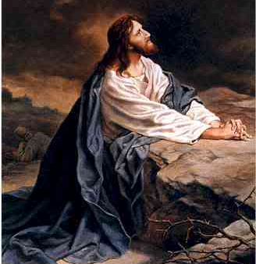
Where was Christ’s Focus?
(John illustrates this in 12-17)
He is on his way to his Father – committed to do his Father’s will, not his own
Tries to raise the spiritual minds of his disciples
  New commandment: love one another
  Serve one another in love
  Told them what would happen, so they could believe when it came to pass
Gives Judas one last chance to stop his betrayal
Focusing on God’s will & helping others will get us through our difficult times of life

Slide 31
Romans 8:1-5
God won the battle in Christ
There is therefore now no condemnation to those who are in Christ Jesus, who do not walk according to the flesh, but according to the Spirit. 2 For the law of the Spirit of life in Christ Jesus has made me free from the law of sin and death. 3 For what the law could not do in that it was weak through the flesh, God did by sending His own Son in the likeness of sinful flesh, on account of sin: He condemned sin in the flesh, 4 that the righteous requirement of the law might be fulfilled in us who do not walk according to the flesh but according to the Spirit.
Now He’s willing to fight the battle in us

Slide 32
Lessons from Today
God is in control….we need to believe it
Focus on what’s important – service to others – “serve one another in love”
Become so familiar with the scriptures that we can reflect on sections that will help us get through trials of life
Live like Jesus: on our way to our Father
Try to develop the eternal life that comes from knowing God & Jesus Christ
Thank Jesus for his victory – then join him!

Slide 33

Let’s go home and put it into practice!
No one born of God makes a practice of sinning, for God's seed abides in him, and he cannot keep on sinning because he has been born of God. By this it is evident who are the children of God, and who are the children of the devil: whoever does not practice righteousness is not of God, nor is the one who does not love his brother. 1 John 3:9-10 (ESV)

