Slide 1
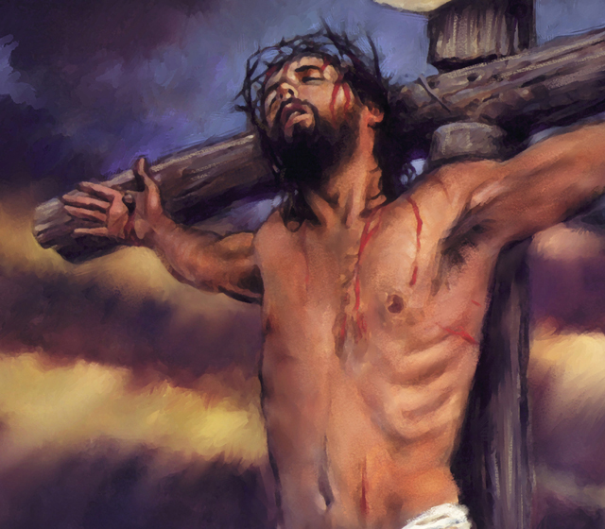
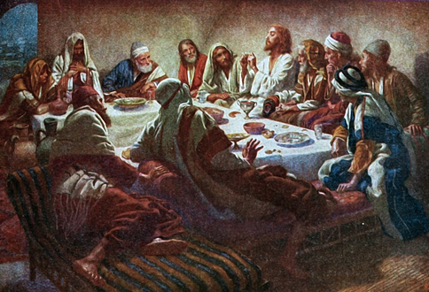
Christ’s Last Day
Gethsemane & Judas’ Betrayal

Slide 2
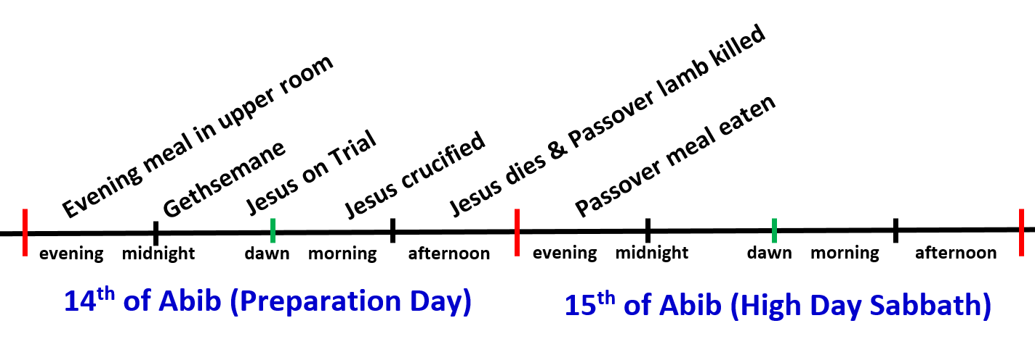
Where are we today?
Gethsemane & Judas’ Betrayal
From about 10pm to just before midnight

Slide 3
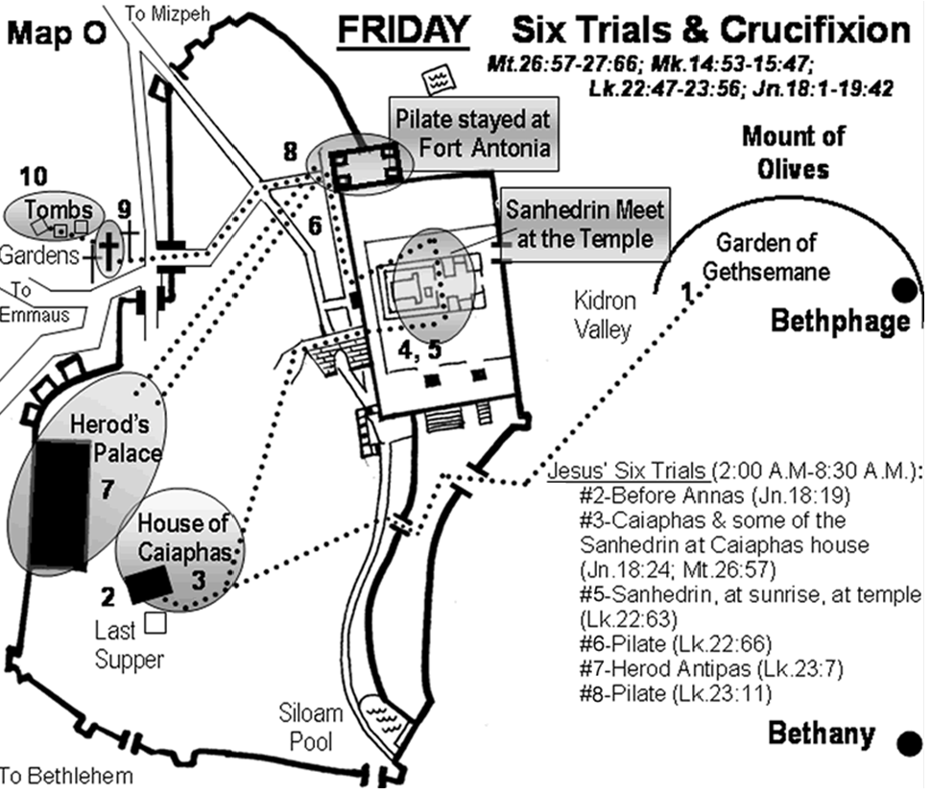

Slide 4

Things to look for today
What went wrong with the religious leaders who knew their Bibles so well? Could this happen to us?
Why did they need Judas to betray Jesus?
Contrast Jesus’ treatment of Judas with his ripping of religious leaders – what does this mean for us?
Jesus knew the terrible things he would have to endure: how would this affect him or you?
He could have called for 12 legions of angels to rescue him: how would this have affected God’s plan?
Let this mind be in you which was also in Christ Jesus

Slide 5
Things to look for today
The Power of prayer: note how Jesus used prayer to communicate to God & find strength to endure to the end
How do we assist those going thru trials? What are some effective ways to help?
Endurance even when others let us down: Jesus kept the faith even when his best friends could not watch with him
Watch God’s way to help Jesus when others let him down
Let this mind be in you which was also in Christ Jesus

Slide 6
Things to look for today
Note Zechariah’s prophecies & see if you could have sequenced them correctly ahead of time – what does this tell you about Bible prophecy?
Compare & contrast Peter & Judas – denial vs betrayal – are they the same?
What helped Jesus get thru Gethsemane?
What indications are there that Jesus had his own will that was at times different from his Father’s?
Watch the battle: Jesus’ will versus God’s will
Let this mind be in you which was also in Christ Jesus

Slide 7

Discussion Time!

Slide 8

Lessons from Today to take home

Slide 9

Romans 5:12-19
Look at the grace of God
12 Therefore, just as through one man sin entered the world, and death through sin, and thus death spread to all men, because all sinned — 13 (For until the law sin was in the world, but sin is not imputed when there is no law. 14 Nevertheless death reigned from Adam to Moses, even over those who had not sinned according to the likeness of the transgression of Adam, who is a type of Him who was to come.
God treated Adam as a “typical man” and condemned all to death in him

Slide 10
Romans 5:12-19
Look at the grace of God
15 But the free gift is not like the offense. For if by the one man's offense many died, much more the grace of God and the gift by the grace of the one Man, Jesus Christ, abounded to many. 16 And the gift is not like that which came through the one who sinned. For the judgment which came from one offense resulted in condemnation, but the free gift which came from many offenses resulted in justification. 17 For if by the one man's offense death reigned through the one, much more those who receive abundance of grace and of the gift of righteousness will reign in life through the One, Jesus Christ.)
God’s grace through Jesus is far greater than his condemnation in Adam

Slide 11
Romans 5:18-19
Look at the grace of God
18 Therefore, as through one man's offense judgment came to all men, resulting in condemnation, even so through one Man's righteous act the free gift came to all men, resulting in justification of life. 19 For as by one man's disobedience many were made sinners, so also by one Man's obedience many will be made righteous.
The benefits of being “in Christ”

Slide 12
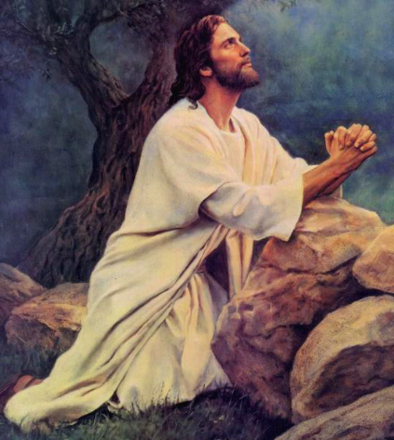
The Power of Prayer
“If it is possible, let this cup pass from me” (Mat 26:39)
“Watch & pray lest you enter into temptation” (Mat 26:40)
Simon: “I have prayed for you that your faith should not fail” (Lk 22:32)
“Watch & pray, for you do not know when the time is” (Mk 13:33)
Parable of the persistent woman (Lk 18:1) “that men ought always to pray & not lose heart”
“whatever things you ask when you pray, believe that you receive them, and you will have them” (Mk 11:24)

Slide 13
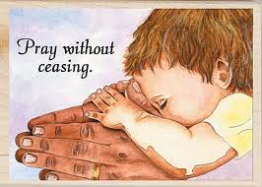

Slide 14
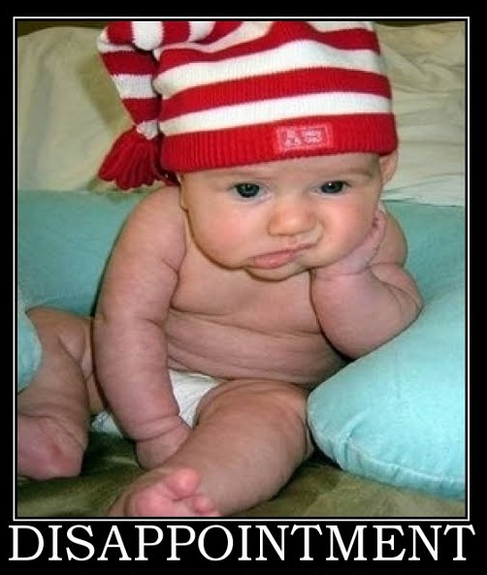
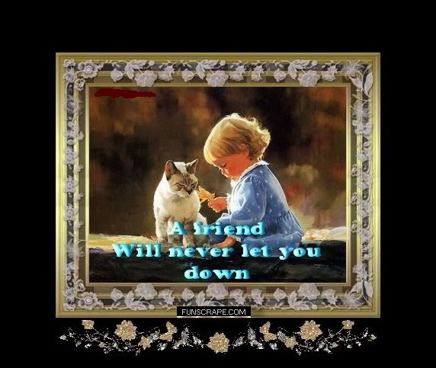
What if others fail us?
(family, friends, ecclesia)
Jesus’ 3 best friends let him down
Judas (a friend) – betrayed Jesus
Peter – denied Jesus
All the disciples forsook him and fled (Mt 26:56)
God will never leave you or forsake you (Josh 1:5)

Slide 15
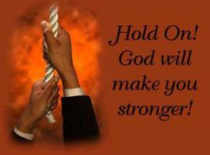
Don’t Give up!
The testing of your faith produces patience (Ja 1:3)

Slide 16
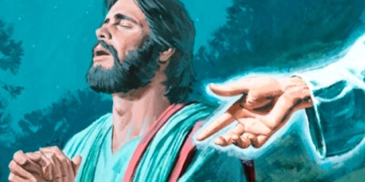
Thank God for Angels!
Jesus was in the wilderness 40 days, tempted by Satan, and with the wild beasts; and the angels ministered to Him (Mk 1:13)
He will give His angels charge over you, to keep you (Lk 4:10; Ps 91:11)
"I tell you the truth, you will all see heaven open and 'angels of God going up and coming down' on the Son of Man” (Jn 1:51 NCV)
When Jesus’ 3 friends let him down, God sent an angel from heaven to strengthen him (Lk 22:43)
Angels are ministering spirits sent forth for those who are the heirs of salvation” (Heb 1:14)

Slide 17
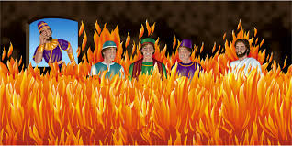
The Angel of the Lord encamps all around those who fear Him and delivers them (Psa 34:6)

Slide 18
Hebrews 10:1-10
Doing God’s Will
For the law, having a shadow of the good things to come, and not the very image of the things, can never with these same sacrifices, which they offer continually year by year, make those who approach perfect. 2 For then would they not have ceased to be offered? For the worshipers, once purified, would have had no more consciousness of sins. 3 But in those sacrifices there is a reminder of sins every year. 4 For it is not possible that the blood of bulls and goats could take away sins.
Animals could not provide forgiveness

Slide 19
Hebrews 10:1-10
Sanctified by the Will of God
5 Therefore, when He came into the world, He said: "Sacrifice and offering You did not desire, but a body You have prepared for Me. 6 In burnt offerings and sacrifices for sin You had no pleasure. 7 Then I said, 'Behold, I have come — In the volume of the book it is written of Me — To do Your will, O God.'"
8 Previously saying, "Sacrifice and offering, burnt offerings, and offerings for sin You did not desire, nor had pleasure in them"(which are offered according to the law), 9 then He said, "Behold, I have come to do Your will, O God." He takes away the first that He may establish the second. 10 By that will we have been sanctified through the offering of the body of Jesus Christ once for all.
We also now are called to do God’s will

Slide 20

Through love serve one another (Gal 5:13)

Slide 21
Judas vs Peter
Judas never was on board with Jesus’ mission
  Looking for money from his involvement
  Probably a political Zionist, looking for overthrow of the Romans and a position of power
  Became very disillusioned with Jesus when Jesus began emphasizing his death & burial
Peter was on board, but failed in a moment of confused weakness
When we are like Peter, even though we make mistakes, God can use them to develop us into His children with greater faith

Slide 22
Lessons from Today
Prayer is powerful – pray in all circumstances
Thank Jesus for his victory – then join him!
Be careful….having lots of Bible knowledge doesn’t make us children of God
Be kind & patient to everyone in God’s family…even when they struggle – pray for them
Be prepared to endure through trials – all God’s children do
Get to know God’s family well, so you can help them through their trials
Commit to God like Peter, and God will help us through our weaknesses and mistakes

Slide 23

Let’s go home and put it into practice!
No one born of God makes a practice of sinning, for God's seed abides in him, and he cannot keep on sinning because he has been born of God. By this it is evident who are the children of God, and who are the children of the devil: whoever does not practice righteousness is not of God, nor is the one who does not love his brother. 1 John 3:9-10 (ESV)

