Slide 1
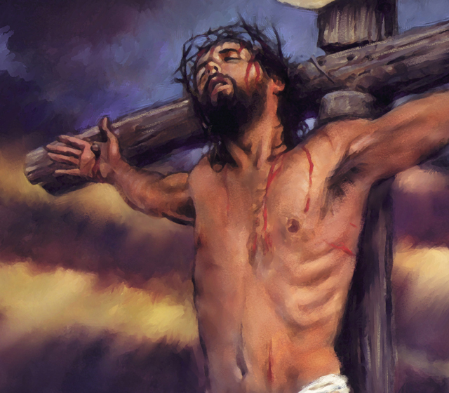
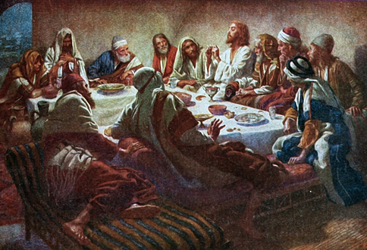
Christ’s Last Day
The 6 Trials

Slide 2
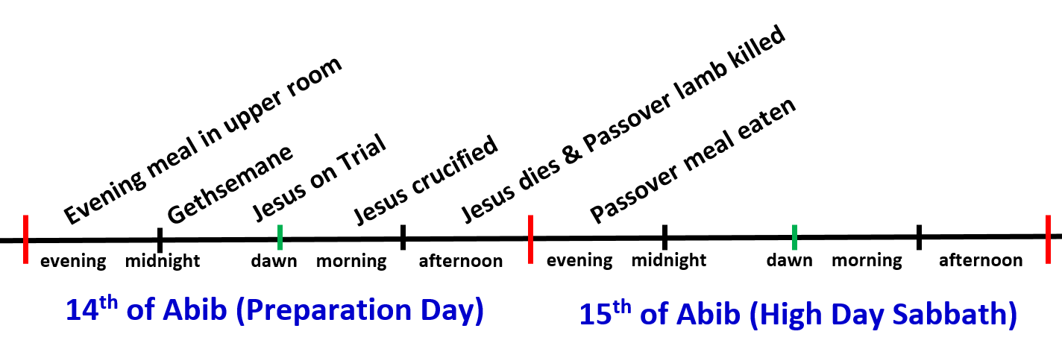
Where are we today?
The 6 Trials
From just before midnight till about 8am

Slide 3
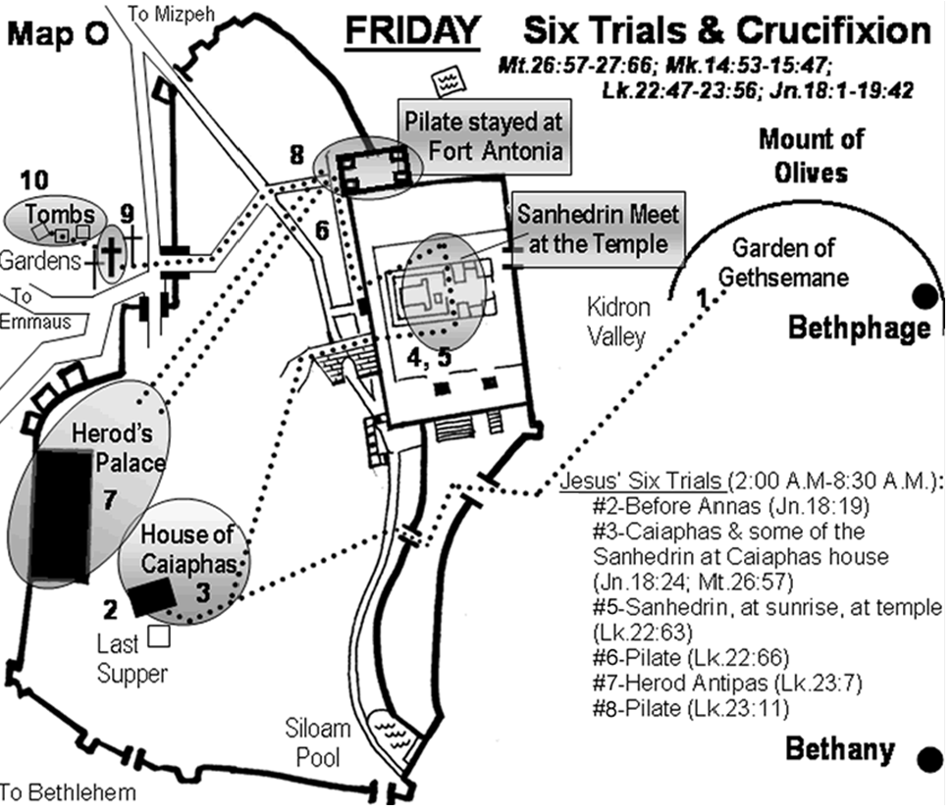

Slide 4

Things to look for today
Try to get the sequence of the trials straight in your mind – who did Jesus stand before & why?
Why did God allow his Son who He loved to suffer such terrible physical & mental abuse?
Watch how Jesus faithfully handled terrible abuse against him – even when he was physically worn out and suffering
Don’t panic when bad things happen! God can bring good out of terrible situations
Why didn’t Judas simply repent and seek forgiveness?

Slide 5
Things to look for today
How did Jesus resist the temptation to seek vengeance when he was abused?
How did the events of these trials upon Jesus actually serve “to condemn Sin in the flesh”?
What was the “good confession” that Jesus gave and how can we do the same?
Watch how they changed the charges against Jesus when he was before Romans vs Jews
Did these trials actually serve to help some people believe Jesus was the Christ?
Through all of the abuse he suffered, did Jesus ever question God and say “this isn’t fair”? What can you learn from him?

Slide 6
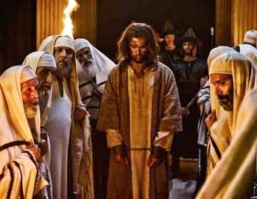
The 6 Trials Jesus Faced
3 Before Jewish Leaders
  Annas
  Caiaphas
  Sanhedrin
3 Before Gentile leaders
  Pilate
  Herod
  Pilate again
Watch his behavior – He defeated Sin & Declared God right

Slide 7
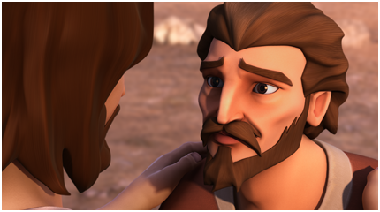
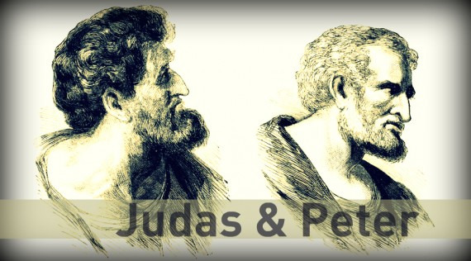
Peter’s Over-Confidence
Peter was a good, faithful believer
He became over-confident in his own abilities
Watch how Jesus handles him
See how Peter recovered from his denials
Contrast Peter with Judas
Do they act the same?

Slide 8
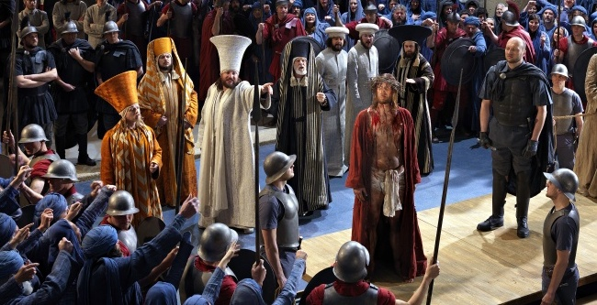
God is in Control!
Gentile governor tries to convince the Jews to choose Jesus – their King
  The Jews hated the Roman rule
  The Jews wanted a king to save them from the Romans
The Jews tell the Gentile governor that they have no king but Caesar!
Notice the amazing way the angels brought all this to pass

Slide 9
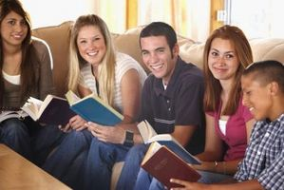
Discussion Time!

Slide 10

Lessons from Today to take home

Slide 11
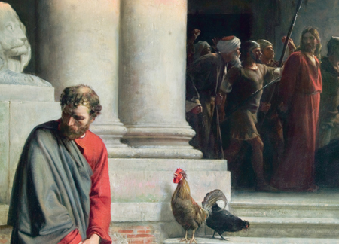
How do we recover from Denials like Peter?
Pray for forgiveness & help to make better decisions
Understand our weaknesses and ask God to strengthen our faith
Get involved in your family & God’s ecclesia– help save others
If others fail – help them recover by encouraging them that the can still live in God’s family if they learn from the mistake and commit to God’s ways
God uses our mistakes to strengthen our faith, if we are willing to allow Him – these are the fiery trials that purify our faith

Slide 12

Luke 9:26
God expects our commitment
26 For whoever is ashamed of Me and My words, of him the Son of Man will be ashamed when He comes in His own glory, and in His Father's, and of the holy angels.
We might deny Jesus in a moment of weakness, but our overall lives must be witnessing to our commitment to our Lord Jesus Christ
Judas changed his mind, but not his heart!

Slide 13
1 Timothy 6:11-15
Live the good confession!
11 But you, O man of God, flee these things and pursue righteousness, godliness, faith, love, patience, gentleness. 12 Fight the good fight of faith, lay hold on eternal life, to which you were also called and have confessed the good confession in the presence of many witnesses. 13 I urge you in the sight of God who gives life to all things, and before Christ Jesus who witnessed the good confession before Pontius Pilate, 14 that you keep this commandment without spot, blameless until our Lord Jesus Christ's appearing,
Don’t be afraid – have confidence in God

Slide 14
1 Peter 2:20-25
Expect to suffer for Christ
For what credit is it if, when you are beaten for your faults, you take it patiently? But when you do good and suffer, if you take it patiently, this is commendable before God. 21 For to this you were called, because Christ also suffered for us, leaving us an example, that you should follow His steps:
22 "Who committed no sin, nor was deceit found in His mouth";
23 who, when He was reviled, did not revile in return; when He suffered, He did not threaten, but committed Himself to Him who judges righteously; 24 who Himself bore our sins in His own body on the tree, that we, having died to sins, might live for righteousness — by whose stripes you were healed.
Jesus left us an example to follow in his steps. Every fight against Sin involves suffering!

Slide 15
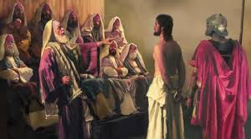
Look at the things Jesus endured in his defeat of Sin
Protected of his disciples
Betrayal of his friend
Denial of his best friend
False witnesses & lies
Physical abuse & torture
Mental battle of his will verses God’s will
His followers forsook him and fled
In all these things Jesus faithfully destroyed the devil
How are you doing compared to Jesus?

Slide 16
Hebrews 12:3-7
Consider the sufferings of Jesus
3 For consider Him who endured such hostility from sinners against Himself, lest you become weary and discouraged in your souls. 4 You have not yet resisted to bloodshed, striving against sin. 5 And you have forgotten the exhortation which speaks to you as to sons:
"My son, do not despise the chastening of the Lord, Nor be discouraged when you are rebuked by Him; 6 For whom the Lord loves He chastens, And scourges every son whom He receives."
7 If you endure chastening, God deals with you as with sons; for what son is there whom a father does not chasten?
Never despise the chastening of the Lord

Slide 17
Lessons from Today
God is in control no matter what happens in our lives – He’s hoping we will trust Him.
Be careful of overconfidence in ourselves – our confidence must be in our God.
We all make many mistakes – pray for forgiveness and move forward – and allow others to do the same!
Don’t get caught up in mob mentality! Seek truth!
Beware of envy – God views it as not trusting Him!
Don’t ever think “the ends justifies the means” in dealing with family or ecclesias – trust God!
Follow Christ’s example: no reviling in return, no vengeance, trust God to handle our mistreatment by others

Slide 18

Let’s go home and put it into practice!
No one born of God makes a practice of sinning, for God's seed abides in him, and he cannot keep on sinning because he has been born of God. By this it is evident who are the children of God, and who are the children of the devil: whoever does not practice righteousness is not of God, nor is the one who does not love his brother. 1 John 3:9-10 (ESV)

