Slide 1
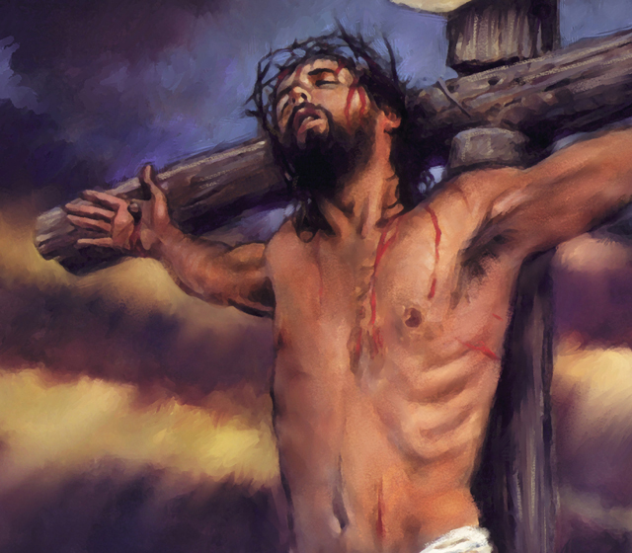
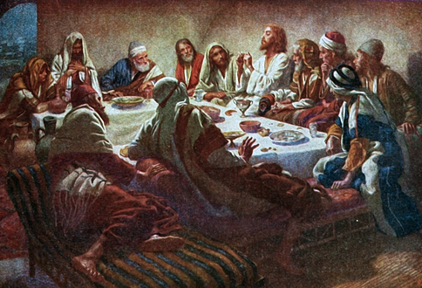
Christ’s Last Day
Christ’s Crucifixion

Slide 2
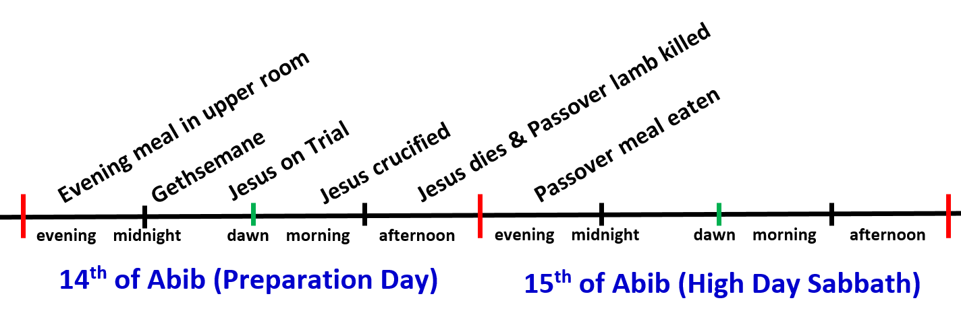
Where are we today?
The Crucifixion
From around 9am till noon

Slide 3
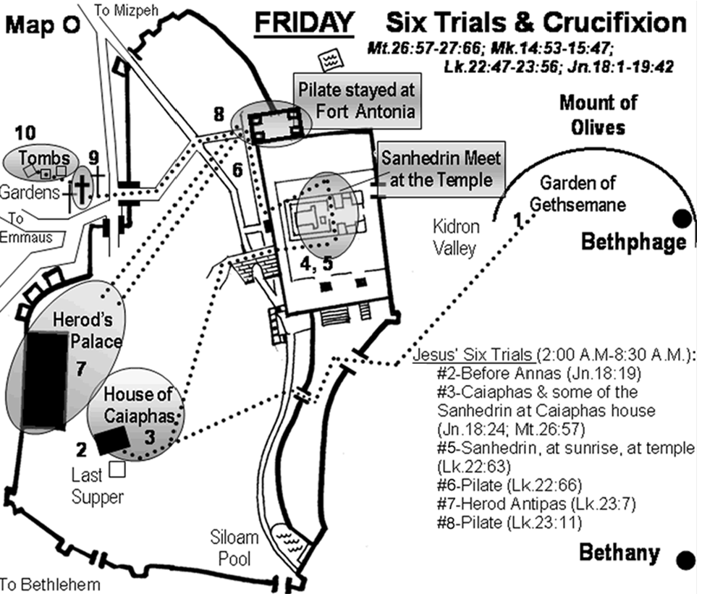

Slide 4

Things to look for today
What impact did helping to carry the cross have on Simon & his family?
Did the prophecies of Hosea 9-10 help you create a clear sequence of events during the crucifixion?
What are some of the types from the OT that parallel Jesus’ crucifixion?
How would the types of the OT help Jesus during his crucifixion?
Why don’t the gospels emphasize and dramatically describe the agony of crucifixion?
Why did God have the 2 thieves crucified at the same time as Jesus?

Slide 5
Things to look for today
How does the crucifixion of Christ become a motivating force in our lives?
What are some ways we can attempt to mend divisions in our ecclesias?
How did Jesus deal with rejection without becoming depressed?
How did Jesus deal with the reviling and ridicule without retaliating?
How did the darkness actually help Jesus get through his crucifixion?
Let this mind be in you which was also in Christ Jesus

Slide 6
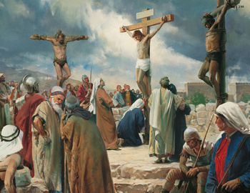
Watch the impact Jesus had on others while going through extreme trials
Peter – a look of understanding & pity
Simon – helped carry cross & then became believer
Weeping women of Jerusalem – get ready for what’s coming on you!
Thief – impressed to point of conversion
Mary – tried to link her up with John
Helping others helped Jesus endure

Slide 7
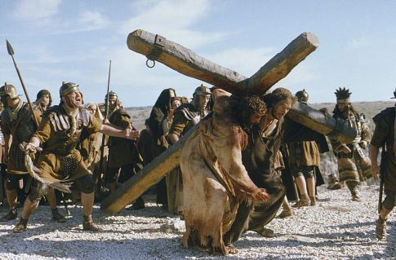
Why did God arrange for Crucifixion?
Not a Jewish way of killing
  Normally stoning (like Stephen)
Recently implemented by Romans
Not the worst form of torture
  The rack, the tub, the saw, etc
So why did God want Jesus crucified?
Everything God does is for a reason!

Slide 8
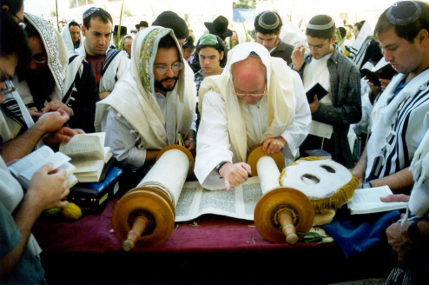
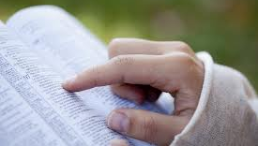
How did Bible reading believers miss the fact that Messiah must die?
Bible prophecy seems clear now
Gen 22: Abraham and Isaac
So many types in the Law of Moses indicated that Messiah would die
Jesus told them plainly “the son of man would be killed, and rise the third day”
What might we be missing today?

Slide 9
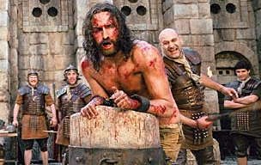
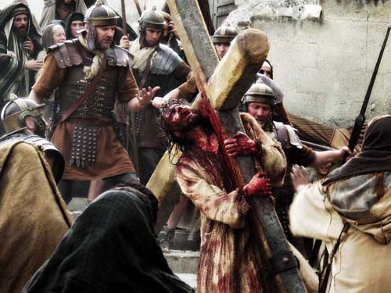
How did Jesus get through this?
His suffering was extreme
He could never give in to Sin
Look for what strengthened him to keep fighting the battle with Sin even under extreme pressure
Consider what might help us today to walk in faith even while we are under the pressure of trials
He provided us an example, hoping we will follow in his steps

Slide 10

Discussion Time!

Slide 11

Lessons from Today to take home

Slide 12
Where are we today?
The Crucifixion
From around 9am till noon

Slide 13
Why Crucifixion?
Prophecy: “if I be lifted up”
Proof: marks in his hands
Law cursed him – so it could be removed
Public: God wanted all world to see Sin condemned (Gal 3:1) “Body of Sin destroyed”
Provided an opportunity for reviling & jeering & shame – but Jesus never gave in to Sin
No one could claim that Jesus wasn’t “tested in all points as we are…..yet without sin”
Link to us: take up your cross daily & follow him
This was slow & public – Jesus had every opportunity to bow to Sin, but won the battle!

Slide 14

1 Peter 2:18-24
Jesus showed us the way
18 Servants, be submissive to your masters with all fear, not only to the good and gentle, but also to the harsh. 19 For this is commendable, if because of conscience toward God one endures grief, suffering wrongfully. 20 For what credit is it if, when you are beaten for your faults, you take it patiently? But when you do good and suffer, if you take it patiently, this is commendable before God. 21 For to this you were called, because Christ also suffered for us, leaving us an example, that you should follow His steps:
22 "Who committed no sin, nor was deceit found in His mouth";
23 who, when He was reviled, did not revile in return; when He suffered, He did not threaten, but committed Himself to Him who judges righteously; 24 who Himself bore our sins in His own body on the tree, that we, having died to sins, might live for righteousness — by whose stripes you were healed.
Now he’s hoping that we will respond to the grace of God and join him in a death to Sin like his

Slide 15
Galatians 2:20-21
We must died the death Christ died to Sin
I have been crucified with Christ; it is no longer I who live, but Christ lives in me; and the life which I now live in the flesh I live by faith in the Son of God, who loved me and gave Himself for me. 21 I do not set aside the grace of God; for if righteousness comes through the law, then Christ died in vain."
This is NOT salvation by works, but it is living a life that responds to God’s grace

Slide 16
Hebrews 12:1-4 (NIV)
Our Struggle with Sin
1 Therefore, since we are surrounded by such a great cloud of witnesses, let us throw off everything that hinders and the sin that so easily entangles, and let us run with perseverance the race marked out for us. 2 Let us fix our eyes on Jesus, the author and perfecter of our faith, who for the joy set before him endured the cross, scorning its shame, and sat down at the right hand of the throne of God. 3 Consider him who endured such opposition from sinful men, so that you will not grow weary and lose heart.
4 In your struggle against sin, you have not yet resisted to the point of shedding your blood.
God expects us to join Christ in his struggle with sin (“fellowship his sufferings”)

Slide 17
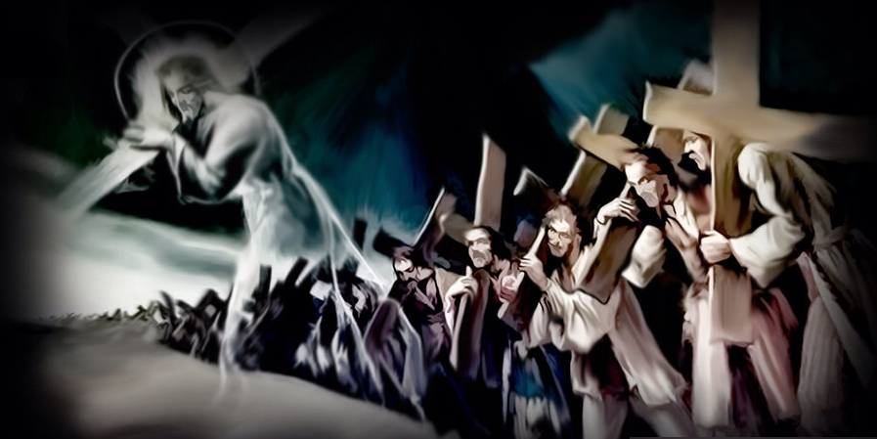
It’s time to take up our cross daily and follow him
(Luke 9:23)
Doesn’t mean we have the die the same way he died.
Does mean we have to live the same way he lived – denying himself and doing God’s will
This is a daily battle – starts in the morning with prayer pleading for God’s help
For whoever desires to save his life will lose it, but whoever loses his life for My sake will save it. (Lk 9:24)

Slide 18
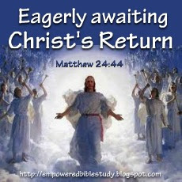
Be careful about your understanding of Bible Prophecy!
We may have missed some key event that may take us by surprise – but don’t despair!
We have the basic framework of latter day events worked out, but the sequence may be a little different than we expect.
We must be ready everyday, at all times!
Therefore you also be ready, for the Son of Man is coming at an hour you do not expect." (Lk 12:40)

Slide 19
Galatians 5:13-16
Serve one another in love
13 For you, brethren, have been called to liberty; only do not use liberty as an opportunity for the flesh, but through love serve one another. 14 For all the law is fulfilled in one word, even in this: "You shall love your neighbor as yourself." 15 But if you bite and devour one another, beware lest you be consumed by one another!
16 I say then: Walk in the Spirit, and you shall not fulfill the lust of the flesh.
Service is the key. Learn to help others!

Slide 20


What can you do to help when you go home?
Volunteer – don’t wait to be asked!
Assess the needs of your family & ecclesia
  Time, labor, money, support, child care, preaching
Get ready for criticism – those who work get it
Pray for God’s help to prosper your work
They (redeemed) are before the throne of God, and serve Him day and night in His temple. And He who sits on the throne will dwell among them. (Rev 7:15)

Slide 21
Lessons from Today
Christ’s crucifixion should remind us daily to take up our cross & follow him – join him in his death to Sin
Death to Sin doesn’t mean living a stoic life – we have to balance it with “living to God”
During our trials…focus on helping others [like our hymn “forget all your troubles in meeting his needs”)
Be careful what we say during trials – Jesus always kept the faith
Be careful with Bible prophecy: we have the basic framework, but may be surprised by a specific event!

Slide 22

Let’s go home and put it into practice!
No one born of God makes a practice of sinning, for God's seed abides in him, and he cannot keep on sinning because he has been born of God. By this it is evident who are the children of God, and who are the children of the devil: whoever does not practice righteousness is not of God, nor is the one who does not love his brother. 1 John 3:9-10 (ESV)

