Slide 1
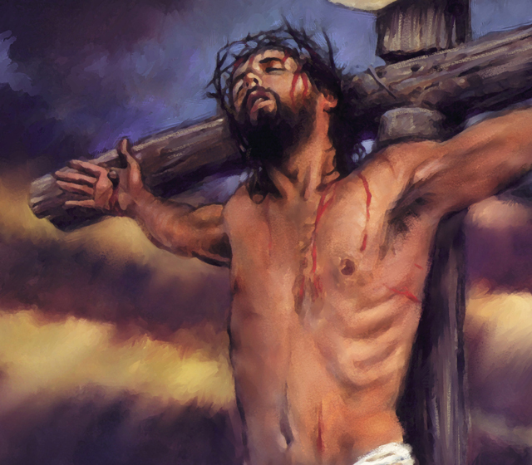
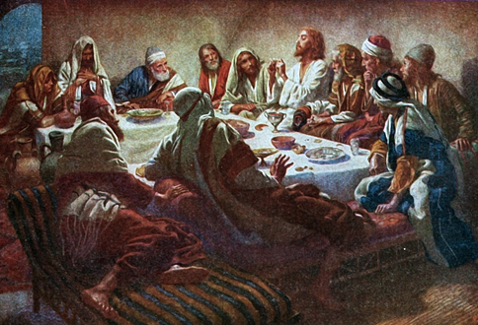
The Day Christ Died
Death & Burial

Slide 2
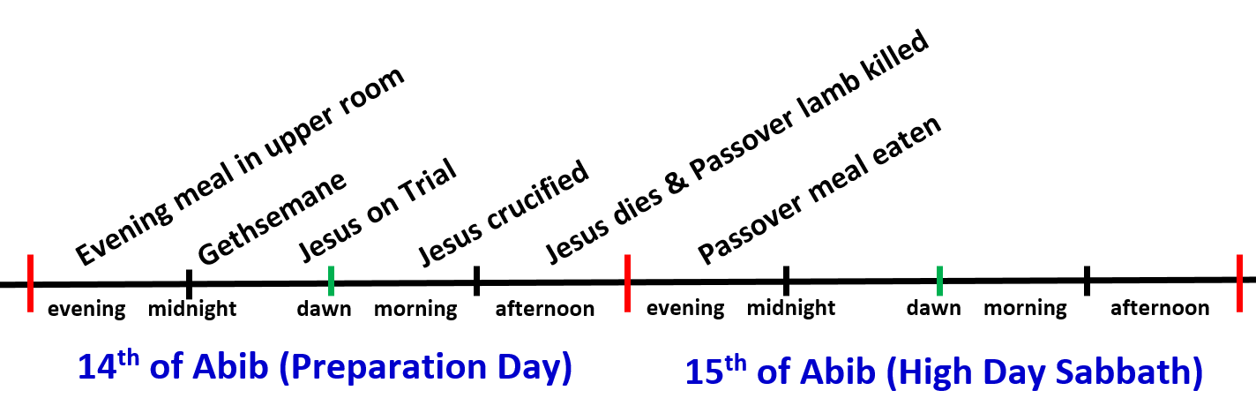
Where are we today?
Death & Burial
From around 12 noon till just before 6pm

Slide 3
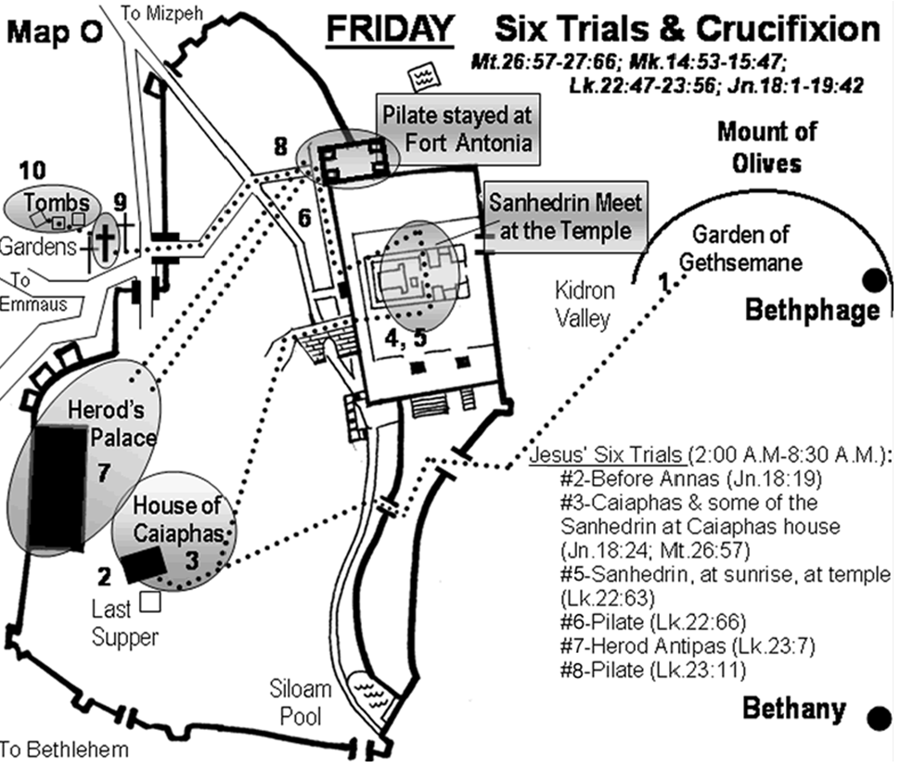

Slide 4

Things to look for today
What impact did the 3 hours of darkness have on Jesus, the thieves, the people, the weather?
  Was the darkness positive or negative?
What was the significance of:
  the tearing of the veil
  the rocks splitting
  the earth quaking
  graves opened
What impact did Christ’s crucifixion have on Joseph of Aramathaea & Nicodemus?
What did Christ’s crucifixion accomplish for God, for Jesus, for all of us?
  How did this alter the law of Sin and Death?
  What impact did this have on the Law of Moses?
  What is the meaning of the water and the blood?

Slide 5
Things to look for today
Why is reality more important than ritual?
  Why does God ask us to go through rituals?
  How do we look beyond the rituals to see the real issues and then implement them in our lives?
What impact did Jesus have on the thieves? What impact did they have on Jesus?
Thy will be done: what does this mean in our lives today?
  In our families
  In our ecclesias
  At our jobs

Slide 6
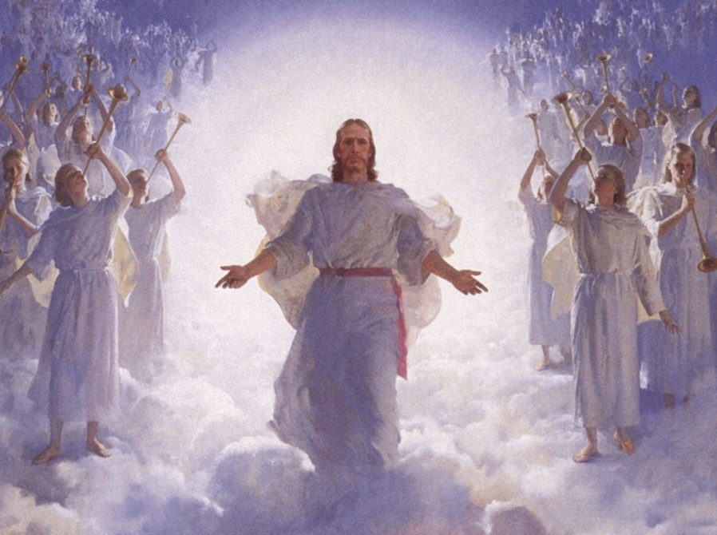
How did Christ’s death & resurrection affect the angels?
What change took place in the status of the angels when Jesus was resurrected to immortality?
What can you learn about the selflessness of angels that they worked so much to develop some who would be elevated above them?
If this is the spirit of the angels, and we hope to become equal to them, what does this mean for us today?

Slide 7
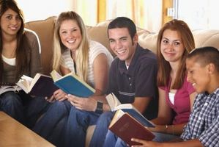
Discussion Time!

Slide 8

Lessons from Today to take home

Slide 9
7 Saying of Jesus on the Cross
Lk 23:34 Father forgive them… (mercy)
Lk 23:43 you will be with me in paradise (hope)
Jn 19:26 woman behold your son (love)
Mk 15:34 my God, my God, why… (trust)
Jn 19:28 I thirst (desire)
Jn 19:30 It is finished! (triumph)
Lk 23:46 Into your hands… (dedication)
There aren’t many words of Jesus recorded from the cross, so they must be significant!

Slide 10
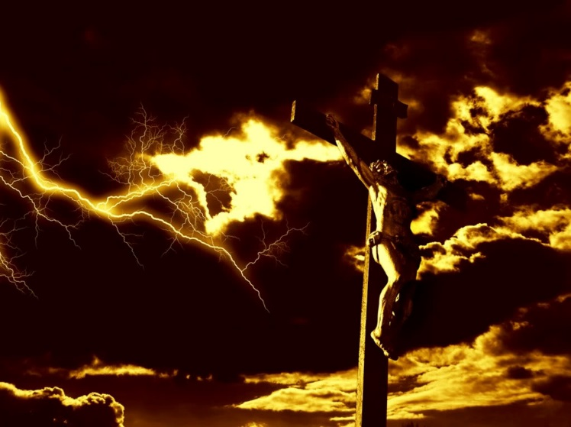
Why did God send the Darkness?
God was angry, so He sent an angel down with darkness (Ps 18)
  It chased away the revilers
  It softened the heat of the afternoon
  It provided some peace for Jesus to talk to people
When God withdrew the darkness at the 9th hour (3pm), Jesus felt he had been left alone
  Then he realized that it was nearly over
  One last prophecy to be fulfilled, so he said “I thirst”
God was in control, helping His Son to get through his defeat of the Devil!

Slide 11

Mark 15:33-34
When the darkness lifted…..
33 Now when the sixth hour had come, there was darkness over the whole land until the ninth hour. 34 And at the ninth hour Jesus cried out with a loud voice, saying, "Eloi, Eloi, lama sabachthani?" which is translated, "My God, My God, why have You forsaken Me?"
Christ’s feeling of being forsaken seems to be connected to the lifting of the darkness

Slide 12
Matthew 27:51-53
When Jesus died….
51 Then, behold, the veil of the temple was torn in two from top to bottom; and the earth quaked, and the rocks were split, 52 and the graves were opened; and many bodies of the saints who had fallen asleep were raised; 53 and coming out of the graves after His resurrection, they went into the holy city and appeared to many.
Veil rent: opened the way into God’s presence Earthquake: opened graves – resurrection

Slide 13
Be thankful!
Thank God for His wonderful plan of redemption – His kindness, patience & mercy in working so hard to transform our lives and adopt us into His family forever
Thank Jesus Christ for his willingness to submit to God’s righteousness, defeat the devil and pioneer the way to life with God
Thank the angels that minister everyday for us: protecting us and working in our lives to develop us into God’s children, so we can join them in their work
And let the peace of God rule in your hearts, to which also you were called in one body; and be thankful. (Col 3:15)

Slide 14
Lessons from Today
Thank God for designing a plan to save us by destroying the devil & motivating us to live to God
Thank Jesus Christ for all he went through for us: good way to thank him is to follow in his steps!
Appreciate God’s willingness to save us when we don’t deserve it & commit to God’s method of salvation: put Sin to death & live to God
Go home committed to serving one another in love – what ever it takes – like Jesus
Have this mind in you that was in Christ Jesus: “I delight to do your will o God” (Ps 40:8)

Slide 15

Let’s go home and put it into practice!
No one born of God makes a practice of sinning, for God's seed abides in him, and he cannot keep on sinning because he has been born of God. By this it is evident who are the children of God, and who are the children of the devil: whoever does not practice righteousness is not of God, nor is the one who does not love his brother. 1 John 3:9-10 (ESV)

Slide 16
Lessons from the Week
Love: Jesus showed Judas even tho Jesus knew Judas wanted to betray him
Humility: Jesus always humbled himself to serve
Balance: between putting Sin to death & also living to God
Pride & selfishness: let go of these to help & serve those for whom Christ died
Surviving trials: focus on helping & serving others – don’t seek isolation!
Thankfulness: it is a core trait that helps us defeat Sin & live to God
Death: the focus of the scriptures is on Christ’s death to Sin – us too!
Patience: need to wait for God’s timeline to happen – He’s in control & knows best
Prayer: it’s powerful and can alter the pathways God will use
Thy will be done: we do need to learn to put God’s before our own
Crucifixion: it was a major event typical of the battle Jesus fought every day
Repentance: Whatever we’ve done, God can help us change our hearts & move forward
Esteeming others better than ourselves: others are more important – work to save them

