Slide 1

Habakkuk
Habaq - “to embrace”
Gen 48:10, Prov 4:8,
Heb 11:13

Slide 2
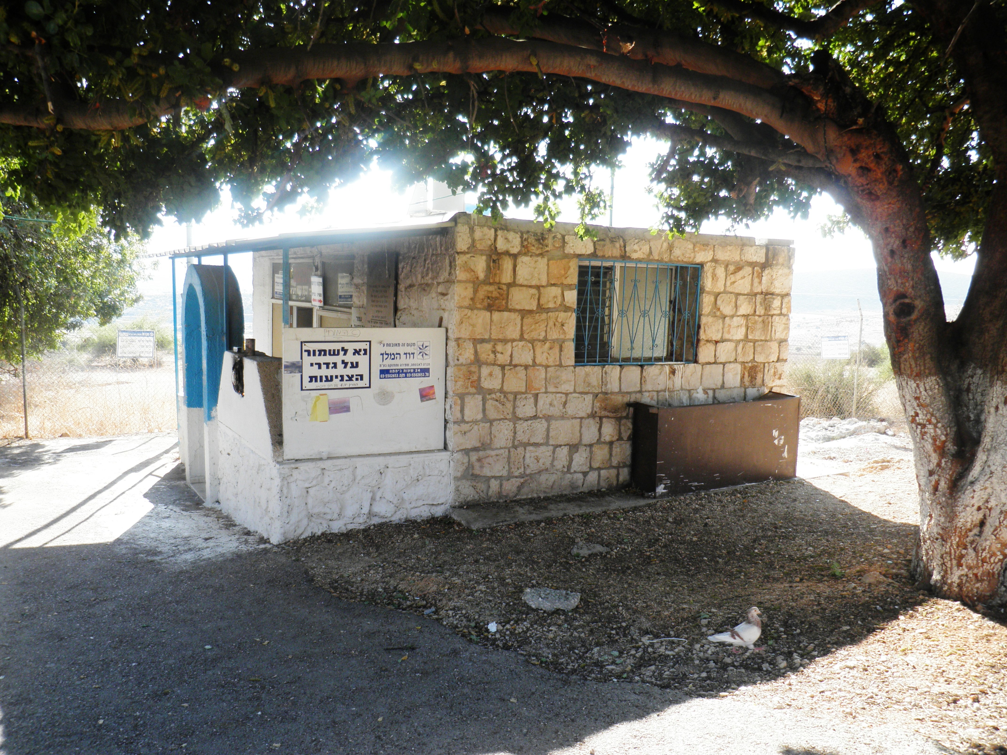

Slide 3
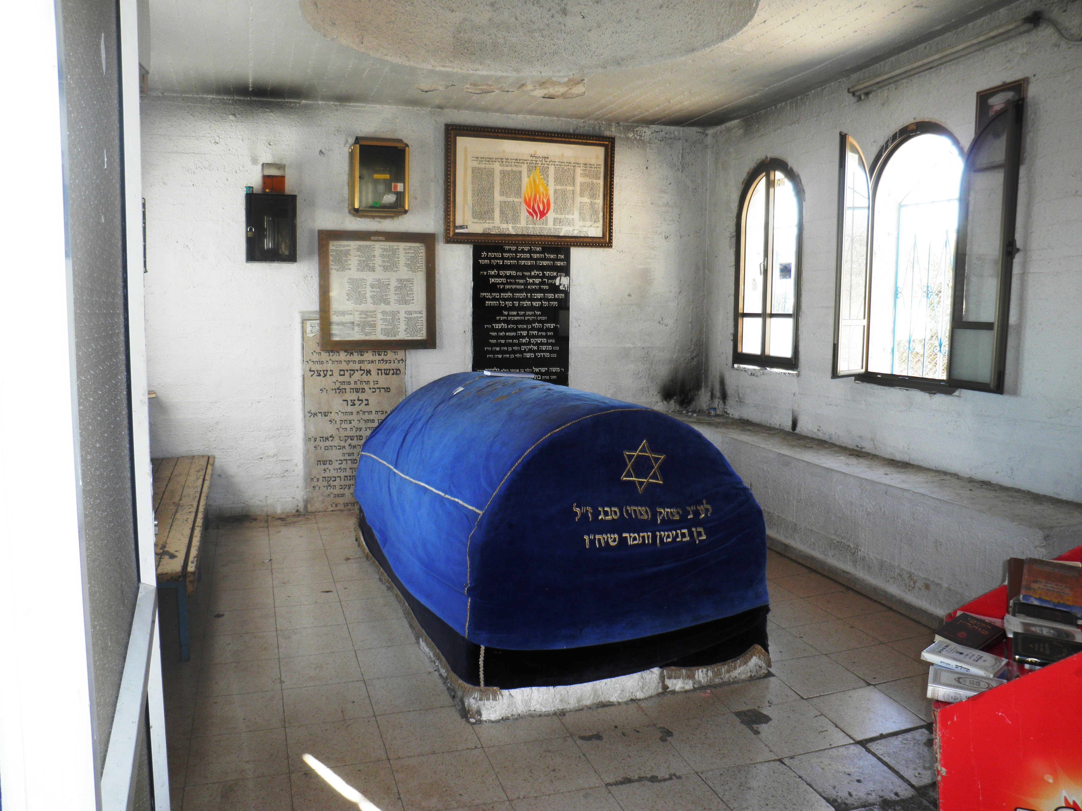

Slide 5
The burden which Habakkuk the prophet did see
A | 1:2-4 | Questions about God’s justice | Why doesn't God remove iniquity from Judah?
B | 1:5-11 | Answer - God will judge! | Judgment will come via the Chaldeans
C | 1:12-2:1 | Complaint about God’s methods | But Babylon is even worse!
D | 2:2-5 | Answer - There is an appointed time | Live patiently by faith
C’ | 2:5-20 | Five Woes on Babylon | Babylon will be judged!
B’ | 3:1-15 | The coming of the mighty Eloah | The conquest of the land and the deliverance of Israel
A’ | 3:16-19 | The outlook of faith | Rejoicing in hope!

Slide 6
The burden which Habakkuk the prophet did see
A | 1:2-4 | Question - why does God tolerate injustice | A’ | 3:16-19 | The perspective of faith
B | 1:5-11 | Answer - God will judge through the Chaldeans | B’ | 3:1-15 | The coming of the mighty Eloah
C | 1:12-2:1 | Complaint - the Babylonians are rapacious idolators | C’ | 2:5-20 | Five Woes on Babylon
D | 2:2-5 | Answer - There is an appointed time, the just live by faith.

Slide 7


Hab 1:2-4
O Lord, how long shall I cry, and thou wilt not hear!
even cry out unto thee of violence, and thou wilt not save!
Why dost thou shew me iniquity, and cause me to behold grievance?
for spoiling and violence are before me:
and there are that raise up strife and contention.
Therefore the law is slacked, and judgment doth never go forth:
for the wicked doth compass about the righteous;
therefore wrong judgment proceedeth.
Hab 3:16-19
When I heard, my belly trembled;
my lips quivered at the voice:
rottenness entered into my bones, and I trembled in myself, that I might rest in the day of trouble: when he cometh up unto the people, he will invade them with his troops.
Although the fig tree shall not blossom,
neither shall fruit be in the vines;
the labour of the olive shall fail,
and the fields shall yield no meat;
the flock shall be cut off from the fold,
and there shall be no herd in the stalls:
Yet I will rejoice in the Lord,
I will joy in the God of my salvation.
The Lord God is my strength, and he will make my feet like hinds’ feet,and he will make me to walk upon mine high places.

Slide 8
ESV
Habakkuk’s Complaint. ch 1
2 O LORD, how long shall I cry for help,
and you will not hear?
Or cry to you “Violence!”
and you will not save?
3 Why do you make me see iniquity,
and why do you idly look at wrong?
Destruction and violence are before me;
strife and contention arise.
4 So the law is paralyzed,
and justice never goes forth.
For the wicked surround the righteous;
so justice goes forth perverted.
Why doesn't God intervene?
Why has God caused him to see the iniquity?
Corrupted legal system and injustice

Slide 9
h2555. חָמָס ḥâmâs; from 2554; violence; by implication, wrong; by meton. unjust gain:— cruel (- ty), damage, false, injustice, x oppressor, unrighteous, violence (against, done), violent (dealing), wrong.
AV (60)- violence 39, violent 7, cruelty 4, wrong 3, false 2, cruel 1, damage 1, injustice 1, oppressor +h0376 1, unrighteous 1;
violence, wrong, cruelty, injustice
Hamas witnesses - Exod 23:1, Deut 19:16, Psa 27:12, Psa 35:11

Slide 10
Jeremiah | Habakkuk | Lamentations
7:16 Therefore pray not thou for this people, neither lift up cry nor prayer for them, neither make intercession to me:for I will not hear thee. | 1:2 O Lord, how long shall I cry, and thou wilt not hear! even cry out unto thee of violence, and thou wilt not save! | 3:8 Also when I cry and shout, he shutteth out my prayer.
6:7 As a fountain casteth out her waters, so she casteth out her wickedness: violence and spoil is heard in her; before me continually is grief and wounds. | 1:3 Why dost thou shew me iniquity, and cause me to behold grievance?or spoiling and violence are before me:
15:10 Woe is me, my mother, that thou hast borne me a man of strife and a man of contention to the whole earth! | 1:3 and there are that raise up strife and contention.

Slide 11
Date BC | Key events | Prophets
640 | Josiah begins to reign aged 8 years | ?Huldah
632 | Begins to seek God aged 16 yrs | ?Zephaniah
628 | Begins purge of Jerusalem aged 20 yrs
627 | Beginning of the work of… | Jeremiah
622 | Discovery of the Law
612 | Fall of Nineveh
609 | Josiah dies

Slide 12
Age
Kingship Discovery Josiah died
Jehoahaz 23 10 23
Jehoiakim 25 12 25
Jehoiachin 18 - 7
Zedekiah 21 - 10

Slide 13
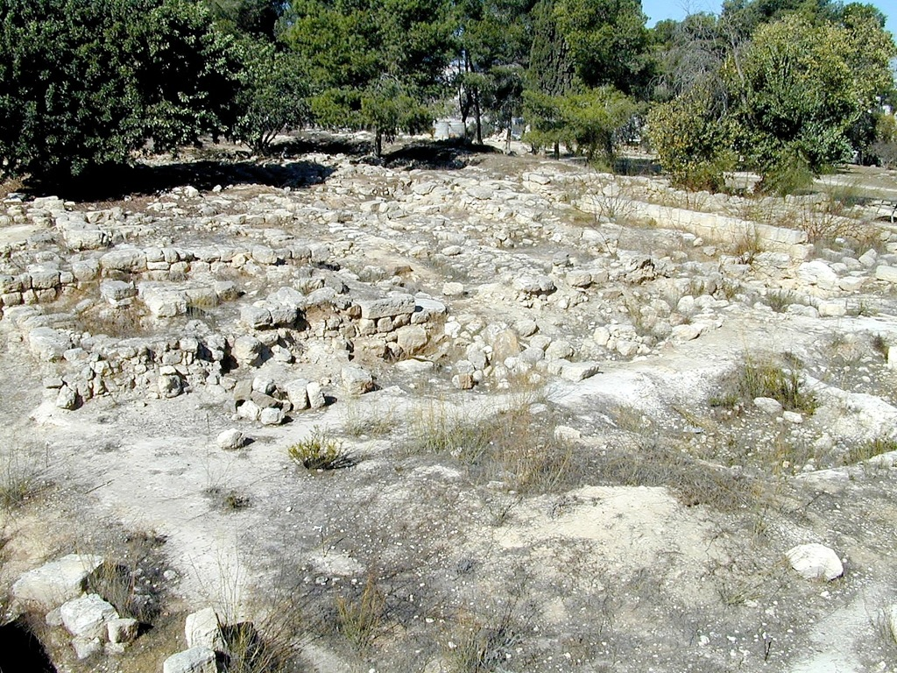
Remains of Jehoiakim’s Palace in Ramat Rachel

Slide 14
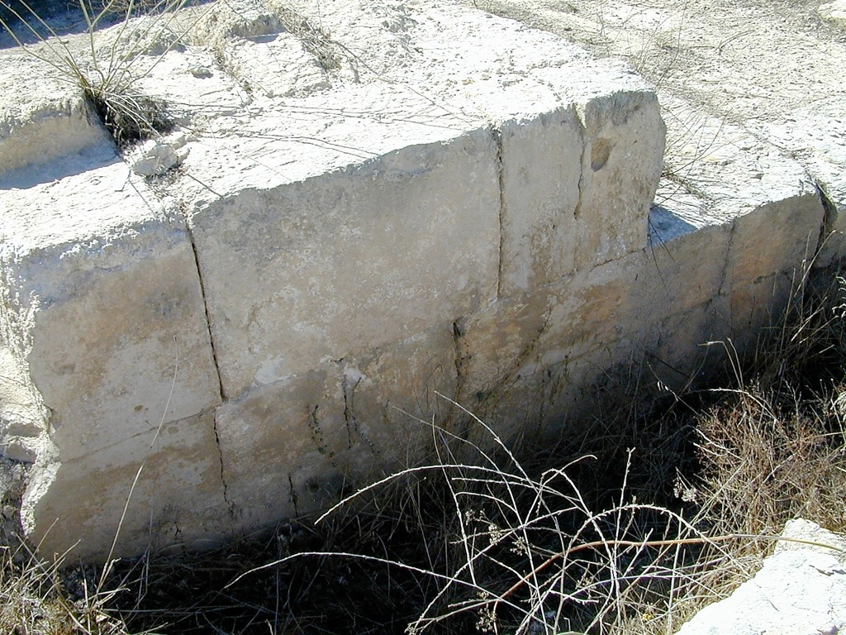
Remains of Palace wall found in Ramat Rachel

Slide 15
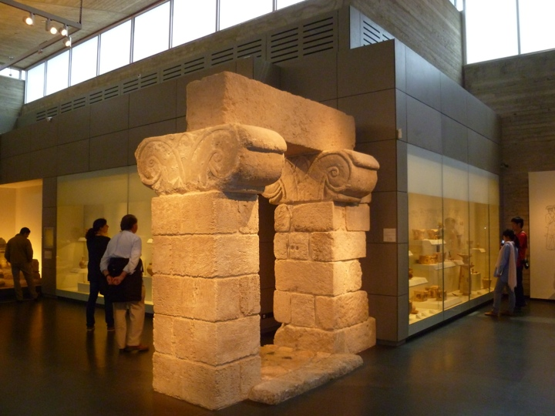

Slide 16
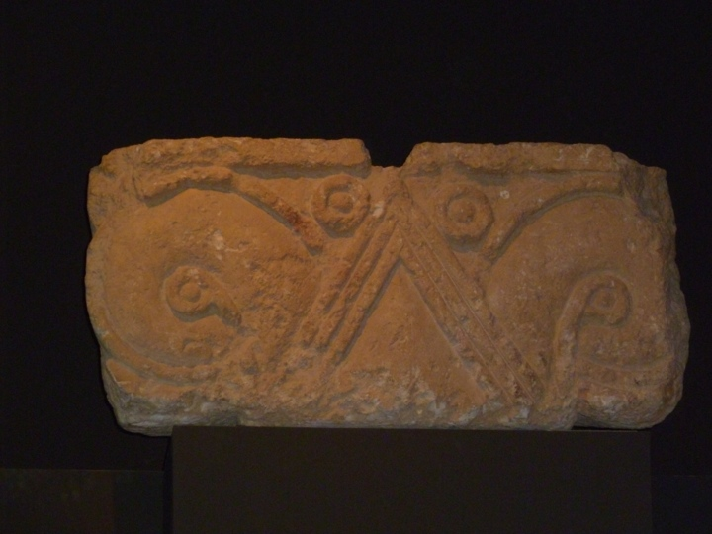

Slide 17
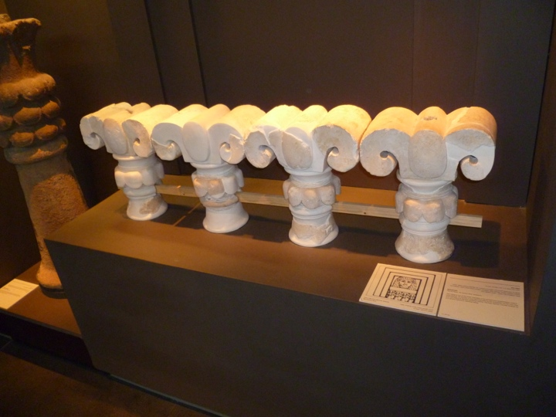

Slide 18
Habakkuk 1
v2 - “cry and shout”
Jer 9:1-6, Psalm 73:2-7, Lam. 3:8,
“violence”
Jer 6:7, 20:8, 22:3,
Exod 23:1, Deut19:16, Psa 27:12, Psa 35:11
v3 - “iniquity and grievance”
Num 23:21, Psa 10:1-7, 55:10
“spoil and violence”
Jer 6:7, 20:8
“strife and contention”
Jer 15:20

Slide 19
Habakkuk 1
v4 - “the law”
Isa 42:1-4
“judgment go forth”
Deut 17:11
“wicked compass the righteous”
1 Kings 21:1-16
“crooked judgment”
Isa 59:9

Slide 20
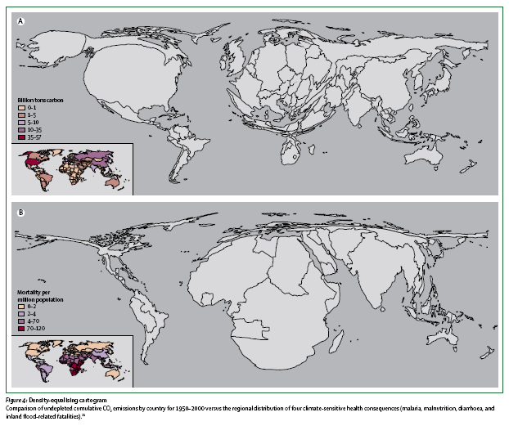

Slide 21
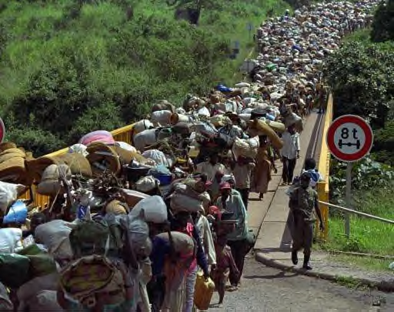

Slide 22
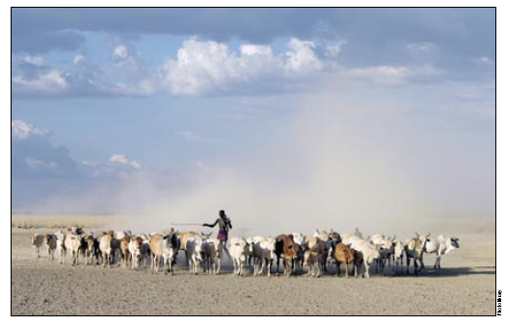
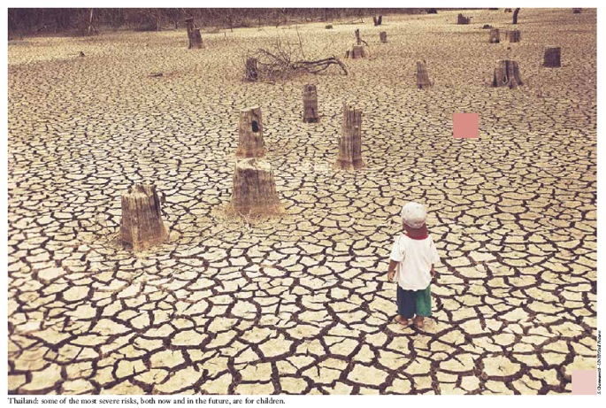
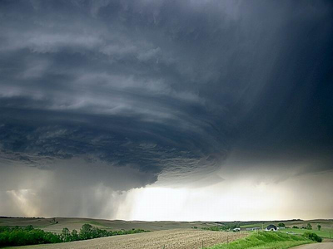
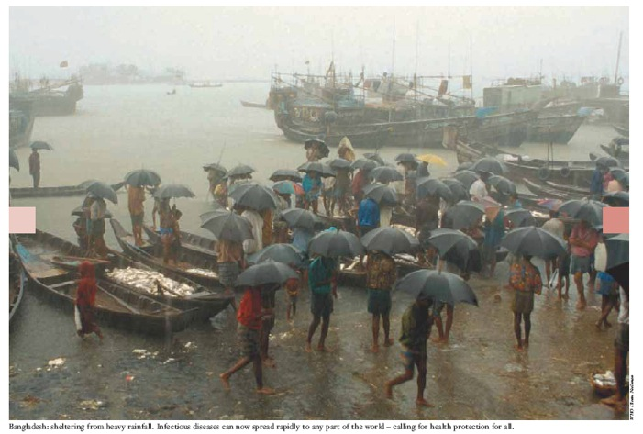

Slide 23



Slide 24
A reflection on humanism in the 21st century
Background document prepared for UNESCO-Nishan Forum, 16 April 2012
The Director-General of UNESCO has proposed to respond to the challenges of our times through the lens of a New Humanism for the 21st century. Why do we need a New Humanism? The ideals of peace, tolerance and dialogue, the principles inscribed in the United Nations Charter, the Constitution of UNESCO or the Universal Declaration of Human Rights, all stem from humanistic values which can be identified throughout human history on all continents. They also form the basis for international cooperation as embodied in such global agendas as the Millennium Development Goals (MDGs) or the Education For All (EFA) goals.
Humanism is UNESCO’s moral and intellectual DNA. The evolutionary philosophy of UNESCO embraces a profound optimism vis-à-vis the notions of human development and progress. In an era when the human population has reached 7 billion individuals, the belief that humanity can and does progress is an inspiration.

Slide 25
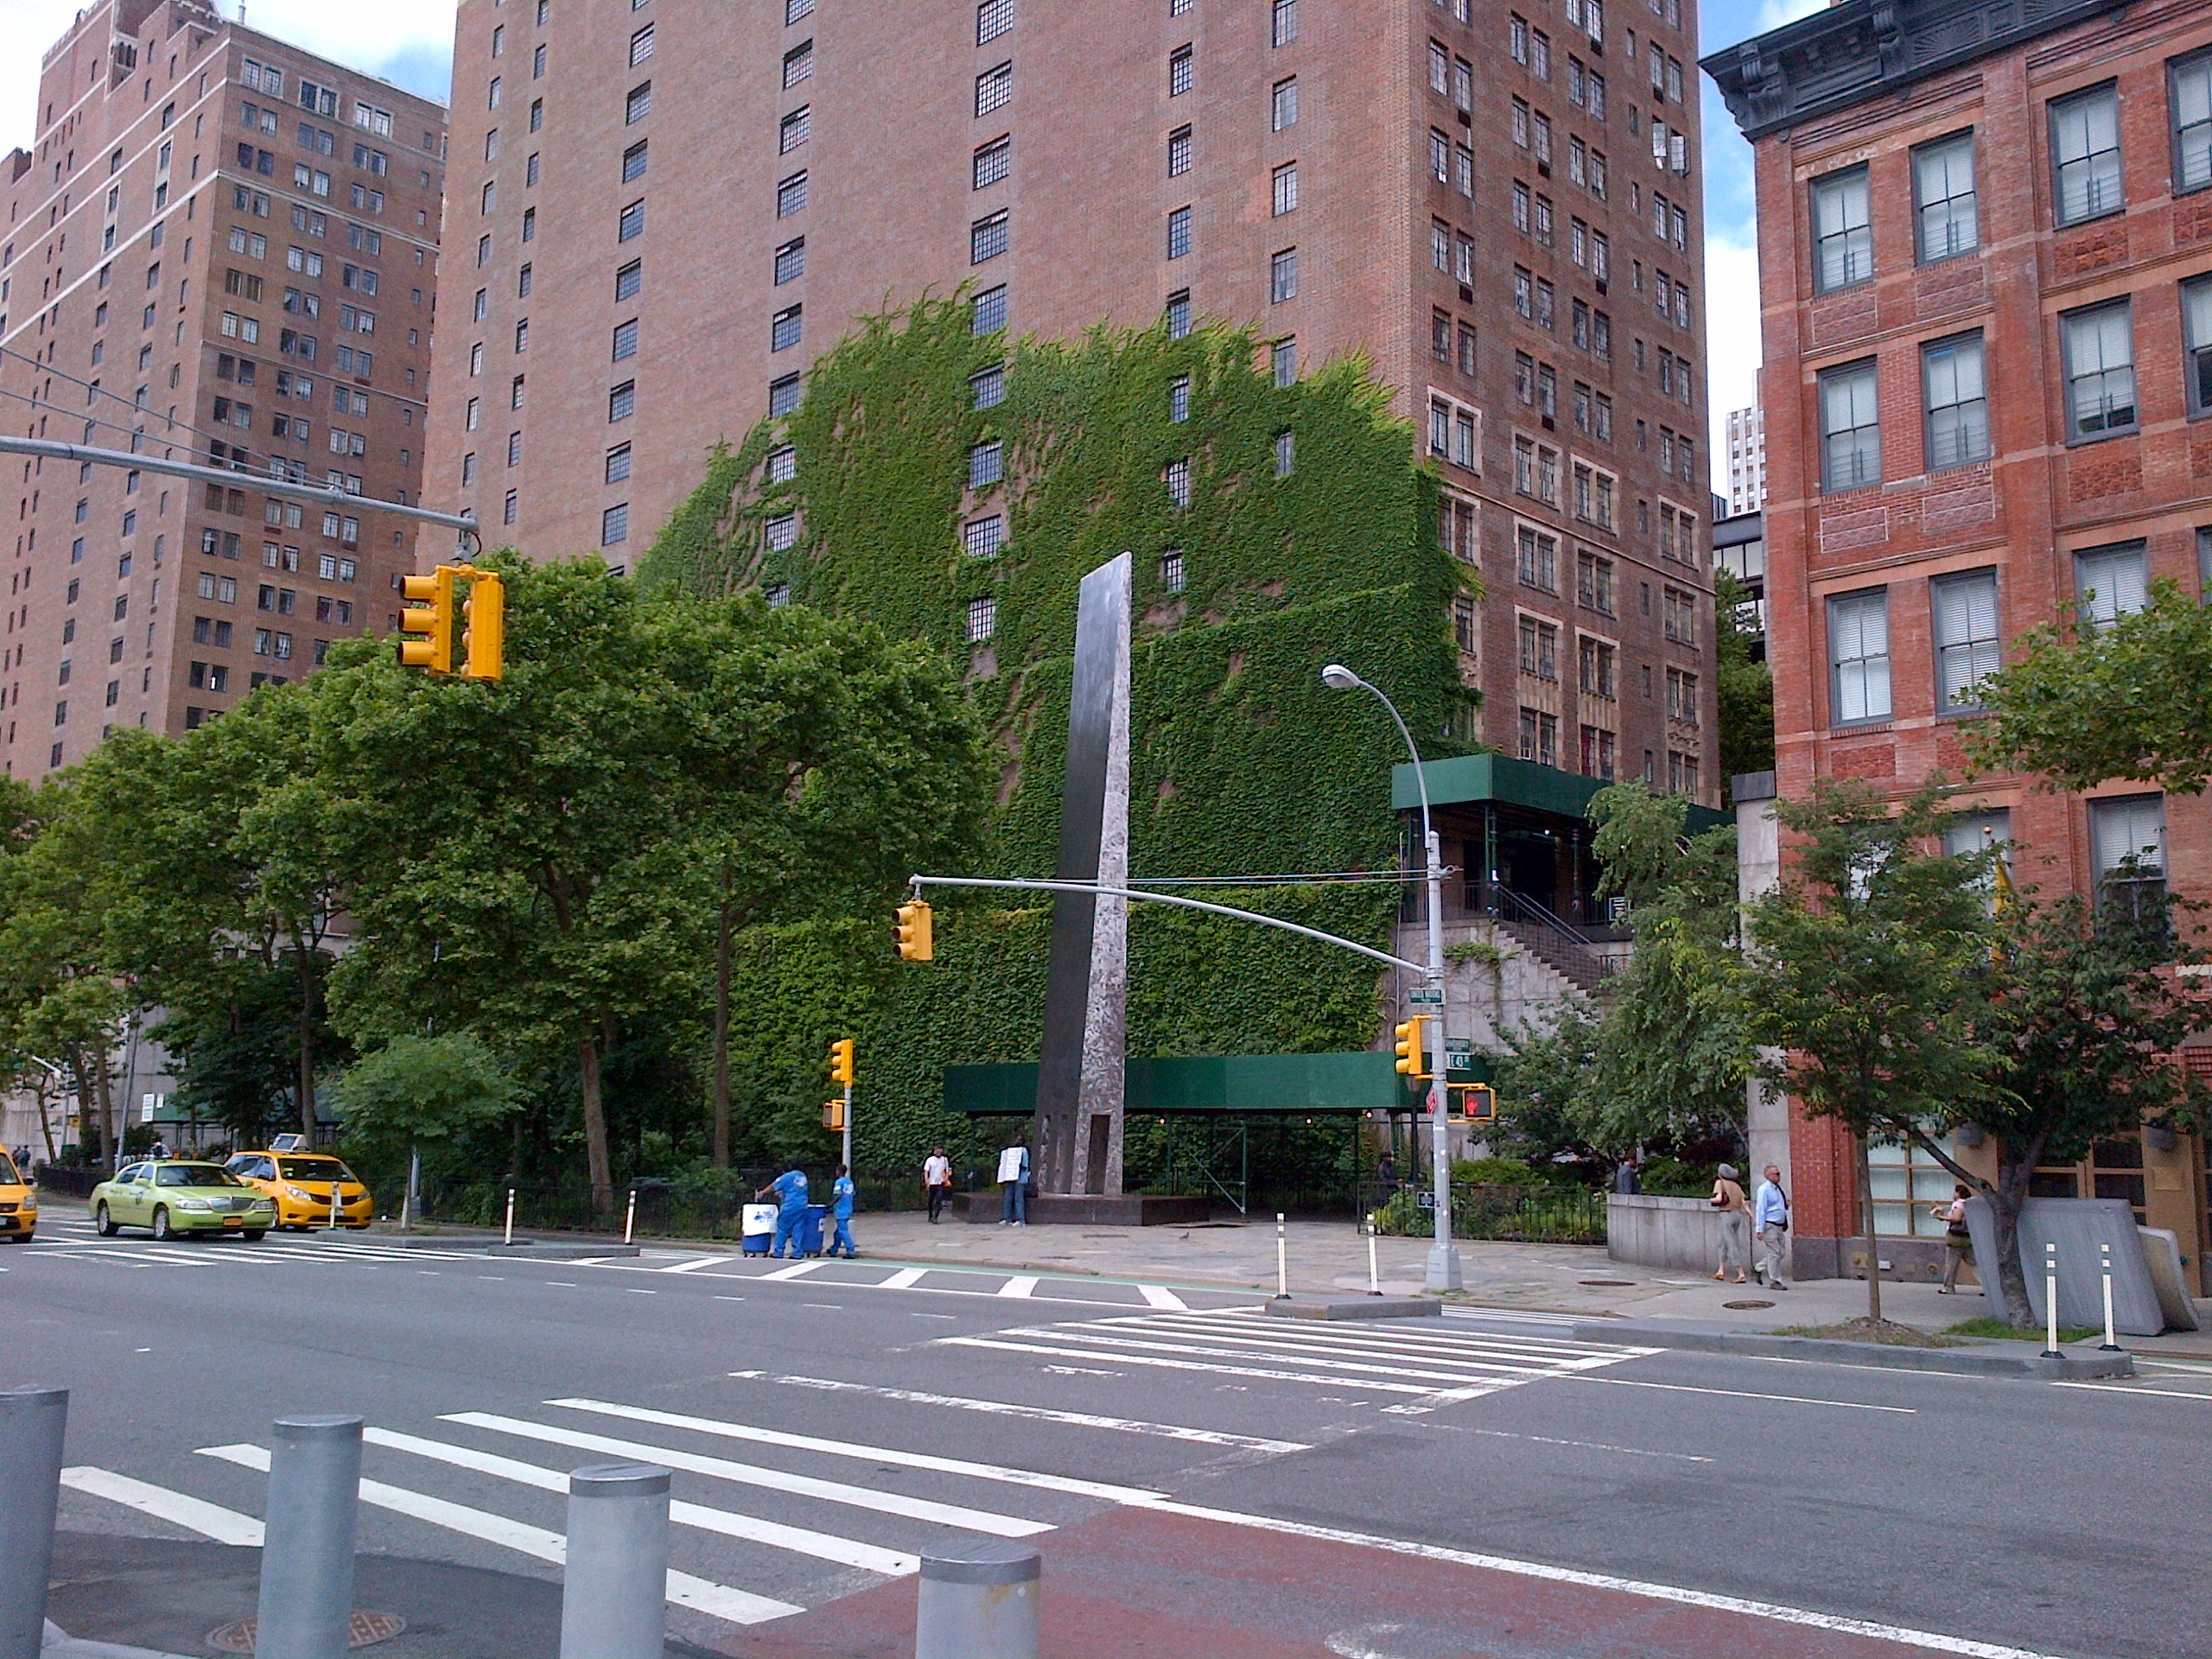

Slide 26
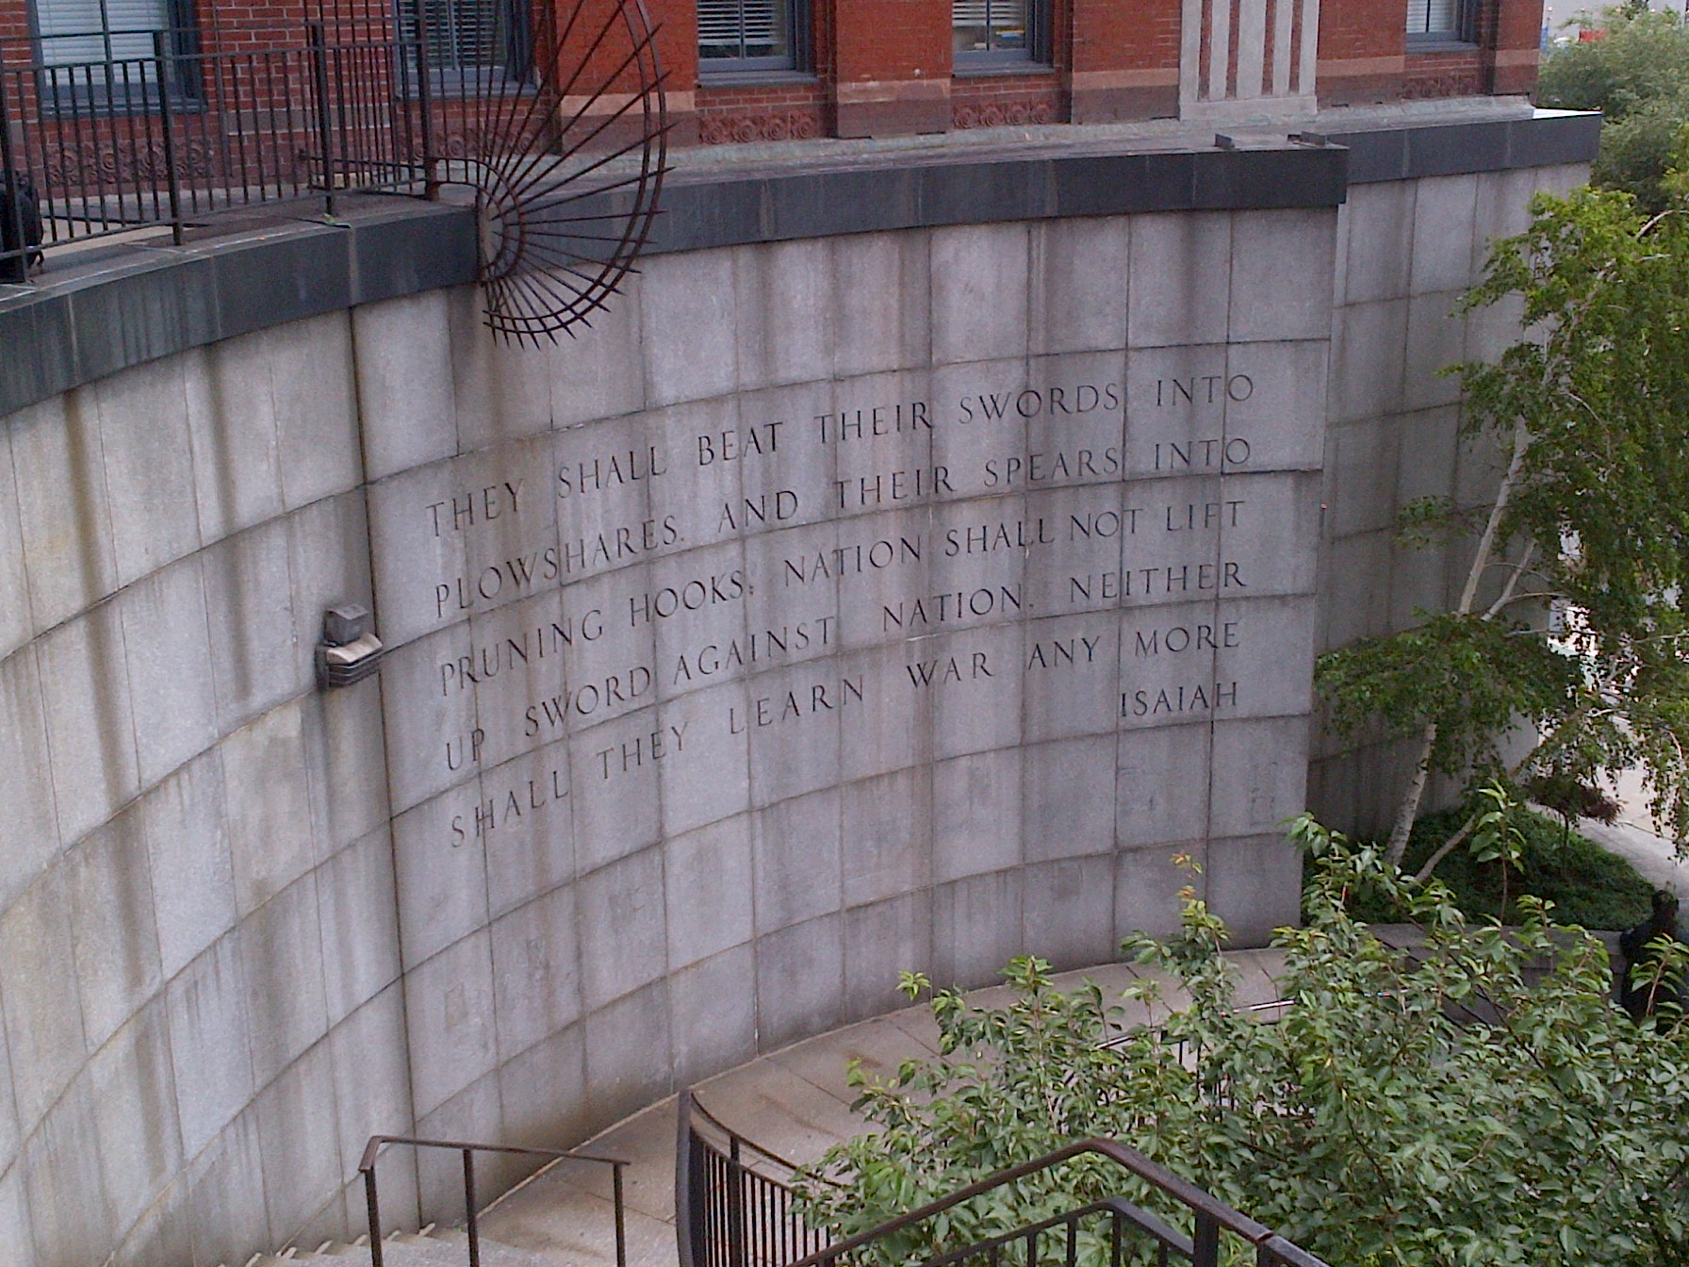

Slide 27
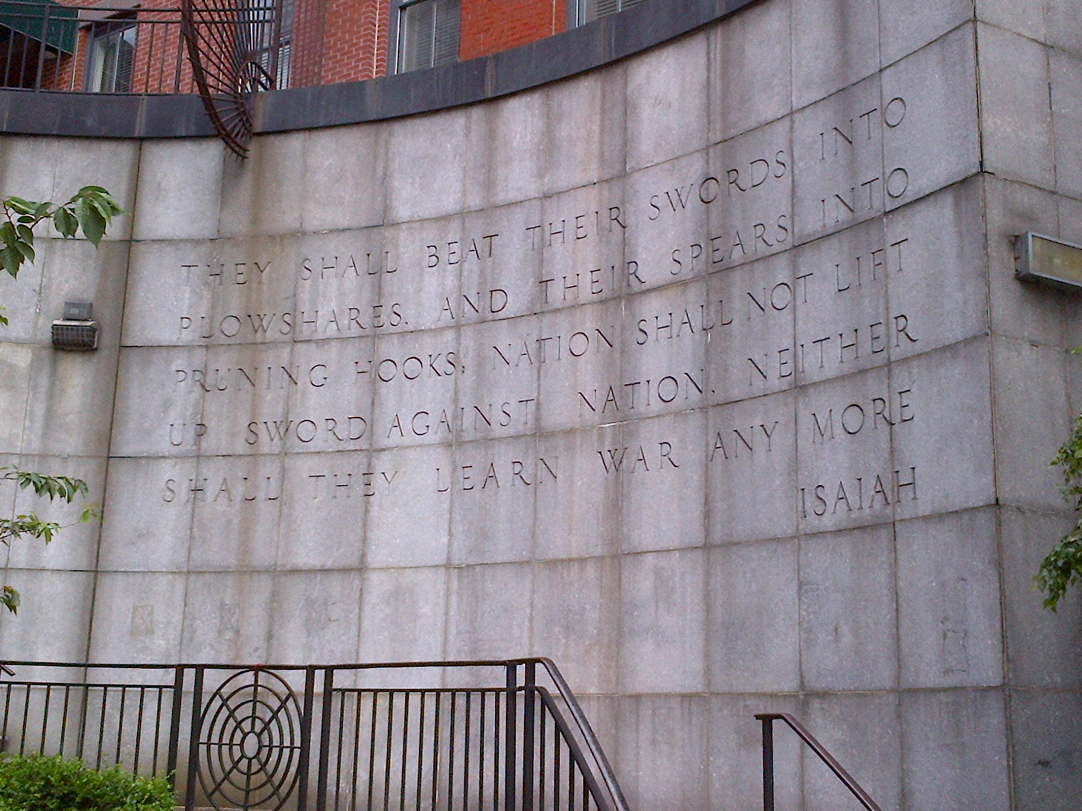

Slide 28


Slide 31
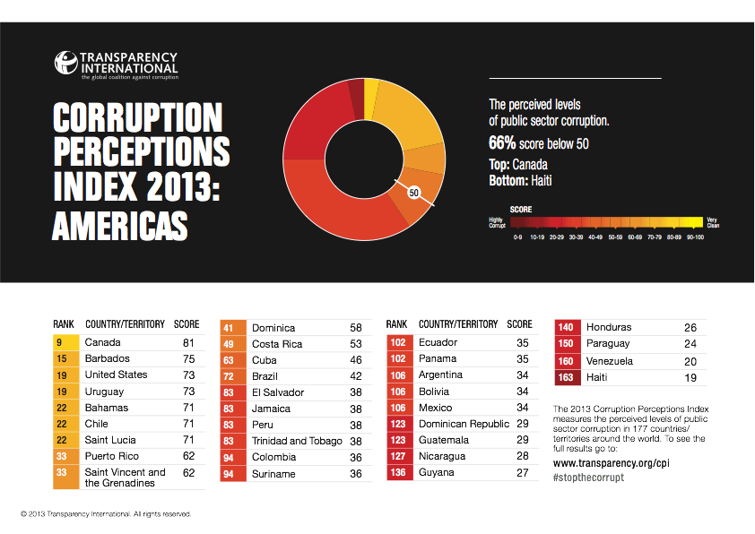

Slide 32
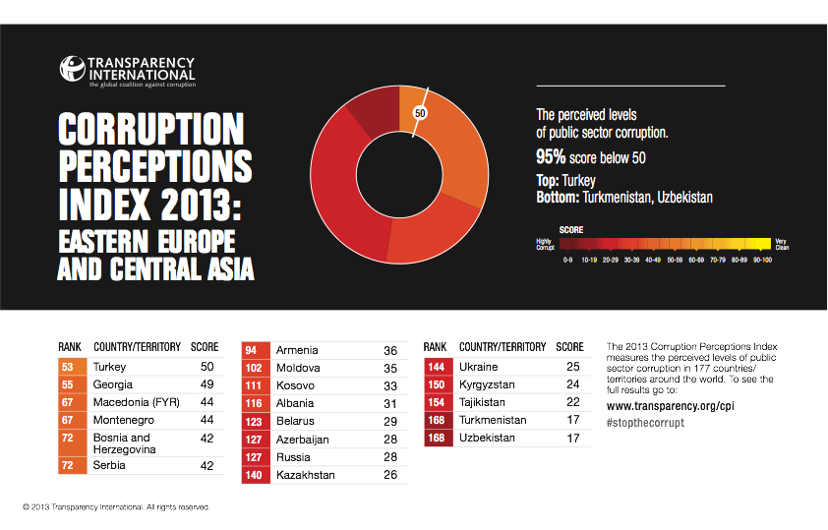

Slide 33
Israel and the Jews are God’s witnesses
Isaiah 43
9 Let all the nations be gathered together, and let the people be assembled: who among them can declare this, and shew us former things? let them bring forth their witnesses, that they may be justified: or let them hear, and say, It is truth.
10 Ye are my witnesses, saith the LORD, and my servant whom I have chosen: that ye may know and believe me, and understand that I am he: before me there was no God formed, neither shall there be after me.

Slide 34
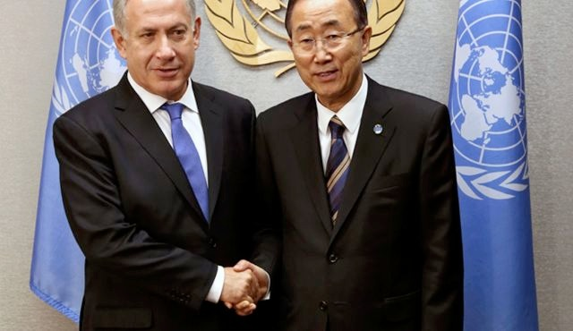
Speech by Prime Minister Benjamin Netanyahu
to the UN General Assembly’s General Debate
27 September 2012
Thank you very much Mr. President.
It's a pleasure to see the General Assembly presided by the Ambassador from Israel, and it's good to see all of you, distinguished delegates.
Ladies and Gentlemen, Three thousand years ago, King David reigned over the Jewish state in our eternal capital, Jerusalem. I say that to all those who proclaim that the Jewish state has no roots in our region and that it will soon disappear.
Throughout our history, the Jewish people have overcome all the tyrants who have sought our destruction. It's their ideologies that have been discarded by history. The people of Israel live on. We say in Hebrew Am Yisrael Chai, and the Jewish state will live for ever …
51

Slide 35
The Jewish people have lived in the land of Israel for thousands of years. Even after most of our people were exiled from it, Jews continued to live in the land of Israel throughout the ages. The masses of our people never gave up the dreamed of returning to our ancient homeland.
Defying the laws of history, we did just that. We ingathered the exiles, restored our independence and rebuilt our national life. The Jewish people have come home. We will never be uprooted again.
Yesterday was Yom Kippur, the holiest day of the Jewish year. Every year, for over three millennia, we have come together on this day of reflection and atonement. We take stock of our past. We pray for our future. We remember the sorrows of our persecution; we remember the great travails of our dispersion; we mourn the extermination of a third of our people, six million, in the Holocaust.
But at the end of Yom Kippur, we celebrate. We celebrate the rebirth of Israel. We celebrate the heroism of our young men and women who have defended our people with the indomitable courage of Joshua, David, and the Maccabees of old. We celebrate the marvel of the flourishing modern Jewish state.
In Israel, we walk the same paths tread by our patriarchs Abraham, Isaac and Jacob. But we blaze new trails in science, technology, medicine, agriculture. In Israel, the past and the future find common ground ...
52

Slide 36
Benjamin Netanyahu
addresses the UN General Assembly, October 1st, 2013
“Now, I know that some in the international community think I'm exaggerating this threat. Sure, they know that Iran's regime leads these chants, "death to America, death to Israel," that it pledges to wipe Israel off the map. But they think that this wild rhetoric is just bluster for domestic consumption. Have these people learned nothing from history? The last century has taught us that when a radical regime with global ambitions gets awesome power, sooner or later its appetite for aggression knows no bounds.
That's the central lesson of the 20th century. And we cannot forget it. The world may have forgotten this lesson. The Jewish people have not.
If Israel is forced to stand alone, Israel will stand alone.”

Slide 37
“Binyamin Netanyahu at the UN: this year, a voice in the wilderness”
“Netanyahu is the lone prophet, well aware that even his own defence chiefs and most Israelis disagree with his position on Iran. At the UN, he will stand alone, the friendless and isolated historian's son, raging against the world's complacency.”
Guardian Newspaper, Oct 2013
“If Israel is forced to stand alone, Israel will stand alone.”
Benjamin Netanyahu, Israeli PM, Oct 2013

Slide 38
Positions on the Legal Status of Jerusalem
“… the International Community unanimously agrees about the illegality of factual, administrative and legal actions taken by Israel at least in East Jerusalem … If resolution 181 is applied to the territory of Jerusalem of 1947, actions in this part of the city violate the partition plan, while actions in the 1967 annexed territory stands in violation of humanitarian law, in particular the Fourth Geneva Convention. Ilona-Margarita Stettner

Slide 39
Habakkuk
Habaq - “to embrace”
Gen 48:10, Prov 4:8,
Heb 11:13

Slide 40
The burden which Habakkuk the prophet did see
A | 1:2-4 | Questions about God’s justice | Why doesn't God remove iniquity from Judah?
B | 1:5-11 | Answer - God will judge! | Judgment will come via the Chaldeans
C | 1:12-2:1 | Complaint about God’s methods | But Babylon is even worse!
D | 2:2-5 | Answer - There is an appointed time | Live patiently by faith
C’ | 2:5-20 | Five Woes on Babylon | Babylon will be judged!
B’ | 3:1-15 | The coming of the mighty Eloah | The conquest of the land and the deliverance of Israel
A’ | 3:16-19 | The outlook of faith | Rejoicing in hope!

Slide 41
The burden which Habakkuk the prophet did see
A | 1:2-4 | Question - why does God tolerate injustice | A’ | 3:16-19 | The perspective of faith
B | 1:5-11 | Answer - God will judge through the Chaldeans | B’ | 3:1-15 | The coming of the mighty Eloah
C | 1:12-2:1 | Complaint - the Babylonians are rapacious idolators | C’ | 2:5-20 | Five Woes on Babylon
D | 2:2-4 | Answer - There is an appointed time, the just live by faith.

Slide 42
Habakkuk 1:2
how long shall I cry | שִׁוַּ֖עְתִּי | shiv·va'·ti | 7768 | to cry out (for help)
even cry out | אֶזְעַ֥ק | ez·'ak | 2199 | to cry, cry out, call
compare Lament 3:8

Slide 43
Habakkuk 1 |  | Jeremiah/Lamentations
v2 | cry … shout | Lam 3:8
v2 | not hear | Jer 7:16
v3 | spoiling and violence | Jer 6:7, 20:8
v3 | strife and contention | Jer 15:10

Slide 44
Habakkuk 1:5 | Acts 13:41
Behold ye among the heathen, and regard, and wonder marvellously: | Behold ye despisers, and wonder and perish:
for I will work a work in your days, which ye will not believe, though it be told you | for I will work a work in your days, which ye will not believe, though a man declare it unto you

Slide 45
New Testament quotation sometimes differs from a literal Greek translation of the Hebrew Massoretic text.
Possible explanations
  A. The Spirit has changed the words to draw out specific meanings contained in the original
  Or
  B. The NT writers were quoting a different Hebrew MT
  Implication : The differences tell us that the Hebrew
  text we have is not the Hebrew Bible of the NT
  Or
  C. The NT writers were quoting a Greek translation that
  either mistranslates the Hebrew MT or translated a
  different Hebrew Text.
  Implication: either we do not have the same Hebrew
  text or NT writers were using an uninspired erroneous
  translation of the Hebrew text.

Slide 46
“The term Septuagint could refer to any historical stage of the Greek translation of the Old Testament. A strict, purist use of Septuagint would allow the term to be used only of the earliest, (probably) unrecoverable translation of the Pentateuch made by the Jewish scholars around 282 BCE.”
The Septuagint Online:http://www.kalvesmaki.com/LXX/

Slide 47
In the third century, the great Christian scholar, Origen (184/85–254/55), keenly interested in the textual differences between the Hebrew and the Greek, set out to arrange the Church's Old Testament in six columns: (1) the Hebrew, (2) a Greek transliteration of the Hebrew, (3) Aquila's translation, (4) Symmachus's translation, (5) the Septuagint (LXX), and (6) Theodotion. The volumes were compiled in Caesarea, probably between 230 and 240 CE, a project funded by Origen's patron. The resultant work, called the Hexapla ("six-fold"), was massive, and has perished except for fragments.
The Septuagint Online:http://www.kalvesmaki.com/LXX/

Slide 48
Origen was a very careful scholar, but he did not observe modern editorial conventions. His version of the LXX draws from several different manuscript families and embraces readings that bring the text closer to the Hebrew text of his day. Thus, this fifth LXX column, while establishing the first "standardized text" of the Christian Church, created problems for modern scholars who would seek to recover a pre-Christian version of the LXX.
The Septuagint Online:http://www.kalvesmaki.com/LXX/

Slide 49
Oftentimes the LXX reflects a Hebrew text different from the standard, Masoretic text (MT) of the 9th c. CE. A number of books feature striking differences between the LXX and MT. For instance:
LXX Jeremiah is shorter than MT Jeremiah by roughly one-eighth, and the order of its chapters is quite different.
LXX Job is about one-sixth smaller than MT Job, and includes an ending not extant in the Hebrew.
Almost half of the verses in LXX Esther are not found in MT Esther.
LXX Exodus and MT Exodus differ in many places according to order of verses, and inclusion or exclusion of words and material
The Septuagint Online:http://www.kalvesmaki.com/LXX/

Slide 50
Isaiah 29:14 | Habakkuk 1:5
Therefore, behold, I will proceed to do a marvellous work among this people, even a marvellous work and a wonder: for the wisdom of their wise men shall perish, and the understanding of their prudent men shall be hid. | Behold ye among the heathen, and regard, and wonder marvellously: Acts 13:41 Behold ye despisers, and wonder and perish: for I will work a work in your days, which ye will not believe, though a man declare it unto you

Slide 51


Hab 1:5-11
Behold ye among the heathen, and regard, and wonder marvellously:
for I will work a work in your days,
which ye will not believe, though it be told you.
For, lo, I raise up the Chaldeans, that bitter and hasty nation,
which shall march through the breadth of the land,
to possess the dwelling places that are not theirs …
Hab 3:1-15
A prayer of Habakkuk the prophet upon Shigionoth.
O Lord, I have heard thy speech, and was afraid:
O Lord, revive thy work in the midst of the years,
in the midst of the years make known;
in wrath remember mercy.
God came from Teman,
and the Holy One from mount Paran. Selah.
His glory covered the heavens,
and the earth was full of his praise …

Slide 52
v5 Unbelievable event - Acts 13:41
v6 Chaldeans, bitter and hasty - Isa 14:6, Jer 6:23, 50:42
v7 terrible and dreadful
v8 horse, leopards, wolves, horsemen, eagle - Jer 4:13,
4:29, 5:6, Deut 28:49
v9 east wind - Jer 18:17, Ezek 17:10, 19:12
v10 scoff at kings - compare Isa 37:12-13
v11 imputing power to his god Deut 32:26-27, Dan 4:30,
5:18-22
The fearsome character of the Babylonians!

Slide 53
7 They are dreaded and fearsome;
their justice and dignity go forth from themselves.
8 Their horses are swifter than leopards,
more fierce than the evening wolves;
their horsemen press proudly on.
Their horsemen come from afar;
they fly like an eagle swift to devour.
9 They all come for violence,
all their faces forward.
They gather captives like sand.
10 At kings they scoff,
and at rulers they laugh.
They laugh at every fortress,
for they pile up earth and take it.
11 Then they sweep by like the wind and go on,
guilty men, whose own might is their god!”

Slide 54
Deuteronomy 28 | Habakkuk 1
v49 a nation against thee from far | v8 shall come from far
v49 as the eagle flieth | v8 they shall fly as the eagle
v50 a nation of fierce countenance | v8 more fierce than the evening wolves
v50 shall not regard the person of the old | v10 they shall scoff at kings

Slide 55
Habakkuk | Deuteronomy
1:11 “Then shall his mind change, and he shall pass over, and offend, imputing this his power unto his god.” | 32:27 “… Our hand is high, and the LORD hath not done all this.”
1v12 “Art thou not from everlasting, O LORD my God, mine Holy One? we shall not die. O LORD, thou hast ordained them for judgment; and, O mighty God [Heb: Rock], thou hast established them for correction.” | Deut 32:4 “He is the Rock, his work is perfect: for all his ways are judgment: a God of truth and without iniquity, just and right is he.”
2:2 “Write the vision, and make it plain upon tables, that he may run that readeth it.” | 27:8 “And thou shalt write upon the stones all the words of this law very plainly.”
Notes:
50,346 sq mi - approx 500k population.

Slide 56
Deut |  | Habakkuk
32:4 | Rock | 1:12
32:20 | faith | 2:4
32:35 | make haste | 1:8
32:42 | arrows | 3:11
32:43 | nations | 1:17, 2:5, 2:8, 3:6
33:2 | God comes | 3:3
33:26 | ride upon heaven | 3:19
33:29 | saved by YHWH | 3:13
33:29 | high places | 3:19

Slide 57
The burden which Habakkuk the prophet did see
A | 1:2-4 | Question - why does God tolerate injustice | A’ | 3:16-19 | The perspective of faith
B | 1:5-11 | Answer - God will judge through the Chaldeans | B’ | 3:1-15 | The coming of the mighty Eloah
C | 1:12-2:1 | Complaint - the Babylonians are rapacious idolators | C’ | 2:5-20 | Five Woes on Babylon
D | 2:2-4 | Answer - There is an appointed time, the just live by faith.

Slide 58
Deuteronomy 28 | Habakkuk 1
v49 a nation against thee from far | v8 shall come from far
v49 as the eagle flieth | v8 they shall fly as the eagle
v50 a nation of fierce countenance | v8 more fierce than the evening wolves
v50 shall not regard the person of the old | v10 they shall scoff at kings

Slide 59
Deut |  | Habakkuk
32:4 | Rock | 1:12
32:20 | faith | 2:4
32:35 | make haste | 1:8
32:42 | arrows | 3:11
32:43 | nations | 1:17, 2:5, 2:8, 3:6
33:2 | God comes | 3:3
33:26 | ride upon heaven | 3:19
33:29 | saved by YHWH | 3:13
33:29 | high places | 3:19

Slide 60
v12 everlasting, Holy One, Rock - Deut 33:27, 1 Sam 2:2, Deut 32:4
The purpose of the judgment is chastening!
v13 deal treacherously - Isa 21:2
v14 no ruler - Deut 28:36
v15 rejoice and glad - Prov 24:17
v17 shall they ... - Isa 13,14, Dan 2,5
will Babylon triumph indefinitely?

Slide 61
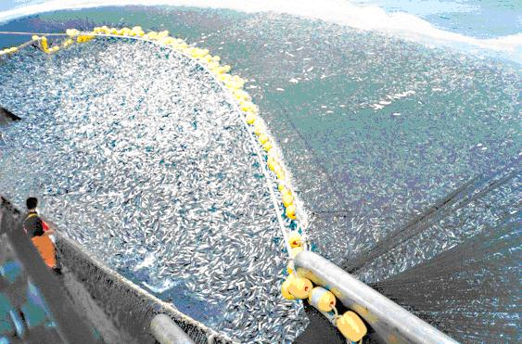
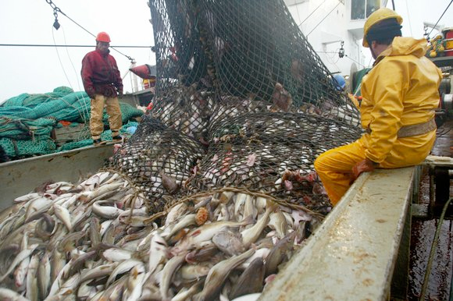
Habakkuk 1:13-17
“wherefore lookest thou upon them that deal treacherously ...
And makest men as the fishes of the sea,
as the creeping things, that have no ruler over them?
They take up all of them with the angle,
they catch them in their net, and gather them in their drag:
therefore they rejoice and are glad.
Therefore they sacrifice unto their net, and burn incense unto their drag;
because by them their portion is fat, and their meat plenteous.
Shall they therefore empty their net,
and not spare continually to slay the nations?”

Slide 62
Habakkuk 1:13-17
A - And makest men as the fishes of the sea,
as the creeping things, that have no ruler over them?
B - They take up all of them with the angle,
C - they catch them in their net, and gather
them in their drag:
D - therefore they rejoice and are glad.
C’ - Therefore they sacrifice unto their net, and
burn incense unto their drag;
B’ - because by them their portion is fat, and their meat
plenteous.
A’ - Shall they therefore empty their net, and not spare continually to slay the nations?”

Slide 63
Hab 2 2-4
And the Lord answered me, and said, Write the vision, and make it plain upon tables, that he may run that readeth it. For the vision is yet for an appointed time, but at the end it shall speak, and not lie: though it tarry, wait for it;because it will surely come, it will not tarry.Behold, his soul which is lifted up is not upright in him:but the just shall live by his faith

Slide 64
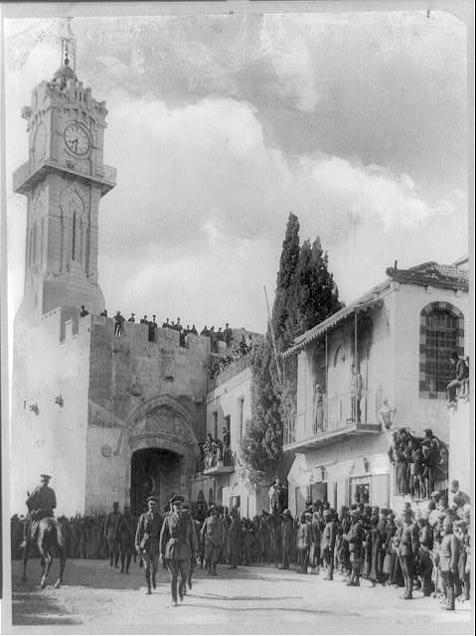
2:1 standing upon the watchtower - Ezek 3:17, 33:7,
Isa 21:6,8
Proverbs 18:10
The name of the Lord is a strong tower:
the righteous runneth into it, and is safe.

Slide 65
The burden which Habakkuk the prophet did see
A | 1:2-4 | Question - why does God tolerate injustice | A’ | 3:16-19 | The perspective of faith
B | 1:5-11 | Answer - God will judge through the Chaldeans | B’ | 3:1-15 | The coming of the mighty Eloah
C | 1:12-2:1 | Complaint - the Babylonians are rapacious idolators | C’ | 2:5-20 | Five Woes on Babylon
D | 2:2-4 | Answer - There is an appointed time, the just live by faith.

Slide 66
Hab 2 2-4
And the Lord answered me, and said, Write the vision, and make it plain upon tables, that he may run that readeth it. For the vision is yet for an appointed time, but at the end it shall speak, and not lie: though it tarry, wait for it; because it will surely come, it will not tarry. Behold, his soul which is lifted up is not upright in him:but the just shall live by his faith.
Heb 10:36-39 - 12:2
For ye have need of patience, that, after ye have done the will of God, ye might receive the promise. For yet a little while, and he that shall come will come, and will not tarry. Now the just shall live by faith: but if any man draw back, my soul shall have no pleasure in him. But we are not of them who draw back unto perdition; but of them that believe to the saving of the soul … and let us run with patience the race that is set before us, Looking unto Jesus the author and finisher of our faith; who for the joy that was set before him endured the cross.

Slide 67
Habakkuk | Romans | Galatians | Hebrews
2:4 Behold, his soul which is lifted up is not upright in him: but the just shall live by his faith. | 1:17 the righteousness of God revealed ... as it is written, The just shall live by faith. | 3:11 ...no man is justified by the law...The just shall live by faith. | 10:37-38 the just shall live by faith: but if any man draw back, my soul shall have no pleasure in him.
Gen 15:6
“And he believed in the Lord; and he counted it to him for righteousness.”
Luke 20:37-38
Now that the dead are raised, even Moses shewed at the bush, when he calleth the Lord the God of Abraham, and the God of Isaac, and the God of Jacob. For he is not a God of the dead, but of the living:for all live unto him”

Slide 68
Habakkuk | Romans | Galatians | Hebrews
2:4 Behold, his soul which is lifted up is not upright in him: but the just shall live by his faith. | 1:17 the righteousness of God revealed ... as it is written, The just shall live by faith. | 3:11 ...no man is justified by the law...The just shall live by faith. | 10:37-38 the just shall live by faith: but if any man draw back, my soul shall have no pleasure in him.
Gal 2:16-20
Knowing that a man is not justified by the works of the law, but by the faith of Jesus Christ, even we have believed in Jesus Christ, that we might be justified by the faith of Christ, and not by the works of the law:for by the works of the law shall no flesh be justified ... For I through the law am dead to the law, that I might live unto God. I am crucified with Christ: nevertheless I live; yet not I, but Christ liveth in me:and the life which I now live in the flesh I live by the faith of the Son of God, who loved me, and gave himself for me.”

Slide 69
Romans 1:17
For therein is the righteousness of God revealed from faith to faith:as it is written, The just shall live by faith.
Psalm 98:2
The Lord hath made known his salvation:
his righteousness hath he openly shewed in the sight of the heathen.

Slide 70
Psalm 98:2-3
the LORD hath made known | His salvation
he hath openly showed | His righteousness | in the sight of the heathen
He hath remembered | His mercy and His truth | to the house of Israel
 |  | all the ends of the earth
have seen | the salvation of our God
.

Slide 71
the LORD hath made known | His salvation | Psalm 98:2-3
he hath openly showed | His righteousness | in the sight of the heathen
He hath remembered | His mercy and His truth | to the house of Israel
 |  | all the ends of the earth
have seen | the salvation of our God
for I am not ashamed of the gospel of Christ | for it is the power of God unto salvation | to every one that believeth; to the Jew first, and also to the Greek
for therein is revealed | the righteousness of God | Romans 1:16-17
.

Slide 72
for I am not ashamed of the gospel of Christ | for it is the power of God unto salvation | to every one that believeth; to the Jew first, and also to the Greek
for therein is revealed | the righteousness of God | Romans 1:16-17
.
out of faithfulness |  | for faithfulness
as it is written | the just shall live | by faith

Slide 73
The burden which Habakkuk the prophet did see
A | 1:2-4 | Question - why does God tolerate injustice | A’ | 3:16-19 | The perspective of faith
B | 1:5-11 | Answer - God will judge through the Chaldeans | B’ | 3:1-15 | The coming of the mighty Eloah
C | 1:12-2:1 | Complaint - the Babylonians are rapacious idolators | C’ | 2:5-20 | Five Woes on Babylon
D | 2:2-4 | Answer - There is an appointed time, the just live by faith.

Slide 74
Habakkuk 2:5
Yea also, because he transgresseth by wine,
he is a proud man, neither keepeth at home,
who enlargeth his desire as hell,
and is as death, and cannot be satisfied,
but gathereth unto him all nations,
and heapeth unto him all people:
Shall not all these take up a parable against him,
and a taunting proverb against him, and say
Jer 51:7, Rev 17:2
Prov 20:1
Prov 21:24
Prov 30:16

Slide 75
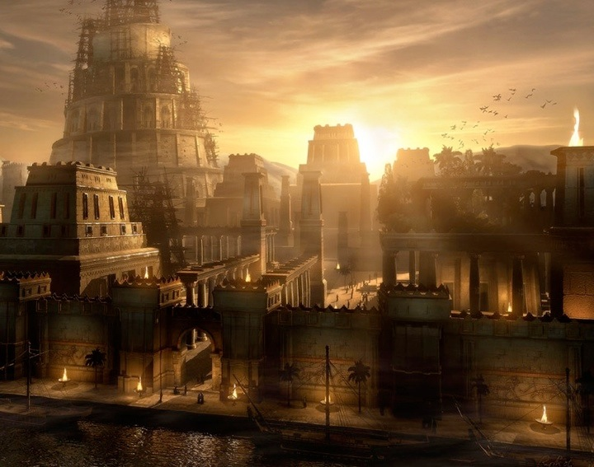

Slide 76
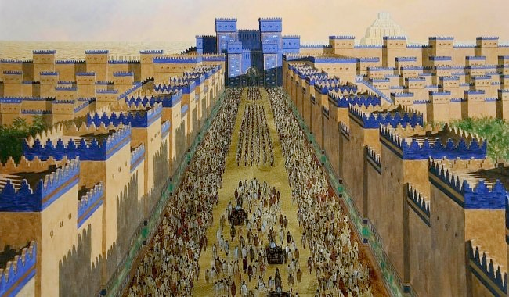

Slide 78
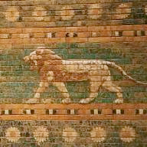

Slide 80
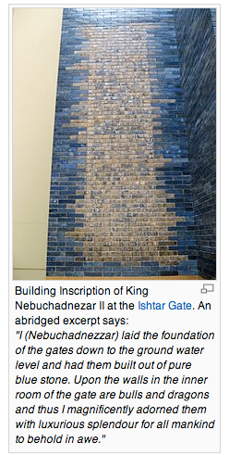

Slide 81
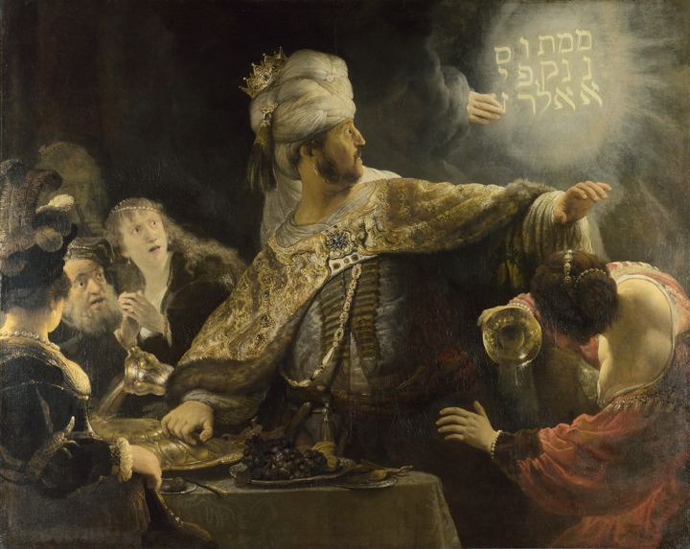

Slide 82
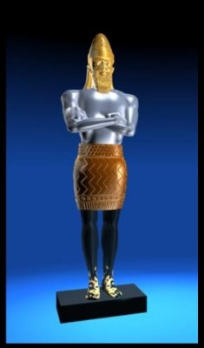
The Head of Gold
Gen 11
4 And they said, Go to, let us build us a city and a tower, whose top may reach unto heaven; and let us make us a name, lest we be scattered abroad upon the face of the whole earth.
5 ¶ And the LORD came down to see the city and the tower, which the children of men builded.
6 And the LORD said, Behold, the people is one, and they have all one language; and this they begin to do: and now nothing will be restrained from them, which they have imagined to do.

Slide 83
A Post-Modern World
postmodernism, in Western philosophy, a late 20th-century movement characterized by broad skepticism, subjectivism, or relativism; a general suspicion of reason; and an acute sensitivity to the role of ideology in asserting and maintaining political and economic power.
Encyclopaedia Britannica
Artifacts of postmodernity include the dominance of television and popular culture, the wide accessibility of information and mass telecommunications. Postmodernity also exhibits a greater resistance to making sacrifices in the name of progress discernible in environmentalism and the growing importance of the anti-war movement. Postmodernity in the industrialised core is marked by increasing focus on civil rights and equal opportunity as well as movements such as feminism and multi-culturalism and the backlash against these movements.

Slide 84
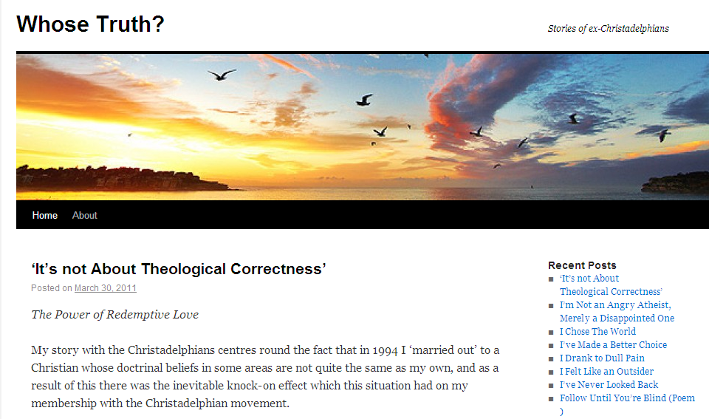

Slide 85
In the World But Not of It
Going from a conservative religious sect to progressive politics in eighteen years.
By xxxxxxxxxxxx
Christadelphianism taught me quite a lot in my first 18 years, but probably the most important lesson was expressed, somewhat ironically, by Bill Clinton at the 2005 Campus Progress National Student Conference.
How can you have shared values in a world as diverse as ours? You can’t if you believe you have the absolute truth … Then all possibility of shared values vanishes because somebody who doesn’t agree with you on something is by definition outside the family of humanity.
These words reflected one of the most significant epiphanies derived from my own ideological evolution …
My initial qualms with Christadelphians centered on the presumption that we would be the only people God would save …

Slide 86
    Five woes
    1: v6-8 Increaseth that which is not his
    – insatiable appetite for territory and wealth
    2: v9-10 Set his nest on high
    – self serving and self confident
    3: v12-14 Building a city by blood
    – seeking prestige and status built on corruption
    (The earth shall be filled with the knowledge of the glory
    of the LORD as the waters cover the sea)
    4: v15-17 drunkards filled with shame
    – peddling human philosophy and moral corruption
    5: v18-19 Idolatry
    – promoting false religion

Slide 87
    1: v6-8 Increaseth that which is not his
    – insatiable appetite for territory and wealth
v8 “because of men's blood, and for the violence of the land, of the city, and of all that dwell therein”.
    4: v15-17 drunkards filled with shame
    – peddling human philosophy and moral corruption
v17 “because of men's blood, and for the violence of the land, of the city, and of all that dwell therein”.

Slide 88
Hab 2:5
Yea also, because he transgresseth by wine,
he is a proud man, neither keepeth at home,
who enlargeth his desire as hell,
and is as death, and cannot be satisfied,
but gathereth unto him all nations,
and heapeth unto him all people:
4. wine - v15-17 drunkards filled with shame
3. at home - v12-14 building a city by blood
2. desire - v9-10 set his nest on high
1. gather nations - v6-8 increases that which is not his
5. Trust in idols - v18-19 idolatry

Slide 89
    Five woes
    v6-8 Increaseth that which is not his
    – insatiable appetite for territory and wealth
    v9-10 Set his nest on high
    – self serving and self confident
    v12-14 Building a city by blood
    – seeking prestige and status built on corruption
    v15-17 drunkards filled with shame
    – peddling human philosophy and moral corruption
    v18-19 Idolatry
    – promoting false religion

Slide 90
Numb 14:21 | Psalm 72:19 | Isaiah 11:9 | Hab 2:14
But as truly as I live, all the earth shall be filled with the glory of the Lord. | and let the whole earth be filled with his glory | for the earth shall be full of the knowledge of the Lord, | For the earth shall be filled with the knowledge of the glory of the Lord,
 |  | as the waters cover the sea | as the waters cover the sea

Slide 91
Habakkuk | Revelation – Babylon the Great (17:5)
2:12 Woe to him that buildeth a town with blood, and stablisheth a city by iniquity! | 17:18 And the woman which thou sawest is that great city, which reigneth over the kings of the earth.
2:15 Woe unto him that giveth his neighbour drink, that puttest thy bottle to him, and makest him drunken. | 17:2 With whom...the inhabitants of the earth have been made drunk with the wine of her fornication. 18:3 For all nations have drunk of the wine of the wrath of her fornication,
3:8 Was the LORD displeased against the rivers? was thine anger against the rivers? was thy wrath against the sea, | 17:2 the great harlot that sitteth upon many waters. 17:15 The waters which thou sawest, where the whore sitteth, are peoples, and multitudes, and nations, and tongues.
Five Woes | Six Woes Rev 18: 10, 16, and 19
2:19 laid over with gold and silver, | 18:12 The merchandise of gold, and silver,
2:8 Because thou hast spoiled many nations, all the remnant of the people shall spoil thee; | 18:4 Come out of her, my people, that ye be not partakers of her sins, and that ye receive not of her plagues.

Slide 92
Habakkuk 2:20
“But the LORD is in his holy temple:
let all the earth keep silence before him”.
Psalm 11
In the Lord put I my trust:
how say ye to my soul,
Flee as a bird to your mountain?
For, lo, the wicked bend their bow,
they make ready their arrow upon the string,
that they may privily shoot at the upright in heart.
If the foundations be destroyed,
what can the righteous do?
The Lord is in his holy temple,
the Lord 's throne is in heaven:
his eyes behold,
his eyelids try, the children of men.
The Lord trieth the righteous:
but the wicked and him that loveth violence his soul hateth.
Upon the wicked he shall rain snares, fire and brimstone,
and an horrible tempest:this shall be the portion of their cup.
For the righteous Lord loveth righteousness;
his countenance doth behold the upright.

Slide 93
The burden which Habakkuk the prophet did see
A | 1:2-4 | Question - why does God tolerate injustice | A’ | 3:16-19 | The perspective of faith
B | 1:5-11 | Answer - God will judge through the Chaldeans | B’ | 3:1-15 | The coming of the mighty Eloah
C | 1:12-2:1 | Complaint - the Babylonians are rapacious idolators | C’ | 2:5-20 | Five Woes on Babylon
D | 2:2-4 | Answer - There is an appointed time, the just live by faith.

Slide 94
Hab 1:5
Behold ye among the heathen, and regard, and wonder marvellously:
for I will work a work in your days,
which ye will not believe, though it be told you.
Deut 32:4
He is the Rock, his work is perfect:
for all his ways are judgment:
a God of truth and without iniquity,
just and right is he.
Habakkuk 3:1
A prayer of Habakkuk the prophet upon Shigionoth.
O Lord, I have heard thy speech, and was afraid:
O Lord, revive thy work in the midst of the years,
in the midst of the years make known;
in wrath remember mercy.

Slide 95
“In wrath remember mercy?”
Isaiah 14:1-4
For the Lord will have mercy on Jacob,
and will yet choose Israel,
and set them in their own land:
and the strangers shall be joined with them,
and they shall cleave to the house of Jacob.
And the people shall take them, and bring them to their place:
and the house of Israel shall possess them
in the land of the Lord for servants and handmaids:
and they shall take them captives, whose captives they were;
and they shall rule over their oppressors.
And it shall come to pass in the day that the Lord shall give thee rest from thy sorrow, and from thy fear, and from the hard bondage wherein thou wast made to serve,
That thou shalt take up this proverb against the king of Babylon, and say ...

Slide 96
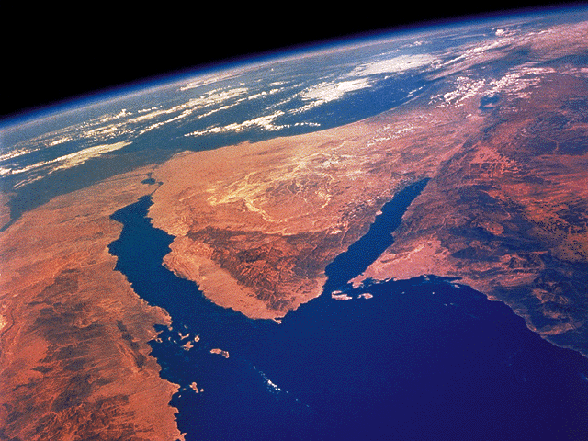
Habakkuk 3:3 | Deuteronomy 33:2 | Psalm 68:17
God came from Teman (South), and the Holy One from mount Paran. Selah. | The LORD came from Sinai, and rose up from Seir unto them; he shined forth from mount Paran, and he came with ten thousands of saints: from his right hand went a fiery law for them. | The chariots of God are twenty thousand, even thousands of angels: the Lord is among them, as in Sinai, in the holy place.

Slide 97
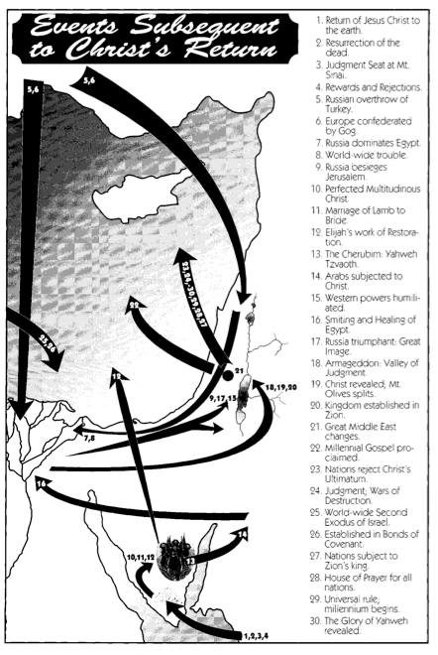

Slide 98
Habakkuk 3 | Judges 5
V6 “He stood, and measured the earth: he beheld, and drove asunder the nations; and the everlasting mountains were scattered, the perpetual hills did bow: his ways are everlasting.” | V5 “The mountains melted from before the LORD, even that Sinai from before the LORD God of Israel.”
V10 “The mountains saw thee, and they trembled: the overflowing of the water passed by: the deep uttered his voice, and lifted up his hands on high.” | V21 “The river of Kishon swept them away, that ancient river, the river Kishon. O my soul, thou hast trodden down strength.”
V11 “The sun and moon stood still in their habitation: at the light of thine arrows they went, and at the shining of thy glittering spear.” | V20 “They fought from heaven; the stars in their courses fought against Sisera.”
V13 “Thou wentest forth for the salvation of thy people, even for salvation with thine anointed; thou woundedst the head out of the house of the wicked, by discovering the foundation unto the neck. Selah.” | V26 “She put her hand to the nail, and her right hand to the workmen’s hammer; and with the hammer she smote Sisera, she smote off his head, when she had pierced and stricken through his temples.”

Slide 99
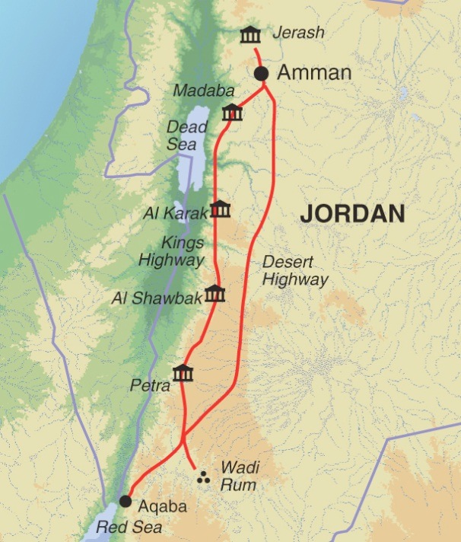
Hab 3 ESV
His splendor covered the heavens, and the earth was full of his praise. His brightness was like the light; rays flashed from his hand; and there he veiled his power. Before him went pestilence,and plague followed at his heels. He stood and measured the earth

Slide 100
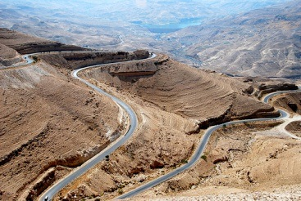
then the eternal mountains were scattered;
the everlasting hills sank low.
His were the everlasting ways.
I saw the tents of Cushan in affliction;
the curtains of the land of Midian did tremble.
Was your wrath against the rivers, O Lord?
Was your anger against the rivers,
or your indignation against the sea,
when you rode on your horses,
on your chariot of salvation?
You stripped the sheath from your bow,
calling for many arrows.
Selah
Numbers 20:19
Isaiah 11:16
Isaiah 19:23
Isaiah 49:11
Isaiah 62:10

Slide 101
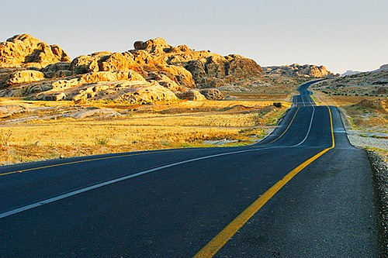
You split the earth with rivers.
The mountains saw you and writhed;
the raging waters swept on;
the deep gave forth its voice;
it lifted its hands on high.
The sun and moon stood still in their place
at the light of your arrows as they sped,
at the flash of your glittering spear.
You marched through the earth in fury;
you threshed the nations in anger

Slide 102
You went out for the salvation of your people,
for the salvation of your anointed.
You crushed the head of the house of the wicked,
laying him bare from thigh to neck.
Selah
You pierced with his own arrows the heads of his warriors,
who came like a whirlwind to scatter me,
rejoicing as if to devour the poor in secret.
You trampled the sea with your horses,
the surging of mighty waters.

Slide 108
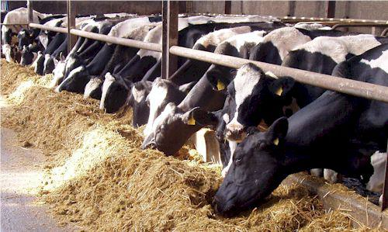

Slide 109
James Tissot

Slide 111
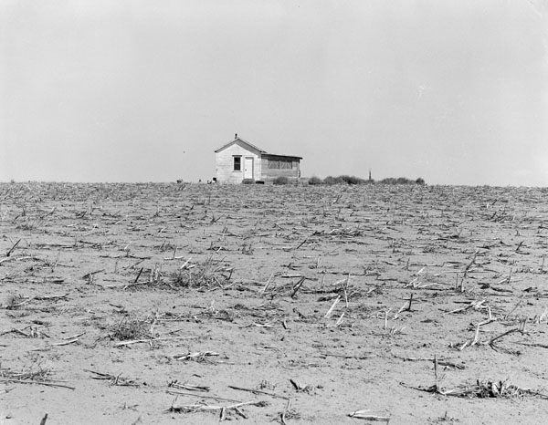
Although the fig tree shall not blossom,
neither shall fruit be in the vines;
the labour of the olive shall fail,
and the fields shall yield no meat;
the flock shall be cut off from the fold,
and there shall be no herd in the stalls:

Slide 112
The Lord God is my strength,
and he will make my feet like hinds' feet,
and he will make me to walk upon mine high places.
To the chief singer on my stringed instruments.
Psalm 18:33, Deut 33:29, Isa 58:14

