Slide 1
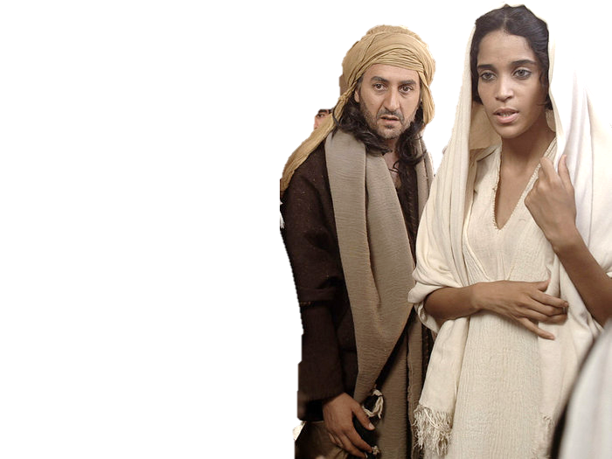
Complementary roles -
One in Christ Jesus
One in Christ Jesus

Slide 2
“Given” and “taken”
  Neither shalt thou make marriages with them; thy daughter thou shalt not give unto his son, nor his daughter shalt thou take unto thy son. Deut 7:3
  And that we would not give our daughters unto the people of the land, nor take their daughters for our sons: Neh 10:30

Slide 3
Scriptural Injunction
Ge 3:16 Unto the woman he said,... thy desire shall be to thy husband, and he shall rule over thee.
Nu 30:13 Every vow, and every binding oath to afflict the soul, her husband may establish it, or her husband may make it void.
1Co 14:34 Let your women keep silence in the ecclesias: for it is not permitted unto them to speak; but they are commanded to be under obedience, as also saith the law.
Eph 5v24 So let the wives [be subject] to their own husbands in everything

Slide 4
Scriptural Injunction
1Co 14:35 And if they will learn any thing, let them ask their husbands at home: for it is a shame for women to speak in the ecclesia.
1Ti 2:11 Let the woman learn in silence with all subjection.
1Ti 2:12 But I suffer not a woman to teach, nor to usurp authority over the man, but to be in silence.
Isaiah 3:12 As for my people, children are their oppressors, and women rule over them. O my people, they which lead thee cause thee to err, and destroy the way of thy paths.

Slide 5
University of Pennsylvania
A pioneering study has shown for the first time that the brains of men and women are wired up differently which could explain some of the stereotypical differences in male and female behaviour, scientists have said.
“
“These maps show us a stark difference - and complementarity - in the architecture of the human brain that helps to provide a potential neural basis as to why men excel at certain tasks, and women at others,” said Ragini Verma, professor of radiology at the University of Pennsylvania in Philadelphia.
“What we've identified is that, when looked at in groups, there are connections in the brain that are hardwired differently in men and women.

Slide 6
University of
Pennsylvania
“In women most of the connections go between left and right across the two hemispheres while in men most of the connections go between the front and the back of the brain,” she said.
Because the female connections link the left hemisphere, which is associated with logical thinking, with the right, which is linked with intuition, this could help to explain why women tend to do better than men at intuitive tasks, she added.
“Intuition is thinking without thinking. It's what people call gut feelings. Women tend to be better than men at these kinds of skill which are linked with being good mothers,” Professor Verma said.

Slide 7
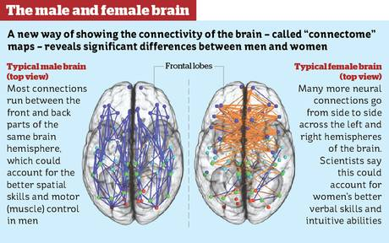

Slide 8
University of
Pennsylvania
Many previous psychological studies have revealed significant differences between the sexes in the ability to perform various cognitive tests.
Men tend to outperform women involving spatial tasks and motor skills - such as map reading - while women tend to better in memory tests, such as remembering words and faces, and social cognition tests, which try to measure empathy and “emotional intelligence”.
It's quite striking how complementary the brains of women and men really are,” said Rubin Gur of Pennsylvania University, a co-author of the study.

Slide 9
Thy Maker is thine husband
For thy Maker is thine husband; Yahweh of hosts is his name; and thy Redeemer the Holy One of Israel; The God of the whole earth shall he be called. Isaiah 54:5
And as the bridegroom rejoiceth over the bride, so shall thy God rejoice over thee. Isaiah 62:5

Slide 10
Thy Maker is thine husband
And I will betroth thee unto me for ever; yea, I will betroth thee unto me in righteousness, and in judgment, and in lovingkindness, and in mercies. I will even betroth thee unto me in faithfulness: and thou shalt know Yahweh. Hos 2:19-20
Now when I passed by thee, and looked upon thee, behold, thy time was the time of love; and I spread my skirt over thee, and covered thy nakedness: yea, I sware unto thee, and entered into a covenant with thee, saith the Lord Yahweh, and thou becamest mine.
Ezekiel 16:8

Slide 11
Thy Maker is thine husband
Turn, O backsliding children, saith Yahweh; for I am married unto you: and I will take you one of a city, and two of a family, and I will bring you to Zion: Jer 3:14
And of Zion it shall be said, This and that man was born in her: and the highest himself shall establish her. Psalm 87:5

Slide 12
Thy Maker is thine husband
Thy Maker is thine husband
Of Christ
For I am jealous over you with godly jealousy: for I have espoused you to one husband, that I may present you as a chaste virgin to Christ.
2 Cor 11:2
Husbands, love your wives, even as Christ also loved the ecclesia, and gave himself for it; That he might sanctify and cleanse it with the washing of water by the word,
That he might present it to himself a glorious ecclesia, ……
This is a great mystery: but I speak concerning Christ and the ecclesia. Ephesians 5:25-32

