Slide 1
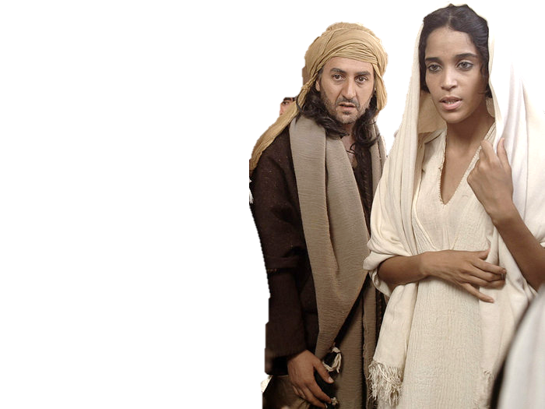
Complementary roles -
One in Christ Jesus
Sisters
in service

Slide 2
Study 1 Foundation Principles
Men and women created with same likeness and image of the Elohim- Gen 1v26,27
They share the same relationship with God, living by the same principles Gal 4v28, 2 Cor 6v18
They have been created for different roles, one with a focus on leadership the other on assisting in the work Gen 2v18, Gen 1v16
This relationship invented by God as part of him filling the earth with his glory.
Their relationship has its counterpart in the relationship between God and his people.
This is why Gods people are so often described in female terms. Cities, the nation of the Israel, the daughters of Jerusalem, the daughters of Zion, the bride of Christ,

Slide 3
Priscilla and Aquila
Ac 18:2 And found a certain Jew named Aquila, born in Pontus, lately come from Italy, with his wife Priscilla; (because that Claudius had commanded all Jews to depart from Rome:) and came unto them.
Ac 18:18 And Paul after this tarried there yet a good while, and then took his leave of the brethren, and sailed thence into Syria, and with him Priscilla and Aquila; having shorn his head in Cenchrea: for he had a vow.
Ac 18:26 And he began to speak boldly in the synagogue: whom when Aquila and Priscilla had heard, they took him unto them, and expounded unto him the way of God more perfectly.
Ro 16:3 Greet Priscilla and Aquila my helpers in Christ Jesus:
1Co 16:19 The ecclesias of Asia salute you. Aquila and Priscilla salute you much in the Lord, with the ecclesia that is in their house.
2Ti 4:19 Salute Prisca and Aquila, and the household of Onesiphorus.

Slide 4
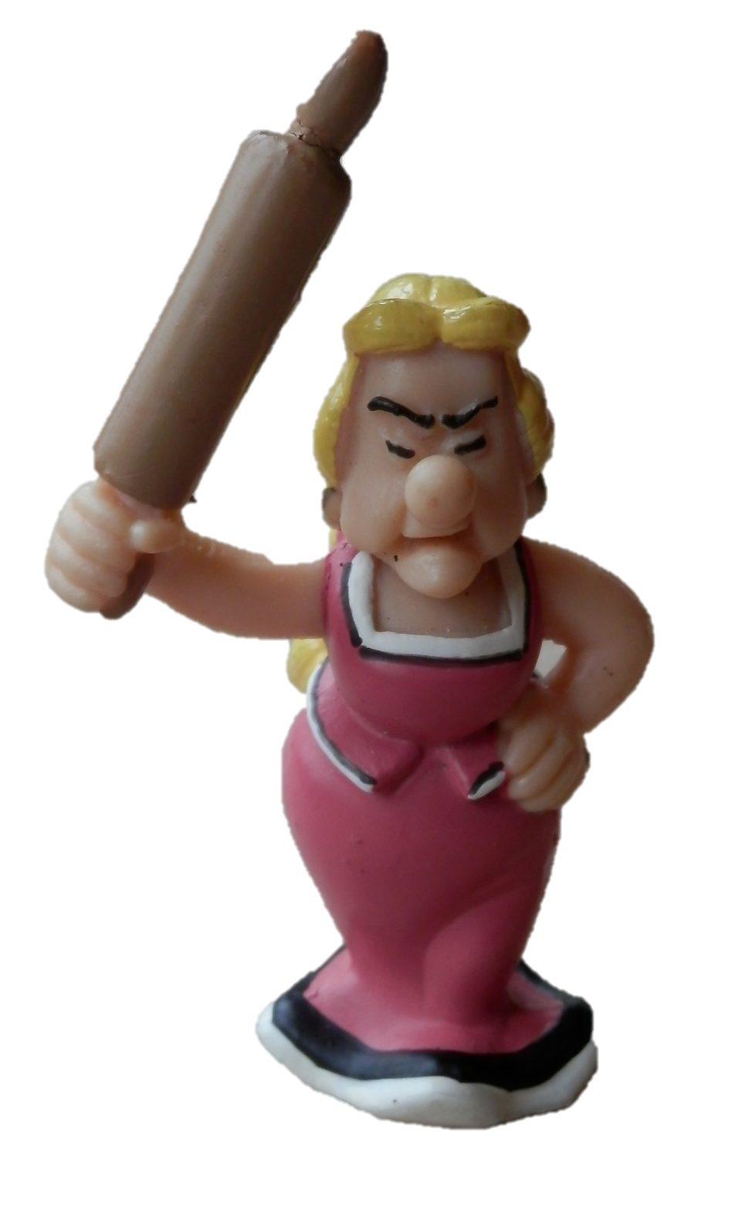

Slide 5
A wise woman’s influence
You can no more suppress a wise woman’s influence and a wise woman’s voice than you can suppress the law of gravitation. You may prevent her delivering a public address; but you cannot prevent her giving good counsel, and you ought not.
Though woman by divine law is in subjection, she is not to be extinguished….. I have seen tyrannical and unsympathetic men wrongly using Paul’s authority to put down and quench Godly women more qualified than they themselves to exercise judgment and give counsel. Let women certainly be modest, but let her not be reduced to a cypher, which God never intended…. We ought to be thankful when women turn up who are able to help with wise suggestions”
Bro Roberts The Christadelphian 34(2) (February 1897) 60

Slide 6
“ But a great lesson emerges; one which no disciple can afford to miss. It has a wider application than the love of two women, and takes us beyond the oven, and the kitchen sink, though it by no means excludes them. It is the lesson that all service for Christ begins at his feet. There, learning of him and understanding what he requires of us, our hearts are filled with the glow of his joy and the serenity of his peace. Only then can we arise and serve him in that quiet confidence and love which will guard us from self righteousness and pride”
A life of Jesus Melva Perkis page 262/263

