Slide 1
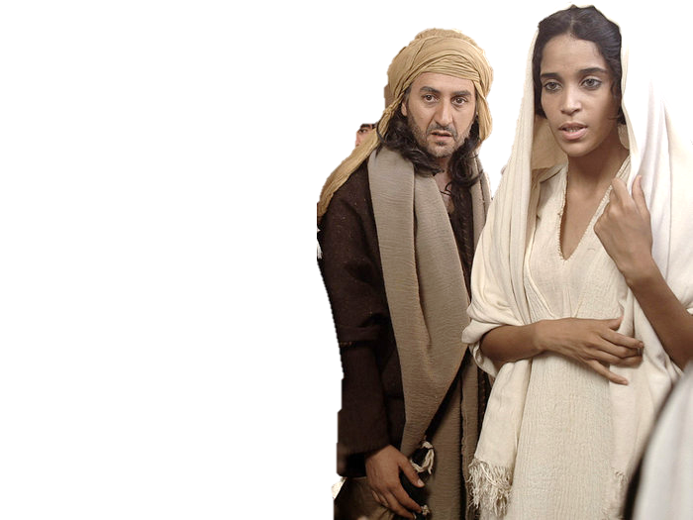
Complementary roles -
One in Christ Jesus
Wonderful Wives

Slide 2
Prov 18v22 Whoso findeth a wife findeth a good thing, and obtaineth favour of Yahweh.
Prov 12v 4 A virtuous woman is a crown to her husband:

Slide 3
“For who hath known the mind of the Lord? or who hath been his counsellor? Or who hath first given to him, and it shall be recompensed unto him again? For of him, and through him, and to him, are all things: to whom be glory for ever. Amen.” Romans 11v34-36
Of him = Ex Ou – out of him
Diaglott V36 Because out of him, and through him, and for him, are all things
Out of whom are all things

Slide 4
Vows made by a Wife
Numbers 30
6 And if she had at all an husband, when she vowed, or uttered ought out of her lips, wherewith she bound her soul;
7 And her husband heard it, and held his peace at her in the day that he heard it: then her vows shall stand, and her bonds wherewith she bound her soul shall stand.
8 But if her husband disallowed her on the day that he heard it; then he shall make her vow which she vowed, and that which she uttered with her lips, wherewith she bound her soul, of none effect: and the LORD shall forgive her.

Slide 5
A Wise or Foolish woman
Every wise woman buildeth her house: but the foolish plucketh it down with her hands.
Prov 14v1

Slide 6
A Virtuous woman
A virtuous woman is a crown to her husband:
Prov 12v4

Slide 7
A common thread?
Eph 5:22 Wives, submit yourselves unto your own husbands, as unto the Lord.
Eph 5:24 Therefore as the ecclesia is subject unto Christ, so let the wives be to their own husbands in every thing.
Col 3:18 Wives, submit yourselves unto your own husbands, as it is fit in the Lord.
Tit 2:5 To be discreet, chaste, keepers at home, good, obedient to their own husbands, that the word of God be not blasphemed.
1Pe 3:1 Likewise, ye wives, be in subjection to your own husbands; that, if any obey not the word, they also may without the word be won by the conversation of the wives;
1Pe 3:5 For after this manner in the old time the holy women also, who trusted in God, adorned themselves, being in subjection unto their own husbands:

Slide 8
A Virtuous woman
A virtuous woman is a crown to her husband:
but she that maketh ashamed is as rottenness in his bones.
Prov 12v4

