Slide 1
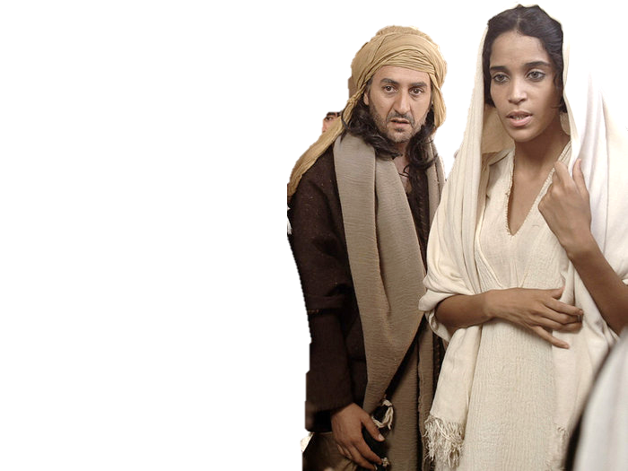
Complementary roles -
One in Christ Jesus
Mothers of Millions

Slide 2
Notwithstanding she shall be saved in childbearing, if they continue in faith and charity and holiness with sobriety.
1 Tim 2v15

Slide 3
The objective?
And did not he make one? Yet had he the residue of the spirit. And wherefore one? That he might seek a godly seed. Mal 2:15

Slide 4
Wise Woman
An adjective, comes from verb hakam – to be wise, act wisely.
TWOT - The essential idea of hakam represents a manner of thinking and attitude concerning life’s experiences; including matters of general interest and basic morality,
These concerns relate to prudence in secular affairs, skills in the arts, moral sensitivity, and experience in the ways of the Lord.

Slide 5
Teachers of good things
The aged women likewise, … teachers of good things; That they may teach the young women to be sober, to love their husbands, to love their children,
To be discreet, chaste, keepers at home, good, obedient to their own husbands, that the word of God be not blasphemed.
Titus 2:3-5

Slide 6
Pauls Instructions
I will therefore that the younger women marry, bear children, guide the house, give none occasion to the adversary to speak reproachfully.
1 Tim 5:14

Slide 7
Paul’s Instructions
Honour thy father and thy mother, as the LORD thy God hath commanded thee; that thy days may be prolonged, and that it may go well with thee, in the land which the LORD thy God giveth thee. Deut 5:16
Children, obey your parents in the Lord: for this is right.
Honour thy father and mother; (which is the first commandment with promise;)
That it may be well with thee, and thou mayest live long on the earth.
Eph 6:1-3

