Slide 1
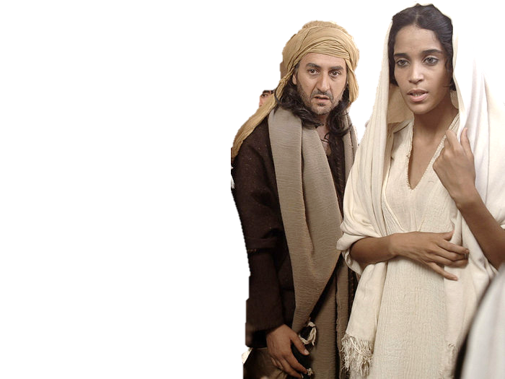
Complementary roles -
One in Christ Jesus
The Beauty of the Bride

Slide 2
A Bride Ready
“Watch therefore for ye know neither the day nor the hour when the Son of man cometh”
Matt 25:13

Slide 3
A Bride prepared
Let us be glad and rejoice, and give honour to him: for the marriage of the Lamb is come, and his wife hath made herself ready.
Rev 19:7

Slide 4
A Fountain of Living Waters
Jer 2:13 For my people have committed two evils; they have forsaken me the fountain of living waters, and hewed them out cisterns, broken cisterns, that can hold no water.
Jer 17:13 O Yahweh, the hope of Israel, all that forsake thee shall be ashamed, and they that depart from me shall be written in the earth, because they have forsaken Yahweh, the fountain of living waters.

Slide 5
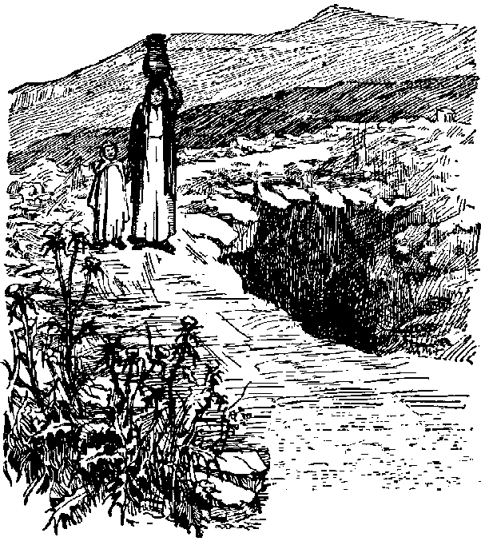
The Well of the Oath
Gen 26 v31 They sware one to another
Shaba = verb – to swear, make an oath
Sheba = noun – Oath, Seven (number)
TWOT – to swear an oath is sometimes described as “to seven oneself”
Beersheba
Beer = Well
Sheba = oath
The well of the 7 fold oath

