Slide 1
Led by the Spirit
Class 1: “The Mind of the Flesh vs. The Mind of the Spirit”
Winfield Bible School
August 2014

Slide 2
Led By the spirit
The Mind of the Flesh vs. The Mind of the Spirit
The Operation of the Spirit in the Lives of Believers
Abba, Father
By This Ye Shall Know
Prepared Unto All Good Works

Slide 3
Why this topic?
Personal discomfort with some positions taken to stay away far from wrong doctrine regarding the Spirit
The Spirit and the believer appears to be a fundamental topic in Scripture
While it was clear that Holy Spirit gifts would cease, it was also clear that the Spirit was an enduring promise in the lives of believers
Spirit life involves many things – to include the Word - but not limited to the Word
As believers, we need to honor God by having an accurate understanding of His work through the Spirit in our lives

Slide 4
Advice from a brother…
“Come back in fellowship!”

Slide 5
Best bible study
We read the Scriptures and let the lessons and truth emerge from the Scriptures themselves
We encourage you, as we go though this examination, to look at all passages with an open perspective
What is it that Scripture tells believers about the Spirit and its activity today?
The objective is to provoke Bible study and meditation

Slide 6
Danger of Doctrinal extremes
We are saved by works
The Trinity of the Father, Son and Holy Spirit
There is a supernatural power of evil and his name is Satan
The Holy Spirit is in “possession” of believers today and reveals to them what to do
  We are saved by faith
  Jesus and God are not “One”
  There is no Satan
  The Holy Spirit is inactive in the lives of believers, except through the power of the Word

Slide 7
A student during his baptismal interview…
Is the Spirit available today?
Well, not the gifts, but otherwise it operates in our lives.
No, the Spirit isn’t available today. We only have the Word.

Slide 8


Slide 9
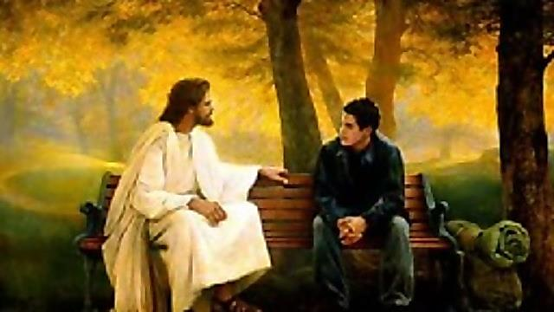
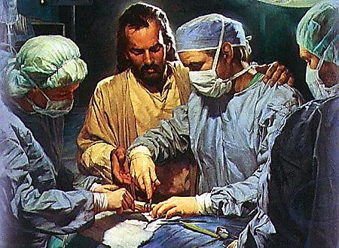
Evangelical error

Slide 10
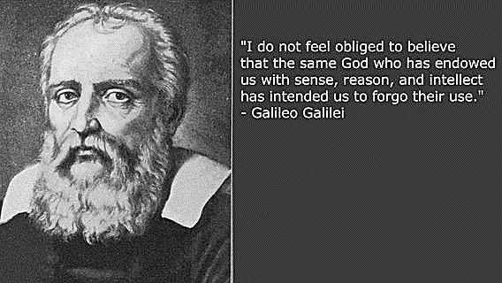

Slide 11
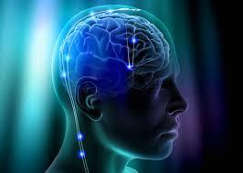

Slide 12
What is meant by the spirit in the lives of believers?
How would you answer the question to an interested friend, “What do you believe the Spirit of God is?”
Our answer might often be “His power”
This is the premise for our classes – the Spirit is the power of God in our lives – under the direction of our Lord
It is manifested in a multitude of ways, consistent since Creation
To have this power in our lives, we have certain obligations which we will examine
Having the Spirit in our lives makes ALL the difference!

Slide 13
Our first “disclaimers”
Nothing in this study is ever intended to indicate that the Spirit works absent our mental process
Scripture itself was written in a way where both our academic and spiritual minds are fully engaged and challenged
God gave us a mind and He expects us to use it – correctly!
The activity of the Spirit is the energizing force that drives us toward spiritual maturity and away from the darkness of the flesh
But, we must have minds that are open and willing to change!

Slide 14
objectives This Week
Examine both Old and New Testament Scriptures about the activity of the Spirit in the lives of believers
Identify the important lessons for our lives as believers today
Feel a greater sense of intimacy and confidence in the Lord’s power in our lives
Better understand our role in making our minds a habitation fit for Son and Father to dwell
How to communicate to those learning the Truth about the Spirit’s activity today

Slide 15
How do we see god’s powerful spirit in our current day?

Slide 16
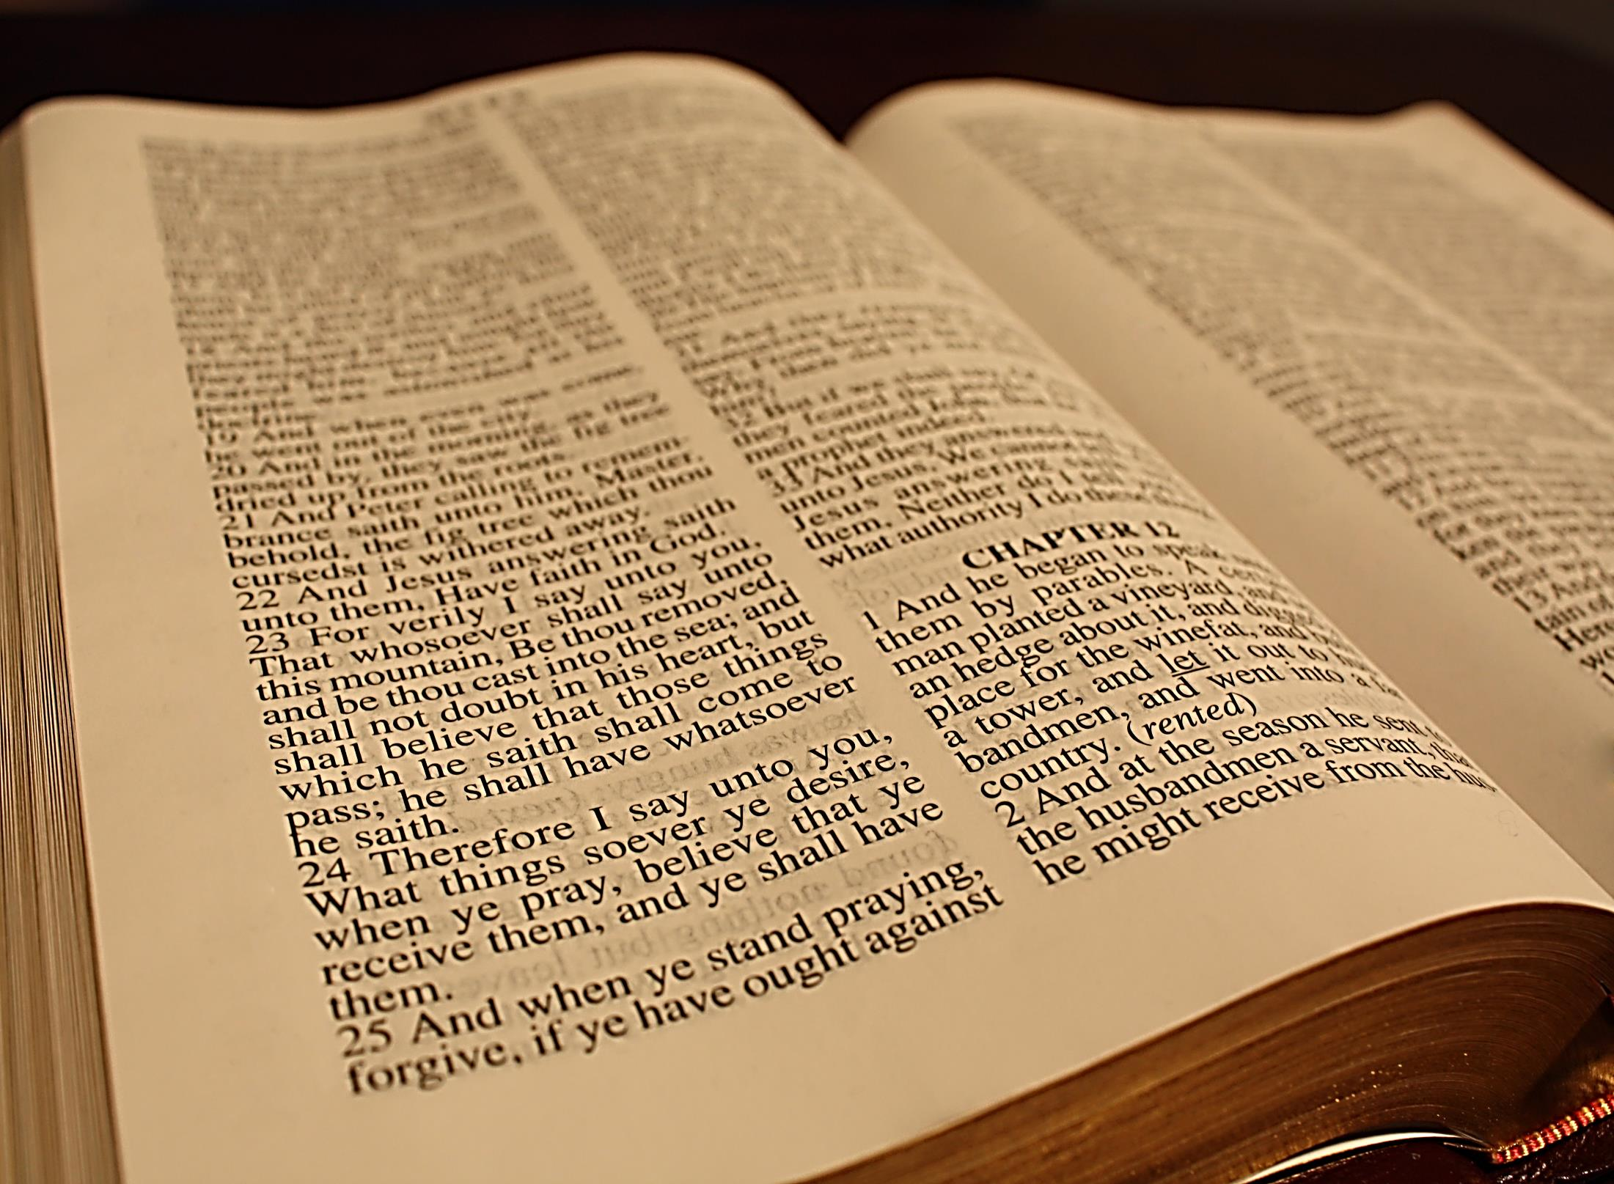

Slide 17
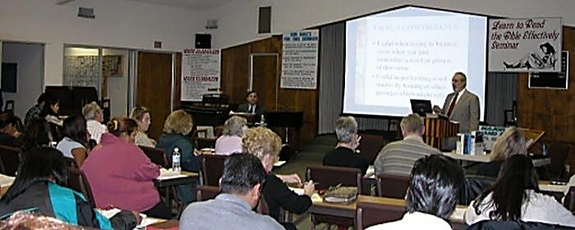

Slide 18
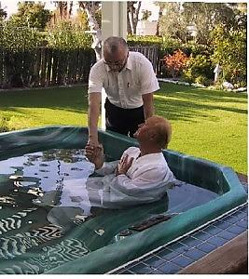

Slide 19
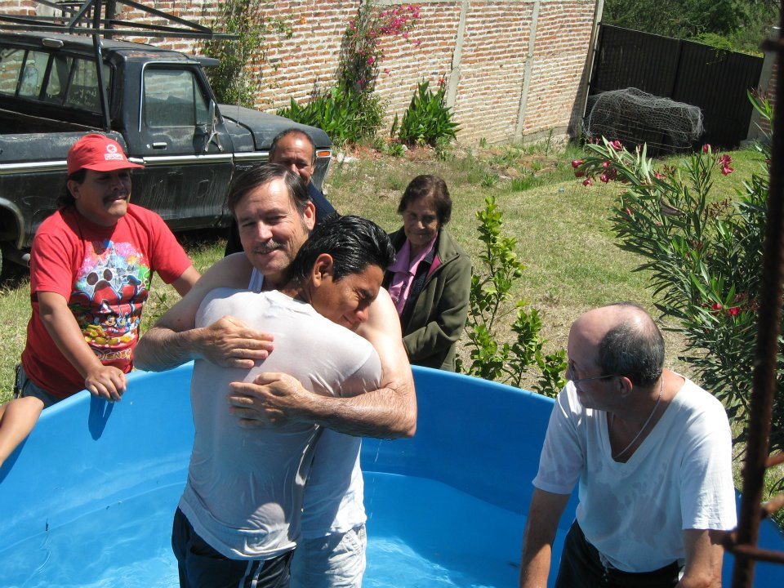

Slide 20


Slide 21
We are intended to experience the activity of the spirit in our lives – it is a gift of god!

Slide 22
The principle of the new creation

Slide 23

And the earth was without form, and void; and darkness was upon the face of the deep.

Slide 24

And the Spirit of God moved upon the face of the waters. And God said, Let there be light: and there was light. And God saw the light, that it was good: and God divided the light from the darkness.

Slide 25


Slide 26
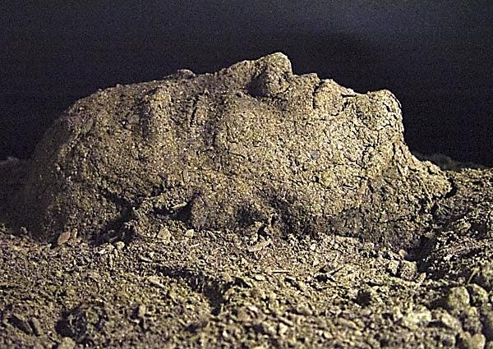
Hebrew: yatsar
to squeeze into shape, to mold into a form

Slide 27
man in his image
“And God said, Let us make man in our image, after our likeness: and let them have dominion over the fish of the sea, and over the fowl of the air, and over the cattle, and over all the earth, and over every creeping thing that creepeth upon the earth. So God created man in his own image, in the image of God created he him; male and female created he them.”
Genesis 1:26-30
tselem – a representative figure or idol – later used of Seth being born in Adam’s image. The word “likeness” is added to accentuate that it is about a physical manifestation. Surely, it meant more. Man was designed to be capable of fulfilling what Jesus Christ accomplished – to be the “express image of his person.” Heb. 1:3
Notes:
Selem – a representative figure or idol

Slide 28
Squeezed into shape, to fashion
“And the LORD God formed (yatsar) man of the dust of the ground, and breathed into his nostrils the breath of life; and man became a living soul.” Genesis 2:7
“And all the people brake off the golden earrings which were in their ears, and brought them unto Aaron. And he received them at their hand, and fashioned it with a graving tool, after he had made it a molten calf: and they said, These be thy gods, O Israel, which brought thee up out of the land of Egypt.” Exodus 32:3-4
“But now, O LORD, thou art our father; we are the clay, and thou our potter; and we all are the work of thy hand.” Isaiah 64:8

Slide 29
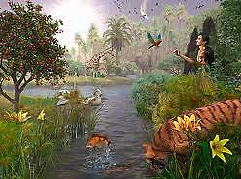
Man’s call to work
“And the Lord God planted a garden eastward in Eden; and there he put the man whom he had formed.” Genesis 2:8
“And the Lord God took the man, and put him into the garden of Eden to dress (till) it and to keep (guard) it.” Genesis 2:15
“And out of the ground the Lord God formed every beast of the field, and every fowl of the air; and brought them unto Adam to see what he would call them: and whatsoever Adam called every living creature, that was the name thereof. And Adam gave names to all cattle, and to the fowl of the air, and to every beast of the field; but for Adam there was not found an help meet for him.” Genesis 2:19-20

Slide 30
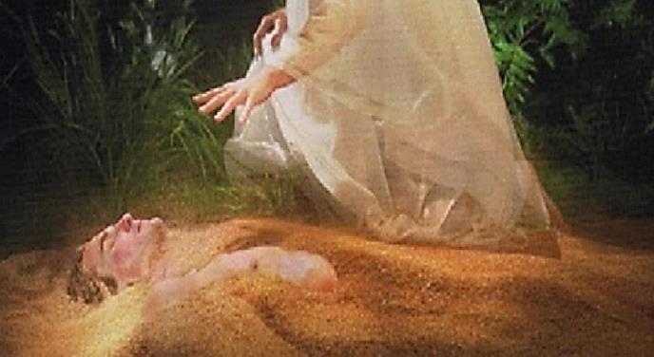
God’s Natural Creation
From the basic dust of the ground, God took Adam from useless soil to form a living being.
He shaped man in a way that he could be equipped to do all the tasks in the Garden – arms to lift, feet to walk, eyes to see, a back to bend.
But, more importantly, He formed man to have a mind that was capable of spiritual thought and fellowship with God – a habitation.
Man was the work of God’s hand – His handiwork or work of art – the standout of all His creation.
He was formed to be able to do work God intended him to do!

Slide 31
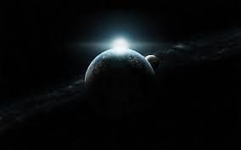
The Natural Creation
Began in darkness
A world without light and without hope
Man did nothing to assist in the creative process – he was unconscious
While in darkness, God sent Light
Adam was specifically formed for the work that was planned for him to do
It was the Spirit power that quickened Adam, with the breath of life making him a living being

Slide 32
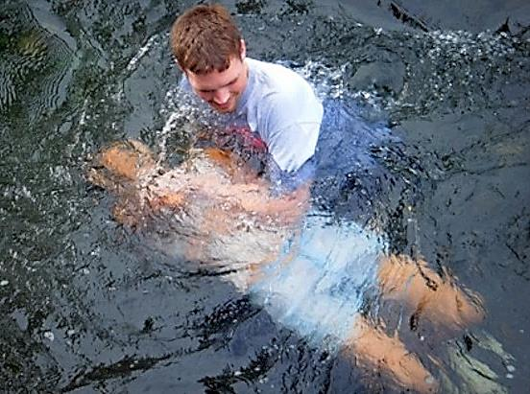
But, what About the Spiritual Creation?

Slide 33
The new creation
Man’s spiritual creation was out of darkness – he too was without form and void
Nothing about his spiritual creation was due to his own power, but the power of the Potter
It is the power of the Spirit that animates and quickens Man
God formed in Christ the New Man, in His image with a purpose
Man would be capable in the New Creation of either reflecting God’s character, or failing and adhering to the flesh – it would be with choice – just as was true with the new Ceation.

Slide 34
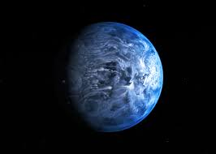
The New Creation
“In the beginning was the Word, and the Word was with God, and the Word was God. The same was in the beginning with God. All things were made by him; and without him was not any thing made that was made. In him was life; and the life was the light of men. And the light shineth in darkness; and the darkness comprehended it not.”
John 1:1-5

Slide 35
John 1:9-13
“That was the true Light, which lighteth every man that cometh into the world. He was in the world, and the world was made by him, and the world knew him not. He came unto his own, and his own received him not. But as many as received him, to them gave he power (exousia – privilege, capacity, competency) to become the sons of God, even to them that believe on his name: Which were born, not of blood, nor of the will of the flesh, nor of the will of man, but of God.”
This new Creation was formed on choice. The Light is available to all men, but they must choose it. If they do, they are born of God and given power to become the Sons of God.

Slide 36
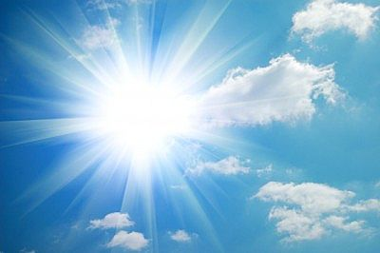
1 Peter 2:9
“But ye are a chosen generation, a royal priesthood, an holy nation, a peculiar people; that ye should shew forth the praises of him who hath called you out of darkness into his marvellous light:”

Slide 37
Created in Christ, workmanship
“For by grace are ye saved through faith; and that not of yourselves: it is the gift of God: Not of works, lest any man should boast. For we are his workmanship, created in Christ Jesus unto good works, which God hath before ordained that we should walk in them.”
Ephesians 2:9-10
“For we are God’s workmanship, created in Christ Jesus to do good works, which God prepared in advance for us to do.” NIV

Slide 38
Prepared in advance for us to do…
Suggests to us that the development that our Lord leads us through – even our trials – are not just “random” acts
God is developing us for specific work that He has planned in advance for us to do!
The learning and faith-building of today is critical for us to have the capability for performing that work
We need to be willing students and faithful in our trials

Slide 39
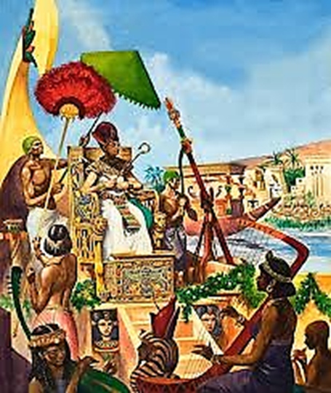
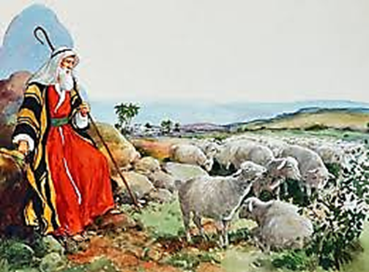
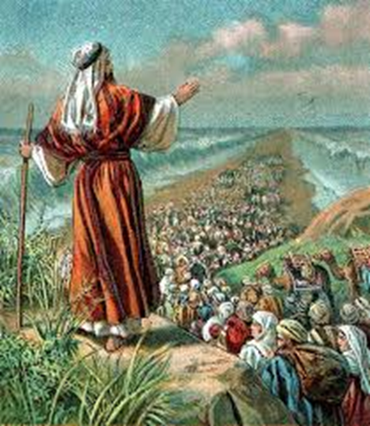
Prepared unto all good works - moses
40 Years in Wisdom of Egypt
40 Years in Midian
40 Years Leading Israel

Slide 40
Quickened by the spirit
John 6:63 - It is the spirit that quickeneth; the flesh profiteth nothing: the words that I speak unto you, they are spirit, and they are life.
Romans 6:11 – “…shall also quicken your mortal bodies by his Spirit that dwelleth in you.”
Ephesians 2:1 - And you hath he quickened, who were dead in trespasses and sins; 2:5 – Even when we were dead in sins, hath quickened us together with Christ…
Colossians 2:13 - And you, being dead in your sins and the uncircumcision of your flesh, hath he quickened together with him, having forgiven you all trespasses;”

Slide 41
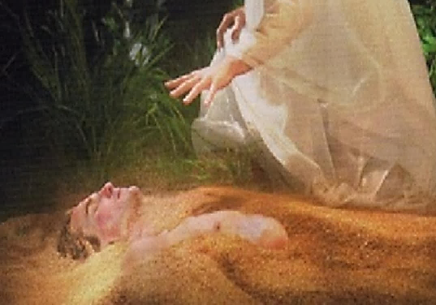
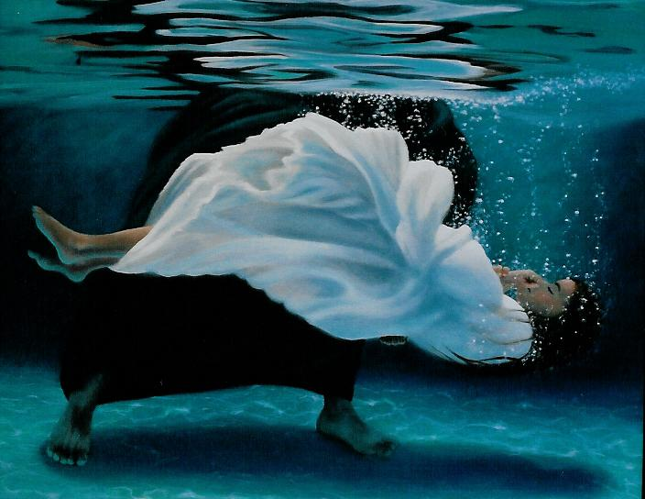
The two creations

Slide 42
Importance to this topic
It is always the Spirit of God that gives life – both in the physical creation and the spiritual
The Spirit “quickens” and delivers from darkness to new life
We are quickened in the new Creation to be “alive unto God through Jesus Christ our Lord” – NOW!
The Spirit’s new Creation begins a process within us to be free from sin and empowered unto all good works
It is this new Creation where both our Lord and his Father will make their abode
The Word provided has a lead role in this transformation

Slide 43
Questions to be examined
How does the Spirit “dwell” with believers today?
How specifically is the Spirit active?
Do we possess the Spirit or is it an ongoing relationship?
How is the Spirit involved in our prayers?
How are we to understand the work of the Spirit and the work of Jesus Christ?
What does it mean to be led by the Spirit?
What is the role of the Word in our Spirit-life?

Slide 44
flesh and spirit

Slide 45
Flesh and mind – each a will to sin!
“And you hath he quickened, who were dead in trespasses and sins; Wherein in time past ye walked according to the course of this world, according to the prince of the power of the air, the spirit that now worketh in the children of disobedience: Among whom also we all had our conversation in times past in the lusts of our flesh, fulfilling the desires of the flesh and of the mind; and were by nature the children of wrath, even as others.”
Ephesians 2:1-3

Slide 46
Mortify, Put to Death
“If ye then be risen with Christ, seek those things which are above, where Christ sitteth on the right hand of God. Set your affection on things above, not on things on the earth. For ye are dead, and your life is hid with Christ in God. When Christ, who is our life, shall appear, then shall ye also appear with him in glory. Mortify therefore your members which are upon the earth; fornication, uncleanness, inordinate affection, evil concupiscence, and covetousness, which is idolatry:”
Colossians 3:1-5
Verse 5 - “Put to death, therefore, whatever belongs to your earthly nature…” NIV

Slide 47
Mind of flesh or spirit dwelling in you?
“For they that are after the flesh do mind the things of the flesh; but they that are after the Spirit the things of the Spirit. For to be carnally minded is death; but to be spiritually minded is life and peace. Because the carnal mind is enmity against God: for it is not subject to the law of God, neither indeed can be. So then they that are in the flesh cannot please God. But ye are not in the flesh, but in the Spirit, if so be that the Spirit of God dwell in you. Now if any man have not the Spirit of Christ, he is none of his.”
Romans 8:5-9

Slide 48
In the flesh, or in the spirit?
“And if Christ be in you, the body is dead because of sin; but the Spirit is life because of righteousness. But if the Spirit of him that raised up Jesus from the dead dwell in you, he that raised up Christ from the dead shall also quicken your mortal bodies by his Spirit that dwelleth in you.”
Romans 8:10-11

Slide 49
My realization
The process of a life of a believer is not to modify or “improve” the mind of the flesh
Rather, there is NO VALUE in the mind of the flesh – it is to be completely deadened and subdued in our mortal life
The thinking of the flesh is enmity to God and CANNOT please Him
Therefore, a life in the Truth is not about adapting or modifying, but about a completely new character and way of thinking
This, I believe, is the primary role of the Spirit in our lives

Slide 50
L.g. sargent, “justified by faith”, 1949
“If the spirit is “in him” then he is embraced and included in “the Spirit”, as he was before included only in that which relates to “the flesh”. To be “in the Spirit”, while it is still to be in a mortal body, is at the same time to be related to an eternal environment which holds the promise of imperishable life: and all this Paul says in his vivid, elliptical language: “And if Christ be in you, the body is dead, because of sin; but the spirit is life because of righteousness”.

Slide 51
Dennis gillett, the genius of discipleship, 1984
“We have suggested already that an ordinary word for this exceptional condition is character. After all, the character of a person is expressed through his spirit, his tone, his disposition. Character is the revelation of what a man is—so is his spirit. Here then is something to mark first of all from the emphatic statement of Paul. The supreme and abiding test of ourselves is what we are internally. Our spirit is the reality, good or bad. As a man thinketh in his heart, so is he. It is not in the occasional external things that we do that the truth about ourselves is discovered. Nor is it in the careful premeditated things that we say that our hearts are truly revealed. God does not measure men by the occasional things but by the spirit.”

Slide 52
thirst for a more powerful spiritual life
“Now we have received, not the spirit of the world, but the spirit which is of God; that we might know the things that are freely given to us of God. Which things also we speak, not in the words which man's wisdom teacheth, but which the Holy Ghost teacheth; comparing spiritual things with spiritual. But the natural man receiveth not the things of the Spirit of God: for they are foolishness unto him: neither can he know them, because they are spiritually discerned.”
1 Corinthians 2:12-14

Slide 53
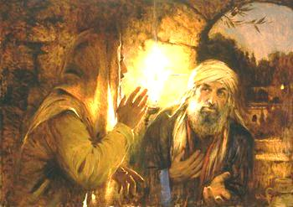
Nicodemus and the movement of the spirit
“Jesus answered and said unto him, Verily, verily, I say unto thee, Except a man be born again, he cannot see the kingdom of God.
That which is born of the flesh is flesh; and that which is born of the Spirit is spirit. Marvel not that I said unto thee, Ye must be born again. The wind bloweth where it listeth, and thou hearest the sound thereof, but canst not tell whence it cometh, and whither it goeth: so is every one that is born of the Spirit.”
John 3:3-8

Slide 54
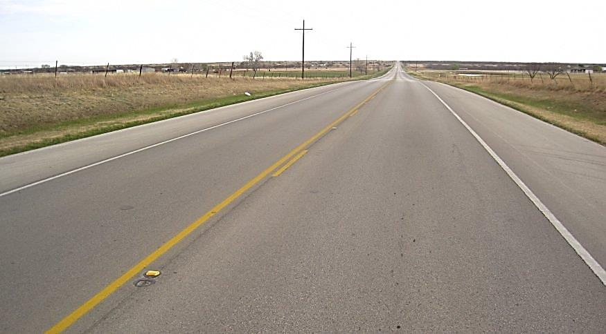

Slide 55
implications
Our primary role is to believe, to love and keep the commandments
When we do this, our spiritual minds become a place where our Lord will choose to operate and the Son and his Father promise to make their abode
We will likely not always understand where the Spirit is blowing or where it is going, BUT, we can experience its presence and acknowledge its power
We are safely under the control of our Master in all aspects of our lives

Slide 56
Tomorrow’s class
The Operation of the Spirit
How has God worked with men and women through the Spirit?

