Slide 1
Led by the Spirit
Class 2” “The Operation of the Spirit”
Winfield Bible School
August 2014

Slide 2
Connections from class 1
The activity of the Spirit is primarily about transforming the mind of the flesh to the mind of the Spirit
Our “contribution” is to believe, to love and to keep the commandments
The Spirit’s operation, under the control of our Lord, will be like the wind - we don’t control it and we don’t always know where it is taking us
But, we can rest assured that if our mind is a place where the Lord will abide, we are in safe hands

Slide 3
Class 2
How has the Spirit operated in the lives of men and women in Scripture?
By application, how can we understand the way God “prefers” to work with Men?
How did the activity of the Spirit shape lives and the spiritually-discerning minds?
What are the implications for believers today?

Slide 4
Spirit in the Old and new testaments
The Spirit in the life of believers is consistent between the Old and New Testament
God worked in lives of men and women to shape their thinking, bring about new awareness and strengthened faith and prepare them for future work
The Angels have always been intimately engaged in this work
While Spirit gifts existed at times, most development was through development of faith and a spiritual mind

Slide 5
Last commands from the lord
“And, being assembled together with them, commanded them that they should not depart from Jerusalem, but WAIT for the promise of the Father, which, saith he, ye have heard of me.”
Acts 1:4

Slide 6
Waiting on the LORD
“Wait on the LORD, be of good courage, and he shall strengthen thine heart: wait, I say, on the LORD.”
Psalm 27:3
WAIT!

Slide 7
example
“When they therefore were come together, they asked of him, saying, Lord, wilt thou at this time restore again the kingdom to Israel? And he said unto them, It is not for you to know the times or the seasons, which the Father hath put in his own power. But ye shall receive power, after that the Holy Ghost is come upon you: and ye shall be witnesses unto me both in Jerusalem, and in all Judaea, and in Samaria, and unto the uttermost part of the earth. And when he had spoken these things, while they beheld, he was taken up; and a cloud received him out of their sight.”
Acts 1:6-9

Slide 8
We might have a few questions!
When is this all going to happen? Wait how long?
Samaria? Really? Who is going to go to Samaria? When?
Who is going to go to the uttermost parts of the earth? When?
To preach to Jews only (as they had during Jesus’s ministry)?
Who is going to lead certain roles, such as caring for widows, preaching?
Do Gentiles need to keep the Law to be saved?

Slide 9
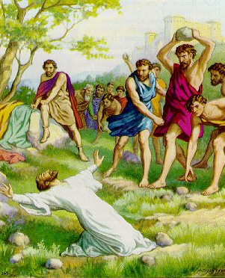
How these questions were answered
Persecution
Collaboration with those once unthinkable (Saul)
Debate and skillful use of Scripture
Murmurings and conflict
Brethren working out a Scripturally-based solution during a major conference after years of heated debate

Slide 10
The story of philip

Slide 11
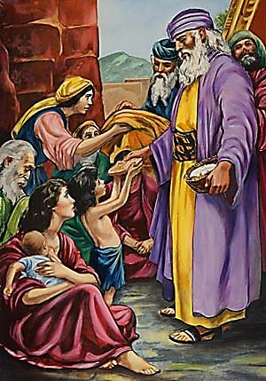
One of the seven
“And the saying pleased the whole multitude: and they chose Stephen, a man full of faith and of the Holy Ghost, and Philip, and Prochorus, and Nicanor, and Timon, and Parmenas, and Nicolas a proselyte of Antioch:
Whom they set before the apostles: and when they had prayed, they laid their hands on them.”
Acts 6:5-6

Slide 12
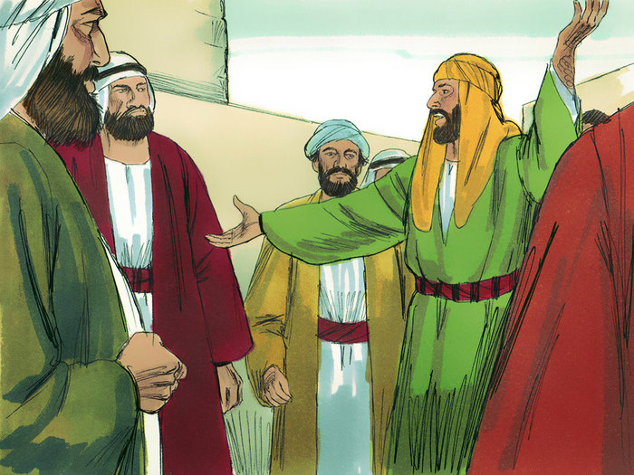
Persecution takes him to samaria
“Then Philip went down to the city of Samaria, and preached Christ unto them. And the people with one accord gave heed unto those things which Philip spake, hearing and seeing the miracles which he did. For unclean spirits, crying with loud voice, came out of many that were possessed with them: and many taken with palsies, and that were lame, were healed. And there was great joy in that city.”
Acts 8:5-8

Slide 13
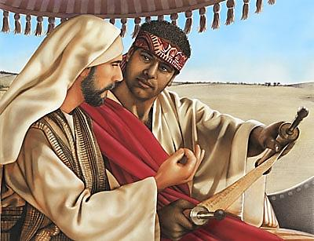
Dispatched by an angel
“And the angel of the Lord spake unto Philip, saying, Arise, and go toward the south unto the way that goeth down from Jerusalem unto Gaza, which is desert. And he arose and went: and, behold, a man of Ethiopia, an eunuch of great authority under Candace queen of the Ethiopians, who had the charge of all her treasure, and had come to Jerusalem for to worship, Was returning, and sitting in his chariot read Esaias the prophet.”
Acts 8:26-28

Slide 14
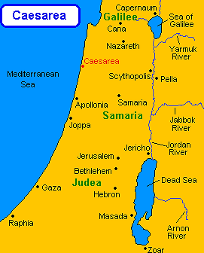
Ecclesias Established in Coastal Region
Apollonia
Lydda
Joppa
Saron
Caesarea

Slide 15
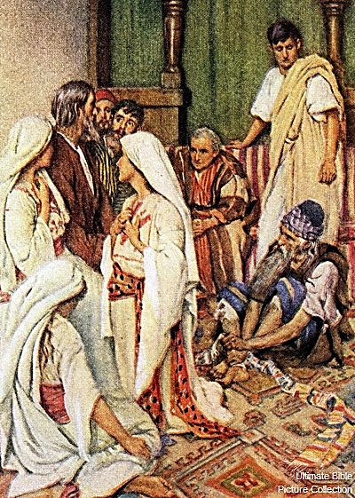
“And the next day we that were of Paul's company departed, and came unto Caesarea: and we entered into the house of Philip the evangelist, which was one of the seven; and abode with him. And the same man had four daughters, virgins, which did prophesy.”
Acts 21:8-9

Slide 16
For the disciple who said “yes”
Learned from example of Apostles in early work in Jerusalem
Came to understand the value of pastoral care as one of the seven
Learned the principles of early ecclesial formation in Samaria
Experienced the control of the Lord in all circumstances in Gaza
Formed ecclesias as he moved up coastline
Finally, all these lessons were put to use in his home ecclesia and family in Caesarea

Slide 17
The construction of the tabernacle

Slide 18
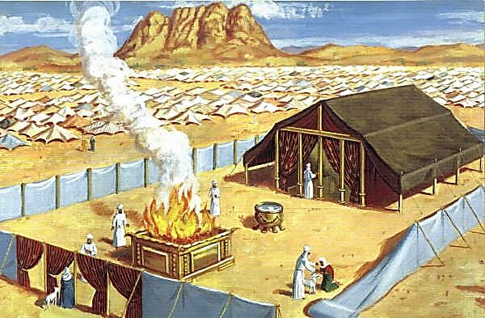

Slide 19
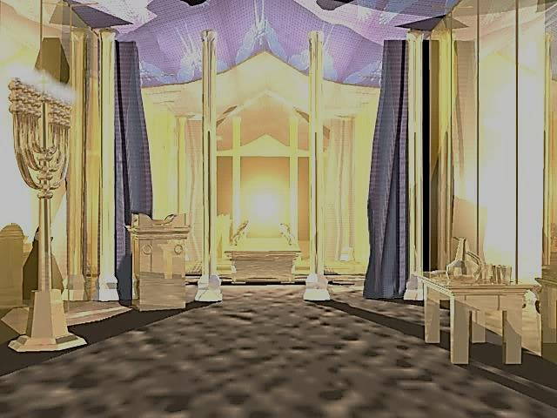

Slide 20
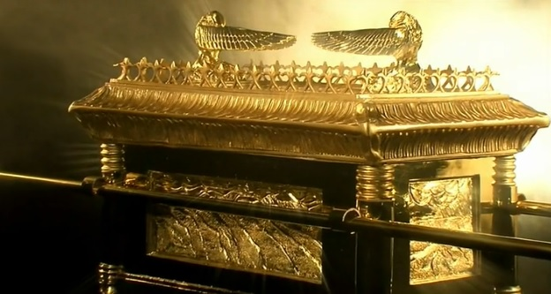

Slide 21
preparation for the work ahead
“And the Lord spake unto Moses, saying, See, I have called by name Bezaleel the son of Uri, the son of Hur, of the tribe of Judah: And I have filled him with the spirit of God, in wisdom, and in understanding, and in knowledge, and in all manner of workmanship, To devise cunning works, to work in gold, and in silver, and in brass, And in cutting of stones, to set them, and in carving of timber, to work in all manner of workmanship. And I, behold, I have given with him Aholiab, the son of Ahisamach, of the tribe of Dan: and in the hearts of all that are wise hearted I have put wisdom, that they may make all that I have commanded thee;”
Exodus 31:1-6

Slide 22
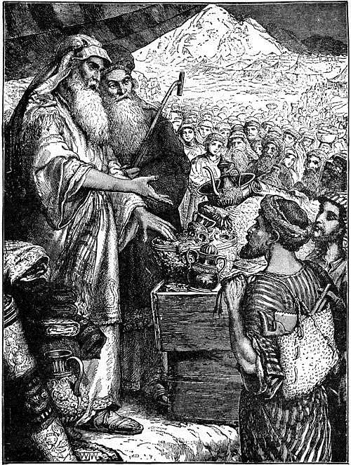
Exodus 31:1-6
Bezaleel was one of several that were Divinely inspired to do the physical workmanship of the Tabernacle in the Wilderness
Note, the gift was not just to guide his hands or increase his level of workmanship
He also was given wisdom, understanding and knowledge.
So, why was this detail given? Why not just give him the carpentry and trade skills?

Slide 23
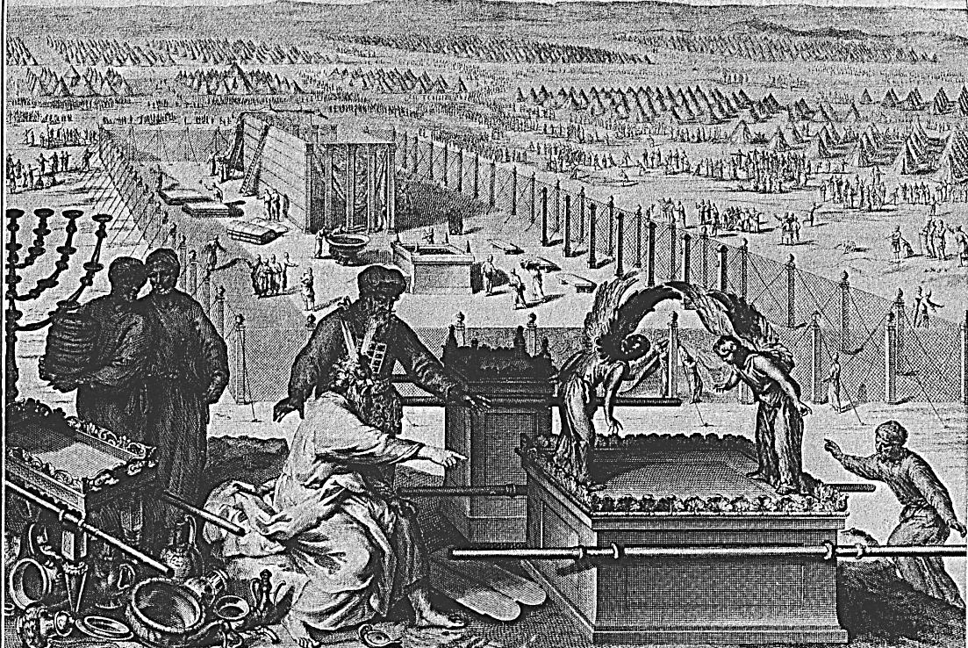
Not just about the work!
God desired Bezaleel to discern the spiritual significance of what he was building.
God wants us, through our work, to learn and gain spiritual insight
Bezaleel was blessed with the Spirit gift of workmanship, but it was matched with a mind focused on the Spirit

Slide 24
Perfected for work
“Now the God of peace, that brought again from the dead our Lord Jesus, that great shepherd of the sheep, through the blood of the everlasting covenant, Make you perfect in every good work to do his will, working in you that which is wellpleasing in his sight, through Jesus Christ; to whom be glory for ever and ever. Amen.”
Hebrews 13:20-21
perfect – “katartizo” – to complete thoroughly, to mend, repair, restore. Other uses, Galatians 6:1 – “restore such an one in the spirit of meekness”. Mark 1:19 – sons of Zebedee “mending” their nets.

Slide 25
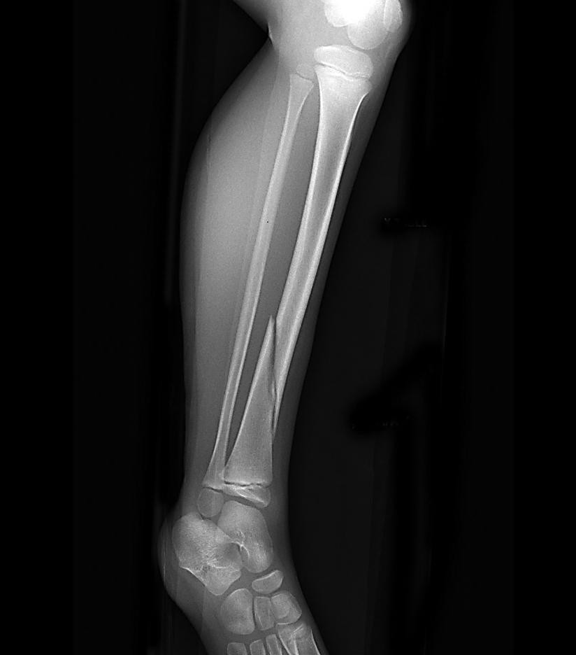
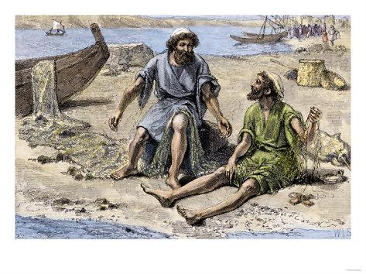
Restore - katartizo
The process the Lord employs in preparing us for work is usually gentle. He carefully repairs and restores a right mind. This doesn’t mean that major events will not occur, but that the Lord prefers to deal with as a still, small voice.

Slide 26
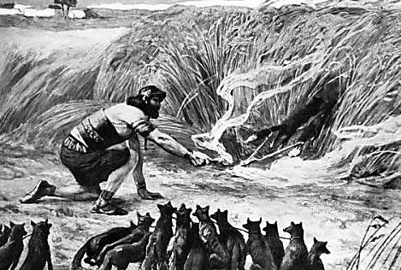
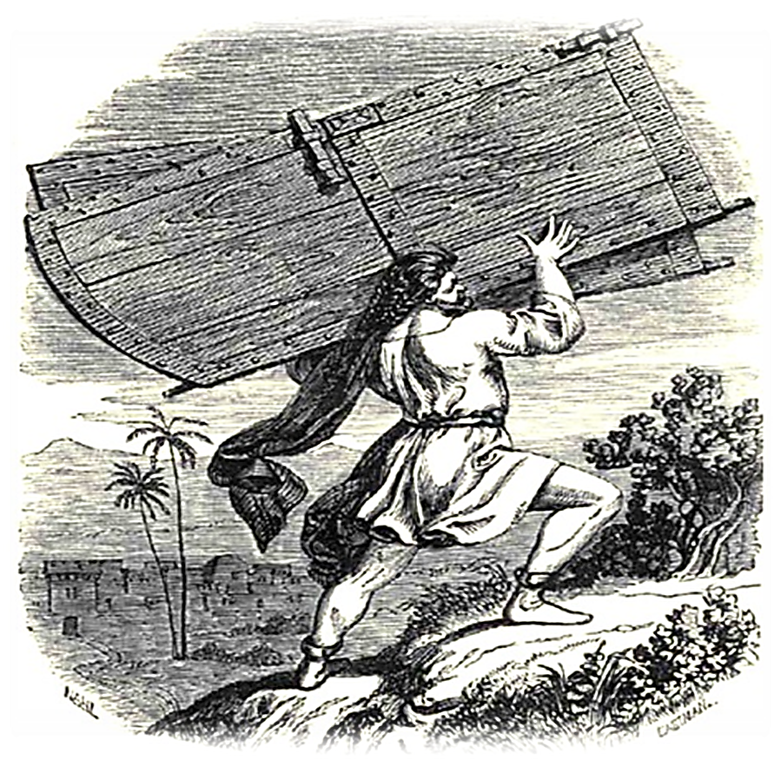
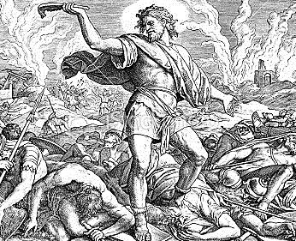
Samson

Slide 27
The spirit and samson
“And the Spirit of the Lord began to move him at times in the camp of Dan between Zorah and Eshtaol.”
Judges 13:25
“And the Spirit of the Lord came mightily upon him, and he rent him as he would have rent a kid, and he had nothing in his hand: but he told not his father or his mother what he had done.”
Judges 14:6

Slide 28
Judges 13:25, 14:6
The word translated “move” in Judges 13:25 is “paam” which means to impel or agitate.
In 14:6, the word “mightily” is “tsalach” which means to push.
Do you believe he was fully conscious at all times of the goading as being from God?
If without the push and goadings, would Samson have been responsive to the work before him?

Slide 29
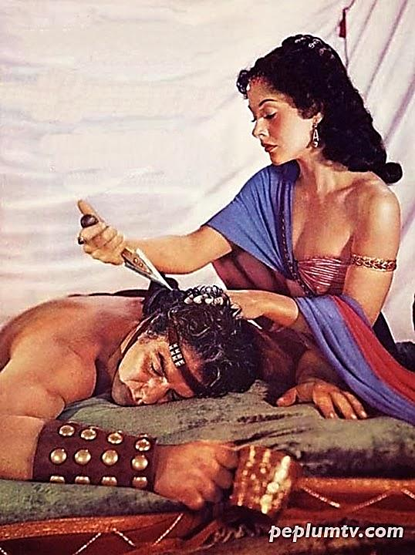
But, after participating in lust of flesh…
“And she said, The Philistines be upon thee, Samson. And he awoke out of his sleep, and said, I will go out as at other times before, and shake myself. And he wist not that the Lord was departed from him. But the Philistines took him, and put out his eyes, and brought him down to Gaza, and bound him with fetters of brass; and he did grind in the prison house.”
Judges 16:20-22

Slide 30
Spirit departed
“I will go out as at other times before, and shake myself. And he wist not that the Lord was departed from him.”
Samson’s story goes like this…
1. Moved by Spirit to do work as a Judge and deliver from Philistines
God was with him, to include Spirit gifts
But, he became an inadequate habitation for the Spirit
Self-examination broken, he wasn’t aware that God was not with him
Without God, he was delivered to prison house in bonds of slavery

Slide 31
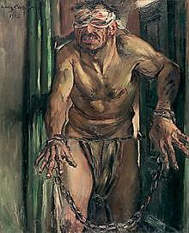
Once he came to his right mind in prison…
“And Samson called unto the Lord, and said, O Lord God, remember me, I pray thee, and strengthen me, I pray thee, only this once, O God, that I may be at once avenged of the Philistines for my two eyes.”
Judges 16:28

Slide 32
Compare to new testament counsel
“And by this we know that we have come to know him, if we keep his commandments. Whoever says “I know him” but does not keep his commandments is a liar, and the truth is not in him, but whoever keeps his word, in him truly the love of God is perfected. By this we may know that we are in him: whoever says he abides in him ought to walk in the same way in which he walked.”
1 John 2:3-6

Slide 33
“lamad” – to teach or goad
“Teach me to do thy will; for thou art my God: thy spirit is good; lead me into the land of uprightness. Quicken me, O LORD, for thy name's sake: for thy righteousness' sake bring my soul out of trouble.”
Psalm 143:10-11
“Shew me thy ways, O Lord; teach me thy paths.”
Psalm 25:4
The Hebrew word for “teach” is “lamad” or to goad. It is not purely academic, but involves active instruction, correction.

Slide 34
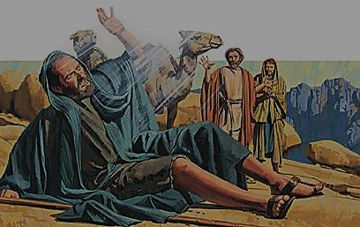
And he fell to the earth, and heard a voice saying unto him, Saul, Saul, why persecutest thou me? And he said, Who art thou, Lord? And the Lord said, I am Jeus whom thou persecutest: it is hard for thee to kick against the pricks.” Acts 9:5

Slide 35
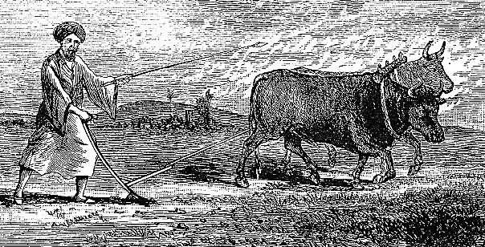
“goading” of saul
Saw the faith of believers he was persecuting
Later he reveals that he had an awareness of being “exceedingly mad” or raging fury (ESV)
He heard the counsel of Gamaliel, but they had only continued to grow and thrive.
He witnessed the words of Stephen, which no scholar could refute
When he persecuted in Jerusalem, he saw new “fires” burning in other cities
Finally, it required a physical act to stop Saul in his tracks!

Slide 36
1 Samuel 16:13
“Then Samuel took the horn of oil, and anointed him in the midst of his brethren: and the Spirit of the LORD came upon David from that day forward. So Samuel rose up, and went to Ramah.”
The word here is “tsalach” or to push.

Slide 37
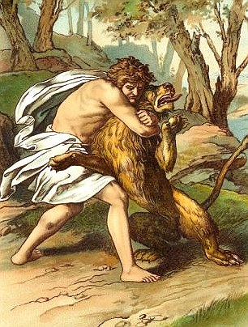
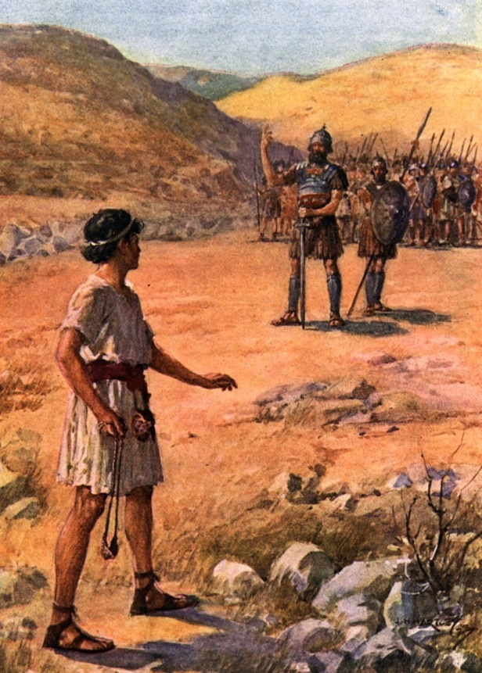
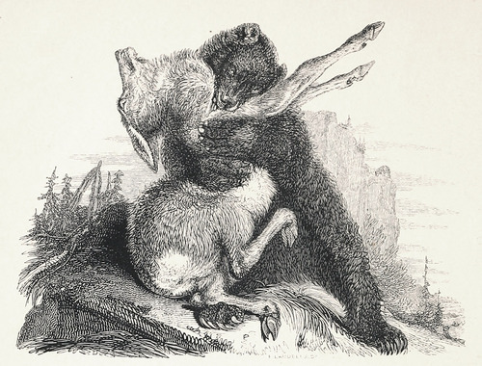
Preparing david for goliath?
“David said moreover, The LORD that delivered me out of the paw of the lion, and out of the paw of the bear, he will deliver me out of the hand of this Philistine. And Saul said unto David, Go, and the LORD be with thee.” 1 Samuel 17:37

Slide 38
application
We also are “goaded” or pushed along
This may come through the reading of the Word
But certainly it must also come through the control of circumstances in our lives – the work of the Angels
We need to change course, to grow, to learn – and the work of the Lord is to push us in the right direction
The goading, if we respond, prepares us for good works and a strong faith that will be required in the future

Slide 39
God dwells with contrite and humble
“For thus saith the high and lofty One that inhabiteth eternity, whose name is Holy; I dwell in the high and holy place, with him also that is of a contrite and humble spirit, to revive the spirit of the humble, and to revive the heart of the contrite ones. For I will not contend for ever, neither will I be always wroth: for the spirit should fail before me, and the souls which I have made. For the iniquity of his covetousness was I wroth, and smote him: I hid me, and was wroth, and he went on frowardly in the way of his heart. I have seen his ways, and will heal him: I will lead him also, and restore comforts unto him and to his mourners.”
Isaiah 57:15-18

Slide 40
God’s involvement with the humble/contrite
“revive the spirit”
Lead
Heal
Restore
Create the fruit of the lips – “sacrifice of praise” - Heb. 13

Slide 41
How god leads believers
“And it came to pass, when Pharaoh had let the people go, that God led them not through the way of the land of the Philistines, although that was near; for God said, Lest peradventure the people repent when they see war, and they return to Egypt: But God led the people about, through the way of the wilderness of the Red sea: and the children of Israel went up harnessed out of the land of Egypt.”
Exodus 13:17-18

Slide 42
Exodus 15:23-27
“And when they came to Marah, they could not drink of the waters of Marah, for they were bitter: therefore the name of it was called Marah. And the people murmured against Moses, saying, What shall we drink? And he cried unto the LORD; and the LORD shewed him a tree, which when he had cast into the waters, the waters were made sweet: there he made for them a statute and an ordinance, and there he proved them, And said, If thou wilt diligently hearken to the voice of the LORD thy God, and wilt do that which is right in his sight, and wilt give ear to his commandments, and keep all his statutes, I will put none of these diseases upon thee, which I have brought upon the Egyptians: for I am the LORD that healeth thee. And they came to Elim, where were twelve wells of water, and threescore and ten palm trees: and they encamped there by the waters.”

Slide 43
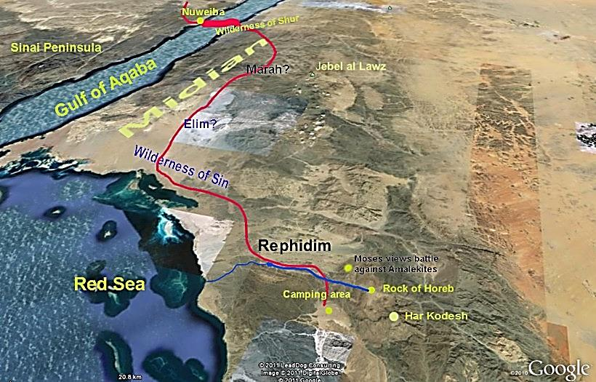

Slide 44
Spiritual insights
Israel was unwilling to rely on God when there was no visible evidence to do so!
If they trusted in Him, His plan would have been to care for all their needs just a couple of days later – likely sufficient for their needs
But, instead of trusting and growing, they murmured
God still, through Moses, provided what they asked for
But it was a missed opportunity for spiritual growth and discernment
What a spiritually discerning mind would have noted is that God had brought them through the desert, opened the Sea, destroyed the Egyptians and provided the pilar of fire and cloud by day – surely He would not have them die of thirst in the Wilderness!

Slide 45
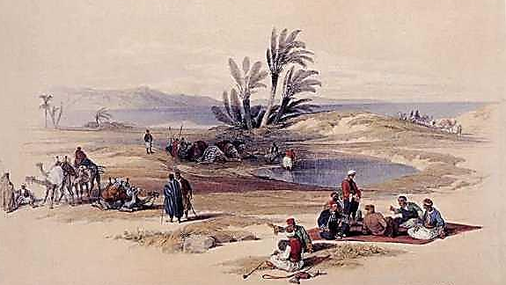
What are the elim’s of our spiritual lives?

Slide 46
Psalm 78:38-42
“But he, being full of compassion, forgave their iniquity, and destroyed them not: yea, many a time turned he his anger away, and did not stir up all his wrath. For he remembered that they were but flesh; a wind that passeth away, and cometh not again. How oft did they provoke him in the wilderness, and grieve him in the desert! Yea, they turned back and tempted God, and limited the Holy One of Israel. They remembered not his hand, nor the day when he delivered them from the enemy.”

Slide 47
How often?
Do we find ourselves wondering why things couldn’t be easier? (difficulties in the ecclesia, repair of relationships, success in preaching)
Do we forget that the Lord is leading our journey and knows all our needs?
Is the weakness of our faith assessed by God as needing special care and less direct roads?
Do we “limit” the Holy one of Israel?

Slide 48
Leading not into temptation
“After this manner therefore pray ye: Our Father which art in heaven, Hallowed be thy name. Thy kingdom come. Thy will be done in earth, as it is in heaven. Give us this day our daily bread. And forgive us our debts, as we forgive our debtors. And lead us not into temptation, but deliver us from evil: For thine is the kingdom, and the power, and the glory, for ever. Amen.”
Matthew 6:9-13

Slide 49
Implications of this prayer
God has a full assessment of what we can and cannot handle
He will take us the way of the “wilderness of the Red Sea” to avoid overwhelming obstacles
His work with us is to increase our faith, that the man of God may be “throughly furnished”
He will goad or push us into paths that build faith and avoid sin

Slide 50
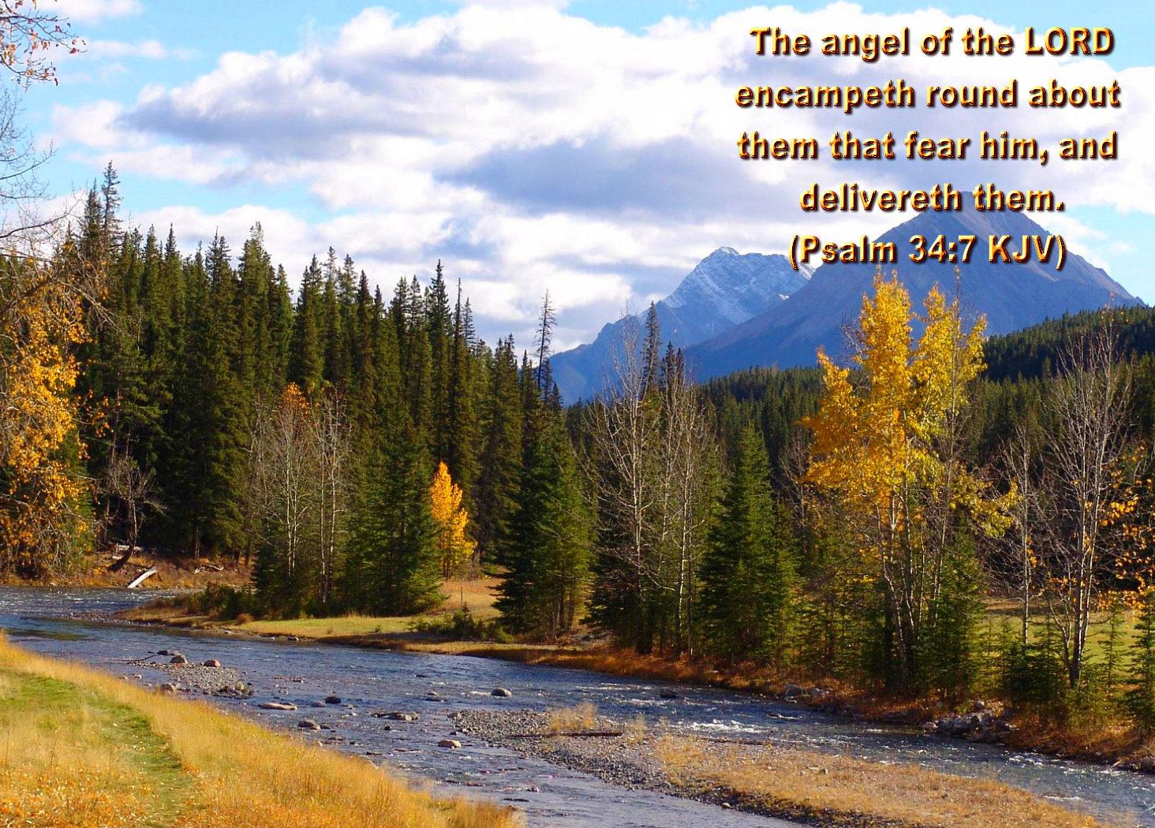

Slide 51
the new testament
Do we find these same influences and Divine movements being promised to believers?

Slide 52
God working through men
“But he that doeth truth cometh to the light, that his deeds may be made manifest, that they are wrought in God.” John 3:21
“And when they were come to Jerusalem, they were received of the church, and of the apostles and elders, and they declared all things that God had done with them.” Acts 15:4
“And when he had saluted them, he declared particularly what things God had wrought among the Gentiles by his ministry.” Acts 21:19

Slide 53
Ephesians 4:20-24
“But ye have not so learned Christ; If so be that ye have heard him, and have been taught by him, as the truth is in Jesus: That ye put off concerning the former conversation the old man, which is corrupt according to the deceitful lusts; And be renewed in the spirit of your mind; And that ye put on the new man, which after God is created in righteousness and true holiness.”
“learned” is “manthano.” Vines defines as “not merely the doctrine of Christ, but Christ himself.” Not merely getting to know the person, but so applying the knowledge to walk differently.”
This “process” is a continual renewal process. It is the “renewing of the spirit of your mind.”

Slide 54
Hebrews 12:5-7,10-11
“And ye have forgotten the exhortation which speaketh unto you as unto children, My son, despise not thou the chastening of the Lord, nor faint when thou art rebuked of him: For whom the Lord loveth he chasteneth, and scourgeth every son whom he receiveth. If ye endure chastening, God dealeth with you as with sons; for what son is he whom the father chasteneth not? For they verily for a few days chastened us after their own pleasure; but he for our profit, that we might be partakers of his holiness. Now no chastening for the present seemeth to be joyous, but grievous: nevertheless afterward it yieldeth the peaceable fruit of righteousness unto them which are exercised thereby.”

Slide 55
Our goading – hebrews 12
“chastening” is the Greek word, “paideia” or tutoring, education, correction, discipline.
God works with us this way. The result is that we either accept it and know that he is doing this for our good, or we rebel against it.
The question is, what am I supposed to learn from this? How is God trying to educate or teach me? How is this teaching me to be more holy?
If we do this, then it provides us with the “peaceable fruit of righteousness unto them which are exercised there by.”
Exercised is “gymnazo” which means to practice or train for a race or Olympic competition.

Slide 56
Our Spiritual Condition Before Belief
“Giving thanks unto the Father, which hath made us meet to be partakers of the inheritance of the saints in light: Who hath delivered us from the power of darkness, and hath translated us into the kingdom of his dear Son: In whom we have redemption through his blood, even the forgiveness of sins: Who is the image of the invisible God, the firstborn of every creature: For by him were all things created, that are in heaven, and that are in earth, visible and invisible, whether they be thrones, or dominions, or principalities, or powers: all things were created by him, and for him: And he is before all things, and by him all things consist.”
Colossians 1:12-17

Slide 57
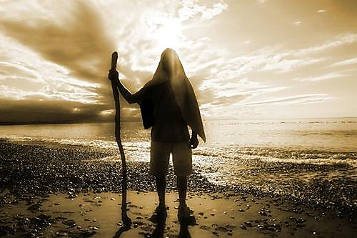
translated
“And Enoch also, the seventh from Adam, prophesied of these, saying, Behold, the Lord cometh with ten thousands of his saints, To execute judgment upon all, and to convince all that are ungodly among them of all their ungodly deeds which they have ungodly committed, and of all their hard speeches which ungodly sinners have spoken against him.”
Jude 14-15
“By faith Enoch was translated that he should not see death; and was not found, because God had translated him: for before his translation he had this testimony, that he pleased God.”
Hebrews 11:5
“translated” – metathesis – a change of position, re-established
In John 5:24 – “but is passed from death to life.”

Slide 58
How are we like enoch?
Enoch, a righteous man of the Sons of God
He witnessed to the sinful, godless of his day
Likely, he would have been murdered by them, had not God “relocated” him, or as the Peshitta says, he “disappeared; for God took him away.”
We too, are precious to our Lord
He protects us and saves us, not only from the evil hands of men, but by the destruction of sin
He, through Christ, secures us and abides with us!

Slide 59
1 Thessalonians 4:3-9
“For this is the will of God, even your sanctification, that ye should abstain from fornication: That every one of you should know how to possess his vessel in sanctification and honour; Not in the lust of concupiscence, even as the Gentiles which know not God: That no man go beyond and defraud his brother in any matter: because that the Lord is the avenger of all such, as we also have forewarned you and testified. For God hath not called us unto uncleanness, but unto holiness. He therefore that despiseth, despiseth not man, but God, who hath also given unto us his holy Spirit. But as touching brotherly love ye need not that I write unto you: for ye yourselves are taught of God to love one another.”

Slide 60
1 Corinthians 6:13-20
“Meats for the belly, and the belly for meats: but God shall destroy both it and them. Now the body is not for fornication, but for the Lord; and the Lord for the body. And God hath both raised up the Lord, and will also raise up us by his own power. Know ye not that your bodies are the members of Christ? shall I then take the members of Christ, and make them the members of an harlot? God forbid. What? know ye not that he which is joined to an harlot is one body? for two, saith he, shall be one flesh. But he that is joined unto the Lord is one spirit. Flee fornication. Every sin that a man doeth is without the body; but he that committeth fornication sinneth against his own body. What? know ye not that your body is the temple of the Holy Ghost which is in you, which ye have of God, and ye are not your own? For ye are bought with a price: therefore glorify God in your body, and in your spirit, which are God's.”

Slide 61
summary
The activity of God through His Spirit has been consistent for believers since Eden
There is an intimacy – not one size fits all – He knows YOU and your needs
If we forsake sin, the Father and Son will make their abode with us
He is shaping our minds to be like His
He is readying us for work that He has prepared in advance for us to do
He moves us, guides us, GOADS us in the right direction
He intends for us to find great comfort and encouragement from His work in our lives

Slide 62
Hymn 142
God moves in a mysterious way, His wonders to perform;
He plants His footsteps in the sea, and rides upon the storm.
Deep in unfathomable mines of never-failing skill,
He treasures up His bright designs, and works His sovereign will.
Ye fearful saints, fresh courage take, the clouds ye so much dread,
Are big with mercy, and will break in blessings on your head.
His purposes will ripen fast, unfolding every hour;
The bud may have a bitter taste, but sweet will be the flower.
Blind unbelief is sure to err, and scan his work in vain;
God is His own interpreter, And He will make it plain.

Slide 63
Next class
Abba, Father
A look at how God invites us into an intimate relationship with Him through His Son

