Slide 1
Led By the spirit
Class 3 - Abba, Father!
Winfield Bible School
August 2014

Slide 2
Summary of class 2
The activity of God through His Spirit has been consistent for believers since Eden
There is an intimacy – not one size fits all – God knows YOU and your needs
If we forsake sin, the Father and Son will make their abode with us
He is shaping our minds to be like His
He is readying us for work that He has prepared in advance for us to do
He moves us, guides us, GOADS us in the right direction
He intends for us to find great comfort and encouragement from His work in our lives

Slide 3
Being led by the spirit demands a relationship

Slide 4
Relationship and the spirit’s activity in our lives
The stronger our relationship, the more visible the process is – we can see the hand of God active now, not only in hindsight
We are more likely to bring our petitions to our God to help us with our weakness of faith and inadequacies
When we fail, we can rely on the goodness of God to revive us and nurture us like a Father

Slide 5
A thirst for god
“As the hart panteth after the water brooks, so panteth my soul after thee, O God. My soul thirsteth for God, for the living God: when shall I come and appear before God?”
Psalm 42:1-2

Slide 6
Psalm 63:1-4
“O God, thou art my God; early will I seek thee: my soul thirsteth for thee, my flesh longeth for thee in a dry and thirsty land, where no water is; To see thy power and thy glory, so as I have seen thee in the sanctuary. Because thy lovingkindness is better than life, my lips shall praise thee. Thus will I bless thee while I live: I will lift up my hands in thy name.”

Slide 7
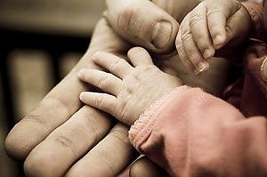
Abba, father

Slide 8
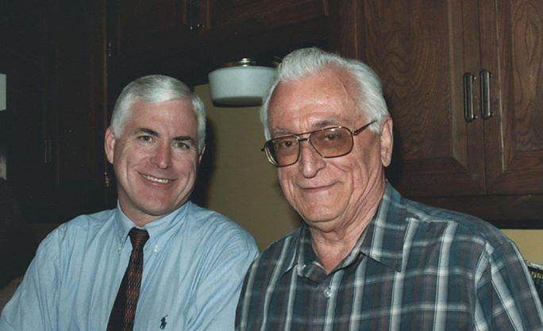

Slide 9
Learning from our father in the flesh
He taught me manners, values, the Truth – even how to throw a curveball!
I always knew he would be there to protect and help when needed
He seemed to enjoy spending time with me, even though I knew he might well have wanted to do other things
When I failed or let him down, I knew he still loved me
He seemed to take joy in my small accomplishments
He was there when I grew into manhood as a trusted confidant that was only interested in my best interest
I learned from him a great lesson of devotion as he cared for my mom

Slide 10
What it required from me
To trust in the love and wisdom of my father
To believe that I was worthy of being loved
For me to do what I could to remain worthy of his love

Slide 11
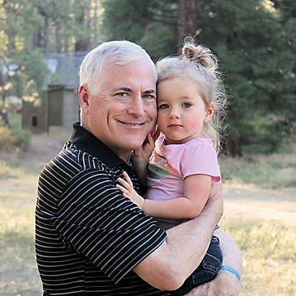

Slide 12
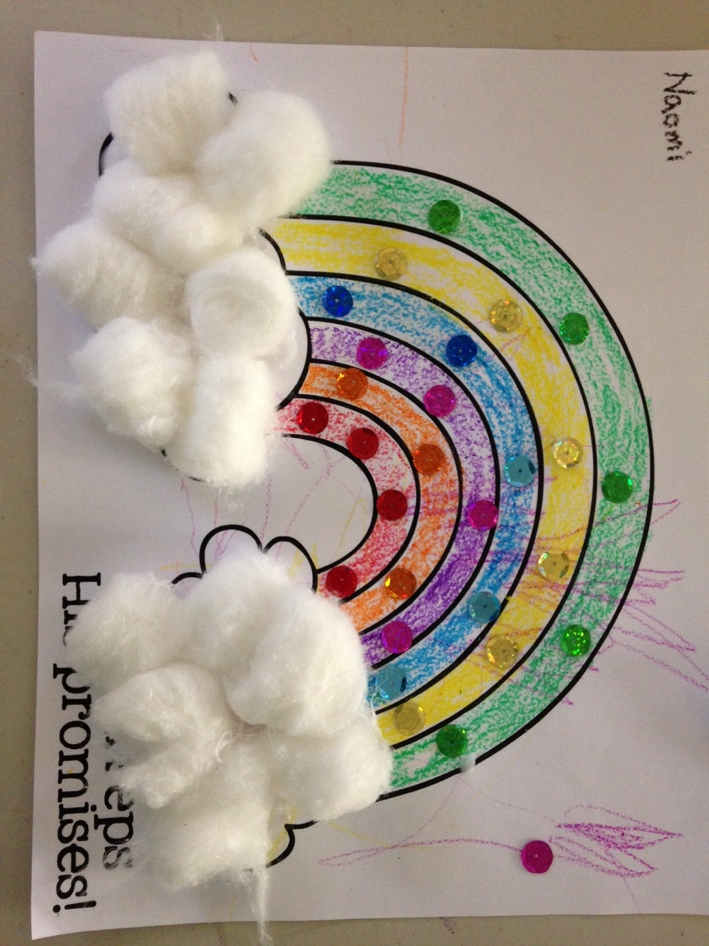

Slide 13
God is not just our father in heaven. He is a perfect father. He is the father that we all wish we were to our children.

Slide 14
Psalm 147:11
“The Lord taketh pleasure in them that fear him, in those that hope in his mercy.”

Slide 15
Isaiah 41:8-13
“But thou, Israel, art my servant, Jacob whom I have chosen, the seed of Abraham my friend. Thou whom I have taken from the ends of the earth, and called thee from the chief men thereof, and said unto thee, Thou art my servant; I have chosen thee, and not cast thee away. Fear thou not; for I am with thee: be not dismayed; for I am thy God: I will strengthen thee; yea, I will help thee; yea, I will uphold thee with the right hand of my righteousness. Behold, all they that were incensed against thee shall be ashamed and confounded: they shall be as nothing; and they that strive with thee shall perish. Thou shalt seek them, and shalt not find them, even them that contended with thee: they that war against thee shall be as nothing, and as a thing of nought. For I the Lord thy God will hold thy right hand, saying unto thee, Fear not; I will help thee.”

Slide 16
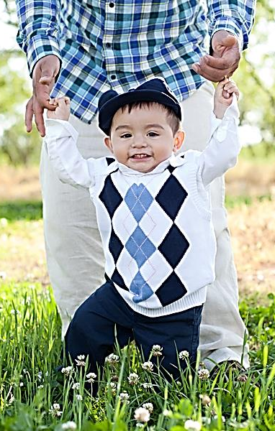
God as a loving father
“When Israel was a child, I loved him, and out of Egypt I called my son. The more they were called, the more they went away; they kept sacrificing to the Baals and burning offerings to idols. Yet it was I who taught Ephraim to walk; I took them up by their arms, but they did not know that I healed them. I led them with cords of kindness, with the bands of love, and I became to them as one who eases the yoke on their jaws, and I bent down to them and fed them.”
Hosea 11:1-4 (ESV)

Slide 17
Obstacles in realizing god is our father
The first is a natural tendency to regard Him as a Figure in the Heavens, whose majesty makes Him remote from mankind.
The second is to attribute human characteristics to God – the eyes of the LORD, His “holy arm” - and make him “a Person”. A “coziness” that some might falsely assume.
A third obstacle arises from our natural sense of unworthiness, a strong impression of His holiness, and therefore the conclusion that however merciful He would wish to be, He cannot really forgive us.

Slide 18
Do we really appreciate the love of god?
He enjoys seeing us grow spiritually
He longs to be part of our nurturing and development
He feels our infirmities and groans
He must take pleasure when we come to Him in love and from a willing heart
Even in our feeble service, He must feel a sense of affection

Slide 19
“Abba, Father”
The phrase appears three times in Scripture
It first speaks first of an intimacy of our Lord to his Father
But represents to us what has been made possible through Christ – that we too can say “Abba, Father.”
It is about our relationship with God in the fight against sin
It is a witness to us that we are adopted sons and daughters
It is connected with the Spirit’s advocacy in our prayers
Abba, Father allows us to accept our vulnerabilities and know that He loves us, despite our failings

Slide 20
Ultimately, how can more fully live an
“abba, father” life?

Slide 21
Three occurrences in scripture
Mar. 14:36 And he said, Abba, Father, all things are possible unto thee; take away this cup from me: nevertheless not what I will, but what thou wilt.
Rom. 8:15 For ye have not received the spirit of bondage again to fear; but ye have received the Spirit of adoption, whereby we cry, Abba, Father.
Gal. 4:6 And because ye are sons, God hath sent forth the Spirit of his Son into your hearts, crying, Abba, Father.

Slide 22
abba
Strong’s
Abbá – "Father," also used as the term of tender endearment by a beloved child – i.e. in an affectionate, dependent relationship with their father; "daddy," "papa."
Compare to Abram – “high father” and Abraham – “father of a multitude”

Slide 23
The father’s affection for his son
At his baptism: “This is my beloved Son, in whom I am well pleased.”
At the transfiguration: “This is my beloved Son, in whom I am well pleased; hear ye him.”
An angel sustained him in Gethsemane

Slide 24
Jesus’s knowledge of his father’s love
“For he whom God hath sent speaketh the words of God: for God giveth not the Spirit by measure unto him. The Father loveth the Son, and hath given all things into his hand.”
John 3:34-35
“Then answered Jesus and said unto them, Verily, verily, I say unto you, The Son can do nothing of himself, but what he seeth the Father do: for what things soever he doeth, these also doeth the Son likewise. For the Father loveth the Son, and sheweth him all things that himself doeth: and he will shew him greater works than these, that ye may marvel.”
John 5:19-20

Slide 25
Praying before selection of apostles
“And it came to pass in those days, that he went out into a mountain to pray, and continued all night in prayer to God.”
Luke 6:12

Slide 26
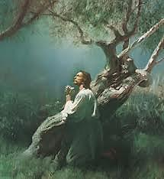
Mark 14:33-36
“And he taketh with him Peter and James and John, and began to be sore amazed, and to be very heavy; And saith unto them, My soul is exceeding sorrowful unto death: tarry ye here, and watch. And he went forward a little, and fell on the ground, and prayed that, if it were possible, the hour might pass from him. And he said, Abba, Father, all things are possible unto thee; take away this cup from me: nevertheless not what I will, but what thou wilt.”

Slide 27
Other translations
perilupos - grieved all around, that is, intensely sad: - exceeding (very) sorry (-owful).
…`Exceeding sorrowful is my soul -- to death” YLT
“…and began to dread, and to be distressed. And he said to them, My soul is sorrowful to the death…” Wycliffe
“My heart is oppressed with anguish to the very point of death:” Weymouth

Slide 28
a.d. norris, 1951
“We became sons of God not because we decided we would, but because God decided He would accept us, and we were confronted with His offer for our acceptance. All things are of God. The most touching demonstration of it is an event in the Garden. When the Son of God cried in his agony in Gethsemane, “My Father, if it be possible let this cup pass from me; nevertheless, not my will, but thine, be done”, he showed again that it was not in the strength of man that even this battle was won. And there appeared an angel from heaven, strengthening him. He was heard in that he feared. A confession of weakness was just what was required at such a moment, and it was greeted with the response it desired. The work must be accomplished, not in the pride of human achievement—which would be defeated—but in trust towards God. The trust was shown and was rewarded.”

Slide 29
Strength given after accepting god’s will
“Saying, Father, if thou be willing, remove this cup from me: nevertheless not my will, but thine, be done. And there appeared an angel unto him from heaven, strengthening (enischuo – invigorating) him.”
Luke 22:42-43
Same word as in Acts 9:19 – where Saul was “strengthened” by the meat from Ananias.

Slide 30
1 peter 2:21-23
“For even hereunto were ye called: because Christ also suffered for us, leaving us an example, that ye should follow his steps: Who did no sin, neither was guile found in his mouth: Who, when he was reviled, reviled not again; when he suffered, he threatened not; but committed himself to him that judgeth righteously:”
JBP – “he simply committed his cause”
ESV – “but continued entrusting himself”
Darby – “but gave himself over into the hands”

Slide 31
Harry tennant, 1982
“There is no greater lesson of bitterness than that of Gethsemane. The sinless Son of God stood on the threshold of death or of immortality, depending on how one looks at it. The sting of death was bitter and the separation from his Father more bitter still in contemplation. As a dutiful Son he cast himself in anguish at the footstool of God: “Abba, Father, all things are possible with thee; take away this cup from me: nevertheless not what I will, but what thou wilt” ( Mark 14:36 ). Christ’s Yes to the will of God meant No to his request for the cup to pass. God’s No to the petition of His Son meant Yes to our hope of life everlasting. When God says No to us, He seeks our Yes to His holy will. The ultimate joy will be ours, if we too can pray: “Abba, Father ... nevertheless not what I will, but what thou wilt”.

Slide 32
To be led by the spirit…
We must fundamentally put our lives in the hands of the Father
We cannot summon on our own the mental horsepower ourselves to conquer sin
We have to trust that God sees what is right and wrong and he will rightly judge
Therefore, we defeat the urges of the flesh to resist – in Christ we have already won!
When we commit our cause to Him, we can confess our own vulnerability and that we cannot control the situation – but He does!

Slide 33
Real-life examples
Wrongly accused at the workplace
Persecuted for righteousness sake
Wronged by a business associate
Wronged by a brother
Wronged by a loved one

Slide 34
Accept our vulnerability

Slide 35
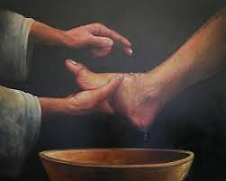
Peter’s confession of his need
“Peter saith unto him, Thou shalt never wash my feet. Jesus answered him, If I wash thee not, thou hast no part with me. Simon Peter saith unto him, Lord, not my feet only, but also my hands and my head.”
John 13:8-9

Slide 36
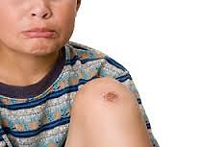
What Does a good parent do?
Tell the vulnerable child…
"Go, stop the bleeding, clean yourself up, and then I'll comfort you.“
Will God comfort me in my pain, or do I need to clean myself up first?
Will he succour and sustain me when I am still hurting and failing, when I do not have the needed faith?

Slide 37
Hebrews 2:17-18
“Wherefore in all things it behoved him to be made like unto his brethren, that he might be a merciful and faithful high priest in things pertaining to God, to make reconciliation for the sins of the people. For in that he himself hath suffered being tempted, he is able to succour (boētheō - to aid or relieve) them that are tempted.”

Slide 38
Knowing our vulnerability
This is a key to an “Abba, Father” life – a spiritual life!
It is accepting that we are flawed, incapable of saving ourselves
It requires acknowledging our weaknesses and asking our Father to help us – while we are struggling!
It helps us to love one another more
It focuses us keenly on our need for God

Slide 39
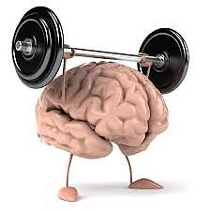
muscular Christianity
I can resist and overcome
If I was stronger, I wouldn’t fail
I need God when I fail!
God loves me when I succeed, but removes His love when I fail

Slide 40
Romans 8:13-17
“For if ye live after the flesh, ye shall die: but if ye through the Spirit do mortify the deeds of the body, ye shall live. For as many as are led by the Spirit of God, they are the sons of God. For ye have not received the spirit of bondage again to fear; but ye have received the Spirit of adoption, whereby we cry, Abba, Father. The Spirit itself beareth witness with our spirit, that we are the children of God: And if children, then heirs; heirs of God, and joint-heirs with Christ; if so be that we suffer with him, that we may be also glorified together.”
Abba, Father involves acknowledgement of being sons, not being in bondage to fear, a harmony between us and our Creator that bears witness of our adoption.

Slide 41
Galatians 4:4-7
“Even so we, when we were children, were in bondage under the elements of the world: But when the fulness of the time was come, God sent forth his Son, made of a woman, made under the law, To redeem them that were under the law, that we might receive the adoption of sons. And because ye are sons, God hath sent forth the Spirit of his Son into your hearts, crying, Abba, Father. Wherefore thou art no more a servant, but a son; and if a son, then an heir of God through Christ.”
The Spirit of Jesus Christ in us is that we can approach our God intimately – as Abba, Father. It is the relationship we have access to through Jesus.

Slide 42
h.a. whittaker, father of the faithful
“Abraham is a great example of a man made perfect, or a man in whom the love of God was being perfected. It wasn’t just that Abraham had faith, but his faith “wrought” with his works and it made his faith perfect. I think this is a marvelous way to understand the work of the Lord in the lives of believers. It is not some mystical or magical process that changes the way we think. Rather, the Lord uses our circumstances, to include our trials, to build our faith in him. To do so, he employs the angels and if we are willing, it will transform our minds. This is what happened with Abraham. He was willing to obey God, even when everything in him found this to be the opposite of his will. But, his faith was just strong enough to endure this and he was faithful on Mt. Moriah. But, the key is that Abraham’s faith AFTER this event was MUCH stronger. If he was willing to do God’s commandments, God would bless him and help him to increase his faith. So, for us today, the same challenge exists. If we are willing, even with our incomplete faith, to do his commandments, he will strengthen us. We will be able to feel his presence in our lives. His power will help us to transform our minds from flesh to Spirit. He has not left us as orphans!”

Slide 43
Romans 8:26-28
“Likewise the Spirit also helpeth our infirmities: for we know not what we should pray for as we ought: but the Spirit itself maketh intercession for us with groanings which cannot be uttered. And he that searcheth the hearts knoweth what is the mind of the Spirit, because he maketh intercession for the saints according to the will of God. And we know that all things work together for good to them that love God, to them who are the called according to his purpose.”

Slide 44
l.g. sargent, 1974
“A passage follows in Romans 8:26–27 of which perhaps no completely satisfactory interpretation has been offered, but its general drift may be understood in the light of what has been said. What spirit is it that helps our infirmity? What spirit that groans? In effect the Spirit means God Himself reaching towards us and cooperating with us in prayers which we can hardly articulate; it is He who searches the minds for the strugglings of bewildered prayer and knows the mind of our own spirit, our inward consciousness, labouring under the burden of our human nature and struggling to rise up to communion with God.”

Slide 45
g.s. sherry, “prayer”, 1937
“Let us consider some things He has told us relating to Himself on the matter of prayer and His attitude towards us in it. He tells us that if we draw near to Him He will draw near to us. That is an assurance of great comfort. He tells us to address Him as our Father and to regard Him as such. He tells us that He knows we are imperfect and weak and do not know how and what to ask for aright, but as a Father He pities us and He will not let these imperfections and weaknesses prevent His regard for us, for He will interpret our unworthy petitions by the spirit whereby we cry “Abba Father.” He searches the heart and knows the groanings of it which are self-contained and which no words can utter and which He alone hears. That spirit maketh intercession according to His Will.

Slide 46
g.s. sherry, “prayer”, 1937, continued
“He searches the heart and knows the groanings of it which are self-contained and which no words can utter and which He alone hears. That spirit maketh intercession according to His Will.
Then He invites us to draw near to Him boldly without a faltering step or wavering voice. To seek His Throne of Grace that He may give us all we require to support us in time of need; and He delights in us if we take Him at His word.”

Slide 47
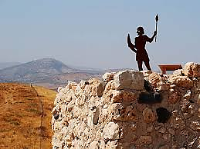
Philippians 4:6-7
“Be careful for nothing; but in every thing by prayer and supplication with thanksgiving let your requests be made known unto God. And the peace of God, which passeth all understanding, shall keep your hearts and minds through Christ Jesus.”
keep – phroureo – to be a watcher in advance, to mount guard or be a sentinel.

Slide 48
1 Peter 1:3-5
“Blessed be the God and Father of our Lord Jesus Christ, which according to his abundant mercy hath begotten us again unto a lively hope by the resurrection of Jesus Christ from the dead, To an inheritance incorruptible, and undefiled, and that fadeth not away, reserved in heaven for you, Who are kept by the power of God through faith unto salvation ready to be revealed in the last time.”

Slide 49
Bro. Michael Owen, 1985
“There is in a small child a natural acceptance of its smallness. It needs help to get by; it does not attempt to manage on its own. It accepts its situation and looks after its interests by making demands on its parents. A child in trouble wants its Mummy or Daddy—urgently. It does not stop to question who the best person might be to run to.
How fast do we run to God? We are called to the privilege of a relationship in which God is “Abba, Father”. Are we quick and joyful in our response? We need not hold back from the Lord’s bidding in fear. His hands reach out to hold us and reassure us. And yet we sometimes try to grow up on our own, as though we thought we did not need the help of our Father and His Son. In fact we need to turn for help, guidance and reassurance to our spiritual family, at every moment of our lives.”

Slide 50
L. G. Sargent, 1974
What is our standing in the sight of God? We stand before Him by grace through the Lord’s gift of himself for us; we stand in the love of God who gave His Son for our salvation; this accounts for our being here at all, and the grace of the Son and the love of the Father continue to be active for us. And these are the basis of the fellowship (koinōnia) which we have with the Father and the Son and with one another. Our fellowship is based on God’s active will in our midst and surrounding us with His purpose for us—the “will” in the word given and in the Word made flesh—and in God’s working in us, with us and for us, by whatever means and in whatever way. Thus the grace of the Lord and the love of God find expression in the fellowship we enjoy within the sphere and ambience of God’s will. Such is “the communion of the Holy Spirit”.

Slide 51
Summary
We are called to be sons and daughters
God loves us as His children and through Christ we are permitted to approach the Creator as “Abba, Father.”
He desires through Christ to have an intimacy with us
Rather than hiding among the trees of the Garden, we are permitted to bring before him our inner groanings and admit our vulnerability
If we commit our cause to Him that judgeth righteously, He will give us strength

Slide 52
Tomorrow’s class
“By This Ye Shall Know”
The fruit manifest by those who are
led by the Spirit

