Slide 1
Led by the Spirit
Class 4 – By This Ye Shall Know
Winfield Bible School
August 2014

Slide 2
Lessons from Class 3 – abba, father
God loves us as His children and through Christ we are permitted to approach the Creator as “Abba, Father.”
He desires through Christ to have an intimacy with us
A significant part of our transformation as Saints is to confess our weakness and inability to conquer sin without our Father
We are encouraged to bring before him our inner groanings and admit our vulnerability
If we commit our cause to Him that judgeth righteously, He will give us strength

Slide 3
Bro. Michael Owen, 1985
“There is in a small child a natural acceptance of its smallness. It needs help to get by; it does not attempt to manage on its own. It accepts its situation and looks after its interests by making demands on its parents. A child in trouble wants its Mummy or Daddy—urgently. It does not stop to question who the best person might be to run to.
How fast do we run to God? We are called to the privilege of a relationship in which God is “Abba, Father”. Are we quick and joyful in our response? We need not hold back from the Lord’s bidding in fear. His hands reach out to hold us and reassure us. And yet we sometimes try to grow up on our own, as though we thought we did not need the help of our Father and His Son. In fact we need to turn for help, guidance and reassurance to our spiritual family, at every moment of our lives.”

Slide 4
application
To be led by the Spirit, we must draw ever closer to our God – Abba, Father
Rather than forging our own ways and “strategically planning” the work, we can trust that the Lord will lead us where he wants us and will give us opportunities to serve that we could never have planned
As a loving Father, our God gently works with us to maximize our faith and bless our work
But, we must trust in our Father and in His love toward us

Slide 5
“When we submit our lives to what we read in scripture, we find that we are not being led to see God in our stories but our stories in God's. God is the larger context and plot in which our stories find themselves.”
Eugene H. Peterson

Slide 6
Unworthy servants
“Will any one of you who has a servant plowing or keeping sheep say to him when he has come in from the field, ‘Come at once and recline at table’? Will he not rather say to him, ‘Prepare supper for me, and dress properly, and serve me while I eat and drink, and afterward you will eat and drink’? Does he thank the servant because he did what was commanded? So you also, when you have done all that you were commanded, say, ‘We are unworthy servants; we have only done what was our duty.’”
Luke 17:7-10 ESV

Slide 7
Important to get the right perspective
The quickening of the Spirit in our lives is not due to our merit!
Even when we answer the call to do the work, we are only doing what is our duty to do – what we are under obligation for
In Romans 12:1 – Paul calls it our “reasonable service”
So, let’s understand that while we have been blessed greatly by the activity of Spirit in our lives, God is not in our debt!

Slide 8
God’s knowledge of us
“Before I formed thee in the belly I knew thee; and before thou camest forth out of the womb I sanctified thee, and I ordained thee a prophet unto the nations. Then said I, Ah, Lord God! behold, I cannot speak: for I am a child. But the Lord said unto me, Say not, I am a child: for thou shalt go to all that I shall send thee, and whatsoever I command thee thou shalt speak. Be not afraid of their faces: for I am with thee to deliver thee, saith the Lord. Then the Lord put forth his hand, and touched my mouth. And the Lord said unto me, Behold, I have put my words in thy mouth. See, I have this day set thee over the nations and over the kingdoms, to root out, and to pull down, and to destroy, and to throw down, to build, and to plant.”
Jeremiah 1:5-10

Slide 9
jeremiah, led by the spirit
God’s knowledge of Jeremiah predated his conception!
It was known before his birth by God what the work was that Jeremiah needed to do
As a Father, God reassured Jeremiah through his fears of self-doubt
God gave Jeremiah the Spirit gift that would allow him to do this work
His requirement was not to fear their faces and know that God was with him

Slide 10
Through christ, we too are foreordained
“Blessed be the God and Father of our Lord Jesus Christ, who hath blessed us with all spiritual blessings in heavenly places in Christ: According as he hath chosen us in him before the foundation of the world, that we should be holy and without blame before him in love: Having predestinated us unto the adoption of children by Jesus Christ to himself, according to the good pleasure of his will, To the praise of the glory of his grace, wherein he hath made us accepted in the beloved.”
Ephesians 1:3-6

Slide 11
application
God knows us, and has known us, far better than we ourselves do
He has prepared work for us to do, based on the need and our capabilities
Our challenge to being led by the Spirit is to believe that He will supply us with the help in time of need – to not limit His power in our lives
But, belief also requires courage – to not be afraid of their faces, to go into frightening corners

Slide 12
How many times?
Has our faith been insufficient to speak a word in season, to answer the reason of the hope that is in you?
Were we too busy and encumbered with the things of the world to find the time to do the service?
Do we shrink back because we have self-doubts?

Slide 13
All self-doubts
“And hereby we know that we are of the truth, and shall assure our hearts before him. For if our heart condemn us (to find fault), God is greater than our heart, and knoweth all things. Beloved, if our heart condemn us not, then have we confidence toward God.”
1 John 3:19-20

Slide 14
“For we ourselves also were sometimes foolish, disobedient, deceived, serving divers lusts and pleasures, living in malice and envy, hateful, and hating one another. But after that the kindness and love of God our Saviour toward man appeared, Not by works of righteousness which we have done, but according to his mercy he saved us, by the washing of regeneration, and renewing of the Holy Ghost; Which he shed on us abundantly through Jesus Christ our Saviour;”
Titus 3:3-6

Slide 15
The balance
One extreme approach to being led by the Spirit is to remain idle, waiting until God thrusts us into His special work
Another extreme approach is to plan one’s life as if it all depends on us – and we may miss the opportunities that the Lord places before us (Plan Your Work and Work Your Plan)
The right balance is to do what is put before us (serving tables) and let the Lord lead us through our ongoing service
But, be prepared to go where the wind blows!

Slide 16
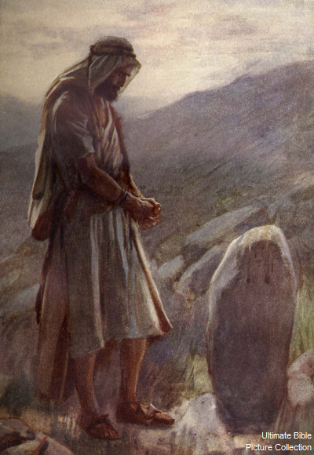
Jacob at bethel
“And, behold, I am with thee, and will keep thee in all places whither thou goest, and will bring thee again into this land; for I will not leave thee, until I have done that which I have spoken to thee of. And Jacob awaked out of his sleep, and he said, Surely the Lord is in this place; and I knew it not.”
Genesis 28:15-16

Slide 17
The lesson of bethel forgotten?
In response to deceptiveness of Laban, he too turns to manipulation
Acted as if it all depended on his arm – when even Laban had learned that the LORD had blessed him for Jacob’s sake
He “stole away “unawares” to free himself from Laban
The pitiful way he confronted Esau
Deception of Esau to steal away safely
The coziness with the Shechemites to find safety

Slide 18
Bethel’s Message completely forgotten
“And Jacob said to Simeon and Levi, Ye have troubled me to make me to stink among the inhabitants of the land, among the Canaanites and the Perizzites: and I being few in number, they shall gather themselves together against me, and slay me; and I shall be destroyed, I and my house.”
Genesis 34:30

Slide 19
Go back to the start!
“And God said unto Jacob, Arise, go up to Bethel, and dwell there: and make there an altar unto God, that appeared unto thee when thou fleddest from the face of Esau thy brother. Then Jacob said unto his household, and to all that were with him, Put away the strange gods that are among you, and be clean, and change your garments: And let us arise, and go up to Bethel; and I will make there an altar unto God, who answered me in the day of my distress, and was with me in the way which I went.”
Genesis 35:1-3

Slide 20
Being led by the spirit
When we are feeling it all depends on us
When we have strayed from our covenant to God
When the pathway seems impossible
Get back to Bethel!
When we face angry faces, opposition of our work, barriers to doing good – remember that God is with us in ALL places whither we go

Slide 21
The call to abstain from sin

Slide 22
Thou shalt not…
Thou shalt not…
Thou shalt not…
Thou shalt not…
Thou shalt not…
Thou shalt not…

Slide 23
The battlefield
“For I delight in the law of God after the inward man: But I see another law in my members, warring against the law of my mind, and bringing me into captivity to the law of sin which is in my members.”
Romans 7:22-23
Have you ever thought of the battle against sin as being a war in your mind? How does it get started? What activates it?

Slide 24
Fleshly lusts war against the soul!
“Dearly beloved, I beseech you as strangers and pilgrims, abstain from fleshly lusts, which war against the soul;”
1 Peter 2:11
strateuomai – Thayer’s 1) to make a military expedition, to lead soldiers to war or to battle, (spoken of a commander) 2) to do military duty, be on active service, be a soldier 3) to fight

Slide 25
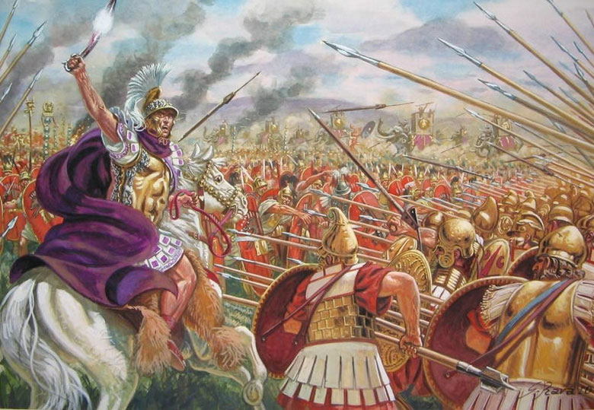

Slide 26
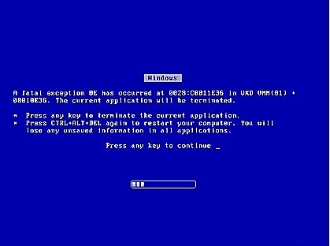

Slide 27


Slide 28
“defeatist” attitude toward sin
What shall we say then? Shall we continue in sin, that grace may abound? God forbid. How shall we, that are dead to sin, live any longer therein?
Romans 6:1-2

Slide 29
“Fleeing for Refuge” P. Gwilliam, 1972
“Having now entered and made our abode in the refuge city, we heed the command of God to strive to abide within it. To stray outside the bounds of this our Refuge, to be found in other society, is to run the same risk as the defaulting Israelite, only with consequences far more serious. In other words, we are no longer free to wander any more at will amongst the things of the world with its “affections and lusts, which war against the soul.” In days of old, literal death could be the result of disobedience. In the days to come, it may mean spiritual death and the resulting exclusion from the presence of the Lord.”

Slide 30
The Message
The more we empty ourselves of sin and free our hearts from the thinking of the flesh, we can then have increasing confidence toward God that He is leading, empowering and strengthening us
As we deaden and subdue the flesh, His spirit power quickens us and operates more fully

Slide 31
Evidence!
And hereby we do know that we know him, if we keep his commandments. He that saith, I know him, and keepeth not his commandments, is a liar, and the truth is not in him. But whoso keepeth his word, in him verily is the love of God perfected: hereby know we that we are in him.
1 John 2:3-5

Slide 32
Consistent counsel from apostle paul
“Flee fornication. Every sin that a man doeth is without the body; but he that committeth fornication sinneth against his own body.:’ 1 Corinthians 6:18
“Let not sin therefore reign in your mortal body, that ye should obey it in the lusts thereof.” Romans 6:12
“But put ye on the Lord Jesus Christ, and make not provision for the flesh, to fulfil the lusts thereof.” Romans 13:4
“Flee also youthful lusts: but follow righteousness, faith, charity, peace, with them that call on the Lord out of a pure heart.” 2 Timothy 2:22
“Teaching us that, denying ungodliness and worldly lusts, we should live soberly, righteously, and godly, in this present world;” Titus 2:12

Slide 33
Here’s the message…
When we participate in lust and sin, our minds cannot be a place where the Lord will make his home
It is not only that we displease our God – we ourselves pay a steep price!
The intimacy with our Lord is affected
The manifestation of the Spirit will be short-circuited
It’s as if we “disinvite” the Lord to operate in our lives

Slide 34
God dwells only in the tents of righteous men
Moses separated from the rebellion of Israel by pitching the Tabernacle of the Congregation outside the camp where God dwells with him
The glory of the LORD departed the Temple over the cherubims in Ezekiel’s vision, leaving sinful Judah, exiting the threshold of the Temple, leaving the east gate and finally ascending on Mt. of Olives
Samson participated in fleshly lusts and the Lord departed from him
Saul’s disobedience and rebellion led to God tom depart from him

Slide 35
Assurance and confidence
“And having an high priest over the house of God; Let us draw near with a true heart in full assurance of faith (JBP - with true hearts and fullest confidence), having our hearts sprinkled from an evil conscience, and our bodies washed with pure water. Let us hold fast the profession of our faith without wavering; (for he is faithful that promised;)”
Hebrews 10:21-23

Slide 36
manifestaTION of the spirit in our lives

Slide 37
MANIFEST – “TO EXHIBIT, DISCLOSE”
“I will not leave you comfortless: I will come to you. Yet a little while, and the world seeth me no more; but ye see me: because I live, ye shall live also. At that day ye shall know that I am in my Father, and ye in me, and I in you. He that hath my commandments, and keepeth them, he it is that loveth me: and he that loveth me shall be loved of my Father, and I will love him, and will manifest myself to him. Judas saith unto him, not Iscariot, Lord, how is it that thou wilt manifest thyself unto us, and not unto the world? Jesus answered and said unto him, If a man love me, he will keep my words: and my Father will love him, and we will come unto him, and make our abode with him.”
John 14:18-23

Slide 38
A “simple” litmus test - love
“For this is the message that ye heard from the beginning, that we should love one another.”
1 John 3:11
“Beloved, let us love one another: for love is of God; and every one that loveth is born of God, and knoweth God. Beloved, let us love one another: for love is of God; and every one that loveth is born of God, and knoweth God. He that loveth not knoweth not God; for God is love.”
1 John 4:7-8
“No man hath seen God at any time. If we love one another, God dwelleth in us, and his love is perfected in us.”
1 John 4:12

Slide 39
MANIFEST IN LOVE FOR BROTHER
“If a man say, I love God, and hateth his brother, he is a liar: for he that loveth not his brother whom he hath seen, how can he love God whom he hath not seen? And this commandment have we from him, That he who loveth God love his brother also.”
1 John 4:20-21

Slide 40
Love as a MANIFESTATION OF THE SPIRIT
“A new commandment I give unto you, That ye love one another; as I have loved you, that ye also love one another. By this shall all men know that ye are my disciples, if ye have love one to another.”
John 13:35

Slide 41
GOD DWELLS WITH THOSE WHO LOVE
“And we have known and believed the love that God hath to us. God is love; and he that dwelleth in love dwelleth in God, and God in him.”
1 John 4:16
dwelleth – “meno” – a verb - to stay in a given place, state, relation; abide; continue; dwell. Compare this Greek word to “mone” (a noun) used in John 14:1 “In my Father’s house are many mansions…” This is from same root, but describes the residence, the abode or mansion.

Slide 42
John’s exclusive use of “meno”
“He that eateth my flesh and drinketh my blood dwelleth in me, and I in him.” John 6:56
Believest thou not that I am in the Father, and the Father in me? the words that I speak unto you I speak not of myself: but the Father that dwelleth in me, he doeth the works.” John 14:10
Even the Spirit of truth; whom the world cannot receive, because it seeth him not, neither knoweth him: but ye know him; for he dwelleth with you, and shall be in you.: John 14:17
But whoso hath this world's good, and seeth his brother have need, and shutteth up his bowels of compassion from him, how dwelleth the love of God in him?” 1 John 3:17
And he that keepeth his commandments dwelleth in him, and he in him. And hereby we know that he abideth in us, by the Spirit which he hath given us.” 1 John 3:24
No man hath seen God at any time. If we love one another, God dwelleth in us, and his love is perfected in us.” 1 John 4:12
Whosoever shall confess that Jesus is the Son of God, God dwelleth in him, and he in God. And we have known and believed the love that God hath to us. God is love; and he that dwelleth in love dwelleth in God, and God in him.” 1 John 4:15-16
The elder unto the elect lady and her children, whom I love in the truth; and not I only, but also all they that have known the truth; For the truth's sake, which dwelleth in us, and shall be with us for ever.” 2 John 1:1-2

Slide 43
John’s use of “meno”
Eating the body and blood of Jesus
The Spirit of Truth
The love of God doesn’t dwell in those who withhold kindness and mercy
Keeping commandments is a reassurance to us that he dwells with us
God’s love is “perfected” in us
Confessing that Jesus is the Son of God
The truth which dwells in us

Slide 44
WHAT’S INVOLVED in dwelling in us?
Our knowledge
Our application of that knowledge
Our fellowship with our Lord and the Father

Slide 45
God’s position about his spirit
From whence come wars and fightings among you? come they not hence, even of your lusts that war in your members? Ye lust, and have not: ye kill, and desire to have, and cannot obtain: ye fight and war, yet ye have not, because ye ask not. Ye ask, and receive not, because ye ask amiss, that ye may consume it upon your lusts. Ye adulterers and adulteresses, know ye not that the friendship of the world is enmity with God? whosoever therefore will be a friend of the world is the enemy of God. Do ye think that the scripture saith in vain, The spirit that dwelleth in us lusteth to envy? But he giveth more grace. Wherefore he saith, God resisteth the proud, but giveth grace unto the humble. Submit yourselves therefore to God. Resist the devil, and he will flee from you. Draw nigh to God, and he will draw nigh to you. Cleanse your hands, ye sinners; and purify your hearts, ye double minded.”
James 4:1-8
RSV/ESV – “…He yearns jealously over the spirit which he has made to dwell in us.”
NIV – “Or do you think Scripture says without reason that he jealously longs for the spirit he has caused to dwell in us?

Slide 46
“Lusteth to envy”
“lusteth” – epipotheo – to dote upon, intensely crave possession, to desire, long after
“For I long to see you…” Romans 1:11
“earnestly desiring to be clothed upon” 2 Cor. 5:2
“…how greatly I long after you all in the bowels of Jesus Christ.” Philippians 1:8
Regarding Ephaphroditus, “…for he longed after you all, and was full of heaviness…” Philippians 2:25
“As newborn babes, desire the sincere milk of the word…” 1 Peter 2:2

Slide 47
Galatians 5:16-17
“This I say then, Walk in the Spirit, and ye shall not fulfil the lust of the flesh. For the flesh lusteth against the Spirit, and the Spirit against the flesh: and these are contrary the one to the other: so that ye cannot do the things that ye would.”

Slide 48
God is not an emotionless bystander – that would not make him a god of love!
God cares about us as His children
He wants the Spirit to grow in us and in our thinking
He is grieved when we act in ways inconsistent with a spiritual mind

Slide 49
Earnest of the spirit
“For in this we groan, earnestly desiring to be clothed upon with our house which is from heaven: If so be that being clothed we shall not be found naked. For we that are in this tabernacle do groan, being burdened: not for that we would be unclothed, but clothed upon, that mortality might be swallowed up of life. Now he that hath wrought us for the selfsame thing is God, who also hath given unto us the earnest of the Spirit.”
2 Corinthians 5:2-5
earnest – arrabon – a pledge, security – used in literature of an engagement ring!
“Who hath sealed us and given the earnest of the Spirit in our hearts.” 1 Cor. 1:22
“…ye were sealed with that holy Spirit of promise, which is the earnest of our inheritance…” Eph. 1:13-14

Slide 50
perhaPS We may TEND TO overthink things!
Despite our shortcomings…
If we love God
If we love our brother
If we abstain from fleshly lusts and keep His commandments
We can have confidence that He is with us! The manifestation of the fruit of the Spirit is our promissory note – our engagement ring!

Slide 51
Sowing flesh or spirit?
“Be not deceived; God is not mocked: for whatsoever a man soweth, that shall he also reap. For he that soweth to his flesh shall of the flesh reap corruption; but he that soweth to the Spirit shall of the Spirit reap life everlasting.”
Galatians 6:7-8

Slide 52
Romans 5:3-5
“And not only so, but we glory in tribulations also: knowing that tribulation worketh patience; And patience, experience; and experience, hope: And hope maketh not ashamed; because the love of God is shed abroad in our hearts by the Holy Ghost which is given unto us.”

Slide 53
Last class
Prepared Unto All Good Works
How the activity of the Spirit in our lives readies us for work prepared in advance for us to do.

