Slide 1
Led By the spirit
Class 5 – Prepared Unto All Good Works
Winfield Bible School

Slide 2
class 4 Summary
Faithful believers are intended to have confidence in their relationship with the Son and the Father
The manifestations of the fruit of the Spirit give us confidence that He is with us
When we forsake sin, we welcome the Father and Son to make their abode with us
God is deeply involved and concerned about our relationship with Him
The manifestations of the Spirit are a promissory ring to us that we are being prepared for the marriage to our Lord

Slide 3
The full process
“That he would grant you, according to the riches of his glory, to be 1 strengthened with might by his Spirit in the inner man; That 2 Christ may dwell in your hearts by faith; that ye, being rooted and grounded in love, May be able to comprehend with all saints what is the breadth, and length, and depth, and height; And to 3 know the love of Christ, which passeth knowledge, that ye might 4 be filled with all the fulness of God. Now unto him that is able to do exceeding abundantly above all that we ask or think, according to 5 the power that worketh in us, Unto him be glory in the church by Christ Jesus throughout all ages, world without end. Amen.”
Ephesians 3:16-21

Slide 4
Led by the spirit – if you want one passage
Strengthened by his might by his Spirit
Christ dwells in our hearts by faith
Know and manifest the love of Christ
Be filled with all the fulness of God (For it pleased the Father that in him should all fulness dwell; - Col. 1:19)
His power worketh in us in what we do and what we think

Slide 5
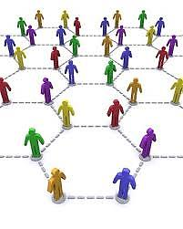
The work ahead

Slide 6
Are we on our own?
“Wherefore, my beloved, as ye have always obeyed, not as in my presence only, but now much more in my absence, work out your own salvation with fear and trembling.”
“For it is God which worketh (Greek: energeo – to be mighty, active, effectual) in you both to will and to do of his good pleasure.”
Philippians 2:12-13

Slide 7
“And you he made alive, when you were dead through the trespasses and sins in which you once walked, following the course of this world, following the prince of the power of the air, the spirit that is now at work in the sons of disobedience. Among these we all once lived in the passions of our flesh, following the desires of body and mind, and so we were by nature children of wrath, like the rest of mankind. But God, who is rich in mercy, out of the great love with which he loved us, even when we were dead through our trespasses, made us alive together with Christ (by grace you have been saved), and raised us up with him, and made us sit with him in the heavenly places in Christ Jesus, that in the coming ages he might show the immeasurable riches of his grace in kindness toward us in Christ Jesus. For by grace you have been saved through faith; and this is not your own doing, it is the gift of God— not because of works, lest any man should boast. For we are his workmanship, created in Christ Jesus for good works, which God prepared beforehand, that we should walk in them.”
Ephesians 2:1-10 (RSV)

Slide 8
Ephesians 2:1-10 (RSV)
“And you he made alive, when you were dead through the trespasses and sins in which you once walked, following the course of this world, following the prince of the power of the air, the spirit that is now at work in the sons of disobedience. Among these we all once lived in the passions of our flesh, following the desires of body and mind, and so we were by nature children of wrath, like the rest of mankind. But God, who is rich in mercy, out of the great love with which he loved us, even when we were dead through our trespasses, made us alive together with Christ (by grace you have been saved), and raised us up with him, and made us sit with him in the heavenly places in Christ Jesus, that in the coming ages he might show the immeasurable riches of his grace in kindness toward us in Christ Jesus. For by grace you have been saved through faith; and this is not your own doing, it is the gift of God— not because of works, lest any man should boast. For we are his workmanship, created in Christ Jesus for good works, which God prepared beforehand, that we should walk in them.”

Slide 9
Ephesians 2:1-10
Notice that the focus of this passage is on what has ALREADY begun
  ye walked
  we all had our conversation
  we were dead
  hath quickened
  hath raised us up
  made us sit together in heavenly places
  we ARE his workmanship, created in Christ Jesus

Slide 10
Romans 9:21-28
“Hath not the potter power over the clay, of the same lump to make one vessel unto honour, and another unto dishonour? What if God, willing to shew his wrath, and to make his power known, endured with much longsuffering the vessels of wrath fitted to destruction: And that he might make known the riches of his glory on the vessels of mercy, which he had afore prepared unto glory, Even us, whom he hath called, not of the Jews only, but also of the Gentiles?”
“afore prepared” – CP Paul as a “chosen vessel” in Acts 9:15. “prepared is same Greek word as “ordained” in Ephesians 2:10

Slide 11
Our role – john 6:27-29
“Labour not for the meat which perisheth, but for that meat which endureth unto everlasting life, which the Son of man shall give unto you: for him hath God the Father sealed. Then said they unto him, What shall we do, that we might work the works of God? Jesus answered and said unto them, This is the work of God, that ye believe on him whom he hath sent.”
Context is after the miracle of the loaves and the disciples asking what they should do to do the works of God. The Lord’s direction was “believe.”

Slide 12
2 timothy 2:19-21
“Nevertheless the foundation of God standeth sure, having this seal, The Lord knoweth them that are his. And, let every one that nameth the name of Christ depart from iniquity. But in a great house there are not only vessels of gold and of silver, but also of wood and of earth; and some to honour, and some to dishonour. If a man therefore purge himself from these, he shall be a vessel unto honour, sanctified, and meet for the master's use, and prepared unto every good work.”

Slide 13
We are not saved by works… we are saved for works!

Slide 14
The conditions of a people zealous of good works
“For the grace of God that bringeth salvation hath appeared to all men, Teaching us that, denying ungodliness and worldly lusts, we should live soberly, righteously, and godly, in this present world; Looking for that blessed hope, and the glorious appearing of the great God and our Saviour Jesus Christ; Who gave himself for us, that he might redeem us from all iniquity, and purify unto himself a peculiar people, zealous of good works. These things speak, and exhort, and rebuke with all authority. Let no man despise thee.”
Titus 2:11-15

Slide 15
A pattern emerges…
Our first role is to believe and forsake ungodliness and fleshly lusts – make ourselves a habitation for the Spirit
As a holy people, we are to learn and grow from the experiences that our Lord exposes us to
It is the Lord who quickens us and prepares us for work that lies ahead – we are his “work of art!”
He will provide the opportunity for us to serve – our requirement is to be ZEALOUS of good works

Slide 16
The role of the scriptures

Slide 17
Scripture prepares us
“But continue thou in the things which thou hast learned and hast been assured of, knowing of whom thou hast learned them; And that from a child thou hast known the holy scriptures, which are able to make thee wise unto salvation through faith which is in Christ Jesus. All scripture is given by inspiration of God, and is profitable for doctrine, for reproof, for correction, for instruction in righteousness: That the man of God may be perfect, throughly furnished unto all good works.”
2 Timothy 3:14-17

Slide 18
2 timothy 3:14-17
“reproof” – elegmos – a proving, a test, or evidence
“correction” – epanorthesis – restoration to an upright or right state
“instruction” – paideia – training (Eph. 6:4 – “nurture”)
“furnished” - exartizo – to finish out, equip fully
What is the purpose of this training and knowledge? That we might be throughly furnished unto all good works.

Slide 19
Engrafted/implanted word
“For the wrath of man worketh not the righteousness of God. Wherefore lay apart all filthiness and superfluity of naughtiness, and receive with meekness the engrafted word, which is able to save your souls.”
James 1:20-21
“For the anger of man does not work the righteousness of God. Therefore put away all filthiness and rank growth of wickedness and receive with meekness the implanted word, which is able to save your souls.” RSV

Slide 20
“Engrafted” “Implanted” word
This is the only place this verb occurs in Scripture
It is NOT “grafted in” as in Romans 11:24 (wild olive tree grafted unto good)
It represents internal growth – within the person
The Word grows in us and is able to “save our souls”

Slide 21
Years ago in our community
There was once a popular teaching that the Word was all that we had in the current dispensation
It was a resource to us that we could consume and it would drive rightful change in our minds
But, in its extreme, it was faith by works – I am spiritual because I have enriched myself in the Scriptures
Let’s not “throw the baby out with the bathwater”, though!
While the Spirit lives in us, by the dwelling of the power of Christ in our lives, it is a primary source of strength and power to our Spirit and the Lord speaks to us through that same Word – it prepares us for good works!

Slide 22
The spirit leading and shaping

Slide 23
Made perfect through suffering
“Though he were a Son, yet learned he obedience by the things which he suffered; And being made perfect, he became the author of eternal salvation unto all them that obey him;”
Hebrews 5:8-9

Slide 24
Thorn in the flesh
“For this thing I besought the Lord thrice, that it might depart from me. And he said unto me, My grace is sufficient for thee: for my strength is made perfect in weakness. Most gladly therefore will I rather glory in my infirmities, that the power of Christ may rest upon me. Therefore I take pleasure in infirmities, in reproaches, in necessities, in persecutions, in distresses for Christ's sake: for when I am weak, then am I strong.”
2 Corinthians 12:9-10

Slide 25
Joseph – prepared for a great work
“And Joseph said unto his brethren, Come near to me, I pray you. And they came near. And he said, I am Joseph your brother, whom ye sold into Egypt. Now therefore be not grieved, nor angry with yourselves, that ye sold me hither: for God did send me before you to preserve life. For these two years hath the famine been in the land: and yet there are five years, in the which there shall neither be earing nor harvest. And God sent me before you to preserve you a posterity in the earth, and to save your lives by a great deliverance. So now it was not you that sent me hither, but God: and he hath made me a father to Pharaoh, and lord of all his house, and a ruler throughout all the land of Egypt.”
Genesis 45:4-8

Slide 26
Was he always aware of god’s plan?
“And unto Joseph were born two sons before the years of famine came, which Asenath the daughter of Potipherah priest of On bare unto him. And Joseph called the name of the firstborn Manasseh: For God, said he, hath made me forget all my toil, and all my father's house. And the name of the second called he Ephraim: For God hath caused me to be fruitful in the land of my affliction.” Genesis 40:50-52
“And Joseph knew his brethren, but they knew not him. And Joseph remembered the dreams which he dreamed of them, and said unto them, Ye are spies; to see the nakedness of the land ye are come.” Genesis 41:8-9

Slide 27
Prepared unto all good works - moses
40 Years in Wisdom of Egypt
40 Years in Midian
40 Years Leading Israel

Slide 28
Aware of insufficiency - Exodus 4:10-12
“And Moses said unto the LORD, I pray LORD, I have not been sufficient in former times, neither from the time that thou hast begun to speak to thy servant; I am weak in speech and slow-tongued.” LXX
“In which time Moses was born, and was exceeding fair, and nourished up in his father's house three months: And when he was cast out, Pharaoh's daughter took him up, and nourished him for her own son. And Moses was learned in all the wisdom of the Egyptians, and was mighty in words and in deeds.” Acts 7:20-22

Slide 29
PREPARation for his work
“And Moses was content to dwell with the man: and he gave Moses Zipporah his daughter. And she bare him a son, and he called his name Gershom (margin: a stranger here): for he said, I have been a stranger in a strange land.”
Exodus 2:21-22

Slide 30
The mixed multitude
“And the children of Israel journeyed from Rameses to Succoth, about six hundred thousand on foot that were men, beside children. And a mixed multitude went up also with them; and flocks, and herds, even very much cattle.”
Exodus 12:37-38

Slide 31
Mixed multitude becomes a problem
“And the mixt multitude that was among them fell a lusting: and the children of Israel also wept again, and said, Who shall give us flesh to eat? We remember the fish, which we did eat in Egypt freely; the cucumbers, and the melons, and the leeks, and the onions, and the garlick: But now our soul is dried away: there is nothing at all, beside this manna, before our eyes.”
Numbers 11:4-6

Slide 32
One law
“And when a stranger shall sojourn with thee, and will keep the passover to the Lord, let all his males be circumcised, and then let him come near and keep it; and he shall be as one that is born in the land: for no uncircumcised person shall eat thereof. One law shall be to him that is homeborn, and unto the stranger that sojourneth among you.”
Exodus 12:48-49

Slide 33
Developing an insight, a sensitivity
Moses would have uniquely understood what it felt like for non-Jews who were joining from the mixed multitude
He understood what it felt like to be a stranger, an outsider
But he would doubtless be called on often to ensure there was no unique burden for these people – there was to be one Law
Would Moses have had this insight without having experienced Midian?

Slide 34
John 15:12-16
“This is my commandment, That ye love one another, as I have loved you. Greater love hath no man than this, that a man lay down his life for his friends. Ye are my friends, if ye do whatsoever I command you. Henceforth I call you not servants; for the servant knoweth not what his lord doeth: but I have called you friends; for all things that I have heard of my Father I have made known unto you. Ye have not chosen me, but I have chosen you, and ordained you, that ye should go and bring forth fruit, and that your fruit should remain: that whatsoever ye shall ask of the Father in my name, he may give it you.”

Slide 35
Prayer in the spirit
“And take the helmet of salvation, and the sword of the Spirit, which is the word of God: Praying always with all prayer and supplication in the Spirit, and watching thereunto with all perseverance and supplication for all saints;”
Ephesians 6:17-18

Slide 36
2 Corinthians 4:6-7,10
“For God, who commanded the light to shine out of darkness, hath shined in our hearts, to give the light of the knowledge of the glory of God in the face of Jesus Christ. But we have this treasure in earthen vessels, that the excellency of the power may be of God, and not of us. Always bearing about in the body the dying of the Lord Jesus, that the life also of Jesus might be made manifest in our body.”
verse 6 – in the natural Creation, what was the light that shined out of darkness?
verse 7 – earthen vessels – “clay jars”
verse 10 – “bearing about” – periphero – to convey or transport – CP Hebrews 13:13 – “Let us go forth therefore unto him without the camp, bearing (phero) his reproach.”

Slide 37
Prepared unto all good works
Strong familiarity with the Word!
Those who have suffered from cancer are in a unique place to serve others
Those who have experienced the joys of preaching the Gospel can reach out to others to have them taste and see
Those who had experienced the loss of their job can support the brother who is emotionally distraught going through the experience
Those who have struggled with a sin and escaped can be a covert in the storm for those experiencing similar issues

Slide 38
1 Timothy 1:12,16
“And I thank Christ Jesus our Lord, who hath enabled me, for that he counted me faithful, putting me into the ministry; Howbeit for this cause I obtained mercy, that in me first Jesus Christ might shew forth all longsuffering, for a pattern to them which should hereafter believe on him to life everlasting.”
“enabled me” Paul –vs. 16 – a PATTERN to them which should believe hereafter
CP Philippians 4:13 – “I can do all things through Christ which strengtheneth me.”

Slide 39
2 Thess. 2:13-14
“But we are bound to give thanks alway to God for you, brethren beloved of the Lord, because God hath from the beginning chosen you to salvation through sanctification of the Spirit and belief of the truth: Whereunto he called you by our gospel, to the obtaining of the glory of our Lord Jesus Christ. Therefore, brethren, stand fast, and hold the traditions which ye have been taught, whether by word, or our epistle. Now our Lord Jesus Christ himself, and God, even our Father, which hath loved us, and hath given us everlasting consolation and good hope through grace, Comfort your hearts, and stablish you in every good word and work.”

Slide 40
Personal experiences

Slide 41
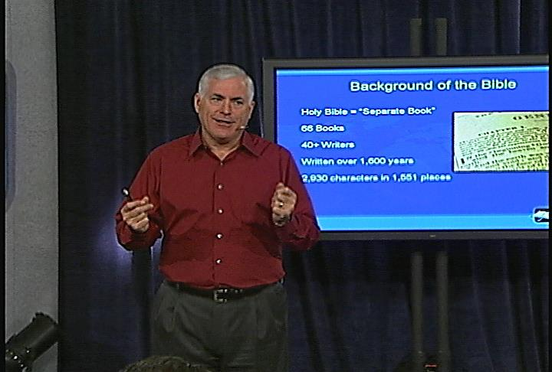

Slide 42
Personal experience - preaching
I have experienced appropriate passages “pop” to mind just at the right time in classes
Often they are passages I had not thought about recently and certainly was not planning to discuss during the class
It is a “magical” experience, which leaves me with a very unique feeling
BUT, I have never had a passage come to mind that I have never studied or read!
I am convinced that the Lord assists me in my work – I am not alone
However, one has to be a willing servant and have done their homework!
For me, it makes me want to do this work every time I get a chance!

Slide 43
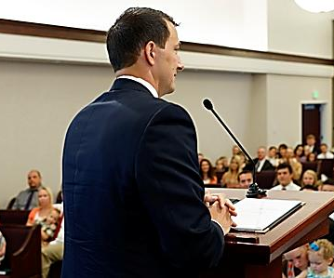
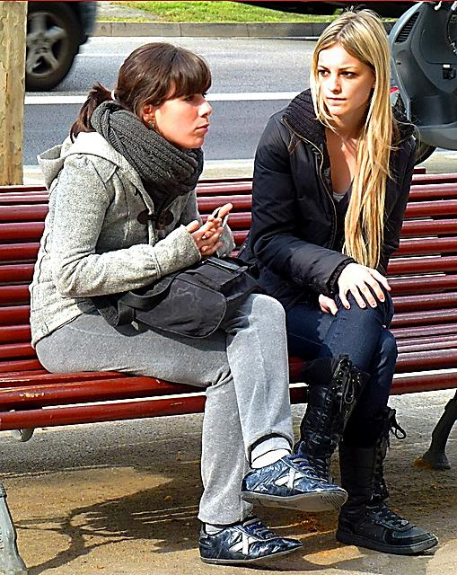
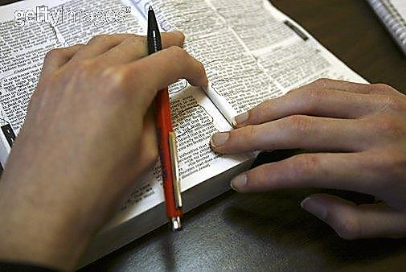
Humility or lack of faith?
“I’m not good at Bible study”
I’m not good at preaching to my friends”
I’m not a good speaker or teacher”

Slide 44
Exhortation to modern believers

Slide 45
What are the lessons about?
The “sufferings” we endure?
Why sometimes our work and efforts may not be fruitful?
About what we think we ARE and ARE NOT capable of?
About our need to “plan out” our work as if it all depends on us?
“Pride” over the work we do

Slide 46
conclusion
The Lord’s power in our lives is active and involved
We have responsibility to believe and abstain from fleshly lusts and ungodliness
We need to exhibit love, since this is the ultimate manifestation of the Spirit being active in our lives
We must recognize that the Father and Son desire intimacy with us and they know us better than we know ourselves
We are a work of art, being prepared for good works
Progressively in our lives, we shall be conscious of the wind moving in our lives
Let’s “put up a sail” and be zealous of the work he gives us

Slide 47
Christ living in us!
“I am crucified with Christ: nevertheless I live; yet not I, but Christ liveth in me: and the life which I now live in the flesh I live by the faith of the Son of God, who loved me, and gave himself for me.”
Galatians 2:20

Slide 48
Thank you
For inviting Sis. Mary Kay and me
For your patience with me as we worked through this material
For helpful comments after classes that helped to encourage, correct and focus
For being wonderful examples to me of a people filled with the Spirit, ready to bear fruit, reflecting the character of our Lord in so many ways
May the Lord richly bless you all and strengthen your ecclesias in these Last Days
May we all feel the presence of our Lord and have confidence that we know him!

